Slide 1

ADER DOTA - Proposed Enhancements
Oncor
December 3, 2025

Slide 2
ADER DOTA Enhancement Proposal
The current ADER Details of the Aggregation (“DOTA”) spreadsheet has been very effective for collecting and analyzing data. However, Oncor proposes enhancements to the DOTA spreadsheet to help DSPs to more efficiently process them as the ADER program grows:
Oncor has seen an increased frequency of requests
The number of ESI IDs requested on the DOTAs has increased
Some characteristics of the DOTA spreadsheet create opportunities for errors
Processing the DOTA spreadsheets is requiring significantly more effort and time to review and analyze distribution system constraints, as well as to keep up with ESI IDs that have been approved or rejected in the past or are new requests
To address these issues, Oncor proposes the following enhancements to the DOTA spreadsheet format which will improve data collection and analyses and provide DSPs a more efficient method to create and populate databases, ultimately reducing processing time and increasing efficiency.

Slide 3
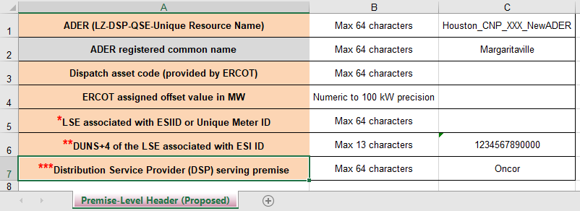
Proposed Enhancement – Premise-Level Header Tab
Move the header table from the Premise-Level tab to a new Premise-Level Header tab
  Create a unique Premise-Level Header tab for that information to aid in creating a database friendly Premise-Level tab
Remove columns with redundant information and add to the Premise-Level Header tab
  LSE associated with ESI ID *
  DUNS+4 of the LSE associated with ESIID or Unique Meter ID **
  Distribution Service Provider (DSP) serving premise ***

Slide 4
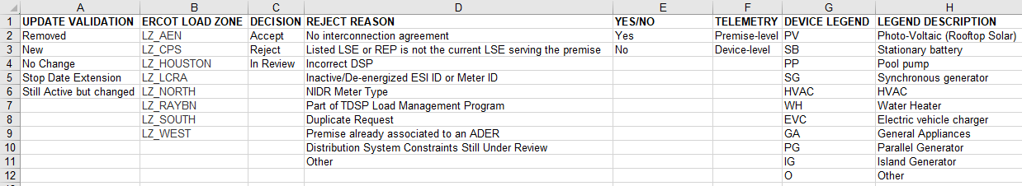
Proposed Enhancement – Hidden Cells / Validations
Move the “Hidden” text columns from the Premise-Level tab
  Currently, the Validation Table is presented on rows 7 through 18 in columns AL-AV
    Deleting any rows between row 7 and row 18 deletes the values used in the drop-down list
  Solution - Create a unique tab for the Validation Table Array
    The Validation Table tab could be hidden to prevent modification or deletion
    Reorganize the table to match the order on the Premise Level spreadsheet tab
      (order as it appears left to right)

Slide 5
Proposed Enhancement – Data Elements
Naming data elements within a database structure requires adherence to a consistent set of conventions to ensure clarity, maintainability, and ease of understanding for all users and developers
  Descriptive and Clear: Names should accurately reflect the data they represent, avoiding ambiguity
  Application of a uniform naming style across the entire database
  While descriptive, names should also be reasonably concise to avoid overly long queries or object references
  Create a Definition Library on a separate tab to provide more detailed descriptions of the naming elements

Slide 6
Proposed Enhancement – Definition Library
COLUMN | DB FRIENDLY HEADINGS | DESCRIPTION | ATTRIBUTE |  | NOTES
A | PREMID | Premise Unique Identifier/Site Name (one row per device per premise: A-Q must be identical per premise) | Max 64 characters
B | SERVADDRESS | Address | Max 64 characters
C | CITY | City | Max 64 characters
D | ZIP | Zip | Max 12 characters
E | ADERSTARTDATE | Premise start date in ADER | MM/DD/YYYY |  | Must be first day of the month
F | ADERSTOPDATE | Premise stop date in ADER | MM/DD/YYYY |  | Stop date must be last date of the month
G | UPDATE | Update Information Submitted by QSE for DSP (What has changed at the premise since the last submittal) |  | Pull Down List with Validation
H | ESIID | ESIID | Max 64 characters
I | NOIESVCTERRITORY | NOIE Service Territory | Max 64 characters |  | •Must be "Yes" if the load is inside a NOIE area; otherwise must be "No" •If NOIE Area is "Yes" then Private Use Network must be "No" •If NOIE Area is "Yes" and Wholesale Meter Point is "No" Unique Meter ID cannot be blank

Slide 7
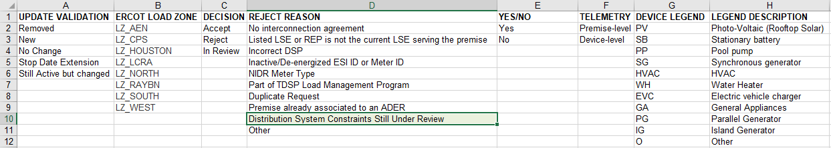
Proposed Enhancement – New Reject Reason
As the volume of ADER requests increases, processing time to complete a thorough distribution system constraints analysis will also increase
  Add a new Reject Reason to indicate the DSP teams are still studying specific ESIIDs
    “Distribution System Constraints Still Under Review”
This will allow a majority of ESI IDs that pass validations to be returned to the LSE or REP
The ESI IDs indicating “still under review” will be returned once the DSP completes their study

Slide 8


