Slide 1
Role of CONE in Wholesale Markets
Presented to:
ERCOT CONE Workshop
Jeff McDonald
Potomac Economics
November 21, 2025

Slide 2
Role of CONE in Wholesale Electric Markets
Expected cost recovery is critical to the merchant decision to invest in new generation capacity.
Market driven resource adequacy requires the market design produce sufficient revenue over the economic lifecycle of the anticipated new investment to recover cost and provide some profit.
Resource adequacy can be achieved through
Markets … the market must be set up to produce the right signals to (a) incent new investment when needed and (b) retire when over-supplied. In this model, you get what the market provides.
Requirements … LSEs are required to acquire their share of the RA requirement. Contract prices will reflect CONE when system is tight. This model allows for more direct control over planning reserve margin.
There is no avoiding CONE … whether the market produces revenue to cover CONE or LSEs contract and must pay CONE for new capacity.

Slide 3
CONE and RA in the ERCOT Market
The ERCOT market model is designed to leverage shortage pricing to increase revenue and incent new investment.
Because of the spot nature of the ERCOT market, the shortage conditions that produce higher revenue are not anticipatory (in the market)… shortage pricing increases as tighter conditions are experienced (not in advance).
ERCOT concept-to-commercial time is low
Contract prices may reflect expected forward shortages before the spot market.
It is important that the market is calibrated to provide CONE when needed. In ERCOT, there is competition between the shortage pricing mechanism and other products…
ERS and FFSS: Out of market supply that undermines shortage pricing.
RDR: Out of market demand response that undermines shortage pricing.
DRRS as RA (potentially): Provides revenue outside of shortage pricing (tbd).
It is important for RA in the ERCOT market to focus on proper calibration and function of the shortage pricing mechanism in conjunction with the offer cap.

Slide 4
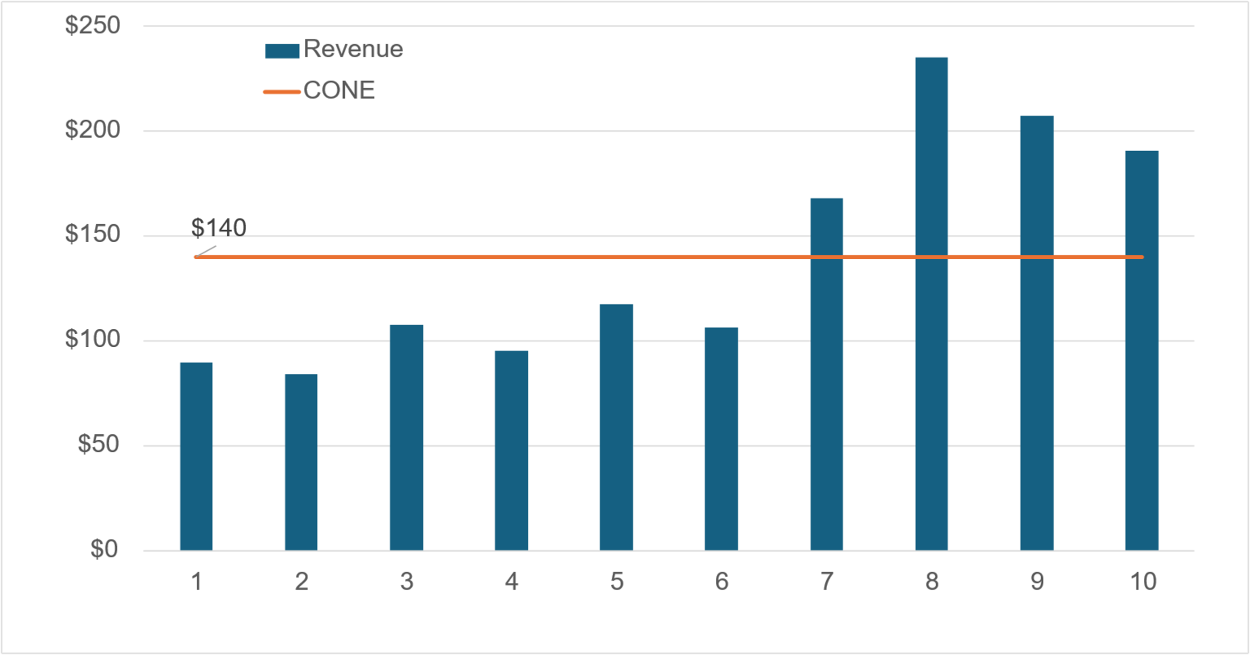
Expected 10 Year Market Revenue Profile
Revenue must be expected to produce levelized CONE ($ / MW Yr) over the investment recovery period.
Revenue < CONE in “long” years, and > CONE in “short” years.
No market-motivated new investment without expectation to recover cost.

Slide 5
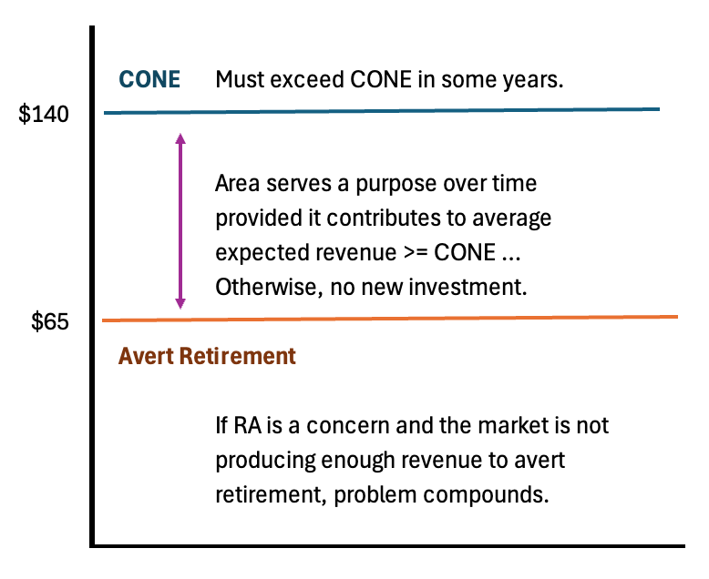
The Gap Between CONE and Retirement Aversion
New investment requires expectation to recover CONE.
From prior chart, some years will be below and others above CONE.
As the system becomes short of capacity, more revenue is generated by the shortage pricing mechanism pushing revenue above CONE in those years.
Market products that add some incremental revenue but undermine shortage pricing can result in operating in the middle zone too often and thwart new investment. Results only in transfer of funds, no new capacity added.

Slide 6
CONE Calculation Highly Sensitive to Inputs
The discounted cash flow model that is used to produce the levelized CONE value is highly sensitive to inputs.
For example…
Increasing only the Overnight Cost and WACC by 15% each increases the levelized CONE from $140/MW Yr to $170/MW Year.
It is easy to make seemingly small changes to a number of factors that are part of the CONE calculation and wind up with significant changes in the resulting CONE calculated value.

