Slide 1
CONE Workshop Introduction
Pete Warnken
Resource Adequacy Department
November 21, 2025

Slide 2
CONE Workshop Objectives
Provide stakeholders with the latest appraisal of (1) generation equipment availability and costs, and (2) the generation technology penetration potential for 2029
Solicit stakeholder perspectives on:
updating the CONE
CONE usage strategy for determining resource costs if ERCOT needs to provide the Commission with market design options to address standard non-compliance

Slide 3
CONE and Resource Expansion Outcomes
Recommendation for updating CONE
Recommendation for how to augment the resource portfolio with non-TEF capacity that may be needed to meet the Reliability Standard by 2029
Recommendation for a CONE usage strategy (e.g., multiple CONE values, use of the SERVM Expansion Planning module to optimize non-TEF capacity additions)

Slide 4
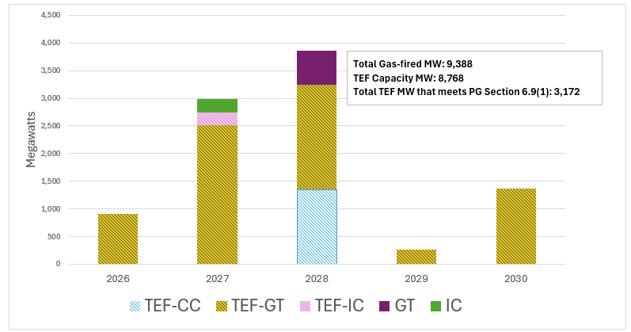
Gas Capacity in the ERCOT Interconnection Queue with Interconnection Agreements
Section 6.9(1): IA, proof of sufficient water supplies, air emission permits, financial security, notice-to-proceed

Slide 5
Next Steps
Send written comments to Pete Warnken, Pete.Warnken@ercot.com
The Brattle Team will help ERCOT compile a summary of the comments
ERCOT and the Brattle team will jointly develop a CONE update proposal for PUCT consideration
An ercot.com webpage will be developed for posting files associated with the Reliability Standard, including CONE-related materials

