Slide 1



ERCOT CONE Workshop
Trends in Costs, and Sketch of a 2026 ERCOT CONE Study
Prepared By
  The Brattle Group
  Sam Newell
  Andrew Thompson
  Nathan Felmus
  Sargent & Lundy
  Joshua Junge
Prepared For
  ERCOT
November 21, 2025

Slide 2
Agenda
Introduction and Context
Brattle 2025 PJM CONE Study
Levelization Considerations Given Industry Trends
Considerations for ERCOT CONE Study

Slide 3
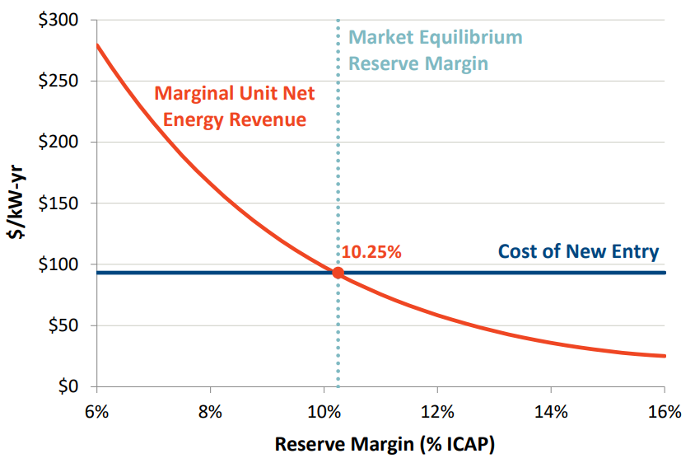
“CONE” has several uses in ERCOT
Introduction and Context
The Cost of New Entry (CONE) is used in ERCOT for:
  Planning: analyze the Market Equilibrium Reserve Margin (MERM) and Economically Optimal Reserve Margin (EORM), and evaluate the cost of reliability standards
  Markets: set the Peaker Net Margin (PNM) threshold (at 3x CONE) which affects energy price caps
For planning purposes, the PUCT in 2024 adopted a $140/kW-year CONE, informed by Brattle’s 2024 ERCOT CONE Study
  Staff recommended the $140/kW-year from the 2024 Study’s sensitivity case for a frame CT translated to level-real
  The 2024 Study also provided bottom-up level-nominal CONE for an aeroderivative CT and a PV+BESS hybrid resource
For the PNM threshold, the PUCT retained the legacy $105/kW-year level-real CONE from 2011 cost estimates in a 2012 Brattle Report
Illustrative Market Equilibrium Reserve Margin (MERM)
Sources: Newell et al., Estimation of the Market Equilibrium and Economically Optimal Reserve Margins for the ERCOT Region, December 20, 2018.

Slide 4
US demand for electricity is growing
Introduction and Context
Forecast of Annual Electric Energy Consumption (TWh/yr)
Electricity demand is surging from:
  Data centers for AI
  Manufacturing reshoring
  Electrification of vehicles, buildings, and industry
Peak demand (MW) growth rates are 5× those of the past decade; energy demand (MWh) is growing even faster with new high-load-factor loads
  Our roll-up of forecasts from 6-12 months ago shows +160 GW peak growth
  Grid Strategies’ just-released national forecast is similar
  Others suggest forecasts are overstated but still will be high
Much more generation and transmission will be needed to meet this growth, challenging:
  Resource adequacy
  Costs and rates, and
  Emissions
West of Rockies (excluding CA)
California
Northeast
High Plains (SPP)
Texas (ERCOT)
MidContinent (MISO)
MidAtlantic (PJM)
Southeast
Sources: Brattle compilation of 2024 and 2025 RTO and utility load forecasts.

Slide 5
Development and supply chains lag demand
Introduction and Context
If these forecasts bear out (likely will be less), the next 5 years could need new capacity for 160 GW peak growth plus reserve margin and replacing retirements
  Lead times are long for all new gas-fired resources, for development, equipment, construction, & interconnection
  New gas-fired capacity will be limited by supply chains:
    <80 GW in queues¹ and not all will be built²
    Supply chains may be limited to 50 GW by 2030
    Lead times for turbines and other critical equipment mean 50 months to build a CC, 44 months for CT³
  Much wind and solar are further in development
  (1500 GW in queues), but they have challenges too:
    Loss of tax credits will reduce builds dramatically
    Resource adequacy value is derated by correlated variability
  1000 GW BESS is in queues but is costly and many may not be built as much outside high-solar CA and ERCOT
New Gas-Fired Plants Insufficient to Meet Projected Demand
GW
Gap to meet with other supply and demand-side resources
Projected Growth in Peak Demand plus Reserve Margins to 2030
Available New Gas-Fired Capacity 2025-2030
Notes: Available new gas-fired capacity does not include uprates to existing plants;
projected peak demand growth calculated from compilation of RTO and utility load forecasts; does not account for the need to replace planned retirements.
Sources:
1. LBNL, “Queued Up: 2024 Edition,” April 2024
2. Rough estimate based on statements from turbine manufacturers
3. Brattle 2025 CONE Study for PJM Quadrennial Review
4. EIA: Solar, battery storage to lead new U.S. generating capacity additions in 2025

Slide 6
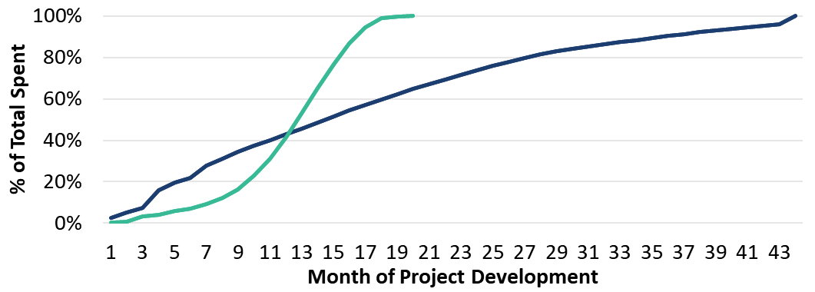
Development timelines have expanded
Brattle 2025 PJM CONE Study
  Brattle/S&L recently completed a 2025 PJM CONE Study (filed 11/7/25 w/FERC). Here we compare to the prior study from 2022
  The timeline from FID to COD for a CT has increased from 20 months to 44, due primarily to longer turbine, transformer, and other major equipment lead times
  Payment schedules including production slot reservation fees for major equipment have shifted more costs into the early years of projects, which paired with longer timelines, increases capital carrying costs
  Most recent data suggests timelines have continued to increase (see following slide)
CT Development Capital Drawdown Schedules in 2022 and 2025
2022 PJM CONE
2025 PJM CONE

Slide 7
Turbines & high voltage transformer lead-times are longest
Brattle 2025 PJM CONE Study – updates since then
  The large-frame gas turbine market is in a supply crunch: OEM backlogs now showing deliveries for H- and F- class CTs pushing into 2029 and beyond,¹ with record order intake and substantial reservation fees required across frame sizes
  In ERCOT, equipment procurement constraints have already derailed projects (e.g., TEF applicants withdrawing peakers due to inability to meet required milestones)
  The grid transformer bottleneck is affecting all new builds at the utility scale: large power transformer lead times commonly ~80–210 weeks, with U.S. average lead times doubling since 2021;² shortages raise costs and delay interconnections for thermal, renewables, and storage
  BESS is the fastest-to-market firming option: utility-scale storage deployments set records in 2024–25,³ and installed costs continue to decline despite policy/tariff noise—supporting near-term additions
1. Project development and delivery-to-COD durations based on OEM advertisement and S&L project data.
2. NTP-to-Delivery durations based on Q3 and Q4 2025 vendor quotes and OEM presentations
3. Project durations assume multiples of each technology needed to achieve >200 MW capacity.
Sources and Notes: 1: Sargent & Lundy database of Q3 and Q4 2025 OEM quotes and vendor presentations; 2: Wood Mackenzie, Supply shortages and an inflexible market give rise to high power transformer lead times, April 2, 2024; 3: Energy Storage News, Global energy storage deployments on track for record year in 2025, BNEF says, October 21, 2025.

Slide 8
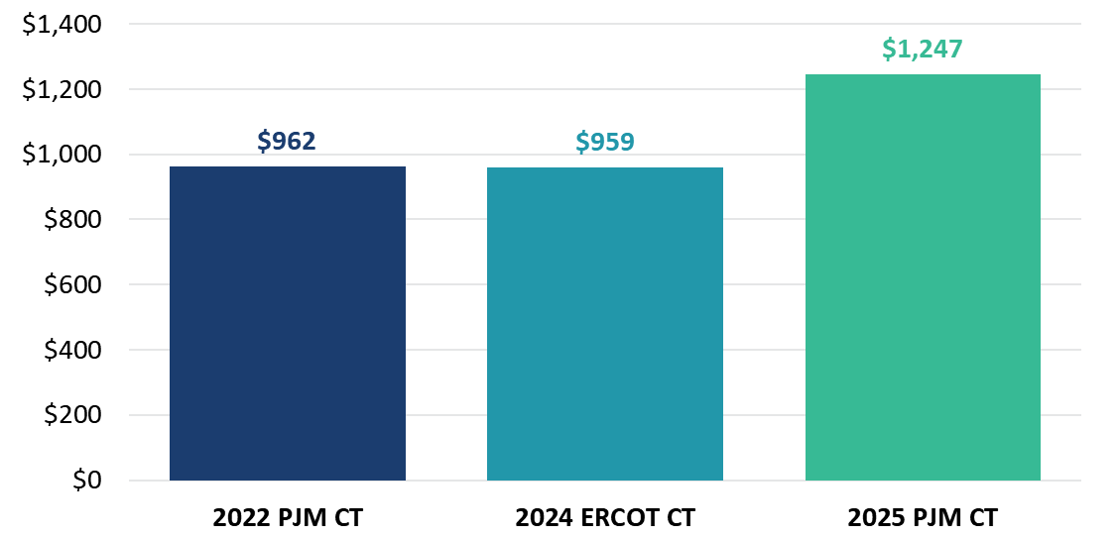
Costs have increased (but moderated by capacity increases)
Brattle 2025 PJM CONE Study
The 2025 PJM CONE Study developed CONE estimates for frame CC, CT, and 4-hour BESS resources coming online for June 2028; PJM decided to use a frame CT reference resource
The study included bottom-up cost analyses with OEM quotes from early 2025; cost premiums and rapid changes in costs became quickly evident.
Overnight capital costs/kW for frame CTs have increased by 30% in real terms since we last assessed costs in the 2022 PJM CONE Study
  Cost of a CT increased from $339m to $545m (in 2028$)
  But the new plant provides more capacity (from 353 MW to 437 MW) with larger turbine, wet compression, and higher firing temperature
  So the net is only +30% per kW in real terms (much more in nominal terms relative to earlier years)
Frame CT Overnight Capital Costs (2028$/kW)
Overnight Capital Costs (2028$/kW)
Sources and Notes:
2022 PJM CT and 2024 ERCOT CT costs translated into 2028$ using an assumed annual inflation rate of 2.2%. 2022 and 2025 PJM CT numbers are for CONE Area 3 (Rest of RTO).
2022 PJM CT: PJM Updated CONE Model, July 2024.
2024 ERCOT CT: ERCOT, CORRECTION TO ERCOT ADDITIONAL SENSITIVITY INFORMATION FOR FRAME CT, filed before the PUCT, Control No. 54584, Item No. 100, July 24, 2024.
2025 PJM CT: Affidavit of Dr. Samuel A. Newell, Dr. Andrew W. Thompson, Dr. Bin Zhou, and Joshua C. Junge Regarding Updates to PJM’s CONE and Net Energy and Ancillary Service Offset Parameters for Delivery Years 2028/29 Through 2031/32, before the Federal Energy Regulatory
Commission, Docket No. ER26-455, Attachment E.

Slide 9
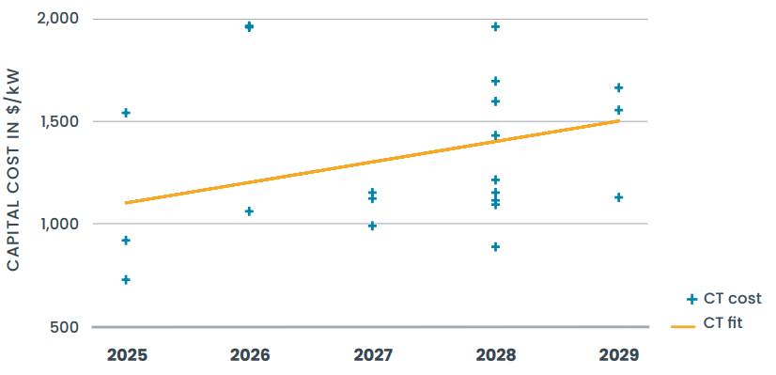
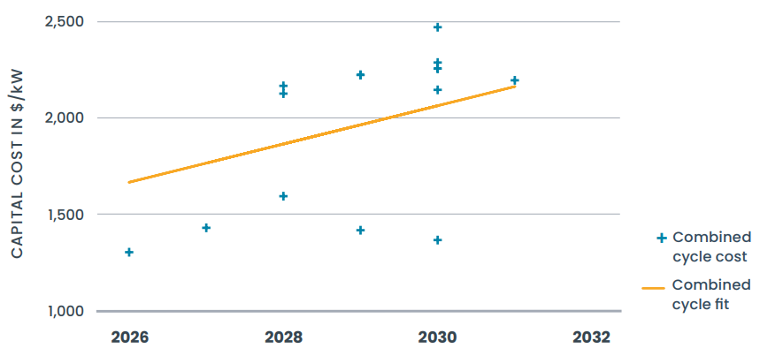
Brattle/S&L cost estimates are in line with other recent estimates
Brattle 2025 PJM CONE Study – comparison to other sources
Public datasets like the NREL Annual Technology Baseline and EIA Annual Energy Outlook tend to lag the most current market information, which often is contained in confidential filings, and therefore tend to present underestimated view of project costs.
From other sources, estimates of installed capital costs based on reviews of Integrated Resource Plans, Certificates of Public Convenience and Necessity, and financial statements of utilities and OEM turbine manufacturers show that installed costs have increased to more than $1,500/kW for CTs and $2,000/kW or higher for CCs for 2029 and beyond operating years (see right)
Brattle/S&L’s cost estimates from the 2025 PJM CONE Study are in line with costs for similar technologies and online years
CT Nominal Installed Capital Cost by Online Year
2025 PJM CT
CC Nominal Installed Capital Cost by Online Year
2025 PJM CC
Sources: GridLab, The New Reality of Power Generation: An Analysis of Increasing Gas Turbine Costs in the U.S., September 2025.

Slide 10
Gas-fired CT Specifications
Brattle 2025 PJM CONE Study
Biggest differences from 2022 PJM CONE Study are:
  Switching from GE 7HA.02 to 7HA.03 turbine, which is more efficient and larger, offering better economies of scale
  Addition of wet compression which increases plant capacity
  Switching from firm gas to dual fuel, due to higher resource adequacy value in PJM’s capacity market
Characteristic | 2022 PJM CT | 2025 PJM CT
Site Type | Greenfield | Greenfield
Turbine Model | GE 7HA.02 60HZ | GE 7HA.03 60HZ
Configuration | 1 x 0 | 1 x 0
Power Augmentation | Evaporative Cooling; no inlet chillers | Evaporative Cooling + Wet Compression
Net Summer ICAP (MW) | 361 / 363 / 353 / 350 / --* | 443 / 443 / 437 / 432 / 444*
Net Heat Rate (HHV in Btu/kWh) | 9320 / 9317 / 9304 / 9311 / --* | 9318 / 9321 / 9288 / 9299 / 9276*
Environmental Controls | Dry Low NOx burners, SCR and CO Catalyst | Dry Low NOx burners, SCR and CO Catalyst
Fuel Supply | Firm Gas | Dual Fuel
Sources and Notes: *For EMAAC, SWMAAC, Rest of RTO, WMAAC, and ComEd respectively.
See Affidavit of Dr. Samuel A. Newell, Dr. Andrew W. Thompson, Dr. Bin Zhou, and Joshua C. Junge Regarding Updates to PJM’s CONE and Net Energy and Ancillary Service Offset Parameters for Delivery Years 2028/29 Through 2031/32.” Filed before the Federal Energy Regulatory Commission November 7, 2025, Docket No. ER26-455; See also Newell et al., PJM CONE 2026/2027 Report, April 21, 2022.

Slide 11
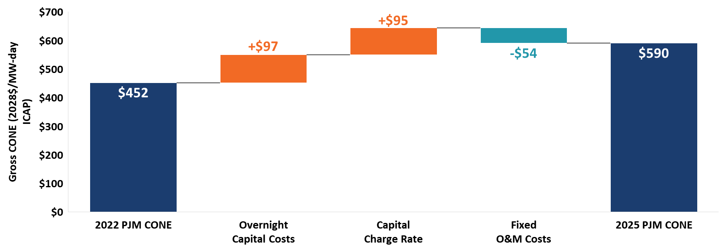
Drivers of Real Increases In CT CONE in PJM
Brattle 2025 PJM CONE Study
Gross CONE (2028$/MW-day ICAP)
For Area 3 (Rest of RTO)
converted to 2028 $s
Tight supply for major equipment, labor, and EPC increases capital cost by 61% in real terms;
Switch to 7HA.03 with dual fuel, wet compression, and higher firing temperature increases ICAP by 24%;
On net, $/kW overnight cost increases by 30% in real terms
Longer construction timeline (from 20 mo. to 44) and higher ATWACC (from 8% in 2022 to 9.5% in 2025);
offset by partial realization of 100% bonus depreciation
Reduction due to change from firm gas to dual fuel;
offset by small increases in property tax and insurance in line with overnight capital costs

Slide 12
Drivers of Increased CT Capital Costs
Brattle 2025 PJM CONE Study
  92% real increase in turbine costs and 51% real increase in SCR costs since 2022 due to tight supply
  Competition for skilled labor causes a 38% real increase in construction labor costs and a 62% real increase in other labor costs
  195% higher electrical interconnection costs in real terms than in 2022
Notes: Land costs are non-zero but less than $500,000.

Slide 13
Drivers of Decreased CT Fixed O&M Costs
Brattle 2025 PJM CONE Study
  Eliminating firm gas contract due to a switch to dual fuel cuts FOM nearly in half
  Reduction in FOM partially offset by higher property taxes and insurance that increased with capital costs
Notes: The small increase in working capital cost is tied to larger overnight costs and a higher short-term borrowing rate. The working capital financing rate has been updated from 2.19% to 5.81% due to increases in corporate bond yields since the 2022 CONE Study.

Slide 14
Conclusions from 2025 PJM CONE Study
Brattle 2025 PJM CONE Study
  Capital costs have increased sharply, somewhat offset by increases in capacity
  Extended delivery times and front-loaded OEM payment schedules for turbines add significant capital carrying costs for CTs and CCs. 2025 PJM CONE Study modeled timeframes of 44 months for a CT and 50 months for a CC from project FID to COD, validated with OEM input, but timelines have since extended
  GE is offering wet compression upgrades and warranting higher firing temperature operating limits to increase maximum output for the 7HA.03 turbine technology, resulting in a higher net summer ICAP and lowering CONE for the CT and CC resources
  BESS overnight costs in $/kW still exceeded those of the selected CT reference technology in PJM, though levelized capital costs are converging due to the increasing CT and CC timelines vs the
  20-month development period for BESS
  However, BESS also is subject to pricing pressures and uncertainties compounded by the current unstable tariff environment, although that also affects all other resource types to a lesser extent

Slide 15
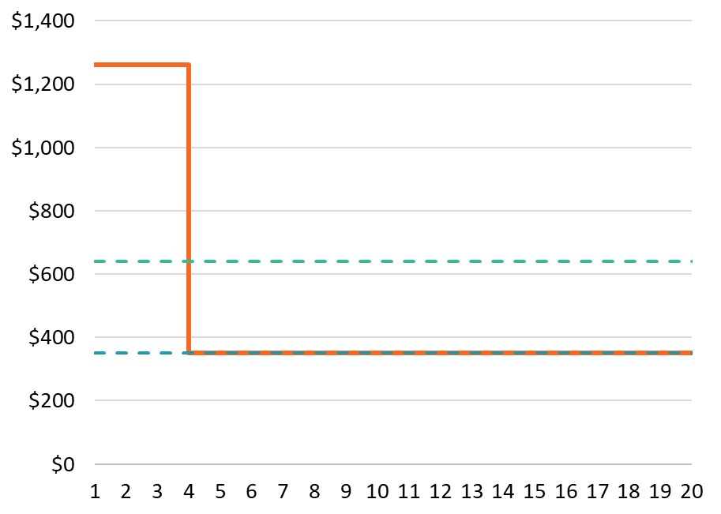
Levelization Approach in Acute Tight Supply Conditions
Levelization Considerations Given Industry Trends
CONE estimates on prior slides are “level-nominal” and this may understate how much an investor would need to enter under current conditions.
  Level-nominal represents the reservation price for a new entrant expecting a revenue trajectory to be constant in nominal terms.
  Yet if entrants expect current tight supply conditions to normalize once supply chains are expanded, and market prices to fall, they would need more front-loaded revenue recovery to be willing to enter, i.e., with prices > level-nominal CONE.
  Additionally, extended development timelines for gas-fired plants may necessitate BESS and other resources to fill the capacity gap. Hence prices may need to rise even above BESS level-nominal CONE to attract entry.
This suggests that high prices could still be insufficient to attract entry under present conditions.
Illustration of Reservation Price vs. Level-Nominal CONE
3-yr BESS Short-term Reservation Price
Price (Multiple of Long-Run CONE)
BESS Net CONE, Level-nominal Cost Recovery
Long-Run Net CONE, Level-nominal Cost Recovery
Year of Asset Life

Slide 16
Short-Term Reservation Prices in Acute Tight Conditions
Levelization Considerations Given Industry Trends
Sources and Notes: All values in Nominal$ for a 2028 online year.
[A]: Level-nominal CONE value from 2025 PJM CONE model for CONE Area 3, Rest of RTO.
[B]: For CT and CC, long-run CONE from Brattle 2025 PJM CONE Report, Table ES-2. For BESS, long-run CONE assumed to be back calculated from the $350/MW-day UCAP long-run Net CONE from Brattle 2025 PJM CONE Report, Figure ES-1. $471 CONE ICAP = $350 Net CONE UCAP × 65% ELCC + $244 Forward E&AS ICAP for BESS.
[C]: Output from 2025 PJM CONE model, reservation price analysis.
[D], [E]: Provided by PJM staff.
[F]: ([C] – [D]) / [E].
[G]: ([A] – [D]) / [E].

Slide 17
What could be added to ERCOT by 2029?
Considerations for ERCOT CONE Study
  Projects already underway/in development with permits in place and turbines on hand or with a delivery slot; additionally need clear pathway to procure tier 1 HV substation transformers since these often set development timeline and 2–4+ year lead times are now typical.
  Brownfield uprates/expansions at existing thermal sites (e.g., duct‑firing packages, HRSG/steam‑path/CT OEM upgrades) that add incremental capacity faster than new builds.
  Select simple‑cycle peakers (smaller frames/aeroderivatives/RICE) where OEM turbine slots exist and sites leverage existing gas/electric interconnection. Wait times are shorter than for heavy frames but tightening and recent estimates for these approach or exceed $3,000/kW overnight costs.
  Non-CT technologies or gray-market options with shorter lead times, if developers can purchase inventory or guaranteed production slots from others already in line.
  Considering schedule alone, utility‑scale BESS (2–6 hours); will generally reach COD before any thermal option, but larger BESS projects are still constrained by HV transformer lead times.

Slide 18
What can be done in an updated ERCOT CONE Study?
Considerations for ERCOT CONE Study
  Determine the most appropriate reference resource (or resources) with ERCOT, stakeholders, and the PUCT given the multiple purposes that CONE is used for
  Identify CONE locations to represent costs investors could face ERCOT-wide
  Develop bottom-up costs for ERCOT-specific representative zones and reference resource(s); or alternatively update costs from 2025 PJM CONE Study with most recent OEM quotes and timeframes with S&L and adjust to ERCOT parameters
  Assess expected net revenues that each reference resource would expect to receive from the energy/ancillary services market
  Further consider levelization calculation given current market conditions (level-real, level-nominal, or more front-loaded)
  Consider implications of updated CONE on system-wide offer caps (HCAP and LCAP)

Slide 19



Contact Information
Dr. Sam Newell
Dr. Andrew W. Thompson
Joshua Junge
Brattle
Principal | boston
Brattle
Energy associate | Boston/Madrid
Sargent & Lundy
Principal Energy Consultant | Chicago
Sam.Newell@brattle.com
Andrew.Thompson@brattle.com
joshua.c.junge@sargentlundy.com
+1 (781) 801-2652
+34 666 639 197
+1 (312) 269 2129

