Slide 1
Technical Working Group (TWG)
ICCP Telemetry Points Modeling
&
EMS SCADA/AGC Changes
Kevin McGarrahan
Tejaswi Potluri
Karthik Gopinath
11/20/2025

Slide 2
RTC+B ICCP Telemetry Modeling – Key Documents
Resource specific ICCP Telemetry Modeling Template (ICCP_Change_Request_example_RTCB_V1.4.xlsx) is posted in two locations
ercot.com site under User Guides: https://www.ercot.com/services/mdt/userguides
RTCBTF site under Key Documents: https://www.ercot.com/committees/tac/rtcbtf
Request all market participants to follow the template for the object name format.
Latest version of RTC+B ICCP Handbook is available at
New single model ESR names for existing combo-model ESRs have been published to the RTCBTF page: https://www.ercot.com/committees/tac/rtcbtf
*Link to RTC+B ERCOT Nodal ICCP Communications Handbook

Slide 3
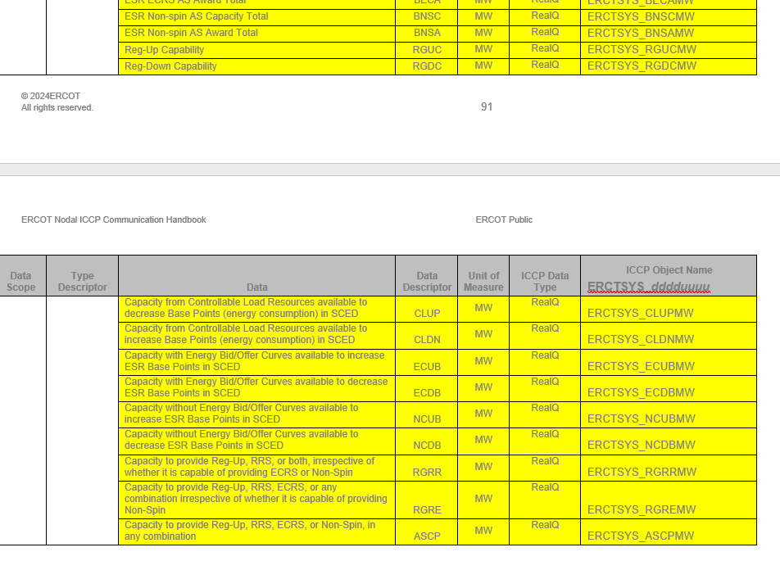
Updates to ICCP handbook
New system level points added
These new points will be available for subscription starting 12/05/2025.
Updated RTC+B ICCP handbook will be made available at the below link:
*Link to RTC+B ERCOT Nodal ICCP Communications Handbook

Slide 4
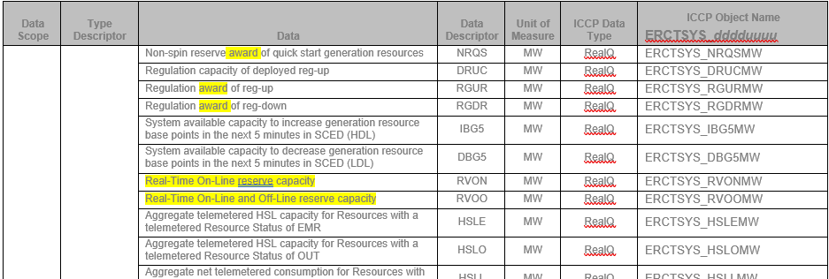
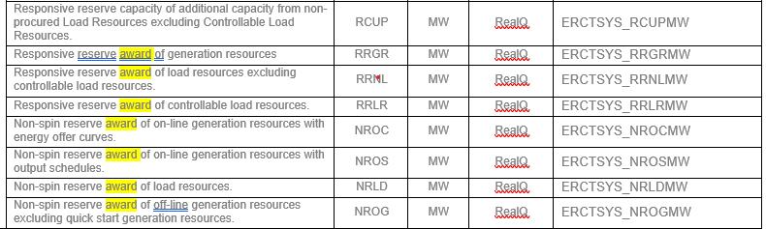
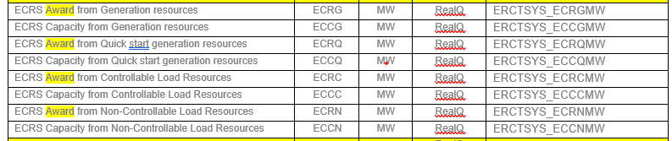
Updates to ICCP handbook
Updated description of some system level points
Example: Replaced responsibility with award
*Link to RTC+B ERCOT Nodal ICCP Communications Handbook

Slide 5
RTC+B ICCP Telemetry Points Modeling Expectations
QSEs to Submit new ICCP telemetry point requests
QSEs/ERCOT to maintain the new ICCP telemetry points for both current system and RTC+B system through weekly model loads.
When submitting ICCP requests for existing resources, please provide RTC specific object names only for modeling. These are the objects in RED text in the template.
Similarly for single model ESR devices, all objects in RED text on the ESR tab are required to be submitted.
In RTC+B, single model ESR device names are changed to ESR1, ESR2,..,ESR# under a given site.

Slide 6
RTC+B ICCP Telemetry Points Modeling Expectations
Within the RTC+B construct,
AS capabilities for IRRs no longer required to be modeled (Updated the ICCP Telemetry Template and Handbook).
CLRs are not expected to participate in FFR service.
The AVR and PSS points are not required to be modelled on CLRs in RTC.
Station specific ICCP telemetry like line flows, auxiliary load are NOT required to be modeled again.
Non-ESR Generation Resources as well as Controllable and Non-Controllable Load Resources are required to model the new RTC+B telemetry points under the existing non-ESR device.

Slide 7
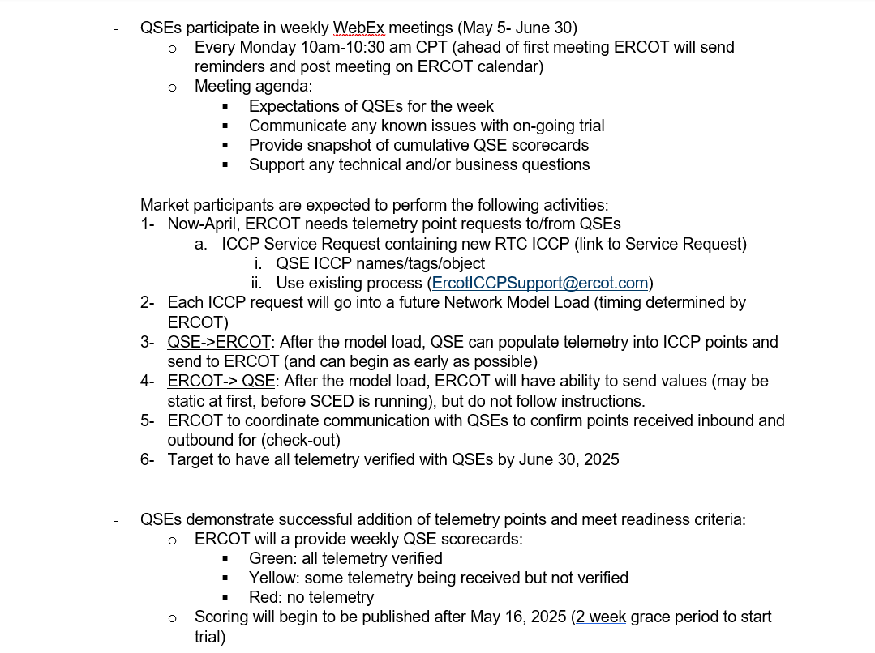
Market Trial Handbooks
QSE Telemetry point Check-Out (Handbook #2)
https://www.ercot.com/files/docs/2025/04/07/RTCB_Market_Trials_Handbook_2_TelemetryPointCheckout.docx

Slide 8
RTC+B ICCP Model Load and Testing
ERCOT will model the RTC+B ICCP points in the network model and perform ICCP model load in lower environment for ERCOT internal verification.
This verified model with the RTC+B ICCP points will be loaded into current Production ICCP system.
ERCOT will publish a schedule to indicate when the new RTC+B specific telemetry points will be available in Production.
ERCOT will provide support to QSEs to setup the RTC+B telemetry points in their Production ICCP system and perform communication testing.
ERCOT and QSE to start testing the RTC+B telemetry points in current Production ICCP system (telemetry points check out) from market trials starting from 05/05.
ERCOT expects continuous good quality telemetry from July 1st week for points that are needed to support RTC+B EMS/SCED open loop testing.

Slide 9
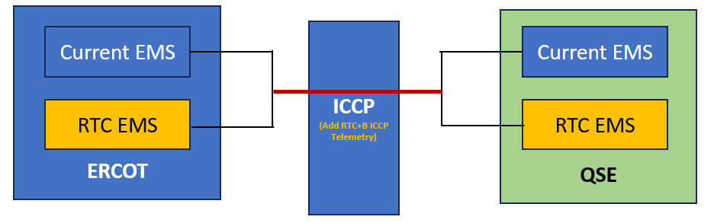
RTC+B Refresher on ICCP configuration
RTC+B ICCP telemetry will be modeled in the current Production ICCP system under existing ICCP links.
No new sandbox will be available for RTC+B specific ICCP testing.
All point-to-point telemetry checkouts will be performed in the current Production ICCP system from market trials starting from 05/05.

Slide 10
RTC+B QSE EMS SCADA/AGC changes
Reminder for QSEs to work with their EMS vendors (and/or in-house development teams) to update their EMS Tools/SCADA/AGC control system functionality to send RTC+B specific telemetry to ERCOT and receive telemetry (like UDSP) from ERCOT and follow control signal.
QSE EMS Tools/SCADA/AGC system changes are expected to be in place to support Market Trials from June time frame.
Examples of RTC+B specific telemetry changes:
UDSP (ERCOT to QSE)
Current Capability ( QSE to ERCOT)
New RTC Resource Status Code (QSE to ERCOT)

Slide 11
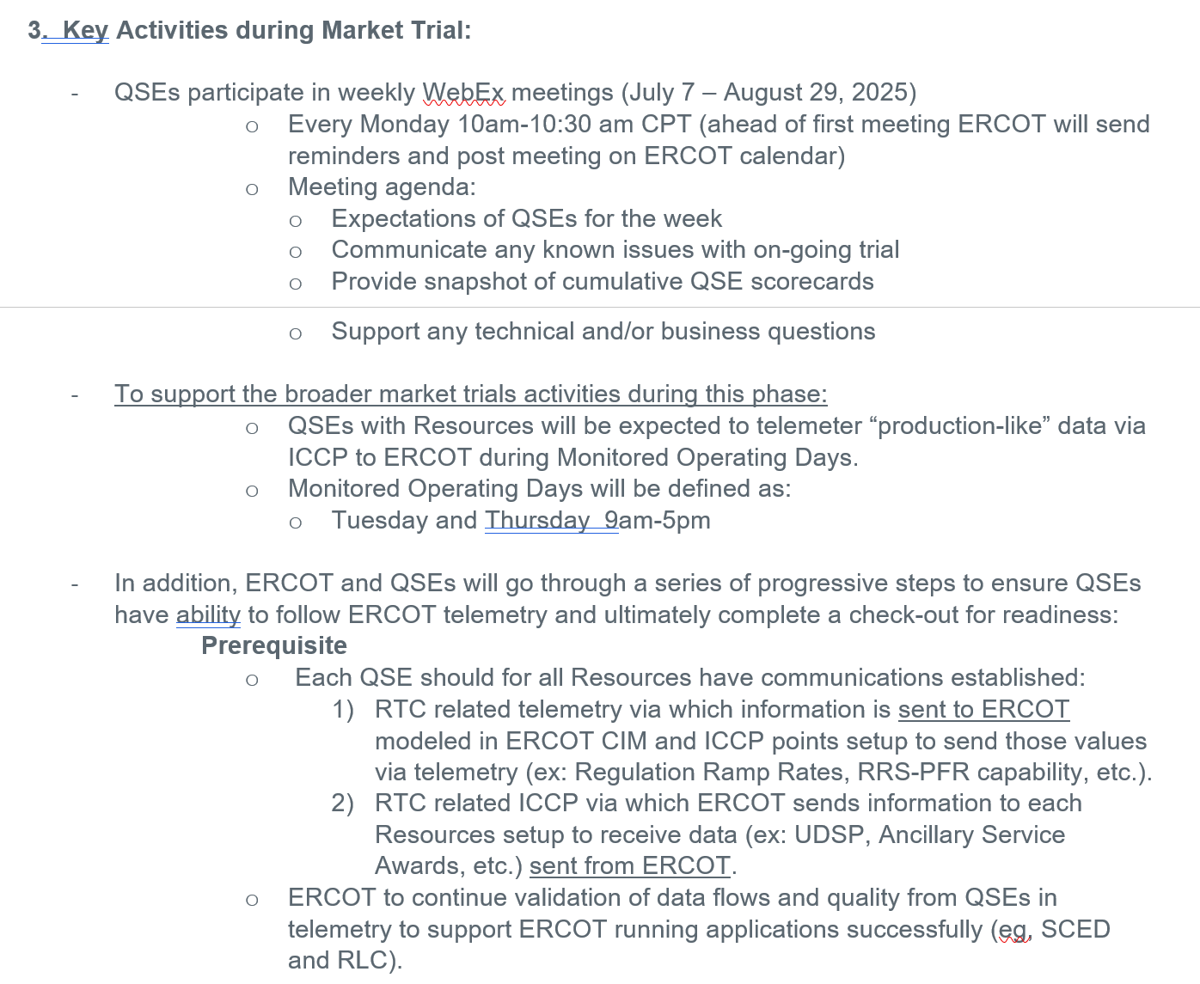
Market Trial Handbooks
Review Handbook #4 for QSE Telemetry Tests
https://www.ercot.com/files/docs/2025/04/07/RTCB_Market_Trials_Handbook_4_QSE-Telemetry-Tests_Rev_06132025_FINAL.docx

Slide 12
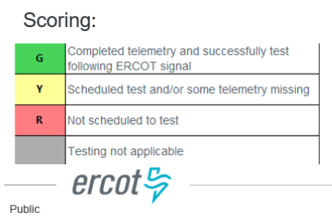
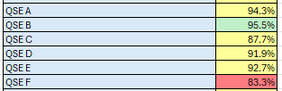
Scorecard 3B for Handbook 3 Acceptable Telemetry Point values received by ERCOT for active resources.
Key points for Telemetry scorecard check
Device types checked - Units, CLRs, NCLRs, ESRs for each QSE
RTCB Telemetry status should be “Good” quality
RTCB Units / CLRs / NCLRs Telemetry values should be within “Expected Range” or an expected value. Details are provided in next few slides.
Expected values are derived from equivalent analogs in current production, based on defined criteria.
RTCB ESR telemetry values are checked against corresponding combo model Battery Unit / CLR counterparts in production.

Slide 13
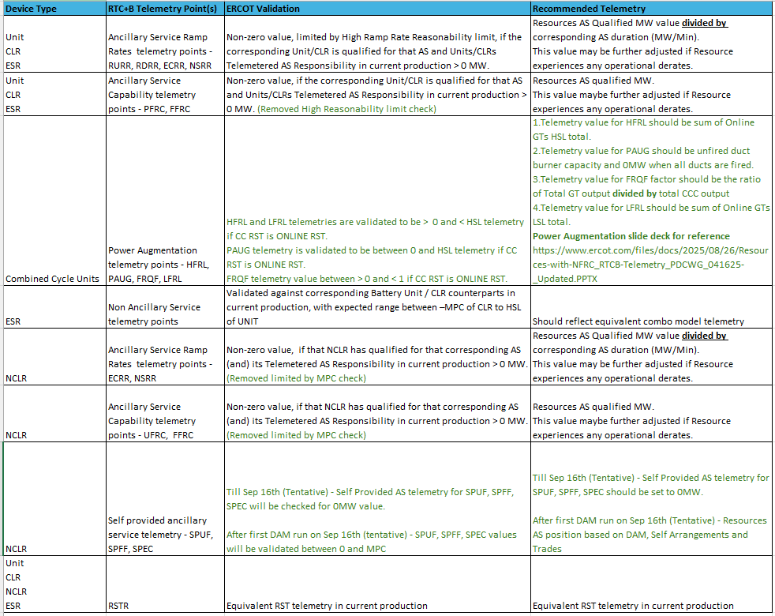
RTC+B Telemetry points validation
Power Augmentation slide deck for reference:
https://www.ercot.com/files/docs/2025/08/26/Resources-with-NFRC_RTCB-Telemetry_PDCWG_041625-_Updated.PPTX

Slide 14
RTC+B Refresher on Resource Statuses for both Telemetry and COP
RTC+B Code (RSTR) | Current Code (RST) | LABEL | TYPE | COP applicable in RTC | DSCRPT
0 | 0 | NA | UNIT | N | UNDEFINED RESOURCE STATUS
1 | 1 | ONRUC | UNIT | Y | ONLINE - HOUR IS RUC-COMMITTED INTERVAL
2 | 3 | ON | UNIT | Y | ONLINE - WITH ENERGY OFFER CURVE
3 | 5 | ONOS | UNIT | Y | ONLINE - WITH OUTPUT SCHEDULE
4 | 8 | ONTEST | UNIT | Y | ONLINE - TEST WITH OUTPUT SCHEDULE
5 | 9 | ONEMR | UNIT | Y | ONLINE - EMR
6 | Not available in Current system | ONSC | UNIT | Y | ONLINE - SYNC CONDENSER
7 | 15 | SHUTDOWN | UNIT | N | ONLINE - UNIT SHUTTING DOWN
8 | 16 | STARTUP | UNIT | N | ONLINE - UNIT STARTING UP
9 | 18 | ONOPTOUT | UNIT | Y | ONLINE - HOUR IS A RUC BUY-BACK HOUR
10 | 23 | ONHOLD | UNIT | N | ONHOLD - OUTPUT TO BE CONSTANT TEMPORARILY
128 | 11 | OUT | UNIT | Y | OFFLINE - UNAVAILABLE
129 | 13 | OFF | UNIT | Y | OFFLINE - AVAILABLE FOR DAM AND RUC COMMITMENT
130 | 14 | EMR | UNIT | Y | AVAILABLE FOR COMMITMENT ONLY FOR EMR
131 | 19 | OFFQS | UNIT | Y | OFFLINE - QSGR AVAILABLE FOR SCED DEPLOYMENT
132 | 20 | EMRSWGR | UNIT | Y | OFFLINE - AVAILABLE ONLY FOR EMERGENCY CONDITION
256 | 256 | NA | LOAD | N | UNDEFINED RESOURCE STATUS
257 | Not available in Current system | ONL | LOAD | Y | ONLINE - LOAD RESOURCE
258 | 260 | OUTL | LOAD | Y | NOT AVAILABLE

Slide 15
RTC+B Refresher on Resource Statuses for both Telemetry and COP
Unit Resource status codes no longer needed in RTC+B
RTC+B Code | LABEL | TYPE | DSCRPT
Status no longer needed in RTC | ONREG | UNIT | ONLINE - ENERGY OFFER CURVE PROVIDING REGULATION SERVICE
Status no longer needed in RTC | ONDSR | UNIT | ONLINE - DYNAMICALLY SCHEDULED RESOURCE
Status no longer needed in RTC | ONOSREG | UNIT | ONLINE - WITH OUTPUT SCHEDULE PROVIDING REGULATION SERVICE
Status no longer needed in RTC | ONDSRREG | UNIT | ONLINE - DYNAMICALLY SCHEDULED RESOURCE PROVIDING REGULATION SERVICE
Status no longer needed in RTC | ONRR | UNIT | ONLINE - SYNCH CONDENSER = RESPONSIVE RESERVE YES - SCED DISPATCH NO - RUC YES
Status no longer needed in RTC | OFFNS | UNIT | OFFLINE - RESERVED FOR NONSPIN
Status no longer needed in RTC | FRRSUP | UNIT | OFFLINE - AVAILABLE FOR FRRS UP
Status no longer needed in RTC | ONFFRRRS | UNIT | ONLINE - AVAILABLE FOR FFR
Status no longer needed in RTC | ONECRS | UNIT | ONLINE - SYNCH CONDENSER PROVIDING ECRS

Slide 16
RTC+B Refresher on Resource statuses for both Telemetry and COP
Load Resource status codes no longer needed in RTC+B
RTC+B Code | LABEL | TYPE | DSCRPT
Status no longer needed in RTC | ONRGL | LOAD | AVAILABLE FOR DISPATCH OF REGULATION SERVICE
Status no longer needed in RTC | ONCLR | LOAD | AVAILABLE FOR DISPATCH OF RRS and NS AS A CONTROLLABLE LOAD RESOURCE
Status no longer needed in RTC | ONRL | LOAD | AVAILABLE FOR RRS and NS EXCLUDING CONTROLLABLE LOAD RESOURCES
Status no longer needed in RTC | FRRSDN | LOAD | AVAILABLE FOR FRRS DOWN
Status no longer needed in RTC | FRRSUP | LOAD | AVAILABLE FOR FRRS UP
Status no longer needed in RTC | ONFFRRRSL | LOAD | AVAILABLE FOR FFR EXCLUDING CONTROLLABLE LOAD RESOURCES
Status no longer needed in RTC | ONECL | LOAD | AVAILABLE FOR ECRS AND RRS EXCLUDING CONTROLLABLE LOAD RESOURCES

Slide 17
Resource status mapping for Generating Units and ESRs
Device | Current system Label (RST) | Current System Code (RST) | RTC+B Label (RSTR) | RTC+B Code (RSTR)
UNIT | NA | 0 | NA | 0
UNIT | ONRUC | 1 | ONRUC | 1
UNIT | ONREG | 2 | ON | 2
UNIT | ON | 3 | ON | 2
UNIT | ONDSR | 4 | ON | 2
UNIT | ONOS | 5 | ONOS | 3
UNIT | ONOSREG | 6 | ONOS | 3
UNIT | ONDSREG | 7 | ON | 2
UNIT | ONTEST | 8 | ONTEST | 4
UNIT | ONEMR | 9 | ONEMR | 5
UNIT | ONRR | 10 | ONSC | 6
UNIT | OUT | 11 | OUT | 128
UNIT | OFFNS | 12 | OFF | 129
UNIT | OFF | 13 | OFF | 129
UNIT | EMR | 14 | EMR | 130
UNIT | SHUTDOWN | 15 | SHUTDOWN | 7
UNIT | STARTUP | 16 | STARTUP | 8
UNIT | FRRSUP | 17 | ON | 2
UNIT | ONOPTOUT | 18 | ONOPTOUT | 9
Device | Current system Label (RST) | Current System Code (RST) | RTC+B Label (RSTR) | RTC+B Code (RSTR)
UNIT | OFFQS | 19 | OFFQS | 131
UNIT | EMRSWGR | 20 | EMRSWGR | 132
UNIT | ONFFRRRS | 21 | ON | 2
UNIT | ONECRS | 22 | ONSC | 6
UNIT | ONHOLD | 23 | ONHOLD | 10

Slide 18
Resource status mapping for Load Resources
Device | Current system Label (RST) | Current System Code (RST) | RTC+B Label (RSTR) | RTC+B Code (RSTR)
LOAD | ONRGL | 257 | ONL | 257
LOAD | ONCLR | 258 | ONL | 257
LOAD | ONRL | 259 | ONL | 257
LOAD | FRSSDN | 261 | ONL | 257
LOAD | FRRSUP | 262 | ONL | 257
LOAD | ONFFRRRSL | 263 | ONL | 257
LOAD | ONECL | 264 | ONL | 257
LOAD | OUTL | 260 | OUTL | 258
LOAD | NA | 256 | NA | 256

