Slide 1
RTC+B Update
for TWG
Matt Mereness
November 20, 2025

Slide 2
Sequence and Dates for Market Trials to Go-Live
Market trials are a progression of activities to mitigate the risk for Go-Live on new systems and processes for both the Market Participants & ERCOT.
30-day Market Notice
11/5/25
March/April
2025
Start
5/5/25
Start
7/7/25
Start
9/2/25
Go-Live
12/5/25*
May 2025
June 2025
July 2025
Aug 2025
Sep 2025
Oct 2025
Nov 2025
Dec 2025
QSE Scorecards & Exit Criteria for each Trial Phase
#1 RTC QSE Submission Testing
(Submit COP, RT AS Offers,
DAM Virtual AS, Outages for ESRs)
#3 Open-loop RTC SCED
(QSE offers, SCED non-binding award/dispatch)
#5 Ongoing Open-Loop
& Periodic Closed-loop SCED/LFC
(QSE RTC offers and telemetry to support closed-loop frequency control test 2-3 tests of 2-4 hour durations)
Transition to Go-Live
Upon completion of testing, confirmation of ERCOT and market readiness for Go-Live.
QSE/Vendor Submission Sandbox and Telemetry Points added Prod EMS model.
#2 RTC QSE Telemetry Checkout (QSEs add/verify new telemetry points for UDSP, New ramp rates, ESR telemetry)
#4 QSE Telemetry Tests
(Individual QSE to follow UDSP and support new ramp rate and ESR telemetry)
#6 Day-Ahead Market
(Non-binding DAM using QSE offers for at least 2 tests)
* Go-Live date reflects 12/5/2025 as first Operating Day
where 12/4/2025 is planned software migration.

Slide 3
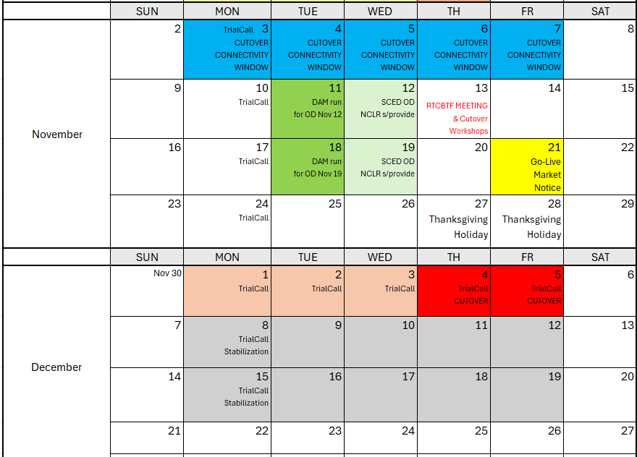
Market Trials and Transition through Go-Live
Currently minimal plans during Thanksgiving week (ERCOT system will be online)
We are here….

Slide 4
Market Notices sent last week
30-day Market Notices sent November 5 across usual channels:
RTC+B Program Readiness
RTC+B Protocol Changes
RTC+B Settlement
RTC+B Credit
RTC+B Market Facing changes
Two other Notices
API End-Point Changes (affects all entities accessing ERCOT XML/API Dec 4/5 impacts)
QSE without Resources Acknowledgement

Slide 5
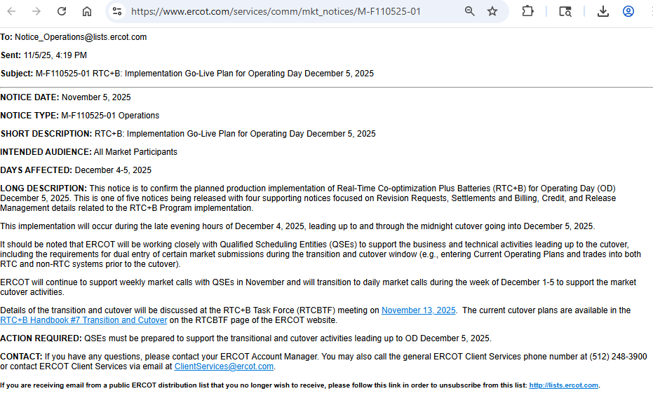
Market Notices sent last week
RTC+B Program Readiness

Slide 6
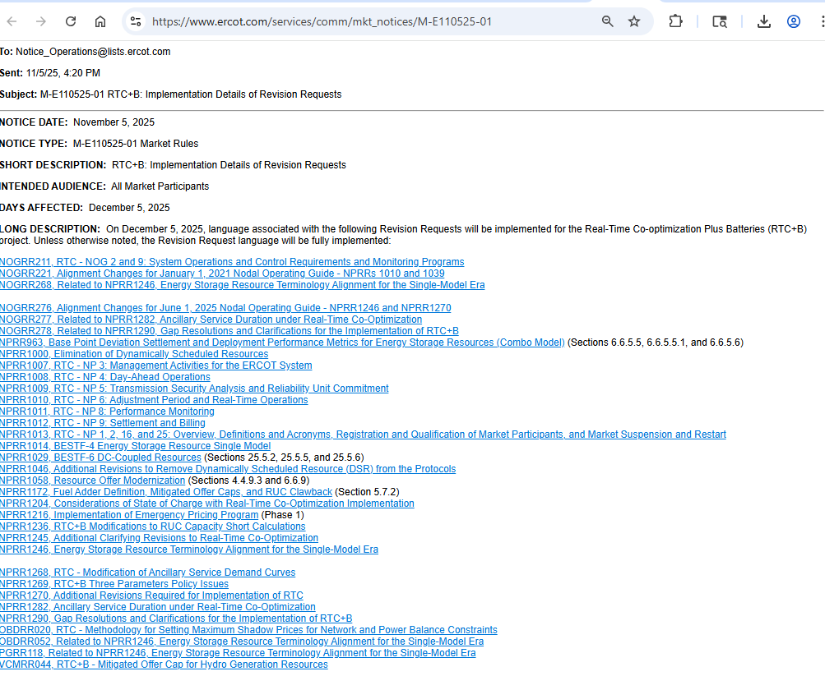
Market Notices sent last week
RTC+B Protocol Changes

Slide 7
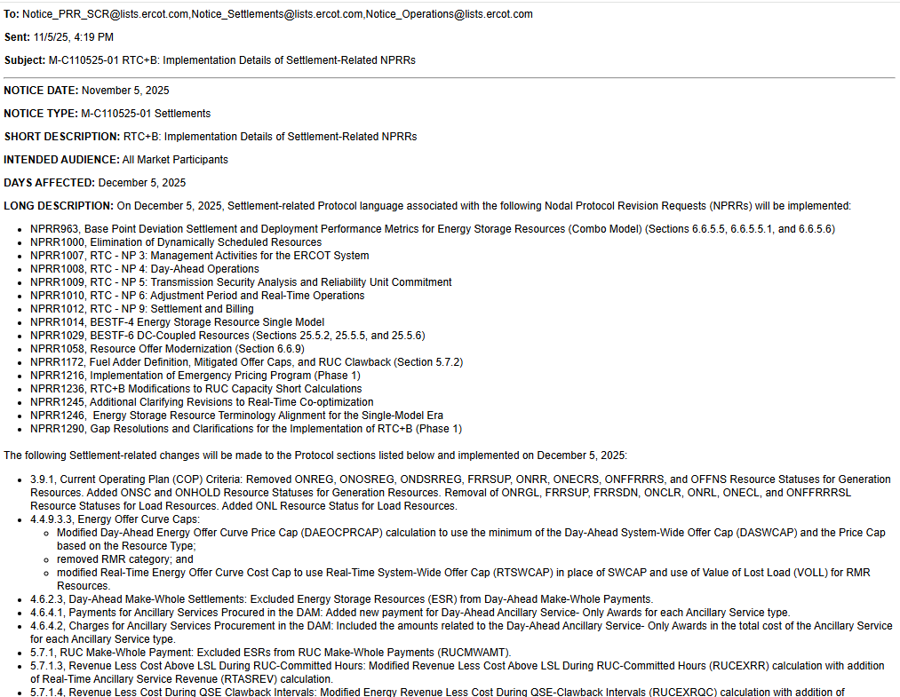
Market Notices sent last week
RTC+B Settlement

Slide 8
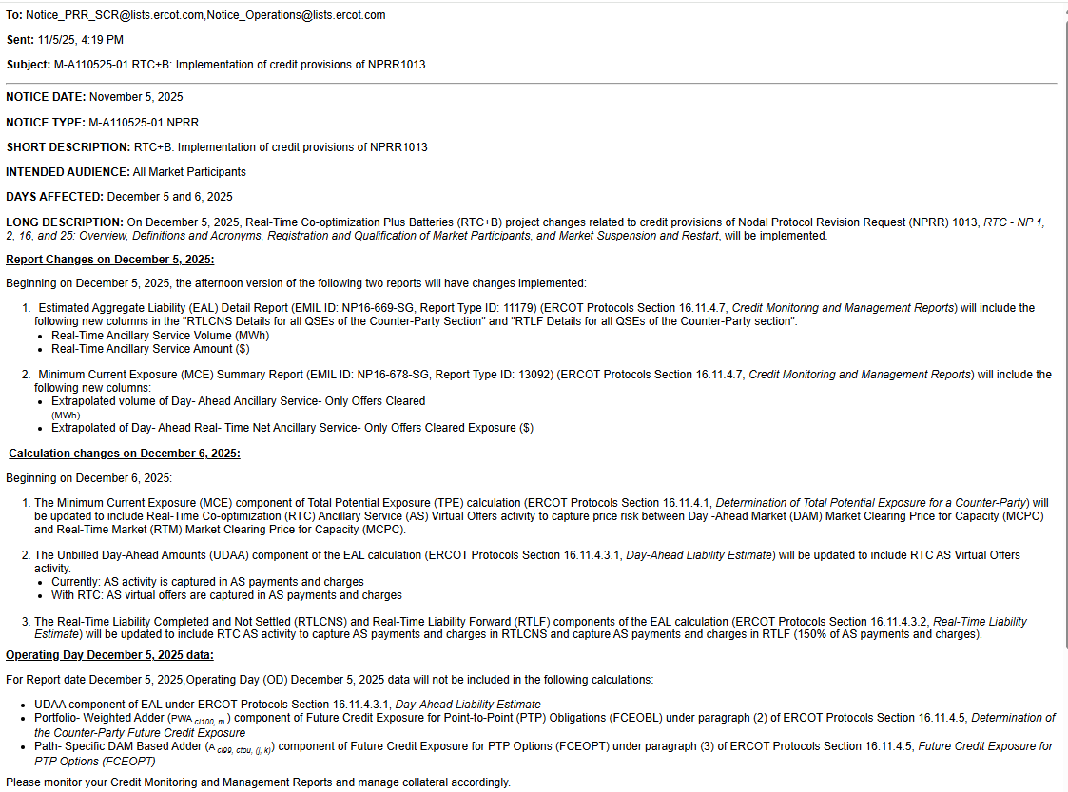
Market Notices sent last week
RTC+B Credit

Slide 9
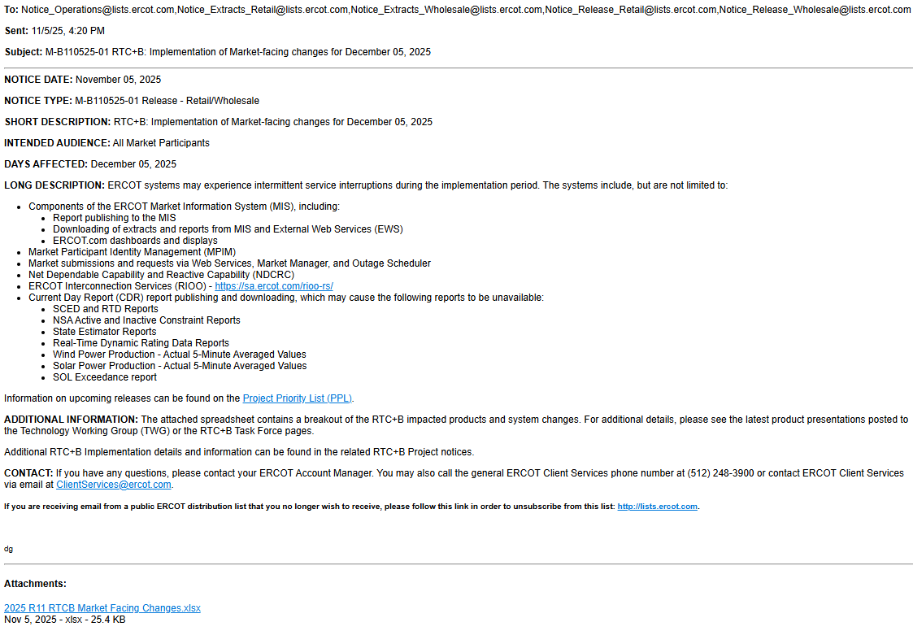
Market Notices sent last week
RTC+B Market Facing changes

Slide 10
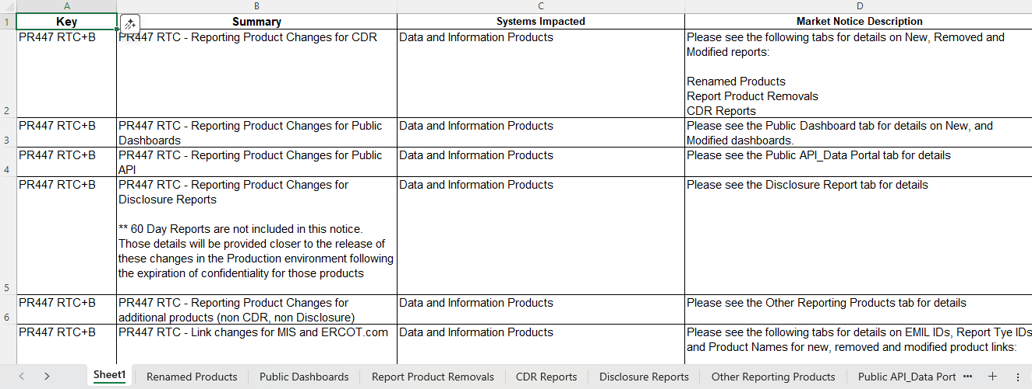
Market Notices sent last week
RTC+B Market Facing changes

Slide 11
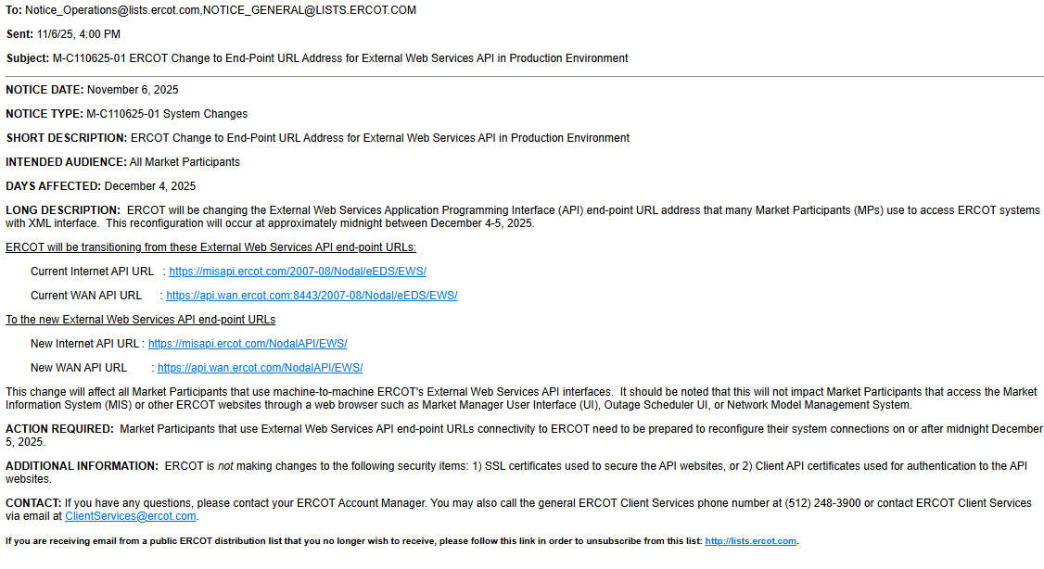
Market Notices sent last week
API End-Point Changes (affects all entities accessing ERCOT XML/API Dec 4/5 impacts)

Slide 12
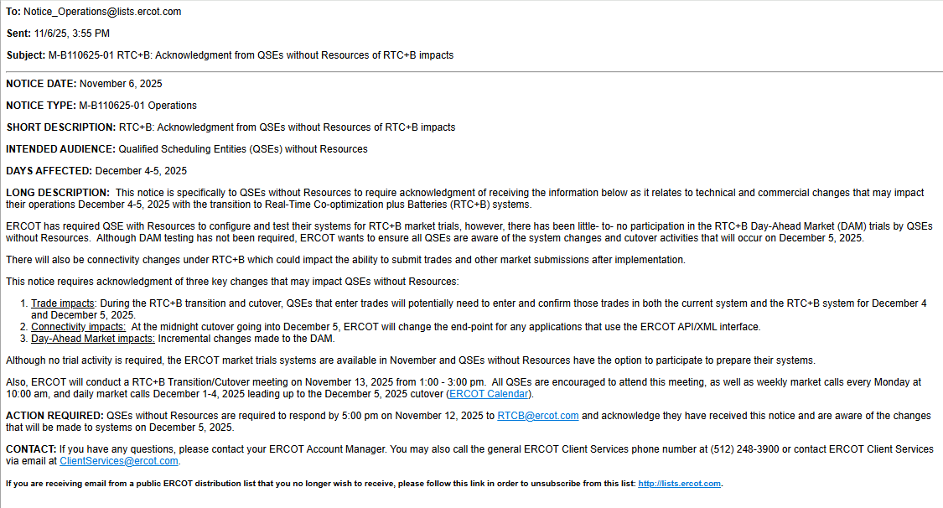
Market Notices sent last week
QSE without Resources Acknowledgement

Slide 13
RTC+B Task Force & Workshops Links to Cutover Workshops Last Week and key materials
RTC+B Cutover Workshop for QSEs
Review RTCB Transition/Cutover Handbook
QSE Dual Entry Expectations
Detailed Cutover Plan
RTC+B Cutover Workshop for TDSPs
Outage Scheduler API URL changes
Outage Scheduler Cutover Plan
SOTE Studies

Slide 14
Cutover Discussion Highlights
Next Week normal weekly call with focus on transition/cutover
Added to ERCOT Calendar:
Daily RTC+B Cutover Calls Mon-Fri Dec 1-5 10am-11am

Slide 15
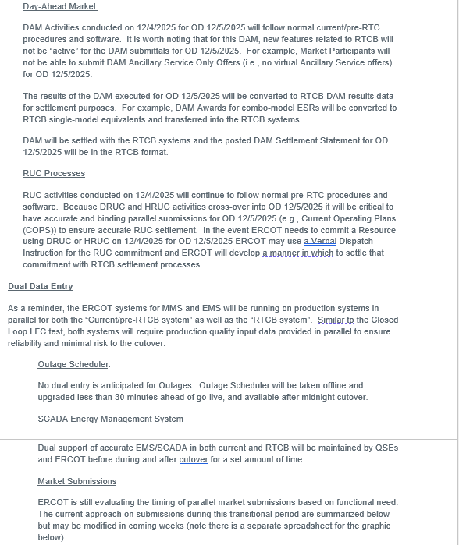
Cutover Discussion Highlights
Link to Cutover Handbook on RTCBTF Homepage
Timing and Dual Entry Requirements

Slide 16
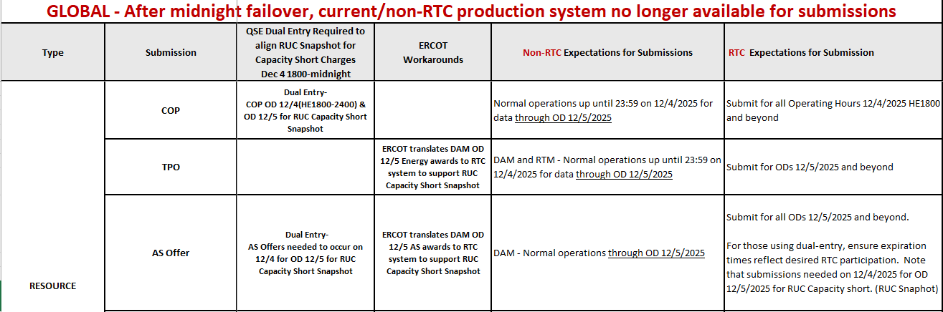
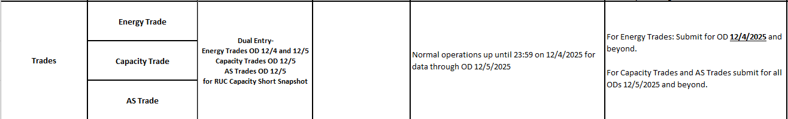
Cutover Discussion Highlights
Link to Cutover Strategy for Dual Submissions spreadsheet on RTCBTF Homepage
Granular Timing and Dual Entry Requirements

Slide 17
Cutover Discussion Highlights
No dual submission requirements for Day-Ahead Market purposes
DAM executions performed Dec 1 – Dec 4 are same pre-RTC system
First “changed DAM” in RTC+B is executed on Dec 5, for OD Dec 6
Dual submissions limited to certain transactions on certain days as described in spreadsheet (prior slide) and explained at a high level in next slide…..

Slide 18
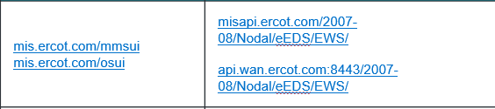
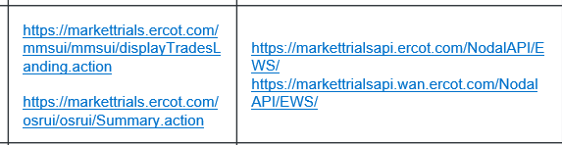
Market Submissions December 1-3
Overlapping / Dual Submissions
Pre-RTC System
Dec 1
Dec 2
Dec 3
Dec 4
Dec 5
Dec 6
QSE Submitting during timeframe of
Dec 1-3
RTC System
Dec 1
Dec 2
Dec 3
Dec 4
Dec 5
Dec 6

Slide 19
Market Submissions December 4
Pre-RTC System
Dec 1
Dec 2
Dec 3
Dec 4
Dec 5
Dec 6
QSE Submitting during timeframe of
Dec 4
RTC System
Dec 1
Dec 2
Dec 3
Dec 4
Dec 5
Dec 6
Example, RUC Snapshots after 1800 Dec 4 (balance of 12/4 and OD 12/5) needs items maintained by QSEs for settlement if any RUCs for Dec 5:
COP
AS Offers
QSE-Trades
After pre-RTC DAM on 12/4 for OD 12/5 is executed:
ERCOT will copy DAM Awards and Self-Arranged AS into RTC tables by 1800

Slide 20

Market Submissions December 5
Pre-RTC System
Dec 1
Dec 2
Dec 3
Dec 4
Dec 5
Dec 6
Midnight cutoff pre-RTC system
QSE Submitting during timeframe of
Dec 5
Energy Trades only*
RTC System
Dec 1
Dec 2
Dec 3
Dec 4
Dec 5
Dec 6
* Energy Trades can be put in for prior OD (back to 1430)

Slide 21
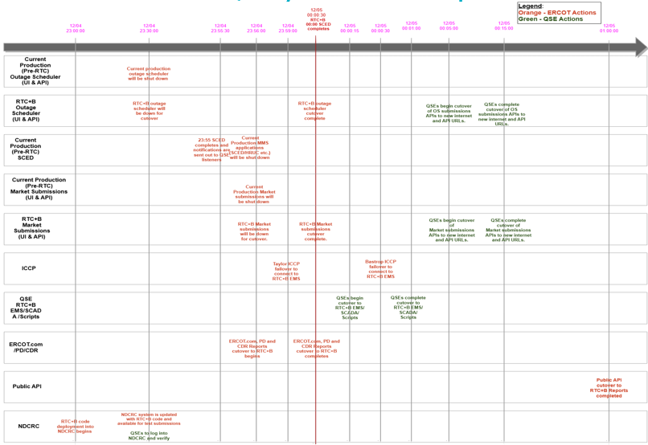
Cutover Step-by-Step Timeline Graphic
Link to Cutover Detail Plan Draft Presentation on RTCBTF Homepage

Slide 22
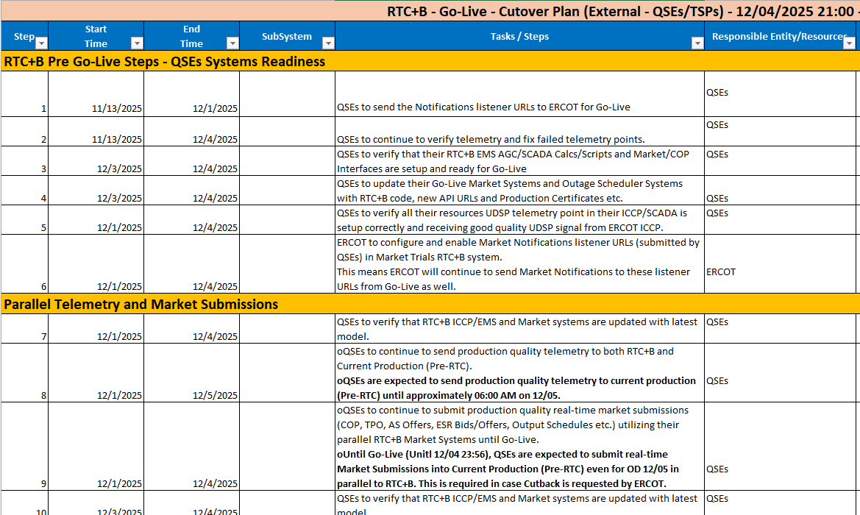
Cutover Step-by-Step Timeline Spreadsheet
Link to Go-Live Cutover Plan External Spreadsheet on RTCBTF

Slide 23
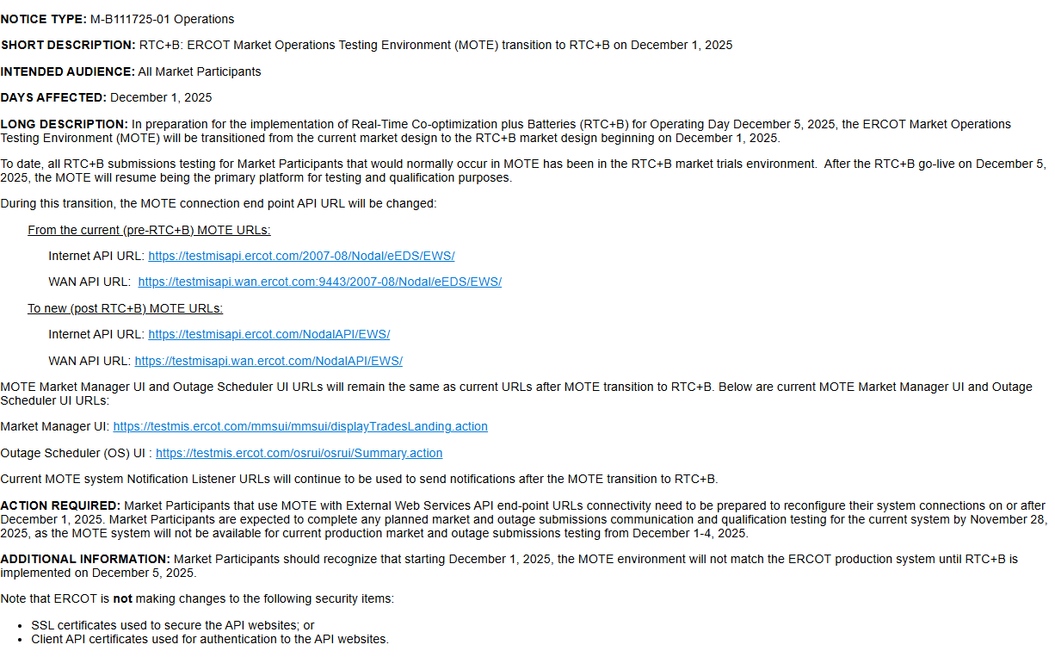
Market Notice for MOTE transition Dec 1

Slide 24
Current MOTE Transition to RTC+B – Cutover Plan
Current MOTE (UIs/APIs) will be down from November 28, 2025, 5:30 PM in preparation for cutover to RTC+B.
Current MOTE (UIs/APIs) will be updated with RTC+B code and configurations and will be up with following new API URLs by 12:00 Noon on December 1, 2025.
New MOTE API URLs:
Internet API URL: https://testmisapi.ercot.com/NodalAPI/EWS/
WAN API URL: https://testmisapi.wan.ercot.com/NodalAPI/EWS/
*ERCOT is not making any changes to current MOTE digital certs and API public key
This means MOTE will be down from November 28, 2025, 5:30 PM until December 1,2025 12:00 noon
Market Participants are expected to complete any planned market and outage submissions communication and qualification testing for current system by November 28, 2025, 5:00 PM, as MOTE system will not be available for current production market and outage submissions testing from December 1-4, 2025.

Slide 25
Current MOTE Transition to RTC+B – Cutover Plan
MOTE Market Manager UI and Outage Scheduler UI URLs will remain same as current URLs after MOTE transition to RTC+B. Below are current MOTE Market Manager UI and Outage Scheduler UI URLs:
Market Manager UI: https://testmis.ercot.com/mmsui/mmsui/displayTradesLanding.action
Outage Scheduler (OS) UI: https://testmis.ercot.com/osrui/osrui/Summary.action
Same current MOTE system Notification Listener URLs will be used to send notifications to Market Participants after the MOTE transition to RTC+B.
MOTE MPIM is NOT impacted due to RTC+B upgrade, so Market Participants will be using same MPIM applications.
ERCOT will open a Secure Webex Call from 1:00 PM till 3:00 PM on December 1,2025 to support QSEs/TSPs MOTE API URLs transition to new MOTE API URLs.
ERCOT will send out Secure Webex Conference call information this week to QSEs/TSPs AR & BAR.
Market Notice will be sent out today with details on current MOTE transition to RTC+B.

Slide 26
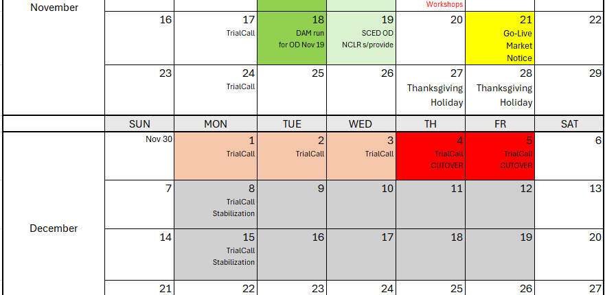
Wrap-Up and Questions
QSEs should be reviewing Cutover plans and considering staffing and system needs for Dec 1-5
MOTE transition activities end of next week
ERCOT will be asking for Cutover night contacts

