Slide 1
Project Update
November 12, 2025
Troy Anderson
ERCOT Portfolio Management

Slide 2
Project Update Agenda
  2025 Release Targets
  Priority/Rank Recommendations for Revision Requests with Impacts
    PGRR131 – Requirements for Interconnection Cost Reporting for Transmission-Connected Generators
  Technology Working Group (TWG)
    Next meeting is 11/20/2025
  Prioritization Update
    Draft #3 – 2026 Priorities
    Status Notes
    2026 Project Planning
Location of Revision Request Project Information: http://www.ercot.com/services/projects

Slide 3
2025 Release Targets – Approved NPRRs / SCRs / xGRRs
R1
R3
R5
January 1/30 | February 2/27 | March 3/27 | April 4/24 | May 5/29 | June 6/26
NPRR945 NPRR1219 | NPRR1254 RTC+B Market Trials Sandbox Deployed | NPRR1145 | RTC+B Market Trials begin on 5/5/2025 | NPRR1253
R2
R4
R6
ü
ü
ü
RTC QSE Submission Testing
3/1
ü
RTC QSE Telemetry Check-out
1/1
3/7
ü
ü
RTC+B
12/5
July 7/31 | August 8/28 | September 9/25 | October 10/23 |  | December 12/18
NPRR1234(a) |  |  | NOGRR245 |  | PGRR091 PGRR115 SCR828
R7
R8
R9
R10
E
R11
Open-loop RTC SCED
Closed-loop SCED/LFC
NPRR1007-1013
RTC+B Stabilization begins
NPRR963(a)
NPRR1000
NPRR1014
NPRR1029(a)
NPRR1054
NPRR1058
NPRR1172
NPRR1204
NPRR1216(a)
NPRR1236
NPRR1245
NPRR1246
NPRR1268
NPRR1269
NPRR1270
NPRR1282
NOGRR211
NOGRR268
NOGRR277
OBDRR020
OBDRR052
PGRR118
QSE Telemetry Tests
Day-Ahead Market
7/21
E
E
E
ü
E
Go-live dates can differ from Protocol effective dates – Please refer to market notices for more details
APPENDIX
Red Text: New additions and target release changes
Strike-Through Text: Previous target release
(a), (b), etc.: Multiple phase release
Project Status Codes
NS = Not Started
I = Initiation
P = Planning
E = Execution
H = On Hold
NPRR963(a) – Portion of NPRR
NPRR1029(a) – Market suspension of ESRs portion
NPRR1216(a) – Invoice workaround
NPRR1234(a) – Section 3.10.7.2, paragraphs 14-19
NPRR1253 – ICCP/Public API
RTC+B Market Trials
RTC+B Stabilization
Release targets are subject to change

Slide 4
Priority / Rank Recommendations for Revision Requests with Impacts
Recommendations for…
Revision Request | Description | Priority | Rank | Comments
NPRR1214 | Reliability Deployment Price Adder Fix to Provide Locational Price Signals, Reduce Uplift and Risk | TBD | TBD | $800k-$1.2M, 12-18 months Impacted Systems: MMS, Settlements, Reporting ERCOT requests a continued table at PRS due to RTC+B resource constraints and design concerns
PGRR131 | Requirements for Interconnection Cost Reporting for Transmission-Connected Generators | 2026 | 4820 | $50k-$75k, 1-2 months Impacted Systems: RIOO, Reporting After further review, ERCOT may suggest a change to a Regulatory rank of 420 for this PGRR
PPL Rank Information
Next 2025 Rank in Business Strategy = 4580 Next 2028 Rank in Business Strategy = 5110
Next 2026 Rank in Business Strategy = 4820 Next 2029 Rank in Business Strategy = 5300
Next 2027 Rank in Business Strategy = 4910 Next Rank in Regulatory = 420

Slide 5
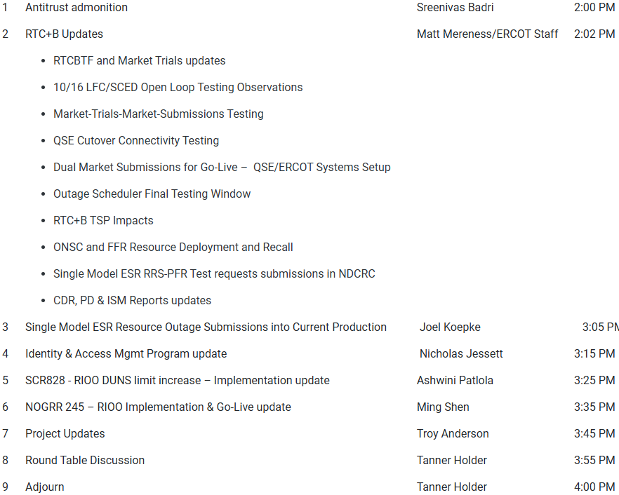
Technology Working Group (TWG)
Agenda for TWG meeting held on 10/23/2025:
Next TWG scheduled for 11/20/2025

Slide 6
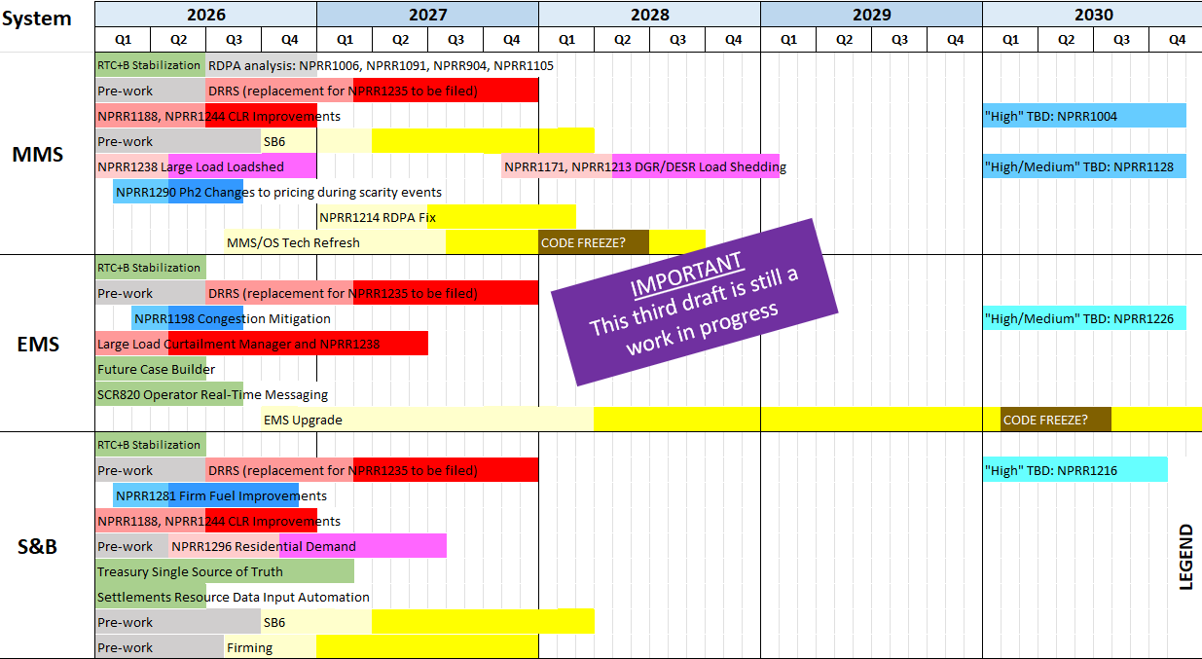
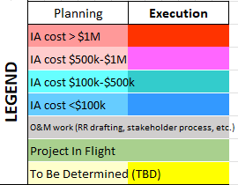
Draft #3 – 2026 Priority Planning
Additional Notes:
All “High” items considered
Color coding reflects IA project cost estimates
Light and dark shading reflects potential project phase durations
Includes internal ERCOT projects drawing on similar resources
Spreadsheet posted for stakeholder review

Slide 7
Aging Revision Request Review at PRS – Status
Draft #3 depicts the latest view of the release plan
NPRR1188 and NPRR1244 Controllable Load Enhancements are approved to start in December 2025 as a single project
  Pre-project discussions with MMS vendor have taken place
  Considering approaches that would reduce the 18-24 month duration estimate
    Current implementation target = Q4 2026
In support of SB6, ERCOT is chartering a Large Load Curtailment Manager project (which will include NPRR1238)
  Candidate for early 2026 project start (go-live target is TBD)
  Impact Analysis is underway (for portion other than NPRR1238)
Smaller projects deemed High Priority in the prioritization workshop are now candidates to start in early 2026 and go-live in 2026
  NPRR1198 – Congestion Mitigation Using Topology Reconfigurations
  NPRR1290 Phase 2 – Gap Resolutions and Clarifications for the RTC+B

Slide 8
2026 Project Planning
ERCOT understands that Market Participants need lead time to implement changes in their systems for many Revision Requests
Confirmed Revision Request Project Starts with 2026 Go-Live Targets
  NPRR1188 – Implement Nodal Dispatch and Energy Settlement for Controllable Load Resources
  NPRR1244 – Clarification of CLR Primary Frequency Response Responsibilities
Revision Request Projects with Potential for 2026 Implementation
  NPRR936 – CRR Account Holder Limits
  NPRR1198 – Congestion Mitigation Using Topology Reconfigurations
  NPRR1277 – Revisions to EAL Formula
  NPRR1281 – Improvements to Alternate FFSS Resource Designation
  NPRR1288 – Remove Multiple Month Transactions in CRR Auctions
  NPRR1290 Phase 2 – Gap Resolutions and Clarifications for RTC+B
  SCR818 Phase 2 – Changes to Incorporate GIC Modeling Data into Existing Modeling Applications
  SCR829 – API for the NDCRC Application
  SCR831 – Short Circuit Model Integration
Other priority Review Request projects may start in 2026 but are expected to Go-Live in a future year
  DRRS, Large Load Curtailment (including NPRR1238), Residential Demand, Firming
Green Text: Deemed “High Priority” at Prioritization Workshop

Slide 9
Appendix

Slide 10
Aging Revision Request Project Review Approach
Initiative Prioritization Workshop held on 8/25/2025
Categorize RRs into “Tiers”
  Tier 1 Critical Must-have items (PUCT/Board directives, etc.)
  Tier 2 High Priority Highest priority after Tier 1
  Tier 3 Medium Priority Fit in without impacting Tier 1 and 2 projects
  Tier 4 No Action Not ready for immediate action
  Tier 5 Candidate for Removal May move to another tier after evaluation
Important Point
  Some aging RRs are expected to require language changes to bring them up to current market or system constructs
    Language updates would be made with a new RR
    ERCOT suggests this analysis be limited to aging items that are prioritized high enough to be queued for implementation

