Slide 1
Large Electronic Load System Operating Limit Implementation
Freddy Garcia
LLWG Meeting
11/20/2025

Slide 2
Large Electronic Load SOL/IROL Region Example
Study Criteria
Contingency
4-cycle 3 phase fault at 345kV station
Large Electronic Load(LEL) Trip Settings:
LEL w/o ride through capability
Voltage dip < 0.7pu for more than 20ms (ITIC curve)
Total loss of 2600 MW of LEL or greater
Resulting in a system frequency overshoot of 60.4 Hz
Location of the fault
Area affected by voltage dip resulting from the fault
Equipment located outside the area of voltage dip
Equipment located inside the area of voltage dip (may trip if unable to ride-through)

Slide 3
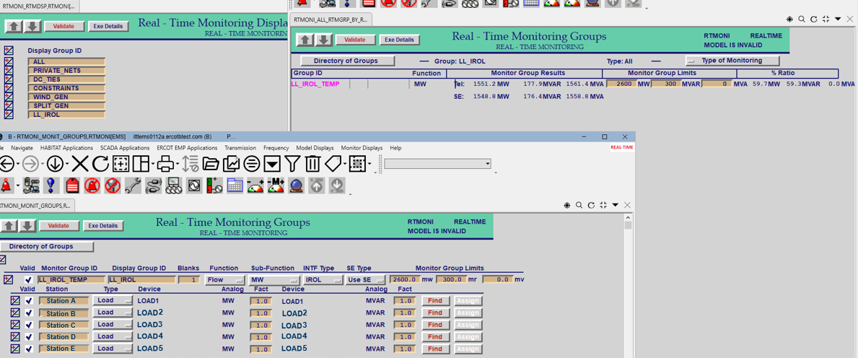
Large Electronic Load SOL/IROL Monitoring

Slide 4
TO Large Electronic Load Limit Instruction
Large Elec. Load SOL Region 1
 | TO1 | TO2 | TO3 | Total LL MW | Cluster Limit
Total Approved MW | 2000 | 850 | 950 | 3800
Percent of Total LL MW | 52.63% | 22.37% | 25.00%
TO Limit to not exceed | 1368 | 582 | 650 | = | 2600
TO will receive limit via Mitigation Plan
LELs without ride through capability in each LEL region by TO provided via Mitigation Plan
Loads curtailed limited to LELs without ride through capability in each load region
TO Load Ratio Share given via Mitigation Plan

Slide 5
Questions

