Slide 1
Large Electronic Load Ride-Through Requirements
NOGRR 282 and NPRR 1308
Patrick Gravois
Operations Engineer – Event Analysis
LLWG
November 20, 2025

Slide 2
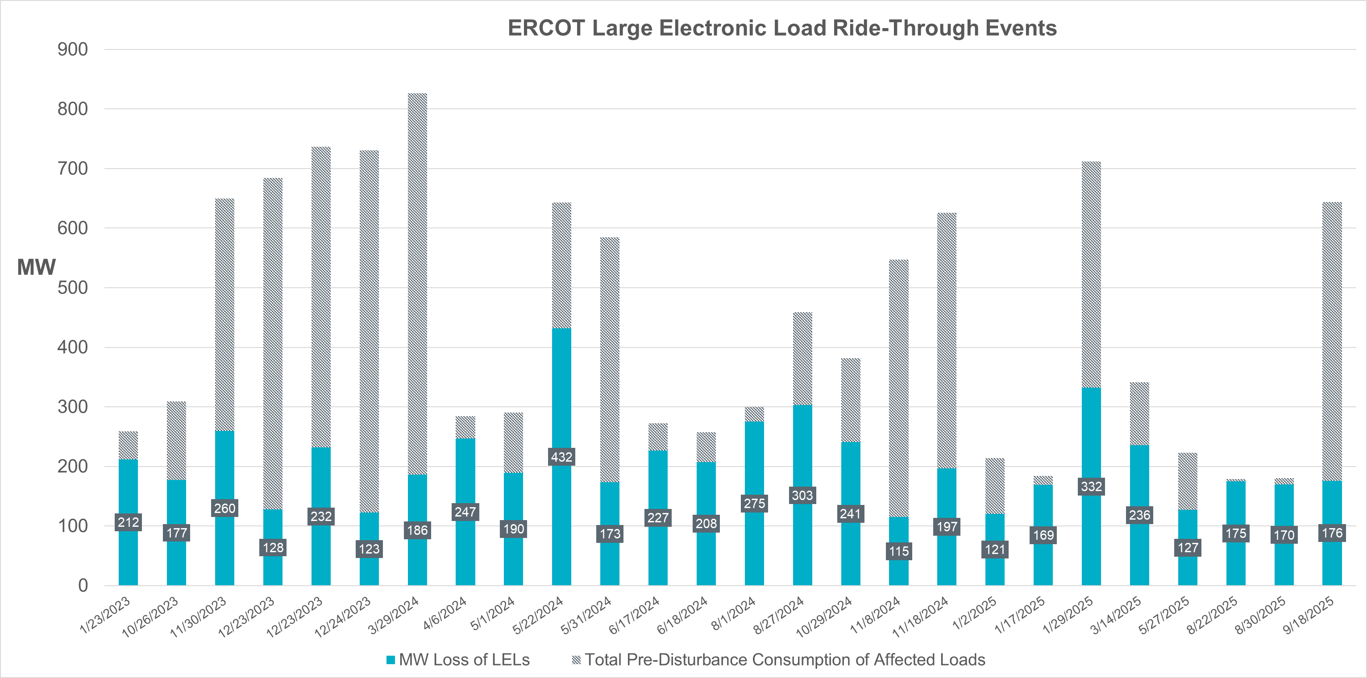
Background and Justification for NOGRR 282 / NPRR 1308
ERCOT has observed many events over the last 3 years in which one or more Large Electronic Loads (LEL) have tripped or instantly reduced consumption during a system fault in which system protection operated as designed.
As LELs increase on the ERCOT system, similar events would increase in magnitude, potentially leading to a major event involving system frequency and voltage instability.
Ride-through performance requirements on LELs are needed to mitigate this risk.
Links to previous ERCOT presentations:
June 13 Large Load Workshop
July 11 LLWG (ERCOT LEL Ride-Through Criteria)
Sept. 19 LLWG (ERCOT study update presentations)
Oct. 24 LLWG (ERCOT study update presentation)

Slide 3
NPRR 1308: Defining Large Electronic Load
Large Load
One or more Facilities at a single site with an aggregate peak Demand greater than or equal to 75 MW behind one or more common Points of Interconnection (POIs) or Service Delivery Points.
Large Electronic Load (LEL)
A Large Load in which 50% or greater of the Demand at the site consists of power electronic based load, specifically computational load, such as data centers and cryptocurrency mining facilities.
Although other types of Large Loads such as variable frequency drives (VFD), variable speed drives (VSD), and hydrogen electrolysis interface with the grid through power electronic devices, ERCOT chose to define LEL to focus on data centers and crypto currency facilities specifically
ERCOT met with various LEL developers and UPS OEMs to understand ride-through capabilities and develop the technical specifications in NOGRR 282

Slide 4
Applicability of Ride-Through Requirements
New Nodal Operating Guide sections:
2.6.4: Frequency Ride-Through Requirements for LELs
2.14: Voltage Ride-Through Requirements for LELs
Paragraph (1) for both sections as follows:
A Customer that proposes to interconnect or maintains an interconnection of a Large Electronic Load (LEL) with the ERCOT System shall ensure the LEL complies with the frequency/voltage ride-through requirements of this section, unless:
(a) The LEL received approval to energize from ERCOT on or before November 14, 2025; or
(b) The LEL satisfied the following requirements on or before November 14, 2025:
(i) Its Large Load Interconnection Study (LLIS) has been completed and results communicated in the manner contemplated by paragraph (6) of Planning Guide Section 9.4, LLIS Report and Follow-up; and
(ii) The interconnecting TDSP for the LEL has provided the confirmation or letter contemplated in Planning Guide Section 9.5, Interconnection Agreements and Responsibilities.

Slide 5
Section 2.6.4 Frequency Ride-Through Requirements for LELs
(2) An LEL shall ride through frequency disturbances of the magnitude and duration specified in Table A below, as measured at the LEL’s Service Delivery Point, or if the LEL is co-located with a Generation Resource or Energy Storage Resource, at the Point of Interconnection Bus (POIB) of that Resource. An LEL is not required to ride-through if it is either performing in accordance with its interconnecting TDSP’s Under-Frequency Load Shed (UFLS) program or providing an Ancillary Service that would require the LEL to trip or reduce consumption due to a frequency disturbance.
Table A
Frequency (f) in (Hz) | Minimum Ride-Through Time (seconds)
f > 61.8 | May ride-through or trip
61.2 < f ≤ 61.8 | 299
58.8 ≤ f ≤ 61.2 | continuous
57.0 ≤ f < 58.8 | 299
f < 57.0 | May ride-through or trip
(3) Nothing in paragraph (2) above shall be interpreted to require an LEL to trip or transfer load to backup generation for frequency conditions beyond those for which ride-through is required.

Slide 6
Section 2.6.4 Frequency Ride-Through Requirements for LELs
(4) If an LEL is consuming electric current from the grid at the time of the frequency disturbance, the LEL shall continue to consume electric current from the grid during frequency deviations requiring ride-through. In addition, an LEL should continue to consume active power within 10% of the pre-disturbance level during frequency deviations requiring ride- through.
ERCOT does not expect LELs would need to reduce consumption for frequency deviations but is providing some allowances to limit unnecessary Compliance issues.
(5) If protection systems are installed and activated to trip the LEL, they shall enable the LEL to ride-through frequency conditions beyond those defined in paragraph (2) above to the maximum level the equipment allows, unless the protection systems are set to respond to an UFLS event or Ancillary Service obligation.
If protection systems are needed by LELs for frequency deviations, those protections settings should be based on actual equipment tolerances and not just set directly or just outside the minimum RT requirement curve.
If equipment does not need to trip for frequency deviations, do not set them to do so.
(6) If frequency protection schemes are installed and activated to trip an LEL, they shall use filtered quantities or add sufficient time delays to prevent misoperations while providing the desired equipment protection. Protection schemes shall not trip an LEL based on an instantaneous frequency measurement.
Issue identified in IBR ride-through events and addressed in NOGRR 245. Frequency measurements during voltage transients may unnecessarily trip protection if instantaneous frequency measurement are used.

Slide 7
Section 2.14: Voltage Ride-Through Requirements for LELs
(2) An LEL interconnecting with the ERCOT System shall ride through the root-mean-square positive sequence voltage conditions of the magnitude and duration specified in Table A below, as measured at the LEL’s Service Delivery Point, or if the LEL is co-located with a Generation Resource or Energy Storage Resource, at the Point of Interconnection Bus (POIB) of that Resource. An LEL shall remain connected to the Transmission Grid during voltage conditions requiring ride-through. Additional LEL performance requirements for voltage conditions requiring ride-through are listed below. (next slides)
Table A
Root-Mean-Square Positive Sequence Voltage (p.u. of nominal) | Minimum Ride-Through Time (seconds)
V > 1.20 | May ride-through or trip
1.10 < V ≤ 1.20 | 2.0
0.90 ≤ V ≤ 1.10 | Continuous
0.80 ≤ V < 0.90 | 2.0
0.50 ≤ V < 0.80 | 0.5
0.20 ≤ V < 0.50 | 0.25
V < 0.20 | 0.15

Slide 8
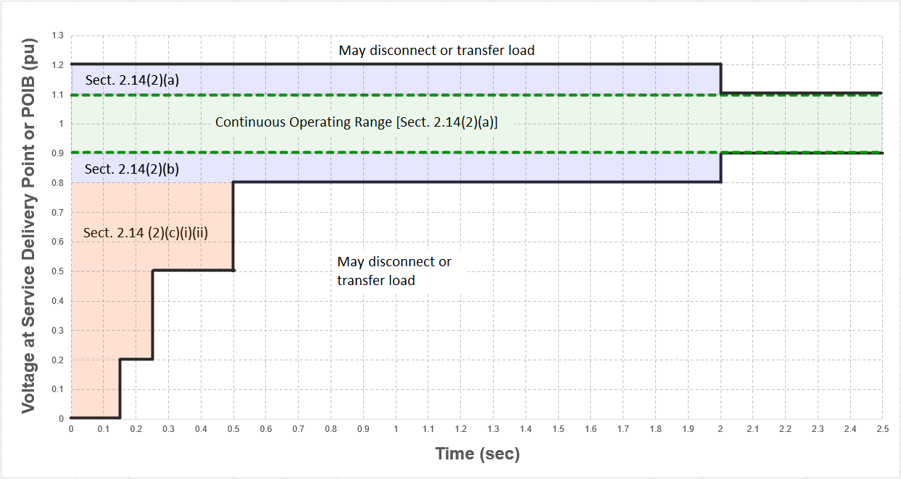
Section 2.14: Voltage Ride-Through Requirements for LELs
Note: Visual representation of Table A in Section 2.14(2) with reference to associated performance requirement section.

Slide 9
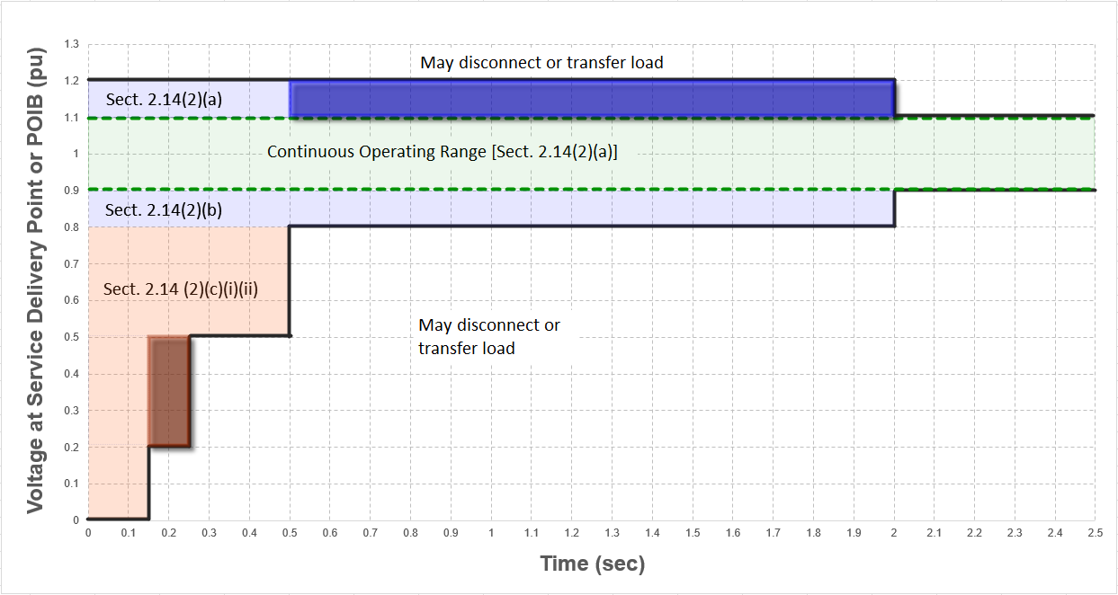
Section 2.14: Voltage Ride-Through Requirements for LELs
Note: Extended VRT requirements from July LLWG highlighted above

Slide 10
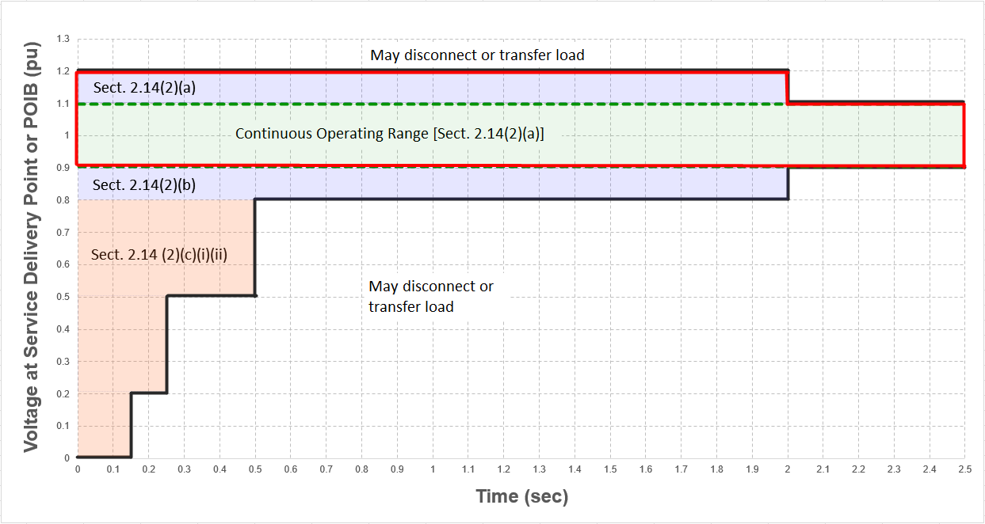
Section 2.14: Voltage Ride-Through Requirements for LELs
(a) When voltage at the Service Delivery Point or, if the LEL co-located with a Generation Resource or Energy Storage Resource, at the POIB, remains within the continuous operating range in Table A during a disturbance or exceeds 1.1 per unit and remains below 1.2 per unit for less than 2 seconds for an overvoltage condition, the LEL shall continue consuming active power from the grid at the pre-disturbance level during the disturbance.
ERCOT does not expect LELs would need to reduce consumption for shallow voltage swells with duration under 2 seconds.

Slide 11
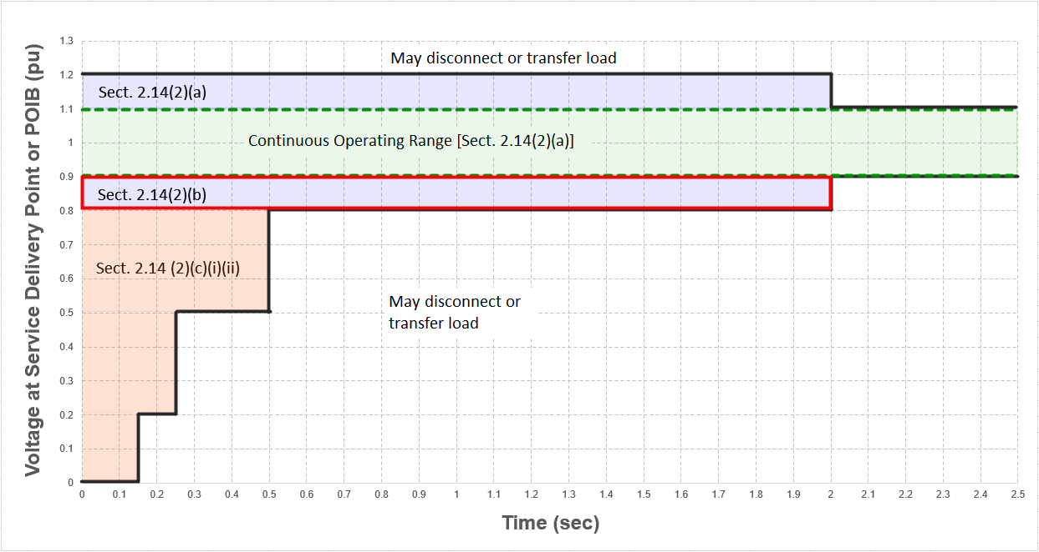
Section 2.14: Voltage Ride-Through Requirements for LELs
(b) When voltage at the Service Delivery Point or POIB falls below 0.9 per unit but remains above 0.8 per unit and then returns to above 0.9 per unit within 2 seconds, the LEL shall continue consuming active power from the grid during the low voltage condition. In such cases, the LEL may reduce its active power consumption proportional to the voltage drop but shall return to 90% of its pre-disturbance consumption level from the grid within one second of voltage at the Service Delivery Point or POIB returning to above 0.9 per unit.

Slide 12
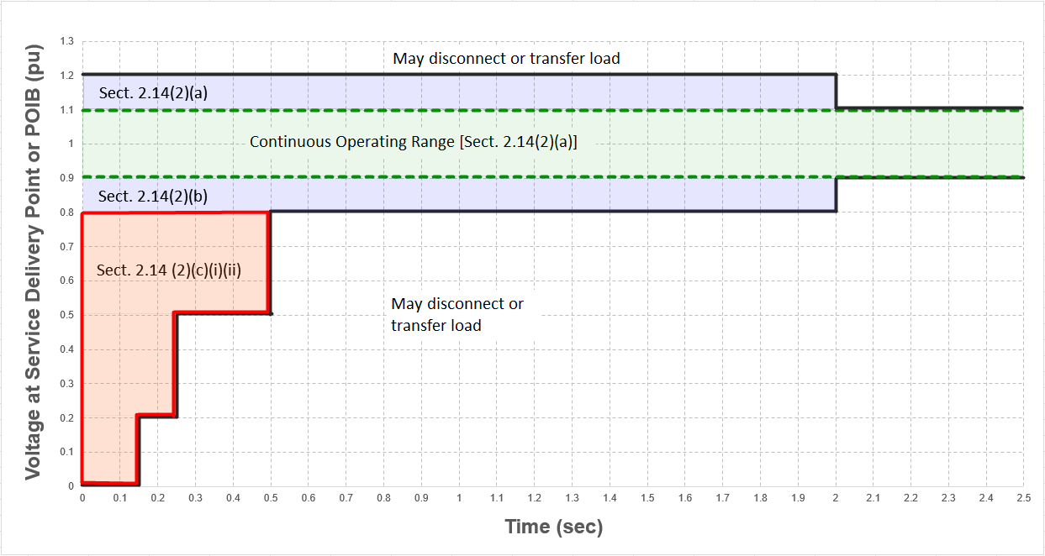
Section 2.14: Voltage Ride-Through Requirements for LELs
May temporarily reduce active power consumption
(c) For any voltage condition at the Service Delivery Point or POIB that an LEL is required to ride-through and involves a voltage condition below 0.8 per unit, the LEL may decrease active power consumption from the grid but shall return to at least 90% of its pre-disturbance consumption level from the grid within one second of voltage at the Service Delivery Point or POIB returning to above 0.90 per unit. Additional performance requirements for the allowable reduction of consumption in active power when voltage drops below 0.8 per unit are defined as follows: (next slides)

Slide 13
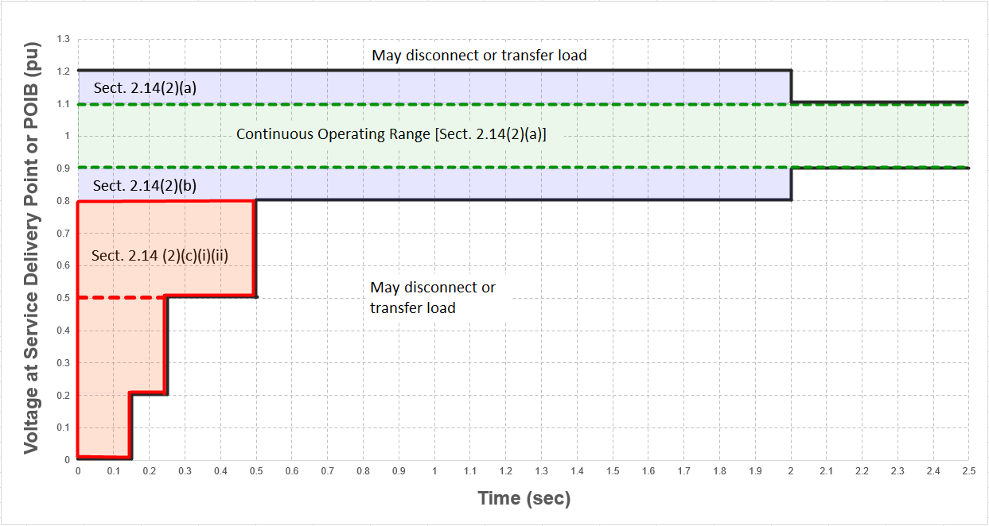
Section 2.14: Voltage Ride-Through Requirements for LELs
(i) For any LEL that satisfies the requirements in paragraph (1)(b) above after November 14, 2025 but on or before January 1, 2028, if the LEL needs to temporarily reduce active power consumption from the grid to allow the facility to ride through the voltage disturbance in accordance with the performance requirements defined in paragraph (c) above, that reduction in active power shall be proportional to the voltage drop for any voltage between 0.8 and 0.5 per unit at the Service Delivery Point or POIB, if capable. The LEL may reduce active power consumption as much as needed for voltage drops below 0.5 per unit. If the LEL equipment is not capable of the performance described above, then the LEL may reduce active power consumption as much as necessary to remain connected to the grid but shall return to pre-disturbance consumption as defined in paragraph (c) above.

Slide 14
Section 2.14: Voltage Ride-Through Requirements for LELs
(ii) For any LEL that satisfies the requirements in paragraph (1)(b) above after January 1, 2028, the LEL shall continue consuming active power from the grid when the voltage at the Service Delivery Point or POIB is between 0.8 and 0.5 per unit but may temporarily reduce active power consumption from the grid proportional to the voltage drop. When the voltage at the Service Delivery Point or POIB is below 0.5 per unit, the LEL may reduce active power consumption as needed to allow the facility to ride through the voltage disturbance in accordance with the performance requirements defined in paragraph (c) above.

Slide 15
Section 2.14: Voltage Ride-Through Requirements for LELs
(2)(d) When a voltage disturbance causes the voltage at the Service Delivery Point or POIB to drop outside the continuous operating range in Table A of paragraph (2) above, an LEL shall not consume electric current during the disturbance at a level that exceeds 125% of its maximum electric current consumption during normal operations.
Recommend that DWG and possibly SPWG review this threshold
LEL ride-through events have shown currents between 150-200% during voltage suppression
125% allows constant power for voltage sags down to 0.8 p.u.
(3) Nothing in paragraph (2) above shall be interpreted to require an LEL to trip or transfer load to backup generation for voltage conditions beyond those for which ride-through is required.
(4) If installed and activated to trip or transfer the LEL, all protection systems (including but not limited to protection for over- /under-voltage) shall enable the LEL to ride-through voltage conditions beyond those defined in paragraph (2) above to the maximum level the equipment allows.
Protection settings should be set for actual equipment tolerances and capabilities, not set directly or just outside the proposed ride-through curve.

Slide 16
Section 2.14: Voltage Ride-Through Requirements for LELs
(5) If instantaneous over-current or over-voltage protection systems are installed and activated to trip or transfer the LEL, they shall use filtered quantities or time delays to prevent misoperation while providing the desired equipment protection. Any alternating current instantaneous over-voltage protection that could disrupt the LEL power consumption shall use a measurement window of at least one cycle of fundamental frequency.
Intent is to mitigate unnecessary protection system trips on instantaneous voltage measurements, as previously seen in IBR ride-through events
VRT curve based on RMS; language does not prohibit any instantaneous over-current or over-voltage from tripping equipment if it is needed to protect equipment
(6) An LEL shall not implement a load trip or transfer scheme that disconnects or transfers load to backup generation due solely to a certain number of voltage sags or swells within a certain period of time if the LEL is required under paragraph (2) above to ride through each such condition.
Intent is to mitigate risk as seen in northern Virginia events

Slide 17
LEL Ride-Through Performance Failures
Paragraph (7) in Sections 2.6.4 and 2.14 below:
(7) If ERCOT determines that an LEL has failed to ride through a frequency/voltage disturbance in accordance with any requirement in this Section 2.6.4/Section 2.14:
(a) The interconnecting TDSP shall provide available information to ERCOT to assist with ERCOT’s event analysis
(b) The Customer representing the LEL shall:
(i) Investigate and determine the root cause of the frequency/voltage ride-through failure and report the results of the investigation to ERCOT within 90 days of ERCOT’s request;
(ii) Develop a plan to ensure the LEL can meet the applicable ride-through performance requirements and submit the plan to ERCOT within 90 days of completion of (i) above; and
(iii) Implement the plan upon ERCOT approval within 180 days of (ii) above unless ERCOT approves a longer timeline.
(c) Notwithstanding the requirements of paragraph (b) above, if ERCOT determines that the operation of an LEL following a failure to comply with the requirements of this Section 2.14 poses an imminent risk to local or system reliability, ERCOT may require the LEL to disconnect from the ERCOT System and remain disconnected until the Customer representing the LEL has demonstrated to ERCOT’s satisfaction that the LEL can comply with the ride- through performance requirements of this Section.

Slide 18
Next Steps
NPRR 1308 will go to December PRS
NOGRR 282 will go to December ROS
Stakeholders may submit formal comments as per the usual stakeholder process
If preferable, LEL developers and Market Participants can contact ERCOT staff with any questions or requests for meetings via email before submitting comments

Slide 19
Questions?

