Slide 1
ERCOT Technology Working Group (TWG)
November 20, 2025

Slide 2
ERCOT TWG
WELCOME

Slide 3
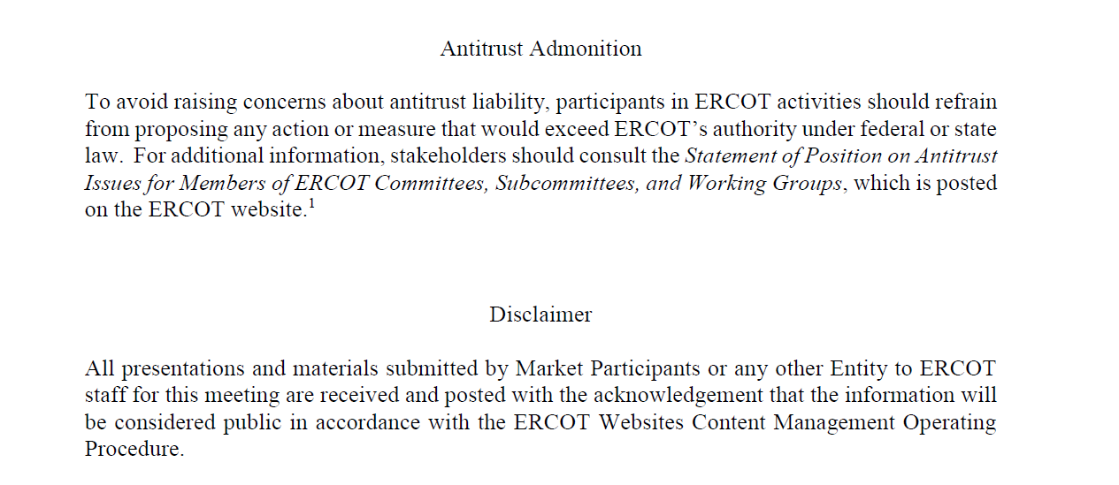
ERCOT TWG

Slide 4
ERCOT TWG Agenda
Item # | Item Description | Presenter | Start Time
1 | Antitrust admonition | Sreenivas Badri | 2:00 PM
2 | NERC EMS WG Updates | Wei Qui | 2:02 PM
3 | Project Updates | Troy Anderson | 2:10 PM
4 | RTC+B Updates RTCBTF and Go-Live Transition updates Dual Market Submissions Requirements and Systems Setup MOTE Cutover Plan Review Go-Live Cutover Plan Review Telemetry and ICCP Handbook updates CDR Reports EWS XSD changes PD, CDR and ISM Reports Go-Live Transition updates | Matt Mereness/ERCOT Staff | 2:20 PM
5 | Outage Considerations, TDSP Echo Points, and RTC Models | Sreenivas Badri | 3:15 PM
6 | Market and Outage Submissions API Gateway - Additional Security Policies Secure Pilot updates | Brandon Johnson | 3:25 PM
7 | SCR820 – Real-Time Operator Messaging Tool updates | Preethi Meher/Christelle Seri | 3:35 PM
8 | DPC Process Automation project updates | Karthik Gopinath | 3:40 PM
9 | Round Table Discussion | Tanner Holder | 3:50 PM
10 | Adjourn | Tanner Holder | 4:00 PM

Slide 5
NERC EMS WG Updates
  NERC EMS WG Updates – Wei Qui

Slide 6
Project Updates
  Project Updates – Troy Anderson

Slide 7
RTC+B Updates
  RTCBTF and Go-Live Transition updates – Matt Mereness
  Go-Live Cutover Plan Review – Sreenivas Badri/Sruthi Hariharan
    Dual Market Submissions Requirements and Systems Setup
    Cutover Plan Review
  MOTE Cutover Plan Review – Sreenivas Badri
  Telemetry and ICCP Handbook Updates – Kevin McGarrahan/Tejaswi Potluri
  CDR, PD and ISM Reports Go-Live Transition updates, CDR Reports EWS XSD changes – Jamie Lavas

Slide 8
Outage Considerations, TDSP Echo Points, and RTC Models
Outage Considerations, TDSP Echo Points, and RTC Models – Sreenivas Badri

Slide 9
EWS API Gateway Additional Security and Secure API Pilot Updates
Market and Outage Submissions API Gateway - Additional Security Policies – Brandon Johnson
Secure Pilot updates - Brandon Johnson

Slide 10
SCR820
SCR820 – Real-Time Operator Communication System (RTOC) – Tool updates and Demo - Preethi Meher/Christelle Seri

Slide 11
DPC Process Automation
DPC Process Automation Project updates – Karthik Gopinath

Slide 12
ERCOT TWG – Round Table Discussion
ERCOT TWG – Round Table Discussion
  Future Topics of Interest
  Topics and presentations from TWG members

Slide 13
ERCOT TWG
Thank You
You can reach Sreenivas at
Sreenivas.Badri@ercot.com and Tanner at tholder@tnsk.com

