Slide 1
NDSWG Meeting
November 2025

Slide 2
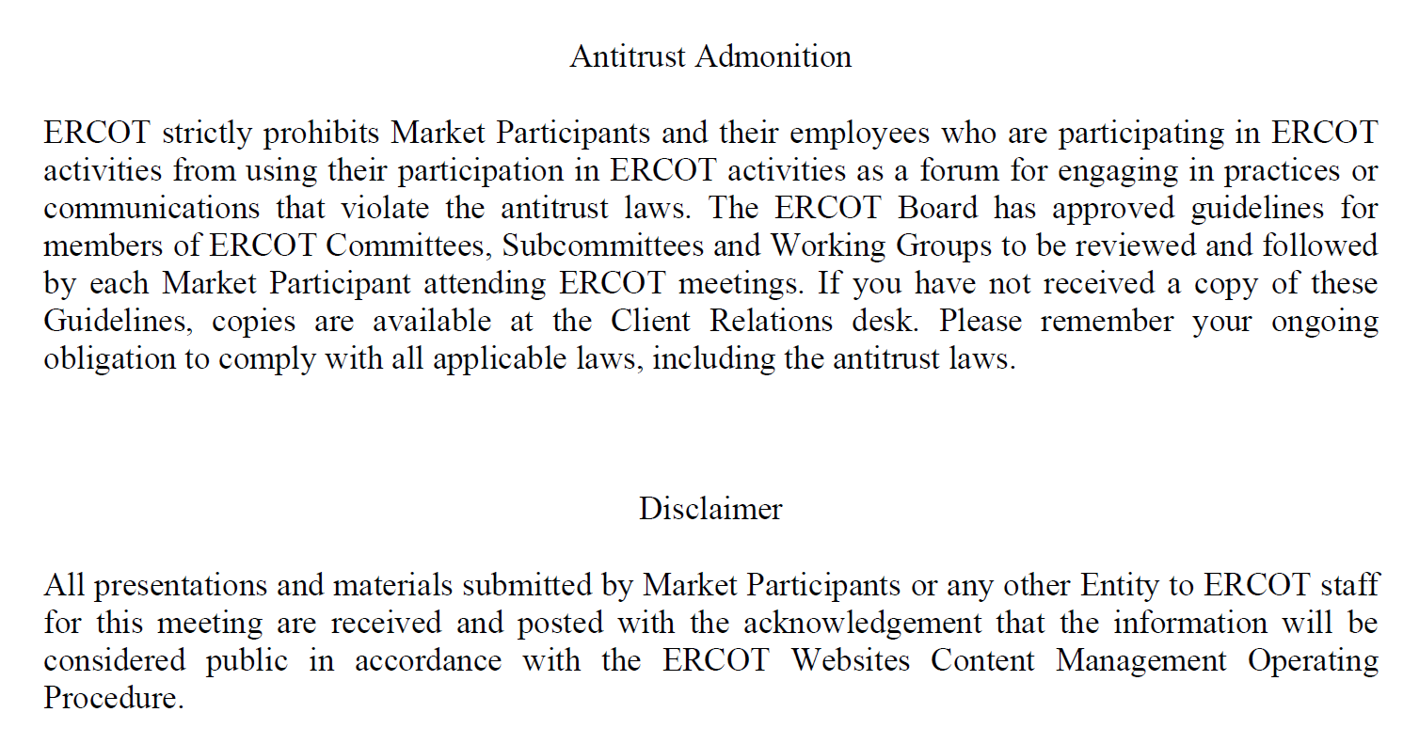
Antitrust Admonition

Slide 3
Topics
RTC Update
Go Live Update
RTC Models available
SOTE Future cases
CIM 16 update
Election for 2026 Chair/Vice Chair

Slide 4
Topics
RTC Update
Go Live Update
RTC Models available
SOTE Future cases
CIM 16 update
Election for 2026 Chair/Vice Chair

Slide 5
RTC Go Live
RTC+B Go Live date is December 5, 2025
December ML1 non RTC+B model will be loaded on December 3, 2025
December ML1 RTC+B will be loaded on December 5, 2025

Slide 6

Full and Redacted Representations of RTC+B Model Posted
ERCOT has posted full and redacted RTC models
Redacted RTC models are posted to the MIS:
Redacted Network Operations Test Model and Difference Report
Full models for TDSPs are posted in the NMMS Citrix Postings location:
Located in the ECEII_NMMS_45_DAY_POSTINGS folder
For the December ML1 models, the “RTC” string will be used to identify the RTC model.

Slide 7
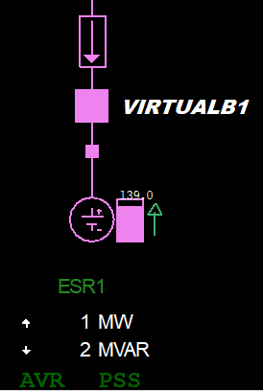
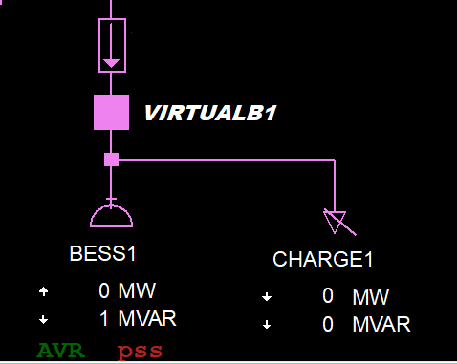
SOTE Future Case
RTC+B SOTE available starting October 6 2025
February ML1 2026 model available
ESRs transition from “combo” to “single” model representation
https://www.ercot.com/services/comm/mkt_notices/M-A092624-04

Slide 8
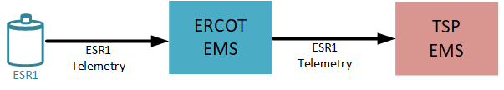
TSPs Must Adjust to New ESR Names in Telemetry “Echo Points”
Telemetry available to TDSPs will change due to new ESR names and transition to single-model representation
Pre-RTC
TSPs incorporating ESR telemetry in their real-time applications must account for changes due to RTC battery modeling
RTC
Mapping Document Between Combo and Single-Model Names

Slide 9
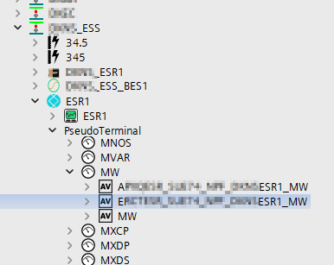
Echo Points – Locating Single-Model Telemetry in NMMS
TDSPs can access single-model ESR telemetry via NMMS
Single-model telemetry is temporarily located underneath a GenericEquipment instance with the same name as the future ESR.
The ICCP string of the echo points are identifiable by the “E” prefix
The mapping between combo and single model names can be found here

Slide 10
Topics
RTC Update
Go Live Update
RTC Models available
SOTE Future cases
CIM 16 update
Election for 2026 Chair/Vice Chair

Slide 11
CIM 16 Update
Siemens have released the first CIM 16 version of NMMS
Modeling found issues with the build and expecting another release
Market Release for testing is by the end of the year

Slide 12
Topics
RTC Update
Go Live Update
RTC Models available
SOTE Future cases
CIM 16 update
Election for 2026 Chair/Vice Chair

Slide 13
Other Topics
Open Discussion…

