Slide 1
Weekly
RTC+B Market Trials Update
ERCOT Staff
November 17, 2025

Slide 2
Outline
Antitrust Admonition
Upcoming Activities
Known Issues
Expectations of QSEs for the Week
ESR deadline for frequency response governor tests
Cutover Workshop highlights
MOTE transition
More Cutover Details (Sreenivas presentation)
Q&A
Appendix- Supporting Materials:
Summary of SCED Functionality
SCED Analysis/Results for prior week
DAM and AS Self-Provision Education
Telemetry Screening
New RTC Pricing Reports location
NPRR1290 Validation Changes
Links to Handbooks
FAQ Updated
Connectivity and Configuration (digital certs)

Slide 3
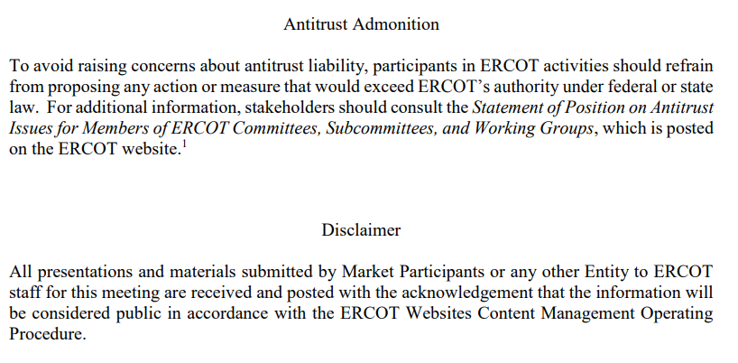
WebEx Meeting reminders (same as other ERCOT forums):
Please keep line muted
If you have a question, please use the chat feature to either:
Type in your question, or
Type in “Question” and wait to be recognized to state question

Slide 4
Sequence and Dates for Market Trials to Go-Live
Market trials are a progression of activities to mitigate the risk for Go-Live on new systems and processes for both the Market Participants & ERCOT.
30-day Market Notice
11/5/25
March/April
2025
Start
5/5/25
Start
7/7/25
Start
9/2/25
Go-Live
12/5/25*
May 2025
June 2025
July 2025
Aug 2025
Sep 2025
Oct 2025
Nov 2025
Dec 2025
QSE Scorecards & Exit Criteria for each Trial Phase
#1 RTC QSE Submission Testing
(Submit COP, RT AS Offers,
DAM Virtual AS, Outages for ESRs)
#3 Open-loop RTC SCED
(QSE offers, SCED non-binding award/dispatch)
#5 Ongoing Open-Loop
& Periodic Closed-loop SCED/LFC
(QSE RTC offers and telemetry to support closed-loop frequency control test 2-3 tests of 2-4 hour durations)
Transition to Go-Live
Upon completion of testing, confirmation of ERCOT and market readiness for Go-Live.
QSE/Vendor Submission Sandbox and Telemetry Points added Prod EMS model.
#2 RTC QSE Telemetry Checkout (QSEs add/verify new telemetry points for UDSP, New ramp rates, ESR telemetry)
#4 QSE Telemetry Tests
(Individual QSE to follow UDSP and support new ramp rate and ESR telemetry)
#6 Day-Ahead Market
(Non-binding DAM using QSE offers for at least 2 tests)
* Go-Live date reflects 12/5/2025 as first Operating Day
where 12/4/2025 is planned software migration.

Slide 5
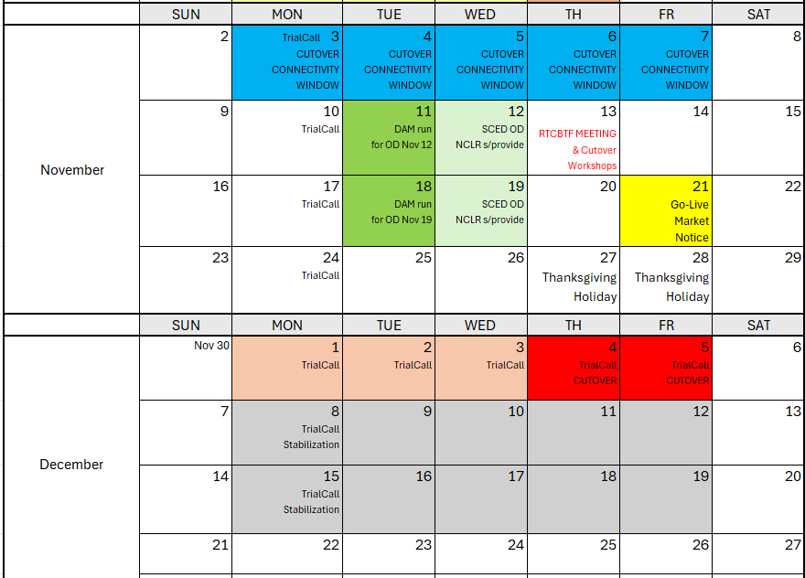
Market Trials and Transition through Go-Live
Currently minimal plans during Thanksgiving week (ERCOT system will be online)
We are here….

Slide 6
Market Notices sent last week
30-day Market Notices sent November 5 across usual channels:
RTC+B Program Readiness
RTC+B Protocol Changes
RTC+B Settlement
RTC+B Credit
RTC+B Market Facing changes
Two other Notices
API End-Point Changes (affects all entities accessing ERCOT XML/API Dec 4/5 impacts)
QSE without Resources Acknowledgement

Slide 7
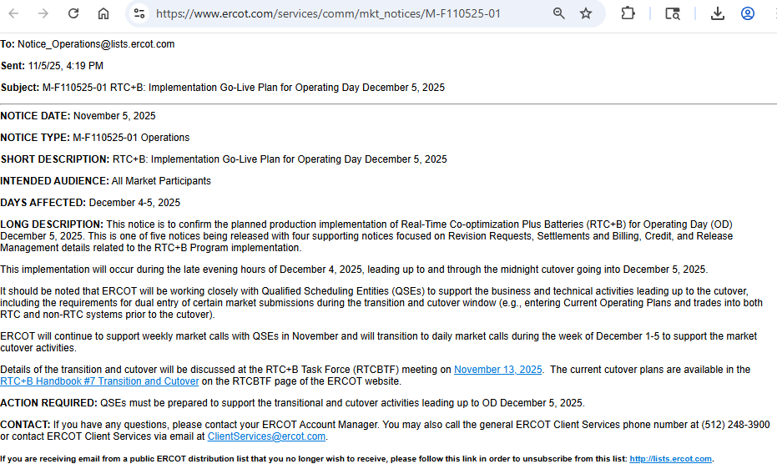
Market Notices sent last week
RTC+B Program Readiness

Slide 8
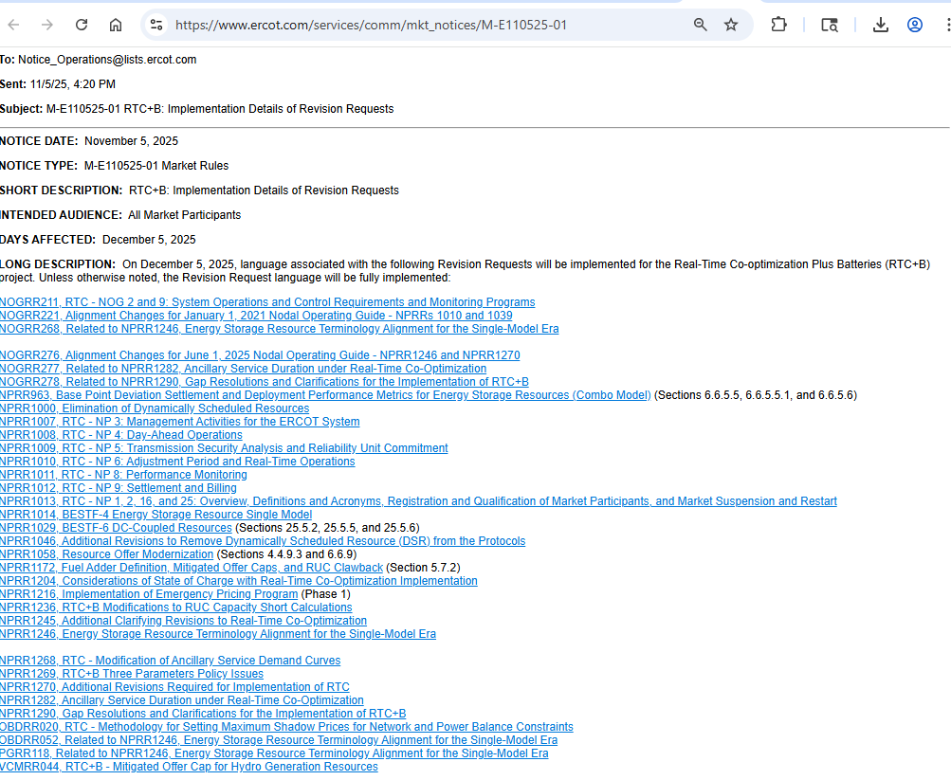
Market Notices sent last week
RTC+B Protocol Changes

Slide 9
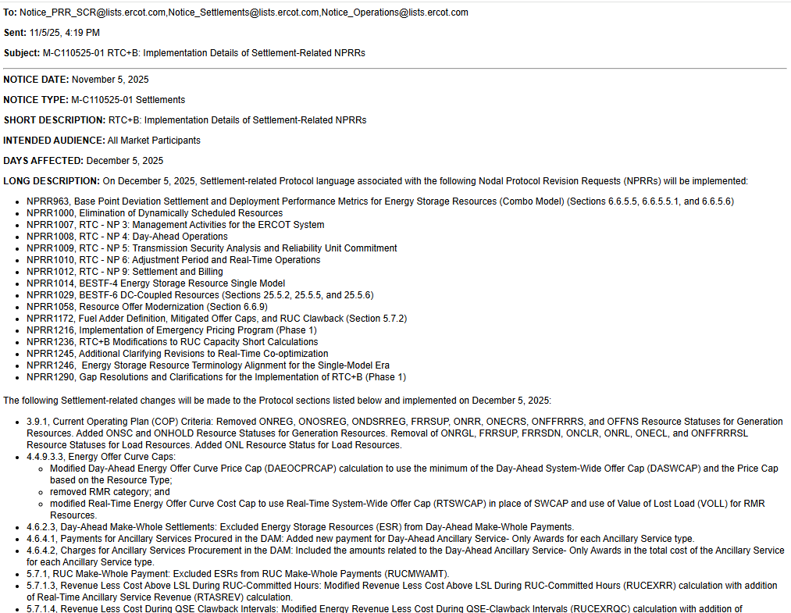
Market Notices sent last week
RTC+B Settlement

Slide 10
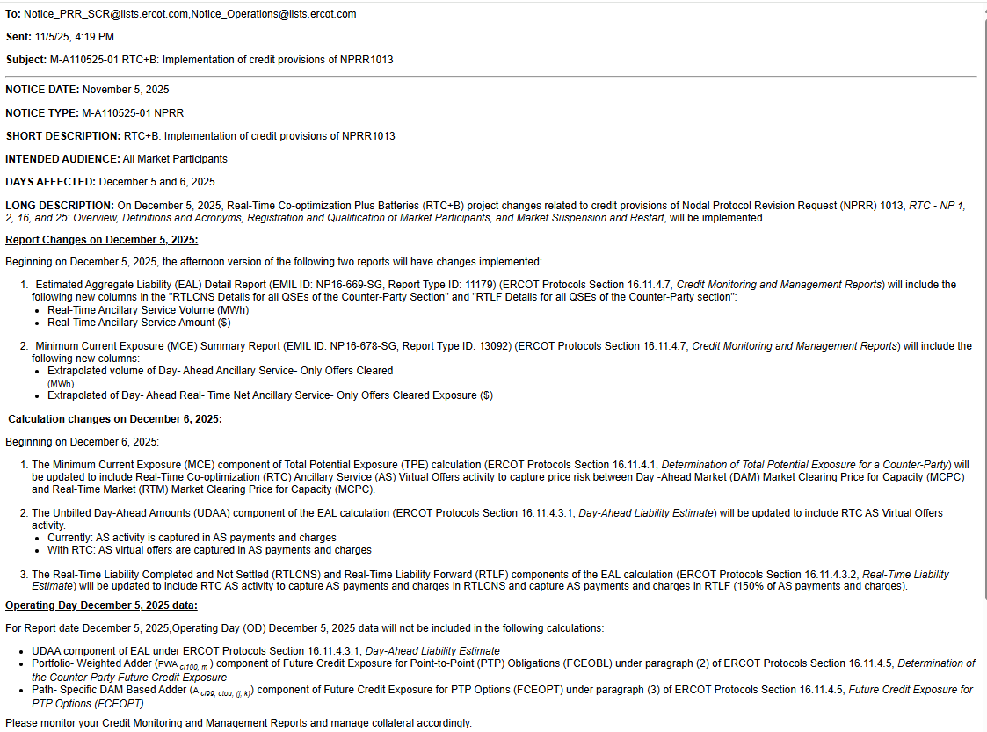
Market Notices sent last week
RTC+B Credit

Slide 11
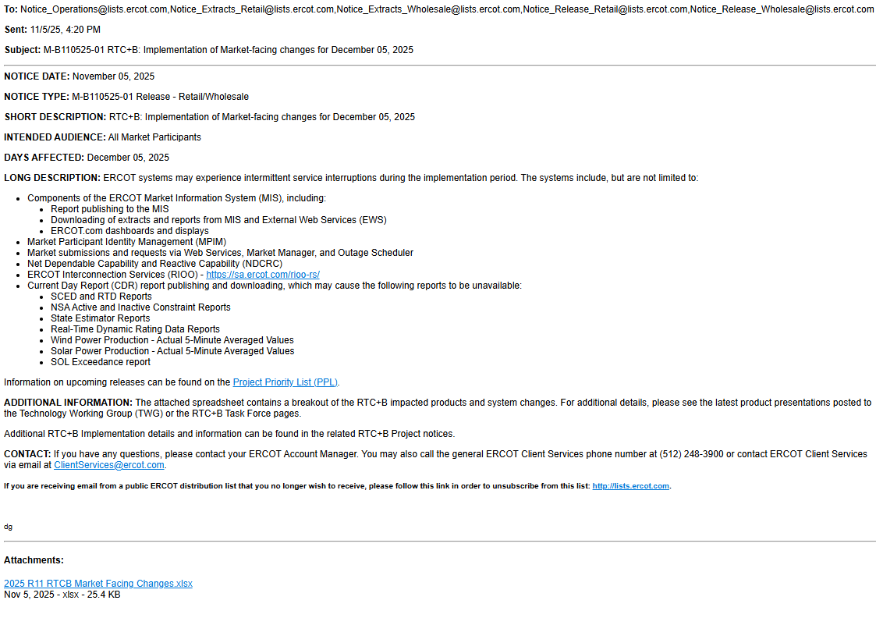
Market Notices sent last week
RTC+B Market Facing changes

Slide 12
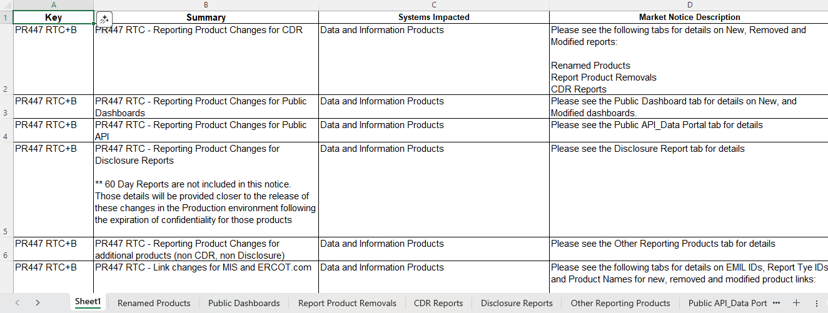
Market Notices sent last week
RTC+B Market Facing changes

Slide 13
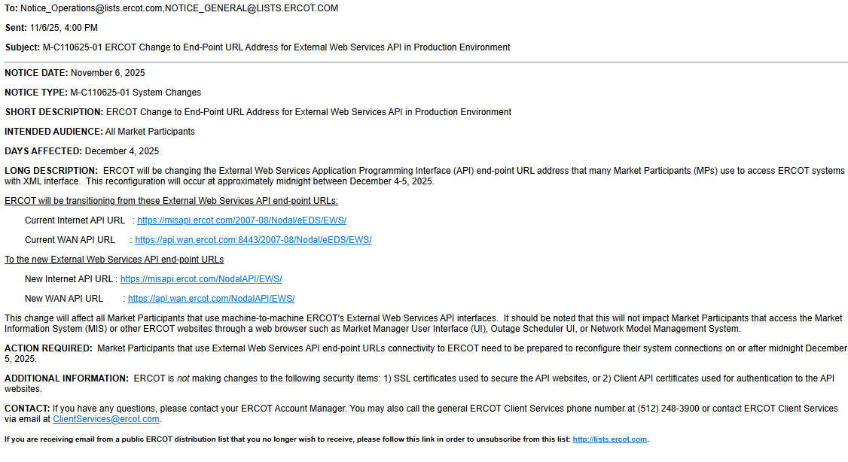
Market Notices sent last week
API End-Point Changes (affects all entities accessing ERCOT XML/API Dec 4/5 impacts)

Slide 14
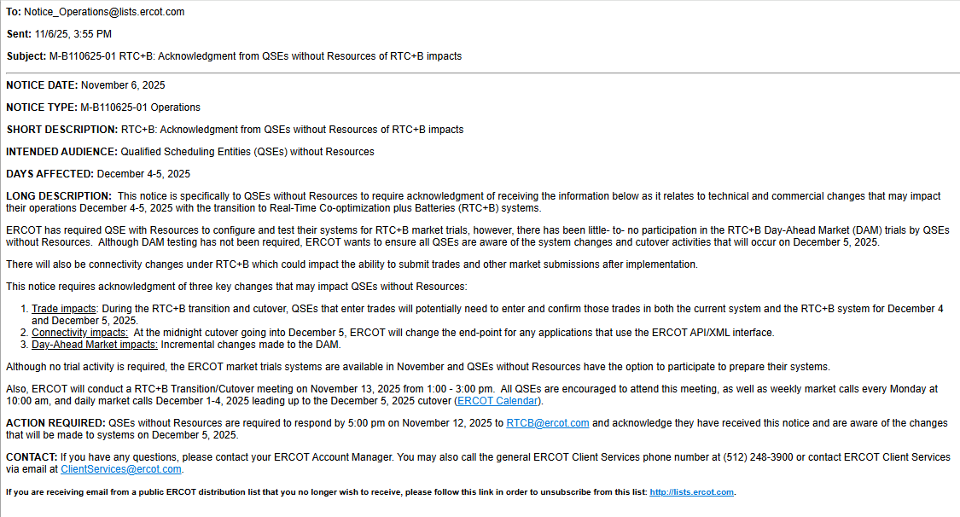
Market Notices sent last week
QSE without Resources Acknowledgement

Slide 15
RTC+B Task Force & Workshops Links to Cutover Workshops Last Week and key materials
RTC+B Cutover Workshop for QSEs
Review RTCB Transition/Cutover Handbook
QSE Dual Entry Expectations
Detailed Cutover Plan
RTC+B Cutover Workshop for TDSPs
Outage Scheduler API URL changes
Outage Scheduler Cutover Plan
SOTE Studies

Slide 16
Market Trials known issues/updates
Current issues/updates:
Update:
DAM execution and this week followed by NCLR Self-Provision:
Reminder DAM submissions timeline extended to noon for each RTC DAM OD
Special Note about ESR Qualification:
During the market trials call on October 27, 2025, ERCOT requested that QSEs submit the ESR single model frequency response governor tests in the NDCRC application as soon as possible.
Currently, ERCOT is still missing tests from 25 ESRs.
If ERCOT does not receive these tests by November 12, 2025, the RRS-PFR qualification for RTCB go-live will be removed.
The RRSPFR qualification will be re-instated upon submitting the test.

Slide 17
Scorecards and Market Results
Not applicable in November

Slide 18
Cutover Discussion Highlights
Next Week normal weekly call with focus on transition/cutover
Added to ERCOT Calendar:
Daily RTC+B Cutover Calls Mon-Fri Dec 1-5 10am-11am

Slide 19
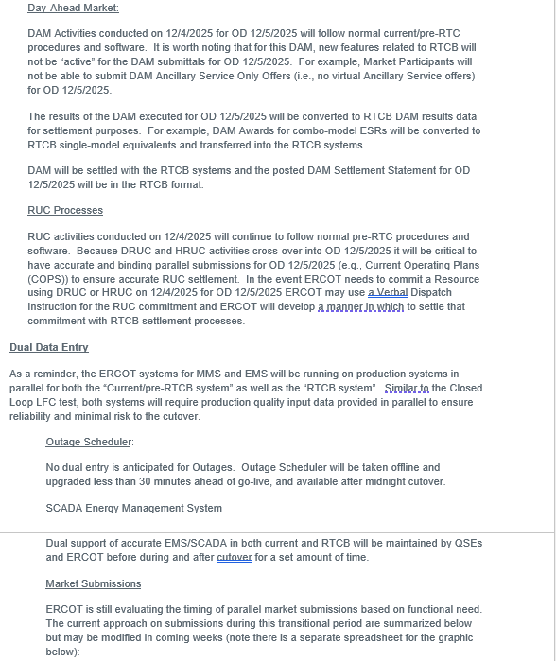
Cutover Discussion Highlights
Link to Cutover Handbook on RTCBTF Homepage
Timing and Dual Entry Requirements

Slide 20
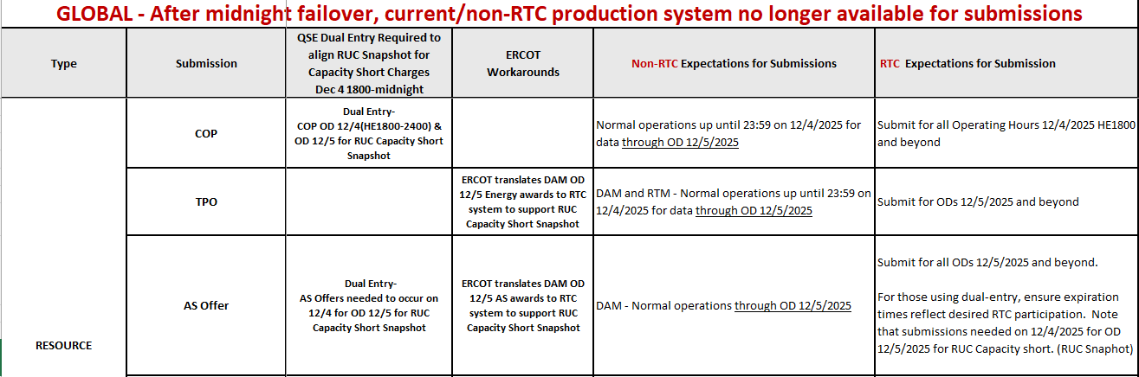
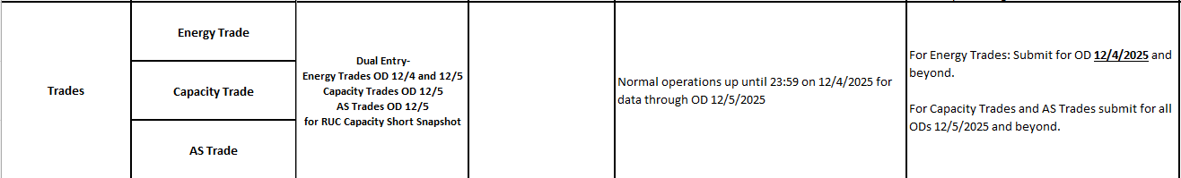
Cutover Discussion Highlights
Link to Cutover Strategy for Dual Submissions spreadsheet on RTCBTF Homepage
Granular Timing and Dual Entry Requirements

Slide 21
Cutover Discussion Highlights
No dual submission requirements for Day-Ahead Market purposes
DAM executions performed Dec 1 – Dec 4 are same pre-RTC system
First “changed DAM” in RTC+B is executed on Dec 5, for OD Dec 6
Dual submissions limited to certain transactions on certain days as described in spreadsheet (prior slide) and explained at a high level in next slide…..

Slide 22
Market Submissions December 1-3
Overlapping / Dual Submissions
Pre-RTC System
Dec 1
Dec 2
Dec 3
Dec 4
Dec 5
Dec 6
QSE Submitting during timeframe of
Dec 1-3
RTC System
Dec 1
Dec 2
Dec 3
Dec 4
Dec 5
Dec 6

Slide 23
Market Submissions December 4
Pre-RTC System
Dec 1
Dec 2
Dec 3
Dec 4
Dec 5
Dec 6
QSE Submitting during timeframe of
Dec 4
RTC System
Dec 1
Dec 2
Dec 3
Dec 4
Dec 5
Dec 6
After pre-RTC DAM on 12/4 for OD 12/5 is executed:
ERCOT will copy DAM Awards and Self-Arranged AS into RTC tables by 1800
Example, RUC Snapshots after 1800 Dec 4 (balance of 12/4 and OD 12/5) needs items maintained by QSEs for settlement if any RUCs for Dec 5:
COP
AS Offers
QSE-Trades

Slide 24
Market Submissions December 5
Pre-RTC System
Dec 1
Dec 2
Dec 3
Dec 4
Dec 5
Dec 6
Midnight cutoff pre-RTC system
QSE Submitting during timeframe of
Dec 5
Energy Trades only*
RTC System
Dec 1
Dec 2
Dec 3
Dec 4
Dec 5
Dec 6
* Energy Trades can be put in for prior OD (back to 1430)

Slide 25
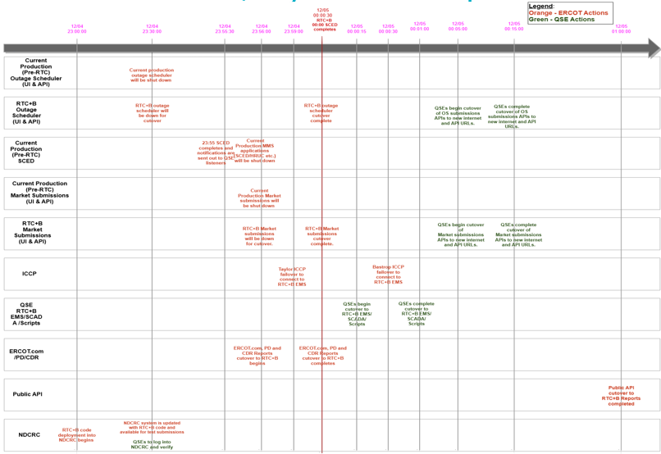
Cutover Step-by-Step Timeline Graphic
Link to Cutover Detail Plan Draft Presentation on RTCBTF Homepage

Slide 26
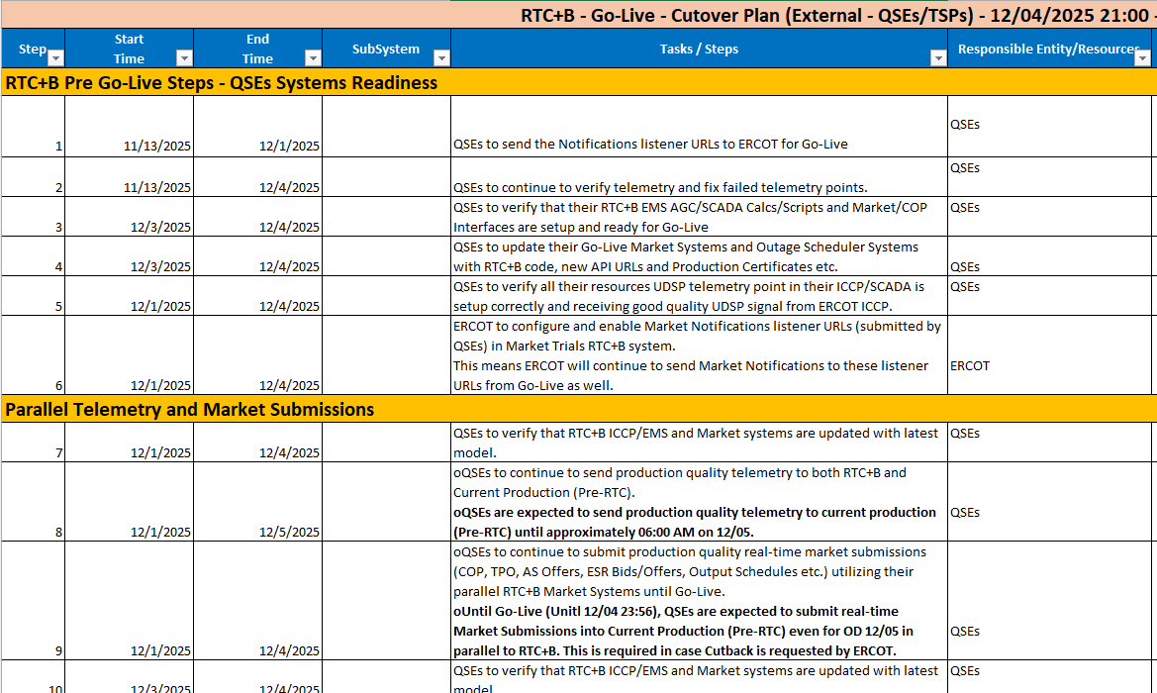
Cutover Step-by-Step Timeline Spreadsheet
Link to Go-Live Cutover Plan External Spreadsheet on RTCBTF

Slide 27
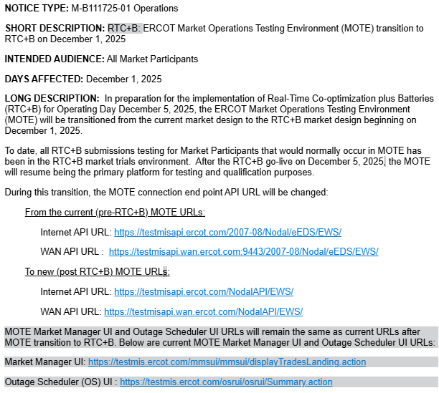
Market Notice later today for MOTE transition Dec 1
DRAFT

Slide 28
Current MOTE Transition to RTC+B – Cutover Plan
Current MOTE (UIs/APIs) will be down from November 28, 2025, 5:30 PM in preparation for cutover to RTC+B.
Current MOTE (UIs/APIs) will be updated with RTC+B code and configurations and will be up with following new API URLs by 12:00 Noon on December 1, 2025.
New MOTE API URLs:
Internet API URL: https://testmisapi.ercot.com/NodalAPI/EWS/
WAN API URL: https://testmisapi.wan.ercot.com/NodalAPI/EWS/
*ERCOT is not making any changes to current MOTE digital certs and API public key
This means MOTE will be down from November 28, 2025, 5:30 PM until December 1,2025 12:00 noon
Market Participants are expected to complete any planned market and outage submissions communication and qualification testing for current system by November 28, 2025, 5:00 PM, as MOTE system will not be available for current production market and outage submissions testing from December 1-4, 2025.

Slide 29
Current MOTE Transition to RTC+B – Cutover Plan
MOTE Market Manager UI and Outage Scheduler UI URLs will remain same as current URLs after MOTE transition to RTC+B. Below are current MOTE Market Manager UI and Outage Scheduler UI URLs:
Market Manager UI: https://testmis.ercot.com/mmsui/mmsui/displayTradesLanding.action
Outage Scheduler (OS) UI: https://testmis.ercot.com/osrui/osrui/Summary.action
Same current MOTE system Notification Listener URLs will be used to send notifications to Market Participants after the MOTE transition to RTC+B.
MOTE MPIM is NOT impacted due to RTC+B upgrade, so Market Participants will be using same MPIM applications.
ERCOT will open a Secure Webex Call from 1:00 PM till 3:00 PM on December 1,2025 to support QSEs/TSPs MOTE API URLs transition to new MOTE API URLs.
ERCOT will send out Secure Webex Conference call information this week to QSEs/TSPs AR & BAR.
Market Notice will be sent out today with details on current MOTE transition to RTC+B.

Slide 30
Wrap-Up and Questions
Go over to other slides for Cutover
This week: Unscripted Real-Time Market, Day-Ahead Market, Self-Provision
Reminder about ESR Qualification:
QSEs submit ESR single model frequency response governor tests in the NDCRC application as soon as possible.
If ERCOT does not receive these tests by November 12, 2025, the RRS-PFR qualification for RTCB go-live will be removed. The RRSPFR qualification will be re-instated upon submitting the test.
QSEs should be reviewing Cutover plans and considering staffing and system needs for Dec 1-5
MOTE transition activities end of next week
ERCOT will be asking for Cutover night contacts
Remainder of meeting for Q&A
Can always email the RTC+B Program mailbox: RTCB@ercot.com

Slide 31
APPENDIX- Supporting Materials
Summary of SCED Functionality
SCED Analysis/Results for prior week
DAM and AS Self-Provision Education
Telemetry Screening
New RTC Pricing Reports location
NPRR1290 Validation Changes
Links to Handbooks
FAQ Updated
Connectivity and Configuration (digital certs)

Slide 32
Summary of SCED functionality
What is RTC SCED using to solve in trials?
Production Network model from NMMS
QSE submitted offers (energy and A/S)
QSE production telemetry
ERCOT performs some overrides for stale data from QSE sites- improving each week
Outages in prod telemetry would be outage in RTC SCED
July 31 improvements implemented:
NPRR1268/1269 ASDC and Proxies logic implemented
AS Plan improved and now same as Prod
Aug 4 improvements implemented:
IRR Forecast synchronization has been manual, but now automated
Aug 18 improvements implemented :
Active constraints flag being manually copied (automation planned for Aug 18)
Load Forecasts being fed into RTC, but ERCOT manually aligns which forecast is being used based on operator selection in Prod (automation planned for Aug 18)

Slide 33
Day-Ahead Market

Slide 34
DAM Operating Day (OD) Test
Testing strongly encouraged, but not required for all QSEs
Handbook #6 Day-Ahead Market
The DAM will run on Tuesdays
DAM submission window closes at noon.
By 0600 QSEs can validate and confirm report posting:
Advisory AS Obligation: Available on Market Trials MMSUI (5 significant digits after decimal point)
ASDCs: Available on Production MIS
Load Ratio Share and PSS/e files will change with RTC cutover, but will not be visible for OD 9/17
For successful DAM completion, and meaningful results, market participants are strongly encouraged to submit various submission types, and not only submission types listed above (E.g., PTPs, EOOs, EBs, AS Self-Arrangement, non-ESR AS and non-ESR TPO submissions).

Slide 35
DAM Operating Day (OD) Test – Pre DAM
Key DAM Submission Changes
AS Obligation – no self-arrangement will be allowed over QSE’s Advisory AS Obligation.
Example: RRS Advisory AS Obligation = 2.18368 -> maximum Self-AS submission = 2.1
COP – can submit negative LSL/HSL for ESR. Can submit values for AS Capability within the existing AS fields.
TPO (EB/OC) – negative MW quantity reflects ESR EB/OC. ESR startup and minimum energy costs are not allowed and ESRs are considered self-committed.
Resource-Specific AS Offers – FRRSUP and FRRSDN offers not allowed. Offers must be between $0 and DAM SWCAP. For ESRs, RRSUFR and ECRSM offers not allowed. All AS offers from ESRs are inclusive of EB/OCs.
AS Only Offers – Offers must be between $0 and DAM SWCAP. REGUP, REGDN, RRSPFR, Online NSPIN, and Online ECRS are allowed. Other AS types are not allowed. Multi-hour and fixed blocks are not allowed.

Slide 36
DAM Operating Day (OD) Test – Post DAM
Post Publish Report Verification
AS-Only Awards
ESR Resource-Specific AS awards
TPO(EB/OC) awards
QSEs with Advisory AS Obligations and AS awards can download/review their Final AS Obligations and ensure observe/handle values with up to 5 significant digits after the decimal
DAM LMPs
DAM MCPCs
DAM Constraint Shadow Prices
Other DAM Awards

Slide 37
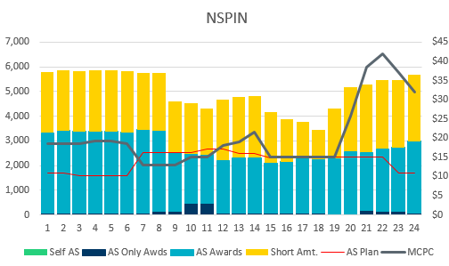
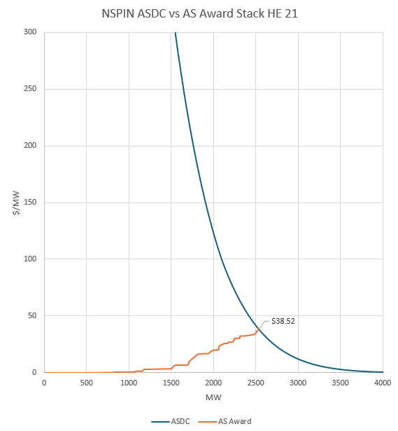
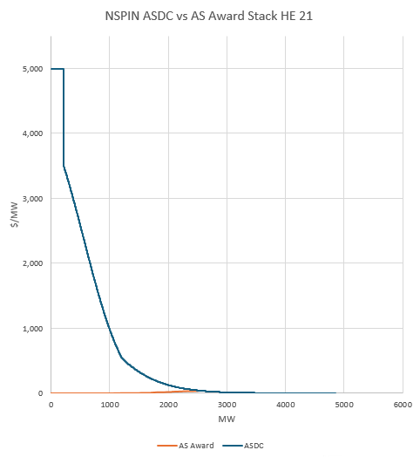
DAM ASDC Price Setting Example
OD 9/17/2025 HE 21
NSPIN MCPC : $38.52
AS Award stack intersected the ASDC @ 2536.6 MW
NSPIN AS Plan @ HE 21 : 2339 MW

Slide 38
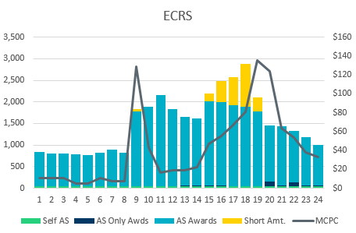
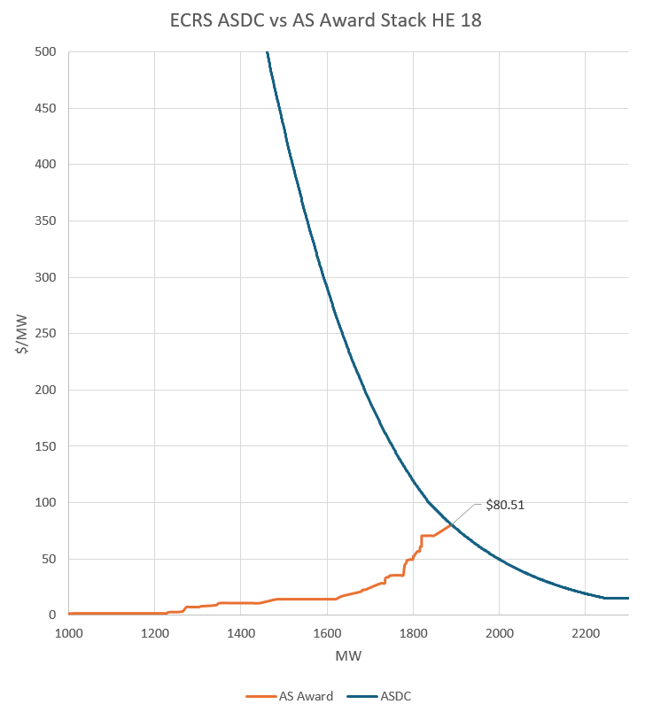
DAM ASDC Price Setting Example
OD 9/17/2025 HE 18
ECRS MCPC : $80.51
AS Award stack intersected the ASDC @ 1888.6 MW
ECRS AS Plan @ HE 18 : 2877 MW

Slide 39
NCLR Self-Provision Reminder: AS Self-Provision is a special design to allow Non-Controllable Load Resources to self-provide their AS Responsibilities into/through SCED/Real-Time Market

Slide 40
NCLR Resource Status Codes
Pre-RTC
Resource Status Codes (RST)
OUTL = 260
ONRL = 259
ONECL = 264
RTC+B
Updated Resource Status Codes (RSTR)
OUTL = 258
ONL = 257

Slide 41
Ramp Rates and Capabilities
RTC+B
Ramp Rates & Awards
UFRC (UFR Capability)
UFRA (UFR Award)
ECRR (ECRS RR Capability *10 Min)
ECRA (ECRS Award)
NSRR (NSPIN RR Capability *30 Min)
NSRA (NSPIN Award)
Pre-RTC
AS Responsibility and Schedule
RRRS
RRSC
ECRS
ECSC
NSRS
NSSC
QSE to ERCOT Telemetry
ERCOT to QSE ICCP

Slide 42
Self-Provision Achieved via Telemetry Points for NCLRs
LEGEND
QSEs will be able to self-provide in real-time via telemetered ICCP points
ICCP Change Request Example RTC+B V1.4 on RTC ERCOT webpage

Slide 43
The Self-Provision Checklist
Scenario: My Load Resource was awarded 15 MW in the DAM, and I purchased 5 MW via a trade.
My total RRS AS Position is 20 MW.
How to correctly self-provide 20 MW:
Is my resource qualified?
Telemetry Points
RSTR set to ONL (257)
UFR must be Armed
Can I cover my obligation?
Qualified MW Amount ≥ Self-provided amount
NPF - LPC ≥ Self-provided amount
Capability to Provide AS ≥ Self-provided amount
Final Step: Telemeter Self-provision
“your offers explain your extra”

Slide 44
Scenario 1
NCLR_1 has a 20 MW RRS AS Position, 15 MW from DAM award and 5 MW from RRS Trade
Scenario ** Assume AS qualified for All Headroom (NPF-LPC) | Max Power Cons. | Net Power Flow | Low Power Cons. | Resource Status | Under Freq. Relay | Self-provided RRS UFR (MW) | Self-provided ECRS (MW) | Current Capability to provide UFR (MW) | ECRS (10min) Ramp Rate (MW/min) | RRS UFR AS Award | ECRS AS Award | Notes
 | MPC | NPF | LPC | RSTR | UFR | SPUF | SPEC | UFRC | ECRR | UFRA | ECRA
NCLR_1 is qualified to provide 20 MW. DAM awards NCLR_1 with 15MW RRS. QSE also has additional 5MW RRS Position via RRS Trades. | 20 | 20 | 0 | ONL | Arm | 20 | 0 | 20 | 0 | 20 | 0 | NCLR_1 Telemetry needs to show: Status = ONL, MPC >= NPF >= 20 MW, NPF-LPC >= 20 MW, RRS capability >= 20 MW, RRS self-provided telemetry = 20 MW SCED will respect the 20 MW self-provided RRS and award the resource 20 MW RRS UFR.
QSE to ERCOT Telemetry
ERCOT to QSE ICCP

Slide 45
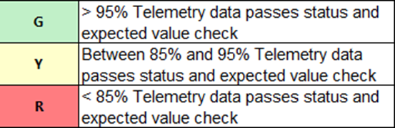
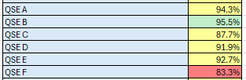
Telemetry Screening for Scorecard 3B for Handbook 3 Acceptable Telemetry Point values received by ERCOT for active resources.
Scoring:
Key points for Telemetry scorecard check
Device types checked - Units, CLRs, NCLRs, ESRs for each QSE
RTCB Telemetry status should be “Good” quality
RTCB Units / CLRs / NCLRs Telemetry values should be within “Expected Range” or an expected value. Details are provided in next few slides.
Expected values are derived from equivalent analogs in current production, based on defined criteria.
RTCB ESR telemetry values are checked against corresponding combo model Battery Unit / CLR counterparts in production.

Slide 46
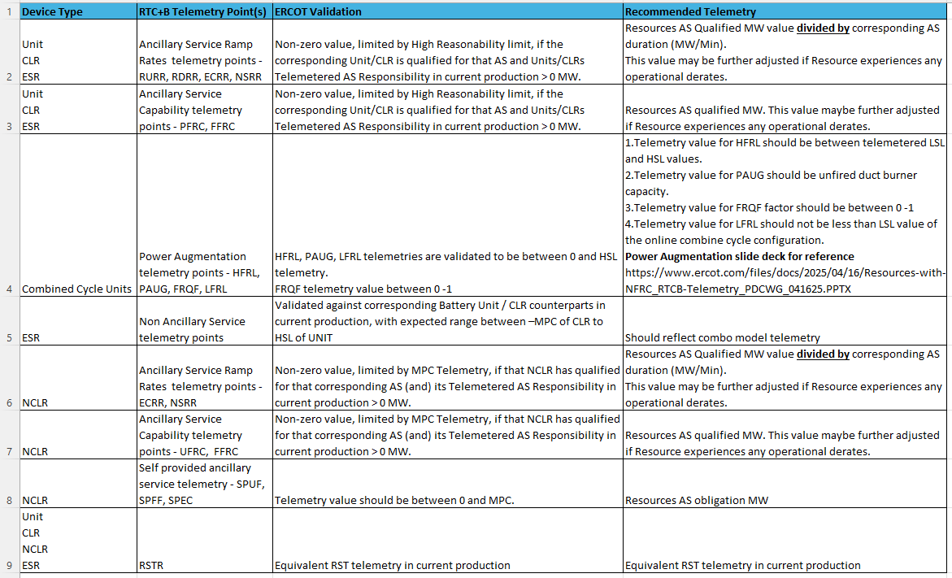
RTC+B Telemetry points screening/validation

Slide 47
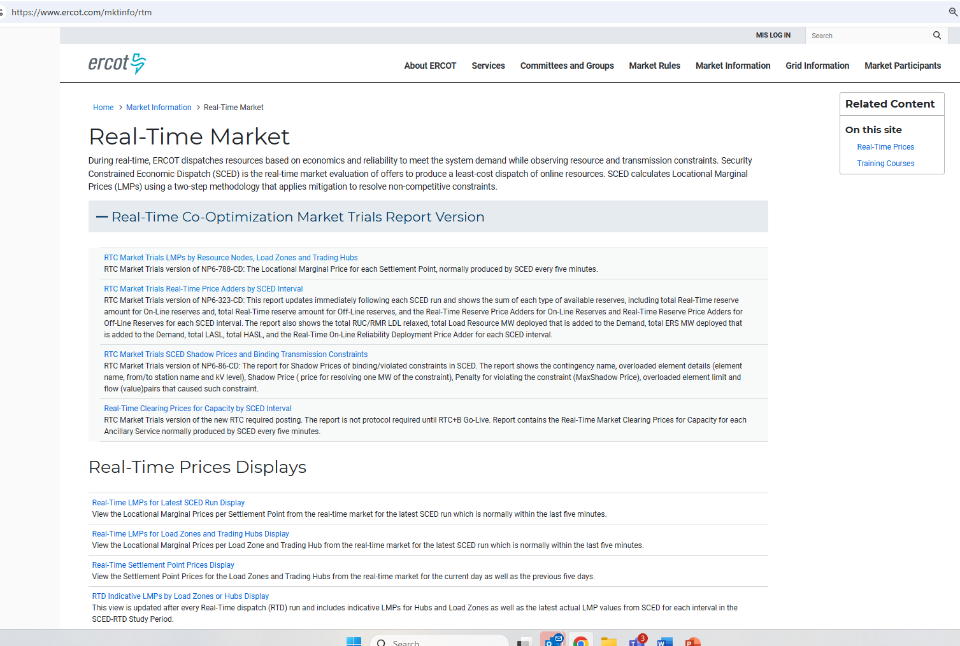
RTC+B New Reports Posted to the ERCOT Website
Links to the available RTC+B versions of Real-Time reports posted on Real-Time Market Information page.

Slide 48
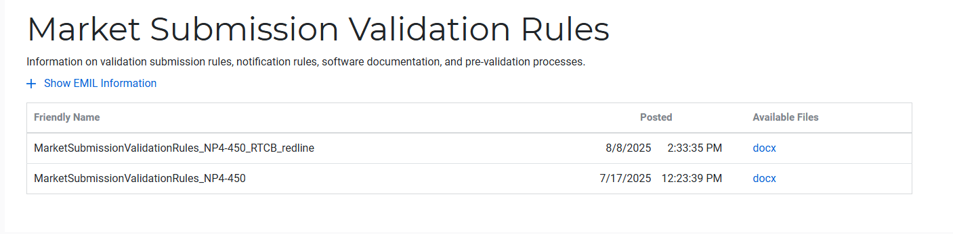
Submission validation update - PROD vs RTC+B
NPRR1290 :
cleaned up protocol language around submitting offer curves and bid curves
disallows having more than 2 price/quantity points in a flat/vertical segment of the curve.
Impacts to QSEs during dual-submission – some submissions accepted in Production will be rejected in Market Trials environment:
RTM Energy bids – protocol requiring “increasing quantities” now enforced.
Reverted this change to validation. Further discussion highlighted protocol should be brought in line to long-standing practice, not validation.
Example: Bid with Q1=0mw, Q2=10mw, Q3=10mw will be rejected as Q3 does not increase from Q2.
TPO & RTM Bid – more than 2 price/quantity pairs with same price or quantity will be rejected
Market Submission Validation
Rules document updated.

Slide 49
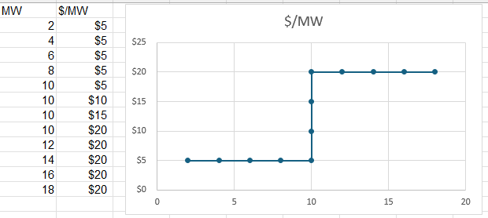
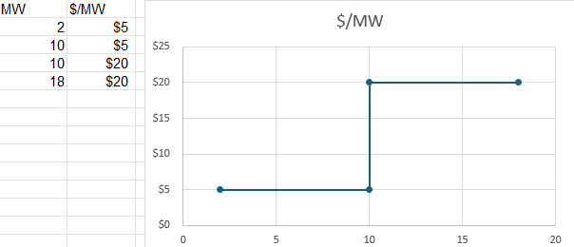
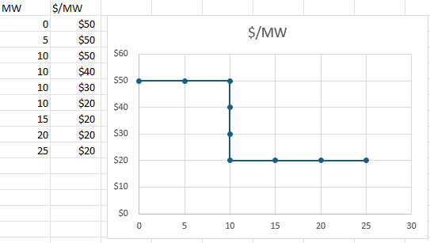
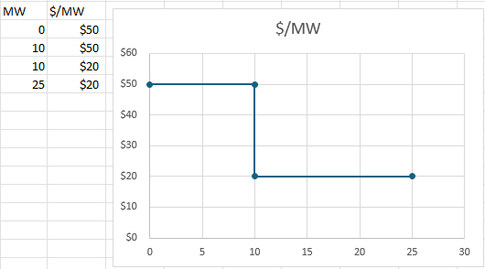
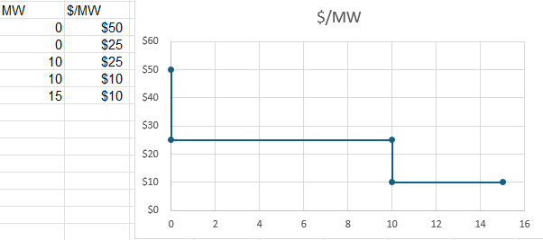
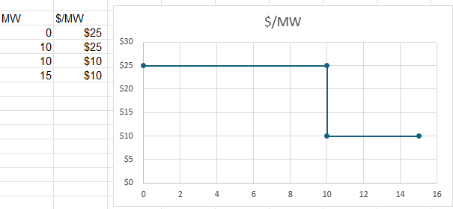
Submission validation update - PROD vs RTC+B
TPO – EB/OC - EOC
RTM EB
RTM EB

Slide 50
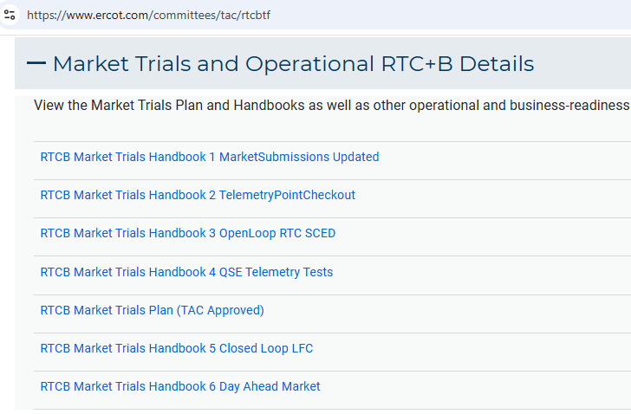
Market Trials Framework:
TAC Approved the Market Trials Plan in October 2024
Discussions with RTC+B Task Force have shaped the Handbooks
Handbook #1- QSE Submission Testing
Handbook #2- QSE Telemetry Tests
Handbook #3- Open Loop SCED
Handbook #4- QSE Telemetry Tests
Handbook #5- Close-Loop LFC Tests
Handbook #6- Day-Ahead Market Tests
All are posted on the
RTCBTF Homepage
under Market Trials banner

Slide 51
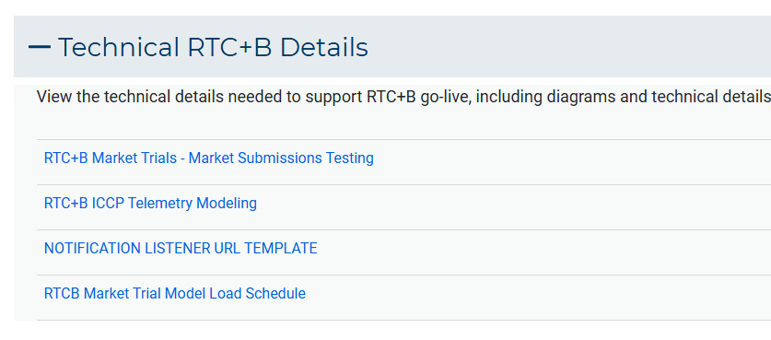
Market Trials Technical Details
Detailed discussions with TWG have provided technical content details
Digital Certificate details
Connectivity/URL details to User Interfaces and APIs
Reminder of how to submit new ICCP requests
RTC and Production Telemetry connectivity
Network Model Load Schedule
All are posted on the
RTCBTF Homepage
under Technical Details banner

Slide 52
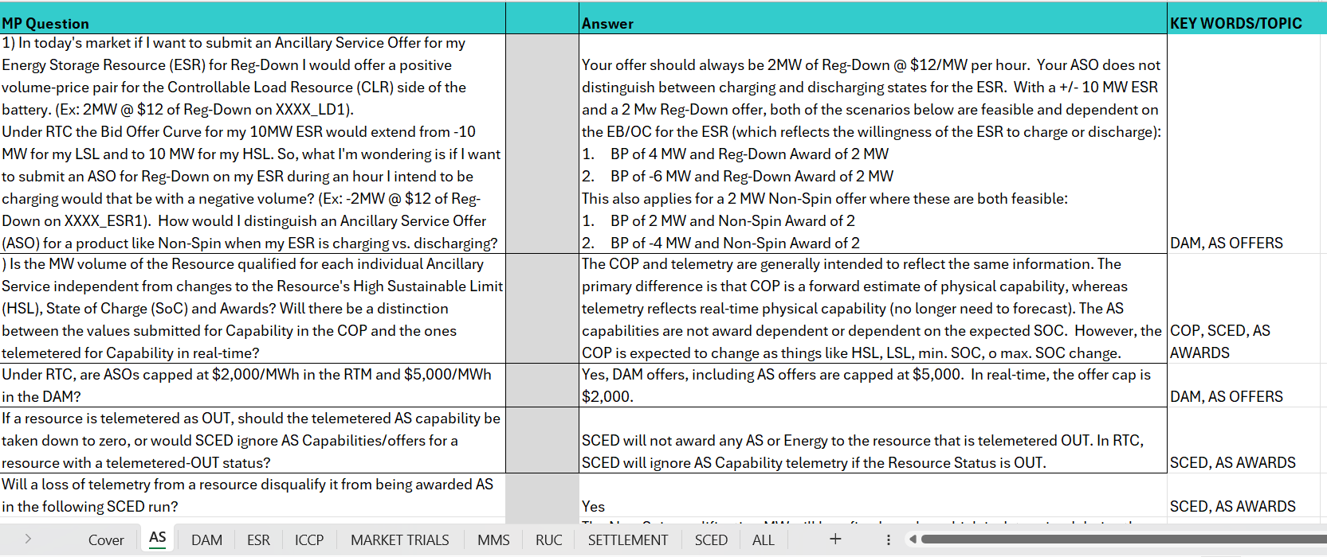
Reminder of RTC+B FAQ
Posted on RTCBTF Home Page under Key Documents
Common questions/responses in Excel Workbook (target weekly updates)
Search workbook for Key Words
Worksheets for categories

Slide 53
RTC+B Market Submissions - Systems configurations
Start
03/2025
Start
05/2025
Start
07/2025
Start
09/2025
Go-Live
12/5/25*
Feb 2025
Mar 2025
Apr 2025
May 2025
June 2025
July 2025
Aug 2025
Sep 2025
Oct 2025
Nov 2025
Dec 2025
Optional: RTC QSE/Vendor Developer
Submission Testing
RTC QSE
Submission Testing
Open-loop
RTC SCED
Ongoing Open-Loop
& Periodic Closed-loop SCED/LFC
Certificate: Current MOTE
Env: ERCOT RTC Market Trial
URL: RTC MIS MOTE URL
Certificate: Current Production
Env: ERCOT RTC Market Trial
URL: RTC MIS Market Trial
Cert: Production
Env: Prod
URL: MIS Prod
QSE/Vendor developer can use MOTE certificates & RTC MIS MOTE API URL to test the submissions until end of submission testing phase (end of June) as needed. At the start of the Open Loop testing, RTC MOTE MIS URLs will be disabled.
URL links: RTC MOTE and Market Trial URL links to be used for MMSUI, OSUI and API submissions. Actual links are provided in next slide.
For notifications/responses to MPs from RTC Market Trials environment, MP will need to provide the listener URL to ERCOT

Slide 54
RTC+B Market Submissions - Systems configurations (Updated with URLs)
RTC+B Market Trials and Go-live
RTC Phase | Digital Certificate | MMSUI / OSUI URL | API / WAN URL
Vendor/QSE Submissions Testing | Current MOTE | RTC MOTE MIS URLs https://testmarkettrials.ercot.com/mmsui/mmsui/displayTradesLanding.action https://testmarkettrials.ercot.com/osrui/osrui/Summary.action | RTC MOTE API/WAN URL https://testmarkettrialsapi.ercot.com/NodalAPI/EWS/ https://testmarkettrialsapi.wan.ercot.com/NodalAPI/EWS/
Open Loop and Closed Loop Testing | Current Production | RTC Market Trial URL https://markettrials.ercot.com/mmsui/mmsui/displayTradesLanding.action https://markettrials.ercot.com/osrui/osrui/Summary.action | RTC Market Trial API/WAN URL https://markettrialsapi.ercot.com/NodalAPI/EWS/ https://markettrialsapi.wan.ercot.com/NodalAPI/EWS/
From RTC Go-live onwards | Current Production | Current Prod MIS URL mis.ercot.com/mmsui mis.ercot.com/osui | New Production API/WAN URL

Slide 55
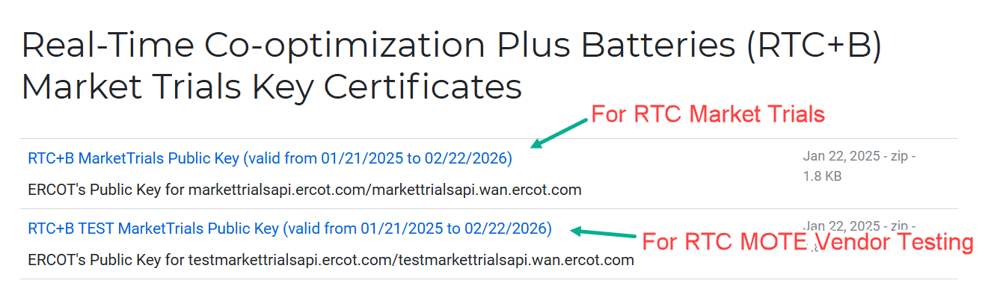
RTC+B Market Submissions - Systems configurations Public Key Update for WAN/API submissions
For API/WAN submissions into Market Trials environments, need to download public keys and place into the keystore location in system being used for RTC+B submissions.
No change to digital user certificates – continue to use existing MOTE and Production Certificates
Market Trial API Public key location: https://www.ercot.com/services/mdt/webservices

