Slide 1
CRR Updates at CMWG
Samantha Findley
November 17, 2025

Slide 2
Agenda
LTAS transactions and solution times
CRR auction limits table – no updates
Market requested TAP information

Slide 3
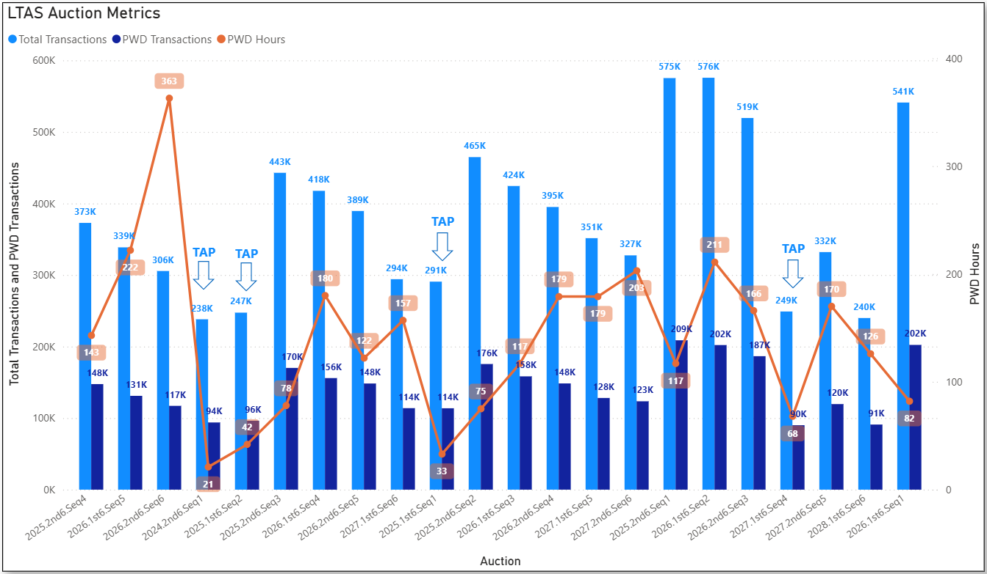
Historical LTAS transactions and solution times

Slide 4
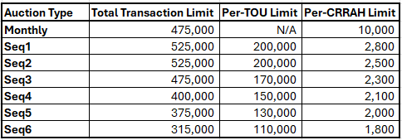
CRR auction transaction limits – no new changes
Note: The per-CRRAH limit for Seq2 was lowered from 2,800 to 2,500 based on transactions submitted for Seq1 (bid window closed on 10/23/2025).

Slide 5
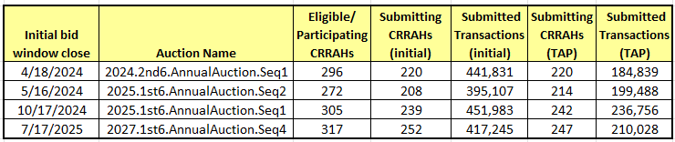
Transaction Adjustment Period information

