Slide 1
RTC-RUC ECRS and Non-Spin Deployment Factors (DF) for Go-Live
Balancing Operations Planning Staff
RTCBTF
November 12, 2025

Slide 2
Introduction
ERCOT relies on (H)RUC studies to assess if sufficient capacity and energy is online and available in every hour to serve load, manage congestion and procure reserves.
  While RTC-RUC will continue to have a set of constraints that are similar to today’s RUC focus on Hour Beginning State of Change (HBSOC), minimum SOC, and maximum SOC within an individual hour, it will have an additional constraint to evaluate how uncertainties may impact the hour to hour change in HBSOC.
RTC-RUC studies like today’s RUC will use selected forecast for load, wind, solar and every ESR’s COP submitted hour-beginning SOC (HBSOC) information but unlike today’s RUC will assign base points and AS awards to resources.
  Note that “AS awards” and “usage of energy” are referring to the perspective of the RUC optimization and not binding AS awards and energy deployment to the Resource’s QSE, e.g., through the Real-Time Market.
Real Time events like unit trips or unexpected weather can cause the deviations from what was “planned” for an operating day both from a capacity and energy perspective.

Slide 3
Introduction, Contd.
AS Deployment Factors (ASDFs) and RUC AS Duration are two levers in RUC to account for potential errors in RUC inputs that allow ERCOT operators to plan for the operating day based on what has the potential to happen.
In other words, ASDFs and RUC AS Duration can be used to ensure that there is enough generation committed in the scenario of ESRs carrying AS that is needed to meet system energy requirements during a multi-hour event of generator forced outages and net load under-forecast. (A prime example of such an event is May 13, 2022.)
  Worth noting the current AS methodology only establishes a MW requirement based on historic uncertainty, it does not establish a MWh requirement to account for energy (MWh) uncertainty. Further while AS product duration requirements partially address this, it does not capture sufficiently the energy picture for multi-hour events, particularly from the point of view of RUC.

Slide 4
Changing RUC AS duration may not be very impactful
Correlating RUC AS Duration to SCED is only impactful in case of how RUC treats RRS “awards” with the proposed RRS-ASDF=0.
  Example, 100MW ESR with 50MWh SOC will be awarded 100MW of RRS in SCED (since Duration is 30 minutes in SCED) whereas RUC will only “award” 50MW.
For Regulation, the ASDF are computed from historical hourly energy (MWh) from regulation deployment. So, with Regulation ASDF > 0 and based on an hourly energy deployed value, the Regulation duration of 1 hour in RUC is appropriate as RUC dispatch is for each hour. This setup will align RUC results to hourly average SCED results.
  Further it may be worth noting that non-zero ASDFs for Regulation Up and Down can offset one another in the RUC process.
Lastly, in case of Non-Spin the qualification criteria will ensure that RUC does not award an ESR at MW levels SCED can’t (i.e., the qualification prevents RUC from thinking a 100 MWh ESR can provide anything beyond 25 MW) .

Slide 5
ASDF = 0 incentivize unreasonable HBSOC inputs and unreasonable RUC results
The purpose of using ASDFs is to enable RUC to account for ESR SOC energy usage in case of under forecast of net-load. An ancillary benefit of using ASDFs is to drive reasonable HBSOC submissions, so that RUC provides reasonable commitment recommendations. ASDFs of zero provide a bad incentive to provide flat HBSOCs, which is not how we see ESRs operate today in aggregate. This effectively tells RUC to not use ERSs for energy and to look elsewhere for Resources to meet load, including generator commitment.
Under what situation can ASDF’s = 0 is arguably acceptable?
  If at 10-am COP HBSOC profiles are reasonable and the forecast for peak hours of an operating day are reasonable (i.e. less weather uncertainty), then in real time ESR energy reserved for ECRS and Non-Spin will likely not be used to serve load. RUC ASDFs for such an input setup can be zero as it is less likely that ECRS and/or Non-Spin will need to be converted into energy (i.e., 100% of the service deployed), particularly across multiple hours, although there is still a risk of generator forced outages.
Under what situation can ASDF’s = 0 is not acceptable?
  However, if at 10-am COP HBSOC profiles are reasonable but forecast for peak hours of an operating day is uncertain (i.e. under-forecast in net load is likely), then in Real Time ESR energy reserved for ECRS and Non-Spin may be used to serve load (i.e. SCED is likely to procure less ECRS and Non-Spin). If this has a strong likelihood to be a multi-hour under-forecast event then the planned operations in the RUC study will be vastly different from Real Time outcome if ASDF were set to be zero or a low value. And there is a higher risk of not having sufficient energy in Real Time to serve load.

Slide 6
Revised analysis for Non-Spin
During the past discussions it was suggested that for estimating Non-Spin deployment factors an approach similar to analysis done for Regulation should be considered.
In response to this, ERCOT has estimated Non-Spin energy deployed by identifying a Resource’s operating range that is for its online Non-Spin Responsibility and then compared Resource’ Base Point relative to this range to identify actual Non-Spin deployment. These MW deployment estimations were then used to estimate Non-Spin energy deployed in each 5-min interval.
Example
HSL
= 300 MW
Ex3.
BP = 270 MW
Non-Spin Deployed = 250 – 170 = 80 MW
Non-Spin Energy Deployed = 80 * 5/60 MWh = 6.667 MWh
ECRS Responsibility
= 50 MW
250 MW
Non-Spin Responsibility = 80 MW
Ex2. BP = 200 MW
Non-Spin Deployed = 200 – 170 = 30 MW
Non-Spin Energy Deployed = 30 * 5/60 MWh = 2.5 MWh
170 MW
Ex1. BP = 130 MW
Non-Spin Deployed = 0
Non-Spin Energy Deployed = 0 MWh
LSL
= 100 MW

Slide 7
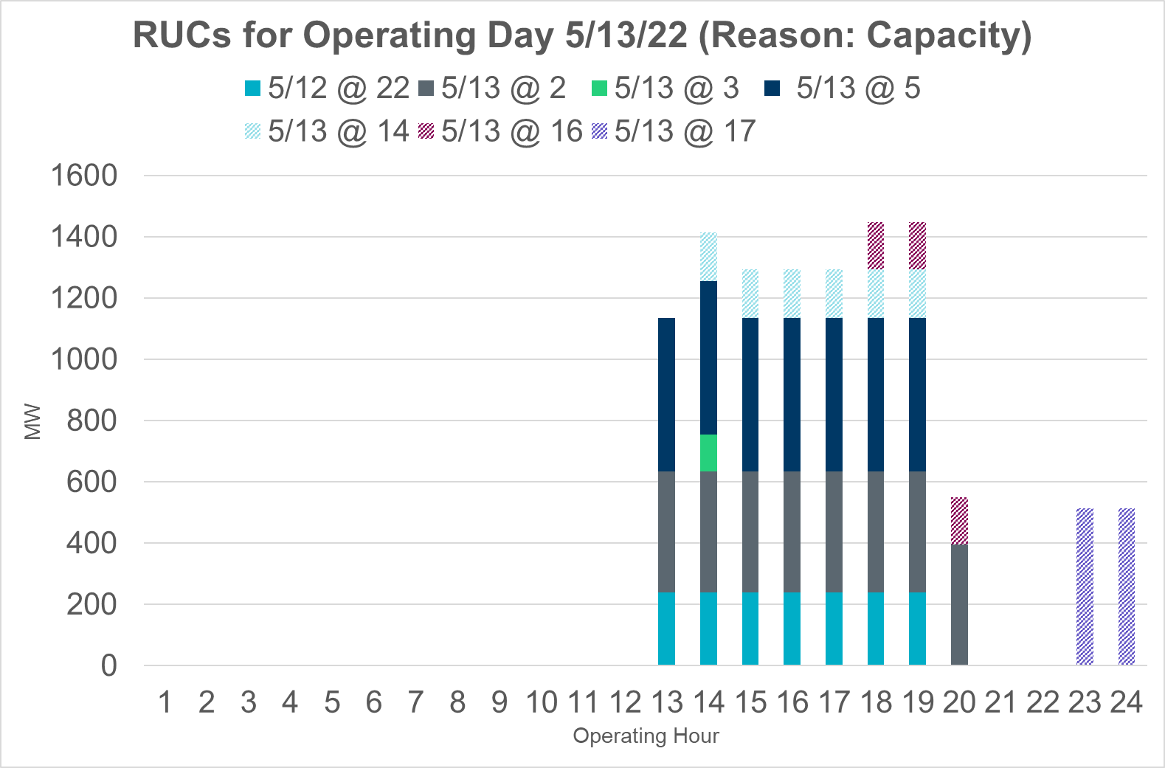
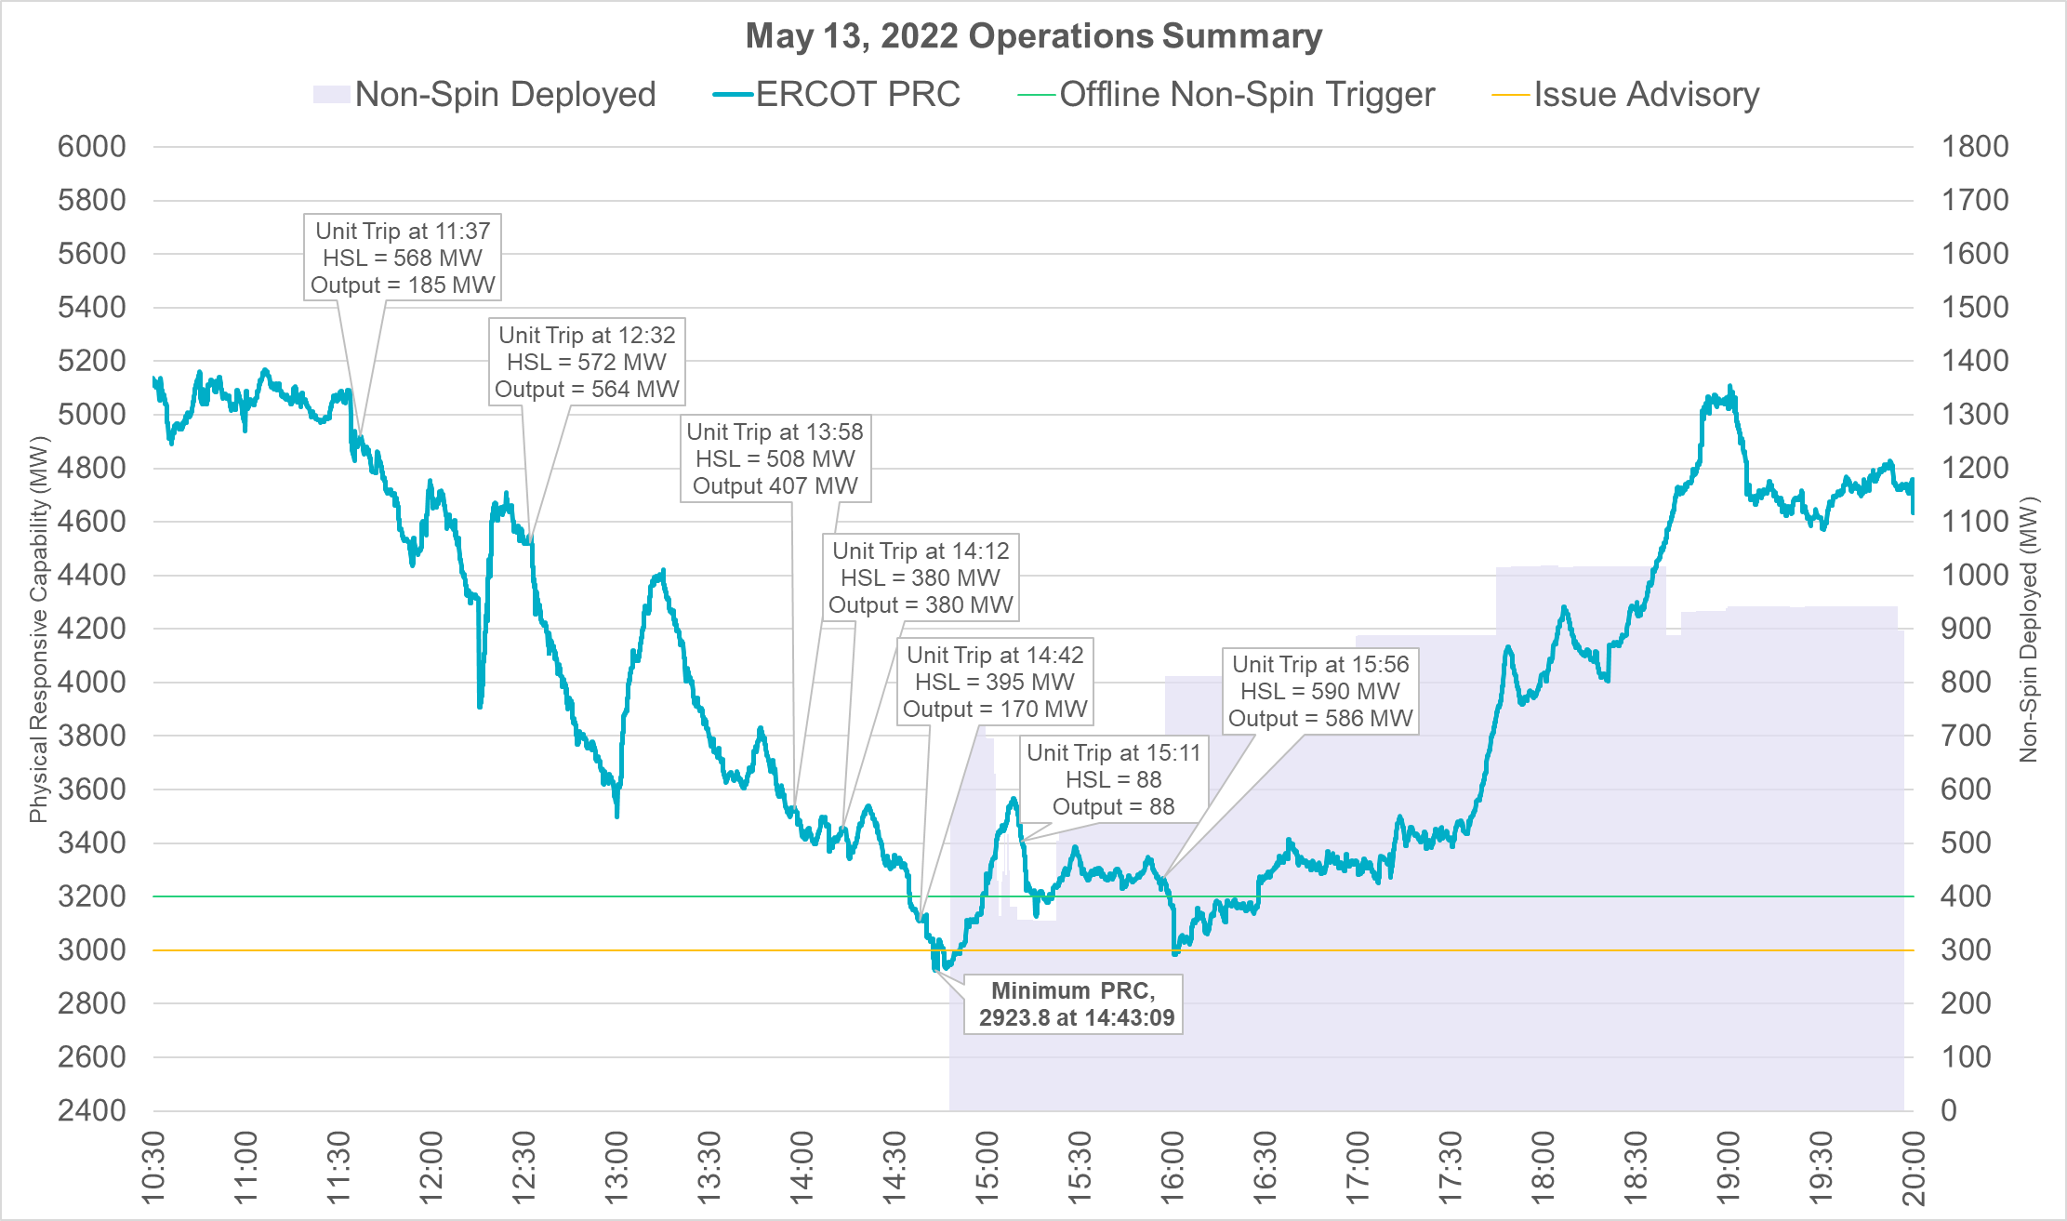
May 13, 2022
May 13, 2022 was expected to be a tight operating day. Capacity margin reduced even further due to higher than forecasted net load and approximately 2,422 MW of forced outages that occurred between 11am and 3pm. Non-Spin was deployed for nearly 5.1 hours on this day.
(Additional Event Details)
Notes:
Nspin deployed between

Slide 8
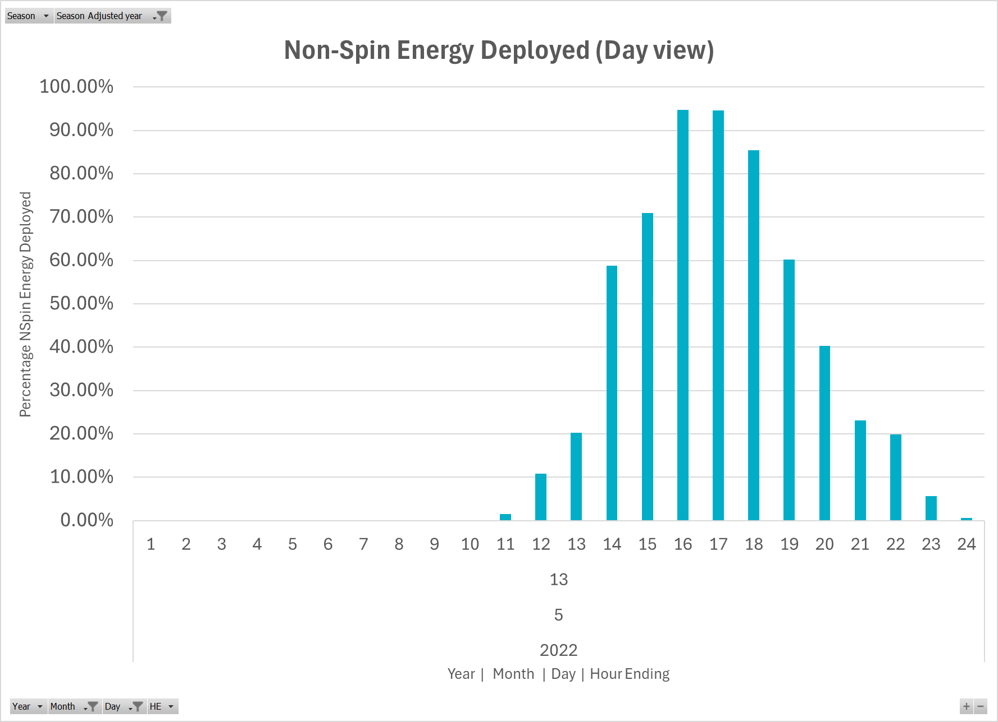
May 13, 2022 Non-Spin Energy Deployed/Used

Slide 9
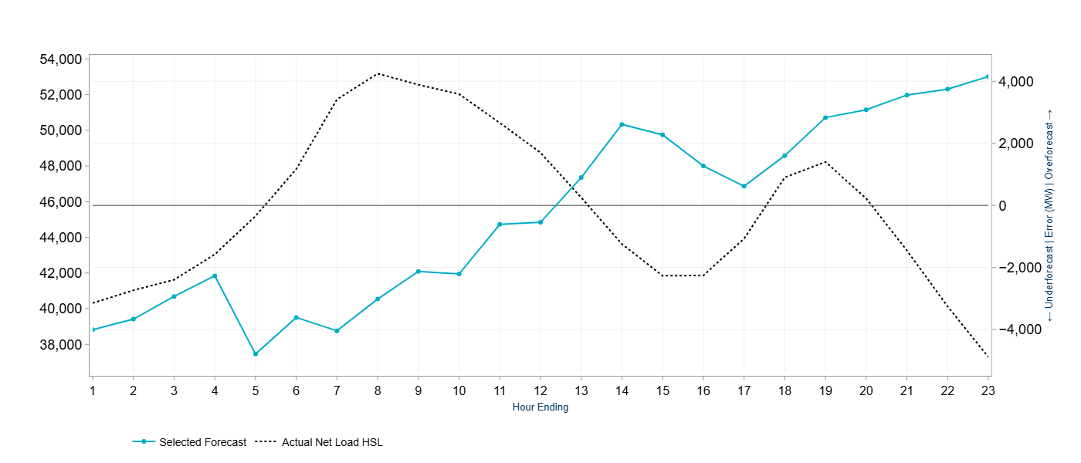
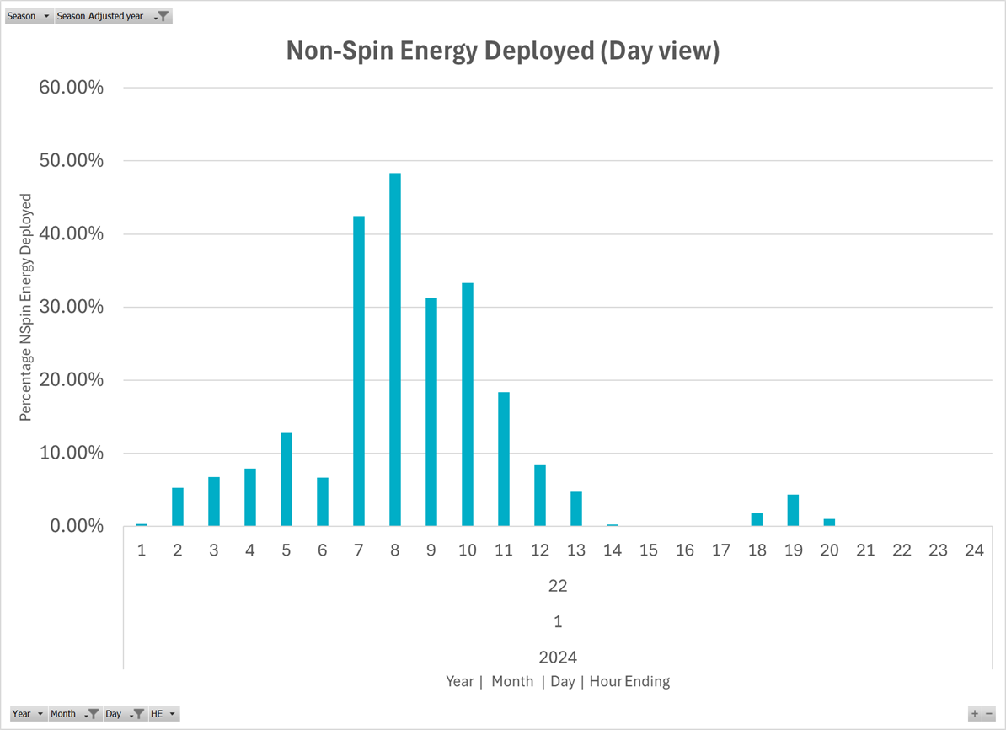
January 22, 2024
January 22, 2024 saw a large under-forecast of net-load primarily due to over forecast of wind. There were RUC commitments going into operations on this day. Non-Spin energy was used for several hours.

Slide 10
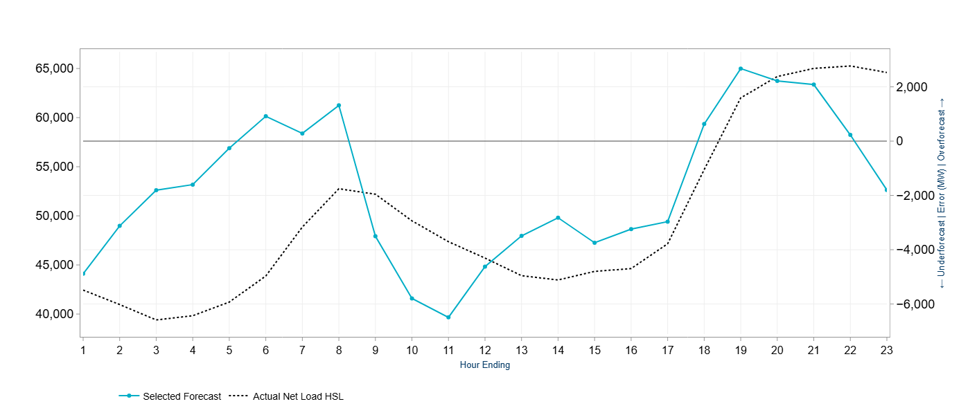
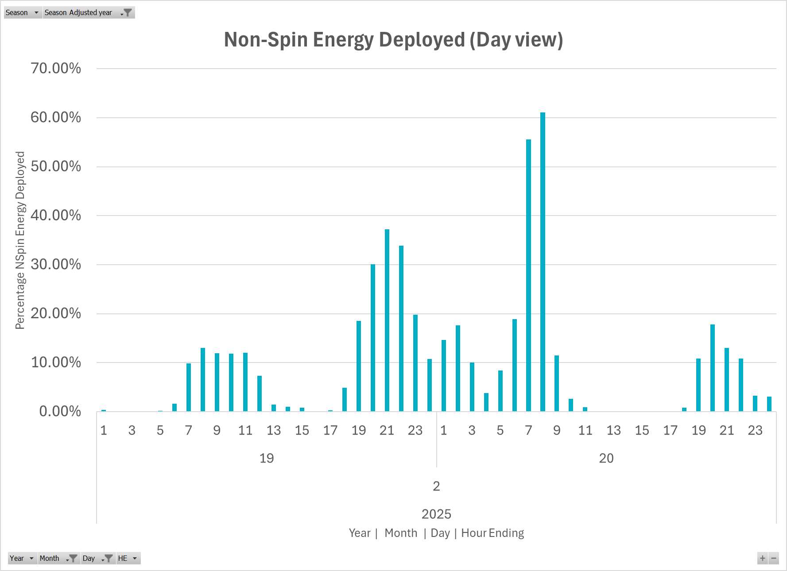
February 19 and 20, 2025
February 20, 2025 was winter peak load day. There was significant sustained under forecast of net-load on February 19, 2025. There were RUC commitments going into operations on this day. Non-Spin energy was used for several hours.

Slide 11
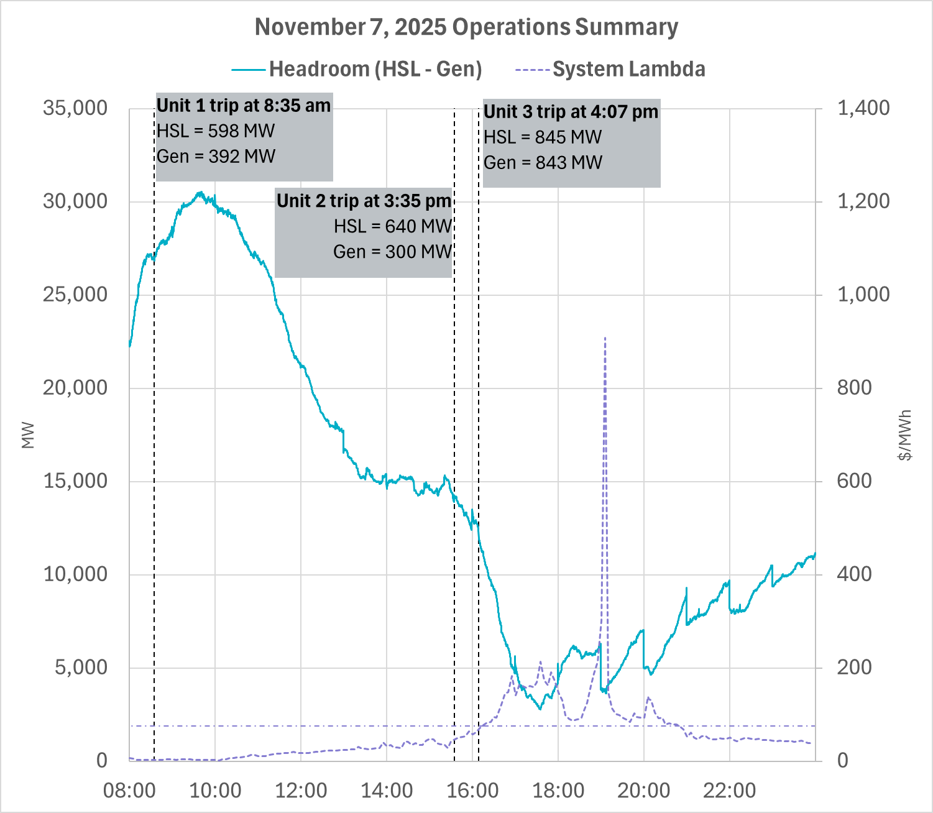
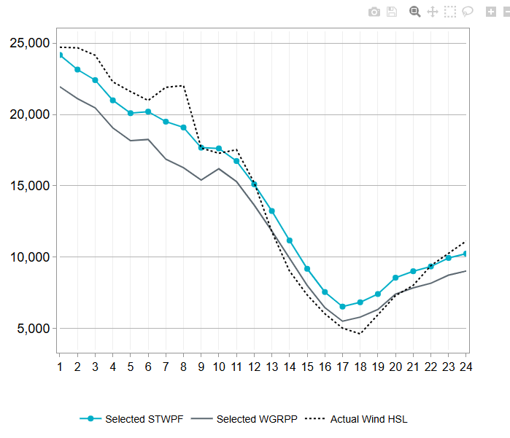
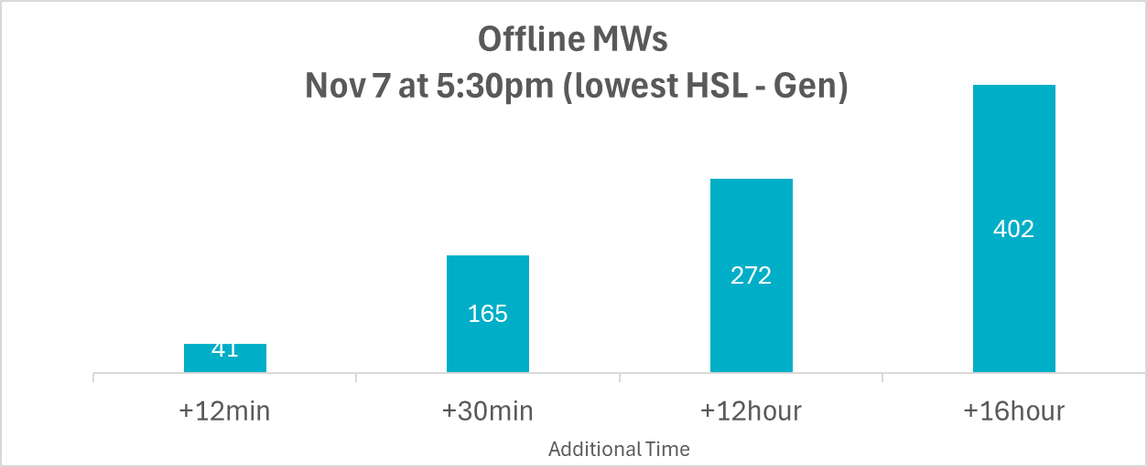
November 7, 2025
Day Ahead assessments of forecasts for November 7, 2025 indicated high uncertainty during peak hours and medium uncertainty during off peak hours for wind and net load, Default selection was considered to be appropriate for the peak hours. No RUCs were issued for this day. In Real Time, actual wind was below the 6 hour ahead forecast (both POE50 and POE80) between HE12 and HE20. Further, three units totaling approximately 2,083 MW capacity were forced out over the course of the day. Non-Spin energy was used for nearly 6 hours.
Wind Forecast Performance

Slide 12
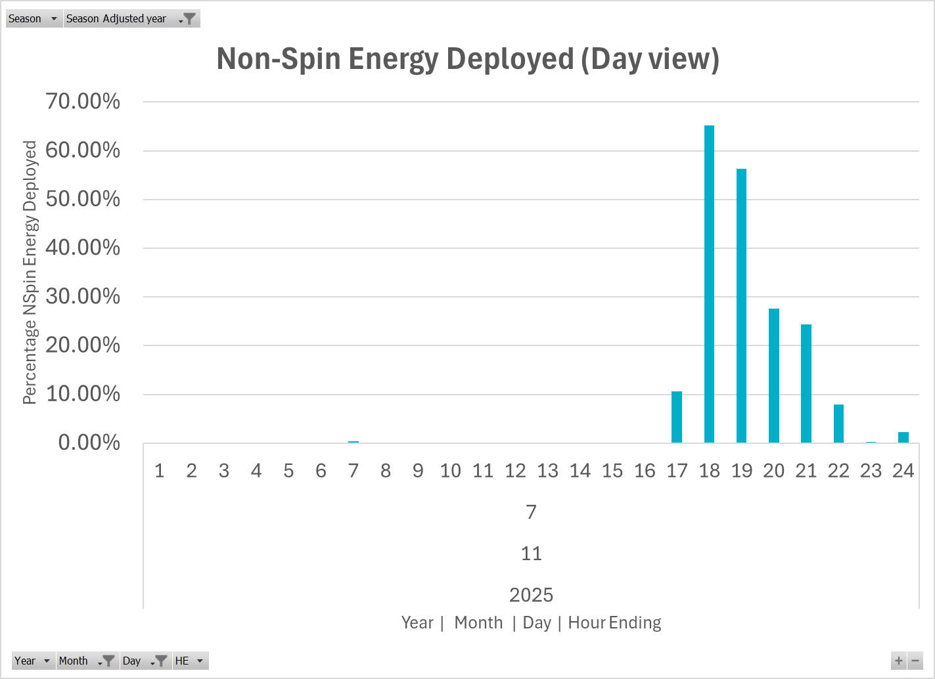
November 7, 2025 Non-Spin Energy Deployed

Slide 13
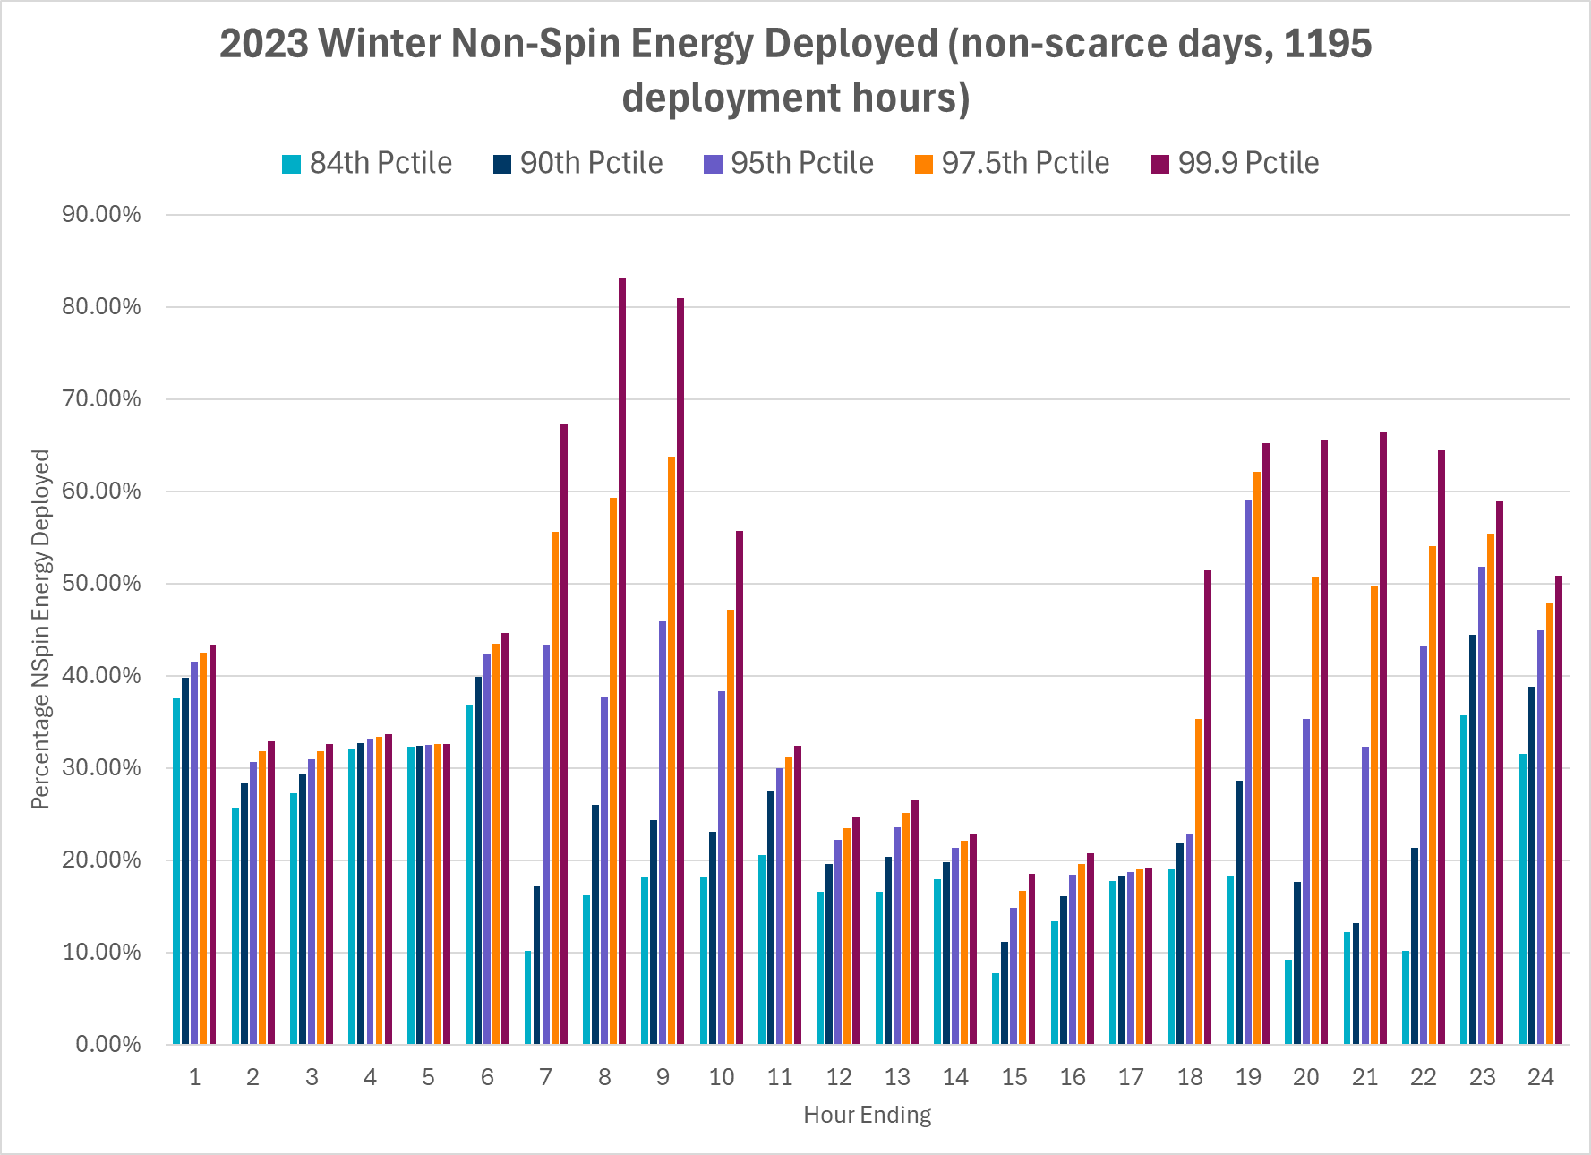
Non-Spin Energy Deployed in 2022-2023 Winter

Slide 14
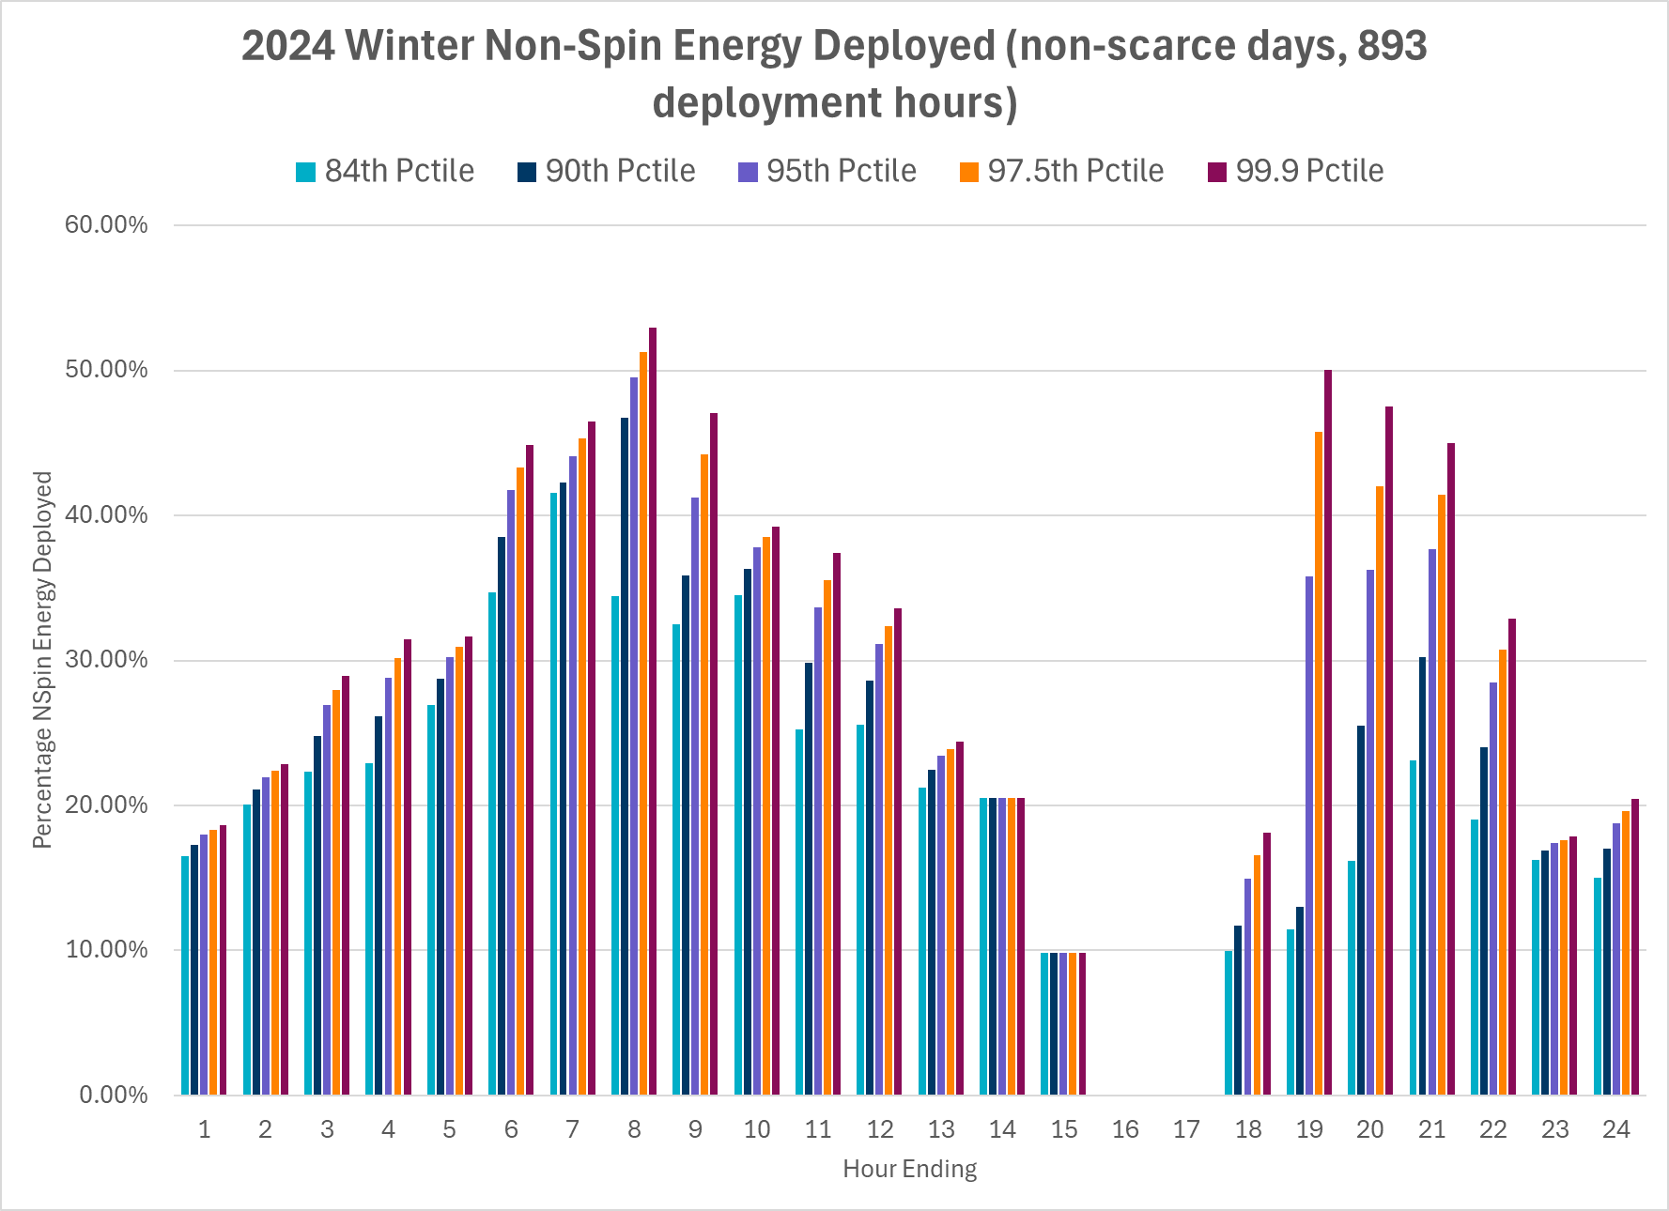
Non-Spin Energy Deployed in 2023-2024 Winter

Slide 15
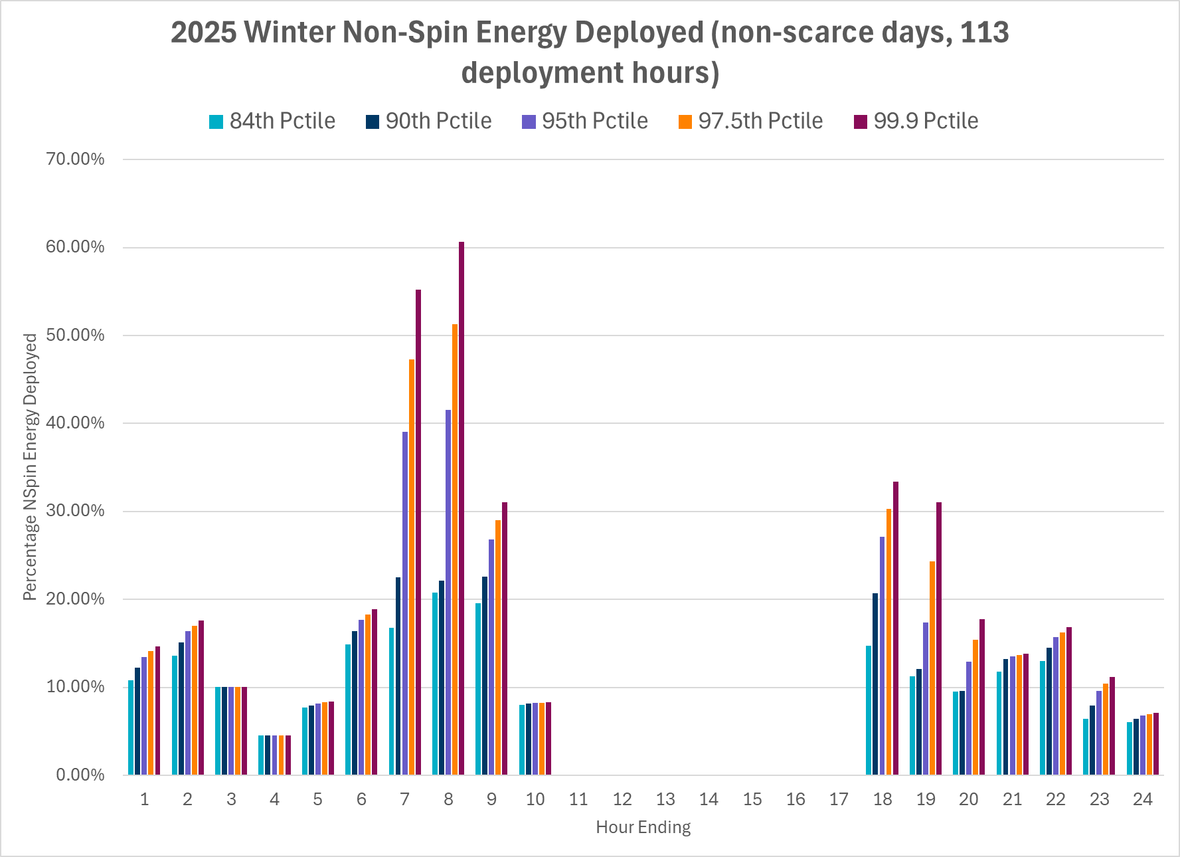
Non-Spin Energy Deployed in 2024-2025 Winter

Slide 16
Non-Spin Energy Use & Non-Spin DF for Go-Live
Non-Spin energy deployment profile in winter is
  Highly dependent on the relative weather/temperature in the season and
  Further hours where peak Non-Spin energy is used seems to be shifting 2023, 2024 and 2025.
Both of these observations are likely due to weather and the increasing installed capacities of solar and energy storage Resources.
Looking at this data there is a strong argument that Non-Spin (if not all) ASDFs should be set a day or two days prior to the Operating Day informed by forecasted uncertainty or other relevant data.
  But this approach will require system changes both to determine the appropriate ASDFs and establish a workflow that updates the ERCOT systems with these.
For Go-Live ERCOT considers it appropriate to
  Learn from the shape of Non-Spin energy deployment from 2025 Winter.
    This shape seems to be appropriate in capturing the risk hours and the relative risk in this season.
  Select conservative ASDFs that allow ERCOT to plan for the Operating Day based on how Non-Spin energy can potentially be used in a multi-hour event.
    As far as temperatures go 2026 Winter may or may not be similar to 2025 Winter. Conservative ASDFs derived from 2025 allow ERCOT to prepare for both the outcomes.

Slide 17
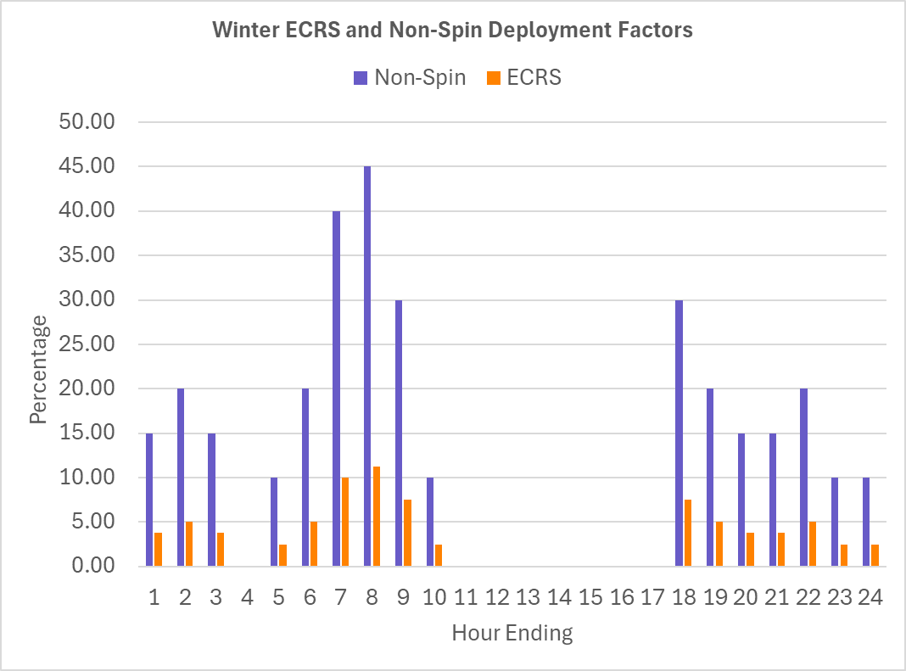
ECRS and Non-Spin ASDFs for 2025-2026 Winter
Specifically for Non-Spin ERCOT will use the 95th percentile value rounded to the nearest 5%.
Further, ERCOT thinks it is appropriate for ECRS ASDFs to follow the same profile as Non-Spin but be scaled down by 75%.

Slide 18
Recap: AS Deployment Factors For Regulation Service
Regulation deployment data for 2024 and 2025 shows (1) year over year growth in average, (2) seasonal variations (higher averages in Summer) and (3) time of day variations (linked to sunrise and sunset).
ERCOT has derived DFs for Regulation Up and Regulation Down based on 75th percentile of the historical deployment of each service in the last two years, rounded to the nearest 5%. This approach learns from historic usage that is closer to average values while accounting for increases in intra-hour uncertainties that may materialize due to growth in installed capacity.

Slide 19
Recap: AS Deployment Factors For RRS PFR and FFR
RRS-PFR energy usage data for 2024 and 2025 show (1) relatively small usage of RRS-PFR, (2) no clear seasonal or time of day variations.
Based on this analysis, ERCOT expects to use a zero (0) DF for RRS-PFR for all hours. Further, with minimal RRS-FFR events, ERCOT expects to use a zero (0) DF for RRS-FFR as well. This selection essentially indicates that ERCOT expects energy usage due to deployment of these services will not significantly impact the next Operating Hour’s planned HBSOC.

Slide 20
Summary
Following is a summary of the approach ERCOT will use to set deployment factors for RTC Go-Live
  Derive ASDFs for Regulation Up and Regulation Down based on 75th percentile of the historical deployment of each service in the last two years, rounded to the nearest 5%.
  Set RRS-PFR and RRS-FFR ASDFs to zero for all hours.
  Derive ASDFs for Non-Spin based on 95th percentile value of the historical deployment of the service in the last year, rounded to the nearest 5%.
  Derive ASDFs for ECRS from Non-Spin ASDFs scaled down by 75%.
ERCOT appreciates the feedback stakeholders have provided on this topic.
ERCOT requests ESR operators submit HBSOC in COPs that reflects their plan to charge and account for their expected discharge throughout the day.
Lastly, ERCOT reiterates that post-RTC Go-Live, as more experience with RTC is gained, ERCOT intends to transition to setting deployment factors a day or two days prior to the Operating Day, informed by forecasted uncertainty, and/or other relevant data.
ERCOT welcomes any further feedback stakeholders may have.

Slide 21
Appendix

Slide 22
Note on HBSOC COP Submission
ERCOT’s observation is that the HBSOC profiles submitted in COPs today are vastly different than the actual SOC seen in Real-Time and many a times are “flat” or unchanging during all hours of a day.
ERCOT reiterates “flat” or unchanging HBSOC profile for an ESR in COP are problematic both today and under RTC.
These type of profiles will greatly restrict RTC RUC’s ability to dispatch ESRs for energy and AS. Even with zero AS deployment factors, ESRs will be exposing themselves to the risk of being caught short by the RUC Capacity Short calculation.
ERCOT requests ESR operators to submit HBSOC in COPs that reflects their plan to charge to cover their AS POSITION and the depletion of SOC based on ASDFs, the AS POSITION they intend to cover. They already (can) do this today after DAM awards and any subsequent AS Trades. On top of this , optionally, they can superimpose any EXPECTED SOC depletion purely from energy basepoint assuming no conversion of AS to energy (excess over energy deployment from ASDFs).

Slide 23
RUC Capacity Short Reference Material
The RUC Capacity Short calculations will use optimization techniques to minimize a QSE’s potential energy and/or Ancillary Service shortfall. This optimization process, will also consider the change in the COP submitted HB SOC across consecutive hours for an ESR to determine the best use of that change in energy to cover the QSE’s energy and Ancillary Services position for each hour in the RUC study period.
Links to background information on RUC Capacity Short Calculation:
  RTC B Modifications to RUC Capacity Short Calcs 02192024 v2.pptx
  RTC B Additional examples RUC Capacity Short Calcs 03172024 v1.pptx
  RTC+B Modifications to RUC Capacity Short Calcs 03172024 (This is a spreadsheet)

Slide 24
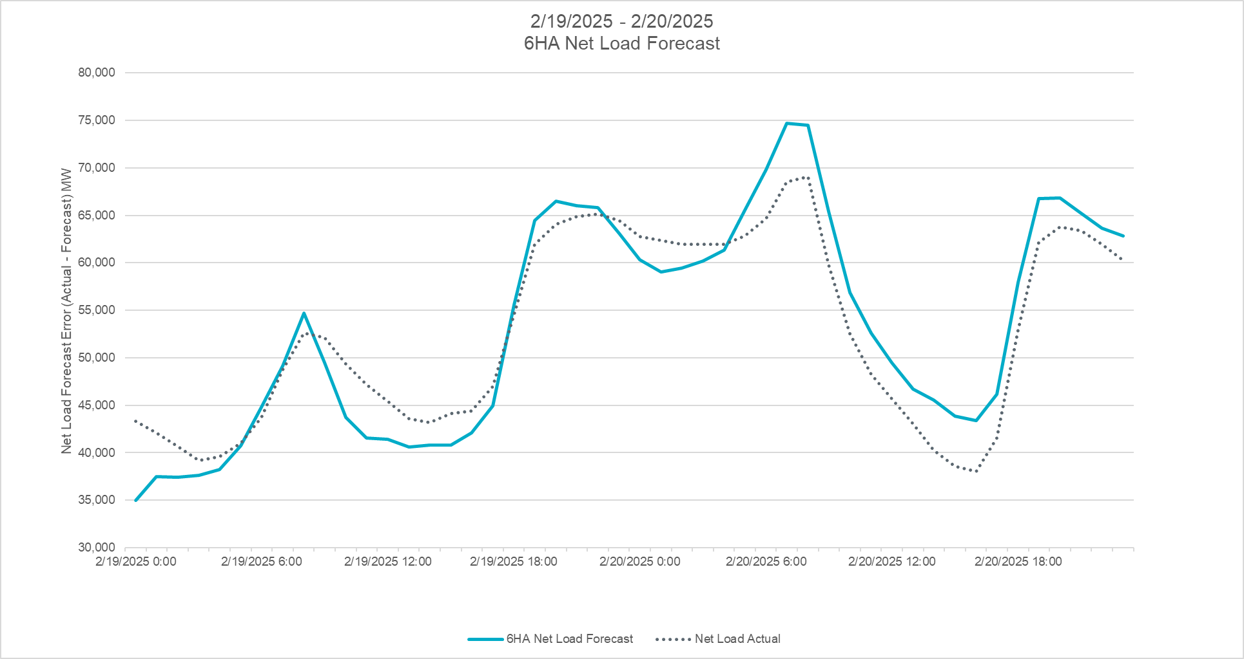
February 19 and 20, 2025

Slide 25
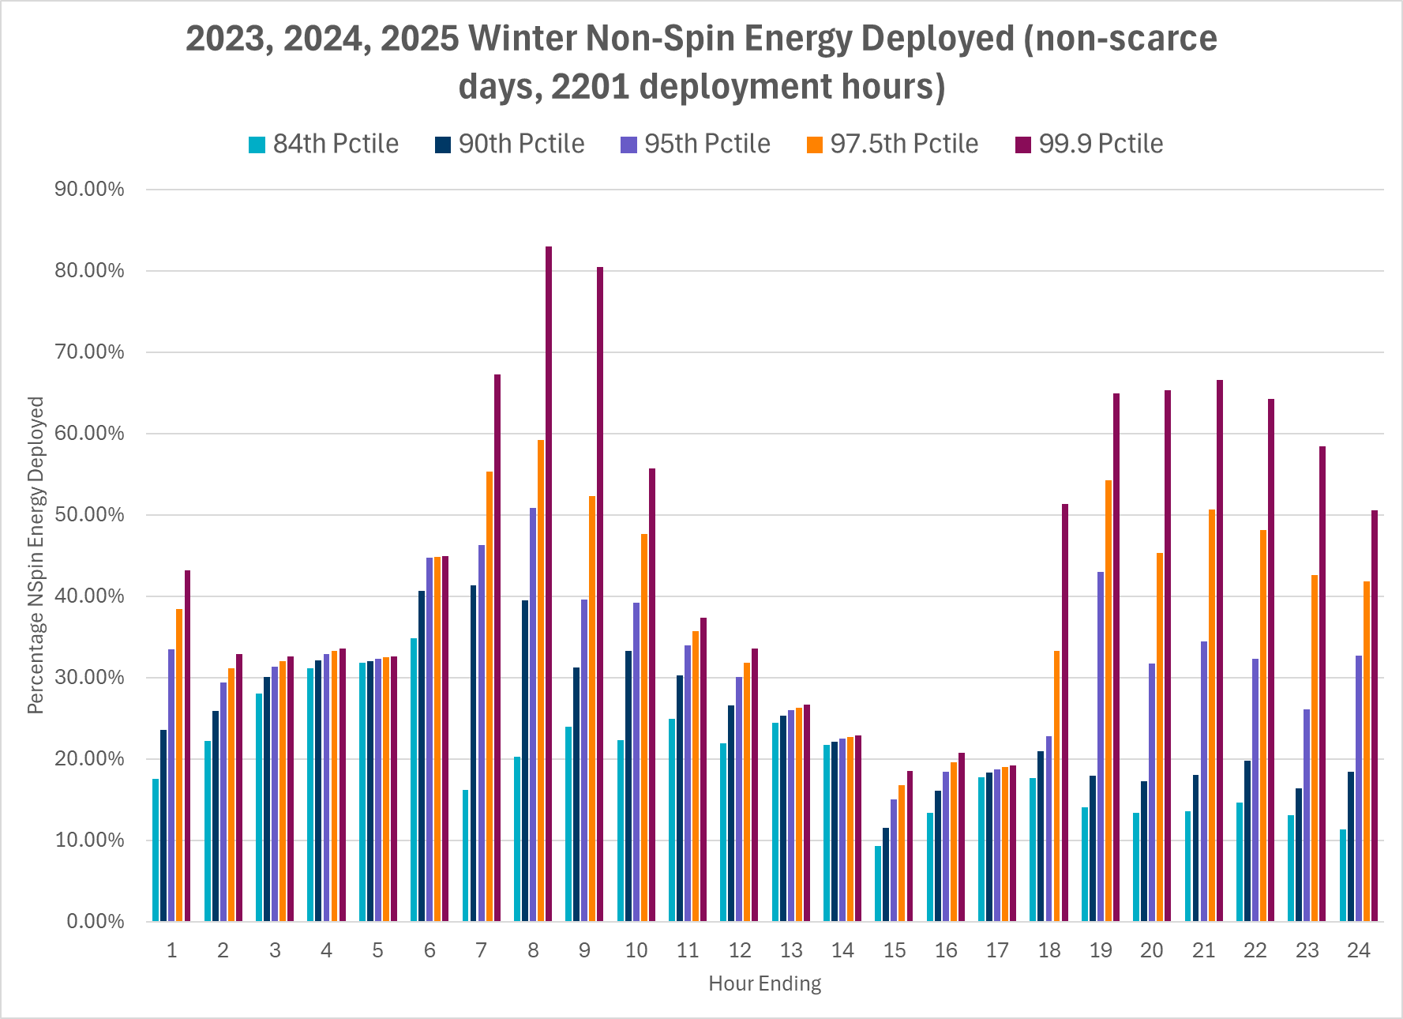
Non-Spin Energy Deployed in Past 3 Winters

