Slide 1
RTC+B – Go-Live Cutover Plan
Sreenivas Badri
Matt Mereness
November 13, 2025

Slide 2
Agenda
Parallel Operations Expectations
Quick review of QSEs RTC+B ICCP/EMS and Market Systems Setup
Go-Live – Cutover Communication
Go-Live – Cutover Plan Review

Slide 3
RTC+B – Parallel Operations
Currently we are in “Parallel Operations”, will continue to be in this state until Go-Live.
Parallel Operations expectations:
QSEs should continue to send Production Quality and Consistent Telemetry to ERCOT RTC+B ICCP system in parallel to current production.
QSEs control room operators should perform the dual entry of telemetry manual overrides etc. based on grid conditions.
QSEs should continue to make Production quality real-time Market submissions to ERCOT RTC+B market systems in parallel to current production.
QSE Telemetry issues (identified by ERCOT and communicating to QSEs) should be fixed no later than 11/28/2025
ERCOT will continue to validate RTC+B telemetry and Market Submissions and communicate issues to QSEs.
ERCOT will continue to validate RTC+B EMS and SCED applications results based on RTC+B telemetry and market submissions and send UDSP, AS Awards etc. through ICCP and post SCED prices.

Slide 4
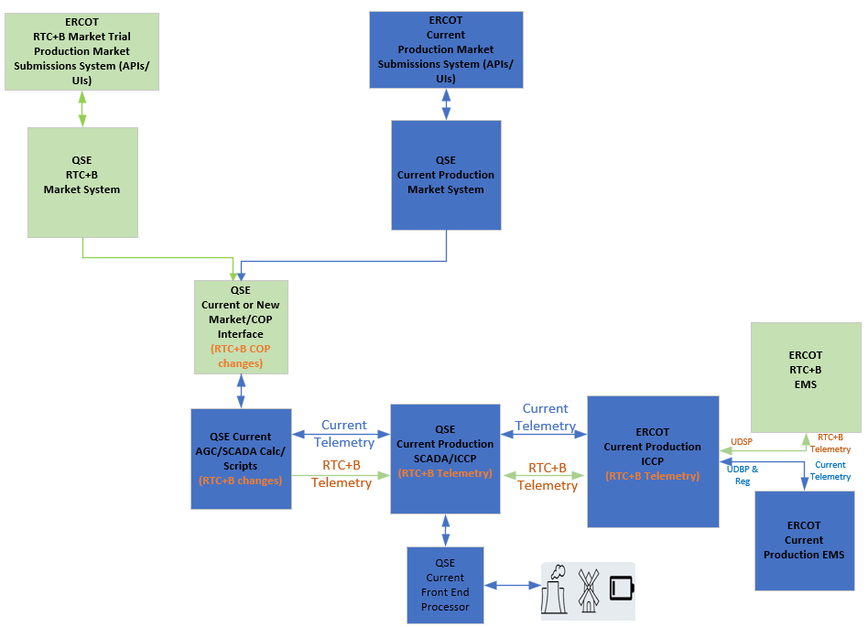
RTC+B – Parallel Operations – Current State of ERCOT and QSE ICCP/EMS Systems Setup

Slide 5
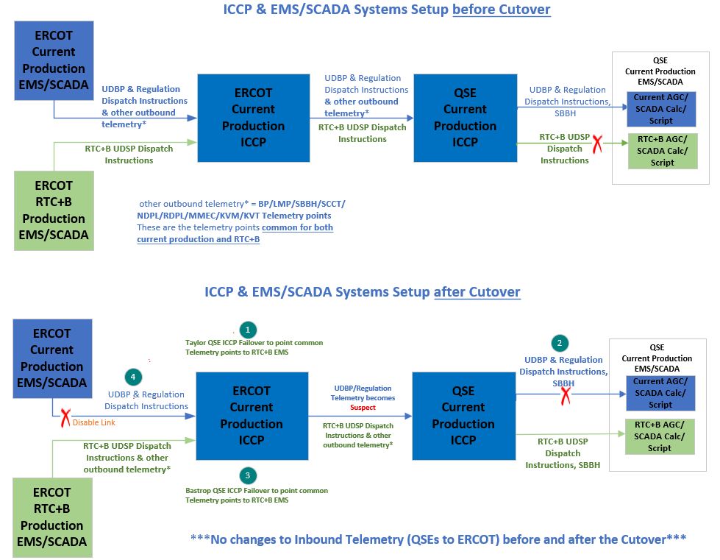
ICCP/EMS Go-Live Cutover Key Steps

Slide 6
QSEs RTC+B Systems configurations for Go-Live
EMS/AGC/SCADA Calc/Scripts
QSEs will utilize System level switch of their EMS/AGC/SCADA Calc/Scripts to cutover their entire system to RTC+B mode. Switchover time must be within 30-60 seconds.
Market Submissions and Notifications
QSEs are utilizing parallel RTC+B Market Systems Production system to submit real-time market submissions into ERCOT RTC+B Market Trial Production System in parallel to current production.
Some QSEs are using current production to support dual real-time market submissions into ERCOT RTC+B Market Trial Production System in parallel to Current Production starting from Open Loop Testing till Go Live.
QSEs Go-Live Market System APIs will have to be updated to point to new RTC+B Go-Live Internet and WAN API URLs during Go-Live.
Outages Submissions
QSEs/TSPs Go-Live Outage Submission APIs will have to be updated to point to new RTC+B Go-Live Internet and WAN API URLs during Go-Live.

Slide 7
RTC+B – Go-Live API URL changes - FAQ
QSEs/TSPs to cutover their Go-Live Market and Outage systems APIs to below new Internet and WAN API End-Point URLs during Go-Live.
Internet API URL: https://misapi.ercot.com/NodalAPI/EWS/
WAN API URL: https://api.wan.ercot.com/NodalAPI/EWS/
API URLs port numbers are not changed but we do support WAN API end point URL on default port 443. ERCOT encourages QSEs to use default port for WAN API end point URL.
ERCOT DNS and IP Addresses remain same as Pre-RTC.
Make sure that current production certificates and API Public Key (available at link https://www.ercot.com/services/mdt/webservices) are installed in Go-Live Market API System and Outage Submissions API System.

Slide 8
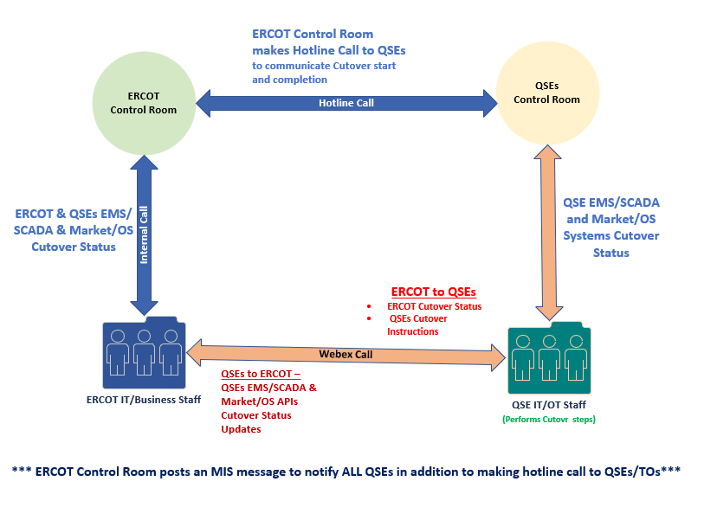
RTC+B - Go-Live Cutover - Communication

Slide 9
Pre-RTC Production System status after RTC Go-Live
ERCOT Pre-RTC EMS will be up and running post go-live on OD 12/05 to support cutback if needed post go-live.
ERCOT requests QSEs to continue to send parallel telemetry to both RTC and pre-RTC systems at least until12/05 06:00AM
Pre-RTC market submissions, outage scheduler
ERCOT requests QSEs to complete real time submissions for OD12/05 in the pre-RTC system before go-live. This is required to support cutback if needed post go-live.
Pre-RTC market applications will be down post go-live.

Slide 10
RTC+B – Go-Live Cutover Plan Review
Go-Live cutover plan spreadsheet is available on RTCBTF site under Technical RTC+B Details section.
https://www.ercot.com/committees/tac/rtcbtf
QSEs should follow this Go-Live cutover plan along with their Internal Procedures for the Go-Live.
It is important for QSEs to line up EMS/Market/OS Scheduler vendors support to get support immediately on any potential critical issues during Go-Live.
ERCOT Control room makes final Go/No-Go decision few minutes before start of the Go-Live activities based on Grid Conditions.
Start & End Times of the Go-Live are subjected to change based on Grid conditions.

Slide 11
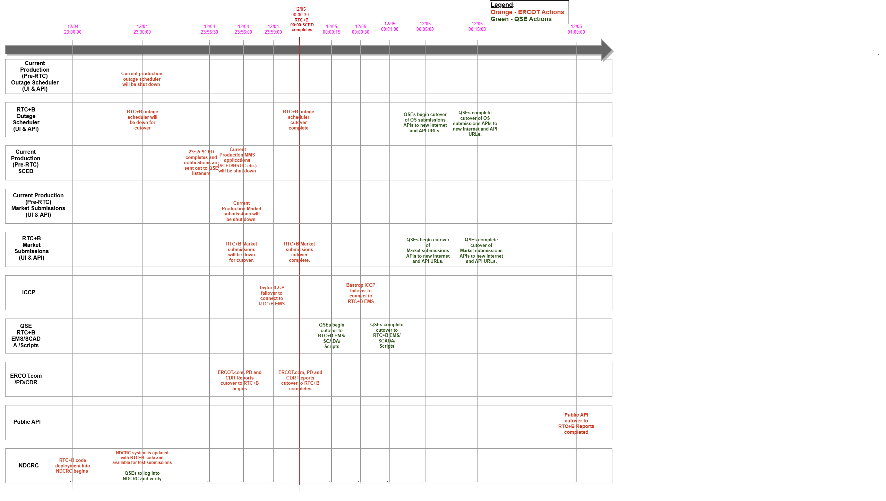
RTC+B - Go-Live ERCOT/QSE Systems Cutover Sequence

Slide 12
RTC+B – Cutback Plan Review
Cutback will be initiated in the unlikely event where:
a critical issue is identified immediately after Go-Live that has significant impacts on Grid Reliability and
issue can not be fixed immediately and
control room makes the decision to cutback
Pre-RTC Market applications will be started and SCED will be run in pre-RTC system using real time market submissions that came into pre-RTC system before Go-Live.
Cutback plan will focus on
Cutback of ERCOT ICCP to ERCOT pre-RTC EMS
QSEs will be requested to cutback to their pre-RTC EMS AGC/SCADA Calc/Scripts.
If issue resolution is expected to take several hours
QSEs will be requested to cutback to their pre-RTC market and outage scheduler submission APIs.
TSPs will also be requested to cutback to pre-RTC outage scheduler APIs.

Slide 13
RTC+B – Go-Live Cutover Plan Deeper Dive Timelines/Details
Deeper Dive Timeline/Details
Review posted spreadsheet

Slide 14
RTC+B – Go-Live Cutover Plan
Questions?
Provide feedback to ERCOT on any concerns/questions at rtcb@ercot.com

