Slide 1
RTC Product Information:
CDR Reports and Public Dashboards for Market Trials and Go-Live
Jamie Lavas
10/2025 TWG

Slide 2
RTC Report Information: CDR
Report delivery for RTC will occur in multiple phases which includes a Market Trials version of existing reports necessary to support Open and Closed Loop testing, new RTC reports, existing report modifications and report removals. Phased Approach:
Market Trials will include a select group of report copies based on existing reports as well as NEW CDR reports. These will occur in 2 groupings.
  Group 1/Open Loop:
    3 report copies needed to support Open Loop Testing
    1 New RTC CDR Report for SCED AS Prices
    Available: July 2025
  Group 2/Closed Loop:
    Remaining 7 report copies to support Closed Loop Testing
    10 New CDR reports (1 removed July 2025)
    Available: September 2025
Go-Live/Cutover will include the remaining CDR report changes (31) for RTC
  Group 3/Go-Live:
    All Existing reports being modified for RTC (15)
    Report removals (9)
    New NPRR1216 Emergency Pricing Report (1), NPRR1269 Updates (30)*
    New AS Trade Overages Report (1)
    New Price Correction Reports (2)

Slide 3
RTC Report Information: Market Trials - Existing
CDR Report delivery for RTC will occur in multiple phases and include a Market Trials version of existing reports necessary to support on-going activities for Open and Closed Loop Testing. These reports will be delivered in Groups 1 & 2.
MT version of existing reports:
10 Existing reports identified as necessary to shadow RTC activities (next slide)
New version includes an updated Product Name, EMIL ID, Report Type ID, filename and XSD element name
These reports will contain RTC Market Trials data based on on-going activities
The PROD version of these reports will continue to post ‘AS IS’ during MT
These reports are available for download on the Market Information System (MIS) Public and are available using External Web Services (EWS) GetReport functionality. Specific posting location information is still to be determined.
These reports are NOT available using the EWS GetContent calls such as GetLMP, GetSCEDViolatedConstraints or GetSystemParameters

Slide 4
RTC Report Information: Market Trials - Existing
The below listed reports are being provided as part of the on-going Market Trials activities. These are copies of existing reports that have been modified to include RTC Market Trials specific data sets.
GROUP | EMIL ID | Rpt ID | Report Type | Product Name
2 | NP4-188-RTCMT | 4100 | MT - Existing | RTC Market Trials DAM Clearing Prices for Capacity
2 | NP4-183-RTCMT | 4101 | MT - Existing | RTC Market Trials DAM Hourly LMPs
2 | NP4-190-RTCMT | 4102 | MT - Existing | RTC Market Trials DAM Settlement Point Prices
2 | NP4-191-RTCMT | 4103 | MT - Existing | RTC Market Trials DAM Shadow Prices
1 | NP6-788-RTCMT | 4104 | MT - Existing | RTC Market Trials LMPs by Resource Nodes, Load Zones and Trading Hubs
2 | NP6-970-RTCMT | 4105 | MT - Existing | RTC Market Trials RTD Indicative LMPs by Resource Nodes, Load Zones and Hubs
1 | NP6-86-RTCMT | 4106 | MT - Existing | RTC Market Trials SCED Shadow Prices and Binding Transmission Constraints
2 | NP6-905-RTCMT | 4107 | MT - Existing | RTC Market Trials Settlement Point Prices at Resource Nodes, Hubs and Load Zones
1 | NP6-323-RTCMT | 4108 | MT - Existing/MOD | RTC Market Trials Real-Time Price Adders by SCED Interval PRIOR NAME: Real-Time ORDC and Reliability Deployment Price Adders and Reserves by SCED Interval
2 | NP6-325-RTCMT | 4109 | MT - Existing/MOD | RTC Market Trials RTD Indicative Price Adders
Note:
8 of these reports exist in a PROD format which are NOT being modified for RTC
2 of these reports are labeled as MOD to indicate they ARE being modified for RTC
  The Market Trials version listed above will include the RTC modifications
  The PROD versions of these reports will include the same modifications but will not be delivered during Market Trials. They are part of the larger go-live bundle that includes existing reports with modifications.

Slide 5
RTC Report Information: Market Trials - Group 1
The following reports are included as part of CDR Group 1/Open Loop testing for Market Trials. The draft XSD for these reports will be made available: 5/30/2025 with MT report delivery in July 2025.
EMIL ID | Rpt ID | Report Type | Product Name
NP6-788-RTCMT | 4104 | MT - Existing | RTC Market Trials LMPs by Resource Nodes, Load Zones and Trading Hubs
NP6-86-RTCMT | 4106 | MT - Existing | RTC Market Trials SCED Shadow Prices and Binding Transmission Constraints
NP6-323-RTCMT | 4108 | MT - Existing/MOD | RTC Market Trials Real-Time Price Adders by SCED Interval PRIOR NAME: Real-Time ORDC and Reliability Deployment Price Adders and Reserves by SCED Interval
NP6-332-CD | 24891 | MT - NEW | Real-Time Clearing Prices for Capacity by SCED Interval

Slide 6
RTC Report Information: Market Trials - Group 2
The following reports are included as part of CDR Group 2/Closed Loop testing for Market Trials. All reports listed below are copies of existing reports. The draft XSD for these reports will be made available: 8/1/2025 with MT report delivery in September 2025.
EMIL ID | Rpt ID | Report Type | Product Name
NP4-188-RTCMT | 4100 | MT - Existing | RTC Market Trials DAM Clearing Prices for Capacity
NP4-183-RTCMT | 4101 | MT - Existing | RTC Market Trials DAM Hourly LMPs
NP4-190-RTCMT | 4102 | MT - Existing | RTC Market Trials DAM Settlement Point Prices
NP4-191-RTCMT | 4103 | MT - Existing | RTC Market Trials DAM Shadow Prices
NP6-970-RTCMT | 4105 | MT - Existing | RTC Market Trials RTD Indicative LMPs by Resource Nodes, Load Zones and Hubs
NP6-905-RTCMT | 4107 | MT - Existing | RTC Market Trials Settlement Point Prices at Resource Nodes, Hubs and Load Zones
NP6-325-RTCMT | 4109 | MT - Existing/MOD | RTC Market Trials RTD Indicative Price Adders

Slide 7
RTC Report Information: Market Trials - Group 2
The following reports are included as part of CDR Group 2/Closed Loop testing for Market Trials. All of these reports are NEW for RTC. The draft XSD for these 10 NEW reports will be made available: 8/1/2025 with MT report delivery in Sept 2025.
EMIL ID | Rpt ID | Report Type | Product Name
NP4-212-CD | 24893 | NEW | DAM and SCED Ancillary Service Demand Curves
NP6-331-CD | 24898 | NEW | Real-Time Clearing Prices for Capacity by 15-Minute Settlement Interval
NP6-329-CD | 24889 | NEW | RTD Indicative Real-Time MCPC
NP6-330-CD | 24890 | NEW | RTD Indicative Ancillary Service Awards by Resource
NP5-528-CD | 24896 | NEW | HRUC Ancillary Service Deployment Factors
NP5-527-CD | 24895 | NEW | DRUC Ancillary Service Deployment Factors
NP5-525-CD | 24897 | NEW | WRUC Ancillary Service Deployment Factors
NP4-532-CD | 24888 | NEW | DAM Total Ancillary Services Sold
NP4-211-CD | 24894 | NEW | RUC Ancillary Service Demand Curves
NP6-328-CD | 24887 | NEW | Total Capability of Resources Available to Provide Ancillary Service
NP5-526-CD | 24886 | NEW | Projected Ancillary Service Deployments Factors
*NP4-211-CD was removed from scope in July 2025. Instead, 3 new ASDC reports by RUC Type will be available at Go-Live.

Slide 8
RTC Report Information: Go-Live - Group 3
The following reports are included as part of CDR Group 3/Go-Live and will not be available during Market Trials. All of these reports are existing reports being modified for RTC and will be made available during cutover. The draft XSD for these reports will be made available: 10/15/2025.
EMIL ID | Rpt ID | Report Type | Product Name
NP4-791-CD | 12349 | MODIFY | Day-Ahead and Real-Time System Wide-Offer Caps
NP3-763-CD | 12315 | MODIFY | Short-Term System Adequacy
NP6-325-CD | 13222 | MODIFY | RTD Indicative Price Adders
NP6-324-CD | 13220 | MODIFY | Real-Time Price Adders for 15-Minute Settlement Interval
NP6-323-CD | 13221 | MODIFY | Real-Time Price Adders by SCED Interval
NP8-143-CD | 11025 | MODIFY | QSE Ancillary Services Capacity Monitor
NP4-197-CD | 13045 | MODIFY | Price Corrections for LMPs by SOG including Price Adders
NP6-327-CD | 21114 | MODIFY | LMP By SOG Including Price Adders (RTC)
NP3-764-CD | 15753 | MODIFY | Hourly RUC Online in SCED Offline in COP Report
NP3-233-CD | 13103 | MODIFY | Hourly Resource Outage Capacity
NP4-193-CD | 12334 | MODIFY | DAM Total Energy Sold
NP4-192-CD | 12333 | MODIFY | DAM Total Energy Purchased
NP4-411-CD | 13096 | MODIFY | DAM Aggregate Credit Exposure
NP4-19-CD | 12330 | MODIFY | DAM Aggregated Ancillary Service Offer Curve
GEN-55-CD | 13499 | MODIFY | Hourly Real-Time Load vs Actual

Slide 9
RTC Report Information: Go-Live - Group 3
The following reports are included as part of CDR Group 3/Go-Live bundles and will not be available during Market Trials. These reports consist of NEW and REMOVED reports for RTC. The draft XSD for these reports will be made available: 10/15/2025.
EMIL ID | RPT ID | Report Type | Product Name
NP4-413-CD | 24892 | NEW | Ancillary Service Trade Overages Report
NP4-412-CD | 24885 | NEW | Emergency Pricing Program Cumulative Hours Tracking
NP4-197-M | 13045 | NEW | RTM Price Corrections for MCPC by 15-Min Settlement Interval
NP4-197-M | 13045 | NEW | RTM Price Corrections for MCPCs by SCED Interval
NP4-216-CD | 26382 | NEW | Hourly RUC Ancillary Service Demand Curves
NP4-214-CD | 26383 | NEW | Daily RUC Ancillary Service Demand Curves
NP4-215-CD | 26384 | NEW | Weekly RUC Ancillary Service Demand Curves
EMIL ID | RPT ID | Report Type | Product Name
NP6-552-CD | 10041 | REMOVE | Group Assignments for Load Resources Providing RRS and ECRS
NP6-577-CD | 21939 | REMOVE | Group Assignments for NCLRs and Off-Line Generation Resources Participating in NSRS
NP4-179-CD | 12327 | REMOVE | Total Ancillary Service Offers
NP8-142-CD | 10052 | REMOVE | Resource AS Supply Insufficiency at 1430
NP6-913-CD | 12350 | REMOVE | SASM Aggregated Ancillary Service Offer Curve
NP6-655-CD | 12343 | REMOVE | Total Ancillary Service Procured in SASM
NP6-569-CD | 12341 | REMOVE | SASM MCPC by Ancillary Service Type
NP6-482-CD | 13097 | REMOVE | SASM Undeliverable and Failed to Provide AS Capacity
NP4-198-M | 13046 | REMOVE | SASM Price Corrections: MCPC

Slide 10
RTC Public Dashboard Information: Go-Live
The following dashboards and displays are being modified for RTC. RTC data and modifications will NOT be available during Market Trials for any of the below listed products. Changes to these products will be implemented at Go-Live.
EMIL ID | Report Type | Product Name
NP6-904-CD | Dashboard - Modify | System ASCAPMON Dashboard
GEN-506-UI | Dashboard - Modify | Capacity Available to SCED Dashboard
GEN-523-UI | Dashboard - Modify | Real-Time LMPs for Latest SCED Run Display
GEN-522-UI | Dashboard - Modify | Real-Time LMPs for Load Zones and Trading Hubs Display
GEN-540-UI | Dashboard - Modify | RTD Indicative LMPs by Load Zones or Hubs Display
GEN-502-UI | Dashboard - Modify | Real-Time Locational Prices (LMP Contour Map): LMPs
GEN-526-UI | Dashboard - Modify | Real-Time Settlement Point Prices Display
NP6-906-UI | Dashboard - Modify | Ancillary Services Dasboard
GEN-530-UI | Dashboard - Modify | Supply & Demand Dashboard
GEN-518-UI | Dashboard - Modify | Real-Time System Conditions Dashboard
GEN-536-UI | Dashboard - Modify | System-Wide Demand Dashboard
GEN-546-UI | Dashboard - Modify | Generation Outages Dashboard
NEW | Dashboard – NEW | Real-Time Clearing Prices for Capacity by SCED Interval Dashboard

Slide 11
Supplemental Posting Information
RTC Draft XSDs will be made available on the Services/Market Data Transparency/XSD page of ERCOT.com. The finalized RTC version of the CDR XSD will be available by 10/15/2025.
Posting Schedule for CDR Reports and XSD Updates:
Draft Disclosure Report Column Definitions Guide will be posted to Services/Market Data Transparency/User Guide page of ERCOT.com.
Please note that there are NO structural changes to any of the shadow settlement extracts therefore no DDL, XSD updates will be made available for this reporting suite. All new RTC data elements will flow through into existing extract tables and columns.
CDR Report Grouping | XSD Posting Date | Report Delivery
Group1/Open Loop | 5/30/2025 | July 2025
Group2/Closed Loop | 8/1/2025 | Sept 2025
Group3/Go-Live | 10/15/2025 | Dec 2025

Slide 12
Appendix of Examples
Change Details – Summary and filename info | Columns Info
Real-Time Clearing Prices for Capacity by SCED Interval NP6-332-CD | Rpt ID: 24891 | Public Frequency: Event – Per SCED Run XSD Element Name: SCEDMCPC | SCEDTimestamp RepeatedHourFlag ASType MCPC
Filename: cdr.00024891.0000000000000000.YYYYMMDD.HH24missFF3.SCEDMCPCNP6332_xml.zip cdr.00024891.0000000000000000.YYYYMMDD.HH24missFF3.SCEDMCPCNP6332_csv.zip File within zip: cdr.00024891.0000000000000000.YYYYMMDD.HHMMSS.SCEDMCPCNP6332.xml cdr.00024891.0000000000000000.YYYYMMDD.HHMMSS.SCEDMCPCNP6332.csv
NEW Report
Product | Change Type | Change Summary
RTC Market Trials LMPs by Resource Nodes, Load Zones and Trading Hubs NP6-788-RTCMT Rpt ID: 4104 XSD Element Name: RTCMTLMPsByResourceNode | Market Facing Change - RTC Market Trials Version | Note: This is a Market Trials copy of the existing report with updated Product Name, EMIL ID, Rpt ID and filename Market Trials File Name: cdr.00004104.0000000000000000.YYYYMMDD.HH24missFF3.LMPSROSNODENP6788_RTC_MT_xml.zip cdr.00004104.0000000000000000.YYYYMMDD.HH24missFF3.LMPSROSNODENP6788_RTC_MT_csv.zip Files within Zip: cdr.00004104.0000000000000000.YYYYMMDD.HHMMSS.LMPSROSNODENP6788_RTC_MT.xml cdr.00004104.0000000000000000.YYYYMMDD.HHMMSS.LMPSROSNODENP6788_RTC_MT.csv
Market Trials Report - Existing
Product | Change Type/Summary | Change Details – New Columns | Change Details – Removed Columns
LMP By SOG Including Price Adders NP6-327-CD | Rpt ID 21114 | Columns/XSD changes | RTRDPA | RTORPA RTORDPA
Modified Report
DASHBOARDS
Product | Change Type | Change Summary
Real-Time Clearing Prices for Capacity by SCED Interval Display | Market Facing Change | New graph: SCED Timestamp and AS Type MCPC Values
Real-Time LMPs for Latest SCED Run Display | Market Facing Change | Update Price Adder calculations and references: RTORDPA/RTRDPA
Supply & Demand Dashboard | Backend Change | Filter update for status changes

Slide 13
Group 1 Summary
Group 1/Open Loop includes 4 Reports in total
Market Trials – 3 Existing (1 report with modifications)
Market Trials – 1 New CDR Report
XSD Delivery Date: 5/30/2025
Product Delivery Date: July 2025
Detailed report changes are captured in the following slides

Slide 14
CDR Report Impact Summary: RTC Group 1
Market Trials – Existing (1 report with modifications)
Group 1/Open Loop includes 3 Reports
XSD Delivery Date: 5/30/2025
Product Delivery Date: July 2025
Product | Change Type | Change Summary
RTC Market Trials SCED Shadow Prices and Binding Transmission Constraints NP6-86-RTCMT Rpt ID: 4106 XSD Element Name: RTCMTSCEDBindingTransmissionConstraint | Market Facing Change - RTC Market Trials Version | Note: This is a Market Trials copy of the existing report with updated Product Name, EMIL ID, Rpt ID and filename Market Trials File Name: cdr.00004106.0000000000000000.YYYYMMDD.HH24missFF3.SCEDBTCNP686_RTC_MT_xml.zip cdr.00004106.0000000000000000.YYYYMMDD.HH24missFF3.SCEDBTCNP686_RTC_MT_csv.zip Files within Zip: cdr.00004106.0000000000000000.YYYYMMDD.HHMMSS.SCEDBTCNP686_RTC_MT.xml cdr.00004106.0000000000000000.YYYYMMDD.HHMMSS.SCEDBTCNP686_RTC_MT.csv
RTC Market Trials LMPs by Resource Nodes, Load Zones and Trading Hubs NP6-788-RTCMT Rpt ID: 4104 XSD Element Name: RTCMTLMPsByResourceNode | Market Facing Change - RTC Market Trials Version | Note: This is a Market Trials copy of the existing report with updated Product Name, EMIL ID, Rpt ID and filename Market Trials File Name: cdr.00004104.0000000000000000.YYYYMMDD.HH24missFF3.LMPSROSNODENP6788_RTC_MT_xml.zip cdr.00004104.0000000000000000.YYYYMMDD.HH24missFF3.LMPSROSNODENP6788_RTC_MT_csv.zip Files within Zip: cdr.00004104.0000000000000000.YYYYMMDD.HHMMSS.LMPSROSNODENP6788_RTC_MT.xml cdr.00004104.0000000000000000.YYYYMMDD.HHMMSS.LMPSROSNODENP6788_RTC_MT.csv

Slide 15
CDR Report Impact Summary: RTC Group 1
Product | Change Type/Summary | Change Details – New Columns | Change Details – Removed Columns
RTC Market Trials Real-Time Price Adders by SCED Interval Previous Name: Real-Time ORDC and Reliability Deployment Price Adders and Reserves by SCED Interval NP6-323-RTCMT Rpt ID: 4108 XSD Element Name: RTCMTPriceAdderSCED | RTC Market Trials Version with RTC changes for: Rename, column/XSD changes | New Columns: RTRDPA RTRDPARDS RTRDPARRS RTRDPAECRS RTRDPANSS RTOLLSL RTOLHSL RTRDPARUS | Batch ID PRC RTORPA RTOFFPA RTOLCAP RTOFFCAP RTOLHSL RTBP RTCLRCAP RTCLRREG RTCLRBP | RTCLRLSL RTCLRNS RTNCLRRRS RTOLNSRS RTSCT30HSL RTOFFNSHSL RTRUCCST30HSL RTORDPA RTOLLASL RTOHASL RTNCLRNSCAP RTNCLRECRS
 | Market Trials File Name: cdr.00004108.0000000000000000.YYYYMMDD.HH24missFF3.RTSCEDpriceAdderNP6323_YYYYMMDD_HHMMSS_RTC_MT_xml.zip cdr.00004108.0000000000000000.YYYYMMDD.HH24missFF3.RTSCEDpriceAdderNP6323_YYYYMMDD_HHMMSS_RTC_MT_csv.zip Files within Zip: cdr.00004108.0000000000000000.YYYYMMDD.HHMMSS. RTSCEDpriceAdderNP6323_YYYYMMDD_HHMMSS_RTC_MT.xml cdr.00004108.0000000000000000.YYYYMMDD.HHMMSS. RTSCEDpriceAdderNP6323_YYYYMMDD_HHMMSS_RTC_MT.csv

Slide 16
CDR Report Impact Summary: RTC Group 1
Market Trials – New
Group 1/Open Loop includes 1 New CDR Report
XSD Delivery Date: 5/30/2025
Product Delivery Date: July 2025
Change Details – Summary and filename info | Columns Info
Real-Time Clearing Prices for Capacity by SCED Interval NP6-332-CD | Rpt ID: 24891 | Public Frequency: Event – Per SCED Run XSD Element Name: SCEDMCPC | SCEDTimestamp RepeatedHourFlag ASType MCPC
Filename: cdr.00024891.0000000000000000.YYYYMMDD.HH24missFF3.SCEDMCPCNP6332_YYYYMMDD_HHMMSS_xml.zip cdr.00024891.0000000000000000.YYYYMMDD.HH24missFF3.SCEDMCPCNP6332_YYYYMMDD_HHMMSS_csv.zip File within zip: cdr.00024891.0000000000000000.YYYYMMDD.HHMMSS.SCEDMCPCNP6332_YYYYMMDD_HHMMSS.xml cdr.00024891.0000000000000000.YYYYMMDD.HHMMSS.SCEDMCPCNP6332_YYYYMMDD_HHMMSS.csv

Slide 17
Group 2 Summary
Group 2/Closed Loop includes 18 Reports in total
Market Trials – 7 Existing (1 report with modifications)
Market Trials – 11 New CDR Report
XSD Delivery Date: 8/01/2025
Product Delivery Date: Sept 2025
Detailed report changes are captured in the following slides

Slide 18
CDR Report Impact Summary: RTC Group 2
Market Trials – Existing
Group 2/Closed Loop (7 Reports)
XSD Delivery Date: 8/1/2025
Product Delivery Date: September 2025
Product | Change Type | Change Summary
RTC Market Trials DAM Clearing Prices for Capacity NP4-188-RTCMT Rpt ID: 4100 XSD Element Name: RTCMTDAMClearingPricesForCapacity | Market Facing Change - RTC Market Trials Version | Note: This is a Market Trials copy of the existing report with updated Product Name, EMIL ID, Rpt ID and filename Market Trials File Name: cdr.00004100.0000000000000000.YYYYMMDD.HH24missFF3.DAMCPCNP4188_RTC_MT_xml.zip cdr.00004100.0000000000000000.YYYYMMDD.HH24missFF3.DAMCPCNP4188_RTC_MT_csv.zip Files within Zip: cdr.00004100.0000000000000000.YYYYMMDD.HHMMSS.DAMCPCNP4188_RTC_MT.xml cdr.00004100.0000000000000000.YYYYMMDD.HHMMSS.DAMCPCNP4188_RTC_MT.csv
RTC Market Trials DAM Hourly LMPs NP4-183-RTCMT Rpt ID: 4101 XSD Element Name: RTCMTDAMHourLMPS | Market Facing Change - RTC Market Trials Version | Note: This is a Market Trials copy of the existing report with updated Product Name, EMIL ID, Rpt ID and filename Market Trials File Name: cdr.00004101.0000000000000000.YYYYMMDD.HH24missFF3.DAMHRLMPNP4183_RTC_MT_xml.zip cdr.00004101.0000000000000000.YYYYMMDD.HH24missFF3.DAMHRLMPNP4183_RTC_MT_csv.zip Files within Zip: cdr.00004101.0000000000000000.YYYYMMDD.HHMMSS.DAMHRLMPNP4183_RTC_MT.xml cdr.00004101.0000000000000000.YYYYMMDD.HHMMSS.DAMHRLMPNP4183_RTC_MT.csv

Slide 19
CDR Report Impact Summary: RTC Group 2
Product | Change Type | Change Summary
RTC Market Trials DAM Settlement Point Prices NP4-190-RTCMT Rpt ID: 4102 XSD Element Name: RTCMTDAMSettlementPointPrice | Market Facing Change - RTC Market Trials Version | Note: This is a Market Trials copy of the existing report with updated Product Name, EMIL ID, Rpt ID and filename Market Trials File Name: cdr.00004102.0000000000000000.YYYYMMDD.HH24missFF3.DAMSPNP4190_RTC_MT_xml.zip cdr.00004102.0000000000000000.YYYYMMDD.HH24missFF3.DAMSPNP4190_RTC_MT_csv.zip Files within Zip: cdr.00004102.0000000000000000.YYYYMMDD.HHMMSS.DAMSPNP4190_RTC_MT.xml cdr.00004102.0000000000000000.YYYYMMDD.HHMMSS.DAMSPNP4190_RTC_MT.csv
RTC Market Trials DAM Shadow Prices NP4-191-RTCMT Rpt ID: 4103 XSD Element Name: RTCMTDAShadowPricesForBindingConstraint | Market Facing Change - RTC Market Trials Version | Note: This is a Market Trials copy of the existing report with updated Product Name, EMIL ID, Rpt ID and filename Market Trials File Name: cdr.00004103.0000000000000000.YYYYMMDD.HH24missFF3.DASPBCNP4191_RTC_MT_xml.zip cdr.00004103.0000000000000000.YYYYMMDD.HH24missFF3.DASPBCNP4191_RTC_MT_csv.zip Files within Zip: cdr.00004103.0000000000000000.YYYYMMDD.HHMMSS.DASPBCNP4191_RTC_MT.xml cdr.00004103.0000000000000000.YYYYMMDD.HHMMSS.DASPBCNP4191_RTC_MT.csv

Slide 20
CDR Report Impact Summary: RTC Group 2
Product | Change Type | Change Summary
RTC Market Trials RTD Indicative LMPs by Resource Nodes, Load Zones and Hubs NP6-970-RTCMT Rpt ID: 4105 XSD Element Name: RTCMTRTDIndicativeLMPs | Market Facing Change - RTC Market Trials Version | Note: This is a Market Trials copy of the existing report with updated Product Name, EMIL ID, Rpt ID and filename Market Trials File Name: cdr.00004105.0000000000000000.YYYYMMDD.HH24missFF3. RTDLMPRNLZHUBNP6970_RTC_MT_ YYYYMMDD_HHMMSS_xml cdr.00004105.0000000000000000.YYYYMMDD.HH24missFF3. RTDLMPRNLZHUBNP6970_RTC_MT_ YYYYMMDD_HHMMSS_csv Files within Zip: cdr.00004105.0000000000000000.YYYYMMDD.HHMMSS. RTDLMPRNLZHUBNP6970_RTC_MT_YYYYMMDD_HHMMSS.xml cdr.00004105.0000000000000000.YYYYMMDD.HHMMSS. RTDLMPRNLZHUBNP6970_RTC_MT_ YYYYMMDD_HHMMSS.csv
RTC Market Trials Settlement Point Prices at Resource Nodes, Hubs and Load Zones NP6-905-RTCMT Rpt ID: 4107 XSD Element Name: RTCMTDAShadowPricesForBindingConstraint | Market Facing Change - RTC Market Trials Version | Note: This is a Market Trials copy of the existing report with updated Product Name, EMIL ID, Rpt ID and filename Market Trials File Name: cdr.00004107.0000000000000000.YYYYMMDD.HH24missFF3.SPPHLZNP6905_RTC_MT_YYYYMMDD _HH24MI_xml.zip cdr.00004107.0000000000000000.YYYYMMDD.HH24missFF3.SPPHLZNP6905_RTC_MT_YYYYMMDD _HH24MI_csv.zip Files within Zip: cdr.00004107.0000000000000000.YYYYMMDD.HHMMSS.SPPHLZNP6905_RTC_MT_ YYYYMMDD _HH24MI.xml cdr.00004107.0000000000000000.YYYYMMDD.HHMMSS.SPPHLZNP6905_RTC_MT_YYYYMMDD _HH24MI.csv

Slide 21
CDR Report Impact Summary: RTC Group 2
Product | Change Type/Summary | Change Details – New Columns | Change Details – Removed Columns
RTC Market Trials RTD Indicative Price Adders Previous Name: RTD Indicative ORDC and Reliability Deployment Price Adders and Reserves NP6-325-RTCMT Rpt ID: 4109 | RTC Market Trials Version with RTC changes for: Rename, column/XSD changes | New Columns: RTRDPA RTRDPARUS RTRDPARDS RTRDPARRS RTRDPAECRS RTRDPANSS RTOLLSL RTOLHSL | Remove Columns: Batch ID RTORPA RTOFFPA RTOLCAP RTOFFCAP RTORDPA RTOLLASL RTOHASL RTNCLRECRS
 |  | Market Trials File Name: cdr.00004109.0000000000000000.YYYYMMDD.HH24missFF3.RTDPriceAdderNP6325_RTC_MT_YYYYMMDD_xml cdr.00004109.0000000000000000.YYYYMMDD.HH24missFF3.RTDPriceAdderNP6325_RTC_MT_YYYYMMDD_csv Files within Zip: cdr.00004109.0000000000000000.YYYYMMDD.HHMMSS.RTDPriceAdderNP6325_RTC_MT_YYYYMMDD_HHMMSS.xml cdr.00004109.0000000000000000.YYYYMMDD.HHMMSS.RTDPriceAdderNP6325_RTC_MT_YYYYMMDD_HHMMSS.csv XSD Element Name: RTCMTRTDPriceAdders

Slide 22
CDR Report Impact Summary: RTC Group 2
Market Trials – New
Group 2 (11 New Reports)
XSD Delivery Date: 8/1/2025
Product Delivery Date: September 2025
Change Details – Summary and filename info | Columns Info
DAM and SCED Ancillary Service Demand Curves NP4-212-CD | Rpt ID: 24893 | Public Frequency: 06:00 - Daily AND event triggered by DAM-SCED-ASDC-NOTF if there is a change XSD Element Name: DAMSCEDASDC | DeliveryDate HourEnding ASType DemandCurvePoint | Quantity Price RepeatedHourFlag
Filename: cdr.00024893.0000000000000000.YYYYMMDD.HH24missFF3.DAMSCEDASDCNP4212_xml.zip cdr.00024893.0000000000000000.YYYYMMDD.HH24missFF3.DAMSCEDASDCNP4212_csv.zip File within zip: cdr.00024893.0000000000000000.YYYYMMDD.HHMMSS.DAMSCEDASDCNP4212.xml cdr.00024893.0000000000000000.YYYYMMDD.HHMMSS.DAMSCEDASDCNP4212.csv
Real-Time Clearing Prices for Capacity by 15-Minute Settlement Interval NP6-331-CD | Rpt ID: 24898 | Public Frequency: Every 15 Mins XSD Element Name: MCPC15Min | DeliveryDate DeliveryHour DeliveryInt | RepeatedHourFlag ASType MCPC
Filename: cdr.00024898.0000000000000000.YYYYMMDD.HH24missFF3.MCPC15MinNP6331_xml.zip cdr.00024898.0000000000000000.YYYYMMDD.HH24missFF3.MCPC15MinNP6331_csv.zip Files within Zip: cdr.00024898.0000000000000000.YYYYMMDD.HHMMSS.MCPC15MinNP6331.xml cdr.00024898.0000000000000000.YYYYMMDD.HHMMSS.MCPC15MinNP6331.csv

Slide 23
CDR Report Impact Summary: RTC Group 2
Change Details – Summary and filename info | Columns Info
RTD Indicative Real-Time MCPC NP6-329-CD | Rpt ID: 24889 | Public Frequency: Every 15 Mins XSD Element Name: RTDMCPC | RTDTimestamp RepeatedHourFlag IntervalID IntervalEnding IntervalEndingRepeatedHourFlag | REGUP REGDN RRS ECRS NSPIN
Filename: cdr.00024889.0000000000000000.YYYYMMDD.HH24missFF3.RTDMCPCNP6329_xml.zip cdr.00024889.0000000000000000.YYYYMMDD.HH24missFF3.RTDMCPCNP6329_csv.zip File within zip: cdr.00024889.0000000000000000.YYYYMMDD.HHMMSS.RTDMCPCNP6329.xml cdr.00024889.0000000000000000.YYYYMMDD.HHMMSS.RTDMCPCNP6329.csv
DAM Total Ancillary Services Sold NP4-532-CD | Rpt ID: 24888 | Public Frequency: Event – Per DAM Run XSD Element Name: DAMASSOLD | DeliveryDate HourEnding ASType Quantity RepeatedHourFlag
Filename: cdr.00024888.0000000000000000.YYYYMMDD.HH24missFF3.DAMASSOLDNP4532_xml.zip cdr.00024888.0000000000000000.YYYYMMDD.HH24missFF3.DAMASSOLDNP4532_csv.zip File within zip: cdr.00024888.0000000000000000.YYYYMMDD.HHMMSS.DAMASSOLDNP4532.xml cdr.00024888.0000000000000000.YYYYMMDD.HHMMSS.DAMASSOLDNP4532.csv

Slide 24
CDR Report Impact Summary: RTC Group 2
Change Details – Summary and filename info | Columns Info
HRUC Ancillary Service Deployment Factors NP5-528-CD | Rpt ID: 24896 | Public Frequency: Event – Per HRUC Run XSD Element Name: HRUCASDF | RUCTimestamp DeliveryHour ASType ASDeploymentFactors RepeatedHourFlag
Filename: cdr.00024896.0000000000000000.YYYYMMDD.HH24missFF3.HRUCASDFNP5528_xml.zip cdr.00024896.0000000000000000.YYYYMMDD.HH24missFF3.HRUCASDFNP5528_csv.zip File within zip: cdr.00024896.0000000000000000.YYYYMMDD.HHMMSS.HRUCASDFNP5528.xml cdr.00024896.0000000000000000.YYYYMMDD.HHMMSS.HRUCASDFNP5528.csv
DRUC Ancillary Service Deployment Factors NP5-527-CD | Rpt ID: 24895 | Public Frequency: Event – Per DRUC Run XSD Element Name: DRUCASDF | RUCTimestamp DeliveryHour ASType ASDeploymentFactors RepeatedHourFlag
Filename: cdr.00024895.0000000000000000.YYYYMMDD.HH24missFF3.DRUCASDFNP5527_xml.zip cdr.00024895.0000000000000000.YYYYMMDD.HH24missFF3.DRUCASDFNP5527_csv.zip File within zip: cdr.00024895.0000000000000000.YYYYMMDD.HHMMSS.DRUCASDFNP5527.xml cdr.00024895.0000000000000000.YYYYMMDD.HHMMSS.DRUCASDFNP5527.csv
WRUC Ancillary Service Deployment Factors NP5-525-CD | Rpt ID: 24897 | Public Frequency: Event – Per WRUC Run XSD Element Name: WRUCASDF | RUCTimestamp DeliveryHour ASType ASDeploymentFactors RepeatedHourFlag
Filename: cdr.00024897.0000000000000000.YYYYMMDD.HH24missFF3.WRUCASDFNP5525_xml.zip cdr.00024897.0000000000000000.YYYYMMDD.HH24missFF3.WRUCASDFNP5525_csv.zip File within zip: cdr.00024897.0000000000000000.YYYYMMDD.HHMMSS.WRUCASDFNP5525.xml cdr.00024897.0000000000000000.YYYYMMDD.HHMMSS.WRUCASDFNP5525.csv

Slide 25
CDR Report Impact Summary: RTC Group 2
Change Details – Summary and filename info | Columns Info
RTD Indicative Ancillary Service Awards by Resource NP6-330-CD | Rpt ID: 24890 | Certified for QSEs Frequency: Event – Per RTD Run XSD Element Name: RTDIndASAwardByRes | RTDTimestamp RepeatedHourFlag IntervalID IntervalEnding IntervalEndingRepeatedHourFlag ResourceName ParticipantName | QSE_DUNS REGDN REGUP RRSPFR RRSFFR RRSUFR ECRS NSPIN
Filename: cdr.00024890.0000000000000000.YYYYMMDD.HH24missFF3.RTDIndASAwardbyResNP6330_xml.zip cdr.00024890.0000000000000000.YYYYMMDD.HH24missFF3.RTDIndASAwardbyResNP6330_csv.zip File within zip: cdr.00024890.0000000000000000.YYYYMMDD.HHMMSS.RTDIndASAwardbyResNP6330.xml cdr.00024890.0000000000000000.YYYYMMDD.HHMMSS.RTDIndASAwardbyResNP6330.csv
RUC Ancillary Service Demand Curves NP4-211-CD | Rpt ID: 24894 | Public Frequency: 06:00 Daily AND event triggered with a change: RUC-ASDC-NOTF XSD Element Name: RUCASDC | DeliveryDate HourEnding ASType DemandCurvePoint Quantity Price RepeatedHourFlag
Filename: cdr.00024894.0000000000000000.YYYYMMDD.HH24missFF3.RUCASDCNP4211_xml.zip cdr.00024894.0000000000000000.YYYYMMDD.HH24missFF3.RUCASDCNP4211_csv.zip File within zip: cdr.00024894.0000000000000000.YYYYMMDD.HHMMSS.RUCASDCNP4211.xml cdr.00024894.0000000000000000.YYYYMMDD.HHMMSS.RUCASDCNP4211.csv

Slide 26
CDR Report Impact Summary: RTC Group 2
Change Details – Summary and filename info | Columns Info
Total Capability of Resources Available to Provide Ancillary Service NP6-328-CD | Rpt ID: 24887 | Public Frequency: Event – Per SCED Run XSD Element Name: TotASResCapability | SCEDTimestamp RepeatedHourFlag CapREGUPTotal CapREGDNTotal CapRRSTotal CapECRSTotal CapNSPINTotal CapREGUP_RRSTotal CapREGUP_RRS_ECRSTotal CapREGUP_RRS_ECRS_NSPINTotal
Filename: cdr.00024887.0000000000000000.YYYYMMDD.HH24missFF3.TotASResCapabilityNP6328_xml.zip cdr.00024887.0000000000000000.YYYYMMDD.HH24missFF3.TotASResCapabilityNP6328_csv.zip File within zip: cdr.00024887.0000000000000000.YYYYMMDD.HHMMSS.TotASResCapabilityNP6328.xml cdr.00024887.0000000000000000.YYYYMMDD.HHMMSS.TotASResCapabilityNP6328.csv
Projected Ancillary Service Deployments Factors NP5-526-CD | Rpt ID: 24886 | Public Frequency: 06:00 Daily XSD Element Name: ProjectedASDF | DeliveryDate HourEnding ASType ASDeploymentFactors RepeatedHourFlag
Filename: cdr.00024886.0000000000000000.YYYYMMDD.HH24missFF3.ProjectedASDFNP5526_xml.zip cdr.00024886.0000000000000000.YYYYMMDD.HH24missFF3.ProjectedASDFNP5526_csv.zip File within zip: cdr.00024886.0000000000000000.YYYYMMDD.HHMMSS.ProjectedASDFNP5526.xml cdr.00024886.0000000000000000.YYYYMMDD.HHMMSS.ProjectedASDFNP5526.csv

Slide 27
Group 3 Summary
Group 3/Go-Live
28 Reports in total
4 New CDR Report
15 Report Modifications
9 Report Removals
XSD Delivery Date: 10/15/2025
Product Delivery Date: Dec 2025
Detailed report changes are captured in the following slides

Slide 28
CDR Report Impact Summary: RTC Group 3
Go-Live – New
Group 3 (7 New Reports)
XSD Delivery Date: 10/15/2025
Product Delivery Date: December 2025
Change Details – Summary and filename info | Columns Info
Ancillary Service Trade Overages Report NP4-413-CD | Rpt ID: 24892 | Certified for QSEs Frequency: 14:30 Daily XSD Element Name: ASTradeOverages | QSEID QSEDuns Delivery Date HourEnding ASType | ASTradeBought ASTradeSold SelfAS Overage RepeatedHourFlag
cdr.00024892.0000000000000000.YYYYMMDD.HH24missFF3.ASTradeOveragesNP4413_xml.zip cdr.00024892.0000000000000000.YYYYMMDD.HH24missFF3.ASTradeOveragesNP4413_csv.zip File within zip: cdr.00024892.0000000000000000.YYYYMMDD.HHMMSS.ASTradeOveragesNP4413.xml cdr.00024892.0000000000000000.YYYYMMDD.HHMMSS.ASTradeOveragesNP4413.csv
Emergency Pricing Program Cumulative Hours Tracking Report NP4-412-CD | Rpt ID: 24885 | Public Frequency: Chron - 15 Minutes XSD Element Name: EPPCumulativeHours | DeliveryDate DeliveryHour DeliveryInterval AvgRTSystemLambda AvgRTRDPA | SumRTSysLambdaRTRDPA HCAPforDAM CumHrsHCAPDAM24Hrs RepeatedHourFlag
cdr.00024885.0000000000000000.YYYYMMDD.HH24missFF3.EPPCumulativeHrsNP4412_YYYYMMDD_HourInterval_xml.zip cdr.00024885.0000000000000000.YYYYMMDD.HH24missFF3.EPPCumulativeHrsNP4412_YYYYMMDD_HourInterval_csv.zip File within zip: cdr.00024885.0000000000000000.YYYYMMDD.HHMMSS.EPPCumulativeHrsNP4412_YYYYMMDD_HourInterval.xml cdr.00024885.0000000000000000.YYYYMMDD.HHMMSS.EPPCumulativeHrsNP4412_YYYYMMDD_HourInterval.csv

Slide 29
CDR Report Impact Summary: RTC Group 3
Change Details – Summary and filename info | Columns Info
RTM Price Corrections for MCPC by 15-Min Settlement Interval NP4-197-M | Rpt ID: 13045 | Public Frequency: Event – Per Price Correction XSD Element Name: RTMPriceCorrectionMCPCSPP | DeliveryDate DeliveryHour DeliveryInterval ASType | MCPCOriginal MCPCCorrected PriceCorrectionTime RepeatedHourFlag
cdr.00013045.0000000000000000.YYYYMMDD.HH24missFF3.pricecorrection_RTM_MCPC_SPP_YYYYMMDD_to_YYYYMMDD_NP4197_xml.zip cdr.00013045.0000000000000000.YYYYMMDD.HH24missFF3.pricecorrection_RTM_MCPC_SPP_YYYYMMDD_to_YYYYMMDD_NP4197_csv.zip File within zip: cdr.00013045.0000000000000000.YYYYMMDD.HHMMSS.pricecorrection_RTM_MCPC_SPP_YYYYMMDD_to_YYYYMMDD_NP4197.xml cdr.00013045.0000000000000000.YYYYMMDD.HHMMSS.pricecorrection_RTM_MCPC_SPP_YYYYMMDD_to_YYYYMMDD_NP4197.csv
RTM Price Corrections for MCPC by SCED Interval NP4-197-M | Rpt ID: 13045 | Public Frequency: Event – Per Price Correction XSD Element Name: RTMPriceCorrectionMCPCSCED | SCEDTimestamp ASType MCPCOriginal | MCPCCorrected PriceCorrectionTime RepeatedHourFlag
cdr.00013045.0000000000000000.YYYYMMDD.HH24missFF3.pricecorrection_RTM_MCPC_SCED_YYYYMMDD_to_YYYYMMDD_NP4197_xml.zip cdr.00013045.0000000000000000.YYYYMMDD.HH24missFF3.pricecorrection_RTM_MCPC_SCED_YYYYMMDD_to_YYYYMMDD_NP4197_csv.zip File within zip: cdr.00013045.0000000000000000.YYYYMMDD.HHMMSS. pricecorrection_RTM_MCPC_SCED_YYYYMMDD_to_YYYYMMDD_NP4197.xml cdr.00013045.0000000000000000.YYYYMMDD.HHMMSS. pricecorrection_RTM_MCPC_SCED_YYYYMMDD_to_YYYYMMDD_NP4197.csv

Slide 30
CDR Report Impact Summary: RTC Group 3
Change Details – Summary and filename info | Columns Info
HRUC Ancillary Service Demand Curves NP4-213-CD | Rpt ID: 26382 | Public Frequency: Event – Per HRUC Run XSD Element Name: HRUCASDC | DeliveryDate DeliveryHour ASType | DemandCurvePoint Quantity Price RepeatedHourFlag
Filename: cdr.00026382.0000000000000000.YYYYMMDD.HH24missFF3.HRUCASDCNP4213_xml.zip cdr.00026382.0000000000000000.YYYYMMDD.HH24missFF3.HRUCASDCNP4213_csv.zip File within zip: cdr.00026382.0000000000000000.YYYYMMDD.HHMMSS.HRUCASDCNP4213.xml cdr.00026382.0000000000000000.YYYYMMDD.HHMMSS.HRUCASDCNP4213.csv
DRUC Ancillary Service Demand Curves NP4-214-CD | Rpt ID: 26383 | Public Frequency: Event – Per DRUC Run XSD Element Name: DRUCASDC | DeliveryDate DeliveryHour ASType | DemandCurvePoint Quantity Price RepeatedHourFlag
Filename: cdr.00026383.0000000000000000.YYYYMMDD.HH24missFF3.DRUCASDCNP4214_xml.zip cdr.00026383.0000000000000000.YYYYMMDD.HH24missFF3.DRUCASDCNP4214_csv.zip File within zip: cdr.00026383.0000000000000000.YYYYMMDD.HHMMSS.DRUCASDCNP4214.xml cdr.00026383.0000000000000000.YYYYMMDD.HHMMSS.DRUCASDCNP4214.csv
WRUC Ancillary Service Demand Curves NP4-215-CD | Rpt ID: 26384 | Public Frequency: Event – Per WRUC Run XSD Element Name: WRUCASDC | DeliveryDate DeliveryHour ASType | DemandCurvePoint Quantity Price RepeatedHourFlag
Filename: cdr.00026384.0000000000000000.YYYYMMDD.HH24missFF3.WRUCASDCNP4215_xml.zip cdr.00026384.0000000000000000.YYYYMMDD.HH24missFF3.WRUCASDCNP4215_csv.zip File within zip: cdr.00026384.0000000000000000.YYYYMMDD.HHMMSS.WRUCASDCNP4215.xml cdr.00026384.0000000000000000.YYYYMMDD.HHMMSS.WRUCASDCNP4215.csv

Slide 31
CDR Report Impact Summary: RTC Group 3
Go-Live – Modify
Group 3 (15 Report Modifications)
XSD Delivery Date: 10/15/2025
Product Delivery Date: December 2025
Product | Change Type/Summary | Change Details – New Columns |  | Change Details – Removed Columns
Day-Ahead and Real-Time System Wide-Offer Caps Previous Name: System Wide-Offer Cap NP4-791-CD Rpt ID: 12349 | Rename, column/XSD changes | DASWCAP RTSWCAP |  | SWCAP
Short-Term System Adequacy NP3-763-CD Rpt ID: 12315 | New columns, ESR logic, filter status changes | CapREGUPTotal CapREGDNTotal CapRRSTotal CapECRSTotal CapNSPINTotal | CapREGUP_RRSTotal CapREGUP_RRS_ECRSTotal CapREGUP_RRS_ECRS_NSPINTotal RepeatedHourFlag | DSTFlag
RTD Indicative Price Adders Previous Name: RTD Indicative ORDC and Reliability Deployment Price Adders and Reserves NP6-325-CD Rpt ID: 13222 | Rename, column/XSD changes | RTRDPA RTRDPARUS RTRDPARDS RTRDPARRS RTRDPAECRS RTRDPANSS RTOLLSL RTOLHSL |  | Batch ID RTORPA RTOFFPA RTOLCAP RTOFFCAP RTORDPA RTOLLASL RTOHASL RTNCLRECRS

Slide 32
CDR Report Impact Summary: RTC Group 3
Product | Change Type/Summary | Change Details – New Columns | Change Details – Removed Columns
Real-Time Price Adders for 15-Minute Settlement Interval Previous Name: Real-Time ORDC and Reliability Deployment Prices for 15-minute Settlement Interval NP6-324-CD | Rpt ID 13220 | Rename, column/XSD changes | RTRDPA RTRDPRU RTRDPRD RTRDPRRS RTRDPECR RTRDPNS RepeatedHourFlag | RTRSVPOR RTRSVPOFF RTRDP DSTFlag
Real-Time Price Adders by SCED Interval Previous Name: Real-Time ORDC and Reliability Deployment Price Adders and Reserves by SCED Interval NP6-323-CD | Rpt ID: 13221 | Rename, column/XSD changes | RTRDPA RTRDPARUS RTRDPARDS RTRDPARRS RTRDPAECRS RTRDPANSS RTOLLSL RTOLHSL | Batch ID PRC RTORPA RTOFFPA RTOLCAP RTOFFCAP RTOLHSL RTBP RTCLRCAP RTCLRREG RTCLRBP | RTCLRLSL RTCLRNS RTNCLRRRS RTOLNSRS RTSCT30HSL RTOFFNSHSL RTRUCCST30HSL RTORDPA RTOLLASL RTOHASL RTNCLRNSCAP RTNCLRECRS
Price Corrections for LMPs by SOG including Price Adders NP4-197-M | Rpt ID: 13045 | Columns/XSD changes | RTRDPAOriginal RTRDPACorrected | DSTFlag Remove in 2026 R3: RTORPAOriginal RTORPACorrected RTORDPAOriginal RTORDPACorrected
LMP By SOG Including Price Adders NP6-327-CD | Rpt ID 21114 | Columns/XSD changes | RTRDPA | RTORPA RTORDPA

Slide 33
CDR Report Impact Summary: RTC Group 3
Product | Change Type/Summary | Change Details – New Columns |  | Change Details – Removed Columns
QSE Ancillary Services Capacity Monitor NP8-143-CD | Rpt ID: 11025 | ESR logic, column/XSD changes | RRSPFR_CAPACITY_GENS_ESR RRS_FFR_NONESR RRS_FFR_ESR RRSPFR_AWARD_GEN_ESR RRS_AWARD_NCLRS RRSPFR_AWARD_CLR RRS_FFR_ALLRES NSRS_OFFNS_OFFLINEGEN_ONLINEGEN NSRS_CAPACITY_ESR NS_AWARD_ONLINE_GEN_W_EOC NS_AWARD_W_OS NS_AWARD_LOADS NS_AWARD_OFFNS_OFFLINEGEN_ONLINEGEN NS_AWARD_QSGR NS_AWARD_ESR DEPLOYED_REG_UP DEPLOYED_REG_DN REG_UP_CAPACITY_ESR REG_DN_CAPACITY_ESR REG_UP_AWARD_ALLRES REG_DN_AWARD_ALLRES | CAP_W_EO_INCREASE_BP_GEN CAP_W_EO_DECREASE_BP_GEN CAP_WO_EO_INCREASE_BP_GEN CAP_WO_EO_DECREASE_BP_GEN CAP_W_EO_EB_INCREASE_BP_ESR CAP_WO_EO_EB_INCREASE_BP_ESR CAP_W_EO_EB_DECREASE_BP_ESR CAP_WO_EO_EB_DECREASE_BP_ESR CAP_INCREASE_BP_5MIN CAP_DECREASE_BP_5MIN ECRS_AWARD_GEN ECRS_AWARD_QS ECRS_AWARD_CL ECRS_AWARD_NCL ECRS_AWARD_ESR ECRS_CAPACITY_ESR CAPACITY_REGUP_RRS CAPACITY_REGUP_RRS_ECRS CAPACITY_REGUP_RRS_ECRS_NS | RRS_GEN_RES RRS_FFR RRS_SUM_RES_RESPONSIBILITY RRS_QSE_RESPONSIBILITY RRS_RESPONSIBILITY_MET NSRS_OFFLINE_GEN_RES NSRS_SUM_RES_RESPONSIBILITY NSRS_QSE_RESPONSIBILITY NSRS_RESPONSIBILITY_MET REG_UP_SUM_RES_RESPONSIBILITY REG_UP_QSE_RESPONSIBILITY REG_UP_RESPONSIBILITY_MET REG_DOWN_SUM_RES_RESPONSIBILITY REG_DOWN_QSE_RESPONSIBILITY REG_DOWN_RESPONSIBILITY_MET CAP_W_EO_INCREASE_BP CAP_W_EO_DECREASE_BP CAP_WO_EO_INCREASE_BP CAP_WO_EO_DECREASE_BP ECRS_RESP_GN ECRS_RESP_QS ECRS_RESP_CL ECRS_RESP_NCL ECRS_SUM_RES_RESP ECRS_QSE_RESPONSIBILITY ECRS_RESPONSIBILITY_MET

Slide 34
CDR Report Impact Summary: RTC Group 3
Product | Change Type/Summary | Change Details – New Columns | Change Details – Removed Columns
DAM Aggregate Credit Exposure NP4-411-CD | Rpt ID 13096 | ESR logic, column/XSD changes | EBOC ASOnly
DAM Total Energy Sold NP4-193-CD | Rpt ID 12334 | ESR logic, calc changes, column/XSD changes | RepeatedHourFlag | DSTFlag
DAM Total Energy Purchased NP4-192-CD | Rpt ID 12333 | ESR logic, calc changes, column/XSD changes | RepeatedHourFlag | DSTFlag
DAM Aggregated Ancillary Service Offer Curve Previous Name: Aggregated Ancillary Service Offer Curve NP4-19-CD | Rpt ID: 12330 | Rename Only | n/a | n/a
Hourly RUC Online in SCED Offline in COP Report NP3-764-CD | Rpt ID 15753 | Backend Change: Filter Status | n/a | n/a
Hourly Resource Outage Capacity NP3-233-CD | 13103 | Backend Change: Filter Status, ESR Logic | n/a | n/a
Hourly Real-Time Load vs Actual GEN-55-CD | 13499 | Backend Change: Filter Status | n/a | n/a

Slide 35
CDR Report Impact Summary: RTC Group 3
Go-Live – Remove
Group 3 (9 Report Removals)
Report Removals– Summary Info
Group Assignments for Load Resources Providing RRS and ECRS NP6-552-CD | Rpt ID: 10041 | Certified for QSEs Last Run Date: 12/3/25 for the 12/4 DRUC
Group Assignments for NCLRs and Off-Line Generation Resources Participating in NSRS NP6-577-CD | Rpt ID: 21939 | Certified for QSEs Last Run Date: 12/3/25 for the 12/4 DRUC
Total Ancillary Service Offers NP4-179-CD | Rpt ID: 12327 | Public Last Run Date: 12/3/25 for the 12/4 DAM
Resource AS Supply Insufficiency at 1430 NP8-142-CD | Rpt ID: 10052 | Secure Last Run Date: 12/3/25 for the 12/4 DAM
SASM Aggregated Ancillary Service Offer Curve NP6-913-CD | Rpt ID: 12350 | Public Last Run Date: 12/5/25
Total Ancillary Service Procured in SASM NP6-655-CD | Rpt ID: 12343 | Public Last Run Date: 12/3/25
SASM MCPC by Ancillary Service Type NP6-569-CD | Rpt ID: 12341 | Public Last Run Date: 12/3/25
SASM Undeliverable and Failed to Provide AS Capacity NP6-482-CD | Rpt ID: 13097 | Certified for QSEs Last Run Date: 12/3/25
SASM Price Corrections: MCPC NP4-198-M | Rpt ID: 13046 | Public Last Run Date: 2026

Slide 36
Public Dashboard Summary
Changes implemented at Go-Live
13 Displays/Dashboards in total
1 New Display
12 Modified Displays/Dashboards
Product Delivery Date: Dec 2025
Detailed display/dashboard changes are captured in the following slides

Slide 37
Public Dashboard Impact Summary: RTC Go-Live
Product | Change Type | Change Summary
Real-Time Clearing Prices for Capacity by SCED Interval Display | Market Facing Change | New graph: SCED Timestamp and AS Type MCPC Values
System Ancillary Services Capacity Monitor (ASCAPMON) Display | Market Facing Change | Updated graph – see slide details
Capacity Available to SCED Dashboard | Market Facing Change | Updated graph - replace HASL/LASL with HSL/LSL
Real-Time LMPs for Latest SCED Run Display | Market Facing Change | Update Price Adder calculations and references: RTORDPA/RTRDPA
Real-Time LMPs for Load Zones and Trading Hubs Display | Market Facing Change | Update Price Adder calculations and references: RTORDPA/RTRDPA
RTD Indicative LMPs by Load Zones or Hubs Display | Market Facing Change | UI text changes, Update Price Adder calculations and references: RTORDPA/RTRDPA
Real-Time Locational Prices (LMP Contour Map): LMPs/SPPs | Market Facing Change | UI text changes, Update Price Adder calculations and references: RTORDPA/RTRDPA
Real-Time Settlement Point Prices Display | Market Facing Change | UI text changes, Update Price Adder calculations and references: RTORDPA/RTRDPA
Ancillary Services Dashboard | Backend Change | Backend sql change based on ASCAPMON data changes
Supply & Demand Dashboard | Backend Change | Filter update for status changes
Real-Time System Conditions Dashboard | Backend Change | Backend sql change to align data sources
System-Wide Demand Dashboard | Backend Change | Filter update for status changes
Generation Outages Dashboard | Backend Change | Filter update to add ESRs

Slide 38
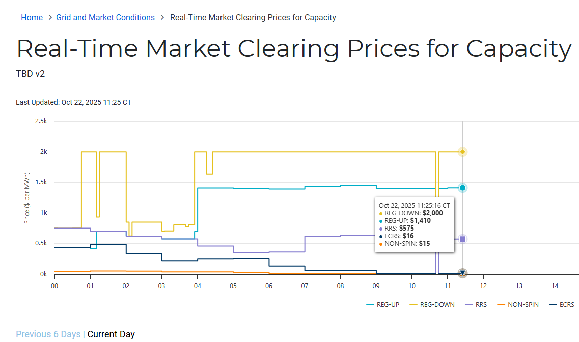
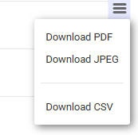
Public Dashboard - Real-Time Clearing Prices for Capacity by SCED Interval Display

Slide 39
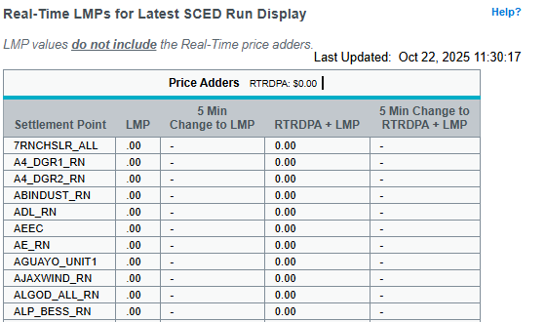
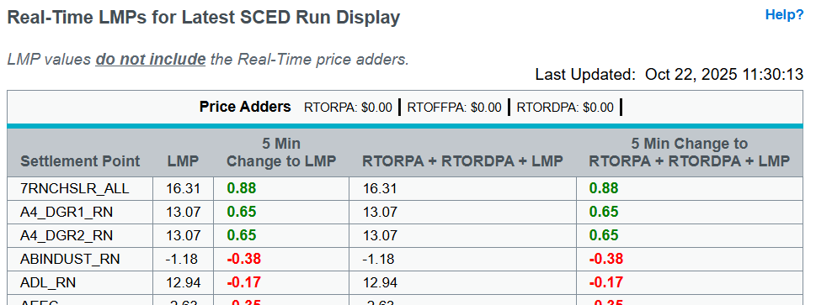
Public Dashboard - Real-Time LMPs for Latest SCED Run Display
RTC
Current

Slide 40
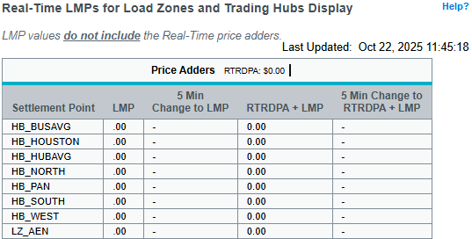
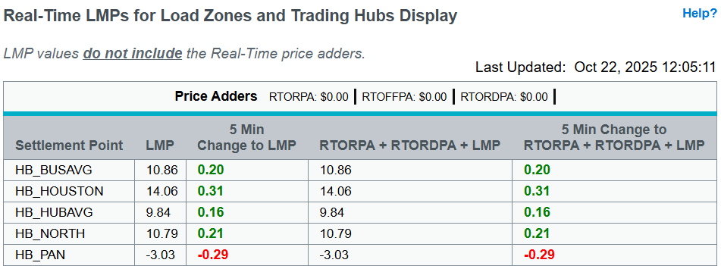
Public Dashboard - Real-Time LMPs for Load Zones and Trading Hubs Display
RTC
Current

Slide 41
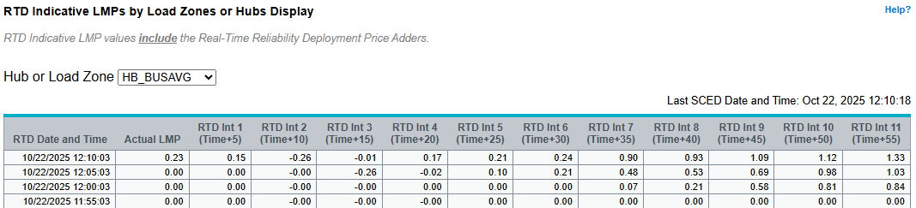
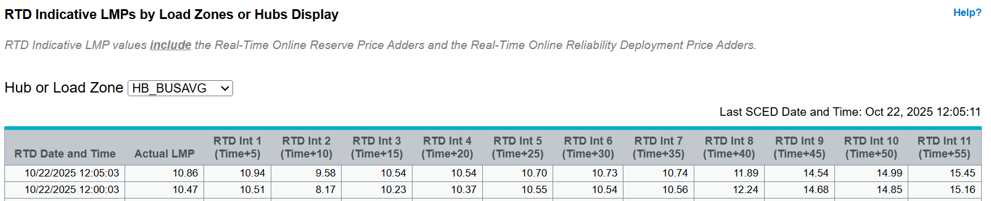
Public Dashboard - RTD Indicative LMPs by Load Zones or Hubs Display
RTC
Current

Slide 42
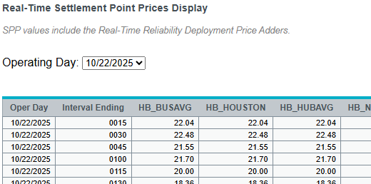
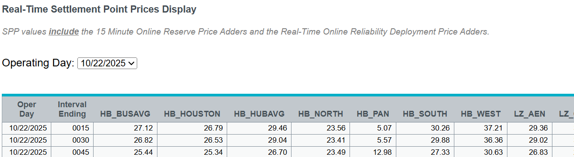
Public Dashboard - Real-Time Settlement Point Prices Display
RTC
Current

Slide 43
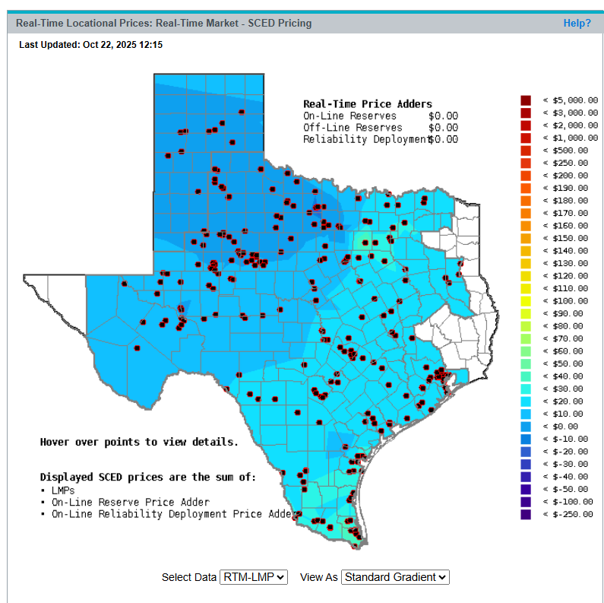
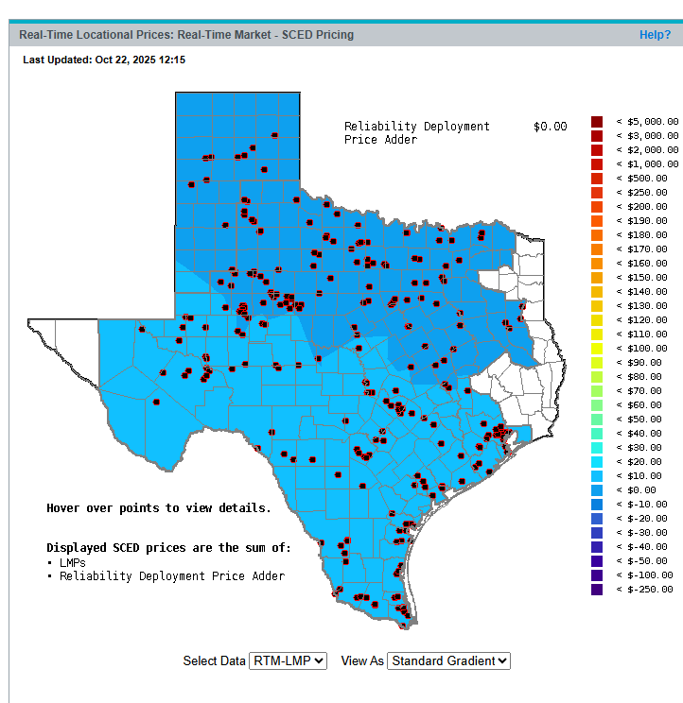
Public Dashboard - Real-Time Locational Prices (LMP Contour Map): LMPs
Current
RTC

Slide 44
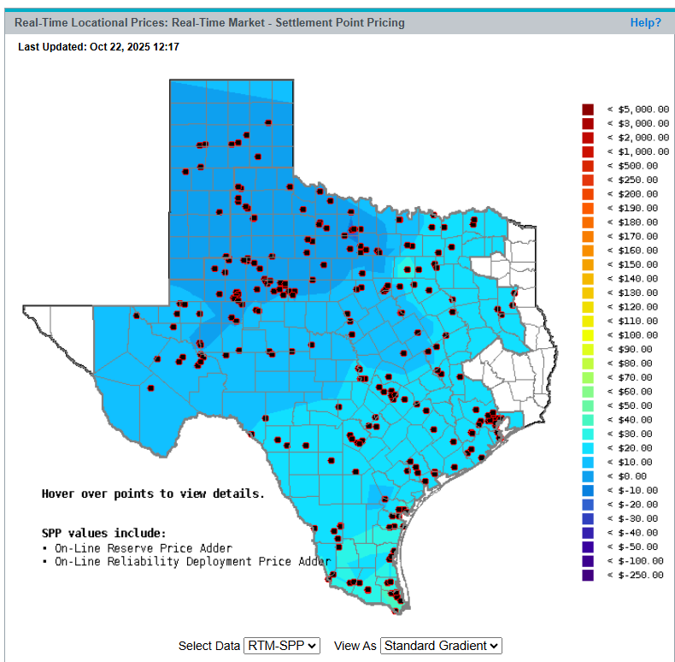
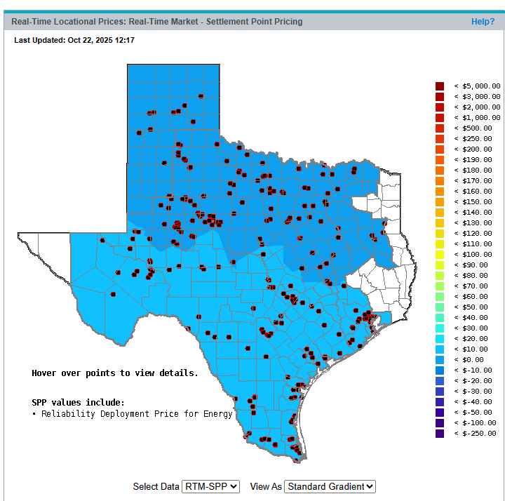
Public Dashboard - Real-Time Locational Prices (LMP Contour Map): SPPs
Current
RTC

Slide 45
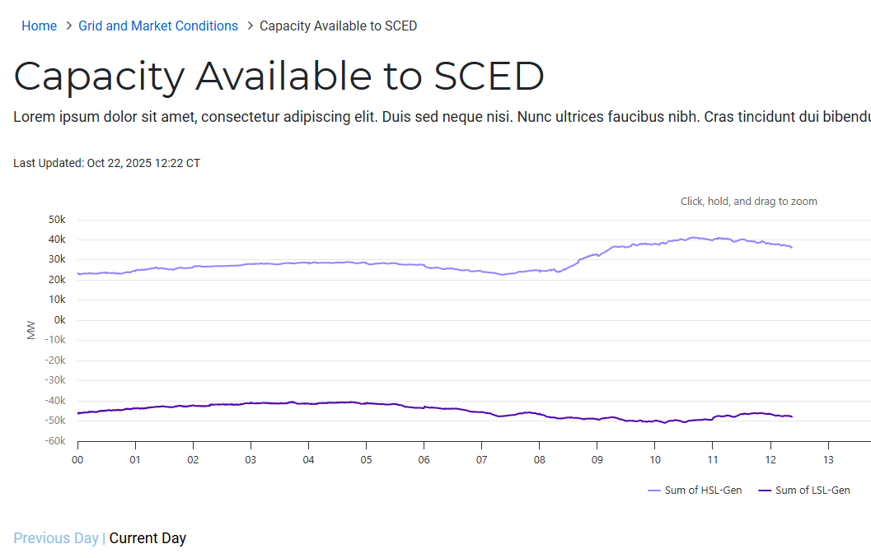
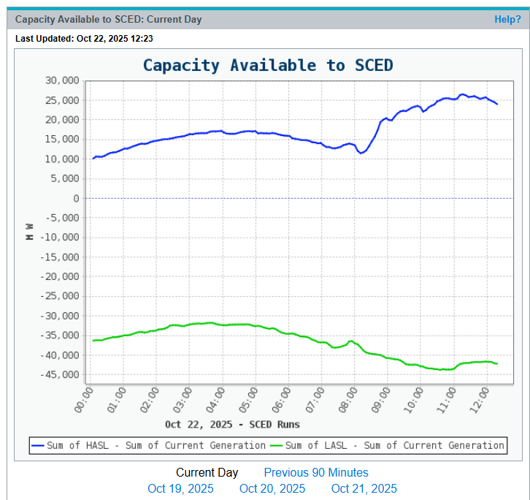
Public Dashboard - Capacity Available to SCED Dashboard
RTC
Current

Slide 46
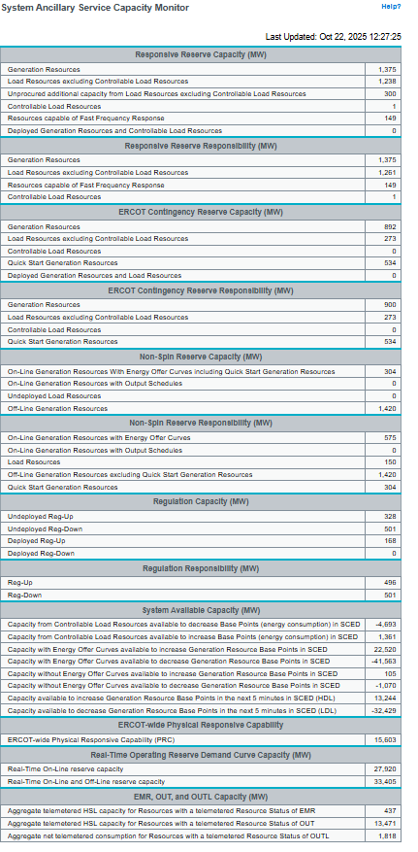
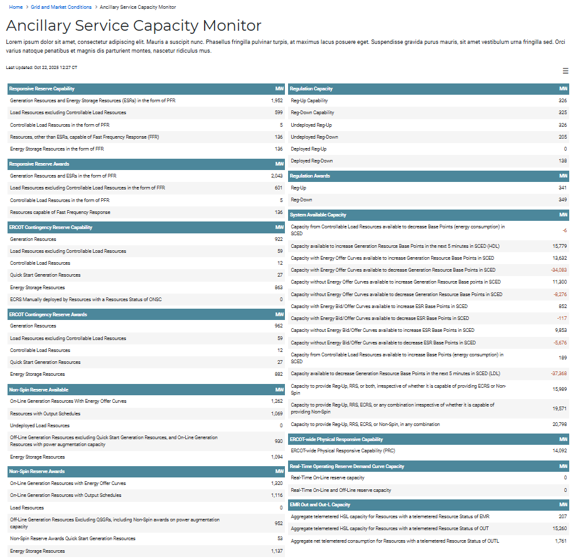
Public Dashboard – System Ancillary Service Capacity Monitor (ASCAPMON)
RTC
Current

Slide 47
Public Dashboard Impact Summary: RTC Go-Live
Report | Change Summary and Details
System Ancillary Services Capacity Monitor (ASCAPMON) Display | Section Heading changes: Replace Capacity with Capability, Replace Responsibility with Awards Column add/mod/removals: See below
Modified Columns | System Available Capacity: Capacity with Energy Offer Curves available to increase Generation Resource Base Points in SCED System Available Capacity: Capacity with Energy Offer Curves available to decrease Generation Resource Base Points in SCED System Available Capacity: Capacity without Energy Offer Curves available to increase Generation Resource Base Points in SCED System Available Capacity: Capacity without Energy Offer Curves available to decrease Generation Resource Base Points in SCED Non-Spin Reserve Capability: Off-Line Generation Resources modified to include NSPIN awards on power augmentation capacity that is not active on online generations resources ECRS Capability: ECRS Deployed Generation Resources and Load Resources

Slide 48
Public Dashboard Impact Summary: RTC Go-Live
Report | Change Summary and Details
System Ancillary Services Capacity Monitor (ASCAPMON) Display | Column add/mod/removals: Continued
Removed Columns | Responsive Reserve Capacity: Deployed Generation Resources and Controllable Load Resources Responsive Reserve Capacity: Unprocured additional capacity from Load Resources excluding Controllable Load Resources Non-Spin Reserve Capacity: On-Line Generation Resources With Energy Offer Curves Non-Spin Reserve Capacity: On-Line Generation Reserves with Output Schedules Non-Spin Reserve Responsibility: Load Resources Non-Spin Reserve Responsibility: Off-Line Generation Resources excluding Quick Start Generation Resources Non-Spin Reserve Responsibility: Quick Start Generation Resources Responsive Reserve Responsibility: Generation Resource s Responsive Reserve Responsibility: Load Resources excluding Controllable Load Resources Responsive Reserve Responsibility: Controllable Load Resources Responsive Reserve Responsibility Resources capable of Fast Frequency Response Regulation Responsibility: Reg-Up Regulation Responsibility: Reg-Down ECRS Capacity: Deployed Generation Resources and Load Resources ECRS Responsibility: Generation Resources ECRS Responsibility: Load Resources excluding Controllable Load Resources ECRS Responsibility: Controllable Load Resources ECRS Responsibility: Quick Start Generation Resources

Slide 49
Public Dashboard Impact Summary: RTC Go-Live
Report | Change Summary and Details
System Ancillary Services Capacity Monitor (ASCAPMON) Display | Column add/mod/removals: Continued
New Columns | Responsive Reserve Capability: RRS Capability from ESRs providing FFR Responsive Reserve Awards: Generation Resource Responsive Reserve Awards: Load Resources excluding Controllable Load Resources Responsive Reserve Awards: Controllable Load Resources Responsive Reserve Awards: Resources Capable of Fast Frequency Response ECRS Capability: ECRS Available ECRS Awards: Generation Resources ECRS Awards: Load Resources excluding Controllable Load Resources ECRS Awards: Controllable Load Resources ECRS Awards: Quick Start Generation Resources ECRS: Awards Ancillary Service Resources awards for ECRS Non-Spin Reserve Capability: Non-Spin Available (Non-Spin Capability ESRs) Non-Spin Reserve Awards: On-Line Generation Resources With Energy Offer Curves Non-Spin Reserve Awards: On-Line Generation Reserves with Output Schedules Non-Spin Reserve Awards: Load Resources Non-Spin Reserve Awards: Off-Line Generation Resources excluding Quick Start Generation Resources Non-Spin Reserve Awards: Quick Start Generation Resources Non-Spin Reserve Awards: Ancillary Service Resources awards for Non-Spin Regulation Capability: Reg-Up Capability Regulation Capability: Reg-Down Capability Regulation Awards: Reg-Up Regulation Awards: Reg-Down System Available Capacity: Capacity to provide Reg-Up, RRS, or both System Available Capacity: Capacity to provide Reg-Up, RRS, ECRS, or any combination System Available Capacity: Capacity to provide Reg-Up, RRS, ECRS, or Non-Spin, in any combination System Available Capacity: Capacity with Energy/Bid Offers available to increase ESR Base Points in the next five minutes in SCED (HDL) System Available Capacity: Capacity with Energy/Bid Offers available to decrease ESR Base Points in the next five minutes in SCED (LDL) System Available Capacity: Capacity without Energy/Bid Offers available to increase ESR Base Points in the next five minutes in SCED (HDL) System Available Capacity: Capacity without Energy/Bid Offers available to decrease ESR Base Points in the next five minutes in SCED (LDL)

Slide 50
RTC Defect Information: CDR
Listed below are any CDR Report defects found during RTC testing which affect reports posted for Market Trials. Updates will be provided as applicable.
  Defect# CDR-1423: RESOLVED
    Real-Time Clearing Prices for Capacity by 15-Minute Settlement | NP6-331-CD | Rpt ID 24898
    Change column name "DeliveryInt" to "DeliveryInterval"
    Current: CDR Group 2 Market Trials version was implemented with “DeliveryInt”
    Fix: By Closed Loop testing the report and XSD will reflect “DeliveryInterval“
  XSD Update
    All Draft RTC XSDs have been posted to the ERCOT Website

