Slide 1
RTC+B Task Force
QSE Cutover Workshop
Matt Mereness
RTCBTF Cutover Workshop for QSEs
November 13, 2025

Slide 2
Outline
Discussion today:
  Scope of RTC+B Program
  Market Trials/Transition Update
  Market Notice Communication walk-through

Slide 3
RTC+B Scope
Final 2025 Refinements for Go-Live
Related NPRRs
within Program

Slide 4
Sequence and Dates for Market Trials to Go-Live
30-day Market Notice
11/5/25
March/April
2025
Start
5/5/25
Start
7/7/25
Start
9/2/25
Go-Live
12/5/25*
May 2025
June 2025
July 2025
Aug 2025
Sep 2025
Oct 2025
Nov 2025
Dec 2025
QSE Scorecards & Exit Criteria for each Trial Phase
RTC QSE Submission Testing
(Submit COP, RT AS Offers,
DAM Virtual AS, Outages for ESRs)
Open-loop RTC SCED
(QSE offers, SCED non-binding award/dispatch)
Ongoing Open-Loop
& Periodic Closed-loop SCED/LFC
(QSE RTC offers and telemetry to support closed-loop frequency control test 2-3 tests of 2-4 hour durations)
Transition to Go-Live
Upon completion of testing, confirmation of ERCOT and market readiness for Go-Live.
QSE/Vendor Submission Sandbox and Telemetry Points added Prod EMS model.
COMPLETED
RTC QSE Telemetry Check-out (QSEs add/verify new telemetry points for UDSP, New ramp rates, ESR telemetry)
QSE Telemetry Tests
(Individual QSE to follow UDSP and support new ramp rate and ESR telemetry)
Day-Ahead Market
(Non-binding DAM using QSE offers for at least 2 tests)
* Go-Live date reflects 12/5/2025 as first Operating Day
where 12/4/2025 is planned software migration.

Slide 5
Sep/Oct Market Trials in-flight
Trials & Transition meetings in-flight every Monday 10-10:30am until December 1-5 (then daily)
  Standalone calendar page each week with WebEx
    RTCBTF Home Page houses all market trials documentation
  Averaging 150-175 participants
  Weekly presentation walk-through with Q&A
    Heavy use of RTCB@ercot.com email -> FAQ
  Link to this Monday’s Trials meeting

Slide 6
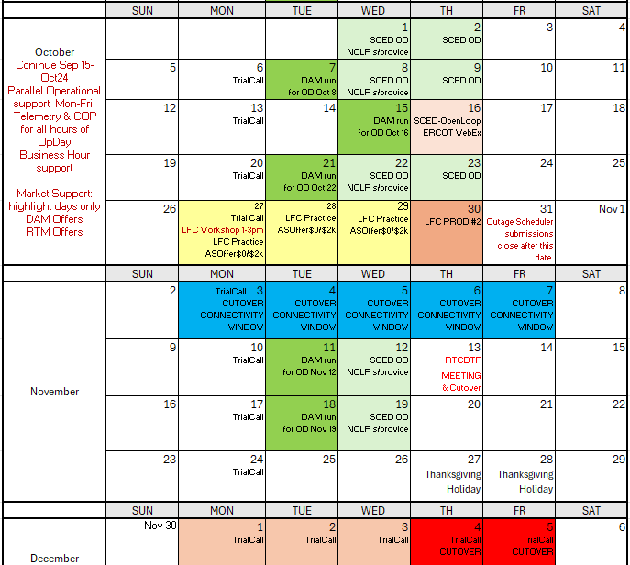
Market Trials and Transition through Go-Live
DST Nov 2
We are here….
NCLR s/provide = NCLR can use self-provision in SCED

Slide 7
Market Notices sent last week
30-day Market Notices sent November 5 across usual channels:
  RTC+B Program Readiness
  RTC+B Protocol Changes
  RTC+B Settlement
  RTC+B Credit
  RTC+B Market Facing changes
Two other Notices
  API End-Point Changes (affects all entities accessing ERCOT XML/API Dec 4/5 impacts)
  QSE without Resources Acknowledgement

Slide 8
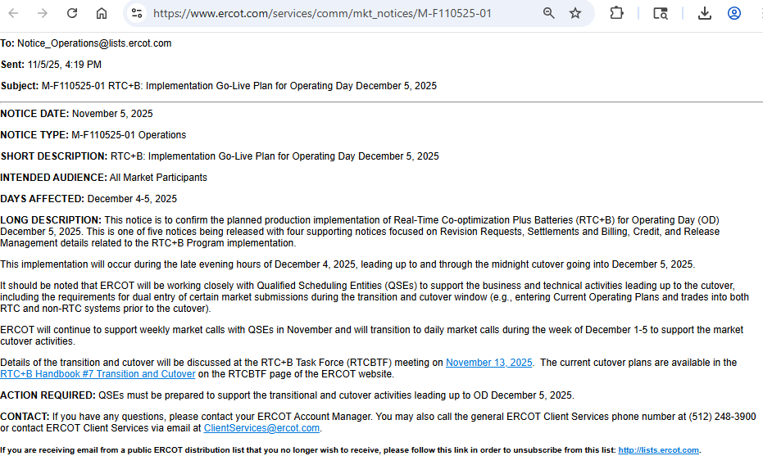
Market Notices sent last week
  RTC+B Program Readiness

Slide 9
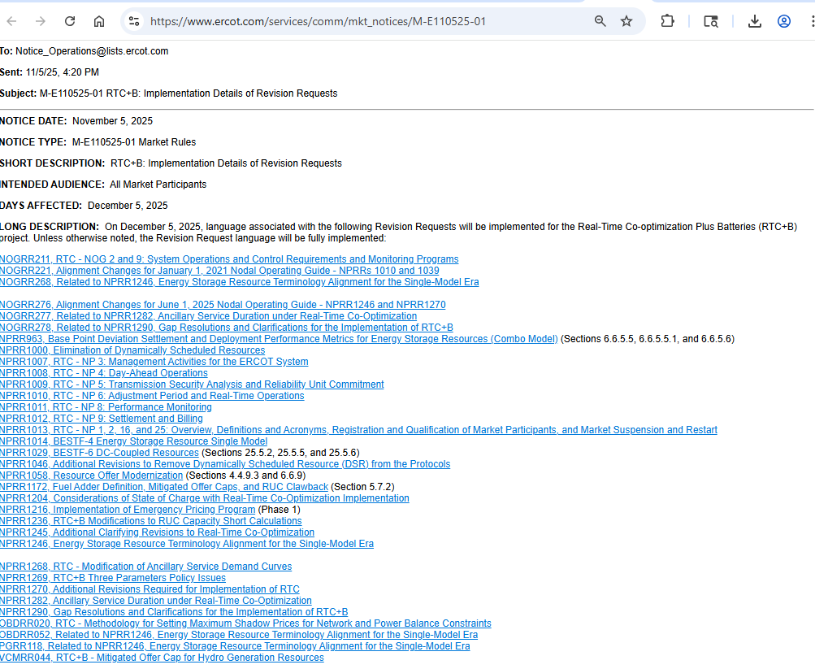
Market Notices sent last week
  RTC+B Protocol Revision Request Changes

Slide 10
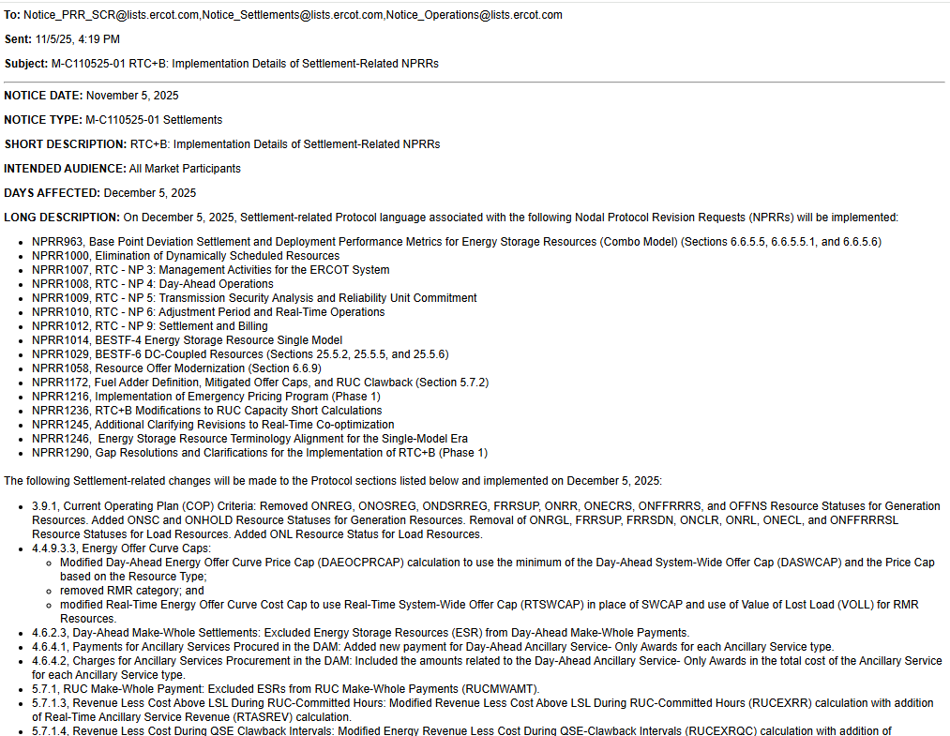
Market Notices sent last week
  RTC+B Settlement

Slide 11
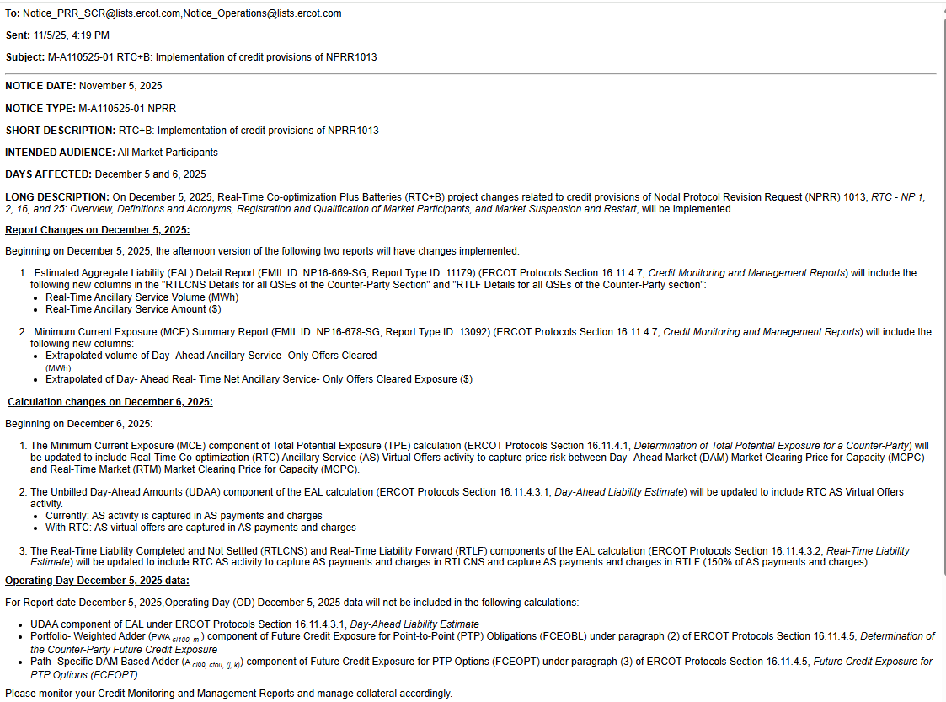
Market Notices sent last week
  RTC+B Credit

Slide 12
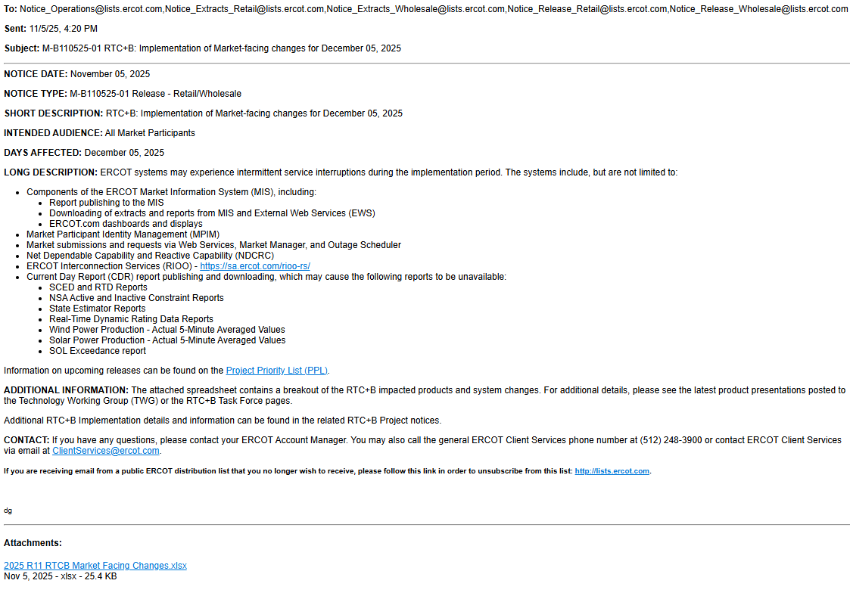
Market Notices sent last week
  RTC+B Market Facing changes

Slide 13
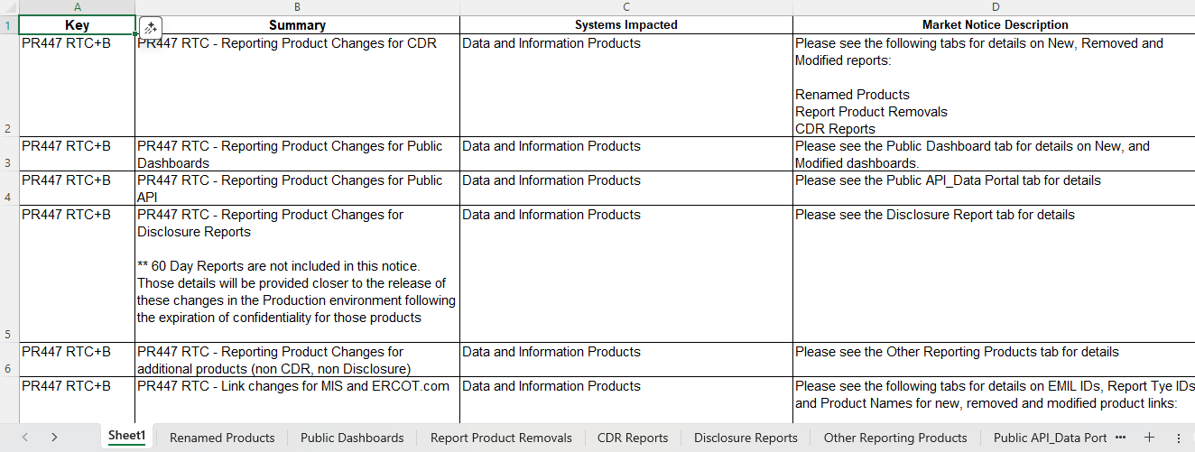
Market Notices sent last week
  RTC+B Market Facing changes

Slide 14
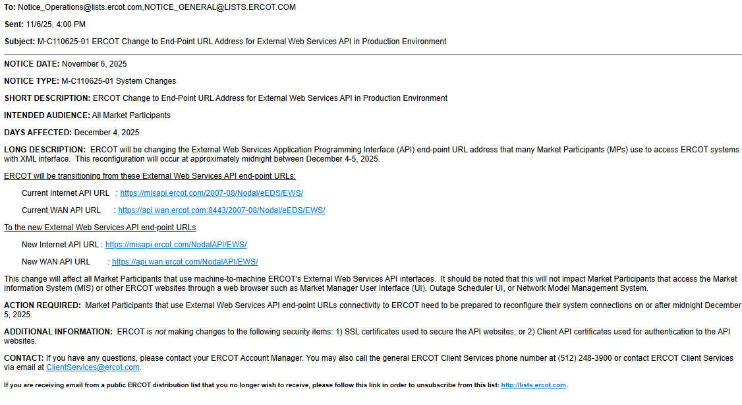
Market Notices sent last week
  API End-Point Changes (affects all entities accessing ERCOT XML/API Dec 4/5 impacts)

Slide 15
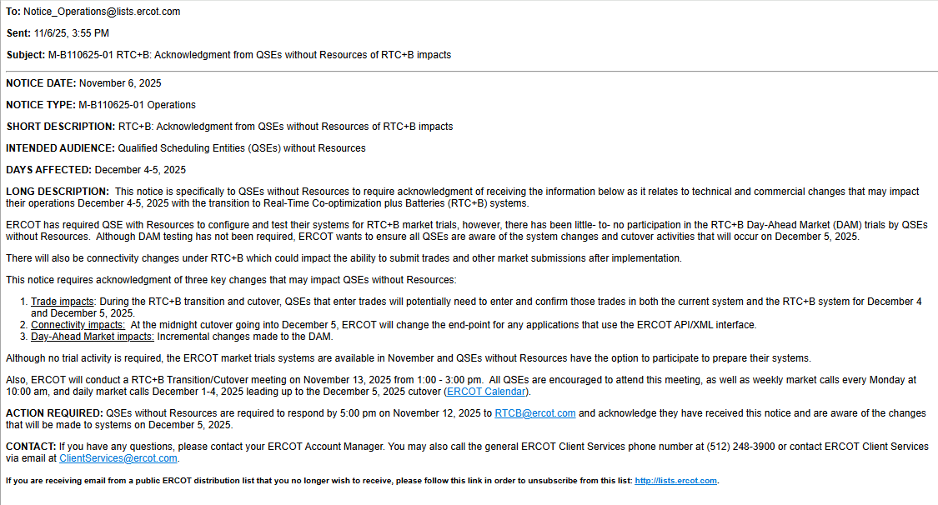
Market Notices sent last week
  QSE without Resources Acknowledgement

Slide 16
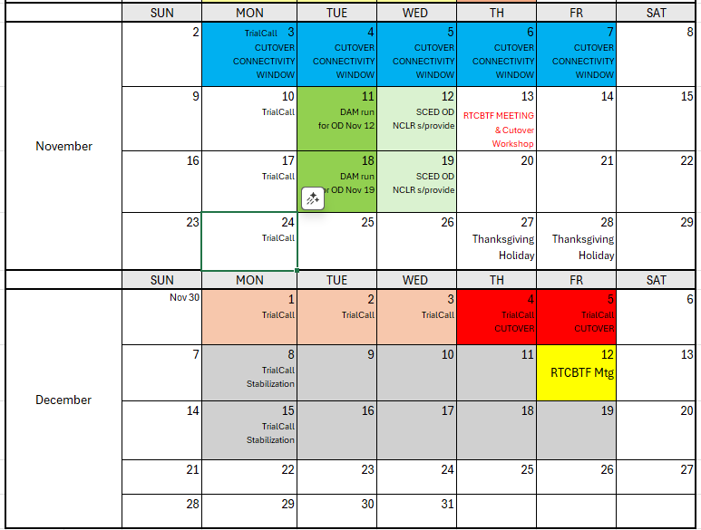
November/December Cutover
Week 2 RTCBTF Workshops for December go-live Cutover
Weeks 2 & 3 Continue Trial Activity
Currently minimal plans week of Thanksgiving

