Slide 1
Critique of ERCOT Analysis and ASDFs for Efficient RTC Design
Shams Siddiqi, Ph.D.
Hunt Energy Network (HEN)
(512) 619-3532
shams@crescentpower.net
RTCBTF Meeting
November 13, 2025

Slide 2
Executive Summary
ERCOT should model reality, not double-count risk. Setting Deployment Factors to zero for services like ECRS and Non-Spin keeps RUC and SCED consistent, prevents unnecessary thermal commitments, and protects customers from higher costs.
Problem: ERCOT’s proposed Deployment Factors (DF > 1) for ECRS and Non-Spin cause a mismatch between how resources are “awarded” in RUC and how they actually operate in SCED. This leads to false RUC scarcity, price suppression, and unnecessary thermal commitments. E.g., if ESRs are already providing these services every five minutes in real time, ERCOT shouldn’t pretend in RUC that they can’t. Doing so forces ERCOT to commit extra gas plants unnecessarily- driving up costs and distorting prices.
Solution: Set DF = 0 for ECRS, Non-Spin, and RRS so that RUC and SCED stay consistent. This aligns modeling with real-time operations, prevents artificial commitments, and ensures ESRs aren’t unfairly penalized. Keep Reg-Up and Reg-Down DFs based on actual deployment history and also use a 4-hour duration for Non-Spin in RUC to reflect energy sustainability needs.
Why: This isn’t a “battery favoritism” issue — it’s about market integrity and accurate modeling:
Consistency: RUC and SCED should use the same assumptions to avoid inconsistency.
Efficiency: Avoids unnecessary thermal commitments.
Fairness: Prevents un-hedgeable RUC short charges for ESRs.
Reliability: Still ensures all services meet their energy-duration requirements.

Slide 3
Stakeholder Call to Action
Stakeholders had historically taken the lead in designing the ERCOT market – Stakeholders need to lead on RTC design related issues like this, AORDC/ASDC design to reflect AS scarcity values, and mechanisms to ensure adequate SOC control by ESRs under RTC
For RTC go-live, let’s align DFs with operational reality — DF = 0 for ECRS, Non-Spin, and RRS ensures efficient, reliable, and fair market outcomes. Let’s also make the obvious change of making duration requirements consistent between RUC and SCED.

Slide 4
ERCOT Justification for Inconsistent SCED-RUC Duration Flawed
ERCOT recognizes that what I pointed out in terms of possible RUC unnecessary commitment and ESR RUC capacity short charge due to inconsistent RRS duration in RUC and SCED:
Correlating RUC AS Duration to SCED is only impactful in case of how RUC treats RRS “awards” with the proposed RRS-ASDF=0.
Example, 100MW ESR with 50MWh SOC will be awarded 100MW of RRS in SCED (since Duration is 30 minutes in SCED) whereas RUC will only “award” 50MW.
ERCOT’s following claim is flawed for ESRs with greater than 1-hour SOC capacity:
Lastly, in case of Non-Spin the qualification criteria will ensure that RUC does not award an ESR at MW levels SCED can’t (i.e., the qualification prevents RUC from thinking a 100 MWh ESR can provide anything beyond 25 MW)
E.g., 4-hour 100MW ESR would be qualified for 100MW Non-Spin. With inconsistent 1-hour duration in RUC, if the ESR had only 100MWh SOC, it may be “awarded” 100MW Non-Spin whereas the maximum Non-Spin award in SCED is 25MW. RUC over-credits Non-Spin leading to possible RUC under-procurement of Non-Spin which is a Reliability exposure for the grid
The obvious correct answer: RUC and SCED durations must always be consistent
RUC duration>SCED duration
Extra RUC
Price Suppression
ESR Exposure
RUC duration<SCED duration
RUC under-procurement
Reliability Exposure

Slide 5
ERCOT Analysis of Non-Spin Deployment is Flawed
DFs only apply to ESRs, ESRs can only provide online Non-Spin, and typically ESRs’ EOC is greater than $75/MWh EOC floor for Non-Spin whereas Non-ESR EOC is closer to $75/MWh
Implies ESRs are last to be deployed by SCED – ERCOT’s use of any Non-Spin deployment over-estimates ESR deployment
At a minimum, ERCOT analysis should be based on ESR deployments – not all Non-Spin deployments
But, more fundamentally, ERCOT analysis is flawed because of the difference between how online Non-Spin has been deployed in the current market v. how Non-Spin “awarded” by RTC RUC is not awarded to AS Plan amount in favor of awarding Energy in RTC SCED
Current Non-Spin deployment simply implies that LMP>EOC (i.e., $75/MWh for non-ESRs) – this in no way implies RTC SCED will go short Non-Spin and award Energy
When RTC SCED awards Energy to marginal or inframarginal capacity (LMP>=EOC) that was previously not awarded (LMP<EOC), then RTC SCED simply awards Non-Spin to other capacity with EOC>LMP
Only in scarcity and RUC under-forecast is it possible that RUC “awards” AS Plan Non-Spin but SCED is unable to award AS Plan amounts due to Energy awards. However, if the RUC forecast is “conservative,” then RUC also will not be able to “award” AS Plan amount of Non-Spin – those instances should not impact DFs
Assuming RUC always under-forecasts, a high Non-Spin “deployment” (i.e., RUC awards Non-Spin but SCED can’t) estimate would be the RT Operating Reserve (RTOLCAP+RTOFFCAP) falling below total AS Plan MW by some percentage of Non-Spin MW (since ESRs are near the last RUC Non-Spin “awards” to be awarded Energy by SCED due to relatively high EOCs)

Slide 6
Severe Scarcity Day: May 13, 2022, Non-Spin Deployments
Assume RUC under-forecasted reserves by 2,422MW with no Resources to commit in time
If all Non-Spin were provided by ESRs (not likely for foreseeable future), DFs are 23-85% in 5 tightest hours
If 50% Non-Spin were provided by ESRs (very conservative approach), DFs are 5-8% in 5 tightest hours

Slide 7
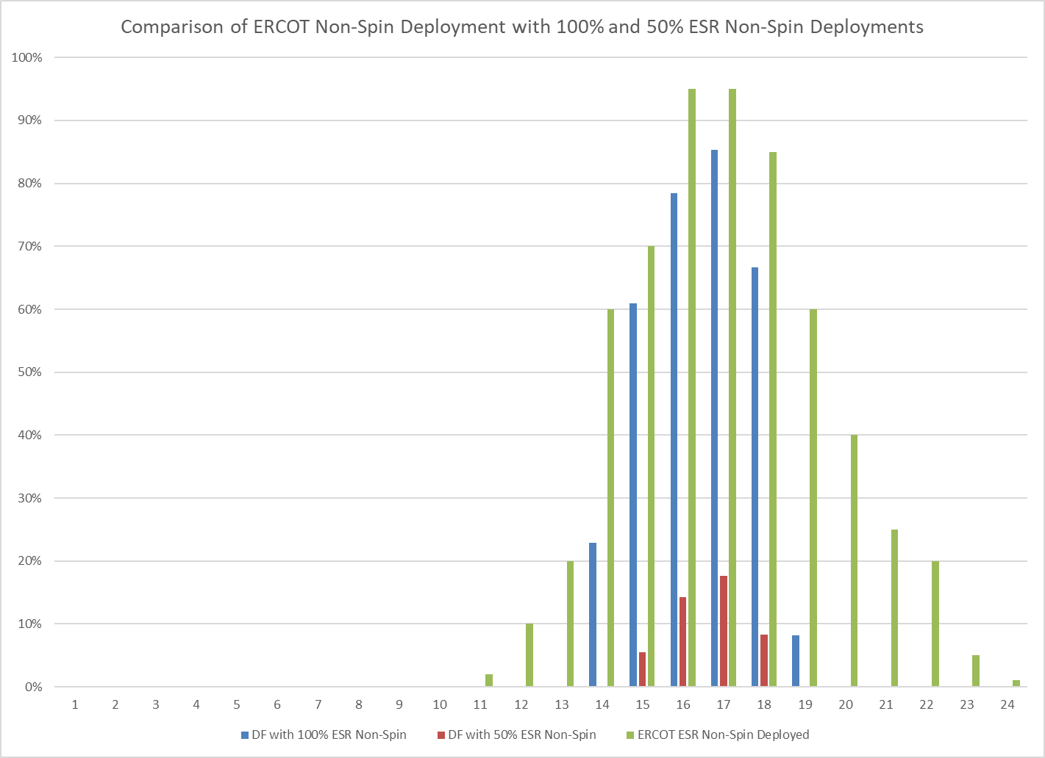
Comparison of May 13, 2022, Non-Spin Deployments
ERCOT’s flawed analysis results in significantly over-estimated deployments
Even if all Non-Spin were provided by ESRs, ESRs would need 3.2 hours SOC to provide sufficient Energy for this day – less than the 4-hour SOC duration requirement. With DF=0, ESRs would still have enough SOC for this very scarce day
With 50% Non-Spin provided by ESRs (still conservative), only 0.5 hour SOC needed for this day

Slide 8
ERCOT DFs = Significant RUC Over-Commitment and Resulting RT AS and Energy Price Suppression
ERCOT recommends using 95th percentile deployment values (top 20 days in a year) for Non-Spin based on its flawed estimates
This implies that if May 13, 2022, is a day that sets DFs, ESRs would need an additional 5.9 hours of SOC on top of their duration requirement to be awarded Non-Spin not just for a similar day but for every day of the year
HEN’s analysis shows that only 0.5 to 3.2 hours SOC is sufficient Energy for this day – less than the 4-hour SOC duration requirement. With DF=0, ESRs would still have enough SOC for this very scarce day.
ERCOT set the duration requirements based on having sufficient SOC for such scarcity days – now they are double counting for that same risk by requiring roughly twice that amount of SOC in RUC
Obviously, this implies that these DFs are over-estimating deployments 95% of the time, i.e., 345 days of the year! This may lead to RUC over-commitments 345 days of the year and unnecessary price suppression for all those days. The offer floor for RUCed Resources must be significantly increased to better undo this price suppression.
ERCOT provides no analysis or justification for setting ECRS DF at 75% of Non-Spin DF
Correct answer: DF=0 for RRS, ECRS, and Non-Spin with consistent RUC and SCED durations

Slide 9
Obvious Change: Consistent RUC and SCED Duration Req.
ERCOT now acknowledges the distortions created by having inconsistent duration requirements in RUC and SCED but incorrectly states that the same issue does not apply to Non-Spin.
ERCOT provides no justification as to why the duration requirements should be inconsistent between RUC and SCED.
ERCOT’s recommendation of 1-hour RUC duration for Non-Spin with DFs that add up to 3.25 hours is nearly the same as setting a 4-hour RUC duration for Non-Spin except for the RUC and SCED inconsistencies that it creates – why not achieve the same goal by setting 4-hour RUC duration for Non-Spin and solve multiple issues?
With the changes in the table below, SCED awards and RUC “awards” will be consistent – avoiding unnecessary RUCs resulting in price suppression and exposure that can’t be hedged and unwarranted RUC short exposure for ESRs
*Note FRRS is being eliminated with RTC.
AS Type | Real Time |  | Qualification |  | RUC
 | Duration | Protocol Reference | Duration | Protocol Reference | Duration
Regulation Service* | 30 minutes | 8.1.1.3.1 (2) | 30 minutes | 8.1.1.2.1.1 (5) | 30 minutes
Responsive Reserve Service (excluding FFR) | 30 minutes | 8.1.1.3.2 (4) | 30 minutes | 8.1.1.2.1.2 (9) | 30 minutes
ERCOT Contingency Reserve Service | 1 hour | 8.1.1.3.4 (2) | 1 hour | 8.1.1.2.1.7 (3) | 1 hour
Non-Spinning Reserve Service | 4 hours | 8.1.1.3.3 (2) | 4 hours | 8.1.1.2.1.3 (8) | 4 hour

Slide 10
Bad DFs result in Increased RUCs and Unwarranted ESR Exposure
ERCOT’s proposed DF>0 for ECRS and Non-Spin and Non-Spin Duration of 1-hour results in terrible outcomes.
Consider self-committed thermals exactly meet net load for the day with 3,000MW of additional offline thermals and 3,000MW of ESR with HB-SOC=3,000MWh for all hours of the day which accurately reflects SCED outcomes [Note: if the ESR charges and discharges within this day, then, of course, the HB-SOC should reflect such charging/discharging]
For all hours where ECRS DF>1, RUC cannot “award” ECRS any of the 3,000MW ESR and must RUC and “award” 3,000MW of thermals to meet AS Plan (assuming cost of RUC commitment is below RUC ECRS ASDC)
In SCED, 3,000MW ESR will be awarded 3,000MW ECRS for all 5-minute intervals of the day
If these ESRs had DAM or bilateral sales, then ESRs are charged RUC short charges (due to snapshot at time of RUC) even though in SCED they provided ECRS all day!
Market distortions: price suppression due to 3,000MW of totally unnecessary thermal RUC (thermals may experience operational issues/limits), unjustified RUC short charges to ESRs and other shorts, distort ESR DAM and bilateral participation,
With 1-hour Non-Spin duration, consider 3,000MW of ESR with HB-SOC=3,000MWh and DF=0.5.
If HB-SOC=1,500 for next hour, RUC may “award” 3,000MW of Non-Spin to ESRs in this hour. This is totally inconsistent with SCED which would award at most 750MW of Non-Spin to ESRs in that hour.
Of course, DF>1 for Non-Spin has the same issues as described for ECRS above.
Table below shows the impact of these recommendations in red text.

Slide 11
Solution: DF=0 for ECRS & Non-Spin; 4-hour Non-Spin Duration
Consider self-committed thermals exactly meet net load for the day with 3,000MW of additional offline thermals and 3,000MW of ESR with HB-SOC=3,000MWh for all hours of the day [Note: if the ESR charges and discharges within this day, then, of course, the HB-SOC should reflect such charging/discharging]
With ECRS DF=0, RUC can “award” ECRS to all 3,000MW ESR and would not RUC thermals to meet AS Plan
In SCED, 3,000MW ESR will be awarded 3,000MW ECRS for all 5-minute intervals of the day
If these ESRs had DAM or bilateral sales, then ESRs are not exposed to RUC short charges
RUC and SCED consistency avoids unnecessary RUC, price suppression and unwarranted ESR exposure
ECRS and Non-Spin awarded ESRs both in SCED and RUC always maintain 1-hour and 4-hour SOC in order to meet any forecast or other uncertainties as ERCOT has argued for,
With 4-hour Non-Spin duration, consider 3,000MW of ESR with HB-SOC=12,000MWh for all hours and DF=0 [Note: ERCOT proposes 1-hour Non-Spin duration – 4-hour Non-Spin duration is reserving enough SOC equivalent to 1-hour duration plus DF=1 for solar ramp-down hour +/- 1-hour but in a manner consistent with SCED.
RUC can “award” 3,000MW of Non-Spin to ESRs for the entire day. This is totally consistent with SCED which would award 3,000MW of Non-Spin to ESRs for all intervals in that day.
DF=0 for RRS, ECRS and Non-Spin is the correct value for RTC Go-Live and thereafter – this value should not be adjusted after Go-Live for reasons above.
Today’s highly conservative RUC has DF=0 for all AS, including Reg-Up and Reg-Down.
Today, ESRs can provide AS with much less SOC than the corresponding AS duration requirements; under RTC and these changes, ESRs must have SOC sufficient to meet corresponding AS duration requirements to be awarded AS in SCED and RUC.

