Slide 1
Guaranteed Reliability Load (GRL) — Operations
Planning Working Group 11/18/25

Slide 2
Summary
Concept:
  Large loads are allowed to bring load on earlier
  Must provide ability to curtail load that is not available in studies
  Once transmission solutions are built load no longer needs to offer
Current thinking: a SCED-based approach will work for GRL curtailment and recovery.
Possible Operational Automation: a tool may be needed to automatically lower offers when reliability events occur.
Discussion of 100 hour limit
Without an hour cap, implementation is streamlined and relatively easy.

Slide 3
Why SCED Works for GRL
Uses the existing systems managing constraints
Curtails GRL economically and locationally as scarcity/congestion arises; restores smoothly as it clears
Preserves nodal granularity; respects transmission constraints and limits operator workarounds
Minimizes new constructs—no parallel manual curtailment stack required
Telemetry would be needed: basepoint MW, ramp limits, and (if applicable) on‑site generation status
Consideration should be given to shift factor relationships and constraint violations

Slide 4
Auto‑Lowering Offer Tool
Due to SF relationships and Constriant Violation Limits, Loads may not be operated for violations
  Relationship should be considered to right size offer caps if needed
    High enough not to operate for normal power balance
    Low enough to operate for local transmission constraints
  Could raise Constraint Violation levels to allow for better operation
    345kV is currently at $4,500/MWh
ERCOT raised potential of an automated tool to lower offer curves during certain contingency violations
  Most likely use of Mitigated Offer Caps

Slide 5
100 Hour Limit Proposal
In comments Google requests a 100 hour limit be imposed
  Market needs some tool to manage risk
  Billions of dollars of investment that could be idled
Limit would cause load to be treated as Firm if reached
  Can cause problems with cascading failures
Need to strike a balance
  System security vs. participation
Is there an alternative that could work for both?
  Notification of future outages
  Structures or processes that limit potential exposure

Slide 6
CLR PGRR Filed (PGRR134)
New PGRR filed with same basic concepts but formalizes CLR use
May be merged with or take place of NPRR1284
Look forward to discussions on that PGRR today

Slide 7
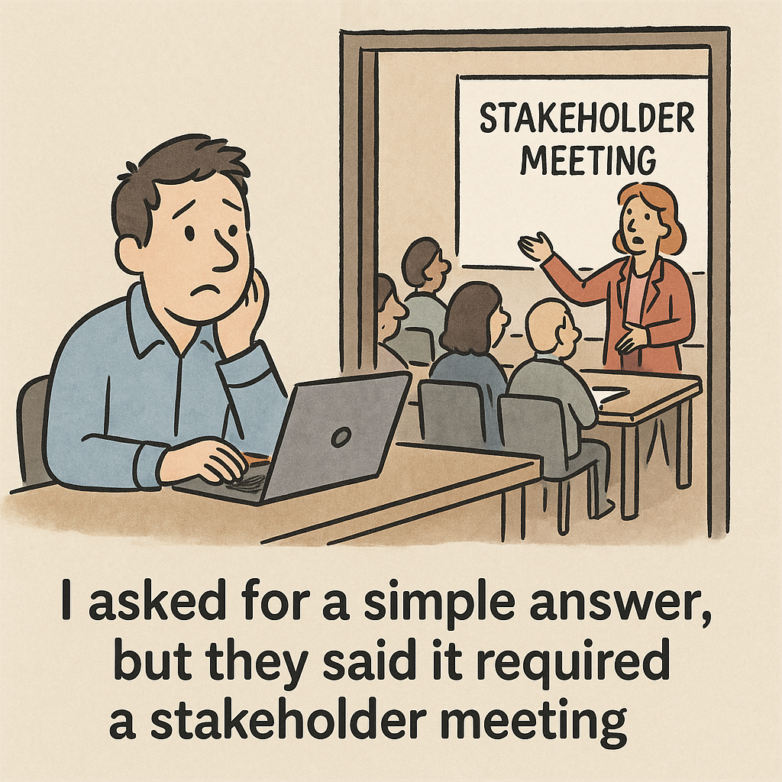
Questions?

