Slide 1
Credit Exposure Update
Credit Finance Sub Group
ERCOT Public
November 14, 2025

Slide 2
Monthly Highlights: September 2025 – October 2025
Market-wide average Total Potential Exposure (TPE) was flat at $1.57 billion in September and October
Forward adjustment factors and real-time prices were mostly flat during the month
Discretionary Collateral is defined as Secured Collateral in excess of TPE,CRR Locked ACL and DAM Exposure
Average Discretionary Collateral slightly decreased from $ 4.04 billion in September compared to $3.97 billion in October
No unusual collateral call activity

Slide 3
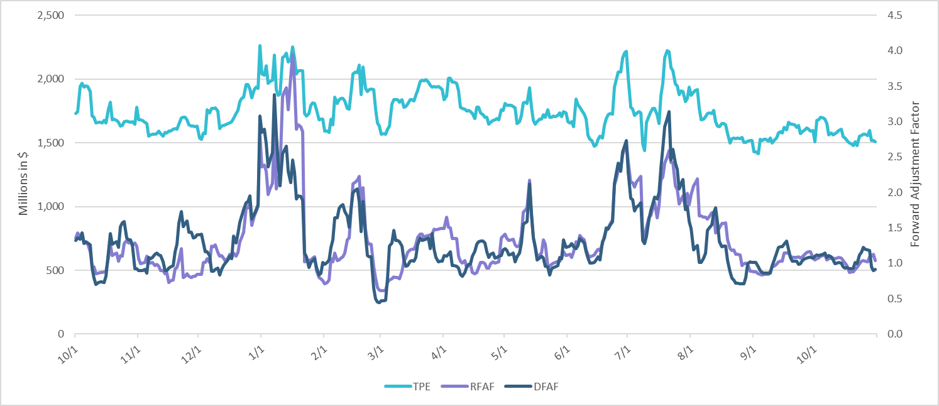
TPE and Forward Adjustment Factors: October 2024 – October 2025

Slide 4
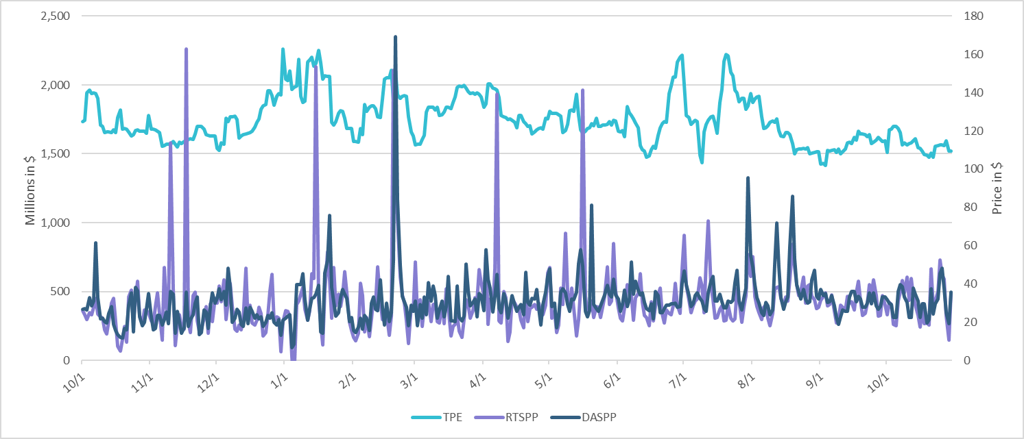
TPE/Real-Time & Day-Ahead Daily Average Settlement Point Prices for HB_NORT:H October 2024 – October 2025

Slide 5
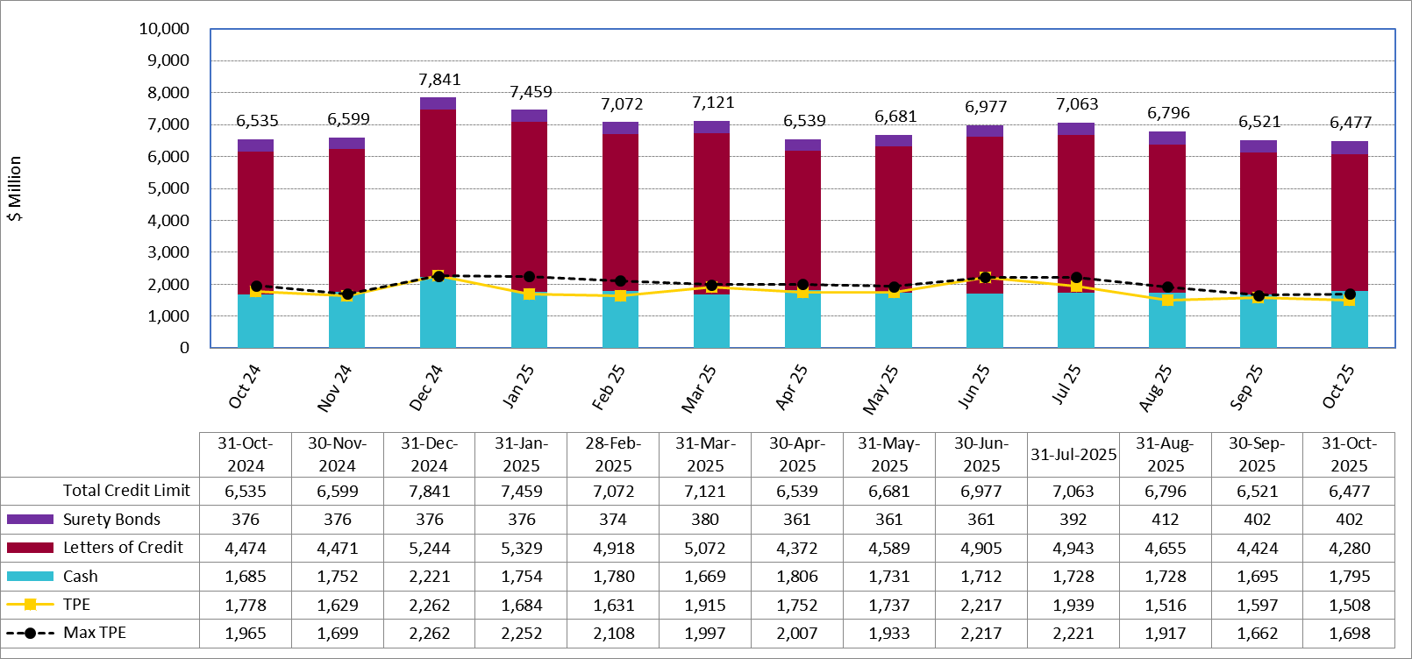
Available Credit by Type Compared to Total Potential Exposure (TPE): October 2024 – October 2025
Numbers are as of month-end except for Max TPE
Max TPE is the highest TPE for the corresponding month

Slide 6
Issuer Credit Limits vs Total LC Amounts Per Issuer: October 2025
As of October 31, 2025
There are a total of 36 banks that have issued LCs.

Slide 7
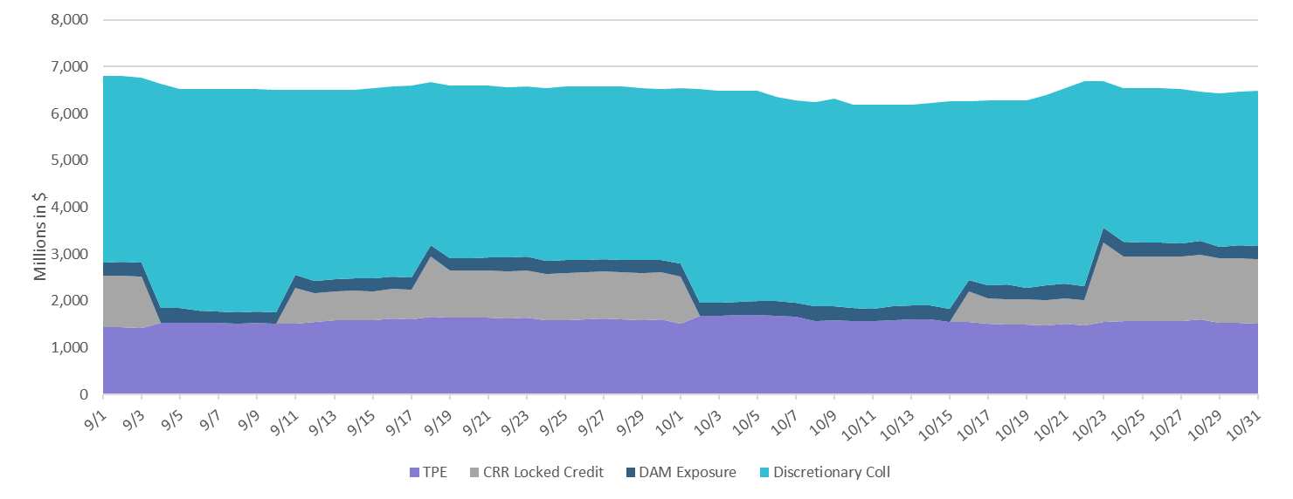
Discretionary Collateral September 2025 – October 2025

Slide 8
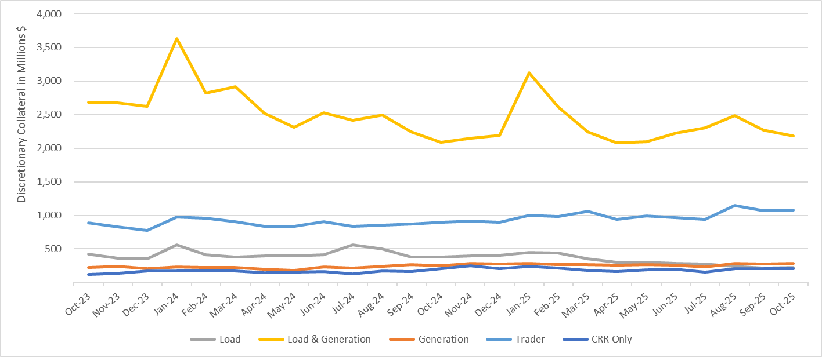
Discretionary Collateral by Market Segment October 2023 - October 2025

Slide 9
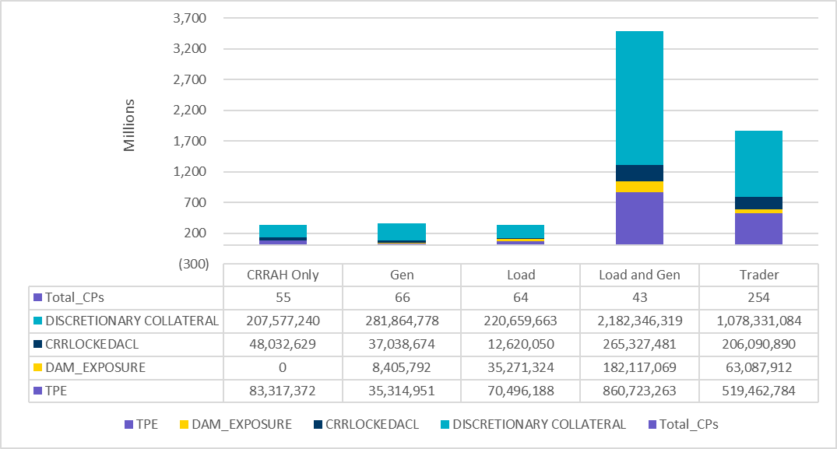
TPE and Discretionary Collateral by Market Segment - October 2025
Load and Generation entities accounted for the largest portion of discretionary collateral

Slide 10
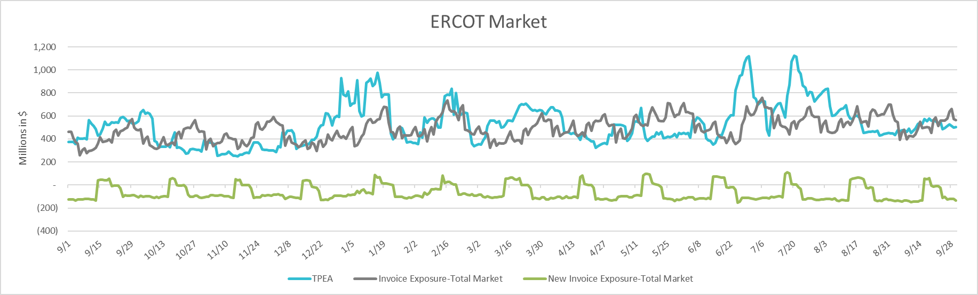
TPEA Coverage of Settlements September 2024 - September 2025
Invoice Exposure | Historical | Future
Existing Invoice Exposure | RTLCNS + UDAA | M1 Days (including current day) Forward Charge Invoice Amounts
New Invoice Exposure | 7 Days Back Net Invoice Amounts (Charges & Credits) | M1 Days (including current day) Forward Net Invoice Amounts (Charges & Credits); Excluding: 1) Securitization Invoices; 2) CRR Auction Invoices; and 3) Subchapter N Funds Distribution Invoice

Slide 11
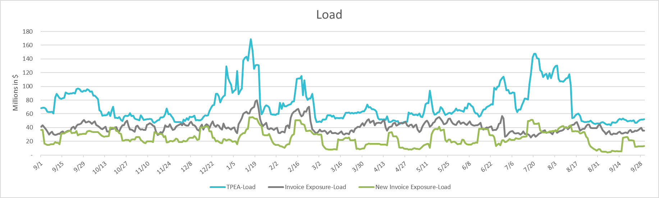
TPEA Coverage of Settlements September 2024 - September 2025
Invoice Exposure | Historical | Future
Existing Invoice Exposure | RTLCNS + UDAA | M1 Days (including current day) Forward Charge Invoice Amounts
New Invoice Exposure | 7 Days Back Net Invoice Amounts (Charges & Credits) | M1 Days (including current day) Forward Net Invoice Amounts (Charges & Credits); Excluding: 1) Securitization Invoices; 2) CRR Auction Invoices; 3) Subchapter N Funds Distribution Invoice

Slide 12
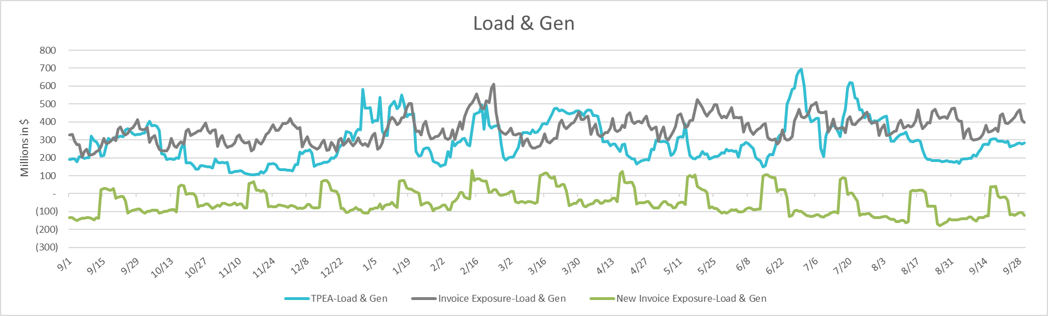
TPEA Coverage of Settlements September 2024 - September 2025
Invoice Exposure | Historical | Future
Existing Invoice Exposure | RTLCNS + UDAA | M1 Days (including current day) Forward Charge Invoice Amounts
New Invoice Exposure | 7 Days Back Net Invoice Amounts (Charges & Credits) | M1 Days (including current day) Forward Net Invoice Amounts (Charges & Credits); Excluding: 1) Securitization Invoices; 2) CRR Auction Invoices; 3) Subchapter N Funds Distribution Invoice

Slide 13
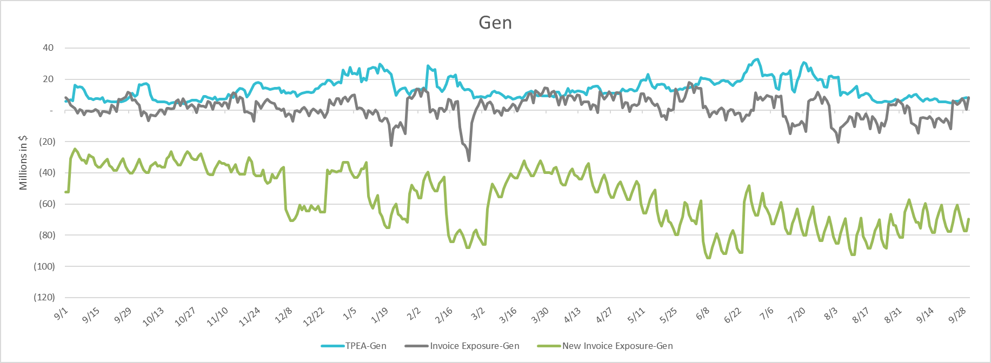
TPEA Coverage of Settlements September 2024 - September 2025
Invoice Exposure | Historical | Future
Existing Invoice Exposure | RTLCNS + UDAA | M1 Days (including current day) Forward Charge Invoice Amounts
New Invoice Exposure | 7 Days Back Net Invoice Amounts (Charges & Credits) | M1 Days (including current day) Forward Net Invoice Amounts (Charges & Credits); Excluding: 1) Securitization Invoices; 2) CRR Auction Invoices; 3) Subchapter N Funds Distribution Invoice

Slide 14
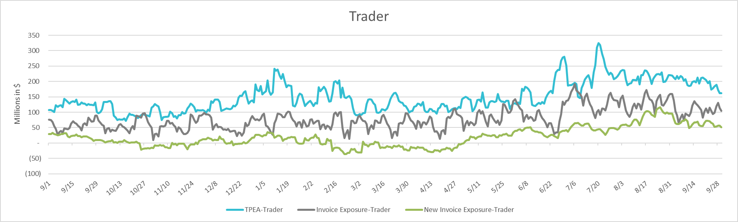
TPEA Coverage of Settlements September 2024 - September 2025
Invoice Exposure | Historical | Future
Existing Invoice Exposure | RTLCNS + UDAA | M1 Days (including current day) Forward Charge Invoice Amounts
New Invoice Exposure | 7 Days Back Net Invoice Amounts (Charges & Credits) | M1 Days (including current day) Forward Net Invoice Amounts (Charges & Credits); Excluding: 1) Securitization Invoices; 2) CRR Auction Invoices; 3) Subchapter N Funds Distribution Invoice

Slide 15
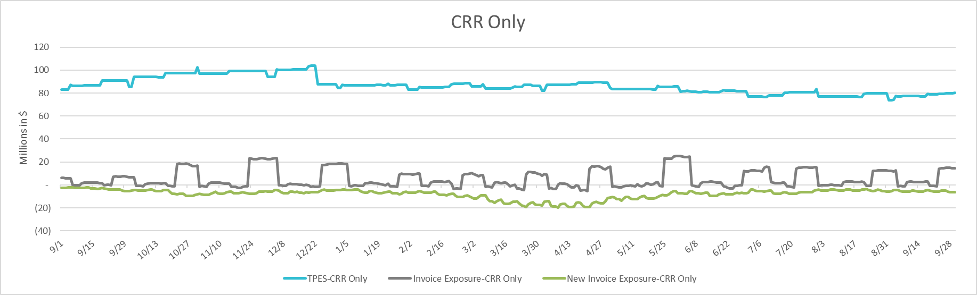
TPEA Coverage of Settlements September 2024 - September 2025
Invoice Exposure | Historical | Future
Existing Invoice Exposure | RTLCNS + UDAA | M1 Days (including current day) Forward Charge Invoice Amounts
New Invoice Exposure | 7 Days Back Net Invoice Amounts (Charges & Credits) | M1 Days (including current day) Forward Net Invoice Amounts (Charges & Credits); Excluding: 1) Securitization Invoices; 2) CRR Auction Invoices; 3) Subchapter N Funds Distribution Invoice

Slide 16
Questions

