Slide 1
Market Participant Guide
for Dashboard Roadmap & Submission for Feedback
Amy Lofton
Manager, ERCOT Digital Content Management
PRS, Other Business
November 12, 2025

Slide 2
Purpose & Overview
Communicate and define the new process for dashboard feedback
Demonstrate form submission process
  New dashboards
  Change to an existing dashboards
  Ability to vote on request
  Display of submitted proposed changes on ERCOT.com; link will be on the
  Grid and Market Conditions page for transparency

Slide 3
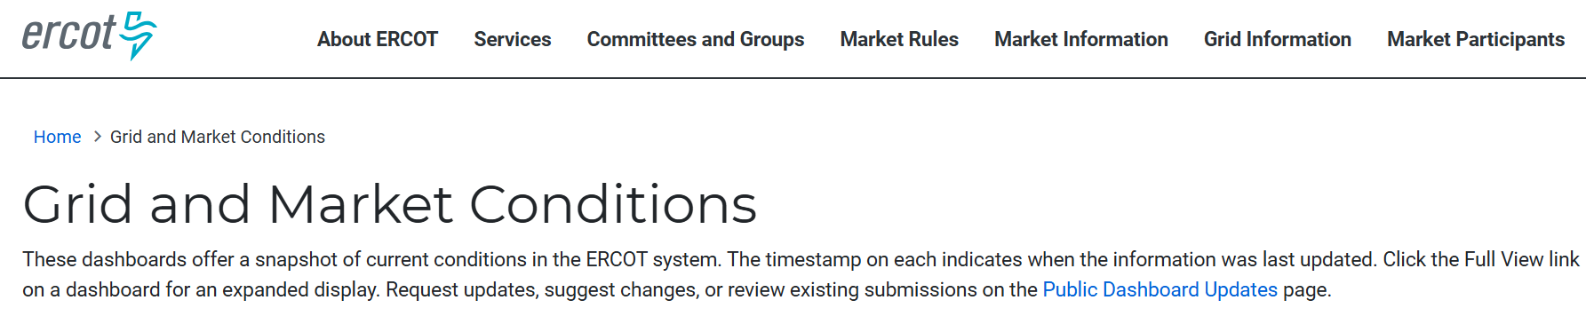
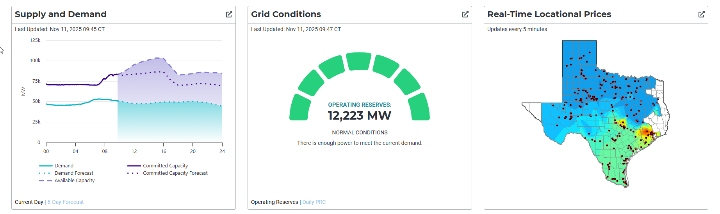
Steps to Submit & View Requests
Access the new page from the Grid or Market Conditions pages.

Slide 4
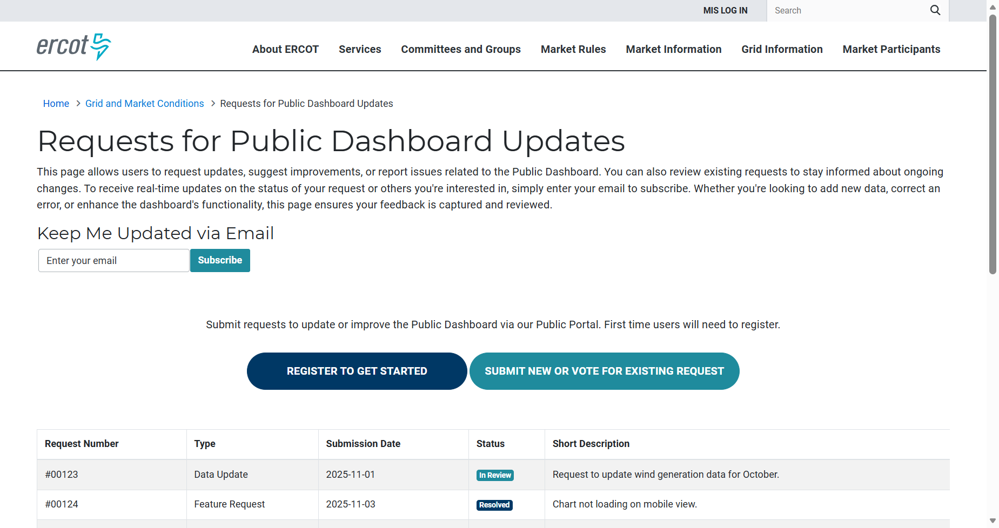
Steps to Submit Request
Request updates, review existing requests, or subscribe to notifications.

Slide 5
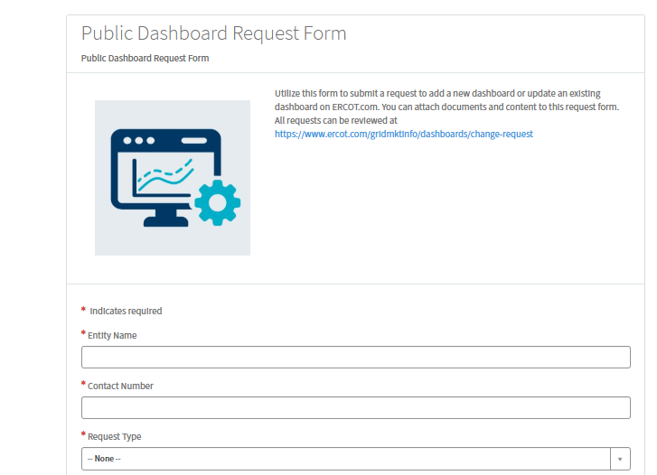
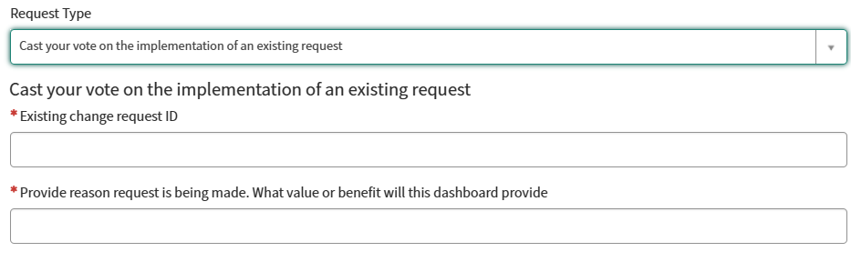
Complete & Submit Form in Public Portal
Submit a new change request or vote on an existing one.

Slide 6
Questions & Contact Info
ERCOT does not make any assurance that requests will be adopted. All requests will be considered and, if granted, will be worked on according to ERCOT's timeline for dashboard enhancements and requests.
Contact Us: webmaster@ercot.com.
Feedback is also received via the ERCOT committees and groups.

Slide 7
Appendix

Slide 8


Dashboards & Displays Process Flow: Implemented in December 2025
1
2
3
4
5
ERCOT Schedules Implementation of Dashboard/Display Changes
Dashboard Requests
Complete Dashboard
ERCOT Impact Analysis Review
Project Review
ERCOT Consideration
4
Rejected:
Roadmap & Status Updates
& Display Request Form.
& Prioritization
Reason posted on website

Slide 9

Considerations for Dashboards
ERCOT consideration
  Does it provide broad value to ERCOT stakeholders?
  What is the level of effort?
  Does the data exist/available?
  Is the data public?
  Does it duplicate existing effort?
  Does it support a long-term process?
  Does a report or other format exist?

Slide 10
Impact Analysis, Project Review and Prioritization
Impact Analysis
  Costs
  Hardware/software
  Hours per department
ERCOT project review
  Budget
  Other ongoing/projected projects
  Priority
  Backlog and prior suggestions will be available on ercot.com; link on Grid and Market Conditions

