Slide 1
RTC+B: Follow Up on RUC Capacity Short Examples From RTC+B TF Meeting On November 4, 2025
Sai Moorty
Market Design
November 13, 2025

Slide 2
Background
There were two questions raised from the last RTCBTF (11/04/2025) meeting related to Example 4.
Example 4 :
Setup:
QSE with 1 ESR
ESR is +/- 100 MW, 100 MWh storage capacity
ESR COP has HBSOC = 100 MWh for the hour of interest and HBSOC is = 0 MWh for next hour
QSE has a 100 MW ECRS position for the hour of interest, ECRS Deployment factor = 0.
RUC Cap Short Calculation Result:
QSE short on 100 MW of ECRS for the hour of interest.
It also showed that the ESR was discharging 100 MW in the same hour to satisfy the energy drain specified by the HBSOC difference across the start and end of the hour of interest (100-0 = 100 MWh).

Slide 3
Responses to two questions from November
Question 1: In Example 4, should the discharging MW for an ESR be used to cover shortages in other Ancillary Service Positions?
Response 1: As ERCOT said on 11/4/2025, it should not be used.
The MW coverage of energy and AS by ESRs is calculated after accounting for energy.
The RUC Capacity Short Calculation already finds, via optimization, the best outcome for the QSE (minimize any shortage).
After the optimization results, subsequently mixing and matching of coverage across energy and other AS products is not correct.
This would be equivalent to giving the Resource credit for the same MW twice, which is not desirable or allowed for other Resource types.
To the degree the AS Deployment Factors are zero (like in example 4) for a particular hour and the QSE is intending to use the ESR to cover an AS Position and not cover an energy position, it would be more appropriate to show a flat HBSOC for that one-hour change.

Slide 4
Responses to two questions from November
Question 2: Market Participant(s) observed that the RUC Capacity Short Calculation could give an ESR with duration greater than 1-hour, additional credit in covering its QSE’s positions for energy and Ancillary Service in comparison to an ESR with a 1-hour duration.
In a scenario that modified Example 4, the Market Participant(s) asked, with a discharge of 100 MW based on HBSOC profile (draining across the hour), how can a +/- 100 MW ESR provide additional 100 MW of ECRS?
Response 2: After review, ERCOT agrees with Market Participant(s) observation. This is a defect which leads to double counting the credit from available MW Capacity
The specific example is the same as Example 4 with the following two changes:
HBSOC for the hour of interest = 200 MWh
HBSOC for the next hour = 100 MWh
RUC Cap Short Calculation Result:
QSE is NOT short for the hour of interest. QSE covers its entire ECRS position of 100 MW
It also showed that the ESR was discharging 100 MW in the same hour to satisfy the energy drain specified by the HBSOC difference across the start and end of the hour of interest (200-100 =100 MWh).

Slide 5
Responses to Question 2 – Cont’d
RUC Capacity Short Calculation Whitepaper posted to RTC+BTF meeting on February 24, 2024
The RUC Capacity Short Calculation is designed to rely on the billing determinant RUCOSFSNAP calculation to prevent double counting of Resource MW capacity usage. Relying on this logic does not work for ESR with duration greater than 1 hour.
Relying on RUCOSFSNAP to prevent double counting of MW capacity led to the ESR constraints in the RUC Capacity Short Calculation being less restrictive than what is used in the RUC engine.
The result of using a less restrictive ESR constraint in the RUC Capacity Short Calculation than what is used in RUC, is that an ESR with a duration greater than 1 hour is not evaluated as “tightly” as an ESR with a duration of 1 hour or less.

Slide 6
Responses to Question 2 – Cont’d
Next Steps
Fix this gap in requirements, that can go into production environment after RTC+B Go-Live
Changes to ESR Resource level constraints in the RUC Capacity Short Calculation to align with the constraints in RUC engine.

Slide 7
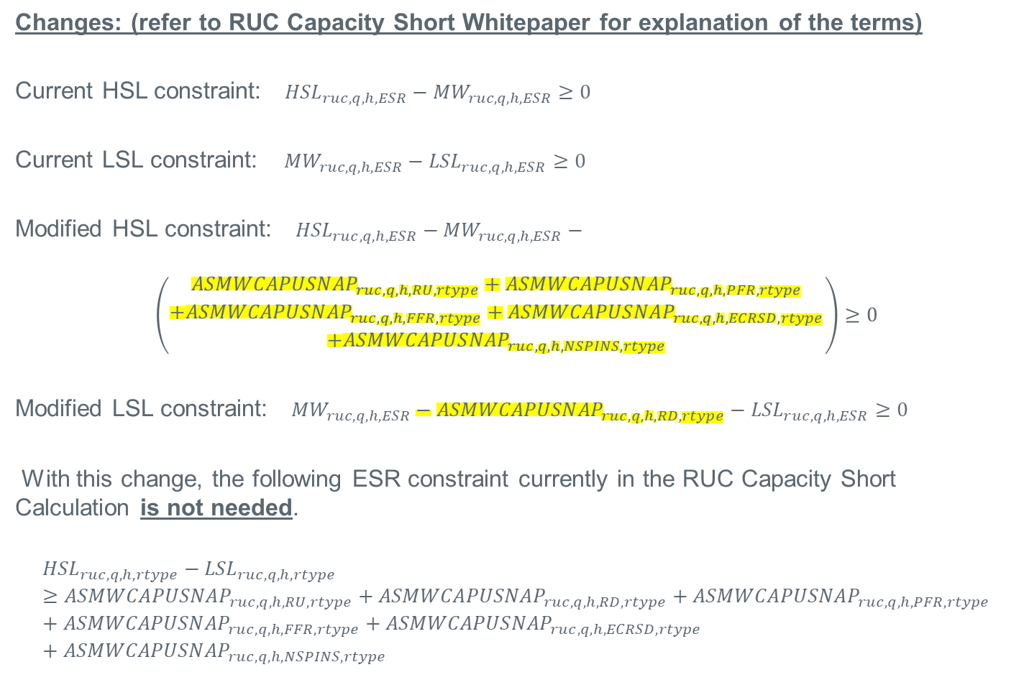
Responses to Question 2 – Cont’d
Changes: (refer to RUC Capacity Short Whitepaper for explanation of the terms)
Current HSL constraint: ${HSL}_{ruc,q,h,ESR}−{MW}_{ruc,q,h,ESR}≥0$
Current LSL constraint: ${MW}_{ruc,q,h,ESR}−{LSL}_{ruc,q,h,ESR}≥0$
Modified HSL constraint: ${HSL}_{ruc,q,h,ESR}−{MW}_{ruc,q,h,ESR}−$
$$\left(\begin{aligned}{ASMWCAPUSNAP}_{ruc,q,h,RU,rtype}+{ASMWCAPUSNAP}_{ruc,q,h,PFR,rtype} \\ +{ASMWCAPUSNAP}_{ruc,q,h,FFR,rtype}+{ASMWCAPUSNAP}_{ruc,q,h,ECRSD,rtype} \\ +{ASMWCAPUSNAP}_{ruc,q,h,NSPINS,rtype}\end{aligned}\right)≥0$$
Modified LSL constraint: ${MW}_{ruc,q,h,ESR}−{ASMWCAPUSNAP}_{ruc,q,h,RD,rtype}−{LSL}_{ruc,q,h,ESR}≥0$
With this change, the following ESR constraint currently in the RUC Capacity Short Calculation is not needed.
$${HSL}_{ruc,q,h,rtype}−{LSL}_{ruc,q,h,rtype}≥{ASMWCAPUSNAP}_{ruc,q,h,RU,rtype}+{{ASMWCAPUSNAP}_{ruc,q,h,RD,rtype}+ASMWCAPUSNAP}_{ruc,q,h,PFR,rtype}+{ASMWCAPUSNAP}_{ruc,q,h,FFR,rtype}+{ASMWCAPUSNAP}_{ruc,q,h,ECRSD,rtype}+{ASMWCAPUSNAP}_{ruc,q,h,NSPINS,rtype}$$

