Slide 1
SSWG Report to ROS
November 6, 2025
Chair: Zach Walker (Zachary.Walker2@oncor.com)
Vice Chair: Chris Ramirez (cramirez@wettllc.com)

Slide 2
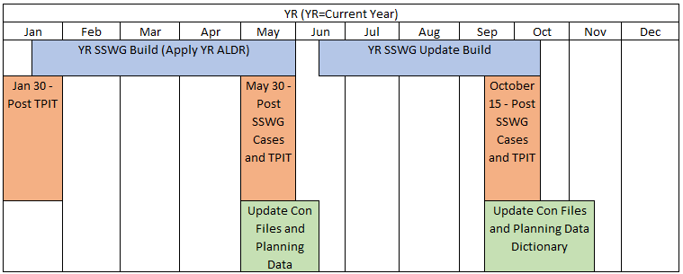
SSWG Report
Key Updates
25SSWG Case Build #2 (update build)
Target Posting: October 17th November 7th
PGRR127 - Addition of Proposed Generation to the Planning Models
SSWG discussed and coordinated with company representatives to file comments
No further feedback at this time
WG agreed to direct future discussions or comments to PLWG
Recommends removal from SSWG open action items
SSWG Report to ROS External

