Slide 1


ERCOT Residential DR Program Analysis
Prepared by
Ryan Hledik
Sam Newell
Kate Peters
Serena Patel
Carly McAdam
Prepared for
ERCOT Wholesale Market Subcommittee (WMS)
November 5, 2025

Slide 2
Notice
This presentation was prepared by The Brattle Group as a preview of a forthcoming report prepared for NRG and Google. It is intended to be read and used as a whole and not in parts. The report reflects the analyses and opinions of the authors and does not necessarily reflect those of The Brattle Group’s clients or other consultants.
Any wholesale market characterizations herein are not intended to be predictive of a future grid state, rather they are baseline assumptions used to assess the price impact of demand response.
We would like to thank Bill Barnes and Travis Kavulla (NRG) and Easar Forghany and Chris Matos (Google) for helpful input and insight throughout this study.
Copyright © 2025 The Brattle Group, Inc.

Slide 3
Background
Introduction
Over 60 GW of load growth anticipated in ERCOT by 2031, driven primarily by data centers and other large loads
Concern that conventional sources of supply will not keep up with load growth, leading to reliability challenges
Residential demand response (DR) remains relatively untapped in ERCOT, despite large air-conditioning load
In other markets, cost-effective participation compensation and effective program design have led to residential DR participation rates in excess of 20%
Nationally, there is 10 GW of residential DR in utility programs
ERCOT’s Residential DR (RDR) program is designed to provide REPs and NOIEs with a price signal to develop programs that tap into latent residential flexibility to address reliability concerns
Residential Demand Response Capability, by State
% of Peak Demand
Residential DR capability in Texas ranks 33rd of all states
Note: Only states with non-zero DR shown (47 states). Data from Form EIA-861, 2024.

Slide 4
Purpose and approach
Introduction
Study purpose
NRG and Google commissioned Brattle to analyze the potential impacts of ERCOT’s proposed RDR program if it is adopted
Focus on potential impacts in next 3 to 5 years
Research questions
Is the RDR program likely to lead to an increase in residential DR capability?
How will the RDR program impact market prices?
Study Approach
Define residential DR offerings utilizing smart thermostats, home batteries, and EV managed charging
Estimate monetizable DR value with and without RDR program compensation
Assess implications for higher participation incentive payments and greater ERCOT-wide DR capability
Analyze potential market price impacts of the Residential DR program at the 500 MW cap

Slide 5
Is the RDR program likely to lead to an increase in residential DR capability?

Slide 6
The Modeled DR Options
Impact on DR Capability
We model three residential technologies to illustrate DR opportunities in ERCOT.
Smart Thermostats
Residential Electric Vehicle Charging
Residential Batteries
Smart thermostats can be adjusted remotely to reduce air-conditioning load during DR event hours.
Pre-cooling strategies, constraints on setpoint adjustments, and a cap on the number of events limits potential loss of customer comfort.
Roughly 83% of homes in Texas have central air-conditioning and could be incentivized to adopt a smart thermostat.
Air-conditioning is a dominant driver of system peak demand in ERCOT.
Residential electric vehicle (EV) charging can be managed remotely to shift charging load to low-cost hours overnight.
Our modeling does not include vehicle-to-grid capability, which could provide additional value once technically and commercially viable.
Forecasts indicate that there could be 1 million light-duty EVs on the road in Texas by 2030.
Residential batteries can be discharged during high-priced or DR event hours and charged during low-priced hours, in addition to providing backup generation and bill savings to owners.
Residential battery adoption is growing in ERCOT, and REPs are beginning to develop retail plans to pay customers for battery performance.
Under NPRR 1296, batteries are only compensated for self-consumption (i.e., not grid injection) dispatch.

Slide 7
Methodology overview
Impact on DR Capability
We simulate DR dispatch to estimate maximum monetizable value from a REP’s perspective, accounting for realistic DR operational constraints to maintain customer comfort.
Operational constraints
Technology-specific limits on number of DR dispatch events/year and hours/day (e.g., for cooling load control, max 15 calls per year and 4 consecutive hours per call)
Account for load building outside of event hours
Value-maximizing dispatch
DR value to REP includes combination of real-time energy, A/S procurement, and RDR compensation
REPs target program dispatch during seasonal net peak hours to earn maximum accreditation (top 6 of 8 in Summer/Winter and top 3 of 5 in Spring/Fall)
Realistic accounting for foresight
Imperfect foresight scenario: REP targets 10x the top net load hours with program dispatch, receives lower accreditation
Near-perfect foresight scenario: REP targets 2x the top net load hours, receives higher accreditation
Actual market data
Simulations and value estimates based on 2019-2024 market prices and currently proposed RDR compensation level

Slide 8
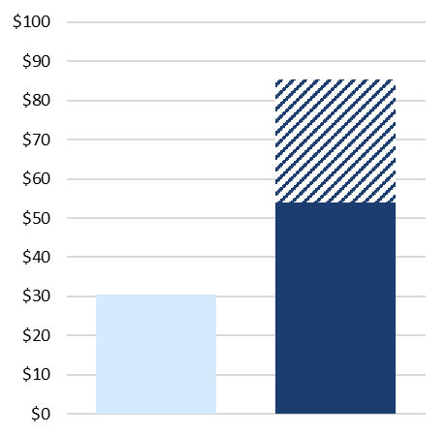
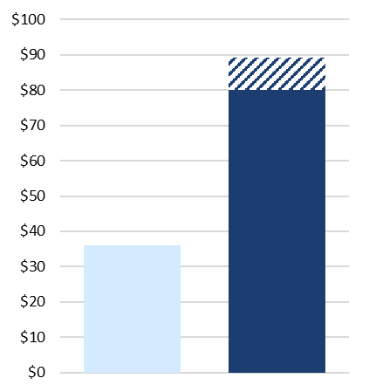
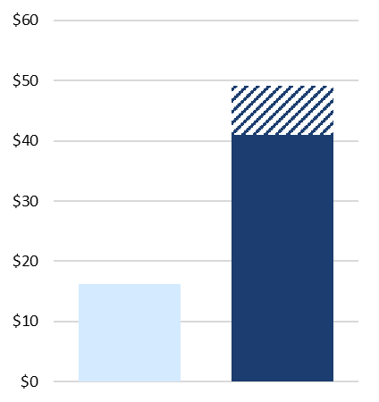
The Impact of RDR on Cost-Effective Compensation Payments
Impact on DR Capability
Increased revenue from RDR means participants could be offered cost-effective compensation payments that are 2x to 3x the levels currently supported by the market.
Maximum Cost-Effective DR Participation Incentive
Smart Thermostat
($/participant/yr.)
Residential EV
($/participant/yr.)
Residential Battery
($/kWh/yr.)
77% - 180% increase
(+ $23 - $55/part./yr)
122% - 147% increase
(+ $44 - $53/part./yr)
154% - 204% increase
(+ $25 - $33/kWh/yr)
Near-perfect foresight
Imperfect foresight
No RDR Program
With RDR
Program
No RDR Program
With RDR
Program
No RDR Program
With RDR
Program
Note: Battery output is not credited for exported energy.

Slide 9
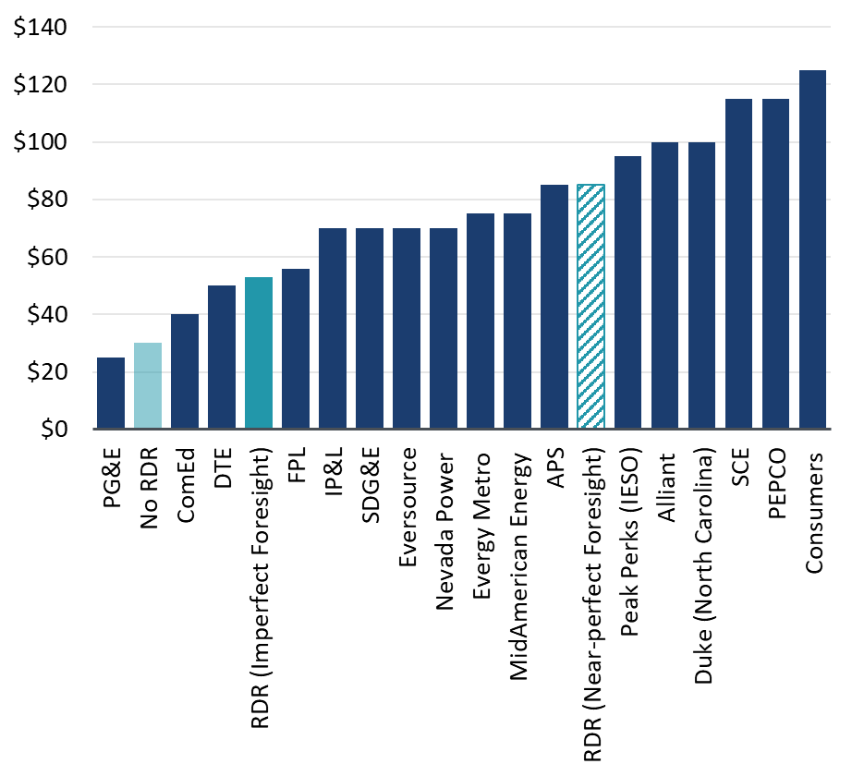
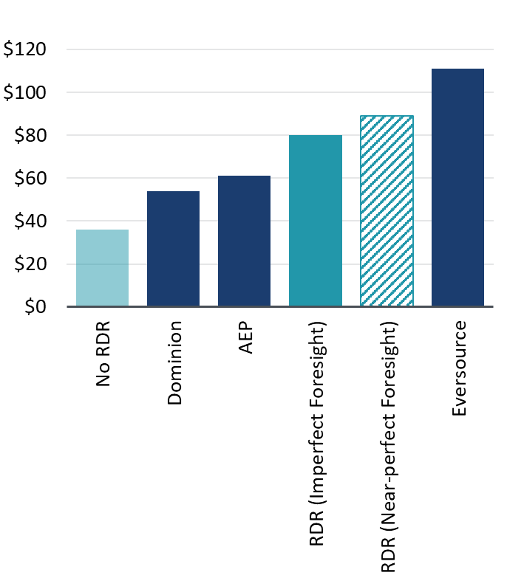
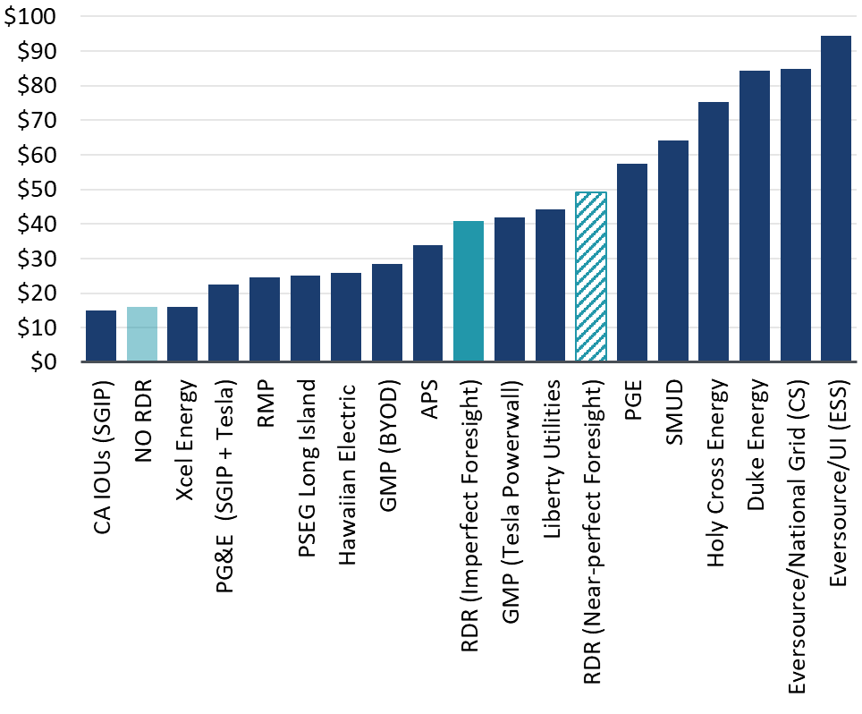
Benchmarking the DR Incentives to Other Jurisdictions
Impact on DR Capability
ERCOT’s RDR program could increase cost-effective DR participation incentives offered in ERCOT’s competitive retail market to levels that have supported significant enrollment in utility programs in other jurisdictions.
Benchmarking Against Participant Incentives Offered in Reviewed Utility Programs
Smart Thermostat
($/participant/yr.)
Residential EV
($/participant/yr.)
Residential Battery
($/kWh/yr.)
Impact of program
Impact of program
Impact of program

Slide 10
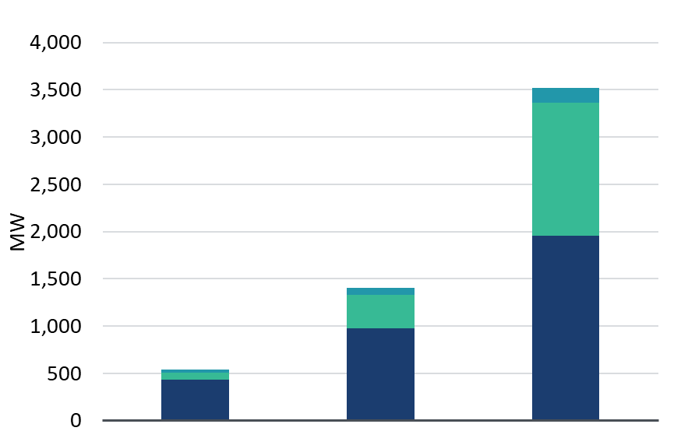
The Potential Impact of DR Program Value on DR Enrollment
Impact on dr Capability
By offering participation compensation at levels observed in other jurisdictions, ERCOT’s DR program could reach its 500 MW enrollment cap within a few years.
2030 ERCOT Residential DR Capacity Potential
7x Current Pricing Case
(3,000 MW increase)
Three residential DR adoption scenarios:
No RDR: Future DR adoption limited to low end of what has been achieved in other jurisdictions.
With RDR (Moderate Adoption): With higher, industry-standard incentives supported by implementing the proposed program, DR enrollment increases to levels achieved by successful utility offerings in other jurisdictions.
With RDR (High Adoption): When coupling higher incentives with the removal of other DR deployment barriers, adoption reaches maximum levels observed in a review of various DR planning studies.
The increase in residential DR capacity associated with these scenarios could exceed the enrollment cap if eventually lifted.
Managed EV
BTM Storage
3x Current Pricing Case
(900 MW increase)
Smart
Thermostat
No RDR
With RDR
Moderate
Adoption
With RDR
High
Adoption
Note: Our analysis focuses on DR offerings that would be supported by direct reduction of energy and ancillary costs and contributions to residential DR accreditation hours. It does not account for alternative DR compensation opportunities in Texas, such as the ADER pilot. Further market research would be valuable to establish a direct relationship between incentives and likely DR participation.

Slide 11
How will the RDR program impact market prices?

Slide 12
Methodology Overview
Impact on Market Prices
We develop a regression-based approach to quantify the impact of the DR program relative to forwards
Driving Question
Approach
How much will the proposed 500 MW RDR program impact the projected energy price increase relative to today’s prices given forecasted additions of non-firm supply and firm demand in ERCOT?
Develop series of regression models to establish a relationship between hourly reserves, gas prices, and settlement prices
Forecast hourly reserves under projected supply and demand additions, calibrated to forwards
Compare the impact of the DR program on average annual prices to ERCOT energy forwards
Hypothesis
Without a price adjustment mechanism, the residential demand response program will reduce prices relative to no DR program (all else equal)

Slide 13
Building a Simplified Pricing Model
Impact on Market Prices
Our pricing model uses regression analysis to relate prices to hourly online and offline reserves as well as monthly gas prices, using data from 2022 and 2024
We develop four regression models using historical hourly reserve levels to predict prices across different periods.
Prices are the dependent variable, with hourly reserves as the primary independent variable and gas prices only included as a second independent variable in the off-peak model
Implicitly, the extreme model captures effects of the ORDC; this period will be most relevant for analyzing DR dispatch
Benchmarking Regression model(s) with Actual Hourly Prices
2022 and 2024
$/MWh
Extreme model predictions
Actual Prices 2024 and 2022
Real-Time Price
Peak model predictions
Off-peak model predictions
Normal model predictions
Reserves (MW)

Slide 14
Projecting Hourly Reserves with and without DR Dispatch
Impact on Market Prices
We adjust historical hourly reserve levels with incremental supply and demand and calibrate to forward prices in each forecast year to project hourly operating reserves, which is the primary input to the pricing model. To test the incremental impact of DR, we represent DR dispatch as added reserves during REP-targeted top net load hours, subject to program constraints, then re-estimate prices.
We forecast hourly operating reserves using 2022 – 2024 reserves plus weather-consistent incremental supply & demand; with load growth, the tightest hours may be tighter (rightmost part of duration curve), while many daytime hours have higher reserves due to expected additions of PV and other resources
These reserves are applied to the pricing model (and we calibrate annual new load and resources until annual average prices match forwards)
Finally, to estimate the DR program’s price impact, we:
Assume a residential DR program with primarily smart t-stat offerings, dispatched up to 60 hours/year (May-Oct), with behavioral limits
Adjust the hourly operating reserves by the DR program cap (500 MW)
Compare the estimated prices to those without the DR.
This analysis is without modeling any RTRDPA price adjustment
Projected Reserves Duration Curve Compared to Historical
MW
2026
2027
2028
2024
1 8,760
Hours (ranked highest to lowest)
Note: These figures are not intended to be predictive of a future grid state, rather they are baseline assumptions used to assess the price impact of demand response.

Slide 15
DR Program has minimal effect on price
Impact on Market Prices
With the 500 MW participation cap, ERCOT’s proposed Residential DR program will not lead to significant price suppression, relative to increasing forward prices
Annual Average Price With and Without DR Program
Absent Price Adjustment
ERCOT energy forwards indicate that prices will increase +$15-20/MWh from recent historical prices by 2028.
Our modeling results suggest prices would still increase nearly as much with the DR program as proposed (absent a price adjustment mechanism, but with a 500 MW cap).
This is a 3-4% reduction in average prices due to RDR, or less than $2/MWh on average.
$/MWh
Historical
Forwards
Estimated DR Price Impact
Note: These figures are not intended to be predictive of a future grid state, rather they are baseline assumptions used to assess the price impact of demand response.
(YTD)

Slide 16
Takeaways
Conclusion
Customer incentives offered by REPs could double or triple with the introduction of the RDR program.
Increased incentives could lead to the 500 MW RDR cap being reached within a few years from residential smart thermostats, EVs, and batteries.
ERCOT is anticipating significant demand growth and tightening of reserves through 2030. The RDR program allows the mobilization of dispatchable capacity in the market.
RDR has the potential to exceed the cap if it is eventually lifted.
In addition to relieving a strained supply-demand balance in the near term, RDR could improve residential customers’ familiarity, experience, and capability with respect to DR, creating a foundation for a more price responsive residential customer base
The introduction of DR as proposed could lower prices by 3-4% relative to forwards, which is substantially less than the price increase expected from tightening reserve margins.

