Slide 1

WMWG update to wms
November 5, 2025
Amanda Frazier, WMWG Chair

Slide 2
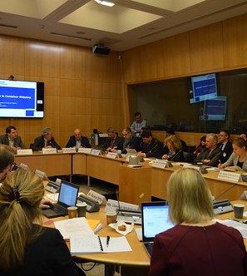
AGENDA
NPRRS ready for WMS vote:
  None
NPRRs Still with WMWG
  NPRR 1278 - Establishing Advanced Grid Support Service as an Ancillary Service
  NPRR 1284 - Guaranteed Reliability Load Process
This Photo by Unknown Author is licensed under CC BY-NC-ND

Slide 3
Discussion of NPRRs
  NPRR1278 - Establishing Advanced Grid Support Service as an Ancillary Service
  Further discussion awaiting PUCT review of NOGRR272.
  NPRR1284 - Guaranteed Reliability Load Process
  Sponsor (Cholla Petroleum) reviewed discussions with ERCOT that would allow Guaranteed Reliability Loads (GRLs) to interconnect under a modified Controllable Load Resource (CLR) registration. CLR registration may obviate the need for inclusion of GRLs within the Reliability Deployment Price Adder (RDPA) – but details will likely require additional discussion and updated language for protocols and binding documents.
  Stakeholders also discussed deployment caps for GRLs as suggested by 7/11 Google Comments highlighting grid operator challenges and impracticalities associated with long-duration contingencies and outages.

Slide 4

THANK YOU

