Slide 1
Weekly
RTC+B Market Trials Update
ERCOT Staff
Novemember 3, 2025

Slide 2
Outline
Antitrust Admonition
Upcoming Activities
October 30 Production LFC Test #2 (done)
Daylight Savings Time this weekend (done)
No SCED/DAM this week required this week
Outage Scheduler submissions after October 31 (read-only)
Known Issues
SCED LFC Test Results
Expectations of QSEs for the Week
Connectivity Testing first week of November Q&A
Appendix- Supporting Materials:
Summary of SCED Functionality
SCED Analysis/Results for prior week
DAM and AS Self-Provision Education
Telemetry Screening
New RTC Pricing Reports location
NPRR1290 Validation Changes
Links to Handbooks
FAQ Updated
Connectivity and Configuration (digital certs)

Slide 3
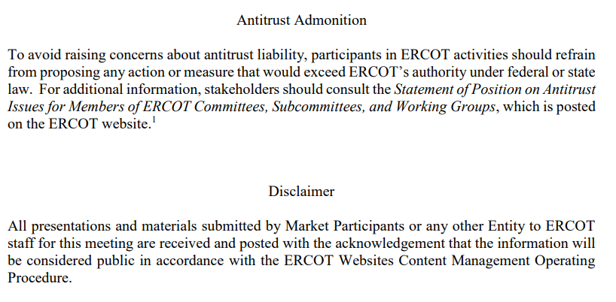
WebEx Meeting reminders (same as other ERCOT forums):
Please keep line muted
If you have a question, please use the chat feature to either:
Type in your question, or
Type in “Question” and wait to be recognized to state question

Slide 4
Sequence and Dates for Market Trials to Go-Live
Market trials are a progression of activities to mitigate the risk for Go-Live on new systems and processes for both the Market Participants & ERCOT.
30-day Market Notice
11/5/25
March/April
2025
Start
5/5/25
Start
7/7/25
Start
9/2/25
Go-Live
12/5/25*
May 2025
June 2025
July 2025
Aug 2025
Sep 2025
Oct 2025
Nov 2025
Dec 2025
QSE Scorecards & Exit Criteria for each Trial Phase
#1 RTC QSE Submission Testing
(Submit COP, RT AS Offers,
DAM Virtual AS, Outages for ESRs)
#3 Open-loop RTC SCED
(QSE offers, SCED non-binding award/dispatch)
#5 Ongoing Open-Loop
& Periodic Closed-loop SCED/LFC
(QSE RTC offers and telemetry to support closed-loop frequency control test 2-3 tests of 2-4 hour durations)
Transition to Go-Live
Upon completion of testing, confirmation of ERCOT and market readiness for Go-Live.
QSE/Vendor Submission Sandbox and Telemetry Points added Prod EMS model.
#2 RTC QSE Telemetry Checkout (QSEs add/verify new telemetry points for UDSP, New ramp rates, ESR telemetry)
#4 QSE Telemetry Tests
(Individual QSE to follow UDSP and support new ramp rate and ESR telemetry)
#6 Day-Ahead Market
(Non-binding DAM using QSE offers for at least 2 tests)
* Go-Live date reflects 12/5/2025 as first Operating Day
where 12/4/2025 is planned software migration.

Slide 5
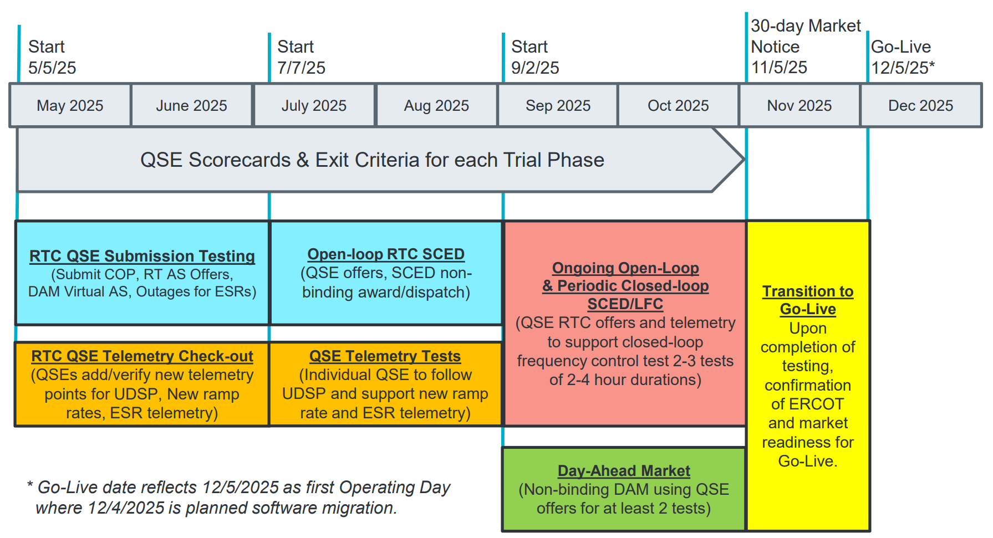
Sep & Oct: Sep11 & Oct 30
Required live-production test to ensure effective frequency dispatch and control.
Sep & Oct:
Optional Day-Ahead Market
Voluntary Day-Ahead Market for all QSEs will be conducted at least 2 times.
QSE can test their market submissions for Day-Ahead AS Self-Arrangement, AS Only Offers, Trades and normal submissions.
DAM participation is strongly encouraged but not required in Readiness metrics since RTC procures AS in Real-Time.
Participation includes much broader QSE population (marketers and load-only QSEs).
ERCOT and QSEs will conduct live-production tests of RTC-SCED and Load Frequency Control (LFC) prior to go-live.
RTC-SCED and frequency control dispatch during the tests will be binding to manage the reliable operations of the grid for2-4 hours.
ERCOT will coordinate with QSEs on how to submit RTC offers and telemetry for Energy and AS for the two systems (current and RTC system).
ERCOT will provide a summary of the test and use analysis and engineering judgement to assess if the test was successful in controlling frequency.
Market Notice sent regarding DAM for all QSEs

Slide 6
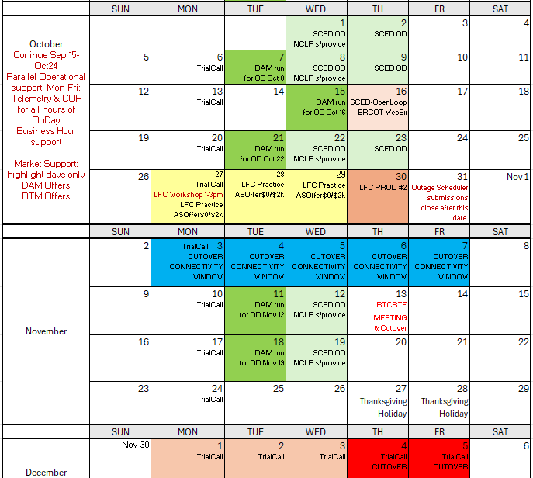
Market Trials and Transition through Go-Live
DAM run Nov2 DST
DST Nov 2
We are here….
NCLR s/provide = NCLR can use self-provision in SCED

Slide 7
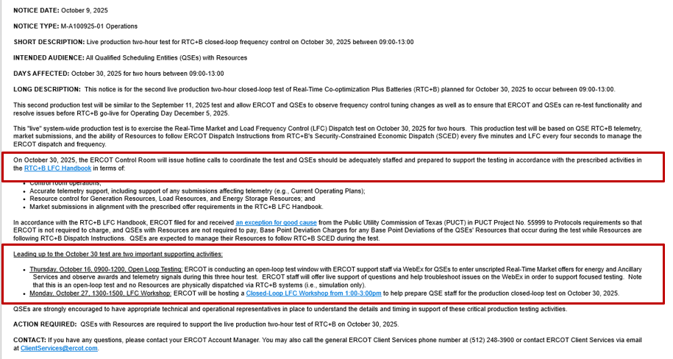
October 30, 2025 Production Closed-Loop LFC Test Link to market notice: https://www.ercot.com/services/comm/mkt_notices/M-A100925-01
Thanks for another successful test- results will be discussed at Nov 13 RTCBTF

Slide 8
RTC+B Daylight Saving Time Support (DST)
This past weekend was DST.
ERCOT executed DAM on Saturday for OD Sunday Nov 2 and RTC-SCED run through DST
Entities asking for “DST in reports” can view the posted reports in market trials

Slide 9
Reminder RTC+B Outage Scheduler Read-Only
From November 1st, RTC+B Outage Scheduler will be made “Read-Only” until Go-Live. This means QSEs/TSPs can only query outages but can not make any changes from 11/01/2025.
Above change is required to allow ERCOT outage coordination team begin 60-day and 90-day ahead outages studies utilizing RTC+B Outage Scheduler.
Starting from November 1st until Go-Live on Dec 4th night, RTC+B outage scheduler system outages will be updated periodically from current production (including converting combo model ESR outages to Single Model) to keep RTC+B outage scheduler in sync with current production outages.
Please refer to Market notice was sent out on 10/03/2025 for more details
https://www.ercot.com/services/comm/mkt_notices/M-A092624-04

Slide 10
Market Trials known issues/updates
Current issues/updates:
Still evaluating closed loop results for any issues
Update:
No DAM this week:
Reminder DAM submissions timeline extended to noon for each RTC DAM OD

Slide 11
Scorecards
Not applicable in November

Slide 12
LFC Closed Loop Test Summary for RTM/SCED 10-30-2025

Slide 13
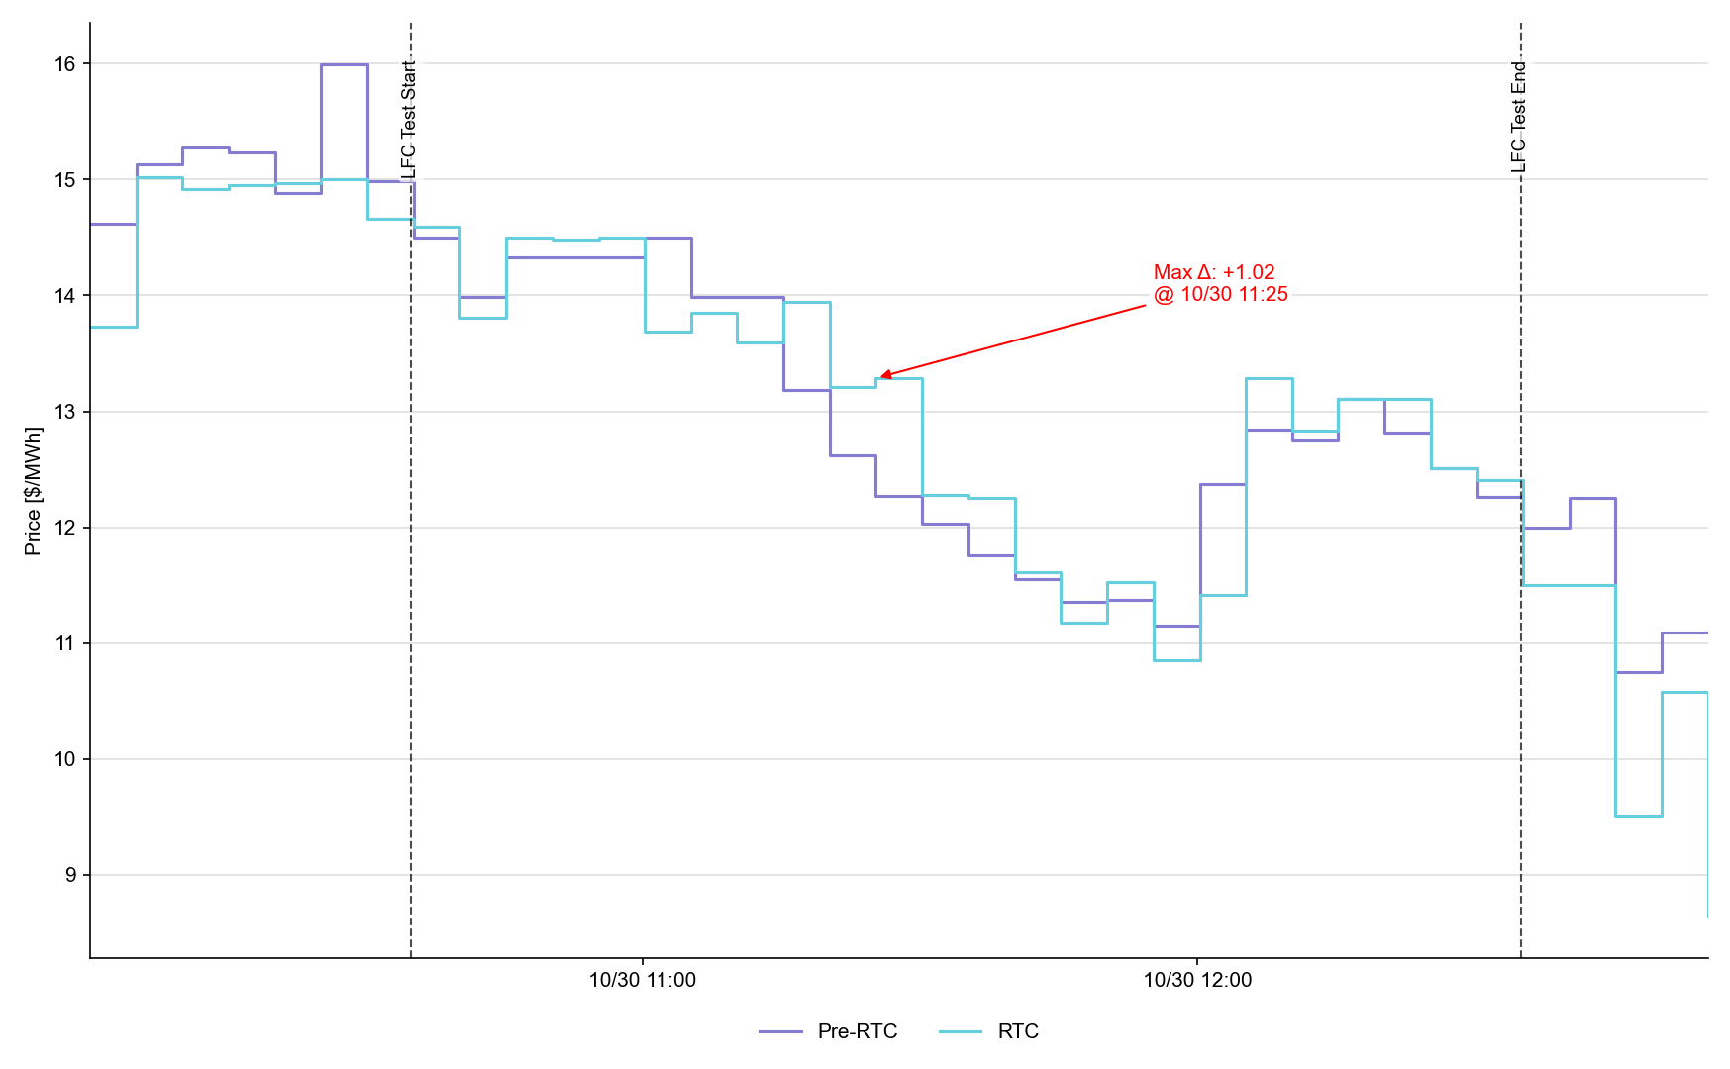
System Lambda (plus Adders)

Slide 14
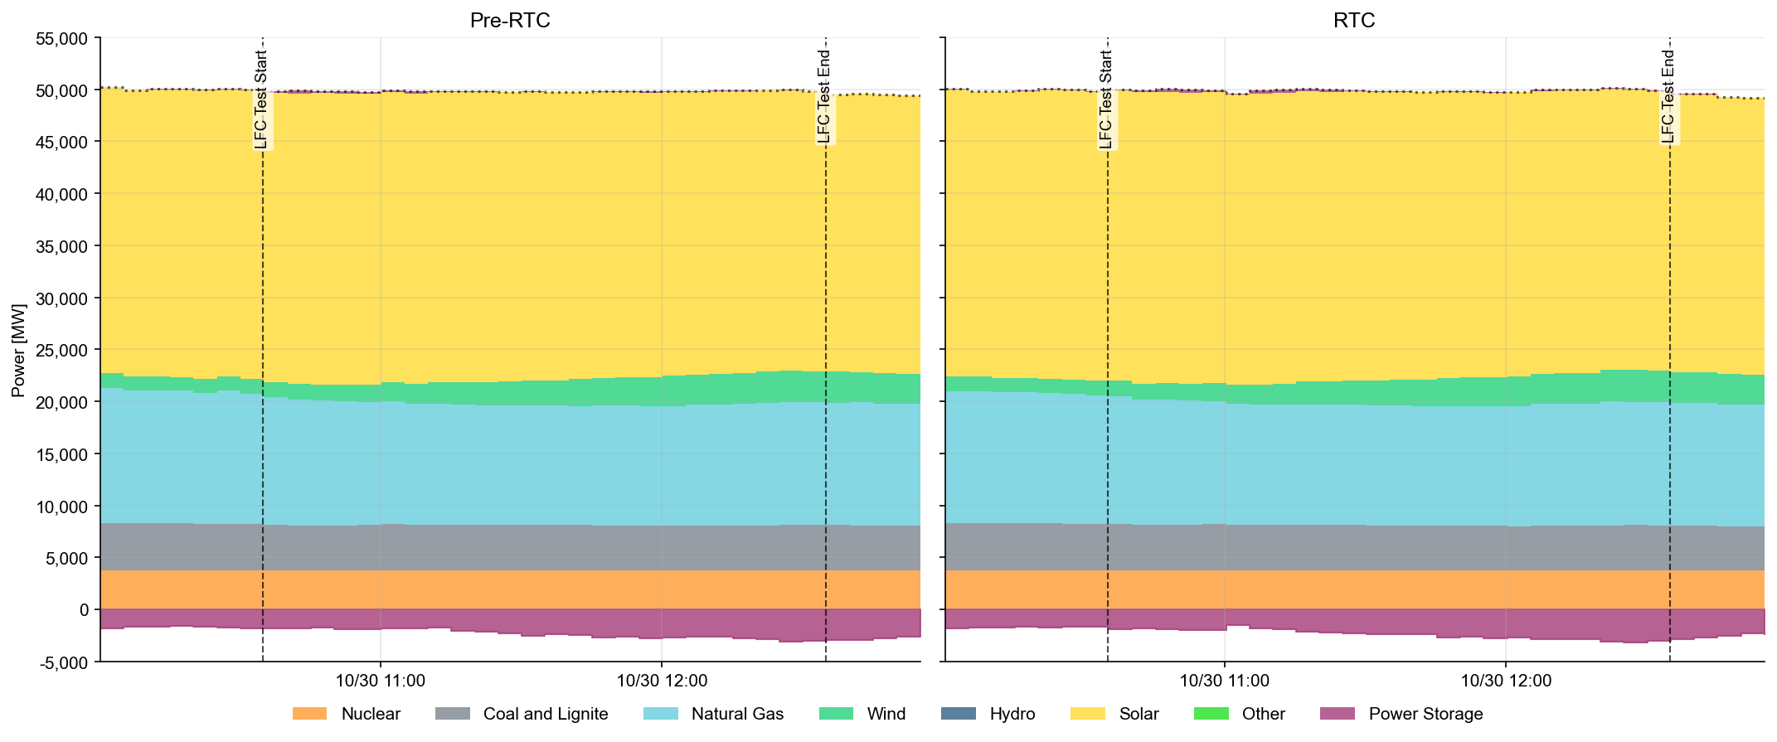
Dispatch Summary by Resource Type

Slide 15
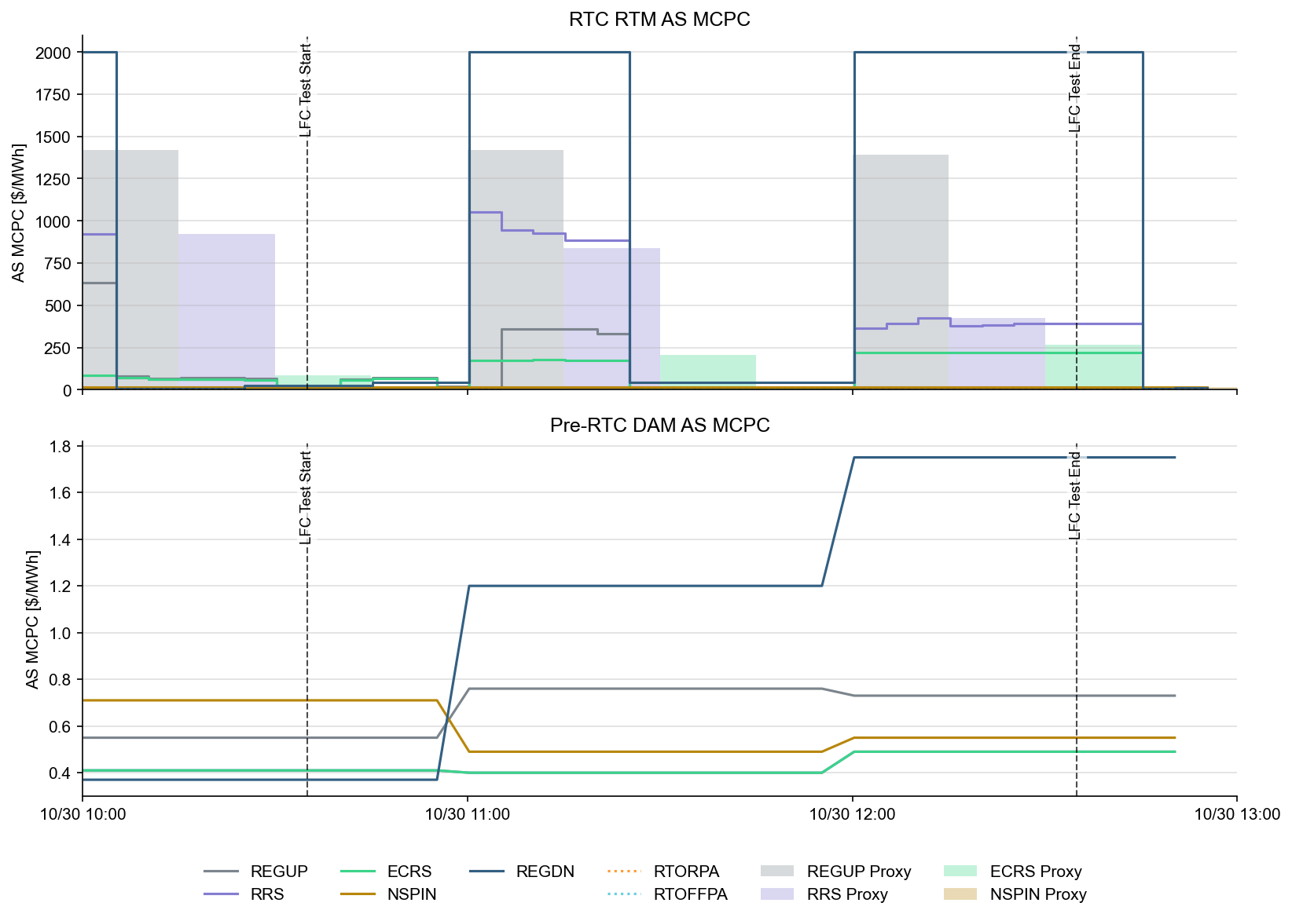
Ancillary Service Prices

Slide 16
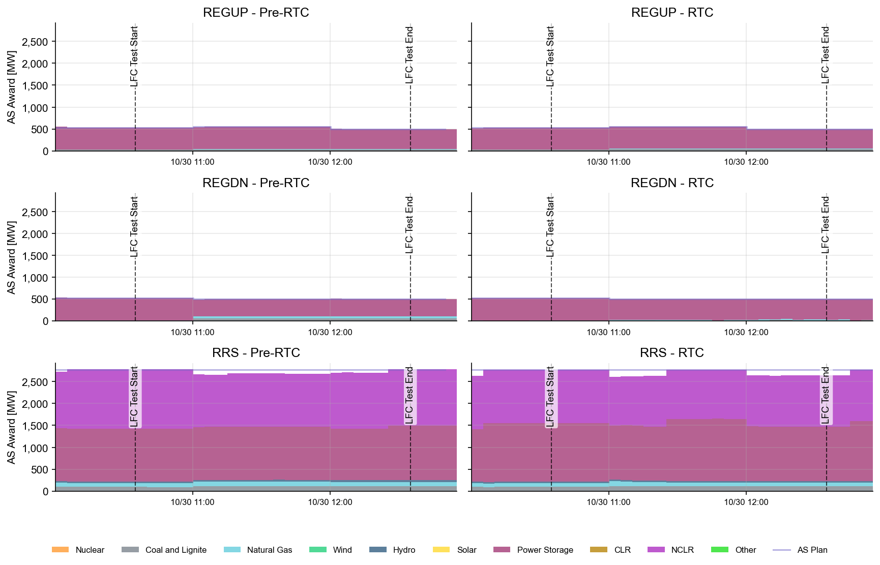
AS Awards* Summary by Resource Type
* Pre-RTC (RTM AS Schedule)

Slide 17
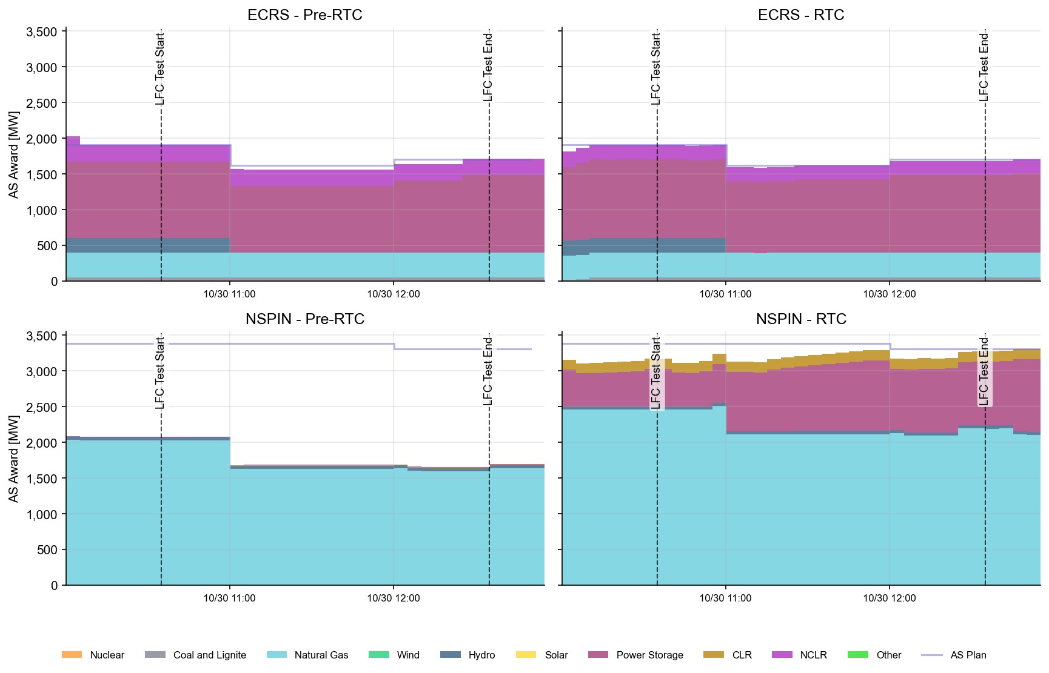
AS Awards* Summary by Resource Type
* Pre-RTC (RTM AS Schedule)
* Pre-RTC (RTM AS Schedule)

Slide 18
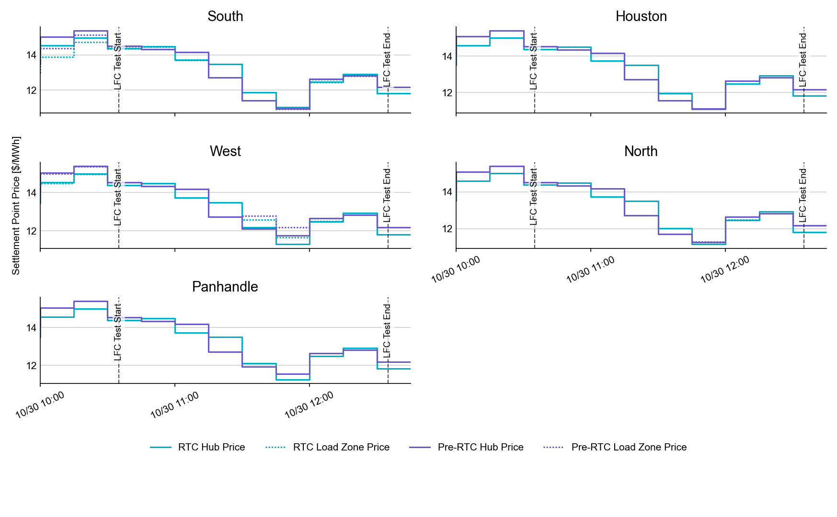
SPP by Hub and Competitive Load Zone

Slide 19
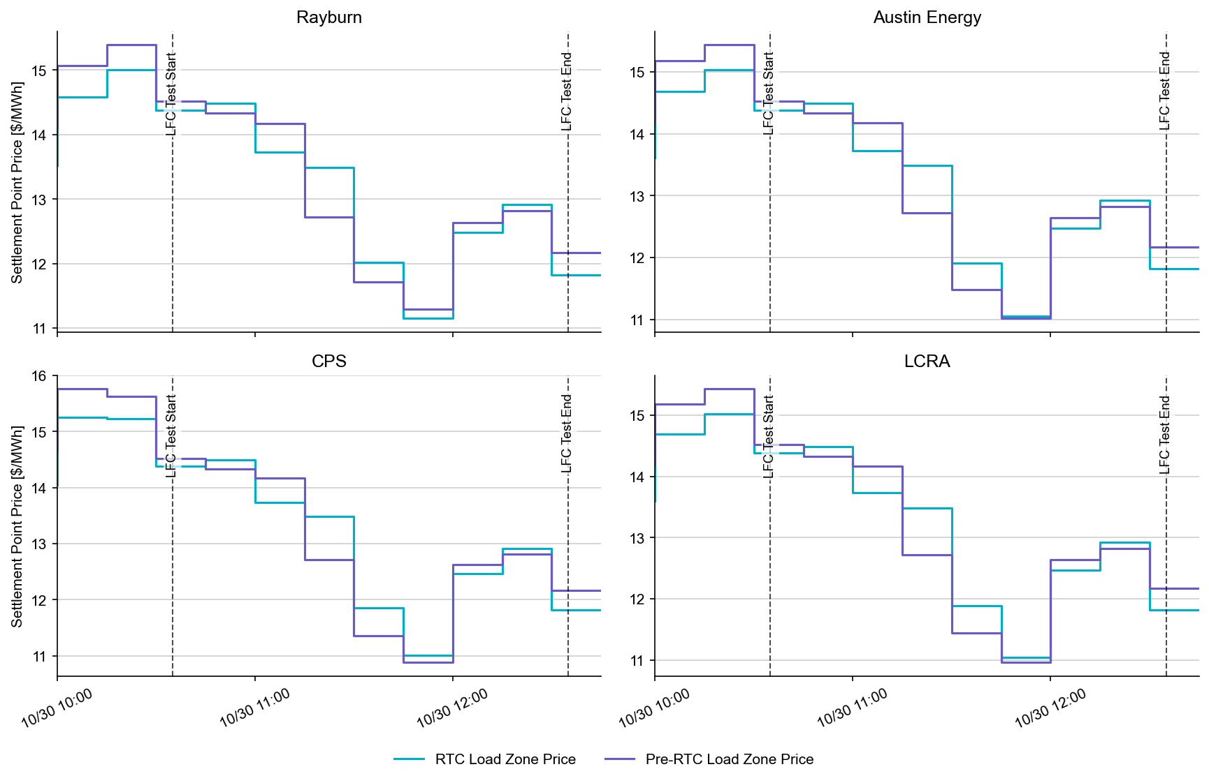
Settlement Point Prices by NOIE Load Zone

Slide 20
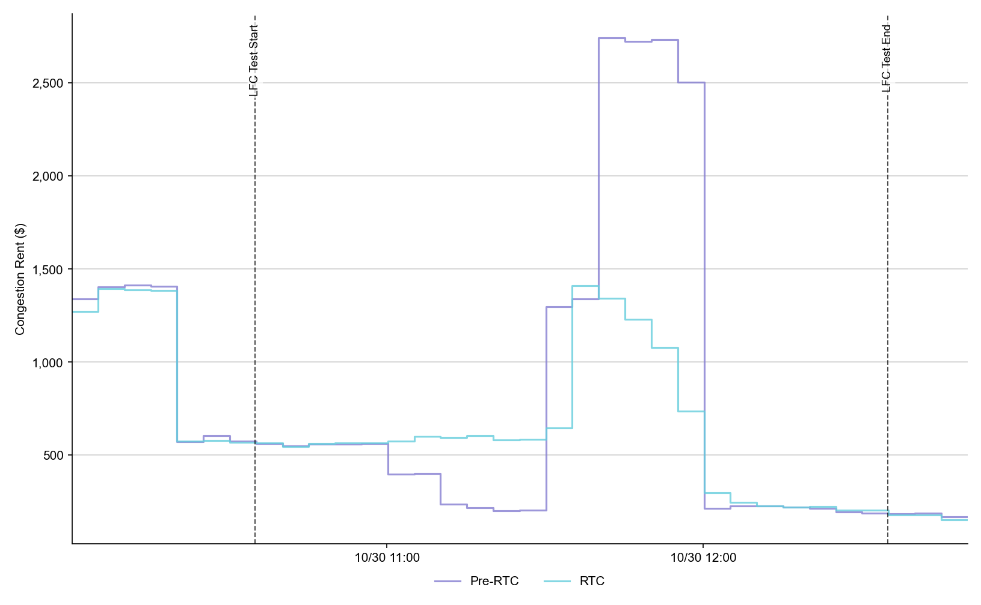
Congestion Rent

Slide 21
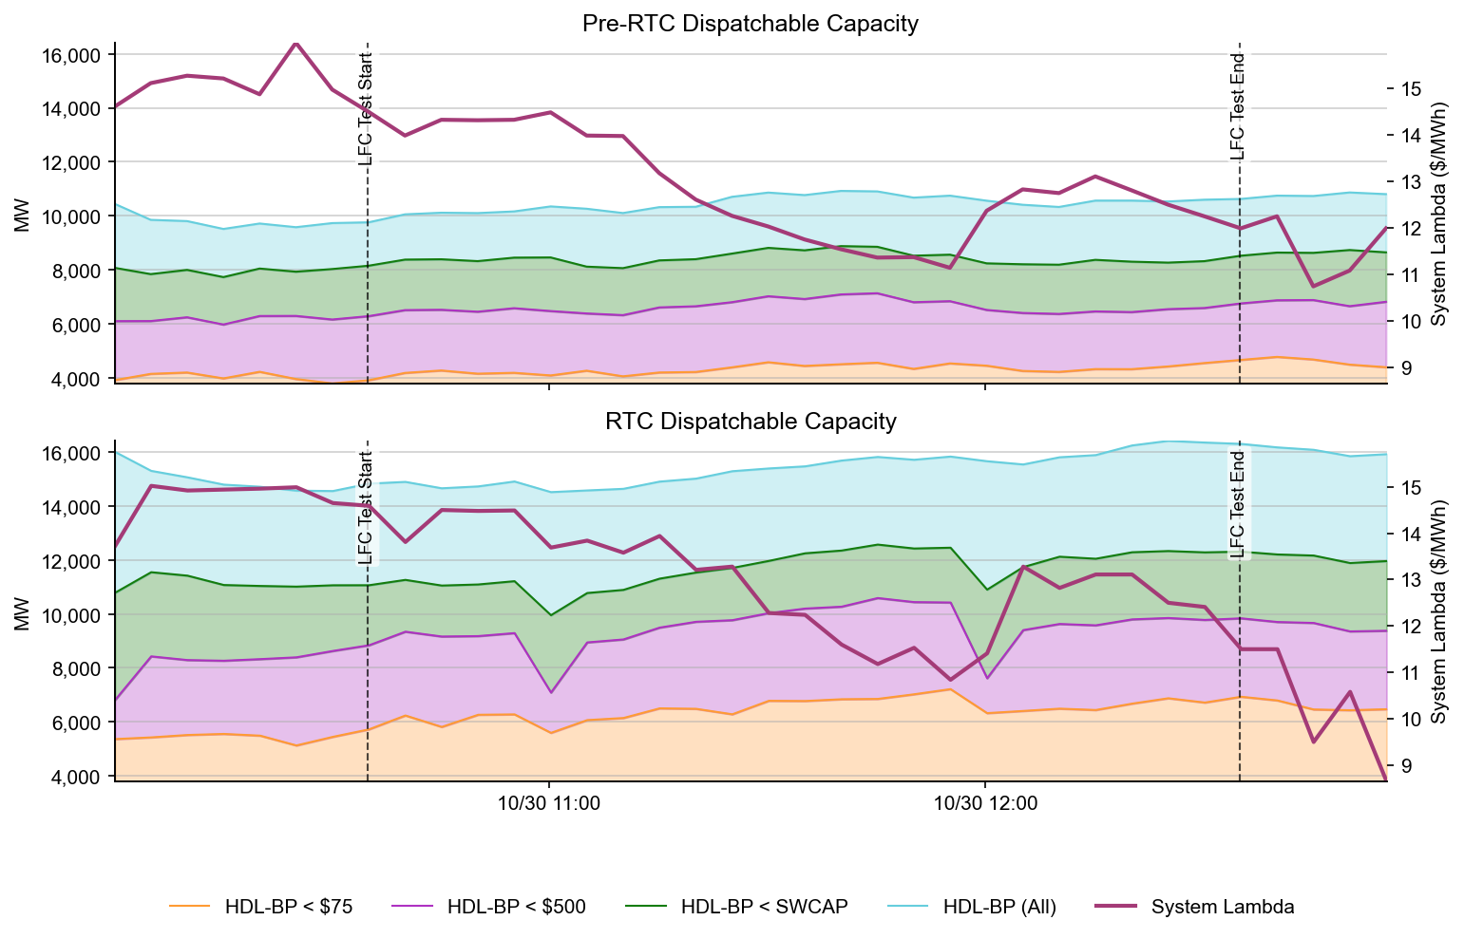
Dispatchable Capacity

Slide 22
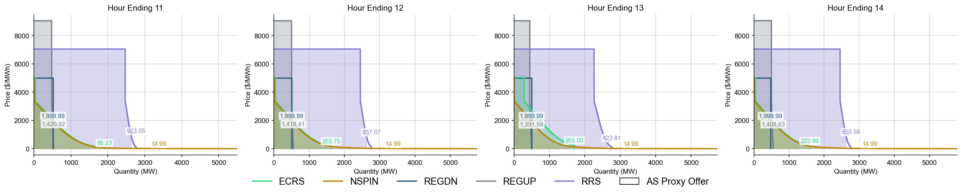
Ancillary Service Demand Curves

Slide 23
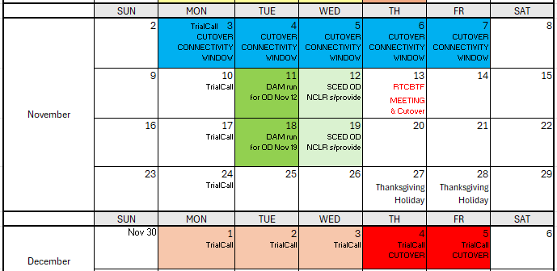
November/December Transition
Link to current Transition/Cutover Details at RTCBTF
RTC+B Market Trials Outage Scheduler turns to READONLY for transitional purposes
System connectivity Test Week 1 (go-live market submission configuration testing)
Week 2 RTCBTF Workshop on Nov 13 for December go-live Cutover
Weeks 2 & 3 Continue Trial Activity
Currently minimal plans week of Thanksgiving

Slide 24
RTC+B QSE Cutover Connectivity Testing - Optional
Some QSEs are using current production to support dual real-time market submissions into ERCOT RTC+B Market Trial Production System in parallel to Current Production.
Some QSEs are using parallel RTC+B Production and/or QA/Dev systems to support dual Real-Time and Day-Ahead Market Submissions into ERCOT RTC+B Market Trial Production System in parallel to current production.
QSEs Cutover Connectivity Testing window will be Open on November 3rd – November 7th to provide QSEs an opportunity to test out go-live cutover configurations and connectivity against ERCOT RTC+B Market Trials Systems.
This testing window allows QSEs who are currently using parallel RTC+B systems for market submissions into RTC+B to test out their cutover software configurations without impacting current production market submissions.
This test helps QSEs minimize risks with Go-Live cutover steps of their market systems.
No changes will be made to ERCOT RTC+B market trial systems.
QSEs are expected to use ongoing RTC+B market trials URLs and Production Certs for this connectivity test and submit production quality market submission into ERCOT RTC+B system.

Slide 25
RTC+B QSE Cutover Connectivity Testing - Optional
Current State
Connectivity Testing
QSE
ERCOT
QSE
ERCOT
Current Production
- Market Submissions System
(Deploy RTC+B Code + Update Configurations/URLs)
Current Production MIS
Current Production - Market Submissions System
Current Production MIS
For brief period connect to RTC+B Market Trials to test connectivity
QSE
ERCOT
QSE
ERCOT
RTC+B - Market Submissions System
RTC+B Market Trials URL
RTC+B - Market Submissions System
RTC+B Market Trials URL

Slide 26
Wrap-Up and Questions
Connectivity Testing this week
Go-Live 30-Day Market Notice this week (Nov 5)
Upcoming Meetings
Educational RUC Capacity Short tomorrow (Nov 4)
RTCBTF next Thursday (Nov 13)
LFC Test Results
AS Deployment Factor
Cutover workshop (afternoon)
Handbook posting
Remainder of meeting for Q&A
Can always email the RTC+B Program mailbox: RTCB@ercot.com
Reminder of Appendix- SCED analysis, Education, Connectivity

Slide 27
APPENDIX- Supporting Materials
Summary of SCED Functionality
SCED Analysis/Results for prior week
DAM and AS Self-Provision Education
Telemetry Screening
New RTC Pricing Reports location
NPRR1290 Validation Changes
Links to Handbooks
FAQ Updated 8/8/2025
Connectivity and Configuration (digital certs)

Slide 28
Summary of SCED functionality
What is RTC SCED using to solve in trials?
Production Network model from NMMS
QSE submitted offers (energy and A/S)
QSE production telemetry
ERCOT performs some overrides for stale data from QSE sites- improving each week
Outages in prod telemetry would be outage in RTC SCED
July 31 improvements implemented:
NPRR1268/1269 ASDC and Proxies logic implemented
AS Plan improved and now same as Prod
Aug 4 improvements implemented:
IRR Forecast synchronization has been manual, but now automated
Aug 18 improvements implemented :
Active constraints flag being manually copied (automation planned for Aug 18)
Load Forecasts being fed into RTC, but ERCOT manually aligns which forecast is being used based on operator selection in Prod (automation planned for Aug 18)

Slide 29
RTC+B Market Trials Summary 10-22-2025
Due to a bug causing the MCPC values to fail to publish when the pricing run is disabled in SCED, MCPC values for the Operating Day are missing. The bug has been flagged, and a fix is being delivered.

Slide 30
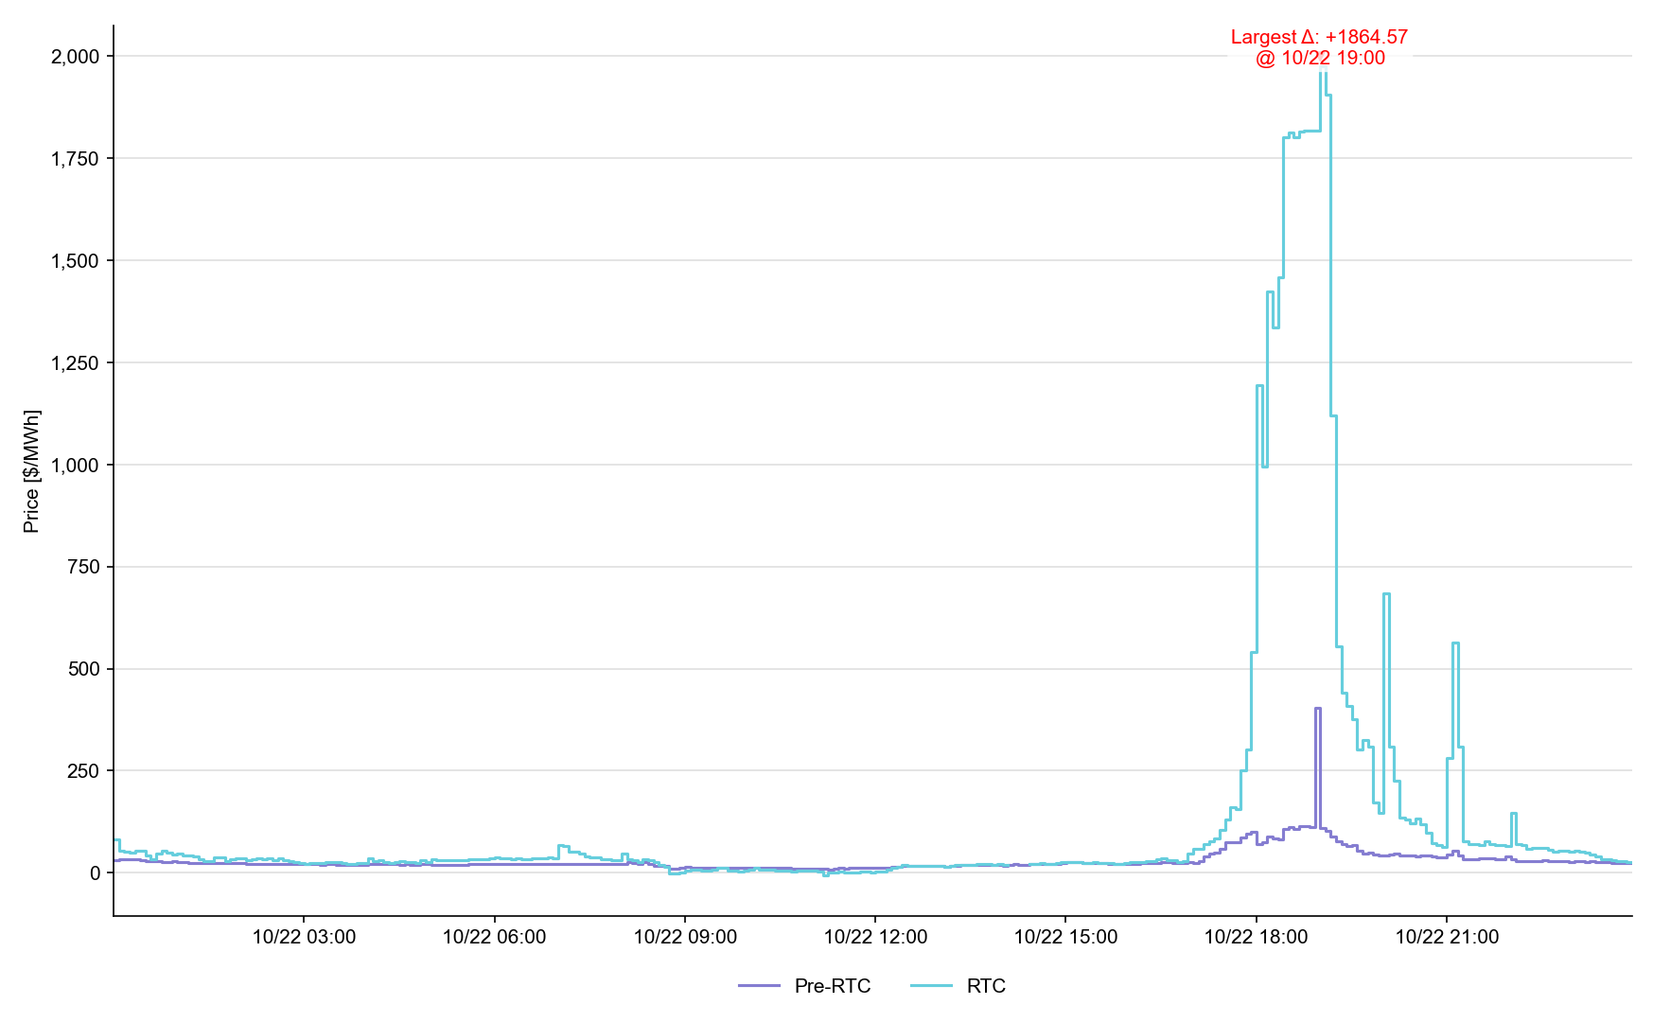
System Lambda (plus Adders)

Slide 31
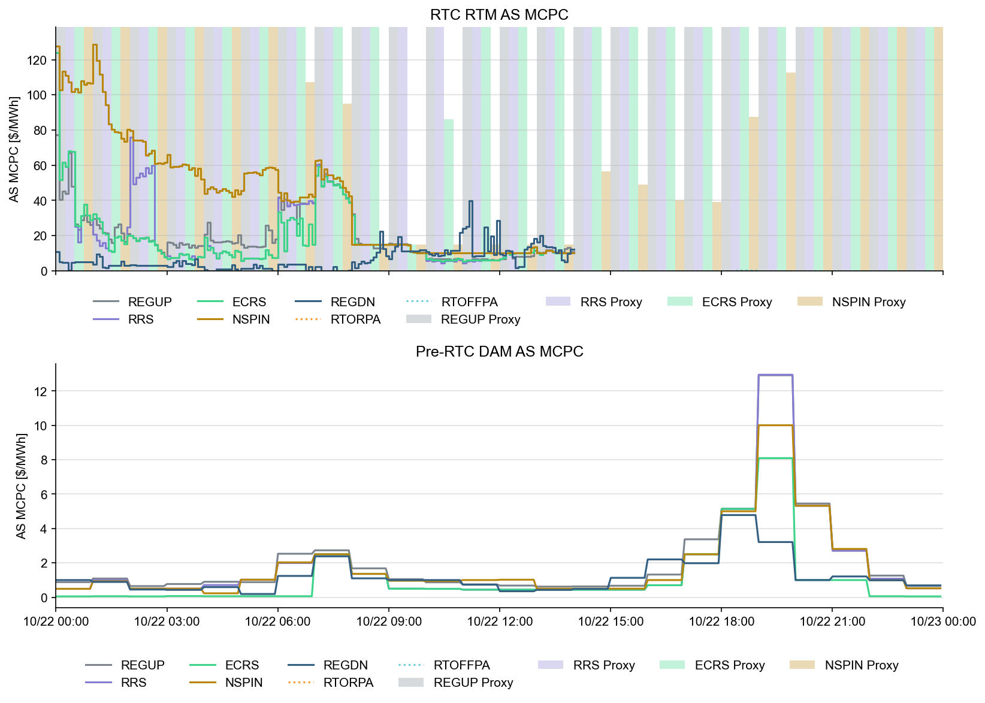
Ancillary Service Prices

Slide 32
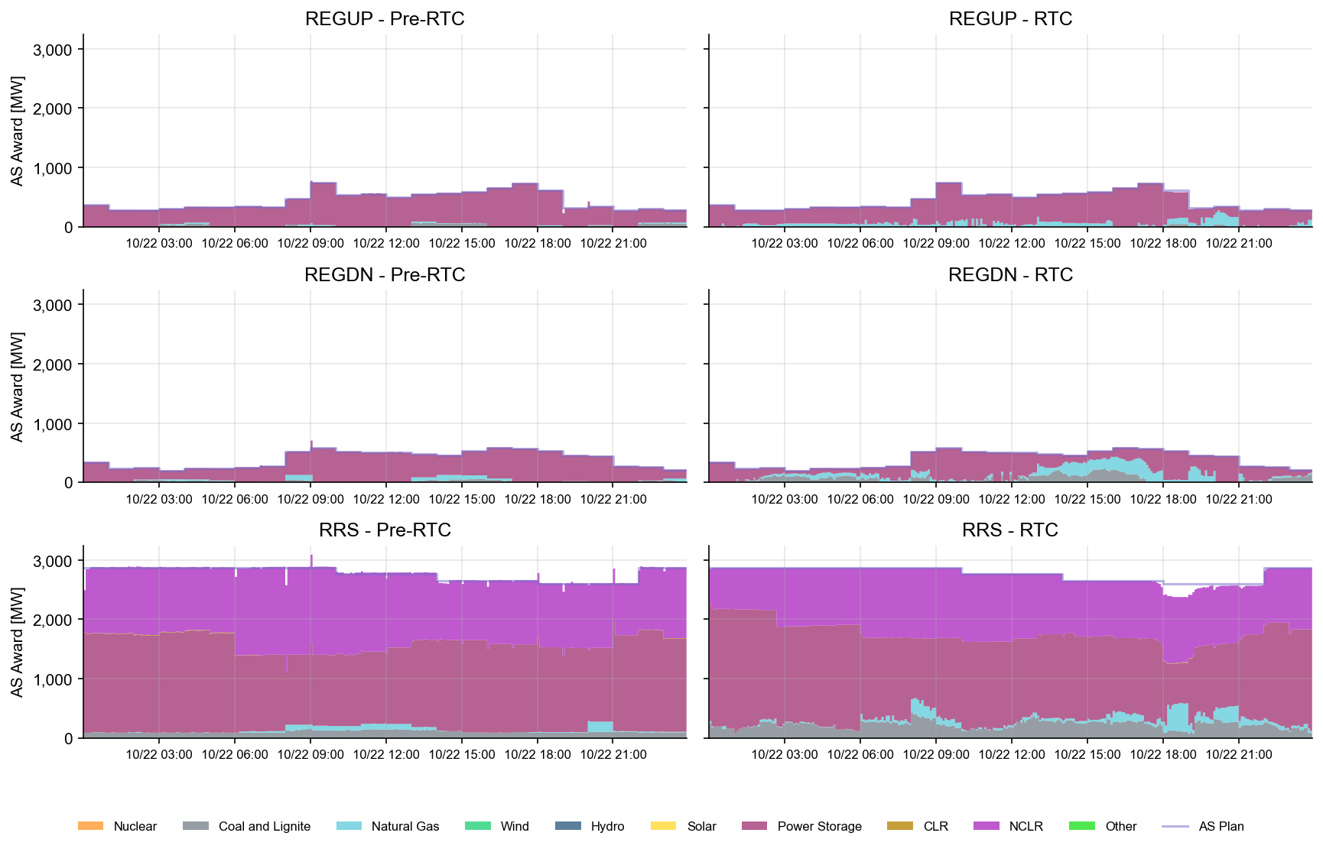
AS Awards* Summary by Resource Type
* Pre-RTC (RTM AS Schedule)

Slide 33
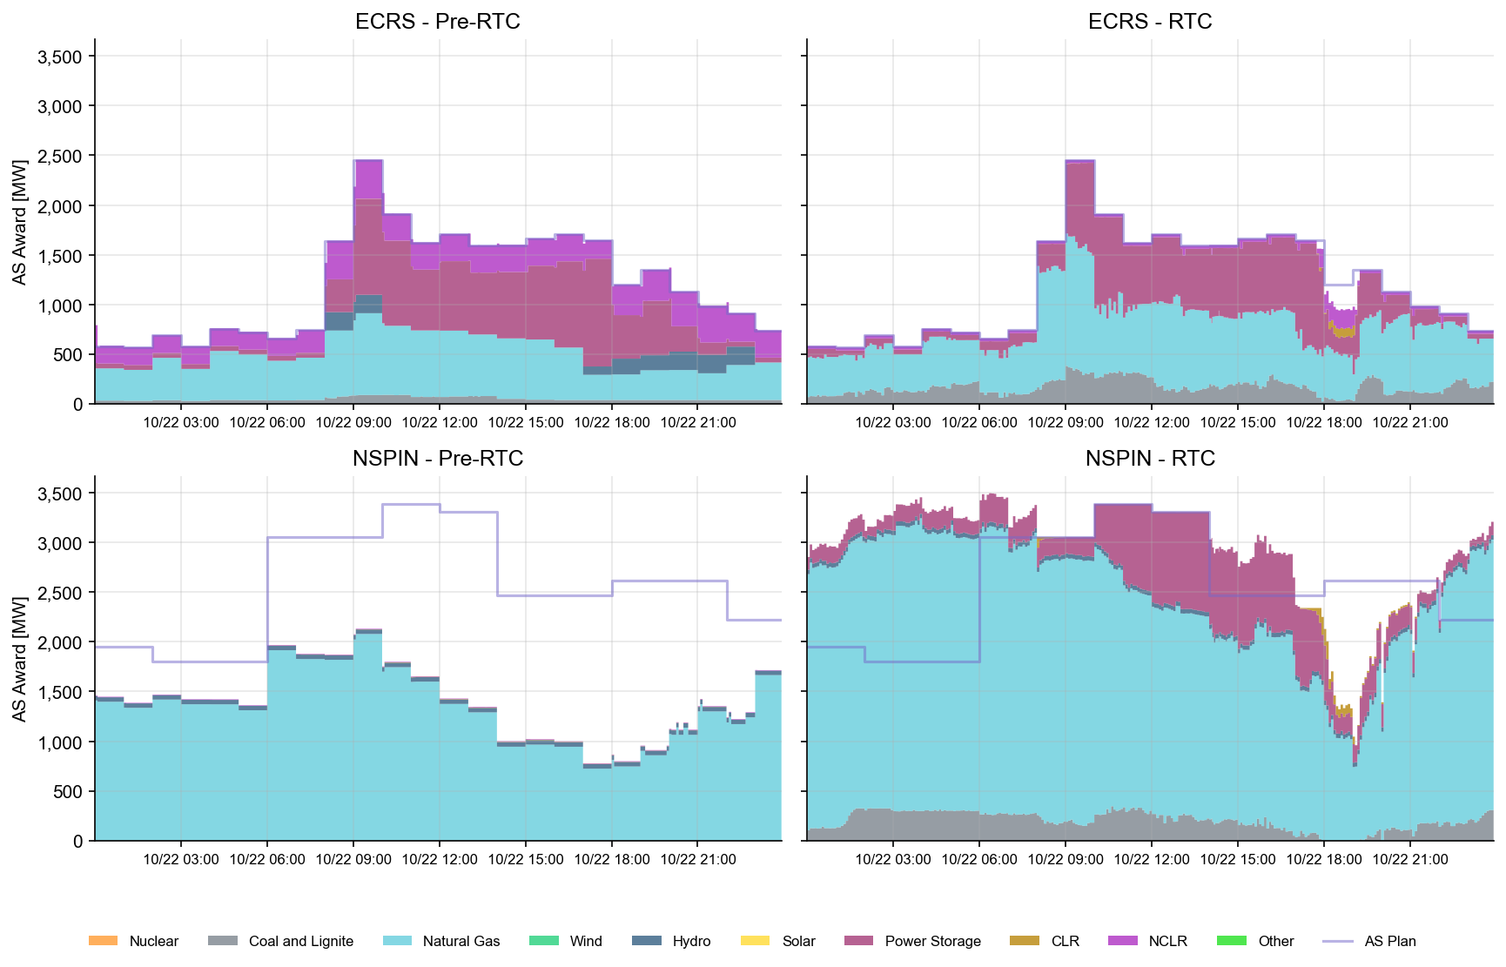
AS Awards* Summary by Resource Type
* Pre-RTC (RTM AS Schedule)
* Pre-RTC (RTM AS Schedule)

Slide 34
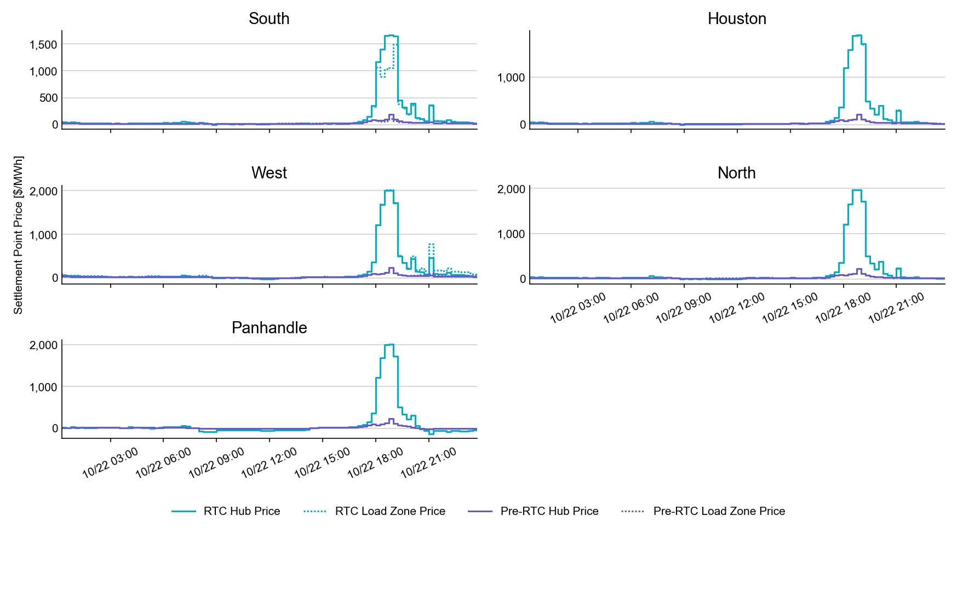
SPP by Hub and Competitive Load Zone

Slide 35
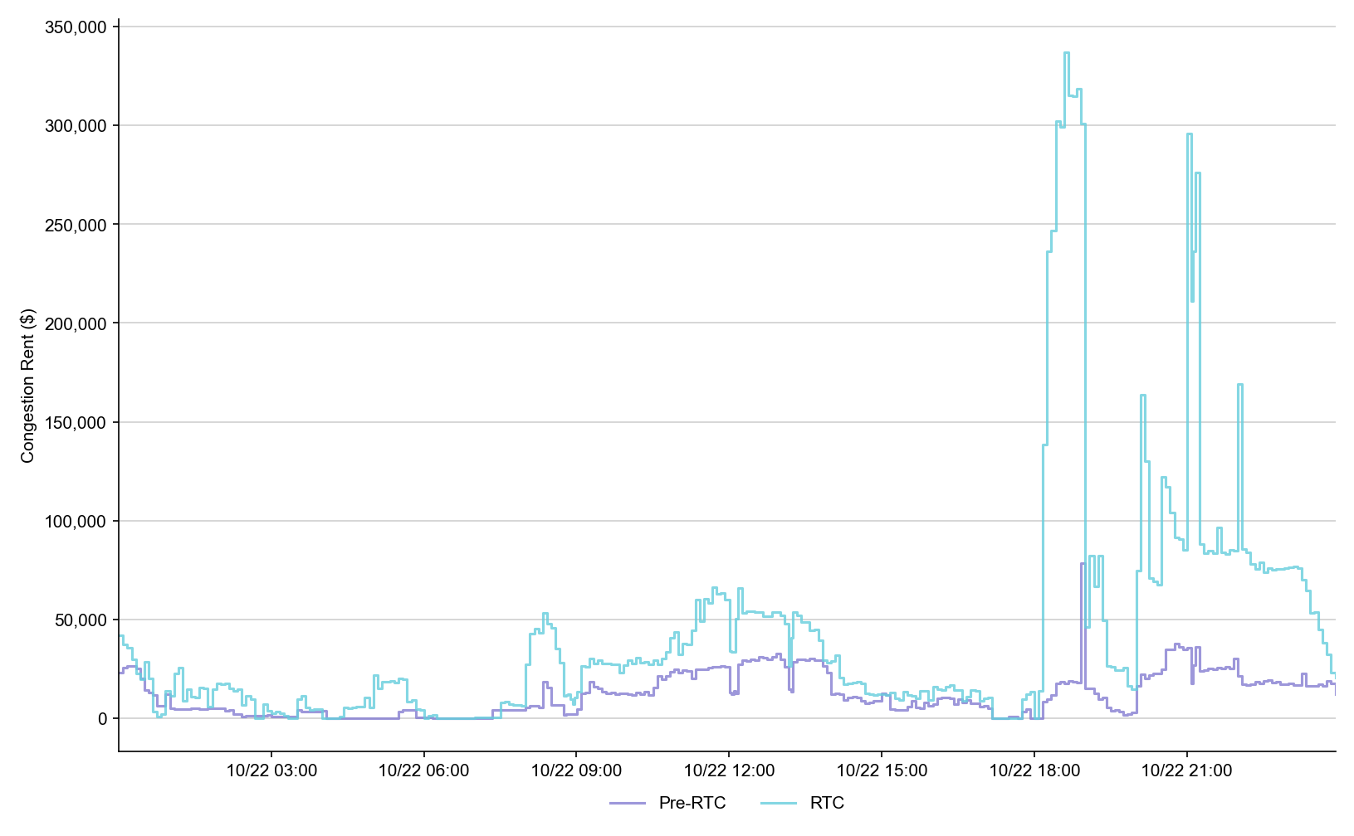
Congestion Rent

Slide 36
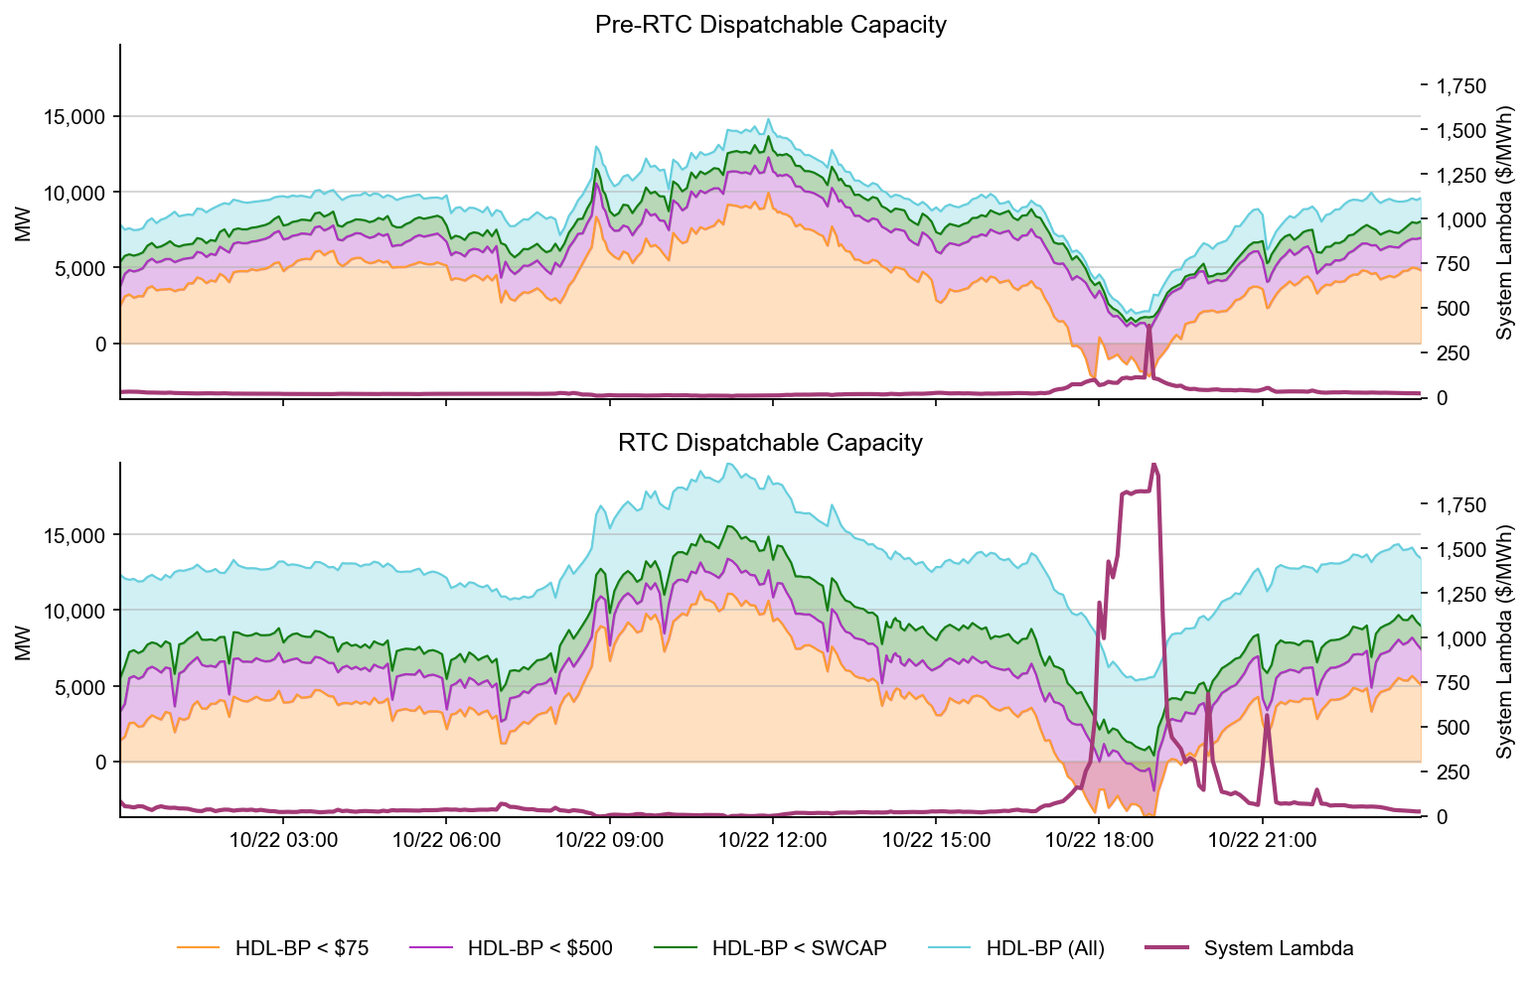
Dispatchable Capacity

Slide 37
RTC+B Market Trials Summary 10-23-2025
Due to a bug causing the MCPC values to fail to publish when the pricing run is disabled in SCED, MCPC values for the Operating Day are missing. The bug has been flagged, and a fix is being delivered.

Slide 38
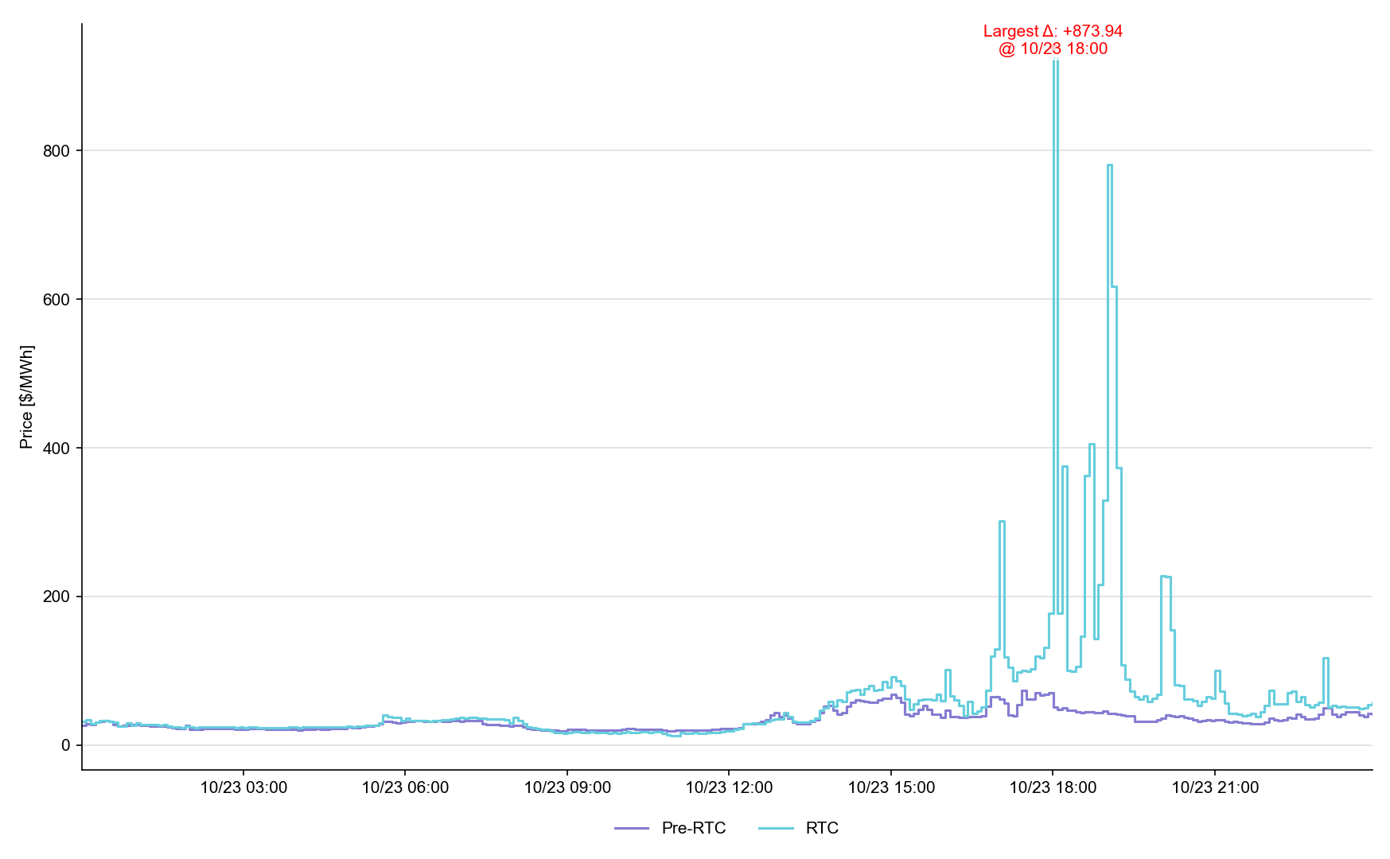
System Lambda (plus Adders)

Slide 39
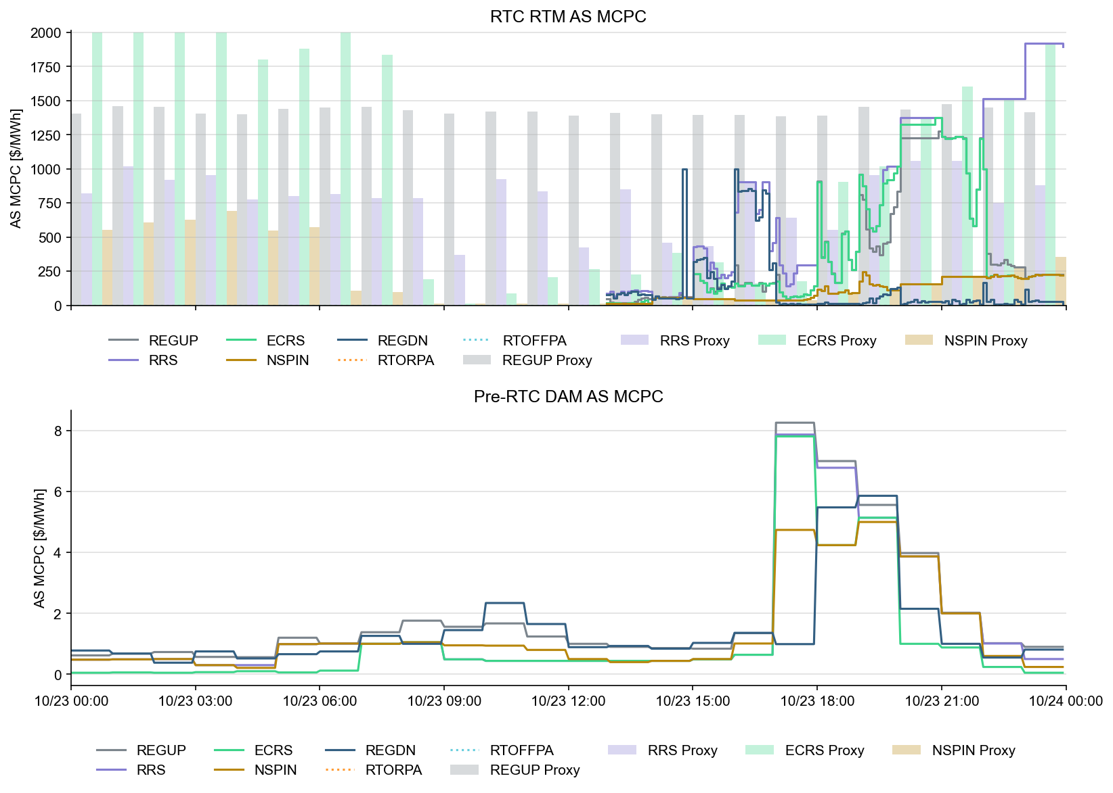
Ancillary Service Prices

Slide 40
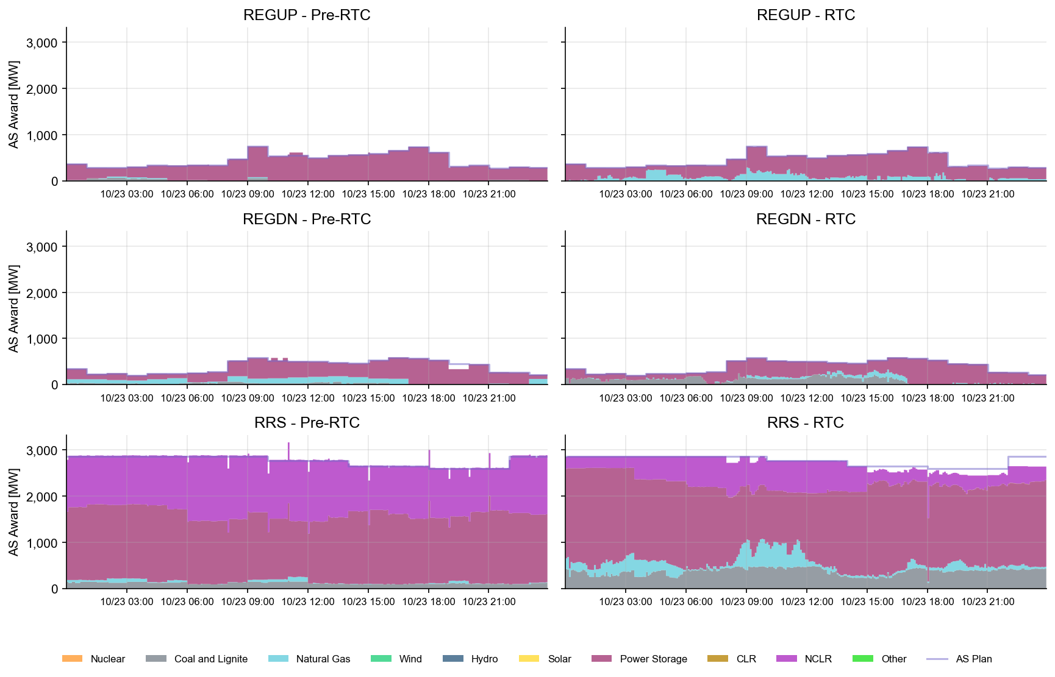
AS Awards* Summary by Resource Type
* Pre-RTC (RTM AS Schedule)
* Pre-RTC (RTM AS Schedule)

Slide 41
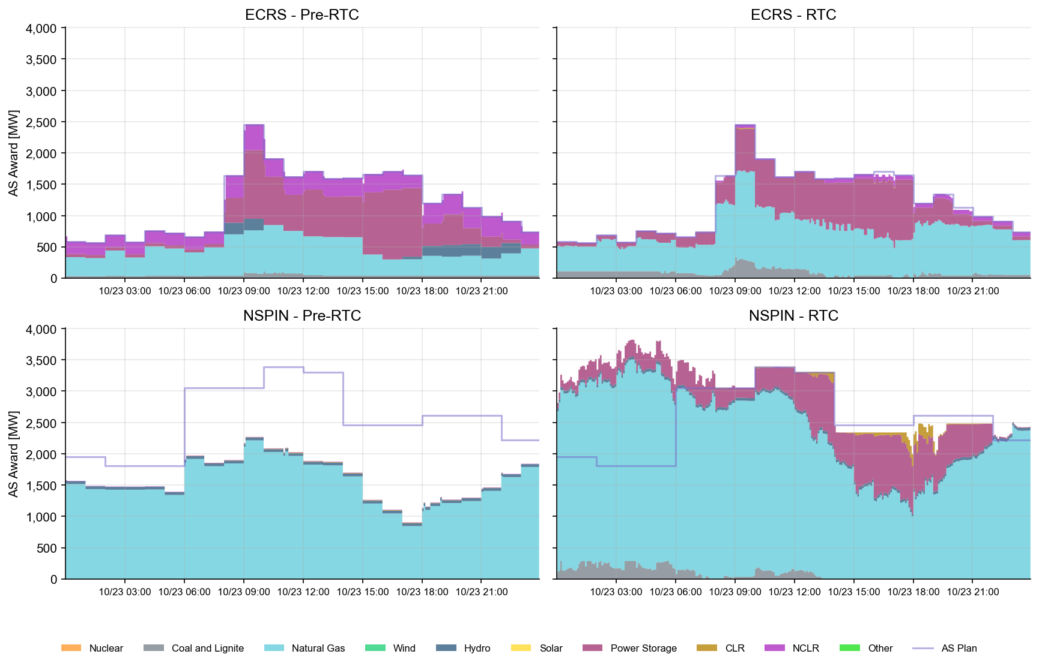
AS Awards* Summary by Resource Type
* Pre-RTC (RTM AS Schedule)

Slide 42
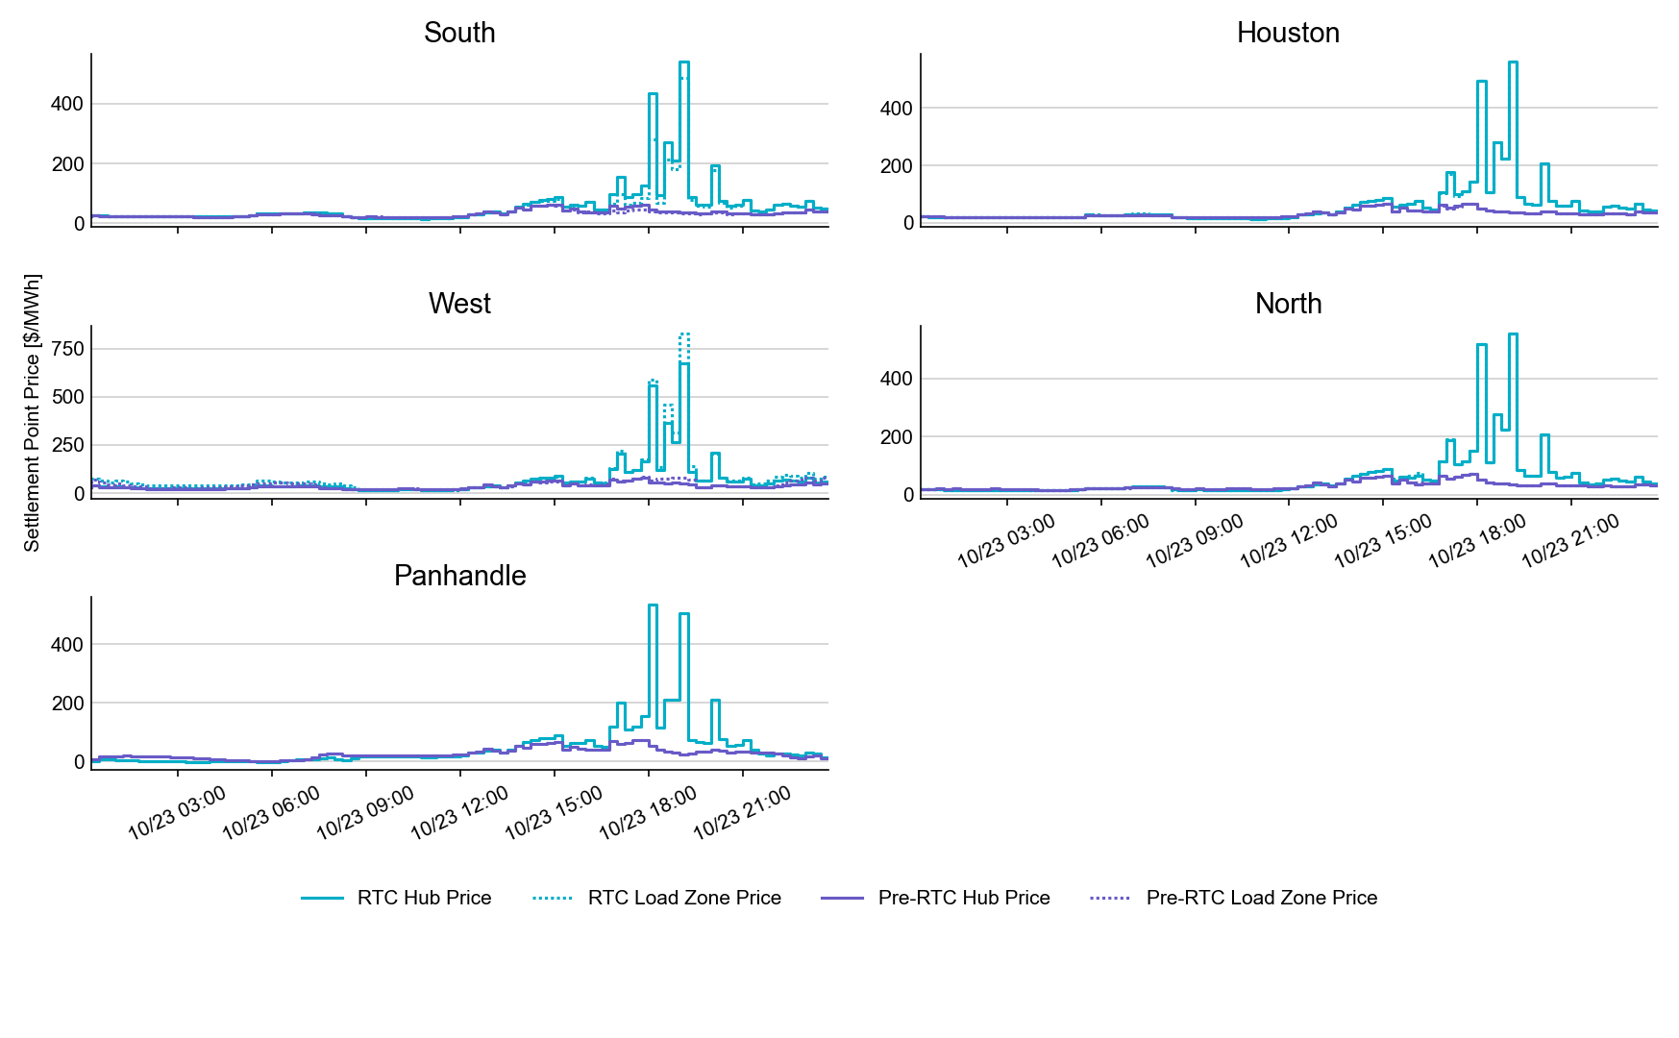
SPP by Hub and Competitive Load Zone

Slide 43
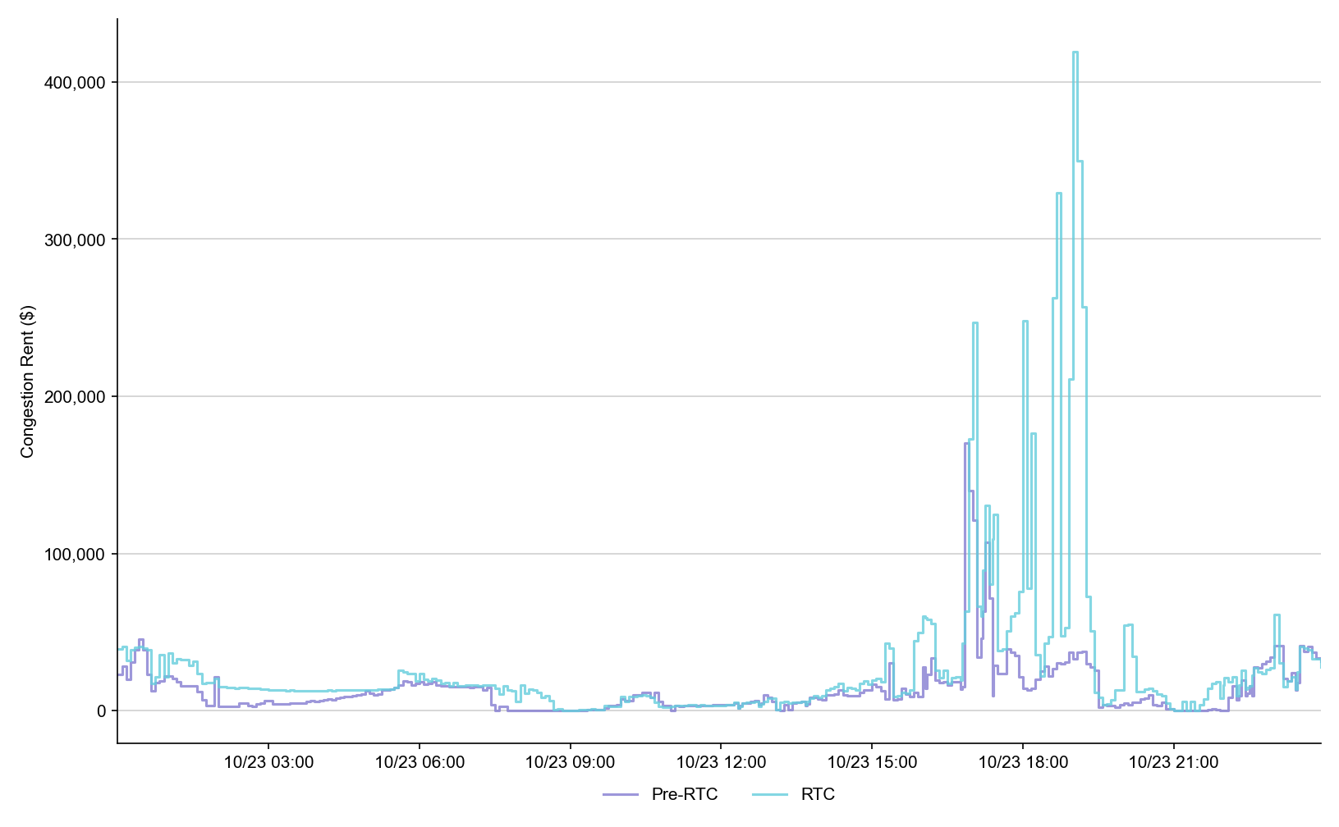
Congestion Rent

Slide 44
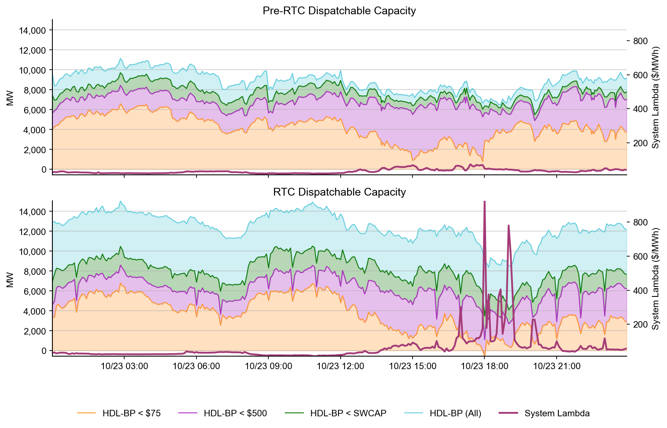
Dispatchable Capacity

Slide 45
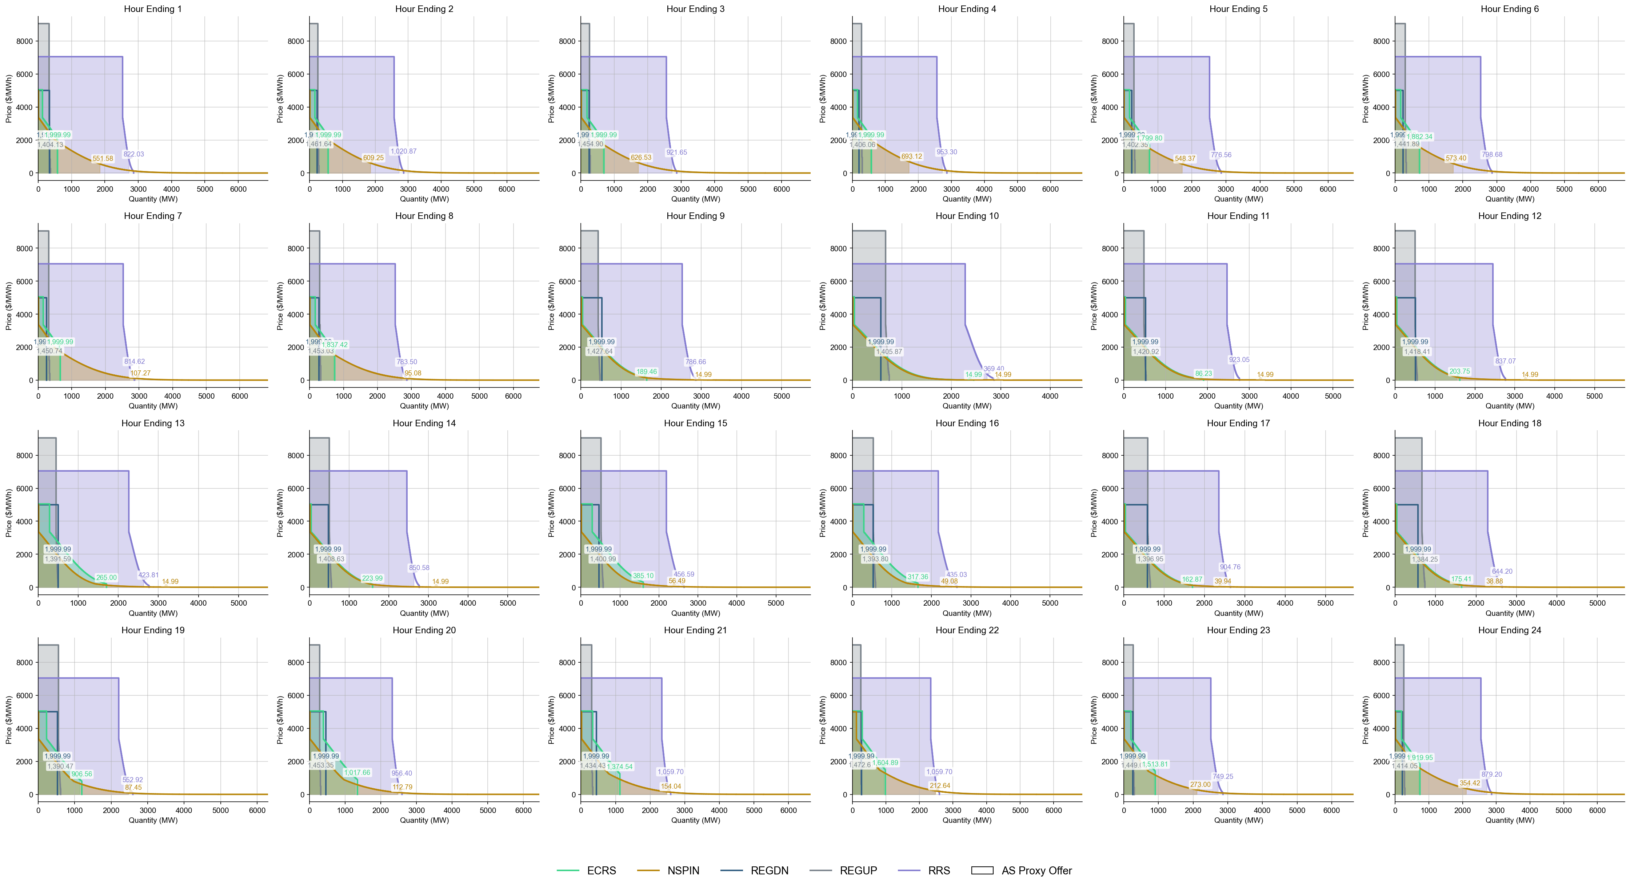
Ancillary Service Demand Curves

Slide 46
Day-Ahead Market

Slide 47
DAM Operating Day (OD) Test
Testing strongly encouraged, but not required for all QSEs
Handbook #6 Day-Ahead Market
The DAM will run on Tuesdays
DAM submission window closes at noon.
By 0600 QSEs can validate and confirm report posting:
Advisory AS Obligation: Available on Market Trials MMSUI (5 significant digits after decimal point)
ASDCs: Available on Production MIS
Load Ratio Share and PSS/e files will change with RTC cutover, but will not be visible for OD 9/17
For successful DAM completion, and meaningful results, market participants are strongly encouraged to submit various submission types, and not only submission types listed above (E.g., PTPs, EOOs, EBs, AS Self-Arrangement, non-ESR AS and non-ESR TPO submissions).

Slide 48
DAM Operating Day (OD) Test – Pre DAM
Key DAM Submission Changes
AS Obligation – no self-arrangement will be allowed over QSE’s Advisory AS Obligation.
Example: RRS Advisory AS Obligation = 2.18368 -> maximum Self-AS submission = 2.1
COP – can submit negative LSL/HSL for ESR. Can submit values for AS Capability within the existing AS fields.
TPO (EB/OC) – negative MW quantity reflects ESR EB/OC. ESR startup and minimum energy costs are not allowed and ESRs are considered self-committed.
Resource-Specific AS Offers – FRRSUP and FRRSDN offers not allowed. Offers must be between $0 and DAM SWCAP. For ESRs, RRSUFR and ECRSM offers not allowed. All AS offers from ESRs are inclusive of EB/OCs.
AS Only Offers – Offers must be between $0 and DAM SWCAP. REGUP, REGDN, RRSPFR, Online NSPIN, and Online ECRS are allowed. Other AS types are not allowed. Multi-hour and fixed blocks are not allowed.

Slide 49
DAM Operating Day (OD) Test – Post DAM
Post Publish Report Verification
AS-Only Awards
ESR Resource-Specific AS awards
TPO(EB/OC) awards
QSEs with Advisory AS Obligations and AS awards can download/review their Final AS Obligations and ensure observe/handle values with up to 5 significant digits after the decimal
DAM LMPs
DAM MCPCs
DAM Constraint Shadow Prices
Other DAM Awards

Slide 50
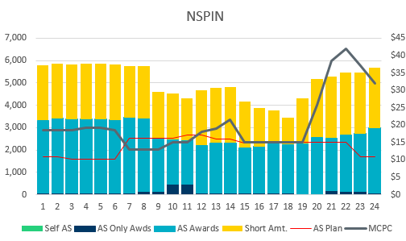
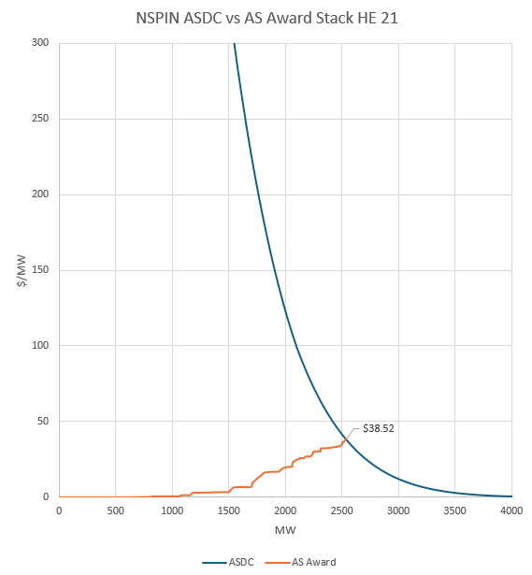
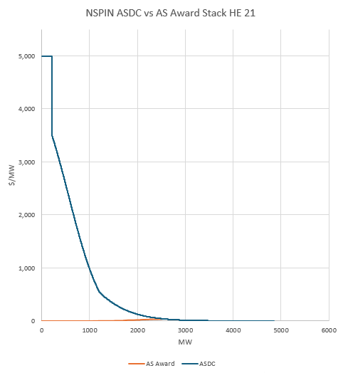
DAM ASDC Price Setting Example
OD 9/17/2025 HE 21
NSPIN MCPC : $38.52
AS Award stack intersected the ASDC @ 2536.6 MW
NSPIN AS Plan @ HE 21 : 2339 MW

Slide 51
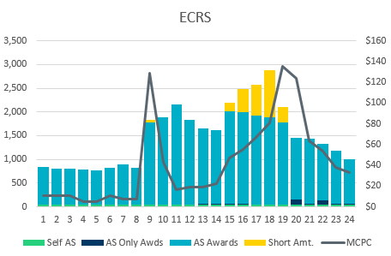
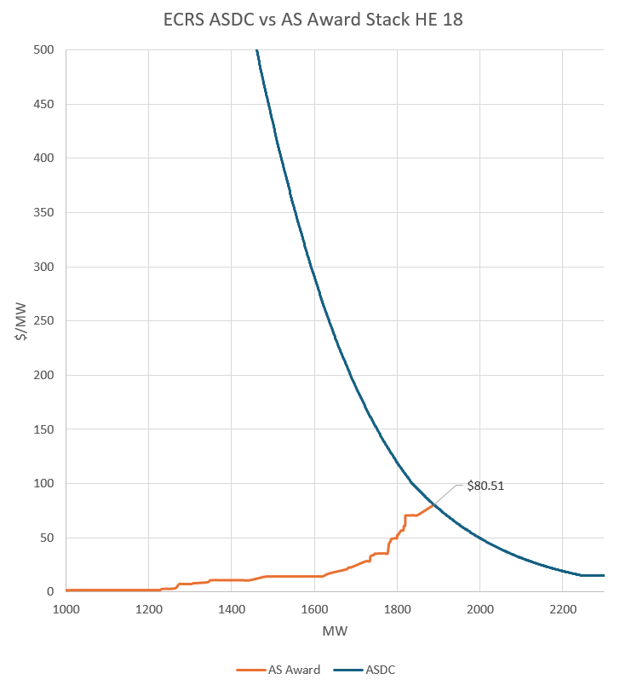
DAM ASDC Price Setting Example
OD 9/17/2025 HE 18
ECRS MCPC : $80.51
AS Award stack intersected the ASDC @ 1888.6 MW
ECRS AS Plan @ HE 18 : 2877 MW

Slide 52
NCLR Self-Provision Reminder: AS Self-Provision is a special design to allow Non-Controllable Load Resources to self-provide their AS Responsibilities into/through SCED/Real-Time Market

Slide 53
NCLR Resource Status Codes
Pre-RTC
Resource Status Codes (RST)
OUTL = 260
ONRL = 259
ONECL = 264
RTC+B
Updated Resource Status Codes (RSTR)
OUTL = 258
ONL = 257

Slide 54
Ramp Rates and Capabilities
RTC+B
Ramp Rates & Awards
UFRC (UFR Capability)
UFRA (UFR Award)
ECRR (ECRS RR Capability *10 Min)
ECRA (ECRS Award)
NSRR (NSPIN RR Capability *30 Min)
NSRA (NSPIN Award)
Pre-RTC
AS Responsibility and Schedule
RRRS
RRSC
ECRS
ECSC
NSRS
NSSC
QSE to ERCOT Telemetry
ERCOT to QSE ICCP

Slide 55
Self-Provision Achieved via Telemetry Points for NCLRs
LEGEND
QSEs will be able to self-provide in real-time via telemetered ICCP points
ICCP Change Request Example RTC+B V1.4 on RTC ERCOT webpage

Slide 56
The Self-Provision Checklist
Scenario: My Load Resource was awarded 15 MW in the DAM, and I purchased 5 MW via a trade.
My total RRS AS Position is 20 MW.
How to correctly self-provide 20 MW:
Is my resource qualified?
Telemetry Points
RSTR set to ONL (257)
UFR must be Armed
Can I cover my obligation?
Qualified MW Amount ≥ Self-provided amount
NPF - LPC ≥ Self-provided amount
Capability to Provide AS ≥ Self-provided amount
Final Step: Telemeter Self-provision
“your offers explain your extra”

Slide 57
Scenario 1
NCLR_1 has a 20 MW RRS AS Position, 15 MW from DAM award and 5 MW from RRS Trade
Scenario ** Assume AS qualified for All Headroom (NPF-LPC) | Max Power Cons. | Net Power Flow | Low Power Cons. | Resource Status | Under Freq. Relay | Self-provided RRS UFR (MW) | Self-provided ECRS (MW) | Current Capability to provide UFR (MW) | ECRS (10min) Ramp Rate (MW/min) | RRS UFR AS Award | ECRS AS Award | Notes
 | MPC | NPF | LPC | RSTR | UFR | SPUF | SPEC | UFRC | ECRR | UFRA | ECRA
NCLR_1 is qualified to provide 20 MW. DAM awards NCLR_1 with 15MW RRS. QSE also has additional 5MW RRS Position via RRS Trades. | 20 | 20 | 0 | ONL | Arm | 20 | 0 | 20 | 0 | 20 | 0 | NCLR_1 Telemetry needs to show: Status = ONL, MPC >= NPF >= 20 MW, NPF-LPC >= 20 MW, RRS capability >= 20 MW, RRS self-provided telemetry = 20 MW SCED will respect the 20 MW self-provided RRS and award the resource 20 MW RRS UFR.
QSE to ERCOT Telemetry
ERCOT to QSE ICCP

Slide 58
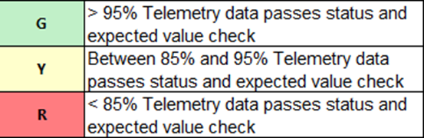
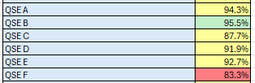
Telemetry Screening for Scorecard 3B for Handbook 3 Acceptable Telemetry Point values received by ERCOT for active resources.
Scoring:
Key points for Telemetry scorecard check
Device types checked - Units, CLRs, NCLRs, ESRs for each QSE
RTCB Telemetry status should be “Good” quality
RTCB Units / CLRs / NCLRs Telemetry values should be within “Expected Range” or an expected value. Details are provided in next few slides.
Expected values are derived from equivalent analogs in current production, based on defined criteria.
RTCB ESR telemetry values are checked against corresponding combo model Battery Unit / CLR counterparts in production.

Slide 59
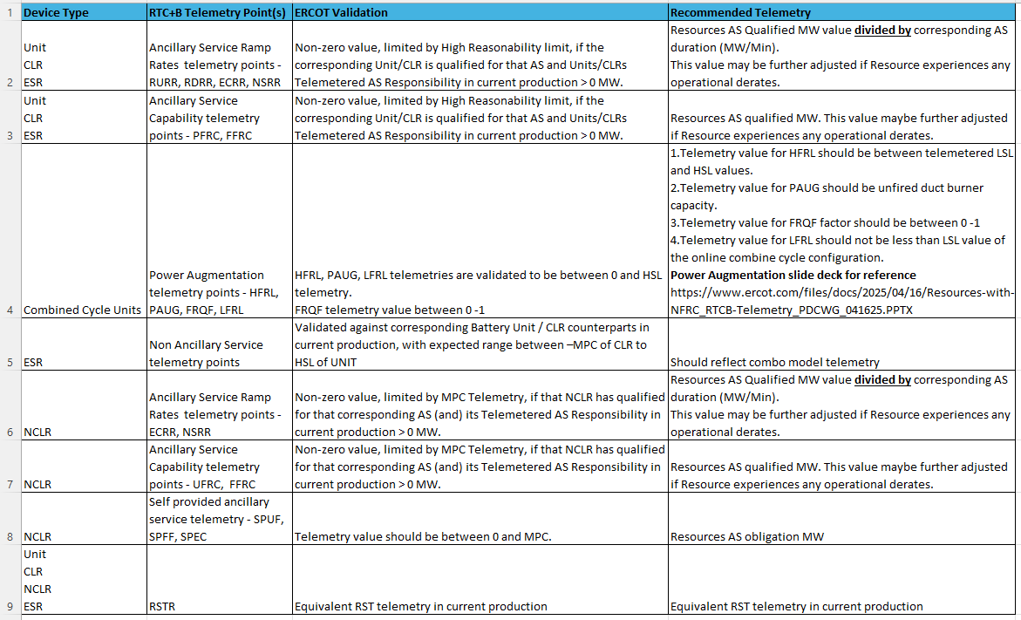
RTC+B Telemetry points screening/validation

Slide 60
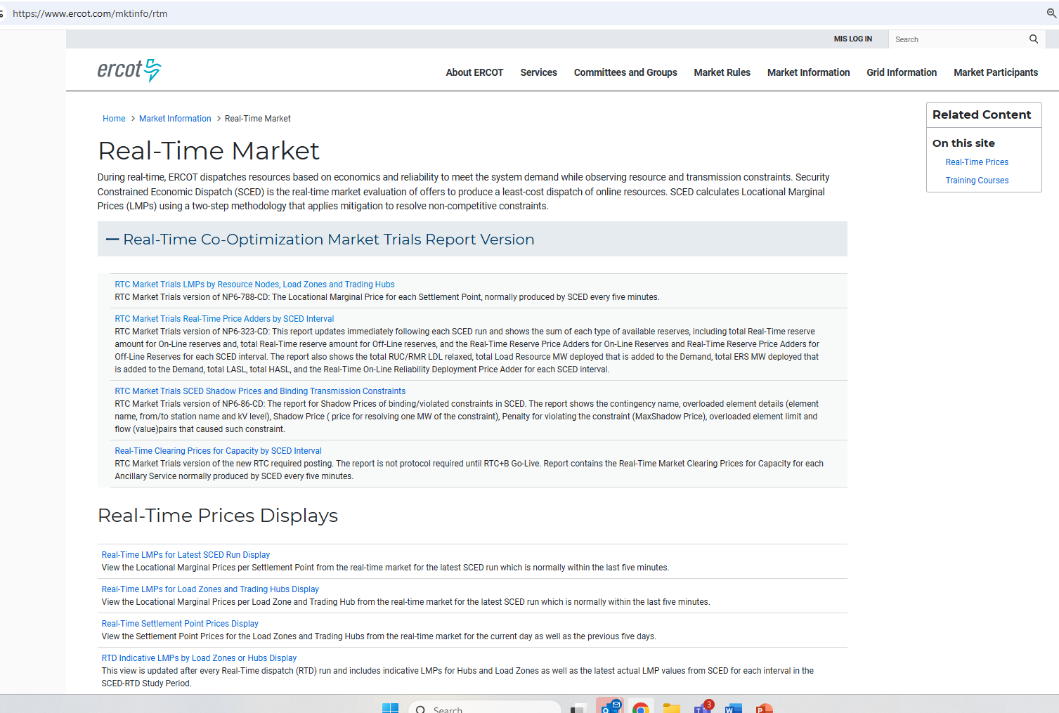
RTC+B New Reports Posted to the ERCOT Website
Links to the available RTC+B versions of Real-Time reports posted on Real-Time Market Information page.

Slide 61
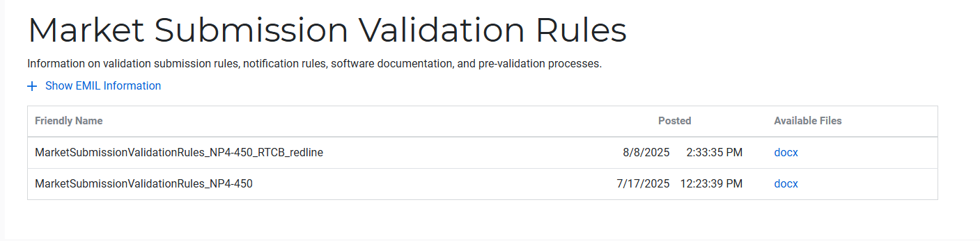
Submission validation update - PROD vs RTC+B
NPRR1290 :
cleaned up protocol language around submitting offer curves and bid curves
disallows having more than 2 price/quantity points in a flat/vertical segment of the curve.
Impacts to QSEs during dual-submission – some submissions accepted in Production will be rejected in Market Trials environment:
RTM Energy bids – protocol requiring “increasing quantities” now enforced.
Reverted this change to validation. Further discussion highlighted protocol should be brought in line to long-standing practice, not validation.
Example: Bid with Q1=0mw, Q2=10mw, Q3=10mw will be rejected as Q3 does not increase from Q2.
TPO & RTM Bid – more than 2 price/quantity pairs with same price or quantity will be rejected
Market Submission Validation
Rules document updated.

Slide 62
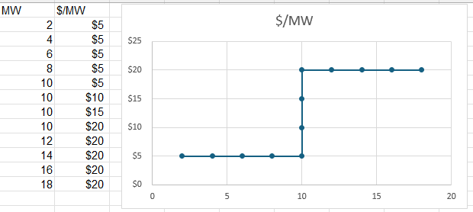
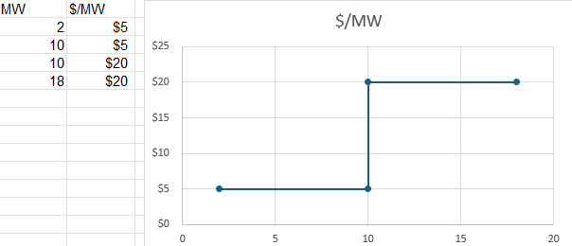
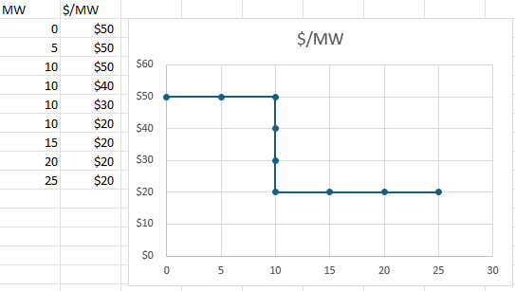
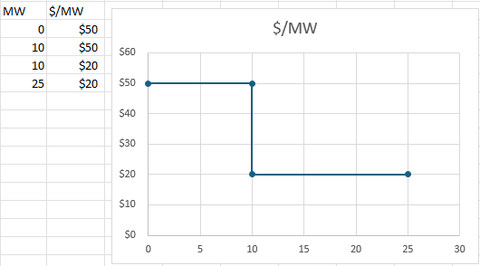
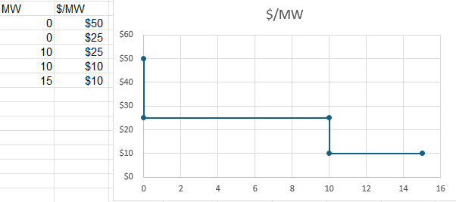
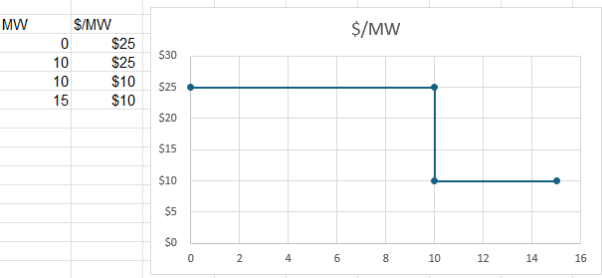
Submission validation update - PROD vs RTC+B
TPO – EB/OC - EOC
RTM EB
RTM EB

Slide 63
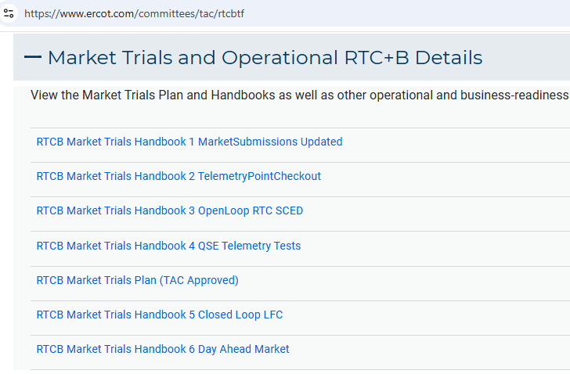
Market Trials Framework:
TAC Approved the Market Trials Plan in October 2024
Discussions with RTC+B Task Force have shaped the Handbooks
Handbook #1- QSE Submission Testing
Handbook #2- QSE Telemetry Tests
Handbook #3- Open Loop SCED
Handbook #4- QSE Telemetry Tests
Handbook #5- Close-Loop LFC Tests
Handbook #6- Day-Ahead Market Tests
All are posted on the
RTCBTF Homepage
under Market Trials banner

Slide 64
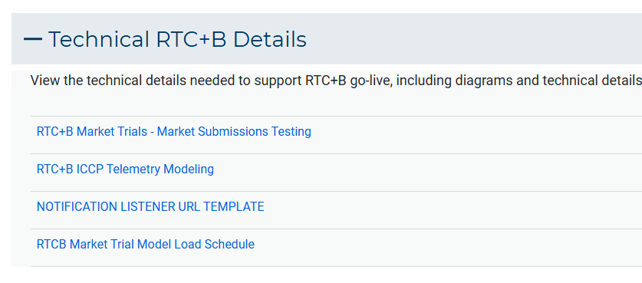
Market Trials Technical Details
Detailed discussions with TWG have provided technical content details
Digital Certificate details
Connectivity/URL details to User Interfaces and APIs
Reminder of how to submit new ICCP requests
RTC and Production Telemetry connectivity
Network Model Load Schedule
All are posted on the
RTCBTF Homepage
under Technical Details banner

Slide 65
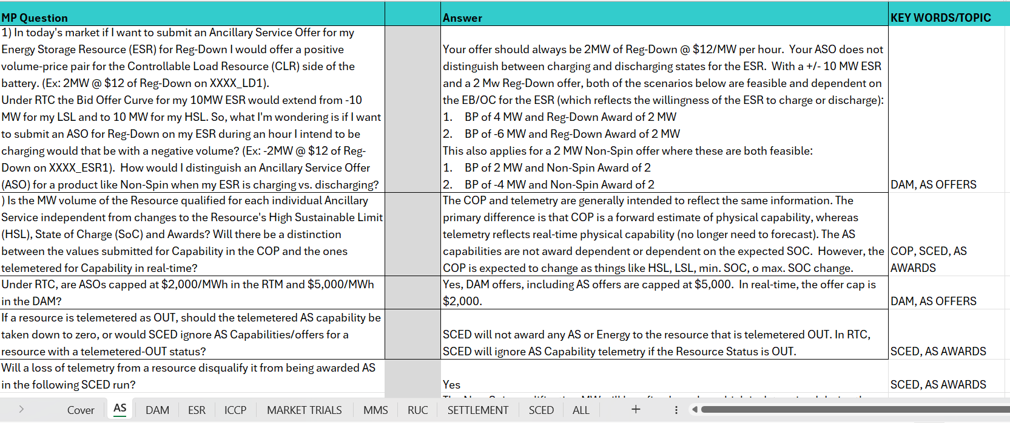
Reminder of RTC+B FAQ
Posted on RTCBTF Home Page under Key Documents
Common questions/responses in Excel Workbook (target weekly updates)
Search workbook for Key Words
Worksheets for categories

Slide 66
RTC+B Market Submissions - Systems configurations
Start
03/2025
Start
05/2025
Start
07/2025
Start
09/2025
Go-Live
12/5/25*
Feb 2025
Mar 2025
Apr 2025
May 2025
June 2025
July 2025
Aug 2025
Sep 2025
Oct 2025
Nov 2025
Dec 2025
Optional: RTC QSE/Vendor Developer
Submission Testing
RTC QSE
Submission Testing
Open-loop
RTC SCED
Ongoing Open-Loop
& Periodic Closed-loop SCED/LFC
Certificate: Current MOTE
Env: ERCOT RTC Market Trial
URL: RTC MIS MOTE URL
Certificate: Current Production
Env: ERCOT RTC Market Trial
URL: RTC MIS Market Trial
Cert: Production
Env: Prod
URL: MIS Prod
QSE/Vendor developer can use MOTE certificates & RTC MIS MOTE API URL to test the submissions until end of submission testing phase (end of June) as needed. At the start of the Open Loop testing, RTC MOTE MIS URLs will be disabled.
URL links: RTC MOTE and Market Trial URL links to be used for MMSUI, OSUI and API submissions. Actual links are provided in next slide.
For notifications/responses to MPs from RTC Market Trials environment, MP will need to provide the listener URL to ERCOT

Slide 67
RTC+B Market Submissions - Systems configurations (Updated with URLs)
RTC+B Market Trials and Go-live
RTC Phase | Digital Certificate | MMSUI / OSUI URL | API / WAN URL
Vendor/QSE Submissions Testing | Current MOTE | RTC MOTE MIS URLs https://testmarkettrials.ercot.com/mmsui/mmsui/displayTradesLanding.action https://testmarkettrials.ercot.com/osrui/osrui/Summary.action | RTC MOTE API/WAN URL https://testmarkettrialsapi.ercot.com/NodalAPI/EWS/ https://testmarkettrialsapi.wan.ercot.com/NodalAPI/EWS/
Open Loop and Closed Loop Testing | Current Production | RTC Market Trial URL https://markettrials.ercot.com/mmsui/mmsui/displayTradesLanding.action https://markettrials.ercot.com/osrui/osrui/Summary.action | RTC Market Trial API/WAN URL https://markettrialsapi.ercot.com/NodalAPI/EWS/ https://markettrialsapi.wan.ercot.com/NodalAPI/EWS/
From RTC Go-live onwards | Current Production | Current Prod MIS URL mis.ercot.com/mmsui mis.ercot.com/osui | New Production API/WAN URL

Slide 68
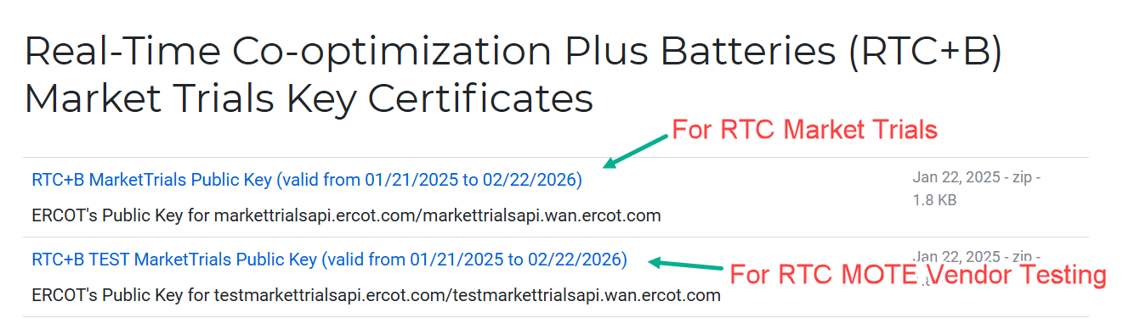
RTC+B Market Submissions - Systems configurations Public Key Update for WAN/API submissions
For API/WAN submissions into Market Trials environments, need to download public keys and place into the keystore location in system being used for RTC+B submissions.
No change to digital user certificates – continue to use existing MOTE and Production Certificates
Market Trial API Public key location: https://www.ercot.com/services/mdt/webservices

