Slide 1
Guaranteed Reliability Load (GRL) — Operations
Wholesale Market Working Group 11/3/25

Slide 2
Summary
Concept:
Large loads are allowed to bring load on earlier
Must provide ability to curtail load that is not available in studies
Once transmission solutions are built load no longer needs to offer
Current thinking: a SCED-based approach will work for GRL curtailment and recovery.
Possible Operational Automation: a tool may be needed to automatically lower offers when reliability events occur.
Discussion of 100 hour limit
Without an hour cap, implementation is streamlined and relatively easy.

Slide 3
Why SCED Works for GRL
Uses the existing systems managing constraints
Curtails GRL economically and locationally as scarcity/congestion arises; restores smoothly as it clears
Preserves nodal granularity; respects transmission constraints and limits operator workarounds
Minimizes new constructs—no parallel manual curtailment stack required
Telemetry would be needed: basepoint MW, ramp limits, and (if applicable) on‑site generation status
Consideration should be given to shift factor relationships and constraint violations

Slide 4
Auto‑Lowering Offer Tool
Due to SF relationships and Constriant Violation Limits, Loads may not be operated for violations
Relationship should be considered to right size offer caps if needed
High enough not to operate for normal power balance
Low enough to operate for local transmission constraints
Could raise Constraint Violation levels to allow for better operation
345kV is currently at $4,500/MWh
ERCOT raised potential of an automated tool to lower offer curves during certain contingency violations
Would need to be automated

Slide 5
100 Hour Limit Proposal
In comments Google requests a 100 hour limit be imposed
Market needs some tool to manage risk
Billions of dollars of investment that could be idled
Limit would cause load to be treated as Firm if reached
Can cause problems with cascading failures
Need to strike a balance
System security vs. participation
Is there an alternative that could work for both?
Notification of future outages
Structures or processes that limit potential exposure

Slide 6
CLR NPRR to be Filed
New NPRR to be filed with same basic concepts but formalizes CLR use
May be merged with or take place of NPRR1284
Look forward to discussions on that NPRR

Slide 7
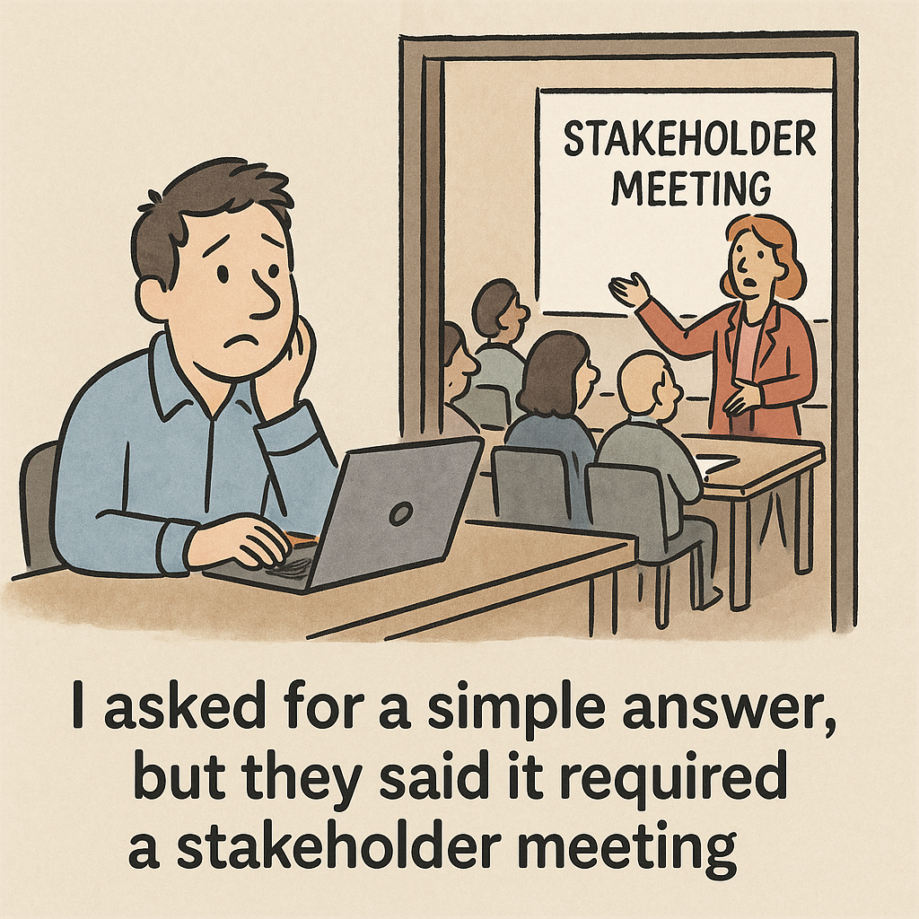
Questions?

