Slide 1
Unregistered Distributed Generation Report:
2025 Q3 Update
Resource Adequacy
11/5/2025

Slide 2
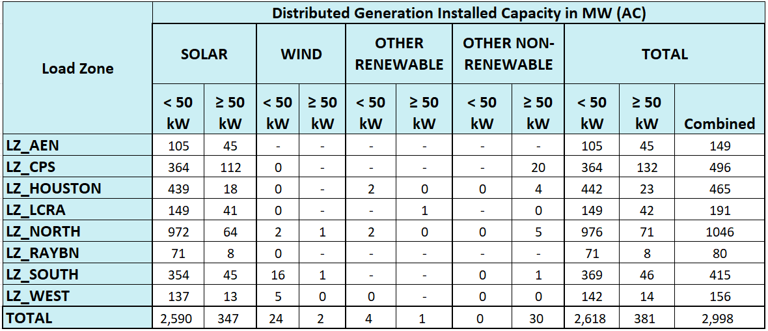
2025 Q3 Unregistered Distributed Generation Report
DG Battery Energy Storage not included in the table above
(83.3 MW Competitive, 20.9 MW NOIEs, 104.2 MW Total)
Totals may not match the sum of their columns/rows due to rounding
Notes:
Competitive and NOIE breakdown:
Competitive: 1,738 MW
NOIE: 1,260 MW
For the quarterly report, NOIE capacity below 50 kW only includes information from NOIEs that have more than two MW of aggregate capacity from those sites.
Other Renewable category includes: biomass (wood/wood wastes), landfill gas, other biomass gases, and water.
Other Non-Renewable category includes: bituminous coal, subbituminous coal, lignite coal, petroleum coke, distillate fuel oil, natural gas, other gases, and waste heat not directly attributed to fuel source.

Slide 3
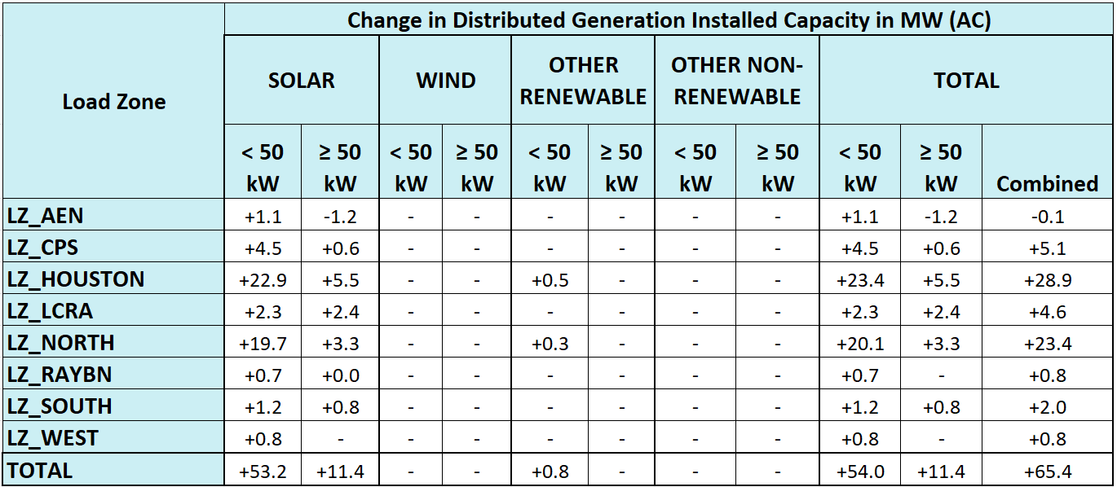
2025 Q2 → 2025 Q3 Change
The decrease in “LZ_AEN, Solar” is due to the removal of a single customer-owned system.
Totals may not match the sum of their columns/rows due to rounding.

Slide 4
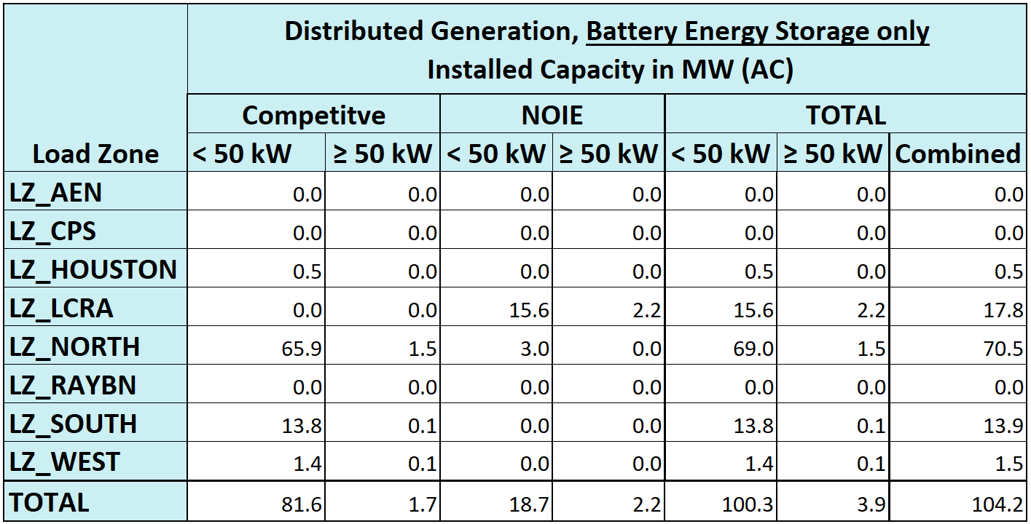
2025 Q3 Unregistered Distributed Generation Report, Battery Energy Storage only
Totals may not match the sum of their columns/rows due to rounding

Slide 5
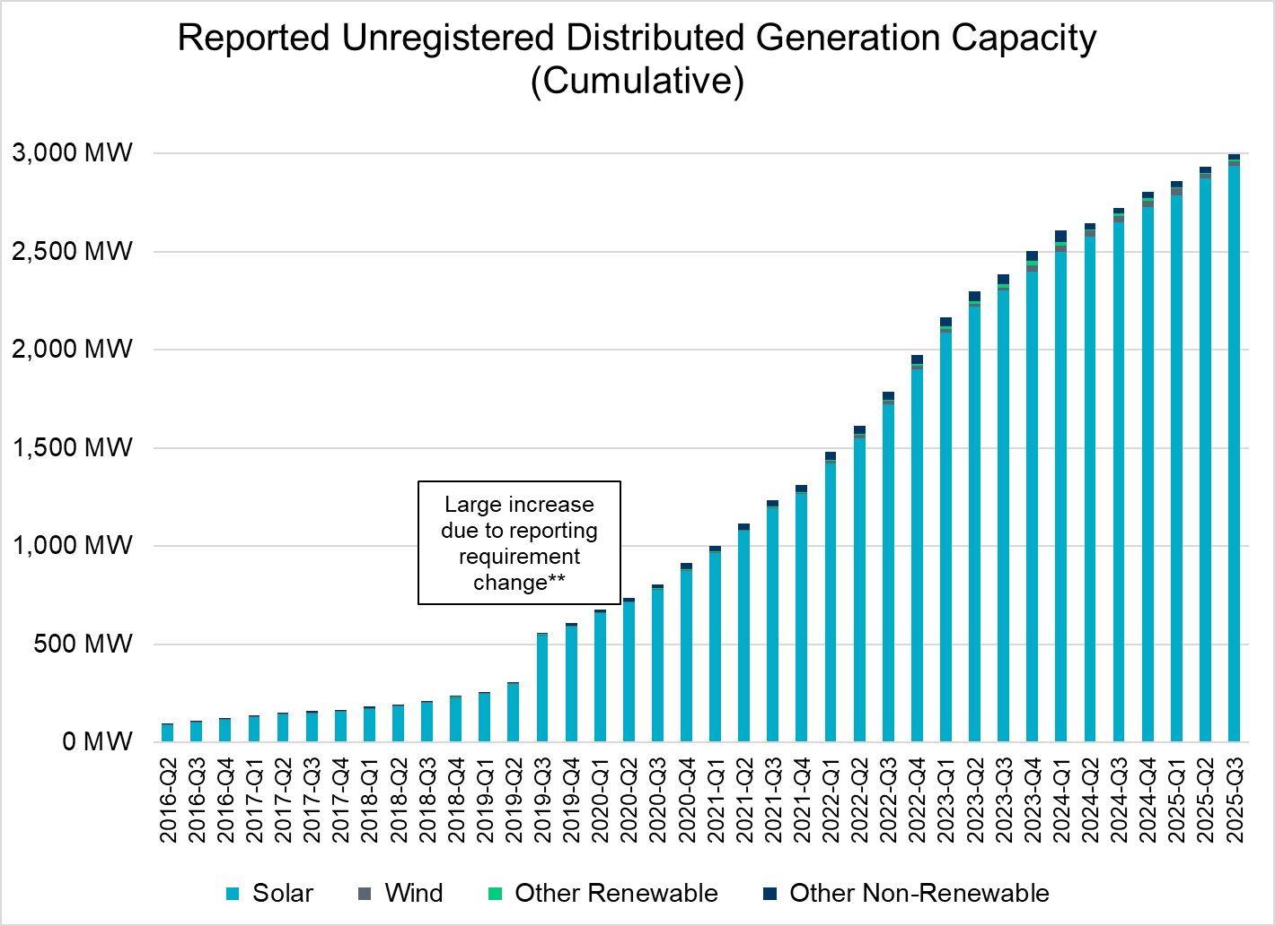
Unregistered DG Growth: 2016-Q2* to 2025-Q3
* 2016-Q2 was the first report published after implementation of report changes per NPRR794/COPMGR044
** 2019-Q3 was the first report published after implementation of report changes per NPRR891

