Slide 1
NOGRR245 (IBR Ride-Through) - RIOO
October 29, 2025

Slide 2
NOGRR245 IBR Ride-Through - RIOO
Requirements
  Capture the ride-through capabilities based on the requirements identified in IEEE 2800-2022 standard for Interconnection and Interoperability of Inverter-Based Resources (IBRs).
RIOO Application changes
  RIOO application is updated with 5 new panels for MPs to enter ride-through capabilities data, for IBRs.
    Frequency Ride-Through
    Voltage Ride-Through
    IEEE Ride-Through
    Ride-Through Exemption
    Ride-Through Extension
  Exemption and Extension panels are view-only, for legacy resources (SGIA signed before 8/1/2024 ).
  The changes will be implemented in both RIOO-IS and RIOO-RS.

Slide 3
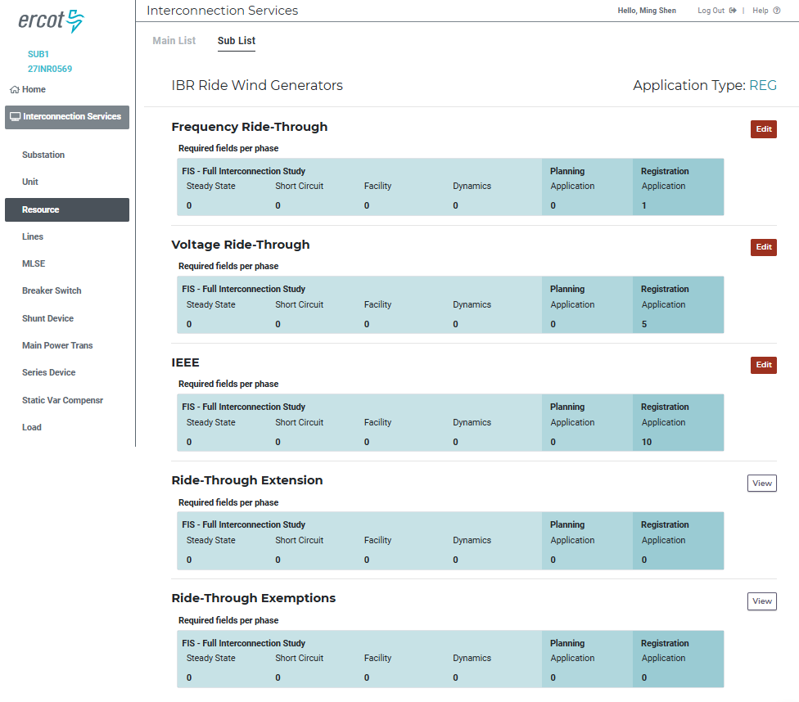
NOGRR245 IBR Ride-Through - RIOO

Slide 4
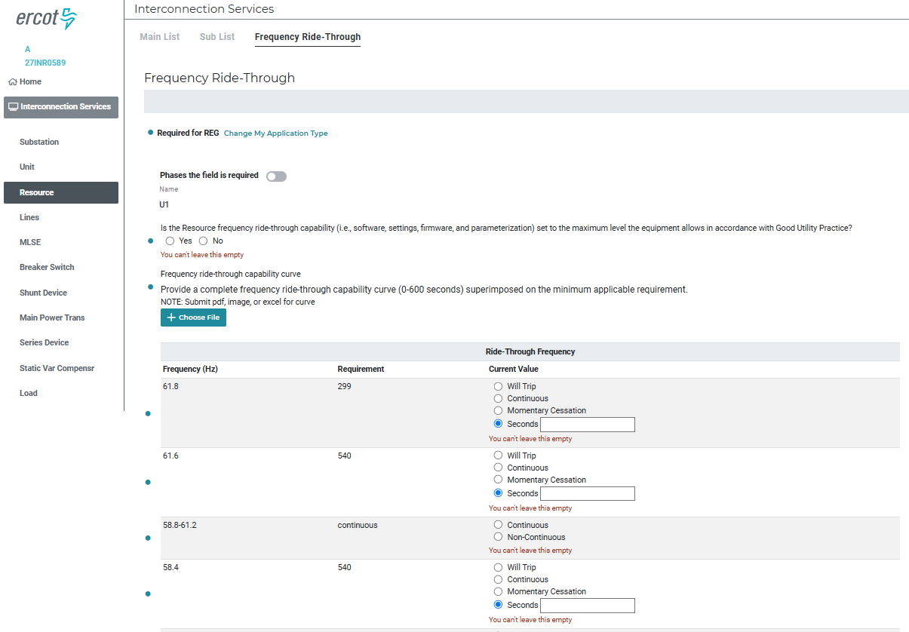
NOGRR245 IBR Ride-Through - RIOO

Slide 5
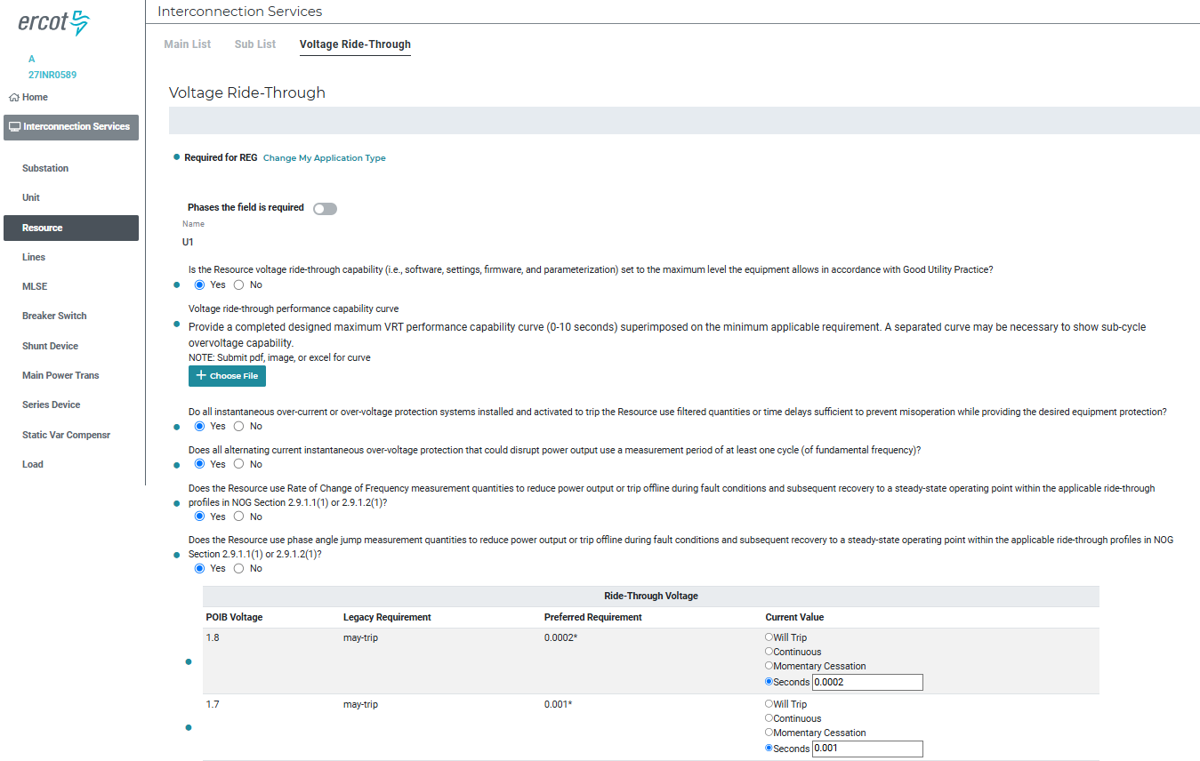
NOGRR245 IBR Ride-Through - RIOO

Slide 6
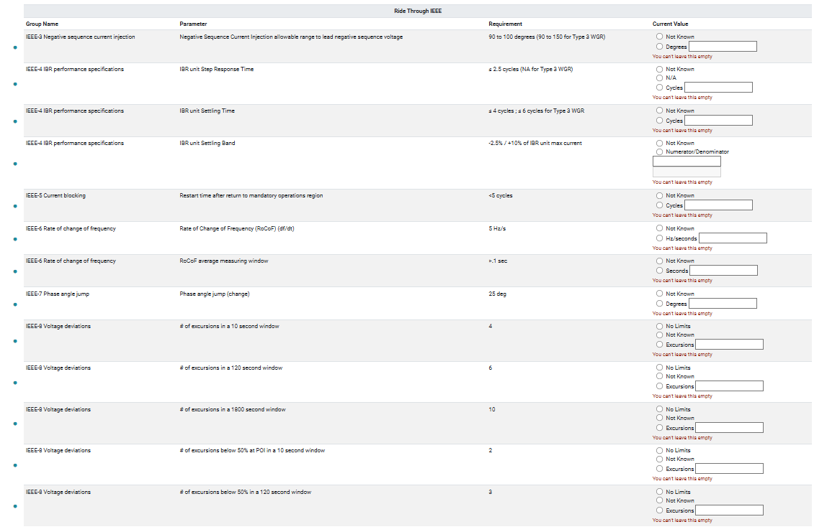
NOGRR245 IBR Ride-Through - RIOO

Slide 7
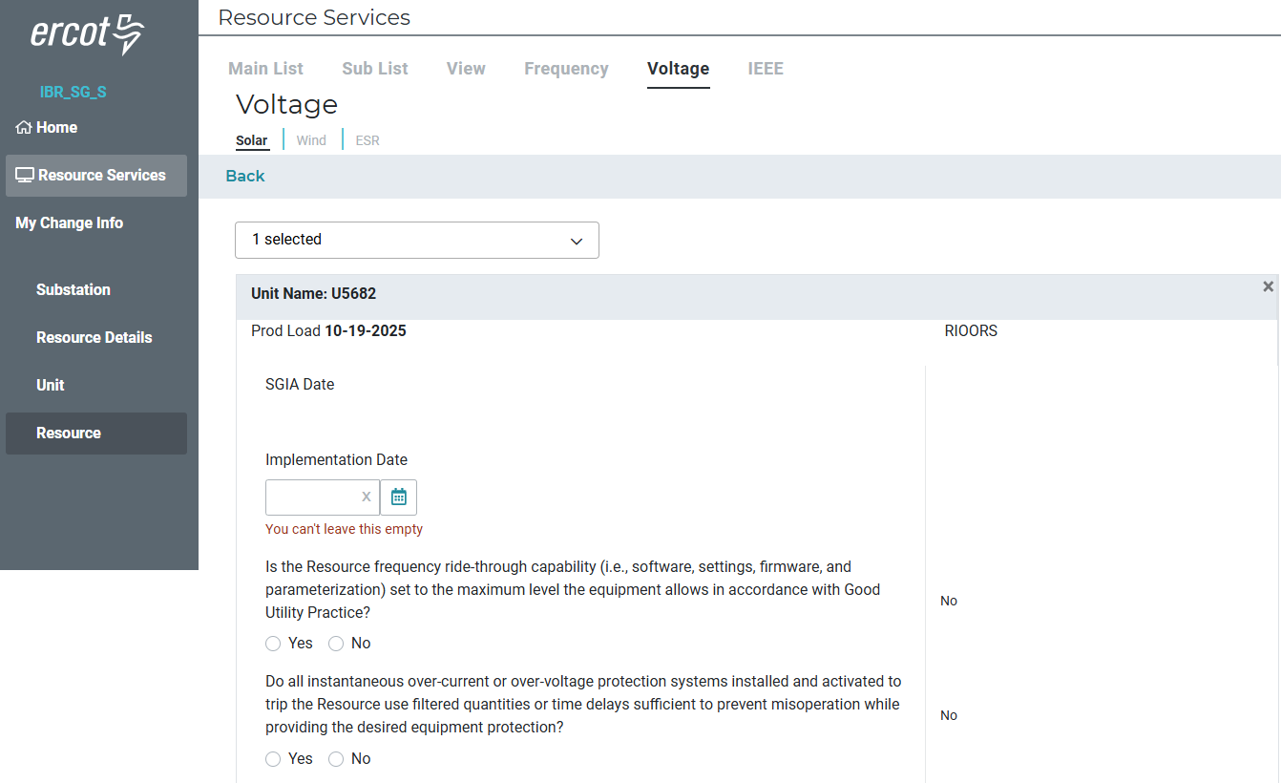
NOGRR245 IBR Ride-Through - RIOO

Slide 8
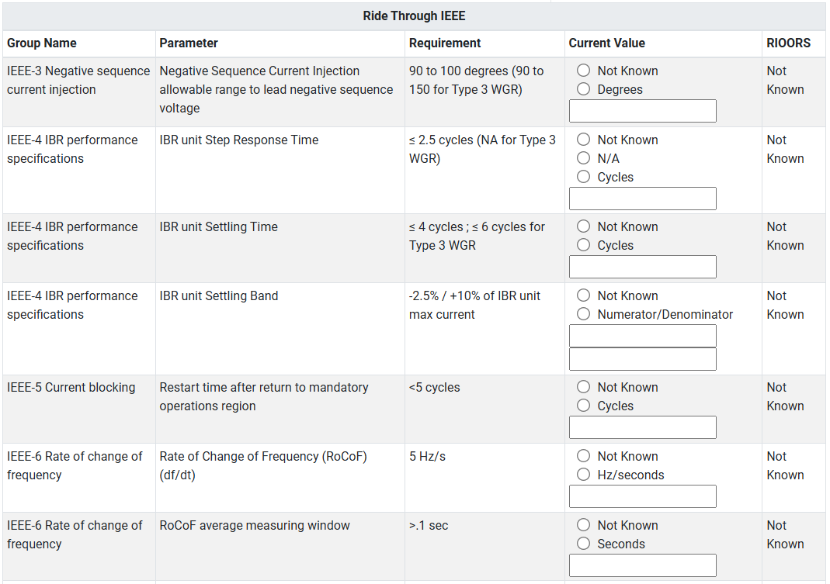
NOGRR245 IBR Ride-Through - RIOO

Slide 9
NOGRR245 IBR Ride-Through - RIOO
Current Status and Release Timelines
  Testing is in progress.
  PROD release – end of October.

