Slide 1
RTC-RUC AS Deployment Factors (DF) for Go Live
Response
Balancing Operations Planning Staff
RTCBTF
October 27, 2025

Slide 2
Recap on ERCOT’s approach for ASDFs for RTC Go-Live
The ASDFs that ERCOT has shared are for immediate use along with RTC Go-Live. These values have been selected based on functionality that is expected to be available at Go-Live and expected submission behavior.
Specifically, upon RTC Go-Live changing ASDFs will require manual operator action. To keep the process manageable and reduce the risk of human input errors, ERCOT intends to set ASDFs in a manner that minimizes manual operator action to change these.
Post-RTC Go-Live, as more operational experience with RTC is gained, ERCOT intends to transition to setting ASDFs a day or two days prior to the Operating Day informed by forecasted uncertainty or other relevant data.
This approach will require system changes both to determine the appropriate ASDFs and establish a workflow that updates the ERCOT systems with these.

Slide 3
Response to Previous Presentation
Set ECRS, NSPIN DFs to 0
ERCOT disagrees with this.
It is correct to say that from a deployment perspective RRS, ECRS & Non-Spin are not the same as Regulation. But it is incorrect to say these services don’t get deployed, implying that the capacity is never converted into energy. SCED will deploy them by effectively going short on procurement when uncertainties materialize.
Non-zero AS deployment factors in RUC assess the system’s preparedness for responding to a sustained or multi-hour event in terms of energy sufficiency to meet demand (i.e. not go into firm load shed). These would be events when SCED is likely to procure less ECRS and NSPIN (i.e. the case where the ESRs are NOT being awarded AS but are being given discharge Base Points to meet the load).
Lastly, ERCOT reiterates, ASDFs for RRS can be zero because historic events have shown that energy drained in providing PFR (and FFR) within an hour have been minimal and the drained energy can be recovered within the hour. The risk of same ESR carrying RRS in multiple hours and running out of energy to provide RRS is significantly lower than the risk with ECRS and Non-Spin.

Slide 4
Response, Contd.
Change duration for AS in RUC to match Real Time
ERCOT disagrees with this. (It’s worth noting that RUC AS duration are codified in the protocols by NPRR1282.)
RUC is a multi-interval optimization that optimizes ALL intervals simultaneously (like DAM). This is the reason why the duration requirements for each AS are set to 1 hour (except for FFR which remains 15 minutes). With these settings the RTC RUC dispatch for energy and AS is the expected average for that hour.
Comment on HBSOC profiles
ERCOT’s observation is that the HBSOC profiles submitted in COPs today are vastly different than the actual SOC seen in Real-Time and many a times are “flat” or unchanging during all hours of a day.
ERCOT reiterates “flat” or unchanging HBSOC profile for an ESR in COP are problematic both today and under RTC.
These type of profiles will greatly restrict RTC RUC’s ability to dispatch ESRs for energy and AS. Even with zero AS deployment factors, ESRs will be exposing themselves to the risk of being caught short by the RUC Capacity Short calculation.
ERCOT requests ESR operators to submit HBSOC in COPs that reflects their plan to charge and account for their expected discharge.

Slide 5
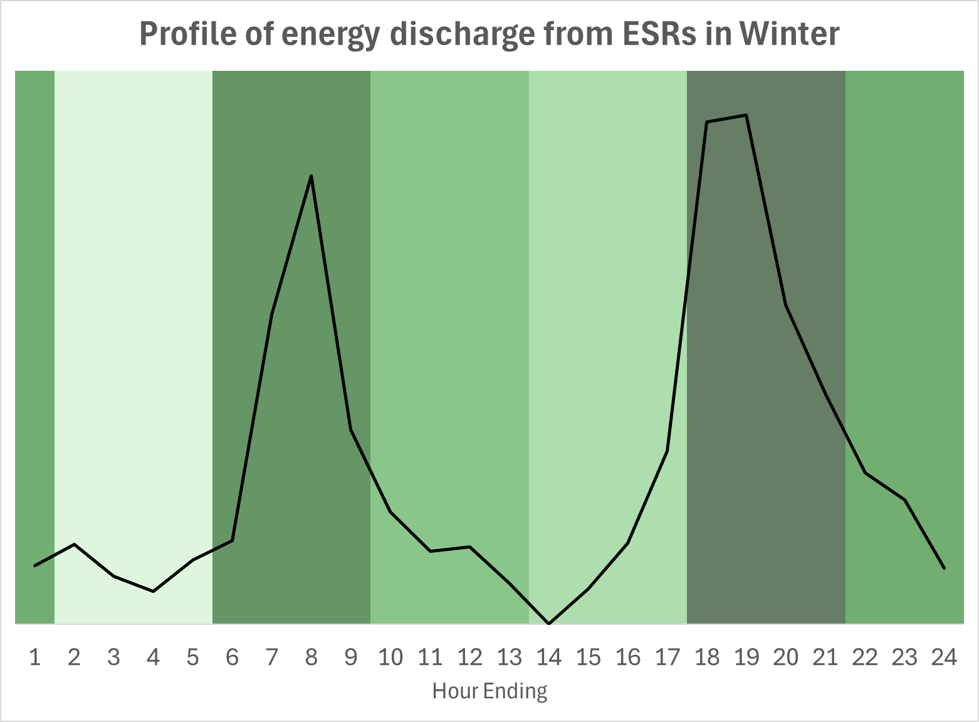
Evolving Thought on ECRS & Non-Spin DF
Non-zero ASDFs for ECRS and Non-Spin are essential so that RUC studies can take into account energy needed to continue serving demand during grid conditions and energy needs that may last across multiple hours.
Further, non-zero ASDFs help in mitigating energy deficiency risks that may be created when the same set of duration limited Resources plan to carry AS for multiple hours in a row. The non-zero ASDFs will incent ESRs intending to cover ECRS and Non-Spin positions to have an appropriate amount of energy for the applicable hours.
Recognizing the feedback received on the ECRS and Non-Spin ASDFs, ERCOT is currently thinking through an approach to set these in a manner that learns from discharge patterns that have been historically seen. This approach will:
allow ASDFs to be set in a manner that respects the estimated relative level of discharge between hours (single or consecutive).
result in some level of variation between DFs across the day.

Slide 6
Summary & Next Steps
ERCOT appreciates the feedback stakeholders have provided on this topic.
ERCOT will continue to flesh out the updated approach for ECRS and Non-Spin DFs and will make a presentation at next RTCTF.
Further, ERCOT requests ESR operators submit HBSOC in COPs that reflects their plan to charge and account for their expected discharge throughout the day.
Lastly, ERCOT reiterates that post-RTC Go-Live, as more experience with RTC is gained, ERCOT intends to transition to setting deployment factors a day or two days prior to the Operating Day, informed by forecasted uncertainty, and/or other relevant data.
ERCOT welcomes any further feedback stakeholders may have.

