Slide 1
Current Large Load Interconnection Process
Agee Springer
Senior Manager, Grid Interconnections
Large Electronic Load (LEL) Interim Voltage Ride Through Assessment and QSA Process
Yunzhi Cheng
Manager, Operations Stability Analysis
LLWG Meeting – October 24, 2025

Slide 2
Overview of Interconnection Process and Current Issues

Slide 3
Interim Large Load Interconnection Process
In March 2022, ERCOT implemented an interim interconnection process for Large Loads wishing to connect within 2 years or less
This process
Ensures new interconnection requests are studied for reliability as required by NERC FAC standards
Identifies new transmission upgrades that are needed to serve the Load
Determines the amount of load that can be served reliably until transmission upgrades are in service and limits the demand to that amount
Planning Guide Revision Request (PGRR) 115 establishes a formal process to replace the current interim interconnection process. ERCOT is working to unbox this language by the end of 2025.
Planning Studies
Agreements and Modeling
Approval to Energize Process

Slide 4
Interim Interconnection Process for Large Loads
Phase 1
Interconnection Request and Planning Studies
Interconnection request made to TSP
Phase 2
Agreements and Modeling
Customer signs a binding agreement with TSP
Phase 3
Approval to Energize
TSP (or RE for netted loads) requests ERCOT approval to energize the Load
TSP performs reliability studies and identifies upgrades needed to serve the Load
ERCOT reviews studies and confirms the amount of Load that can be served reliably by the customer’s desired energization date, the timeline that load can ramp, and the upgrades needed to serve the full requested amount.
RE submits updated Reactive Study that includes the Load
Netted Loads Only
Load is added to ERCOT’s planning models and Network Operations Model
TSP submits ERCOT Polled-Settlement (EPS) Meter design that includes the Load
Netted Loads Only
New or amended Standard Generation Interconnection Agreement (SGIA) that includes the Load is signed
ERCOT validates Load modeling and telemetry quality
Load is approved to consume energy up to established ERCOT limit
After energization, ERCOT monitors Load consumption to ensure limits identified in planning studies are not exceeded
ERCOT and TSP agree to study scope and assumptions
Prior to requesting approval to energize
(If required) SSO study must be complete and any required mitigation in place
ERCOT Interim Ride-Through Evaluation must be complete
(If required) SB6 Net Metering Review is complete
(If required) PG 5.5(6) review is complete and approved

Slide 5
Additional details – LLI Scoping Process
In order to reduce the need for re-studies, a scope must be agreed on between the TSP and ERCOT prior to the commencement of Large Load studies.
The scoping meeting will identify the required studies (Steady State, Stability, SSO), define the study area, and identify the appropriate cases to use.
ERCOT will provide to the TSP a list of other Large Load requests that must be included in the study. These are loads that have, at a minimum, an approved steady state study and a signed interconnection agreement with the applicable TSP.
ERCOT will also provide a list of “may study” loads that are may reach the milestones needed to become “must study” loads in the near future. Inclusion of these loads in the study is not required. However, failure to include them may result in a restudy if one of these loads signs agreements and moves forward.

Slide 6
Additional details – Approval to Energize Prerequisites
If an SSO study is required, it will be identified in the study scoping process during the planning phase.
However, the project may proceed through the interconnection process while the study is in progress.
The study must be complete and any required mitigation in place before approval to energize can be requested.
If the load is netting with a generator included on the list in Market Notice M-B090225-01, the project must go through the Net Metering Review required by SB 6 before approval to energize (see next slide).
If the load is netting with an Inverter Based Resource (IBR), the dynamic models for the IBR and load must go through the process defined in Planning Guide 5.5(6) before the load may be energized.
The Interim VRT assessment process will be covered later in this presentation.

Slide 7
Overview of SB 6 Net Metering Arrangement Review Process
Resource Entity submits Notice of Net Metering Arrangement and all required data
ERCOT completes studies and files report with the PUC
(120 days)
PUC makes final determination
(60 days)
Large Load Approval to Energize Process
SB 6 Net Metering Review Process
ERCOT Modeling Process
(90-120 days – May proceed concurrently with Net Metering Review)

Slide 8
Challenge – Individual Study Approach and Restudies
Both parties need certainty during the planning phase
Lack of information requires assumptions
Which loads to include in study area
Load composition and dynamic response
Small changes in study assumptions and load model parameters can dramatically change study outcomes
Uncertainty and sheer volume of requests is straining the individual study approach
Large Load developers need certainty about available grid capacity to make business decisions that determine composition of load
Grid planners need certainty about load size & composition to assess available grid capacity and reliability impacts

Slide 9
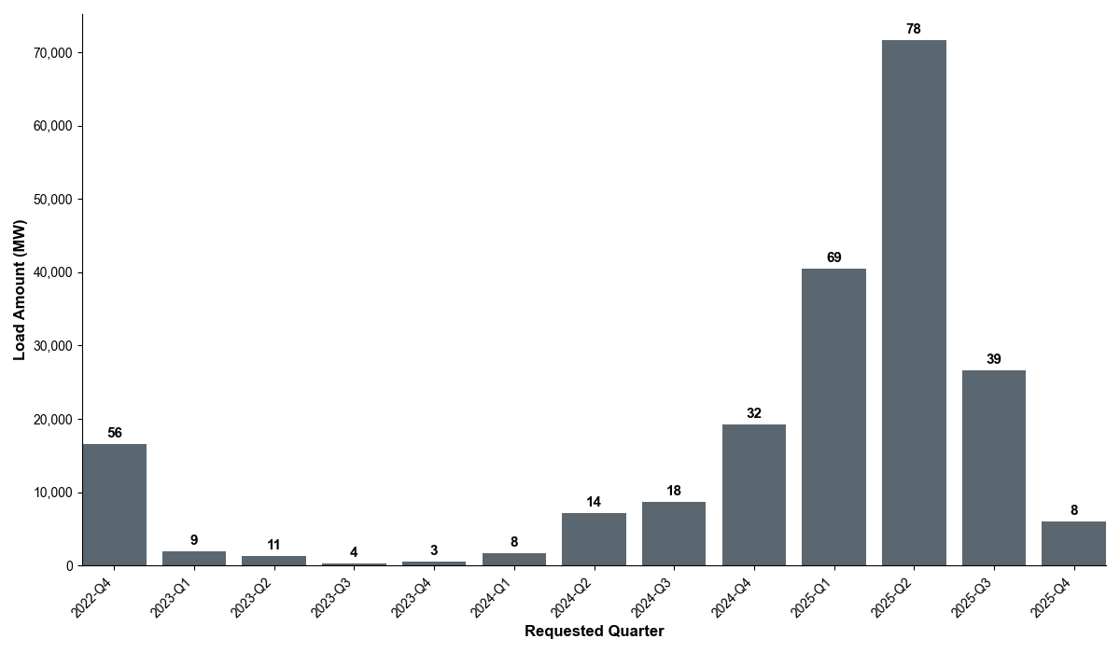
Large Load Project Submittal Date

Slide 10
Challenges Manifesting in Each Phase of the Current Process
Phase 1
Interconnection Request and Planning Studies
Many customers are seeking connection in specific areas (WTX, DFW, etc.). So, study assumptions may quickly become outdated as additional customers arrive in an area.
Phase 2
Agreements and Modeling
TSPs can sign agreements with customers before studies are completed. This creates an expectation from the customer that the signed load can be served.
Phase 3
Approval to Energize
Communication gap - approval of planning studies is not an approval to energize
Challenges
There are many unsigned “officer letter” loads in the planning cases. This makes studies difficult because it is not known which of these loads will actually connect (issues identified in studies may or may not be real).
Challenges
Requirements are evolving as ERCOT better understands the risks posed by these Large Loads. This can lead to new requirements that are identified after customer has already started construction.
Challenges
Mismatch between assumptions in LLIS and other ERCOT planning studies – can be difficult to get transmission upgrades approved.
Studies often require updates if other area loads sign agreements
Studies may need to be updated as the industry recognizes new reliability risks associated with these types of loads

Slide 11
Evolution of the LLI Process – Possible Options
Consider system-wide or regional studies to eliminate restudies
Prioritize Large Loads that can positively impact both transmission and resource adequacy
Registration as a Controllable Load Resource (CLR) – dependent on implementation of NPRR1188/NPRR1244
Credit for bringing own generation
Create single source submittal of Large Load information to ERCOT
Standardization across TSPs via PUC’s proposed load forecast and load interconnection standards
Re-evaluate whether direct relationship is needed between ERCOT & Large Load customers to increase transparency and efficiency in process

Slide 12
Questions?

Slide 13
Large Electronic Load (LEL) Interim Voltage Ride Through Assessment and QSA Process

Slide 14
Large Electronic Load VRT Assessment
All Large Electronic Loads (LEL) that have not already received approval to energize will be evaluated for voltage ride-through capability and impacts
If the evaluation demonstrates the LEL will ride through a severe fault, the load may begin the approval to energize process.
If the evaluation determines the LEL cannot ride through a severe fault, ERCOT will assess whether the addition of the LEL will lead to (or exacerbate) an area having at least 2600 MW of load trip for a single fault.

Slide 15
Large Electronic Load VRT Assessment (continued)
If ERCOT’s assessment determines the addition of the new load (which cannot ride through) will not lead to or exacerbate an area having at least 2600 MW of load trip for a single fault, the load may begin the approval to energize process.
However, the load may be subject to future curtailment under some system conditions in the event enough LEL connects in the area to create a reliability risk.
If ERCOT’s assessment determines the addition of the new load (which cannot ride through) will lead to or exacerbate an area having at least 2600 MW of load trip for a single fault, ERCOT must define a System Operating Limit (SOL) in ERCOT systems to monitor the area and ensure that the limit is not exceeded
SOLs for LEL VRT are expected to be Interconnection Reliability Operating Limits (IROLs) since the exceedance of the limit could lead to instability that adversely impacts the reliability of the Bulk Electric System (https://www.nerc.com/pa/stand/glossary%20of%20terms/glossary_of_terms.pdf)
Before the LEL may be given approval to energize, ERCOT must:
Define the SOL/IROL
Communicate with impacted TSPs
Implement situational awareness in the ERCOT control room
Document a Mitigation Plan and train the ERCOT operators on its implementation

Slide 16
Interim LEL VRT and QSA Process
2025
2026

Slide 17
Timeline
Large Load Initial Energization Date | Last Day for a TSP to meet prerequisites | Completion of Assessment
Upcoming December 2025 to January 2026^{(a)} | Prior November 1, 2025 (VRT assessment prerequisites) | November 30, 2025
Upcoming February to June 2026^{(a)} | Prior December 1, 2025 (VRT assessment prerequisites) | January 31, 2026
Upcoming July, August, September 2026 | Prior February 1, 2026 (QSA prerequisites) | April 30, 2026
(a). If the LEL VRT assessment determines that SOL/IROL implementation is required, the initial energization will be considered after the implementation of SOL/IROL (typically up to 8 weeks)

Slide 18
Prerequisites for the Interim VRT Assessment
In order to be included in an ERCOT Interim VRT Assessment, the Large Load must meet the following prerequisites
All elements of the Large Load Interconnection Study (LLIS) are complete and approved by ERCOT
If the load is netted with a Generation Resource, the Reactive Power study must be complete and approved by ERCOT Resource Integration
All required interconnection agreements are completed (refer to PG Section 9.5)
The ERCOT DWG Large Load Survey must be completed and models must be submitted to and reviewed by the ERCOT Dynamic Studies Department
Submit models to LargeLoadInterconnection@ercot.com. Please put “Interim VRT Assessment” in the subject line.
If any data in the survey and model differs from what was use in the LLIS stability study, the updated model and survey must be provided to ERCOT and the interconnecting TSP. The interconnecting TSP must determine if a new stability study is required or provide a written explanation to ERCOT as to why no new study is needed.
Once the VRT assessment is integrated into the QSA, the perquisites will match those described in paragraph (5) of Section 5.3.5.

Slide 19
Questions?

Slide 20
Appendix

Slide 21
Interim LEL Ride-Through Evaluation Process
ILLE
Coordinate with TSP to fill out DWG LEL Survey and provide updated PSSE model
LEL elects to change settings and/or equipment to improve ride through performance
TSP
Submit Survey and Model to ERCOT
Yes
ERCOT
Review Survey Responses and Model
Perform Assessment
Questions?
No
OR
LEL may proceed to Energization when ERCOT tools and procedures are in place and will be curtailed under some conditions
Does the LEL ride through?
Does RT performance cause SOL/IROL violation?
No
Yes
LEL may proceed to Energization
Yes
LEL may proceed to Energization but may be curtailed in the future under some conditions to prevent SOL/IROL exceedance
No

