Slide 1
RTC+B - FFR and ONSC Resources Deployment/Recall
ERCOT Staff
October 23, 2025
TWG

Slide 2
Resources providing FFR

Slide 3
Fast Frequency Response
FFR is automatically triggered when system frequency falls below 59.85 Hz
For Resources providing RRS with FFR, ERCOT may manually deploy the FFR RRS in an attempt to recover frequency to meet NERC Performance Control Standards after utilizing Reg-Up and the SCED process which includes an off-cycle SCED run.” Per RTC NPRR-1010, Section 6.5.7.6.2.2 (6)
Full response within 15 cycles
MW qualified to provide FFR must be able to sustain its output for full 15 minutes
FFR capacity provides blocky response in the beginning but dispatchable by SCED after initial 15 cycles full-response is delivered. The Resources are expected to follow UDSP after the initial blocky response.
ERCOT to send ICCP-based FFR deployment instructions to SCED dispatchable Resources providing FFR:
  For automatic deployment ICCP deployment signal remain active until Frequency recovers above 59.95 Hz and helps guide recall
  Following the receipt of manual deployment instruction, provide full response immediately, and Manual ICCP deployment signal will remain active until recalled
  For Resources providing FFR, once deployed, the Resource must stay deployed for the duration of the sustained response period, defined as 15 minutes or until time of recall instruction from ERCOT.

Slide 4
Fast Frequency Response
A Resource that has offered FFR capacity and transitioning from not having an FFR Award to having an FFR Award is expected to activate FFR controls upon receiving the FFR Award. The Resources should minimize the delay in activating the FFR controls.
The Resource should honor the existing FFR Award until the Resource receives and implements the latest FFR Award from the next RTCB SCED execution. The Resources should minimize the delay in adjusting the FFR Award.

Slide 5
Automatic Deployment of FFR

Slide 6
FFR – Automatic Deployment

Slide 7
FFR – Automatic Deployment
1. FFR Response within 15 cycles of frequency dropping to 59.85 Hz

Slide 8
FFR – Automatic Deployment
3. UDSP = Previous UDSP + FFR Award
2. FFR ICCP Instruction will be set to True when ERCOT Frequency is 59.85 Hz

Slide 9
FFR – Automatic Deployment
5. Frequency recovered above 59.95 Hz

Slide 10
FFR – Automatic Deployment
8. SCED runs 1-min after FFR is Recalled

Slide 11
Manual Deployment of FFR

Slide 12
FFR – Manual Deployment
1. FFAC is set to True when FFR is manually deployed by ERCOT

Slide 13
FFR – Manual Deployment
5.Once FFR is recalled UDSP ramps to 0(BP=0) and Resource is expected to follow UDSP
3.SCED runs 1-min after FFR deployment
4.When FFR is recalled FFAC is set to False

Slide 14
FFR – Manual Deployment

Slide 15
Resources with a Resource Status of “ONSC”

Slide 16
ONSC Resources
ONSC Resources may be deployed for Ancillary Services by one of the following methods
  Automatic Deployment triggered when frequency drops to 59.8 Hz
  Manual Deployment
    To meet NERC Standard defined in Nodal Protocol Section 6.5.7.6.2.2 (2)(d)
    During scarcity conditions following declaration of an EEA. Nodal Protocol Section 6.5.7.6.2.2 (5) & 6.5.9.4.2 (1)(a)(v).
ERCOT will send ICCP based deployment instructions to ONSC Resources providing RRS and ECRS (one per service). The ICCP instruction is a flag that is set to True when deployed.
ICCP deployment signals will remain True until frequency has recovered above 59.98 Hz.
  Once the ICCP Deployment signal reflects False, QSEs can stop generating MW from ONSC Resources and restore ONSC capability.
MW qualified to provide ONSC is set equal to the Resource’s proven 20s response capability
ONSC Resource is expected to provide full response when deployed
RTC-SCED will set the BP for ONSC Resources to be equal to their MW output.

Slide 17
Automatic Deployment of ONSC-ECRS/ONSC-RRS

Slide 18
ONSC- Automatic Deployment
1. Frequency dropped below 59.8 Hz, ONSC-RRS/ONSC-ECRS Response within 20s

Slide 19
ONSC- Automatic Deployment
2. ONSC-ECRS(OECA)/ONSC-RRS(ORRA) deployment instruction will be set to True when frequency drops below 59.8 Hz

Slide 20
ONSC- Automatic Deployment
3.SCED runs 1-min after ONSC deployment

Slide 21
ONSC- Automatic Deployment
6. SCED runs 1-minute after ONSC recall

Slide 22
Manual Deployment During EEA
Generally, manual deployment of ONSC Resources will be initiated following declaration of an EEA-1 but before ERCOT enters into EEA-2.
  When ERCOT declares EEA-2 or EEA-3 without declaring EEA-1, ERCOT may immediately deploy ONSC Resources.
Manual deployment instructions will be sent via ICCP (same ICCP as automatic deployment) to deploy all awarded ONSC RRS and/or ECRS MW capacity.
  QSEs will have 10 minutes following the receipt of ERCOT deployment instruction to provide energy from the ONSC Resources providing RRS and/or ECRS.
Following the recovery of PRC above 2500 MW and stable system frequency, ERCOT will reset the ONSC RRS and/or ECRS ICCP Deployment signals to reflect zero MW deployment.
  QSEs can then stop generating MW from ONSC Resources and restore ONSC capability.

Slide 23
Manual Deployment Non-EEA Conditions
Manual deployment instructions will be sent via ICCP (same ICCP as automatic deployment) to deploy all awarded ONSC RRS and/or ECRS MW capacity.
  QSEs will have 10 minutes following the receipt of ERCOT deployment instruction to provide energy from the ONSC Resources providing RRS and/or ECRS.
Following the recovery of system frequency (currently 59.98 Hz), and if ERCOT is not under an EEA condition, ERCOT will reset the ONSC RRS and/or ECRS ICCP Deployment signals to reflect zero MW deployment.
  QSEs can then stop generating MW from ONSC Resources and restore ONSC capability.

Slide 24
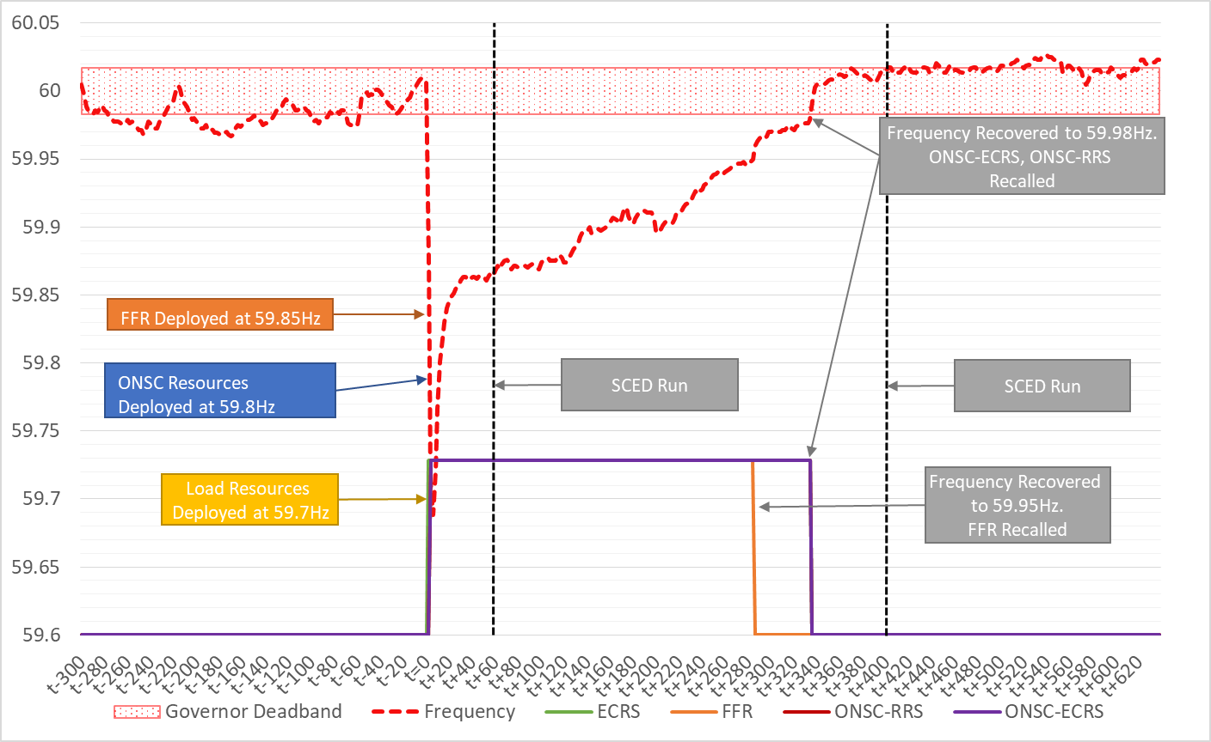
A/S Deployment Coordination

Slide 25
Summary
ERCOT will send ICCP deployment instructions to SCED dispatchable Resources providing FFR for both automatic and manual deployments
ERCOT will send ICCP deployment instructions to ONSC Resources(ECRS and RRS separately) for both automatic and manual deployments.
Awards from previous RTC-SCED run are effective until QSEs receive new RTC-SCED FFR award and implement new awards in their control systems

