Slide 1
ERCOT Technology Working Group (TWG)
October 23, 2025

Slide 2
ERCOT TWG
WELCOME

Slide 3
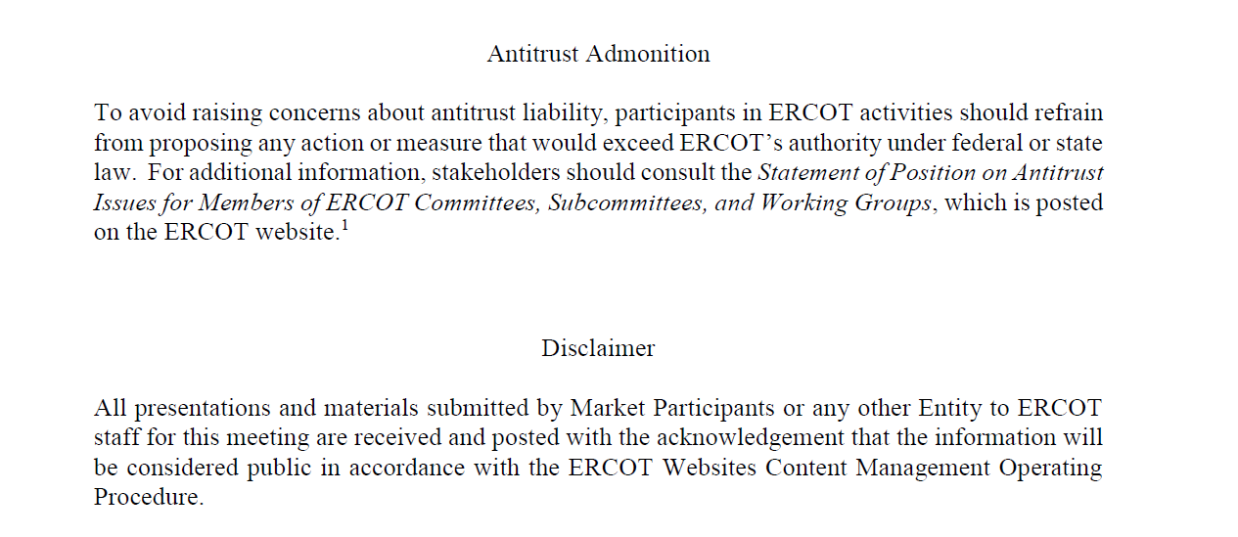
ERCOT TWG

Slide 4
ERCOT TWG Agenda
Item # | Item Description | Presenter | Start Time
1 | Antitrust admonition | Sreenivas Badri | 2:00 PM
2 | RTC+B Updates RTCBTF and Market Trials updates 10/16 LFC/SCED Open Loop Testing Observations Market-Trials-Market-Submissions Testing QSE Cutover Connectivity Testing Dual Market Submissions for Go-Live – QSE/ERCOT Systems Setup Outage Scheduler Final Testing Window RTC+B TSP Impacts ONSC and FFR Resource Deployment and Recall Single Model ESR RRS-PFR Test requests submissions in NDCRC CDR, PD Reports updates | Matt Mereness/ERCOT Staff | 2:02 PM
3 | Single Model ESR Resource Outage Submissions into Current Production | Joel Koepke | 3:05 PM
4 | Identity & Access Mgmt Program update | Nicholas Jessett | 3:15 PM
5 | SCR828 - RIOO DUNS limit increase – Implementation update | Ashwini Patlola | 3:25 PM
6 | NOGRR 245 – RIOO Implementation & Go-Live update | Ming Shen | 3:35 PM
7 | Project Updates | Troy Anderson | 3:45 PM
8 | Round Table Discussion | Tanner Holder | 3:55 PM
9 | Adjourn | Tanner Holder | 4:00 PM

Slide 5
RTC+B Updates
RTCBTF and Market Trials updates – Matt Mereness
10/16 LFC/SCED Open Loop Testing Observations – Karthik Gopinath/Sruthi Hariharan
Market-Trials-Market-Submissions Testing – Sreenivas Badri/Sruthi Hariharan
QSE Cutover Connectivity Testing
Dual Market Submissions for Go-Live – QSE/ERCOT Systems Setup
Outage Scheduler Final Testing Window
RTC+B TSP Impacts – Sreenivas Badri
ONSC and FFR Resource Deployment and Recall – Abhi Masanna Gari
Single Model ESR RRS-PFR Test requests submissions in NDCRC – Abhi Masanna Gari
CDR, PD Reports updates – Jamie Lavas

Slide 6
Single Model ESR Resource Outage Submissions into Current Production
Single Model ESR Resource Outage Submissions into Current Production
– Joel Koepke

Slide 7
Identity & Access Mgmt Program update
Identity & Access Mgmt Program update – Nicholas Jesset

Slide 8
SCR828
SCR828 - RIOO DUNS limit increase – Ashwini Patlola

Slide 9
NOGRR245
NOGRR 245 – RIOO Implementation & Go-Live update
– Ming Shen

Slide 10
Project Updates
Project Updates – Troy Anderson

Slide 11
ERCOT TWG – Round Table Discussion
ERCOT TWG – Round Table Discussion
Future Topics of Interest
Topics and presentations from TWG members

Slide 12
ERCOT TWG
Thank You
You can reach Sreenivas at
Sreenivas.Badri@ercot.com and Tanner at tholder@tnsk.com

