Slide 1
Update on ESR Qualification Amounts for post RTC Go-Live
ERCOT Staff
TWG
October 23, 2025

Slide 2
Ancillary Service Qualification under ESR Single model
ERCOT has sent RFIs to the Market Participants to share the Ancillary Service Qualified MWs for Regulation, ECRS, RRS-FFR and Non-Spin that will apply to each ESR post implementation of Real Time Co-Optimization with Battery Single Model(RTC+B.)
ERCOT has based the AS Qualified MWs with the existing qualified MWs for the ESR’s injection side(ESR-GR), ESR’s charging side and submitted data during the AS qualification process.
ERCOT has also shared how each ESR’s qualified MWs for Regulation and ECRS are adjusted for NPRR1282:Ancillary Service Duration under Real-Time Co-Optimization

Slide 3
RRS-PFR Qualification approach for ESRs
Under RTC+B, ERCOT’s expectation is that the droop characteristic of an ESR is based on its full range, i.e. LSL to HSL. For instance, a 1% droop response would be such that if ESR were to be charging at LSL, when frequency drops to 59.4 Hz(i.e. a 1% change from nominal frequency), the ESR will provide 100% response by moving from LSL to HSL.
  An ESR that is set up to meet the expectations as described in this example is considered as 1% response ESR and will be qualified for RRS-PFR up to 100% of their HSL to LSL range.
ERCOT understands that some ESRs likely are not setup to follow droop characteristics described above and absent a control system change may move from LSL to 0 in the example above.
  Such ESRs are considered as an effective 2% response ESR and will be qualified for RRS-PFR up to 50% of their HSL to LSL range. The QSE have the option of keeping the same settings or change the control system such that they can meet 1% droop characteristics.
ERCOT’s review showed that all Governor Frequency Response tests submitted for ESRs currently use ESR base load as HSL. In the RFI, ERCOT requested QSEs to determine the option they would like to use and re-submit the Governor Frequency Response tests in the ERCOT NDCRC application for each ESR with Base Load set to HSL-LSL.
  ERCOT intends to use these resubmitted forms to update each ESRs RRS % Limit.

Slide 4
RRS-PFR Qualification approach for ESRs
RFI Summary
Option 1 | ESRs are already tuned to move from LSL to HSL for 1% change in frequency(Considered as 1% droop Resources). These ESRs will submit an updated test to demonstrate the 1% droop response with ESR base load set to HSL-LSL
Option 2 | ESRs are tuned to moved from 0 to HSL or LSL to 0 for 1% change in frequency. These ESRs intend to operate with this setting and considered as 2% droop Resources. These ESRs will submit an updated test using existing PFR test data with ESR base load set to HSL-LSL
Option 3 | The ESRs are tuned to move from 0 to HSL or LSL to 0 for 1% changes in frequency, i.e., they are 2% droop Resources, however these ESRs will change the droop settings to meet the 1% droop expectations and submit a test to demonstrate 1% droop response with ESR base load set to HSL-LSL
Several ESRs in Option 1 and Option 3, have not submitted the updated PFR tests. Additionally, changing the droop settings will require QSEs to submit new Dynamic models for ERCOTs approval per ERCOT Planning Guide.
It is essential that QSEs submit the updated tests as soon as possible for ERCOT to seed the RRS percentage limits that reflects the droop characteristics in the network model before RTCB go-live.

Slide 5
RRS-PFR Qualification approach for ESRs
To expedite the process, ERCOT is asking QSEs to submit updated tests for ESRs using the existing PFR test data and settings, which will categorize the ESRs under Option 2. This approach will not impact the maximum amount of RRS-PFR an ESR can provide as an effective 2% droop Resource.
  For example, a ± 100 MW ESR that is currently qualified for RRS-PFR for 100% of HSL on ESR-GR and 100% of MPC on ESR-CLR can provide maximum RRS-PFR response of 100 MW for 1% change in frequency.
  Under RTCB, this ESR will be a 2% droop Resource until droop settings are changed and will provide a maximum RRS-PFR response of 100 (i.e.,50% of HSL-LSL) for a 1% change in frequency.
This approach will quickly establish initial RRS qualification amounts for the ESRs for RTCB go-live. The ESRs can continue to work on adjusting the droop settings to meet the 1% droop expectation and submit a PFR test reflecting these changes to increase the RRS qualification amount.

Slide 6
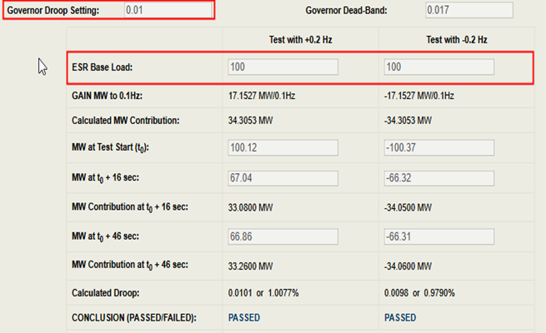
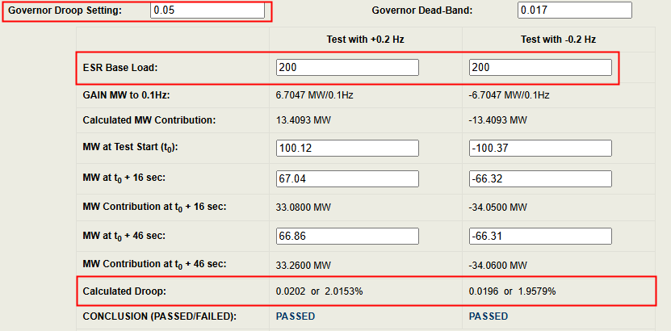
Example1
±100 MW ESR is tuned to provide 100% of HSL response with 1% droop for 1% change in frequency and ESR intends to keep these settings. Effective droop for such ESRs with Base Load set to full range is 2%.
NDCRC - Existing Test
NDCRC - Expected Test with ESR Base Load set to full range
Note: The Maximum Droop setting per ERCOT Nodal Operating Guide is 5%

Slide 7
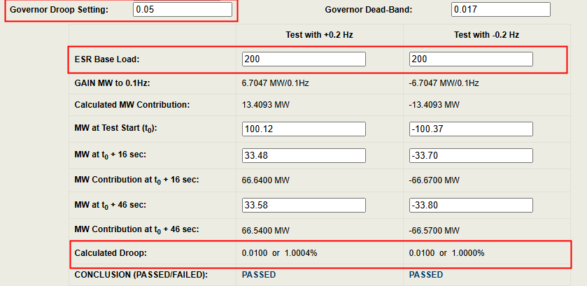
Example2
±100 MW ESR is already tuned to provide 100% of HSL to LSL response for 1% change in frequency or ESR is tuned to 100% of HSL response for 1% change in frequency and intends to change control settings to meet HSL to LSL expectation.
NDCRC Display:

Slide 8
Questions

