Slide 1
RTC+B Update
Matt Mereness
TWG
October 23, 2025

Slide 2
Outline
Discussion today:
Update on RTCBTF Issues List
Scope of RTC+B Program
Update on NPRRs
Market Trials Update

Slide 3
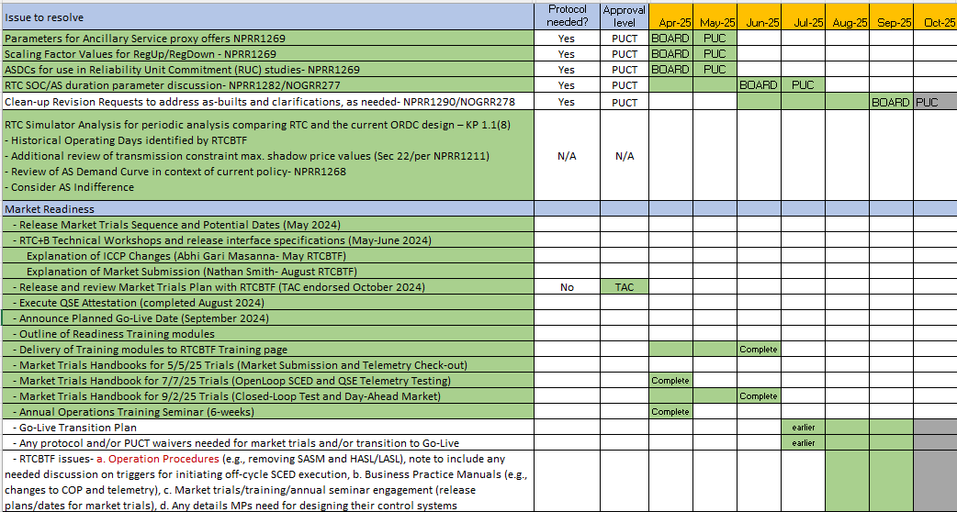
RTCBTF Remaining Items for Go-Live
RTCBTF- Completing market trials and transition plan details
Market Trials

Slide 4
Summary and Timeline of NPRRs
NPRRs set for PUCT May 15 Open Meeting (PUCT approved)
NPRR1268 for ASDC Modifications (IMM sponsor)
NPRR1269 for 3 Parameter/Policy Changes (ERCOT sponsor)
NPRR1270 for AS Qualification details (ERCOT sponsor)
AS Duration / State of Charge (NPRR1282 / NOGRR277)
Approved at Board and PUCT
Final Clarifying NPRR1290/NOGRR278
Approved at PRS
On to August TAC and Sep Board
Remaining Stakeholder path to Board Meetings before Go-Live:
PRS Aug 13 > TAC Aug 27 > Board Sep 23

Slide 5
RTC+B Scope
Final 2025 Refinements for Go-Live
Related NPRRs
within Program

Slide 6
Sequence and Dates for Market Trials to Go-Live
30-day Market Notice
11/5/25
March/April
2025
Start
5/5/25
Start
7/7/25
Start
9/2/25
Go-Live
12/5/25*
May 2025
June 2025
July 2025
Aug 2025
Sep 2025
Oct 2025
Nov 2025
Dec 2025
QSE Scorecards & Exit Criteria for each Trial Phase
RTC QSE Submission Testing
(Submit COP, RT AS Offers,
DAM Virtual AS, Outages for ESRs)
Open-loop RTC SCED
(QSE offers, SCED non-binding award/dispatch)
Ongoing Open-Loop
& Periodic Closed-loop SCED/LFC
(QSE RTC offers and telemetry to support closed-loop frequency control test 2-3 tests of 2-4 hour durations)
Transition to Go-Live
Upon completion of testing, confirmation of ERCOT and market readiness for Go-Live.
QSE/Vendor Submission Sandbox and Telemetry Points added Prod EMS model.
RTC QSE Telemetry Check-out (QSEs add/verify new telemetry points for UDSP, New ramp rates, ESR telemetry)
QSE Telemetry Tests
(Individual QSE to follow UDSP and support new ramp rate and ESR telemetry)
Day-Ahead Market
(Non-binding DAM using QSE offers for at least 2 tests)
* Go-Live date reflects 12/5/2025 as first Operating Day
where 12/4/2025 is planned software migration.

Slide 7
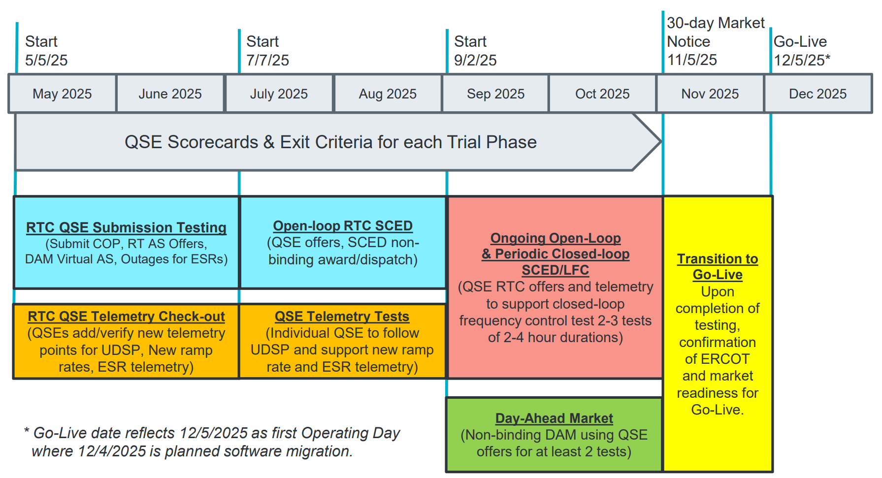
COMPLETED
May & June:
Establishing Connectivity
QSE will test their market submissions for defined subset transactions that are new or modified by RTC+B.
Scorecard goal is for 95% of QSEs to demonstrate successful submissions and have mitigation plans in place for remaining 5% to address in next trial phase.
QSE will add telemetry points for Energy Management System (EMS) system interface with ERCOT (such as Updated Desired Set Points (UDSP), New Ramp Rates, and ESR Telemetry)
Scorecard goal is for 98% of QSEs to demonstrate successful telemetry additions, and mitigation plans in place for remaining 2% to address in next trial phase. (Note 3-week lag in telemetry migrating through network model validation and into trials environment).

Slide 8
COMPLETED
July & August:
Initial Real-Time Market execution and verify QSE ability to follow ERCOT frequency signals
QSE will support “parallel production” 2days/week by entering $bids/offers for non-binding RTC energy and A/S awards and dispatch (Open-loop test)
Scorecard goal for 100% of QSEs to demonstrate successful submissions and telemetry reflective of production, and mitigation plans in place for any outliers.
Coordination of individual QSE tests on subset of resources to ensure resources can follow new UDSP telemetry point from ERCOT.
Scorecard goal is for 98% of QSEs to successfully demonstrate, and mitigation plans in place for remaining 2% to address in next trial phase.

Slide 9
IN FLIGHT
Sep 11 & Oct 30:
Required live-production test to ensure effective frequency dispatch and control.
Sep & Oct:
Optional Day-Ahead Market
Voluntary Day-Ahead Market for all QSEs will be conducted at least 2 times.
QSE can test their market submissions for Day-Ahead AS Self-Arrangement, AS Only Offers, Trades and normal submissions.
DAM participation is strongly encouraged but not required in Readiness metrics since RTC procures AS in Real-Time.
Participation includes much broader QSE population (marketers and load-only QSEs).
ERCOT and QSEs will conduct live-production tests of RTC-SCED and Load Frequency Control (LFC) prior to go-live.
RTC-SCED and frequency control dispatch during the tests will be binding to manage the reliable operations of the grid for2-4 hours.
ERCOT will coordinate with QSEs on how to submit RTC offers and telemetry for Energy and AS for the two systems (current and RTC system).
ERCOT will provide a summary of the test and use analysis and engineering judgement to assess if the test was successful in controlling frequency.
Market Notice sent regarding DAM for all QSEs

Slide 10
Sep/Oct Market Trials in-flight
Trials meeting every Monday 10-10:30am until December
Standalone calendar page each week with WebEx
RTCBTF Home Page houses all market trials documentation
Averaging 150-175 participants
Weekly presentation walk-through with Q&A
Heavy use of RTCB@ercot.com email -> FAQ
Link to this Monday’s Trials meeting

Slide 11
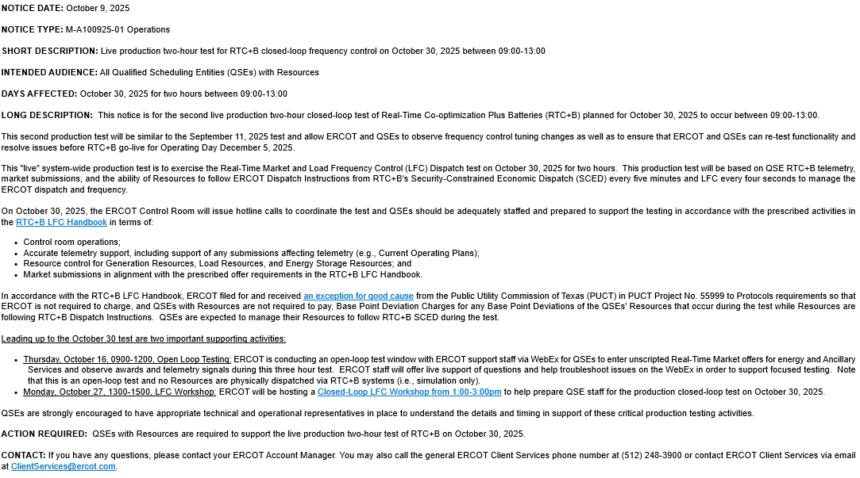
October 30, 2025 Production Closed-Loop LFC Test Link to market notice: https://www.ercot.com/services/comm/mkt_notices/M-A100925-01

Slide 12
Upcoming Testing
Successful October 16 test SCED Open Loop ERCOT WebEx
ERCOT encouraged full participation with accurate telemetry and “unscripted market submissions” to help test and shake-out any additional issues
Focused/support window for Market & ERCOT provided another round of scrutiny of systems and market outcomes to minimize risk to go-live.
October 30 is second and last planned Closed-Loop LFC Test
Will essentially be a repeat of September 11 test (same structure, timing, and expectations)
Test to observe Frequency tuning changes in production
Both ERCOT and QSE opportunity to test any fixes
Repeat the critical cutover process that will be used 35 days later for go-live
Closed Loop LFC Workshop, Monday October 27
Lack of engagement from other QSEs in DAM
Considering Market Notice requiring “QSE Acknowledgement of DAM changes and Cutover activities that are forthcoming” to capture QSEs without Resources in engagement.
ERCOT will initiate outreach in coming days

Slide 13
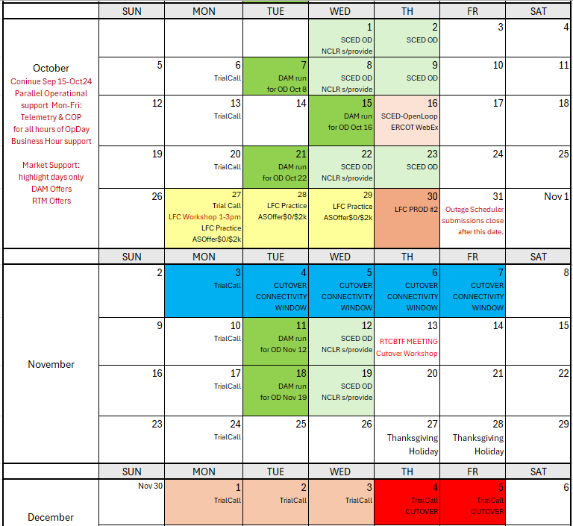
Market Trials and Transition through Go-Live
We are here….
NCLR s/provide = NCLR can use self-provision in SCED

Slide 14
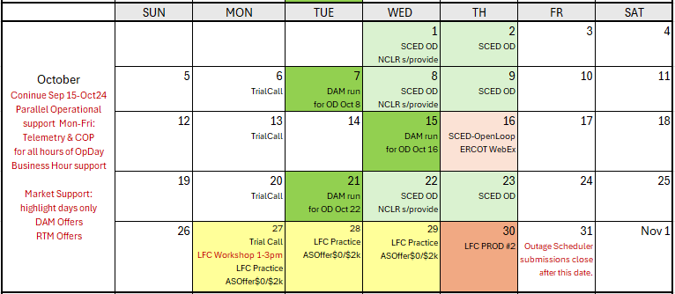
Completing October Trials
Oct 16 SCED Open-Loop WebEx
Oct 27 LFC Workshop Link
Oct 30 Production 2-hour LFC Test

Slide 15
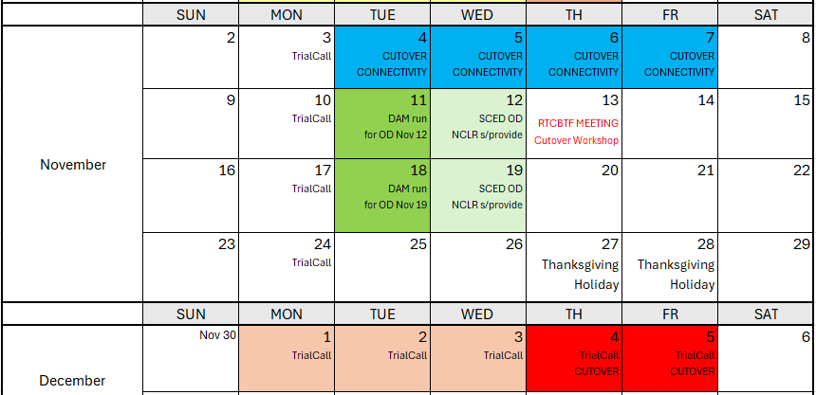
November/December
Discussing Transition/Cutover Details at RTCBTF this week (Wed, Oct 15)
RTC+B Market Trials Outage Scheduler turns to READONLY for transitional purposes
System connectivity Test Week 1 (go-live market submission configuration testing)
Week 2 RTCBTF Workshop for December go-live Cutover
Weeks 2 & 3 Continue Trial Activity
Currently minimal plans week of Thanksgiving

Slide 16
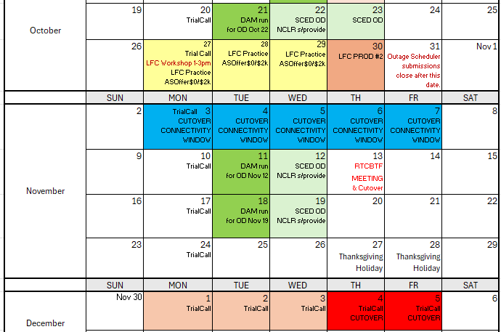
Wrap-Up
Upcoming activities:
Monday October 27- three meetings on Monday
- 10am Weekly Trial Call
- 1-3pm LFC Workshop for Oct 30 WebEx
- 3-5pm RTCBTF Discussion of AS Deployment Factors WebEx
Thursday October 30- Closed Loop LFC Test 10:35am-12:35pm
Thursday November 13- RTCBTF and Go-Live Cutover Workshop
Monday December 1-5 Go-Live week
Questions on RTC+B activities?
Can be directed to:
mmereness@ercot.com
RTCB@ERCOT.com

