Slide 1
Project Update
October 8, 2025
Troy Anderson
ERCOT Portfolio Management

Slide 2
Project Update Agenda
2025 Release Targets
Priority/Rank Recommendations for Revision Requests with Impacts
None
Technology Working Group (TWG)
Next meeting is 10/23/2025
Initiative Ranking Workshop Update
Draft #2 – Making Progress
Status Notes
Location of Revision Request Project Information: http://www.ercot.com/services/projects

Slide 3
2025 Release Targets – Approved NPRRs / SCRs / xGRRs
R1
R3
R5
January 1/30 | February 2/27 | March 3/27 | April 4/24 | May 5/29 | June 6/26
NPRR945 NPRR1219 | NPRR1254 RTC+B Market Trials Sandbox Deployed | NPRR1145 | RTC+B Market Trials begin on 5/5/2025 | NPRR1253
R2
R4
R6
ü
ü
ü
RTC QSE Submission Testing
3/1
ü
RTC QSE Telemetry Check-out
1/1
3/7
ü
ü
RTC+B
12/5
July 7/31 | August 8/28 | September 9/25 | October 10/23 |  | December 12/18
NPRR1234(a) |  |  | NOGRR245 |  | PGRR091 PGRR115 SCR828
R7
R8
R9
R10
E
R11
Open-loop RTC SCED
Closed-loop SCED/LFC
NPRR1007-1013
RTC+B Stabilization begins
NPRR963(a)
NPRR965
NPRR1000
NPRR1014
NPRR1029(a)
NPRR1054
NPRR1058
NPRR1172
NPRR1204
NPRR1216(a)
NPRR1236
NPRR1245
NPRR1246
NPRR1268
NPRR1269
NPRR1270
NPRR1282
NOGRR211
NOGRR268
NOGRR277
OBDRR020
OBDRR052
PGRR118
QSE Telemetry Tests
Day-Ahead Market
7/21
E
E
E
ü
E
Go-live dates can differ from Protocol effective dates – Please refer to market notices for more details
APPENDIX
Red Text: New additions and target release changes
Strike-Through Text: Previous target release
(a), (b), etc.: Multiple phase release
Project Status Codes
NS = Not Started
I = Initiation
P = Planning
E = Execution
H = On Hold
NPRR963(a) – Portion of NPRR
NPRR1029(a) – Market suspension of ESRs portion
NPRR1216(a) – Invoice workaround
NPRR1234(a) – Section 3.10.7.2, paragraphs 14-19
NPRR1253 – ICCP/Public API
RTC+B Market Trials
RTC+B Stabilization
Release targets are subject to change

Slide 4
Priority / Rank Recommendations for Revision Requests with Impacts
Recommendations for…
Revision Request | Description | Priority | Rank | Comments
NPRR1214 | Reliability Deployment Price Adder Fix to Provide Locational Price Signals, Reduce Uplift and Risk | TBD | TBD | $800k-$1.2M, 12-18 months Impacted Systems: MMS, Settlements, Reporting ERCOT requests a continued table at PRS due to RTC+B resource constraints and design concerns
NPRR1294 | Move OBD to Section 22 – Demand Response Data Definitions and Technical Specifications | N/A | N/A | <$5k O&M
NPRR1299 | Clarifications to Emergency Response Service (ERS) | N/A | N/A | <$5k O&M
PPL Rank Information
Next 2025 Rank in Business Strategy = 4580 Next 2028 Rank in Business Strategy = 5110
Next 2026 Rank in Business Strategy = 4820 Next 2029 Rank in Business Strategy = 5300
Next 2027 Rank in Business Strategy = 4910 Next Rank in Regulatory = 420

Slide 5
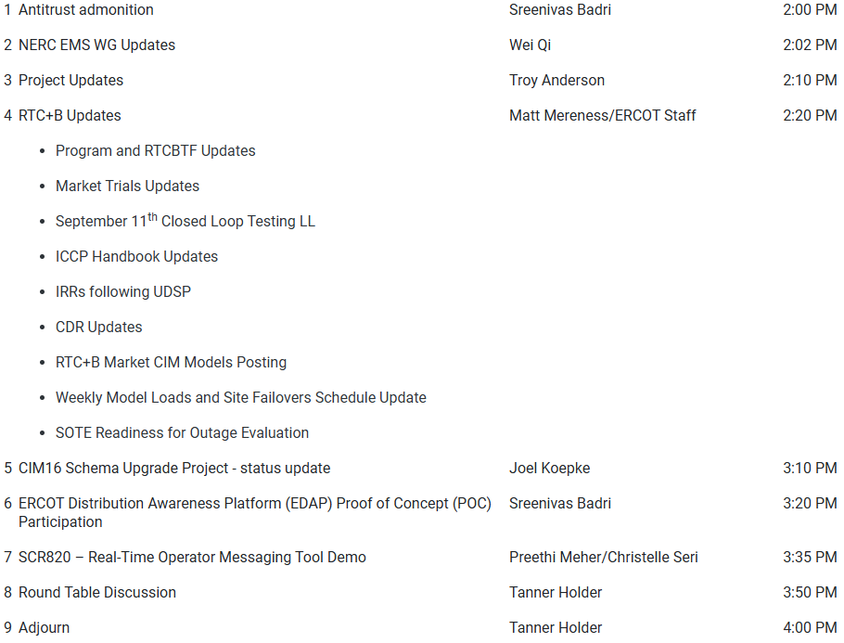
Technology Working Group (TWG)
Agenda for TWG meeting held on 9/25/2025:
Next TWG scheduled for 10/23/2025

Slide 6
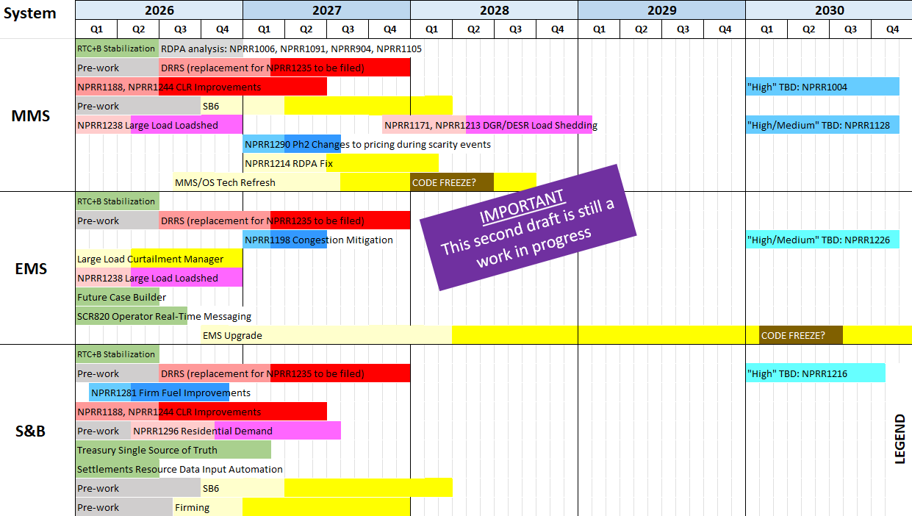
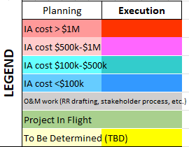
Draft #2 – Making Progress
All “High” items considered
Color coding reflects IA project cost estimates
Light and dark shading reflects potential project phase durations
Includes internal ERCOT projects drawing on similar resources
Spreadsheet posted for stakeholder review
Additional Notes:

Slide 7
Aging Revision Request Review at PRS – Status
Draft #2 depicts the latest view of the release plan
Still very much in progress
Impact Analyses loaded for NPRR1188 and NPRR1244 as a single project targeting an early 2026 start (perhaps even December 2025)
Resource analysis underway
Pre-project discussions with vendor are underway
Considering approaches that would reduce the 18-24 month project duration
In support of SB6, ERCOT is envisioning a Large Load Curtailment Manager project that may include elements of NPRR1238
Candidate for early 2026 project start (go-live target is TBD)
Impact Analysis is getting underway (for portion other than NPRR1238)
Smaller projects temporarily moved from 2026 to 2027 until we have a better feel for pockets of resource availability in 2026
NPRR1198, NPRR1290 Phase 2

Slide 8
Aging Revision Request Project Review Approach
Initiative Prioritization Workshop held on 8/25/2025
Categorize RRs into “Tiers”
Tier 1 Critical Must-have items (PUCT/Board directives, etc.)
Tier 2 High Priority Highest priority after Tier 1
Tier 3 Medium Priority Fit in without impacting Tier 1 and 2 projects
Tier 4 No Action Not ready for immediate action
Tier 5 Candidate for Removal May move to another tier after evaluation
Important Point
Some aging RRs are expected to require language changes to bring them up to current market or system constructs
Language updates would be made with a new RR
ERCOT suggests this analysis be limited to aging items that are prioritized high enough to be queued for implementation

