Slide 1
ERCOT Recent Large Load Loss/Reduction Events
Patrick Gravois
Operations Engineer – Event Analysis
LLWG
October 24, 2025

Slide 2
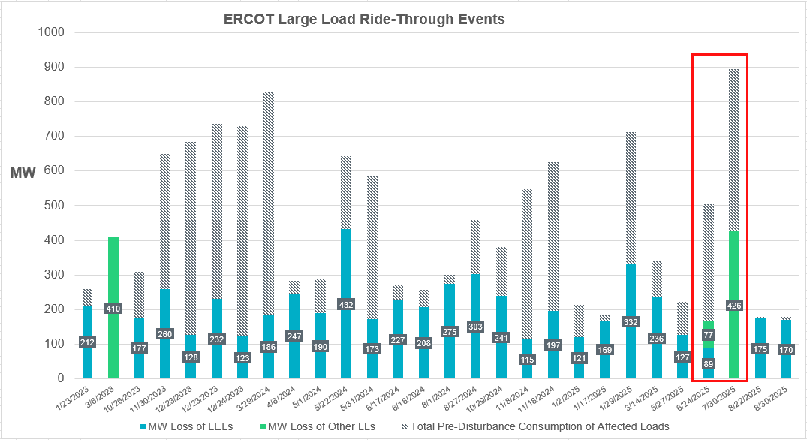
ERCOT Large Load Loss/Reduction Events 2023-Present
Recent events involve both Large Electronic Loads (LEL) and other types of Large Loads
6/24/2025 event included additional consequential load loss not shown in chart
8/22 and 8/30 events involved single crypto facility in Panhandle

Slide 3
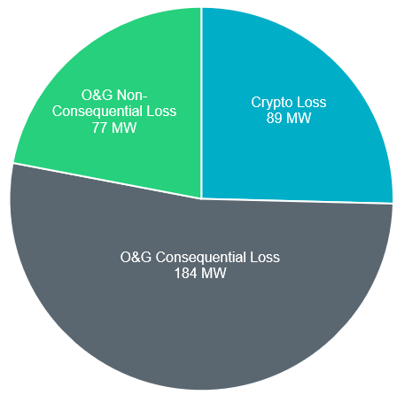
ERCOT Load Loss/Reduction Event – June 24, 2025
Far West Texas Event on June 24, 2025 @ 01:08 AM
~350 MW total load reduction (~184 MW consequential load loss)
Consequential load loss of ~184 MW
Non-consequential load loss of ~166 MW
2 nearby crypto facilities reduced ~89 MW of consumption
System frequency increased to 60.06 Hz and
Line-Line-to-Ground (LLG) fault due to lightning strike on 138 kV in Far West Texas area with high concentration of oil and gas facilities; fault cleared in ~5 cycles
All individual oil/gas loads involved are <75 MW
recovered in 5min 8sec
(some >75 MW if aggregated by substation)
Multiple line circuits experienced an outage of ~1 second, causing 9 oil/gas loads to connected to the outage lines to disconnect from the system
Additional 10 oil/gas loads remained connected and did not fully ride-through the voltage sag and reduced a combined ~77 MW of consumption

Slide 4
ERCOT Load Loss/Reduction Event – June 24, 2025
Load Identifier | Pre-fault consumption | Post-fault consumption | Consumption loss | % Loss | Low Voltage at POI | Load Type
Load A | 112.3 | 60.6 | 51.7 | 46.0 | 0.535 pu | Crypto
Load B | 157.0 | 119.3 | 37.7 | 24.0 | 0.670 pu | Crypto
Load C | 36.9 | 0.0 | 36.9 | 100.0 | outaged | oil/gas
Load D | 29.2 | 0.0 | 29.2 | 100.0 | outaged | oil/gas
Load E | 27.5 | 0.0 | 27.5 | 100.0 | outaged | oil/gas
Load F | 23.4 | 0.0 | 23.4 | 100.0 | outaged | oil/gas
Load G | 16.5 | 0.0 | 16.5 | 100.0 | outaged | oil/gas
Load H | 16.0 | 0.0 | 16.0 | 100.0 | outaged | oil/gas
Load I | 16.4 | 0.0 | 16.4 | 100.0 | outaged | oil/gas
Load J | 22.7 | 10.8 | 11.9 | 52.4 | 0.287 pu | oil/gas
Load K | 45.4 | 34.2 | 11.2 | 24.7 | 0.287 pu | oil/gas
Load L | 31.2 | 20.1 | 11.1 | 35.6 | 0.525 pu | gas
Load M | 20.6 | 11.4 | 9.2 | 44.6 | 0.279 pu | oil/gas
Load N | 9.2 | 0.0 | 9.2 | 100.0 | outaged | oil/gas
Load O | 9.2 | 0.0 | 9.2 | 100.0 | outaged | oil/gas
Load P | 12.4 | 5.8 | 6.6 | 53.2 | 0.287 pu | oil/gas
Load Q | 16.4 | 10.2 | 6.1 | 37.4 | 0.295 pu | oil/gas
Load R | 13.8 | 7.7 | 6.1 | 44.2 | 0.295 pu | oil/gas
Load S | 21.2 | 16.0 | 5.2 | 24.5 | 0.266 pu | oil/gas
Load T | 17.0 | 11.9 | 5.1 | 30.0 | 0.529 pu | oil/gas
Load U | 35.2 | 30.5 | 4.6 | 13.2 | 0.525 pu | gas
Total | 689.6 | 338.6 | 351.0
Note: Partial tripping (non-consequential) of oil/gas loads varied between 10%-55% load loss of pre-disturbance consumption

Slide 5
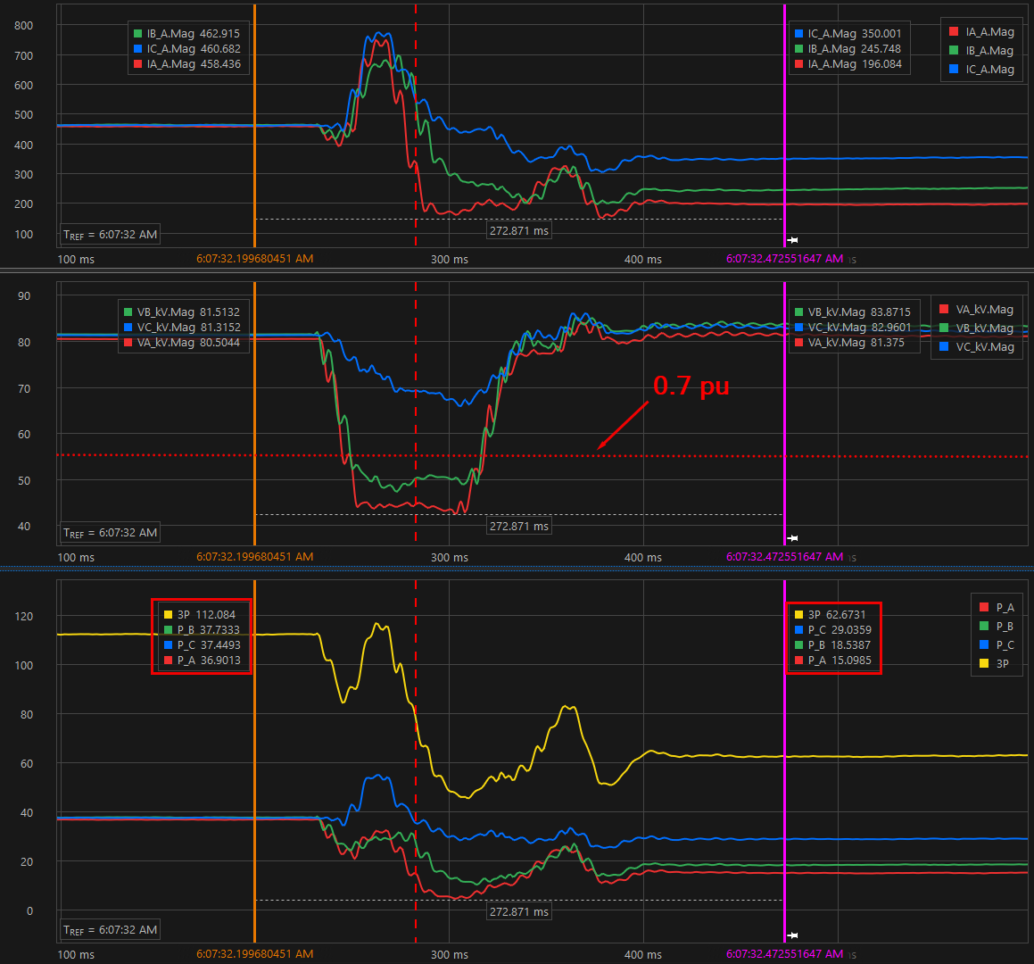
June 24 Event – Crypto Facility Reduction (Load A)
A-phase and B-phase voltages drop below 0.7pu for >20 msec
Active power reduction in A-phase and B-phase consists of 80% of total reduction (52 MW)
Current spikes to 160% of pre-fault current during fault
Facility returns to pre-fault consumption in ~2 hours

Slide 6
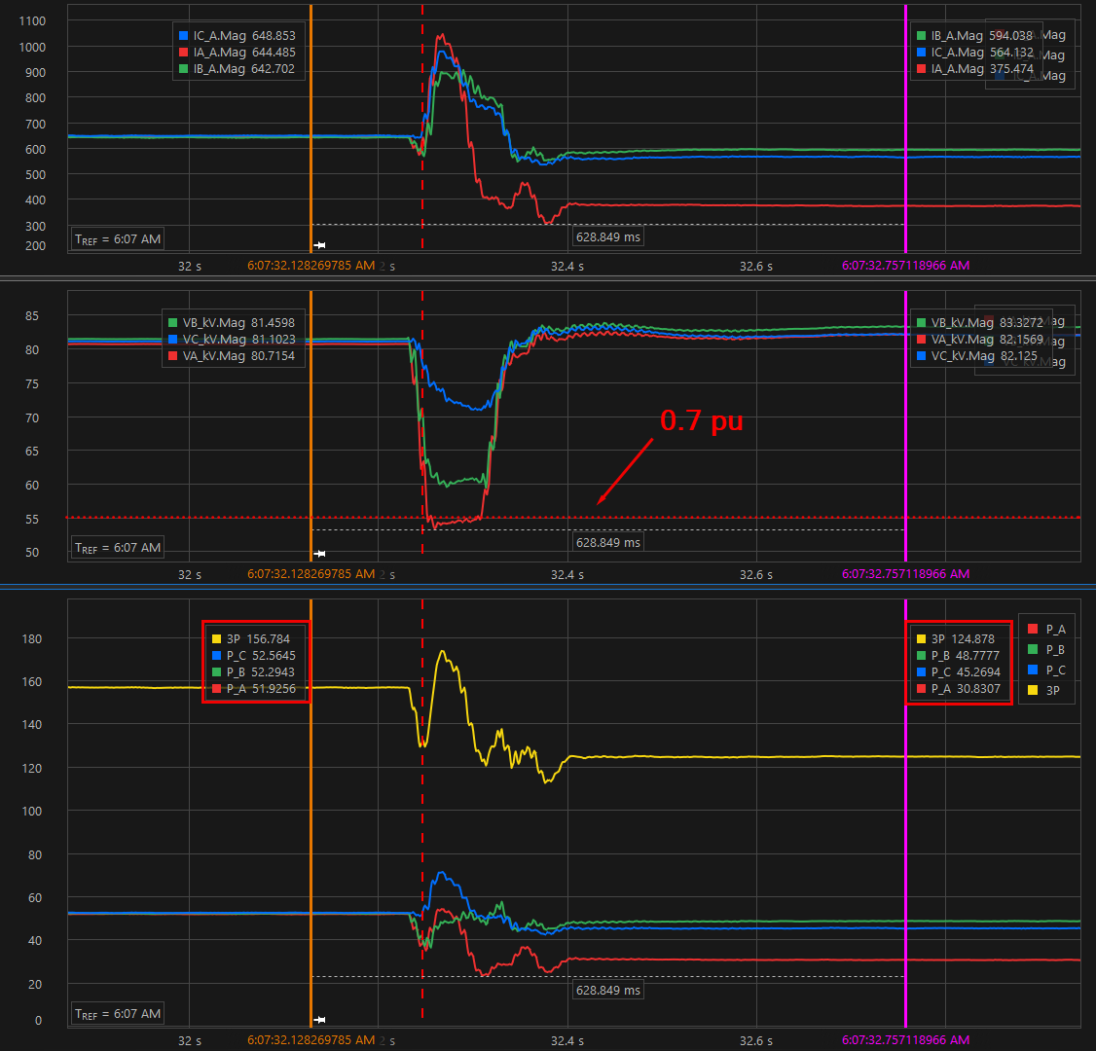
June 24 Event – Crypto Facility Reduction (Load B)
Only A-phase voltage drops below 0.7pu for >20 msec (barely)
Active power reduction in A-phase consists of 70% of total reduction (38 MW)
Current spikes to 150% of pre-fault current during fault
Facility returns to pre-fault consumption in ~5 mins

Slide 7
ERCOT Load Loss/Reduction Event – July 30,2025
Texas Coast Event on July 30, 2025 @ 05:39 AM;
~426 MW total load reduction
Line-Line-to-Ground (LLG) fault on 138 kV due to conductor falling in Texas Coast area near multiple large industrial oil/gas facilities
3 large industrial oil/gas facilities reduced a combined 426 MW during the event
System frequency increased to 60.037 Hz and recovered in ~3min
Fault cleared in ~5 cycles
One facility involved in multiple events between 2020 and 2023
Load Identifier | Max Load | Pre-fault consumption | Post-fault consumption | Consumption loss | % Loss | Low Voltage at POI | Load Description
Load A | 80 | 61.8 | 30.7 | 31.1 | 50.3 | 0.687 pu | Oil/Gas Production, Processing and Transmission
Load B | 700 | 666.6 | 418 | 248.6 | 37.3 | Between 0.5 and 0.7 pu | Oil/Gas Production, Processing and Transmission
Load C | 170 | 166.5 | 20.5 | 146 | 87.7 | 0.728 pu | Oil/Gas Production, Processing and Transmission
Totals |  | 894.9 | 469.2 | 425.7 | 47.6

Slide 8
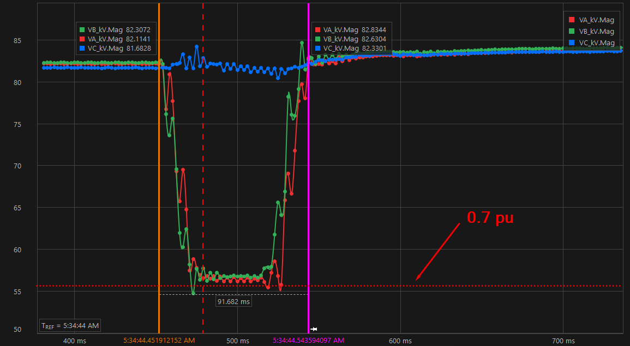
July 30 Event – Oil/Gas Facility Reduction (Load A)
Voltage at Service Delivery Point shown below
A-phase and B-phase voltages drop close to 0.7 pu
Current data toward LL from Service Delivery Point not available
LL reduced consumption by ~50% and returns to pre-disturbance consumption ~5 hours later

Slide 9
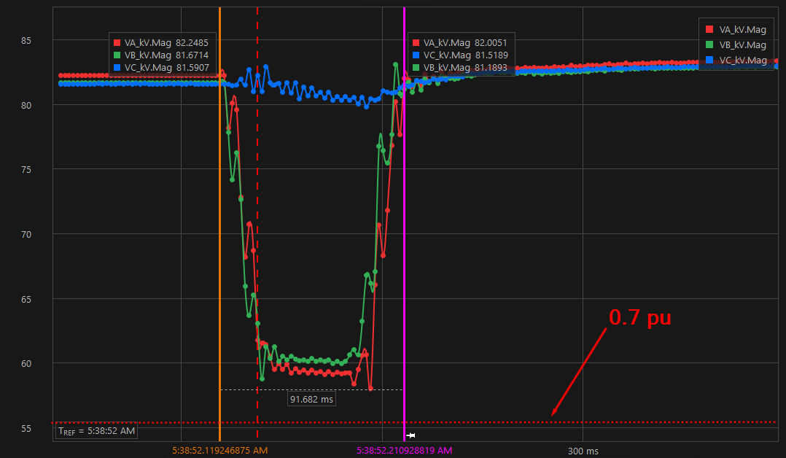
July 30 Event – Oil/Gas Facility Reduction (Load C)
Voltage at Service Delivery Point shown below
A-phase and B-phase voltages drop close to 0.75 pu
Current data toward LL from Service Delivery Point not available
LL reduced consumption by ~90% and returns to pre-disturbance consumption several hours later

Slide 10
Key Observations and Next Steps
Non-electronic Large Loads have shown to be sensitive to voltage sags; particularly for multi-phase faults
Recent events continue to verify that crypto mining facilities trip or reduce consumption for voltage sags close to 0.7pu at the Service Delivery Point; faulted phase(s) have most significant loss
ERCOT waiting on interconnecting TSP to coordinate with loads involved in July 30 event to determine specifics of load that reduced and if ride-through capabilities can be improved

Slide 11
Questions?

