Slide 1
2026 Reliability Assessment Preparation Update
Supply Analysis Working Group
Pete Warnken
Resource Adequacy Department
October 24, 2025

Slide 2
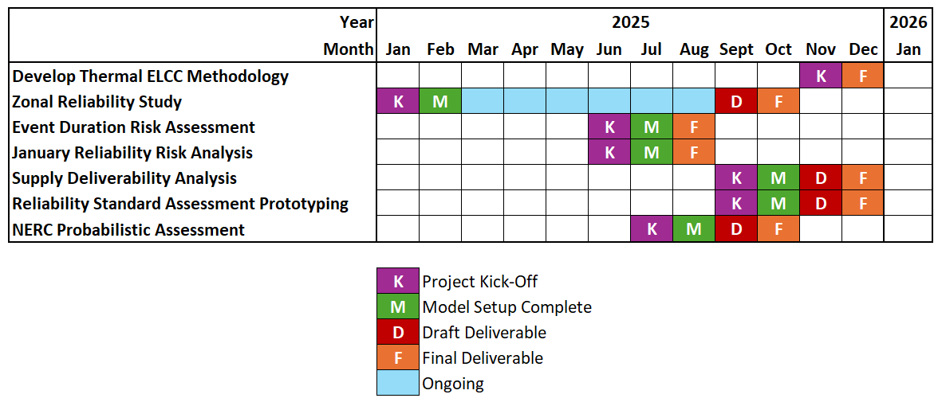
Current SERVM Project Schedule
Only change from last month has been to move the start of the thermal ELCC methodology development from October to November

Slide 3
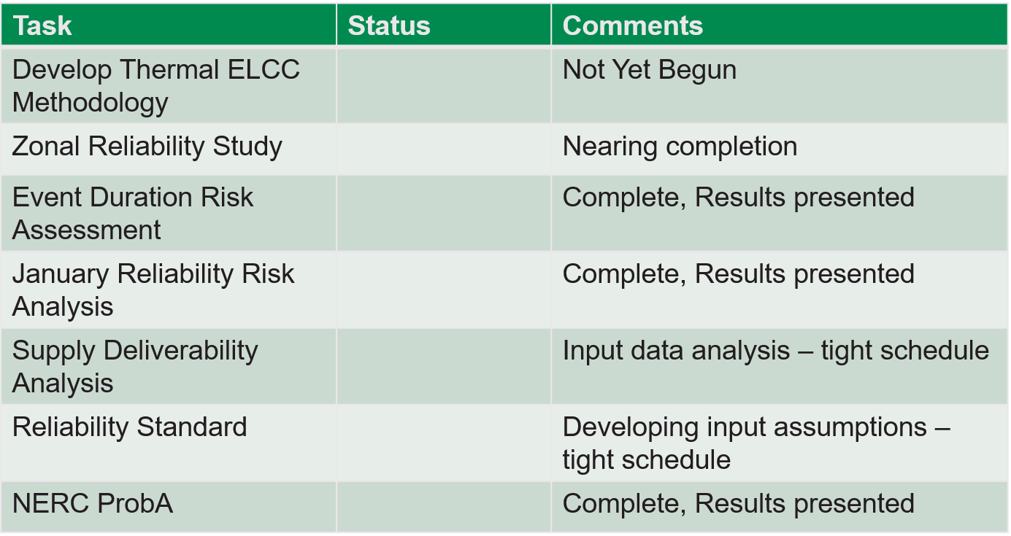
SERVM Project Status

Slide 4
Reliability Assessment Assumption Status
Table at right is not intended to cover all assumptions that may be documented in ERCOT’s Assumptions filing
Updates since the last SAWG meeting indicated in red

Slide 5
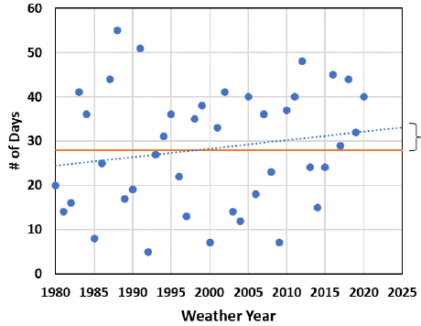
Proposed Weather-Year Weighting Method
Currently, each weather year has the same probability of occurrence; the method proposed by PowerGem applies larger weights for weather years with higher-than-normal summer temperatures
Plot the number of days where the daily maximum system-average temperature exceeded a certain high level for each weather year being modeled
Create a linear trend line for the plotted number of days
Compare the average number of temp exceedance days across all the weather years with the average for the most current weather years
Apply linear scaling adjustments to weight each weather year that exceeds the average number of temp exceedance days
The weights would result in the new weighted average number of exceedance days to match the exceedance days for the most current weather years
# of Days with Temps > __ °F
Chart source: DTE Energy Resource Adequacy Assessment report, September 2022

