Slide 1
NPRR 1295 and PGRR 130 Joint Commenters
PLWG 10/28/2025

Slide 2
Agenda
Introduction
GTC proliferation history
Relevant PUC rule
Language review and discussion
(7)(a) Transparency
(7)(b) Additional Benefit in Reducing Excessive Number of GTCs
(7)(c) Stakeholders partially funding Transmission Projects
(8) Benefit of Incremental Generation Deliverability During EEA (getting input from resource adequacy experts and will discuss this item in November)
(9-10) Potential language addition for benchmarking and bid price

Slide 3
Introduction
Joint commenters look forward to productive conversations around these issues and seek to improve the first draft of language for this crucial issue
EDF and Pattern are withdrawing NPRR 1070, as NPRR 1295 replaces the unresolved items in it
While there have been improvements in the planning process and rapidly growing loads are improving some GTC congestion, the number of GTCs continues to escalate in recent years with no significant process improvements to exit them – the only requirement is a one-time analysis to state the exit strategy with no further required updates or any limits on duration or number of GTCs
While GTCs are a powerful tool for operations to manage flows and system stability, having a large number of GTCs creates an operational burden and causes additional risks in the control room, multiplying the potential for cascading loss of load, as well as adding significant congestion cost to customers and affected generators

Slide 4
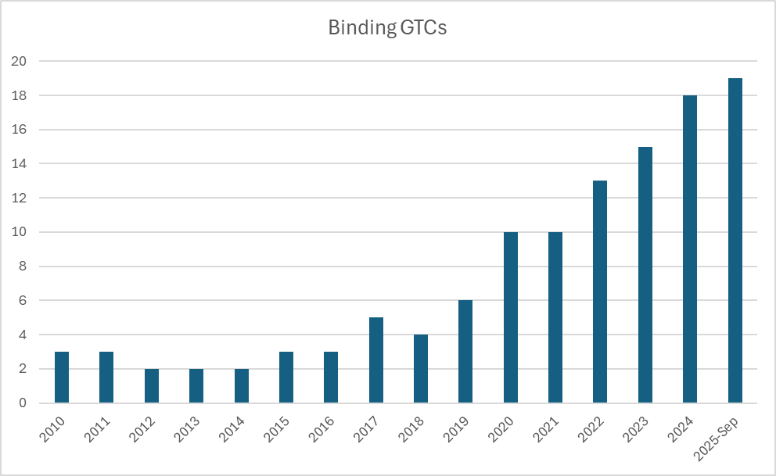
GTC Proliferation – Number/Year
The past 7 years show dramatic increase in number of GTCs to manage, creating complexity in control room
Note 2025 data does not include Q4, or the two new Far West Import GTCs (current total number = 25)
Source Yes Energy

Slide 5
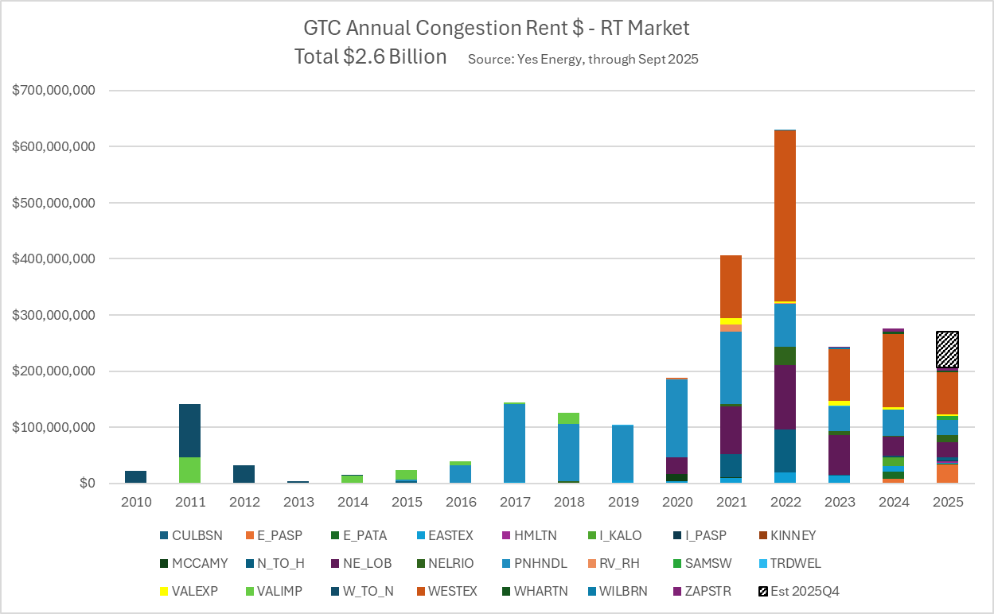
GTC Proliferation – Cost/Year
Improvements since 2022 include:
Increasing load in West and nearby Panhandle
Less impact from scarcity pricing
Some upgrades helping (e.g., second circuit in LRGV)
Does not yet include two new Far West Import GTCs

Slide 6
Relevant PUC Rule
While NPRR 1295 comments do reference the GTC impact to resiliency and an opportunity to leverage information gained by studies already required, Sponsors are not citing PUC Subst. R. 25.101(b)(3)(A)(iii) which concerns Resiliency Projects.
This revision request is based on PUC Subst. R. 25.101(b) )(3)(A)(i) concerning economic projects. This rule provides that “adequately quantifiable and ongoing direct and indirect costs and benefits to the transmission system attributable to the project may be included in the cost-benefit study.”
Although ERCOT has not utilized this provision, the rule clearly allows additional benefits to be considered in evaluating economic projects. The unique nature of GTC exit strategies warrants consideration of additional benefits that meet this criteria, expanding on the concept included in 3.11.2 Planning Criteria (5)&(6): “Other adequately quantifiable and ongoing direct and indirect costs and benefits to the transmission system attributable to the project may be considered as appropriate.”

Slide 7
(7)(a) Transparency and follow-up studies
ERCOT staff feedback indicates the initial proposal is not practical
Stakeholders (TOs) need ERCOTs input on and ongoing basis on what projects could improve GTLs or exit GTCs beyond the initial posting of GTC exit alternative within 180 days
What level of analysis of existing GTCs would be feasible (including potentially increasing FTEs) and most beneficial to improve the situation?
In the February 2020 GTC Workshop, ERCOT Staff indicated an intention to: “Review the adequacy of the identified GRC exit alternatives (every 3 years)” and “Review if the GTC exit alternatives can be recommended based on the reliability and/or economic criteria” … Is this what needs adding to protocols? How could it be improved further?

Slide 8
(7)(b) Benefit in Reducing Number of GTCs
As noted in the NPRR comments, the number of GTCs that are problematic and the benefit amount are both placeholders and sponsors are seeking ERCOT and TO input on this item
We understand avoiding new GTCs could have a larger incremental benefit than eliminating existing ones – and that could be the focus of a different revision request
Brainstorming – How can we “adequately quantify” the incremental benefit of reducing the number of GTCs?

Slide 9
(7)(c) Generators partially funding Transmission Projects
Per Docket 55566 at the PUCT for generators with SGIAs after 12/31/2025
Allowance of $14 million for projects 138 kV or less
Allowance of $20 million for projects greater than 138 kV
A $50 million transmission upgrade for a generator at 345 kV will cost the generator $30 million
Per NP 3.11.4.11
Generators can pay for 100% of a new transmission project
We are looking to add an option to add incremental transmission upgrades to remove GTCs and/or increase GTLs
Currently 25 GTCs with 2 being removed with new transmission projects (Hamilton and Sam Switch) without the additional cost allocations

Slide 10
New issue: Accuracy of Congestion Cost Savings Test in Economic Evaluation of Projects
ERCOT needs to benchmark the models being used to make sure that they align with real world congestion history.
A great source of data which is public and available is the 60 day SCED report. Data Product Details
On the next slide, we look at one 15 minute period on 4/19/2025
Recommendation would be for ERCOT to use an annual average bid for each resource from the year prior in their models
Thermal would have to calculate the average heat rate based off FIP and apply the forward looking FIP to those curves

Slide 11
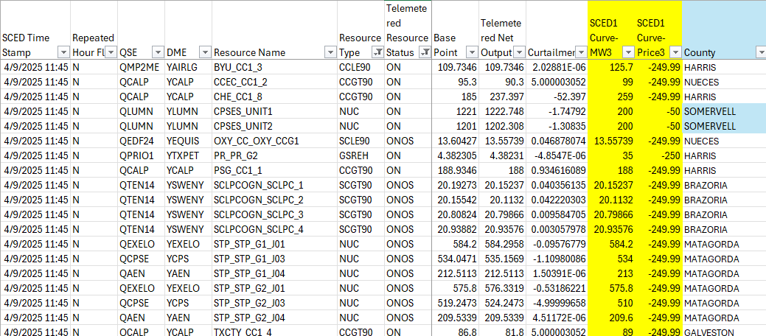
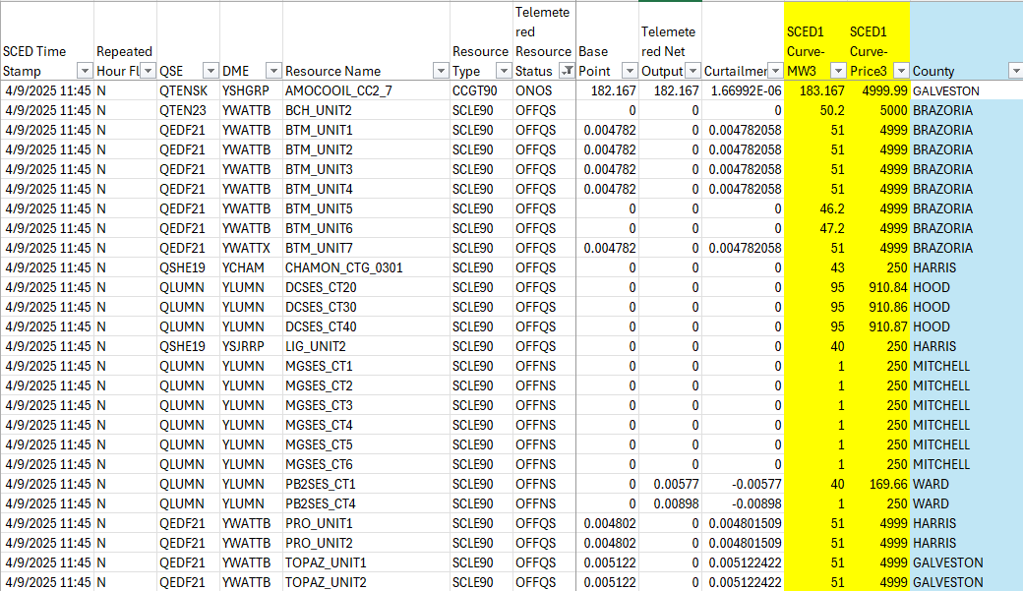
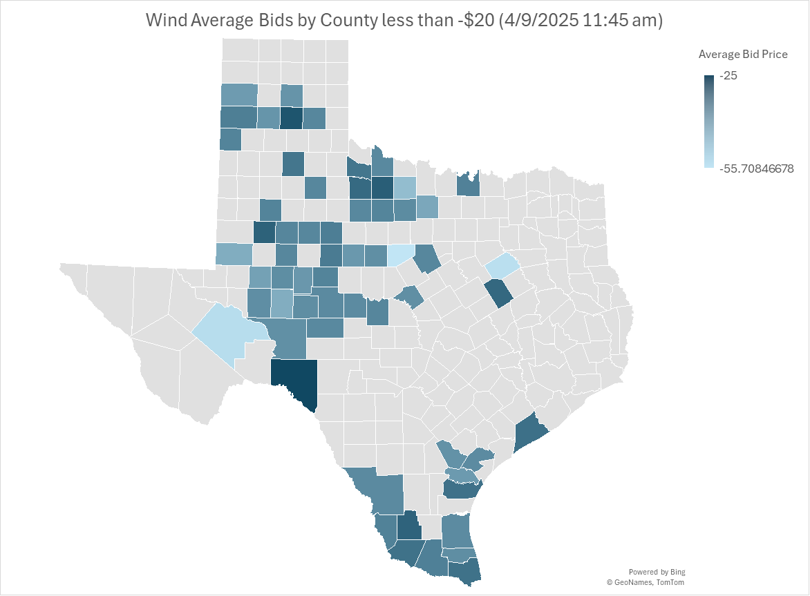
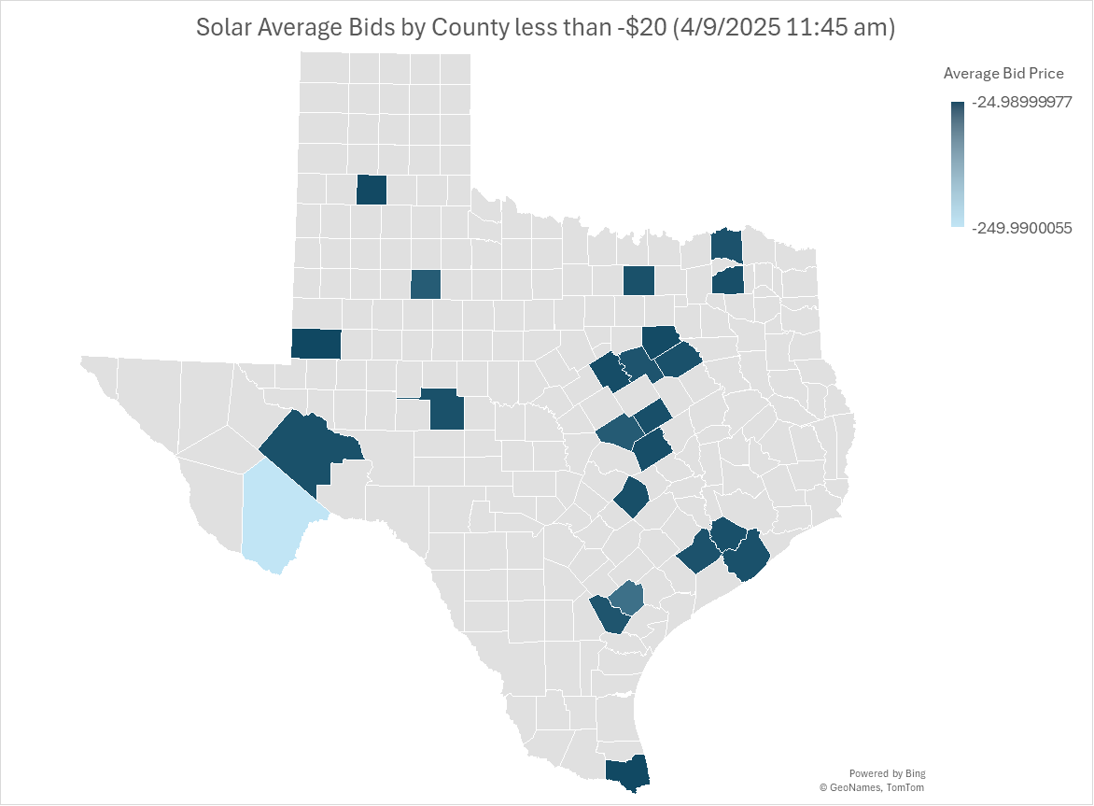
60 Day SCED Data from 4/9/2025 11:45 am
Most renewables are clearly bidding below $0/MWh
Some thermals are bidding negative whereas other thermals are bidding more than their fuel costs

Slide 12
Proposed Language Addition in NPRR 1295
(7) In order to improve system stability and resiliency by resolving identified Generic Transmission Constraints (GTCs) and/or improving Generic Transmission Limits (GTLs) ERCOT will:
(a) Show for all transmission project evaluations whether the project provides exit solutions for resolving nearby GTCs or increases any GTLs;
(b) Endorse any GTC solution option that is within $20 million of meeting the cost-to-benefit criteria when there are more than five GTCs, in order to reflect the intangible resiliency value of reducing the number of GTCs impacting system operations; and
Allow individual stakeholder(s) to pay for the additional difference above the threshold in paragraph (7)(b) above. ERCOT will endorse that option when stakeholder(s) demonstrate commitment to pay the additional cost.
(8) When evaluating the economic benefits of GTC exit solutions or projects that improve GTLs, in addition to the savings described in paragraphs (5) and (6) above, the impact of GTCs on generation available to serve system load during Emergency Conditions may be evaluated. Any information available from generation adequacy studies or resiliency studies that consider a range of system conditions may be used to estimate the value of improved deliverability of generation due to relieving GTCs.
ERCOT will prepare by March 1 of each even year a benchmark of the production cost model utilized in performing the Congestion Cost Study against the prior year actual congestion costs.
ERCOT will use the annual average bids for each resource from the 60-Day SCED Disclosure Reports Gen Resource Data from the year prior in their production cost model utilized in performing the Congestion Cost Study.

