Slide 1
ERCOT Frequency Events
September 2025
ERCOT
Operations Planning
PDCWG | October 20, 2025

Slide 2
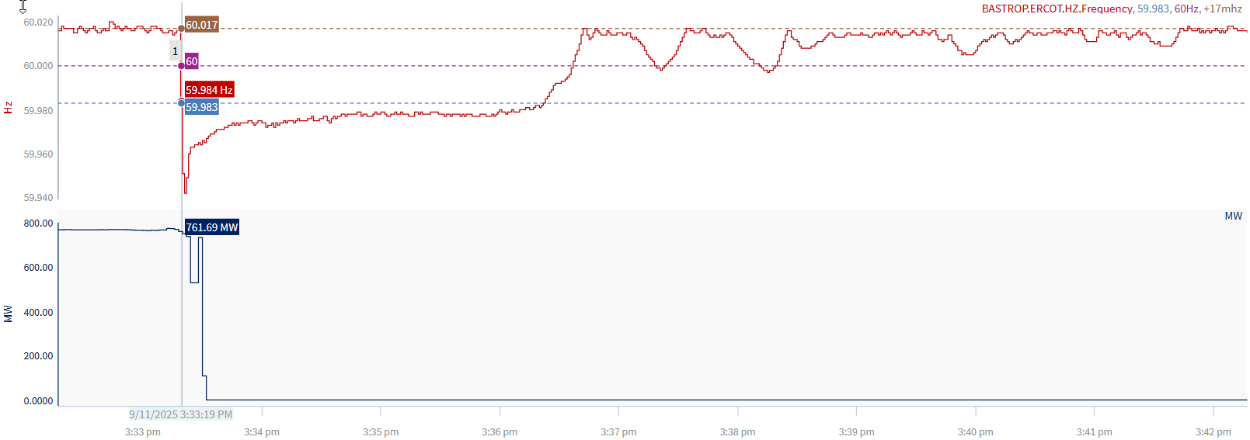
9/11/2025 15:33:19(Non-FME)
Notes:
The unit tripped offline while carrying ~762 MW
Starting Frequency: 60.017 Hz
Minimum Frequency: 59.942 Hz
A-C Time : 3 seconds
Recovery Time(back to deadband): 3 minutes 3 seconds
ECRS Released: 0 MW
Trip Reason: High Pressure Feedwater Heater tube leak
Reason for no selection: C point is 59.943
Contextual Information:

Slide 3
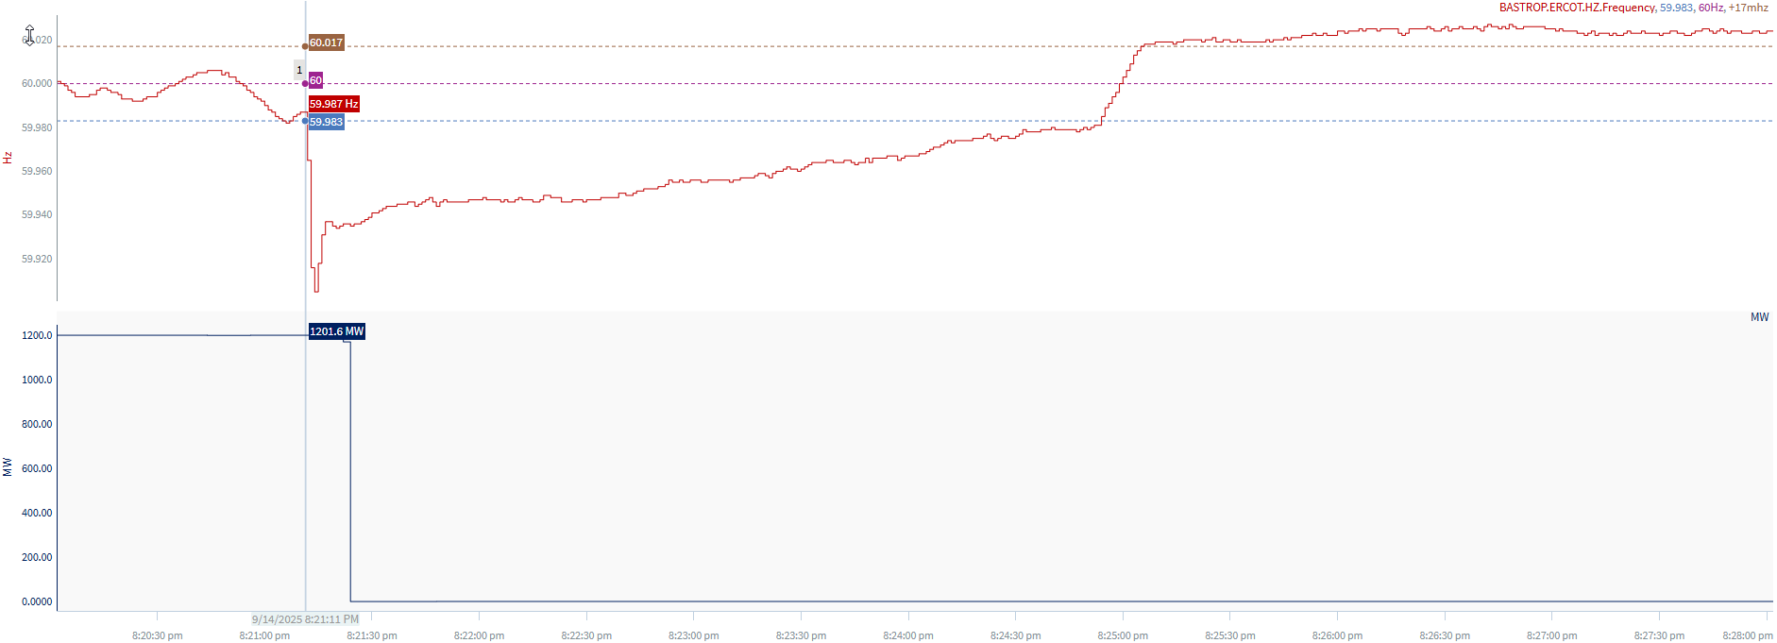
9/14/2025 20:21:11 (FME)
Notes:
The units tripped offline while carrying ~ 1202 MW
Starting Frequency: 59.987 Hz
Minimum Frequency: 59.905 Hz
A-C Time : 3 seconds
Recovery Time(back to deadband): 3 minutes 54 seconds
ECRS Released: 0 MW
Trip Reason: Unreported firmware update test
Contextual Information: A total of 280 MW of regulation Up was deployed and manual offset of 600 MW was applied during the event

Slide 4
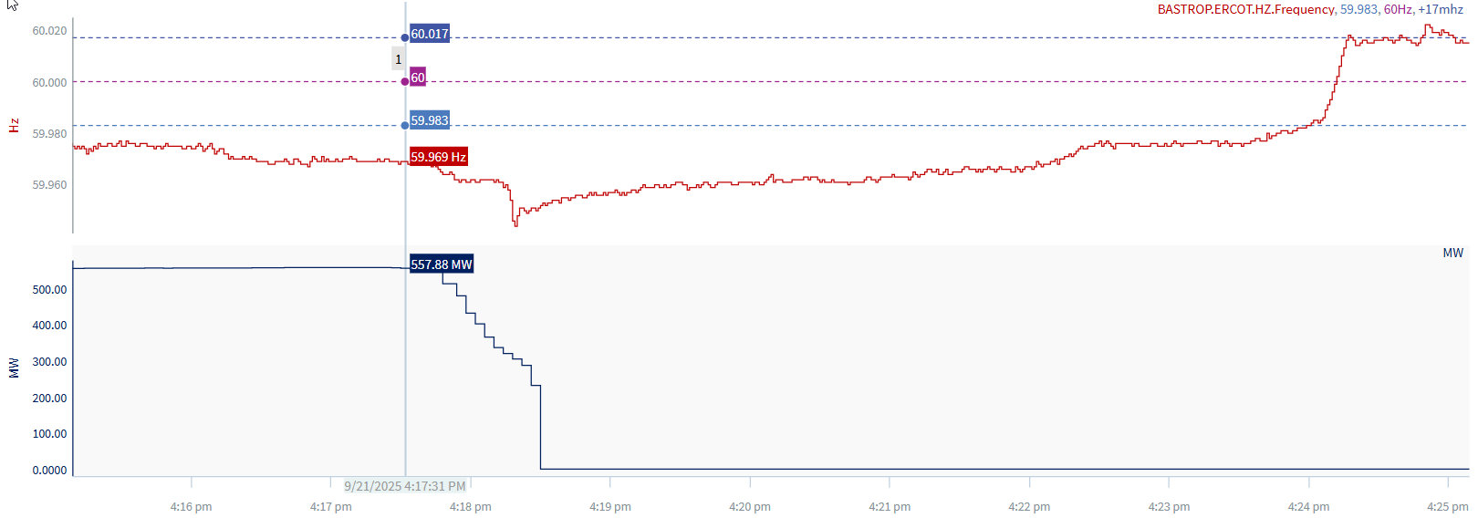
9/21/2025 16:17:31 (Non-FME)
Notes:
A unit experienced runback while carrying~558 MW and tripped offline
Starting Frequency: 59.969 Hz
Minimum Frequency: 59.944 Hz
A-C Time :
Recovery Time(back to deadband): 6 minutes 29 seconds
ECRS Released: 0 MW
Trip Reason: losing a bus at the time of switching
Reason for no selection: Frequency is outside the low deadband and unit trip is not clean
Contextual Information: A total of 608 MW of regulation Up and a manual offset of 400 MW was deployed during the event.

Slide 5
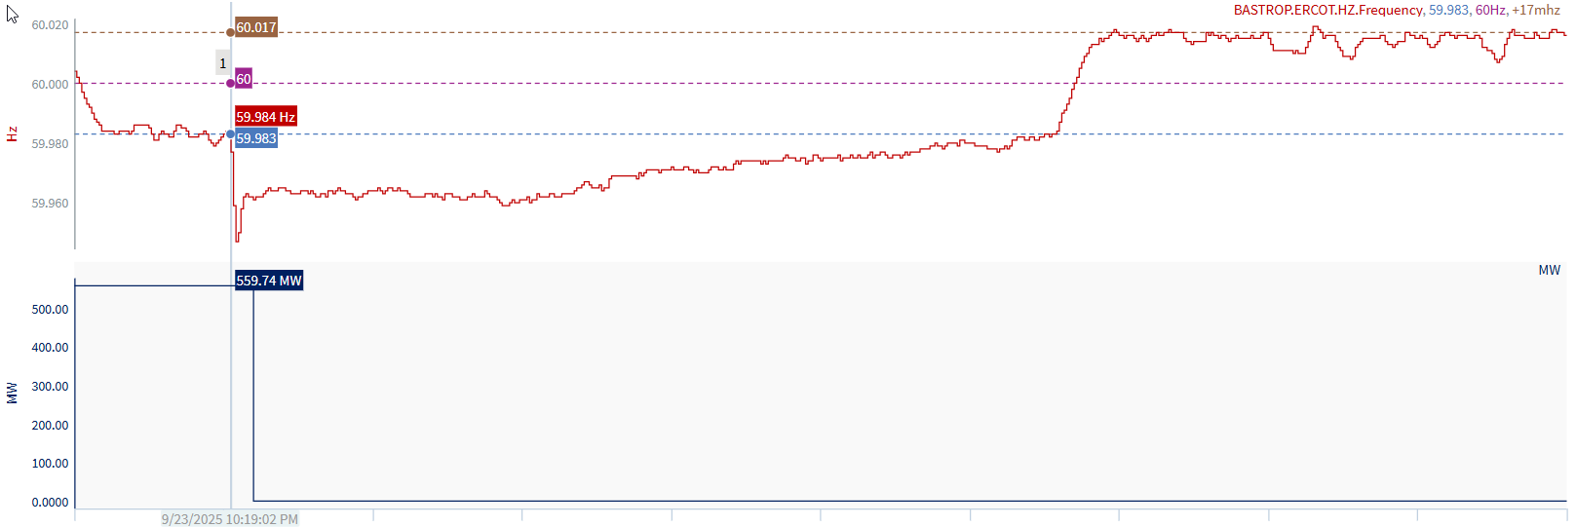
9/23/2025 22:19:02 (Non-FME)
Notes:
Unit tripped offline while carrying ~560 MW
Starting Frequency: 59.984 Hz
Minimum Frequency: 59.947 Hz
A-C Time : 3 seconds
Recovery Time(back to deadband): 5 minutes 33 seconds
ECRS Released: 0 MW
Trip Reason: unknown at this time
Contextual Information: A total of 208 MW of regulation Up and a manual offset of300 MW was deployed during the event.

Slide 6
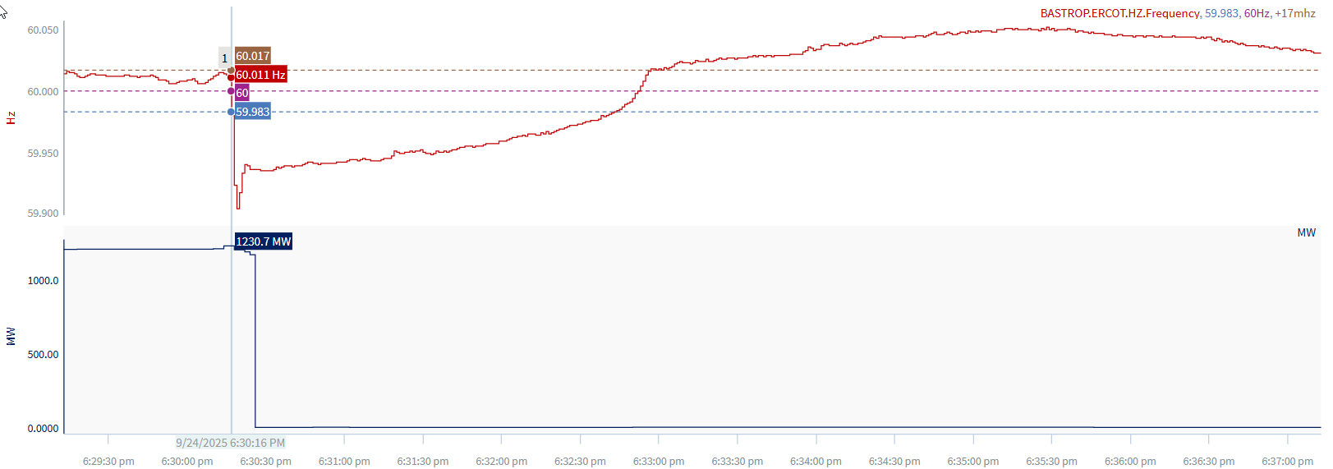
9/24/2025 18:30:16 (FME)
Notes:
A unit tripped for a loss of ~745 MW and experienced runback
Starting Frequency: 60.011 Hz
Minimum Frequency: 59.904 Hz
A-C Time : 4 seconds
Recovery Time(back to deadband): 2 minutes 27 seconds
ECRS Released: 0 MW
Trip Reason: loss of both feedwater pumps
Contextual Information: A total of 398 MW of regulation Up and a manual offset of 500 MW was deployed during the event.

Slide 7
Questions?
Thank you!

