Slide 1
CRR Updates at CMWG
Samantha Findley
October 20, 2025

Slide 2
Agenda
LTAS transactions and solution times
CRR auction limits table – no updates
NPRR 1292 Granular Product Type for CRR TOU

Slide 3
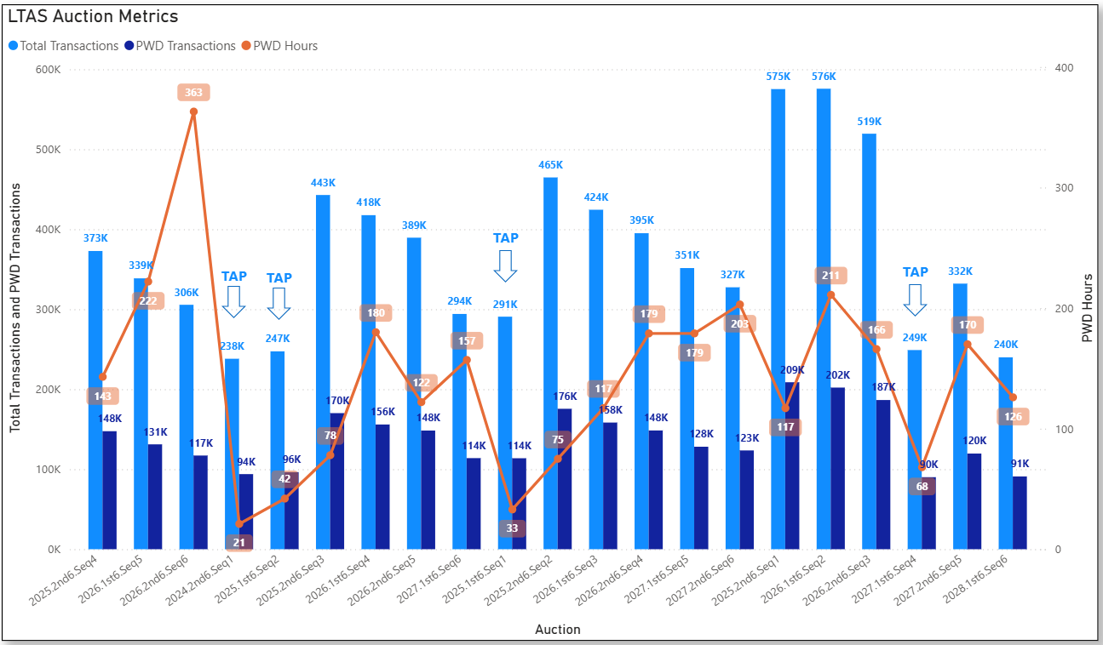
Historical LTAS transactions and solution times

Slide 4
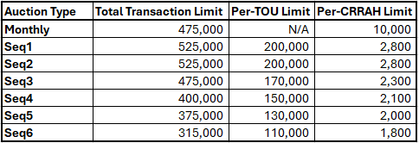
CRR auction transaction limits – no updates
Note: The per-CRRAH limit for Seq2 may need to be lowered depending on transactions submitted for Seq1 (bid window close on 10/23/2025). If ERCOT lowers the per-CRRAH limit for Seq2, the 2026.2nd6.AnnualAuction.Seq2 auction notice will contain the updated limit.

Slide 5
NPRR 1292 Granular Product Type for CRR TOU
We are still in discussion with the vendor.
We anticipate being able to submit bids for PeakWD and PeakWE. Awarded PeakWD or PeakWE bids would have two CRR IDs (one for solar and one for non-solar TOUs).
Still discussing how transition would work for calendar years already in flight (i.e., PCRRs already allocated, TOUs already defined).
Planning to restructure LTAS auctions with this implementation (changing to 6 monthly optimizations)
We are planning for NPRR 1292 to be implemented in the same release as removal of the budget constraint. If the budget constraint is not removed at the same time, the optimization run time may be significantly longer. In the testing phase this would be studied.
For PeakWD and PeakWE CRRs existing in baseload at the time of implementation of the new TOUs, those existing CRRs can only be offered as PeakWD and PeakWE bilaterally and in auctions.

