Slide 1
Monthly Review of Reliability Unit Commitment Market Impacts – September 2025
Wholesale Market Working Group
ERCOT Market Analysis

Slide 2
RUC Resource-Hours
* The difference between “Instructed” and “Effective” values is a result of Resources starting up, shutting down, receiving partial hour instructions, or otherwise not being dispatchable by SCED.

Slide 3
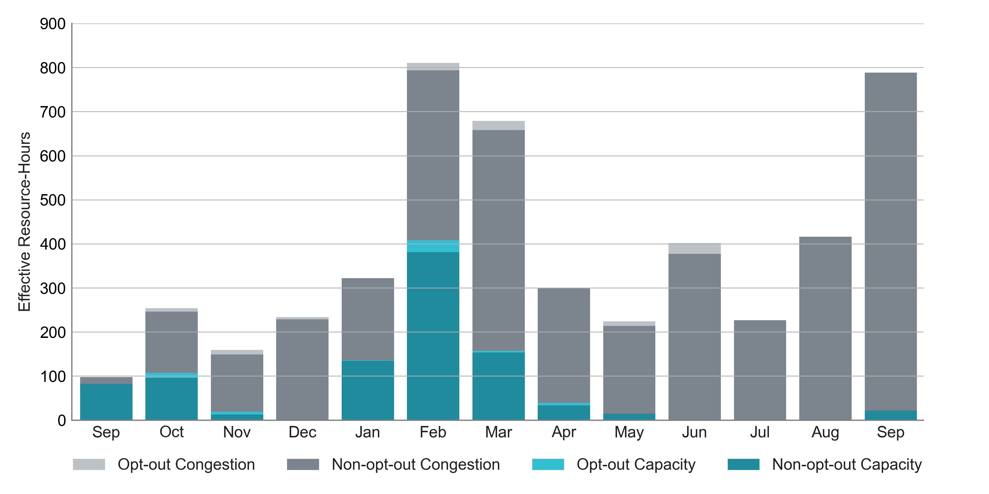
RUC Instruction Reasons: Last 13 Months 97% of RUC effective hours in September 2025 were nominally attributed to congestion.

Slide 4
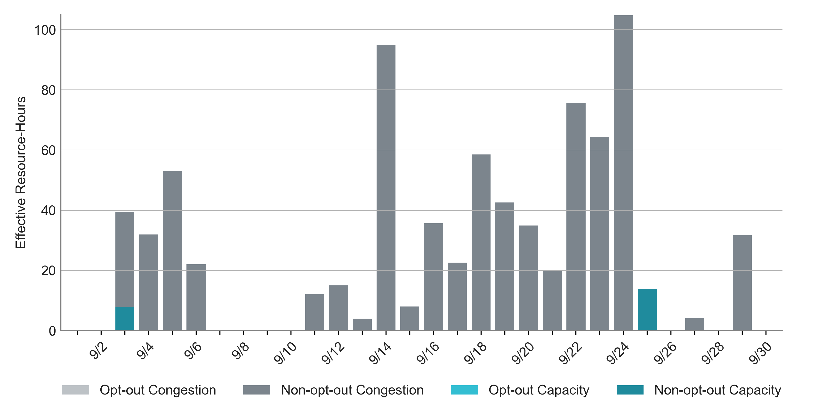
RUC Instruction Reasons in September 2025
788.2 RUC effective Resource-hours:
766.6 hours (97%) for congestion

Slide 5
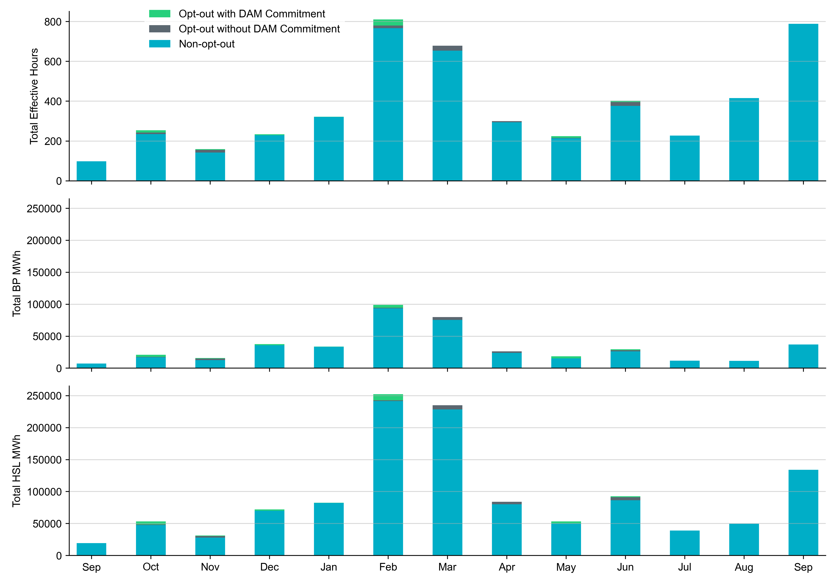
Non-opt-out and Opt-out Totals: Last 13 Months September 2025 had a total of 788.2 non-opt-out effective Resource-hours (100%) and 0 opt-out effective Resource-hours (0%).

Slide 6
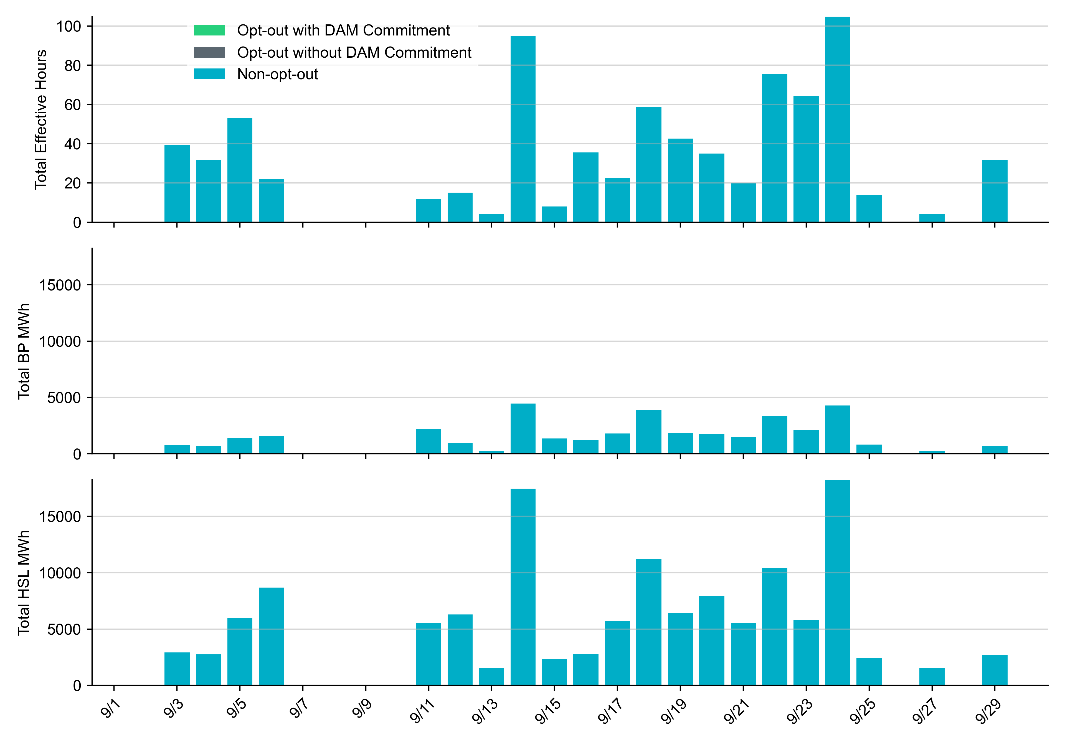
Non-opt-out and Opt-out Totals: September 2025

Slide 7
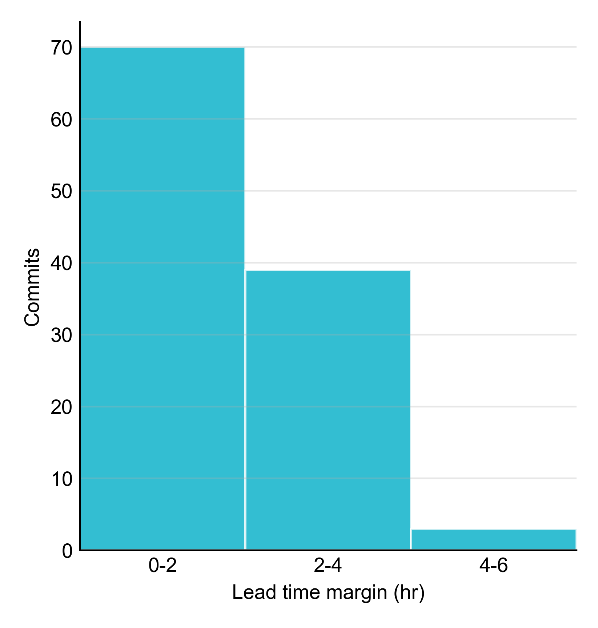
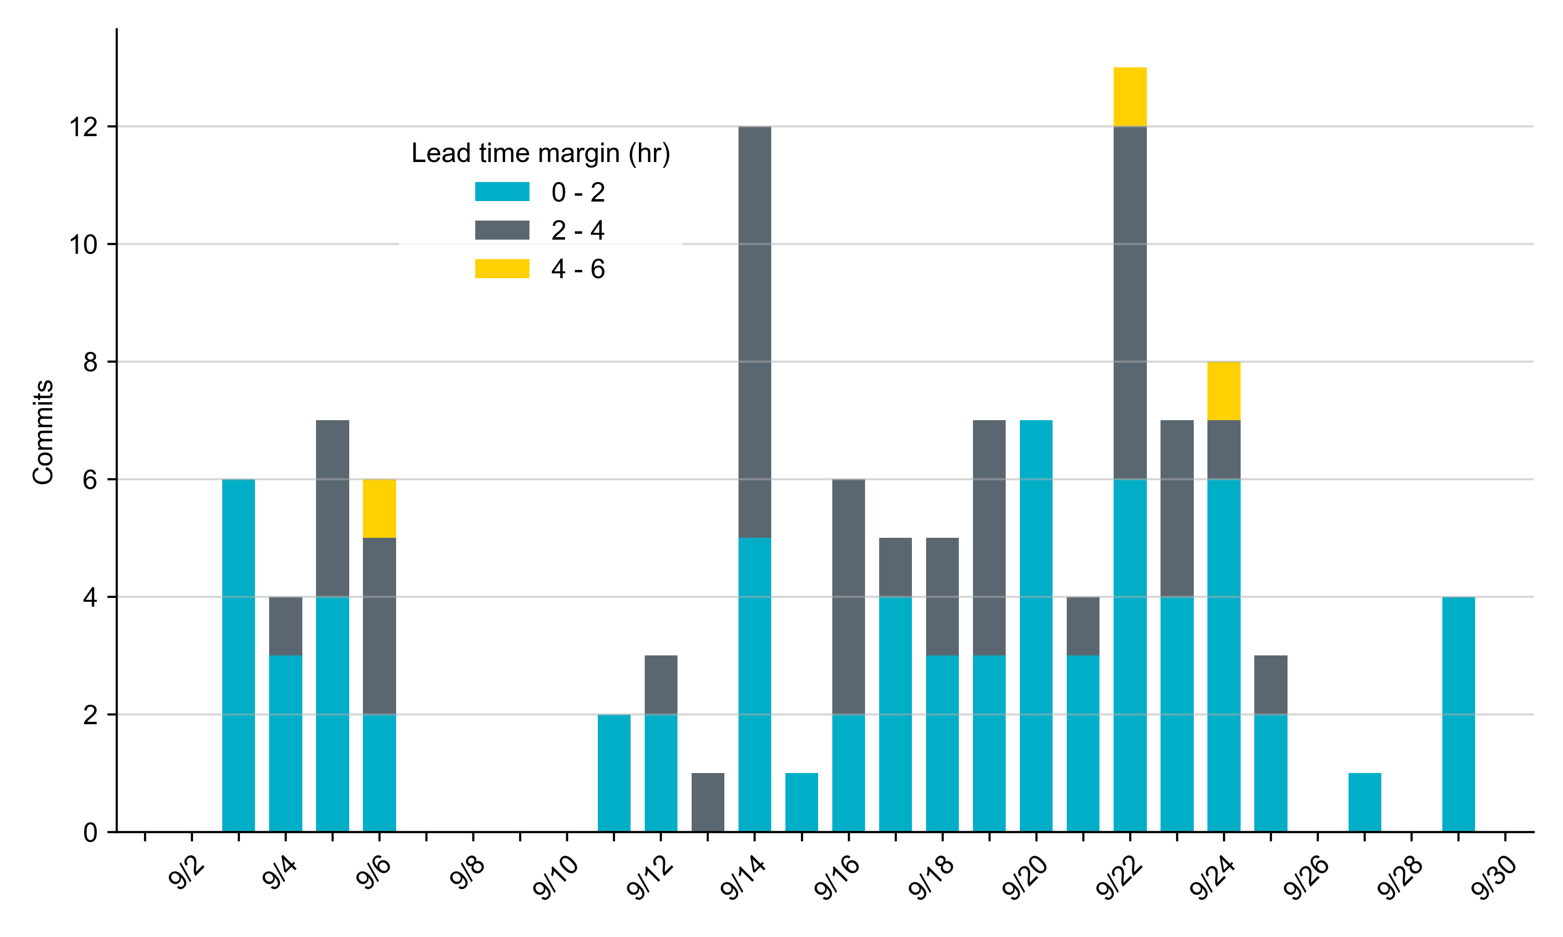
RUC Lead Time Margin: September 2025
Most RUC commitment windows (63%) had a lead time margin of 2 hours or less.
Lead time refers to the length of time between a RUC instruction and the start of the commitment window.
Lead time margin is the difference between lead time and the Resource’s startup time.
In cases where a Resource is committed for multiple back-to-back time blocks, lead time margin is calculated from the first instruction.

Slide 8
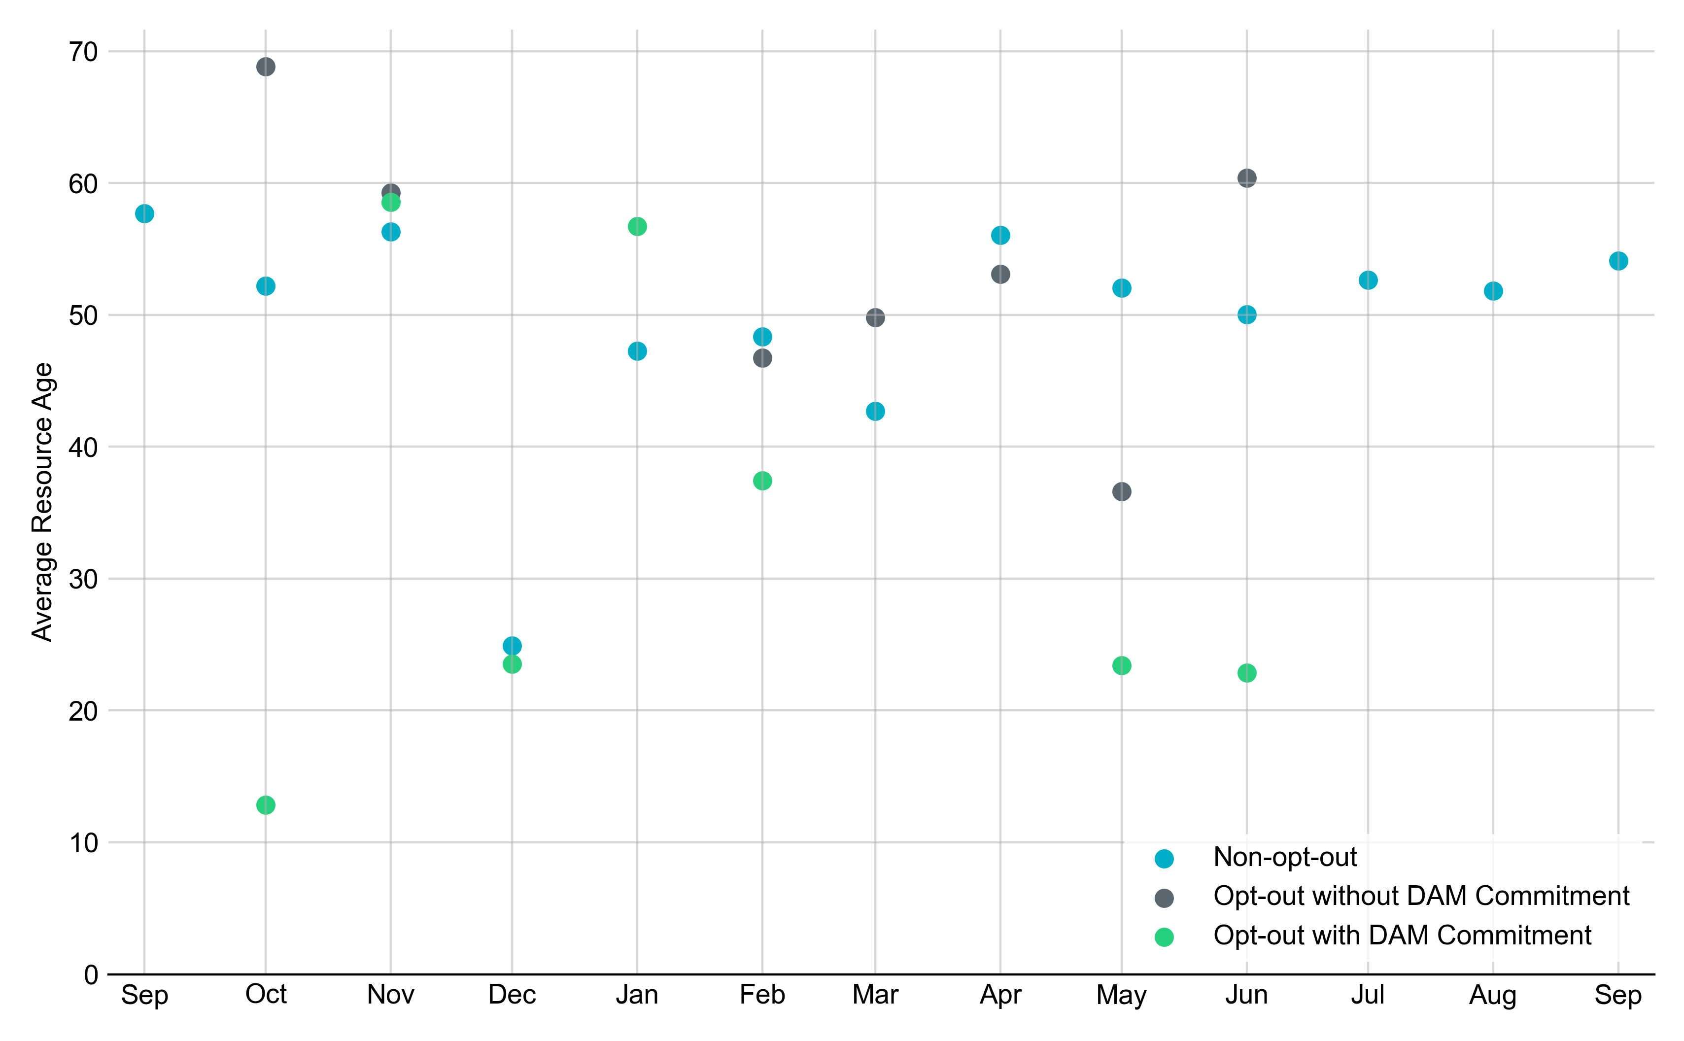
Average Resource Age: Last 13 Months In September 2025, the average age of RUC-committed Resources was 54.1 years for Non-opt-out Resource-hours.
Note: For Resource configurations with multiple physical generators, the age of the oldest generator is used.

Slide 9
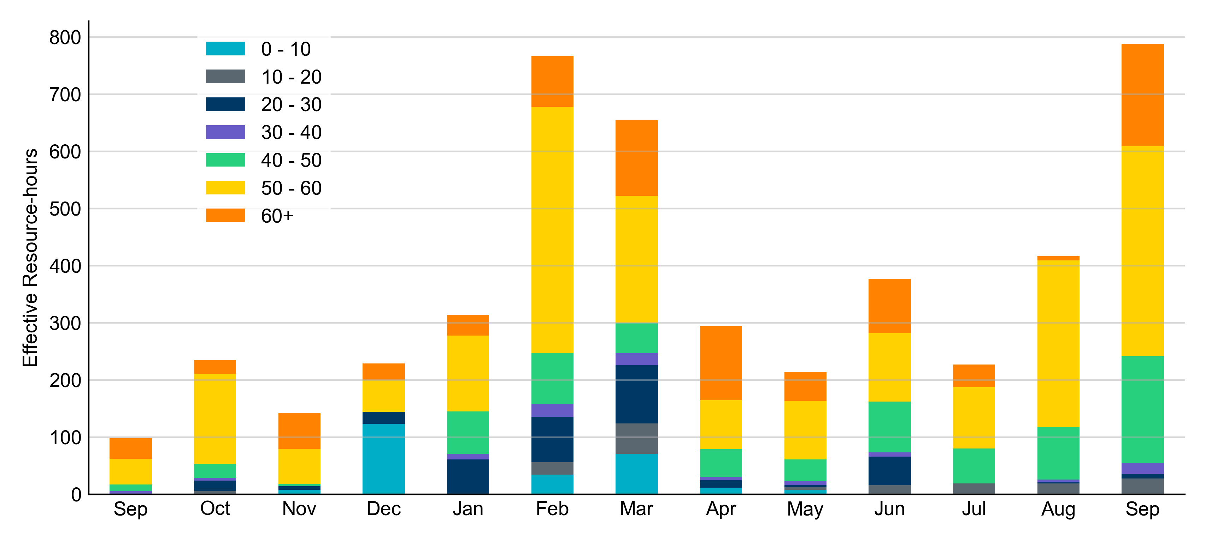
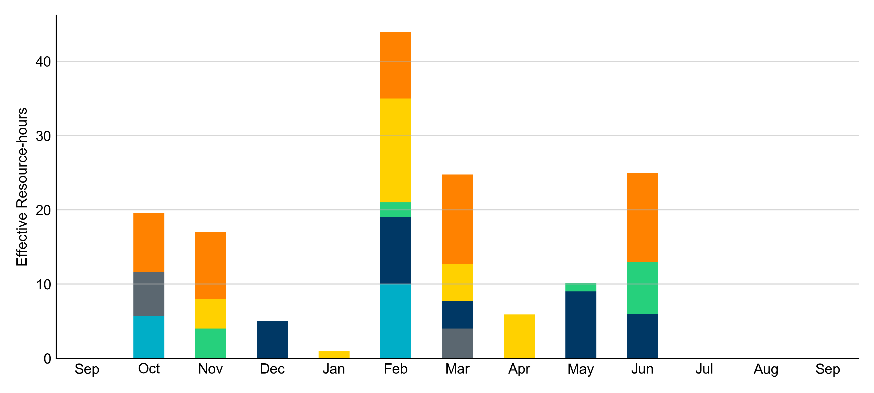
Age Category: Last 13 Months In September 2025, most RUC Effective Resource-Hours (69%) were provided by resources that were at least 50 years old.
Non-opt-out
Opt-out

Slide 10
RUC-Instructed Resource Dispatch above Low Dispatch Limit (LDL) in Non-Opt-Out Hours
Out of all 788.2 non-opt-out Effective Resource-hours, RUC-instructed Resources were dispatched above their LDL for 45.1 Resource-hours.
In 1.6 of these Resource-hours, the Locational Marginal Price (LMP) for the RUC-instructed Resource exceeded the RUC offer floor.
In 43.5 of these Resource-hours, the LMP for the RUC-instructed Resource fell below the RUC offer floor.
All 43.5 Resource-hours saw the RUC-instructed Resource being mitigated.
There were no Exceptional Fuel Cost submissions for any Resources committed by RUC.

Slide 11
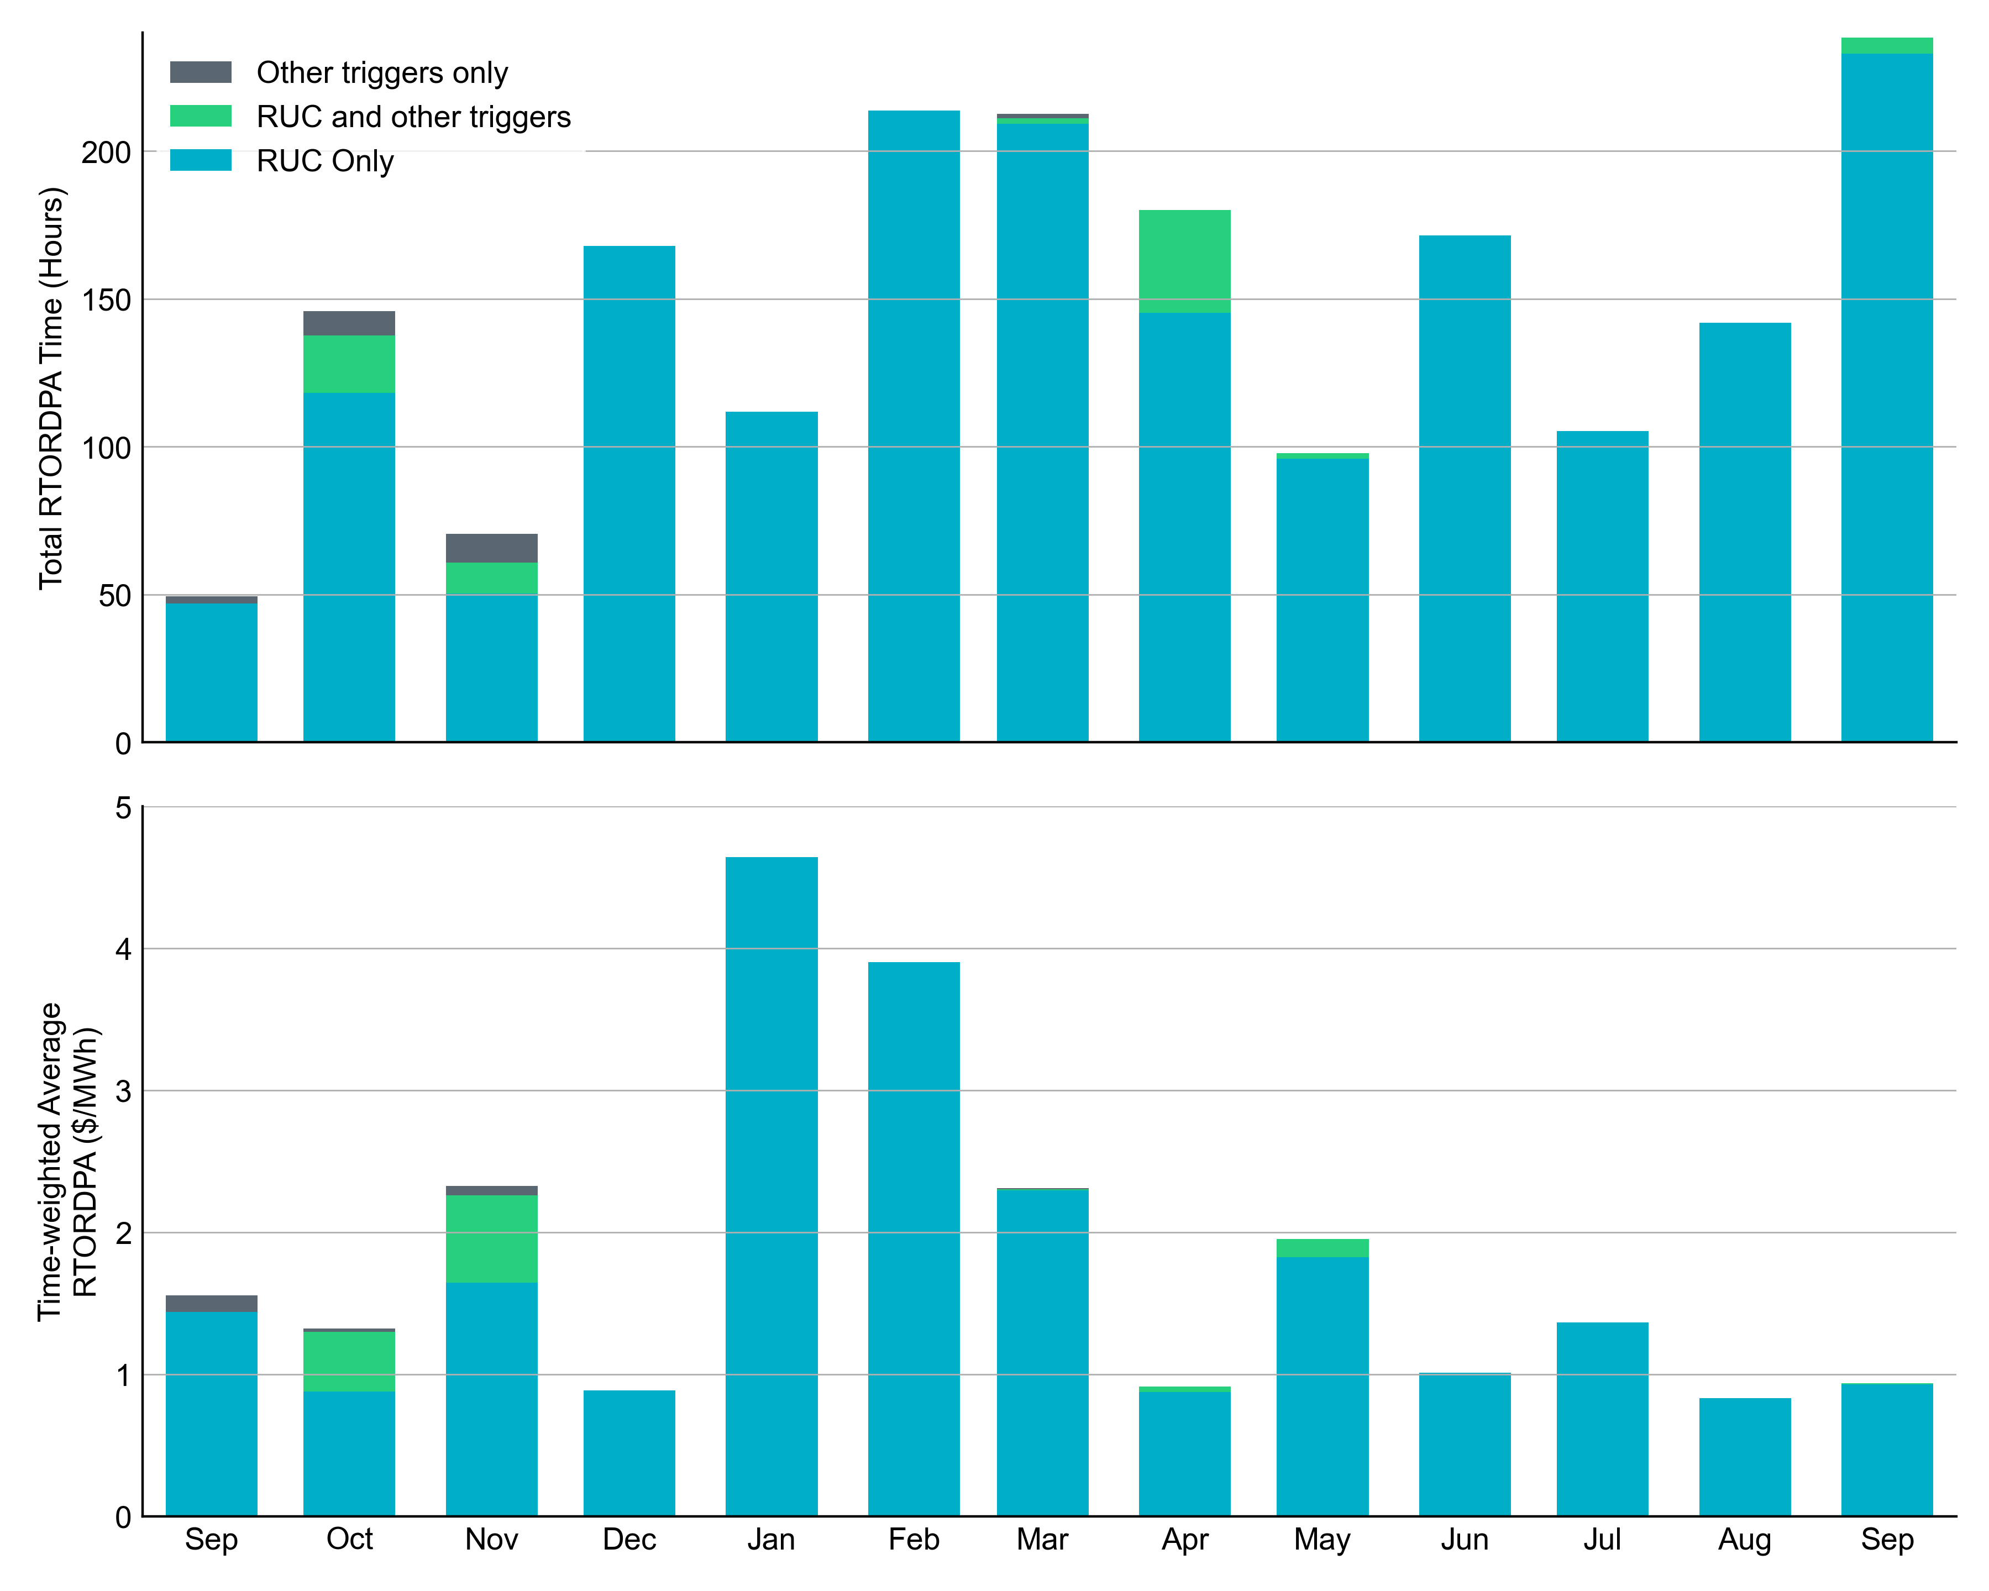
Reliability Deployment Price Adder: Last 13 Months September 2025 had a total of 238.3 RTORDPA hours with a time-weighted average value of $0.94/MWh.
These graphs show RTORDPA instances by reliability action: 'RUC Only' for instances triggered solely by Reliability Unit Commitment, 'RUC and other triggers' for instances with RUC and additional triggers, and 'Other triggers only' for instances with non-RUC triggers. The daily average RTORDPA is calculated using the total duration across all categories. See ERCOT protocol section 6.5.7.3.1 for details.

Slide 12
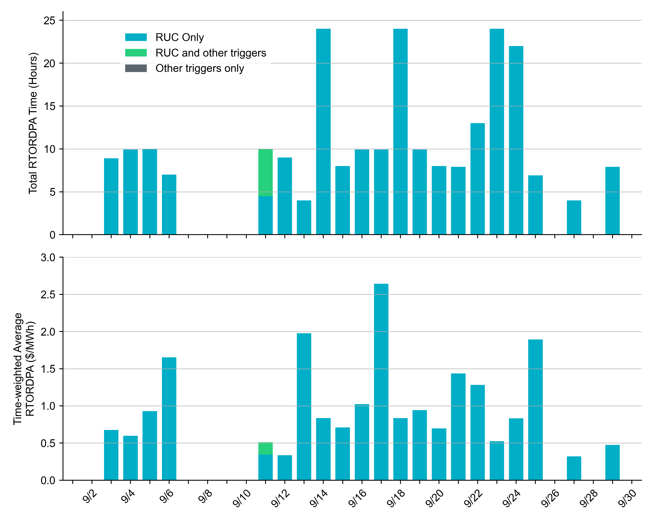
Reliability Deployment Price Adder: September 2025 OD 09/17 had the highest daily time-weighted average RTORDPA of $2.64/MWh.
These graphs show RTORDPA instances by reliability action: 'RUC Only' for instances triggered solely by Reliability Unit Commitment, 'RUC and other triggers' for instances with RUC and additional triggers, and 'Other triggers only' for instances with non-RUC triggers. The daily average RTORDPA is calculated using the total duration across all categories. See ERCOT protocol section 6.5.7.3.1 for more details.

Slide 13
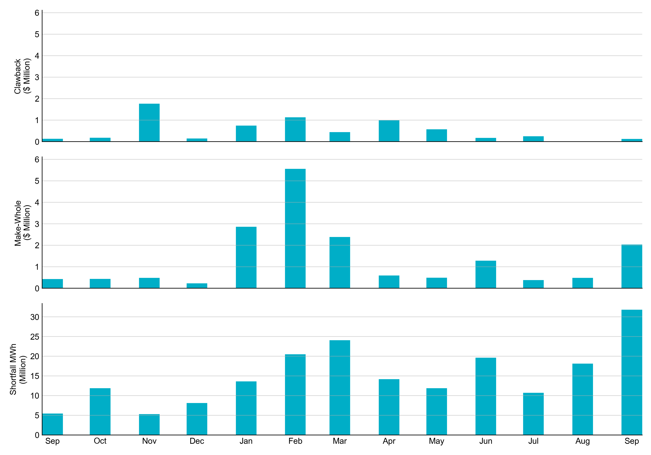
RUC Clawback, Make-Whole, and Shortfall For September 2025, the total Clawback Charge was $122,634. The total Make-Whole Payment was $2,035,251.
Of the $2,035,251 in Make-Whole Payments made in September 2025, $9.37 was uplifted to load due to rounding.
The remaining amount was collected through Capacity-Short Charges.
Data as of October 7th, 2025

Slide 14
RUC Clawback by Settlement Type
Month | Initial Settlement ($) | Final Settlement Change ($) | True-up Settlement Change ($) | Net as of October 07, 2025 ($)
Sep ‘24 | 140,239 | 0 | -7,864 | 132,375
Oct ‘24 | 179,331 | 0 | 0 | 179,331
Nov ‘24 | 2,022,874 | 0 | -259,986 | 1,762,888
Dec ‘24 | 147,389 | -3 | 0 | 147,386
Jan ‘25 | 1,037,717 | 0 | -294,094 | 743,623
Feb ‘25 | 3,272,312 | 0 | -2,138,639 | 1,133,673
Mar ‘25 | 545,642 | 0 | -87,084 | 458,558
Apr ‘25 | 993,341 | 119 | -418,816 | 574,643
May ‘25 | 574,643 | 0 | - | -
Jun ‘25 | 173,176 | 0 | - | -
Jul ‘25 | 246,345 | 134 | - | -
Aug ‘25 | 12,319 | 0 | - | -
Sep ‘25 | 122,634 | - | - | -
Negative dollars represent a payment from ERCOT to a market participant
“-” indicates settlement has yet to be completed.
Net figures may differ slightly due to rounding.

Slide 15
RUC Make-Whole by Settlement Type
Month | Initial Settlement ($) | Final Settlement Change ($) | True-up Settlement Change ($) | Net as of October 07, 2025 ($)
Sep ‘24 | -239,681 | 0 | -192,123 | -431,804
Oct ‘24 | -364,395 | 0 | -72,381 | -436,776
Nov ‘24 | -164,191 | 0 | -317,703 | -481,894
Dec ‘24 | -179,587 | 0 | -53,342 | -232,929
Jan ‘25 | -834,867 | -80,530 | -1,947,157 | -2,862,554
Feb ‘25 | -1,198,579 | -17,762 | -4,344,131 | -5,560,472
Mar ‘25 | -1,701,707 | 0 | -111,462 | -1,813,169
Apr ‘25 | -594,864 | -3,693 | 104,830 | -493,728
May ‘25 | -493,728 | 0 | - | -
Jun ‘25 | -1,285,661 | 0 | - | -
Jul ‘25 | -382,594 | -294 | - | -
Aug ‘25 | -487,773 | 0 | - | -
Sep ‘25 | -2,035,251 | - | - | -
Negative dollars represent a payment from ERCOT to a market participant
“-” indicates settlement has yet to be completed.
Net figures may differ slightly due to rounding.

