Slide 1
Credit Exposure Update
Credit Finance Sub Group
ERCOT Public
October 15, 2025

Slide 2
Monthly Highlights: August 2025 – September 2025
Market-wide average Total Potential Exposure (TPE) decreased from $1.65 billion in August to $1.57 billion in September
  The decrease was largely driven by lower forward adjustment factors
    Discretionary Collateral is defined as Secured Collateral in excess of TPE,CRR Locked ACL and DAM Exposure
  Average Discretionary Collateral decreased from $4.36 billion in August compared to $4.04 billion in September
No unusual collateral call activity

Slide 3
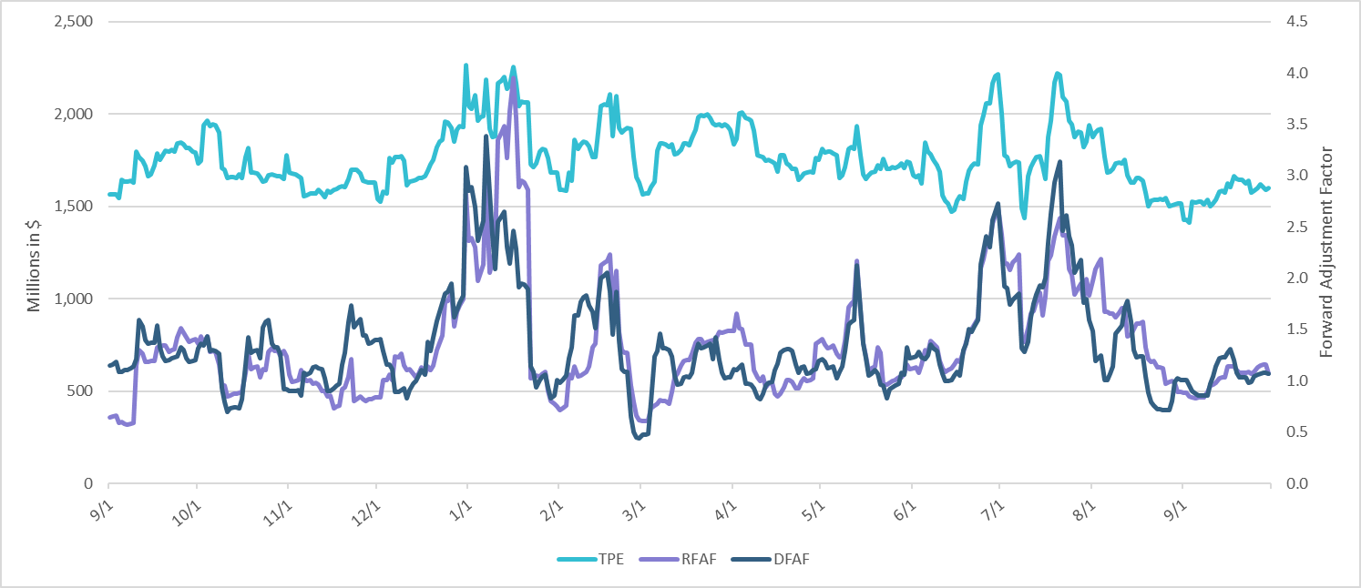
TPE and Forward Adjustment Factors: September 2024 – September 2025

Slide 4
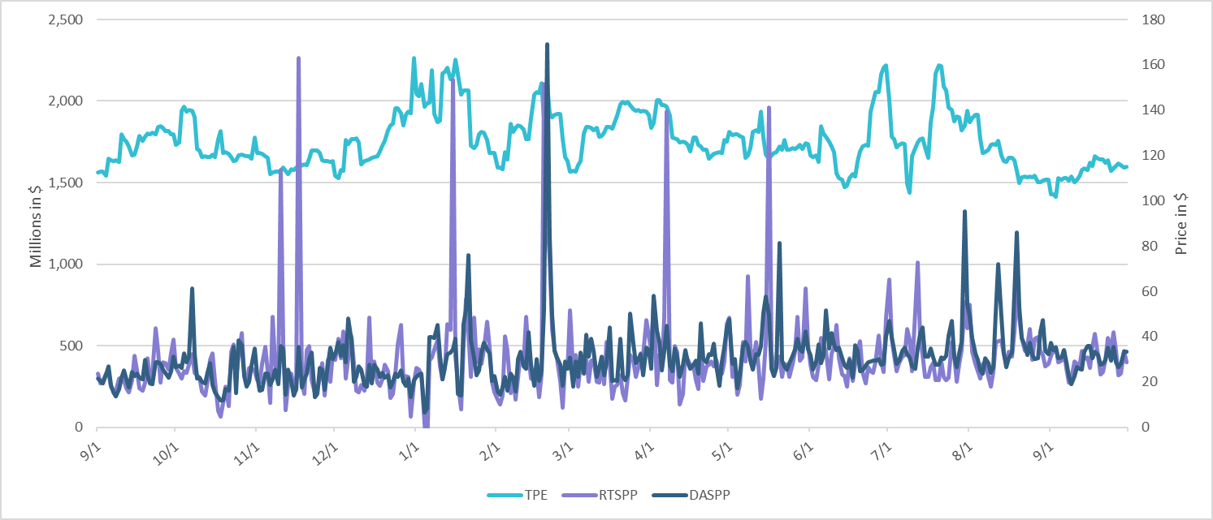
TPE/Real-Time & Day-Ahead Daily Average Settlement Point Prices for HB_NORT:H September 2024 – September 2025

Slide 5
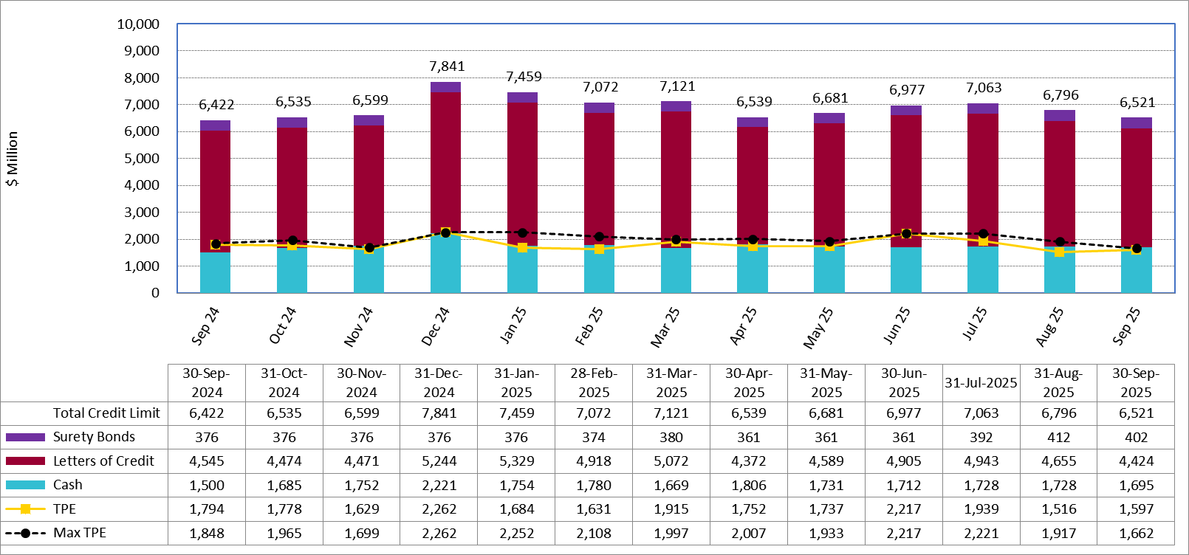
Available Credit by Type Compared to Total Potential Exposure (TPE):
September 2024 – September 2025
Numbers are as of month-end except for Max TPE
Max TPE is the highest TPE for the corresponding month

Slide 6
Issuer Credit Limits vs Total LC Amounts Per Issuer: End-September 2025
As of September 30, 2025
There are a total of 36 banks that have issued LCs.

Slide 7
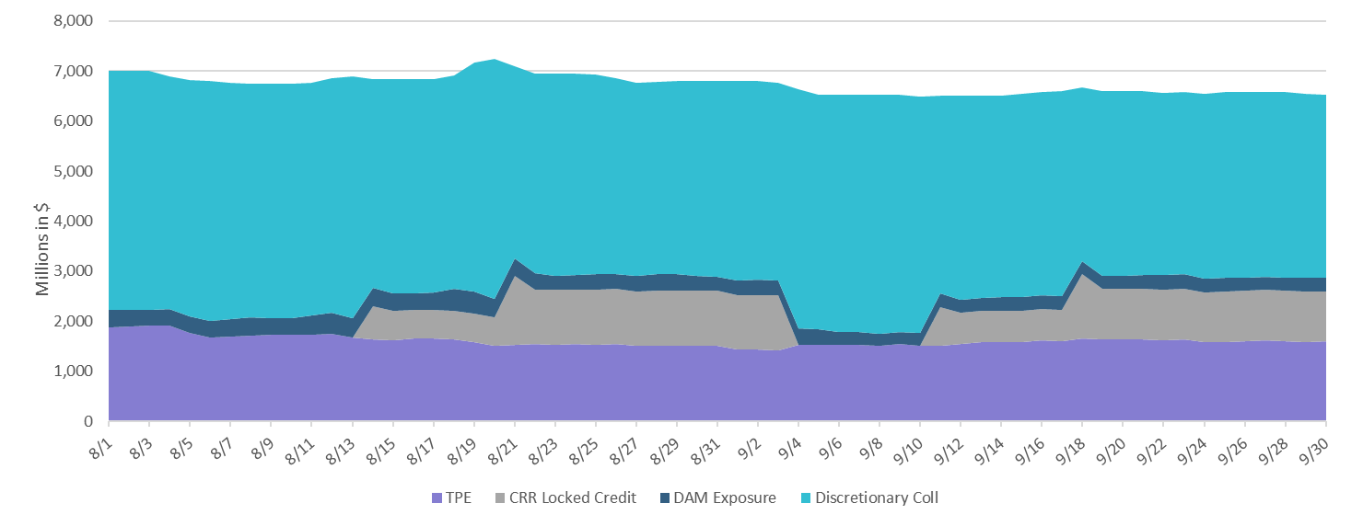
Discretionary Collateral August 2025 – September 2025

Slide 8
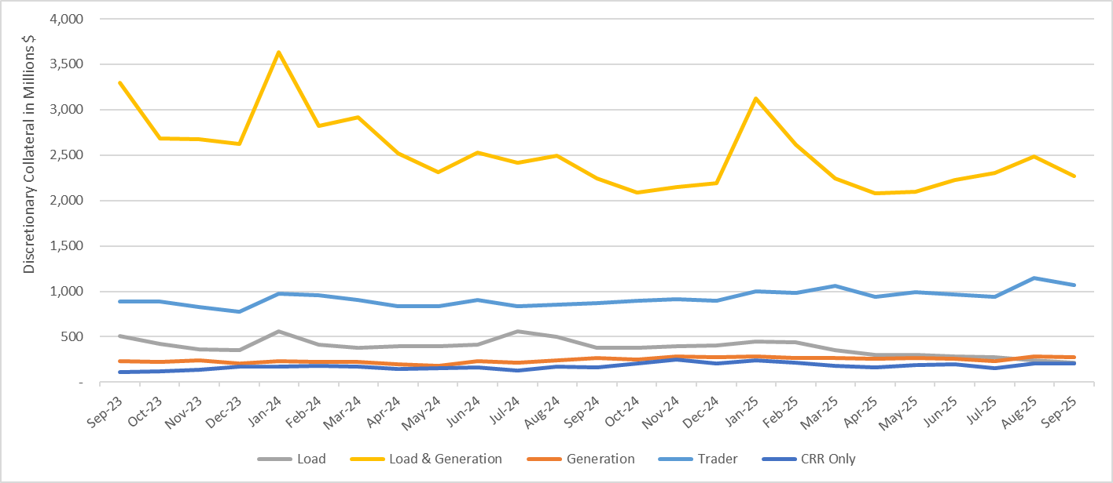
Discretionary Collateral by Market Segment September 2023 - September 2025

Slide 9
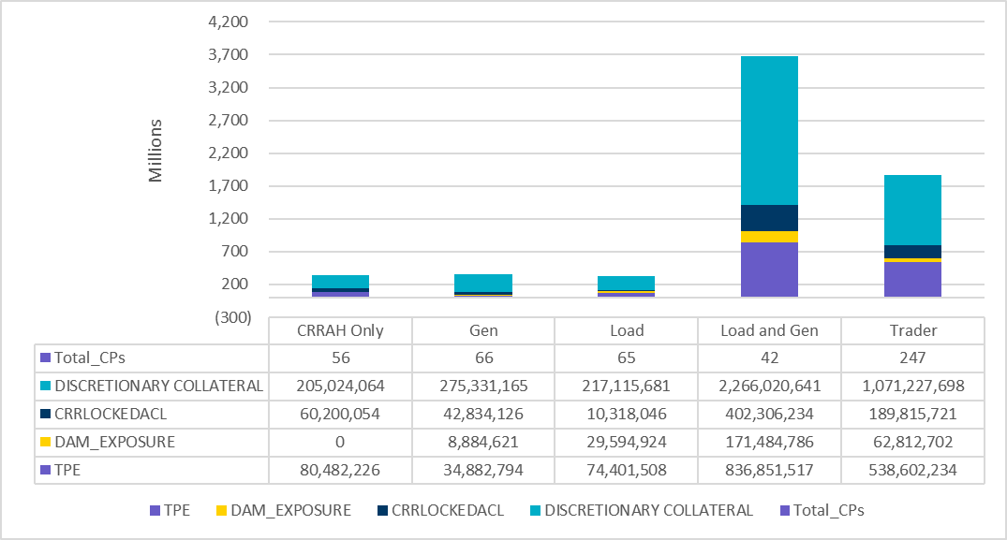
TPE and Discretionary Collateral by Market Segment - September 2025
Load and Generation entities accounted for the largest portion of discretionary collateral

Slide 10
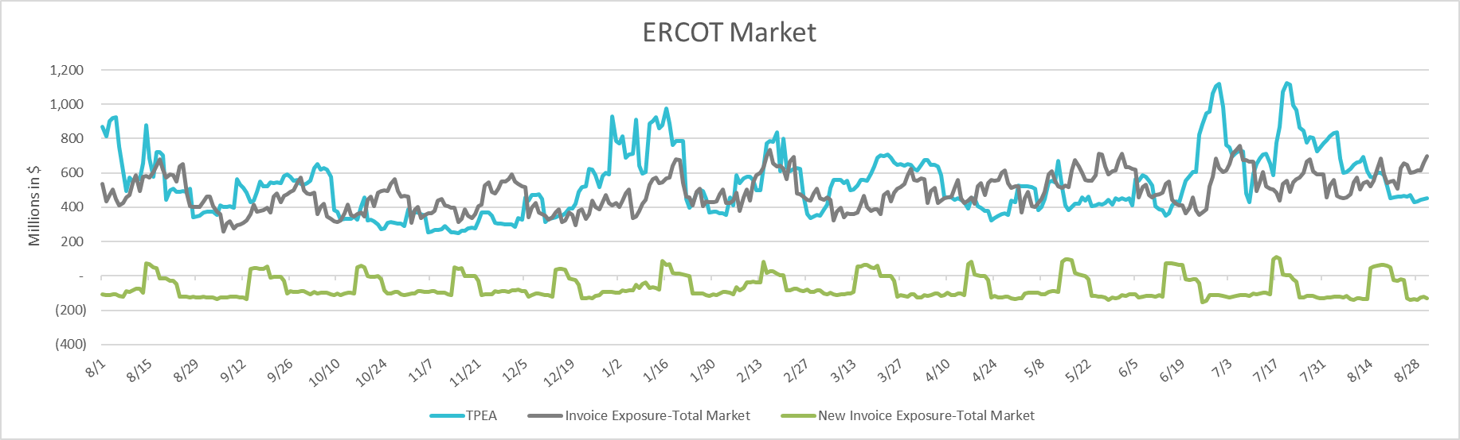
TPEA Coverage of Settlements August 2024 - August 2025
Invoice Exposure | Historical | Future
Existing Invoice Exposure | RTLCNS + UDAA | M1 Days (including current day) Forward Charge Invoice Amounts
New Invoice Exposure | 7 Days Back Net Invoice Amounts (Charges & Credits) | M1 Days (including current day) Forward Net Invoice Amounts (Charges & Credits); Excluding: 1) Securitization Invoices; 2) CRR Auction Invoices; and 3) Subchapter N Funds Distribution Invoice

Slide 11
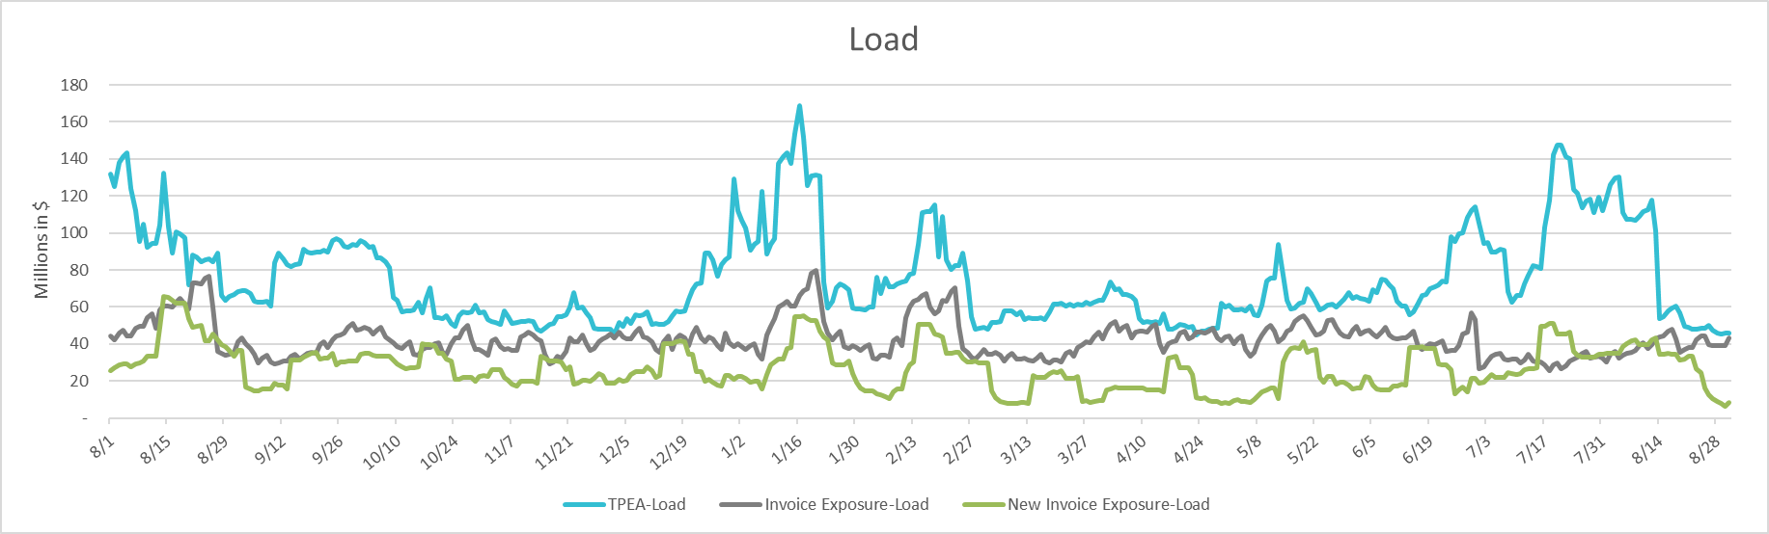
TPEA Coverage of Settlements August 2024 - August 2025
Invoice Exposure | Historical | Future
Existing Invoice Exposure | RTLCNS + UDAA | M1 Days (including current day) Forward Charge Invoice Amounts
New Invoice Exposure | 7 Days Back Net Invoice Amounts (Charges & Credits) | M1 Days (including current day) Forward Net Invoice Amounts (Charges & Credits); Excluding: 1) Securitization Invoices; 2) CRR Auction Invoices; 3) Subchapter N Funds Distribution Invoice

Slide 12
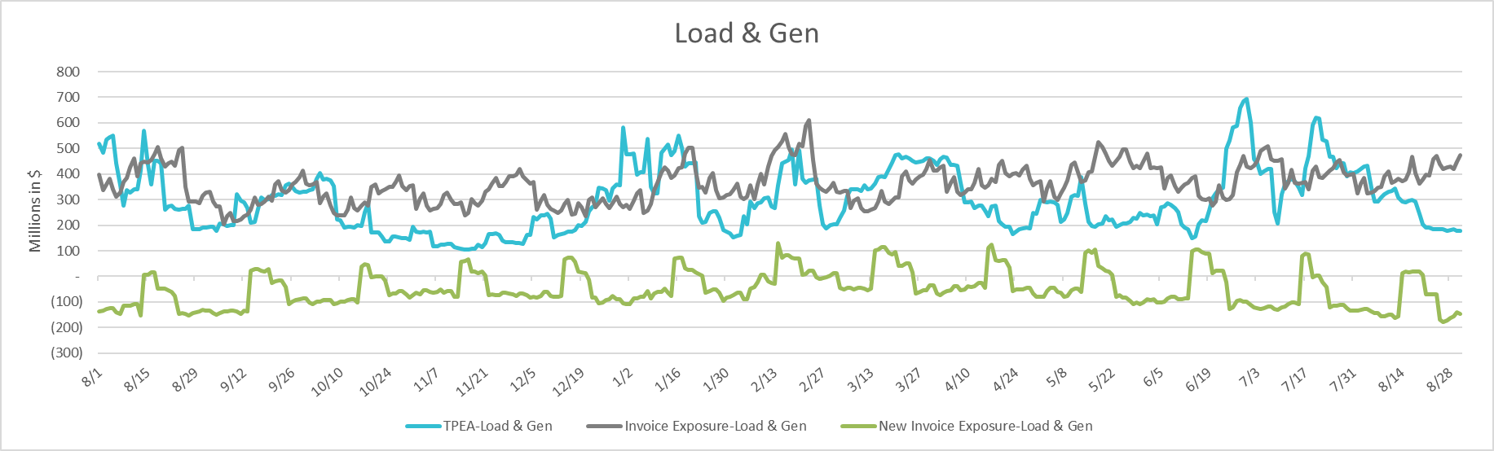
TPEA Coverage of Settlements August 2024 - August 2025
Invoice Exposure | Historical | Future
Existing Invoice Exposure | RTLCNS + UDAA | M1 Days (including current day) Forward Charge Invoice Amounts
New Invoice Exposure | 7 Days Back Net Invoice Amounts (Charges & Credits) | M1 Days (including current day) Forward Net Invoice Amounts (Charges & Credits); Excluding: 1) Securitization Invoices; 2) CRR Auction Invoices; 3) Subchapter N Funds Distribution Invoice

Slide 13
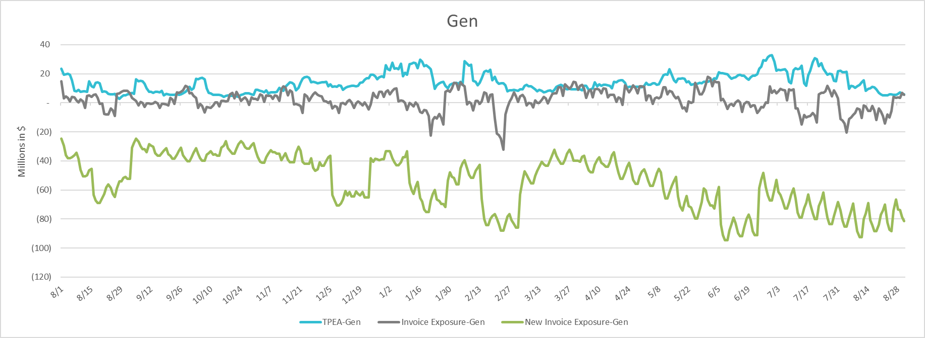
TPEA Coverage of Settlements August 2024 - August 2025
Invoice Exposure | Historical | Future
Existing Invoice Exposure | RTLCNS + UDAA | M1 Days (including current day) Forward Charge Invoice Amounts
New Invoice Exposure | 7 Days Back Net Invoice Amounts (Charges & Credits) | M1 Days (including current day) Forward Net Invoice Amounts (Charges & Credits); Excluding: 1) Securitization Invoices; 2) CRR Auction Invoices; 3) Subchapter N Funds Distribution Invoice

Slide 14
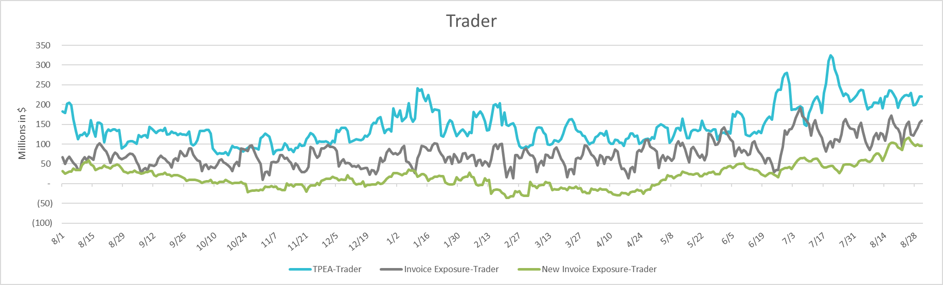
TPEA Coverage of Settlements August 2024 - August 2025
Invoice Exposure | Historical | Future
Existing Invoice Exposure | RTLCNS + UDAA | M1 Days (including current day) Forward Charge Invoice Amounts
New Invoice Exposure | 7 Days Back Net Invoice Amounts (Charges & Credits) | M1 Days (including current day) Forward Net Invoice Amounts (Charges & Credits); Excluding: 1) Securitization Invoices; 2) CRR Auction Invoices; 3) Subchapter N Funds Distribution Invoice

Slide 15
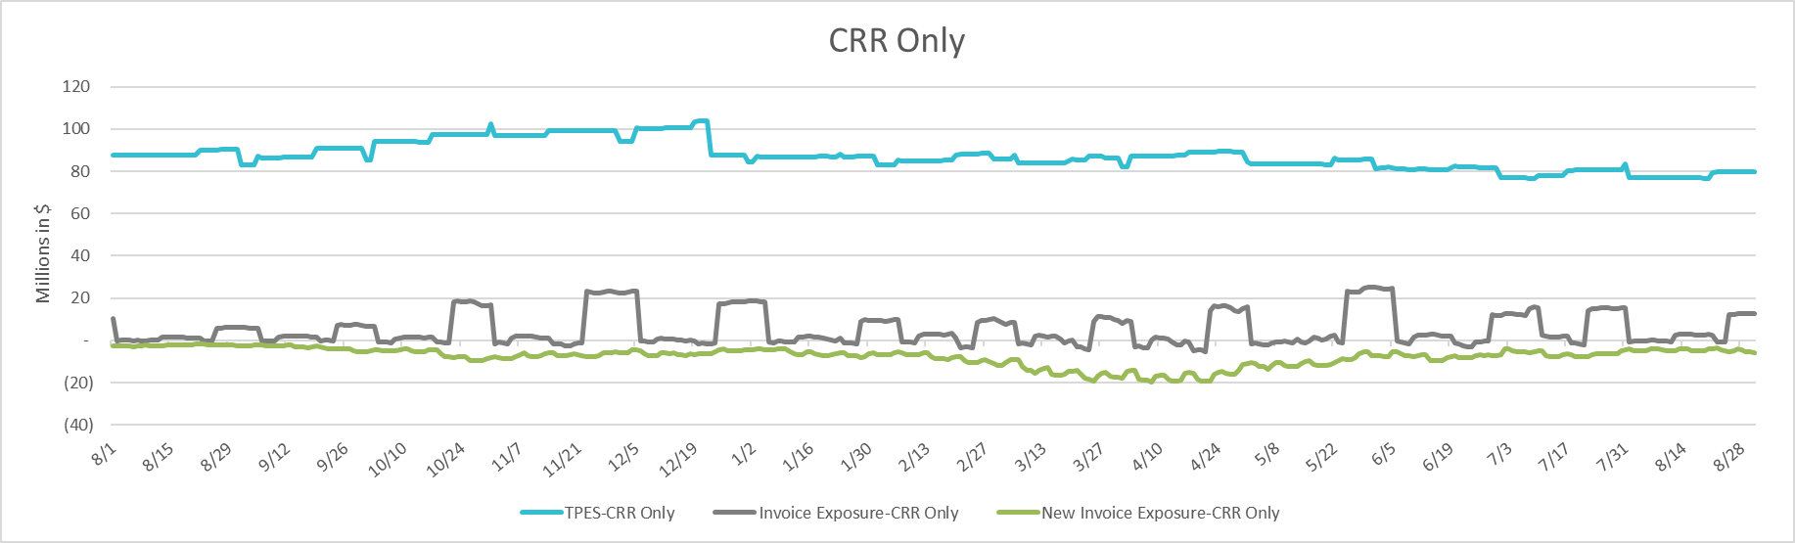
TPEA Coverage of Settlements August 2024 - August 2025
Invoice Exposure | Historical | Future
Existing Invoice Exposure | RTLCNS + UDAA | M1 Days (including current day) Forward Charge Invoice Amounts
New Invoice Exposure | 7 Days Back Net Invoice Amounts (Charges & Credits) | M1 Days (including current day) Forward Net Invoice Amounts (Charges & Credits); Excluding: 1) Securitization Invoices; 2) CRR Auction Invoices; 3) Subchapter N Funds Distribution Invoice

Slide 16
Questions

