Slide 1
NOGRR245
December 31, 2025 Deadline
October 02, 2025

Slide 2
Nodal Operating Guide Dates
Resources must meet or exceed FRT requirements as soon as practicable but no later than 12/31/25 or at synchronization for new IBRs synchronizing after 12/31/25
Resources with SGIA before 8/1/24, must maximize performance to meet - as close as reasonably possible - capability in IEEE 2800-2022 sections 5, 7 and 9 as soon as practicable but no later than 12/31/25 or COD (whichever is later)
Resources with SGIA before 8/1/24 must maximize VRT performance as soon as practicable but no later than 12/31/25 or COD (whichever is later)
Key Takeaway:
Resources must meet ride-through requirements by 12/31/25 unless extension is granted.

Slide 3
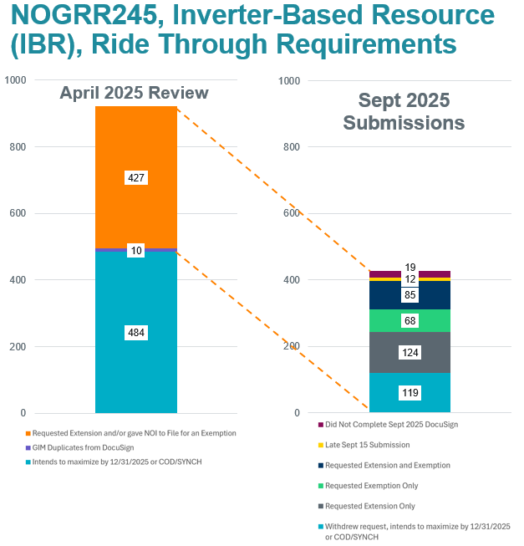



Intend to Maximize by 12/31/25 or COD/Synch
632 Resources intending to Maximize by 12/31/2025 or by COD/Synch
Key Takeaway: 632 Resources intend to meet requirements by 12/31/25 or Synch/COD

Slide 4
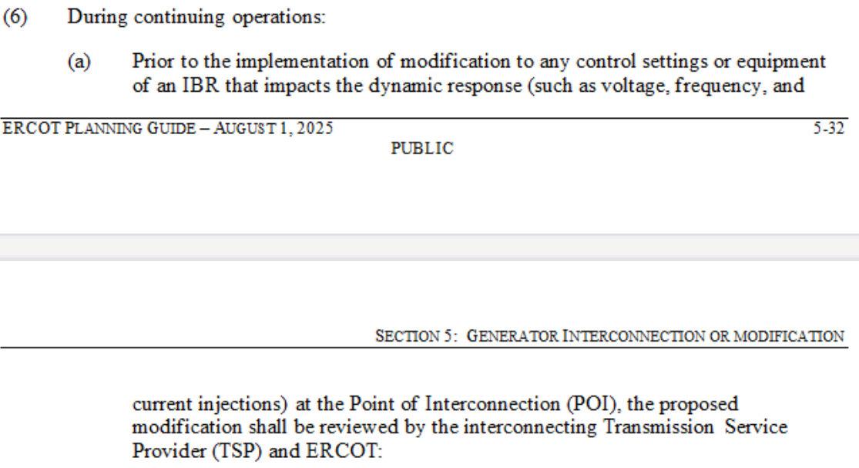



PG 5.5(6)(a)
Before making any modifications affecting dynamic response at POI, RE must submit to ERCOT for approval
ERCOT has up to 30 Business Days to review data
Modifications may require TSP to conduct limited study
Many submittals require iterative process to resolve issues
Key Takeaway: Time is of the essence. To get modifications done by 12/31/25 will require getting models to ERCOT ASAP

Slide 5
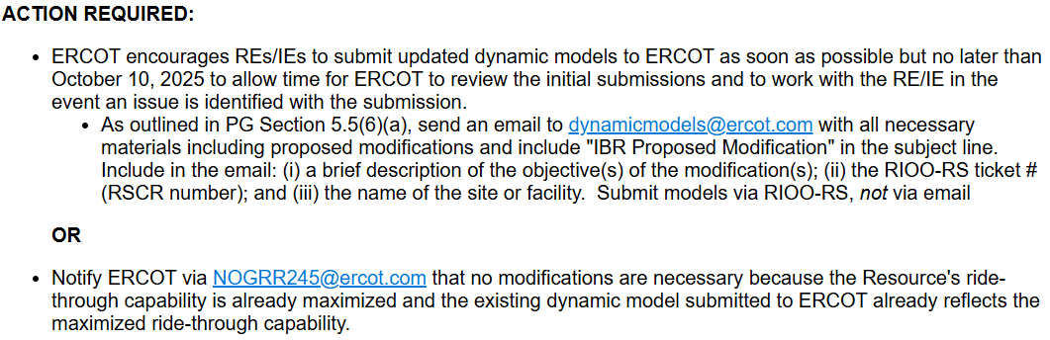



Market Notice and Action Required
M-B093025-01 Resources maximizing ride-through capability by 12/31/25 for Nodal Operating Guide Revision Request (NOGRR) 245 must follow Planning Guide5.5(6)

Slide 6

Questions
?

