Slide 1
PDCWG Report to ROS
Chair: Chad Mulholland, NRG
Vice Chair: N/A
ROS
October 2nd, 2025

Slide 2
Report Overview & Notes
Report Overview
  Meeting Minutes
    Frequency Control & Regulation Reports (July/August)
    TRE Report
    Analysis of Disturbances
  BAL-001-TRE-2 FMEs and IMFR
    One FME in July and August – on 8/25, at 03:46
    Overall Interconnection frequency response was excellent
    225 units were evaluated, and 48 of those scored below the 0.75 threshold
    44 of the 48 units that failed were ESR type units, and ERCOT has reached out to most of those QSEs
  Frequency Control Report

Slide 3
Frequency Measurable Events Performance

Slide 4
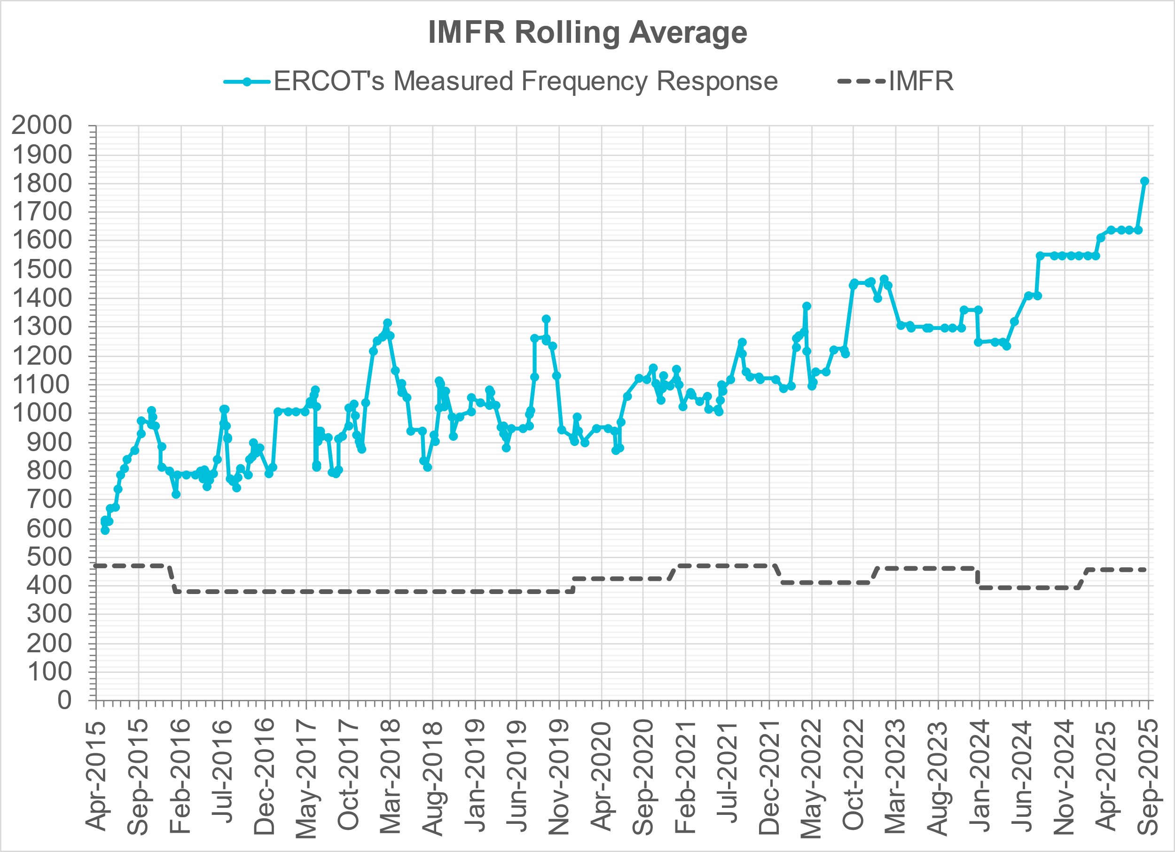
Interconnection Minimum Frequency Response (IMFR) Performance
IMFR Performance currently
1810.17 MW/0.1HZ
Frequency Response Obligation (FRO): 455 MW/0.1 Hz

Slide 5
Questions?

Slide 6
Frequency Control Report
May 2025

Slide 7
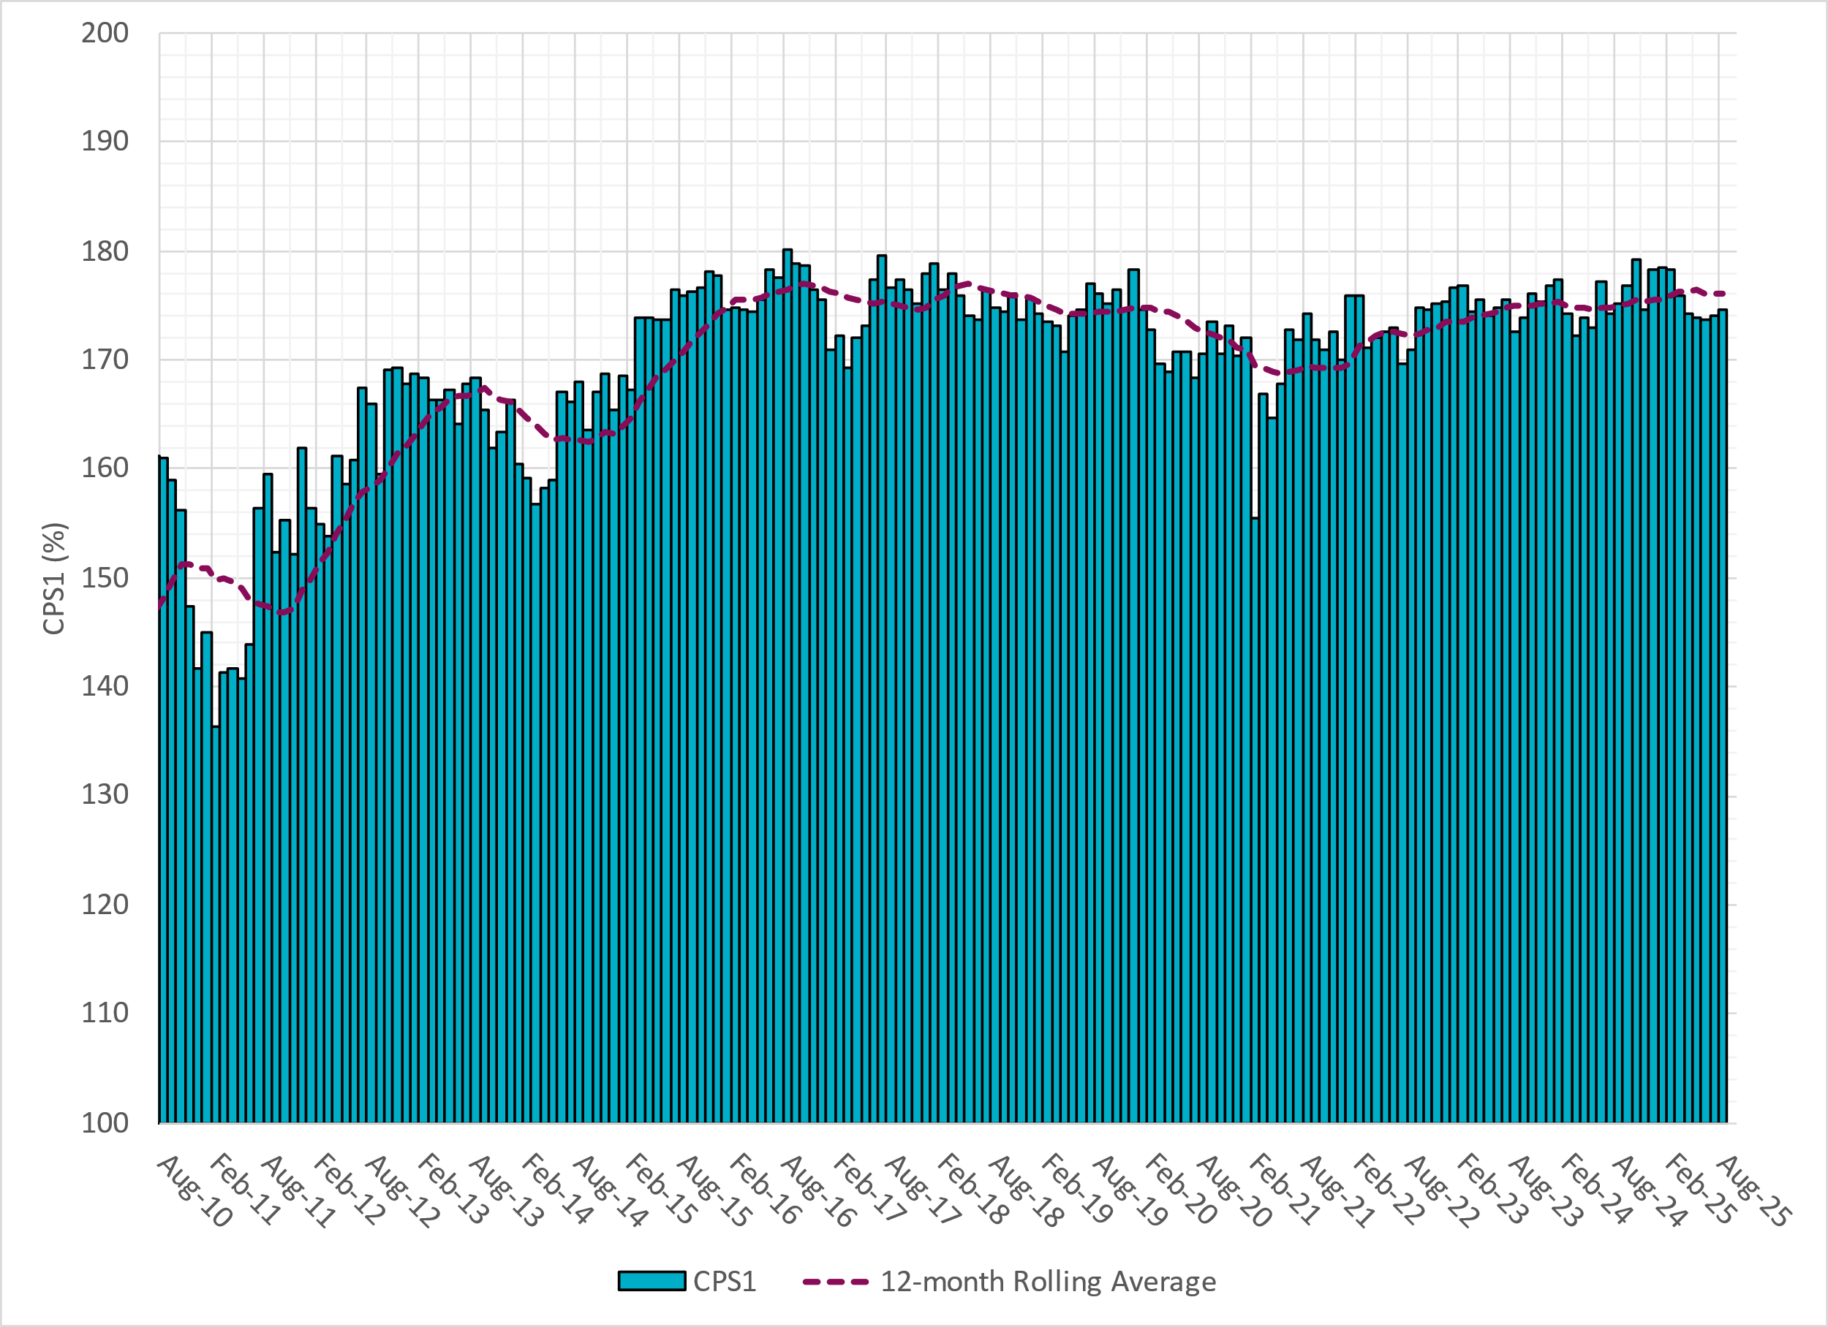
CPS1 Performance
Current 12-Month Rolling Average: 176.03%

Slide 8
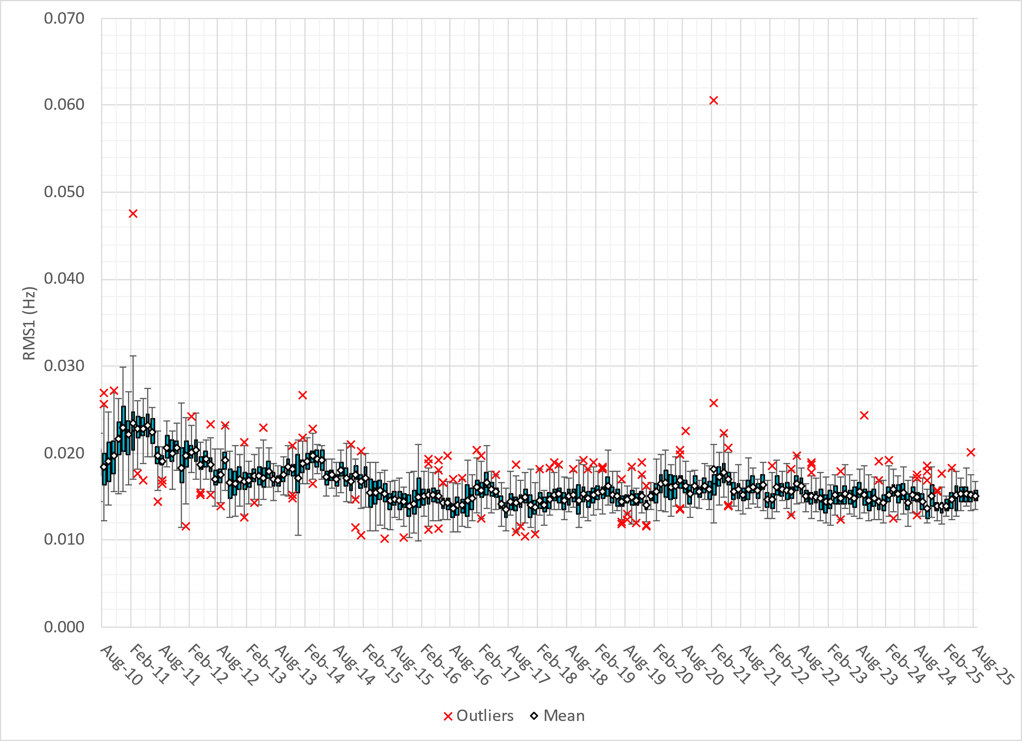
RMS1 Performance of ERCOT Frequency
Notes:
15.08 mHz on avg for August 2025

Slide 9
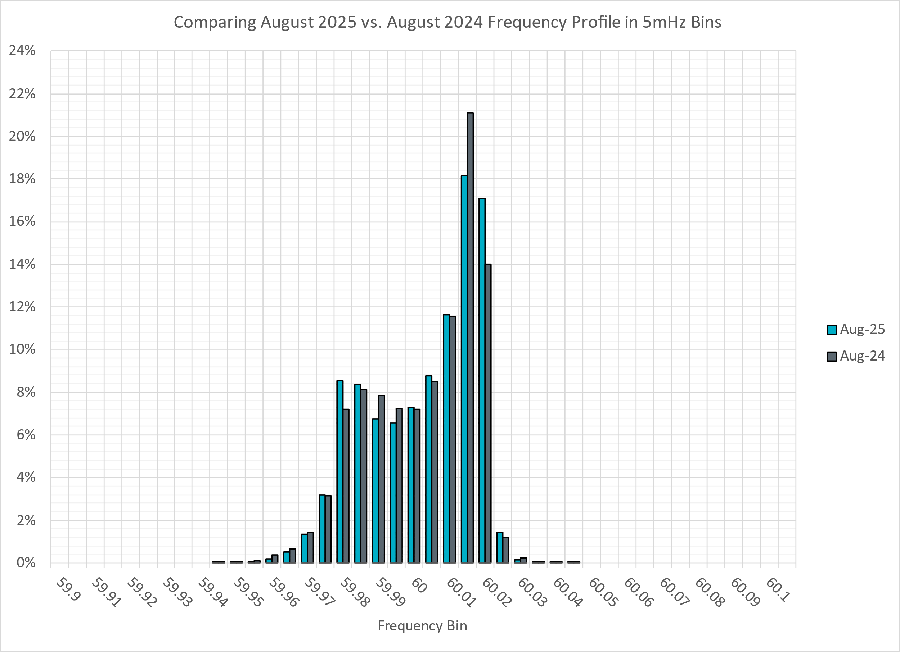
Frequency Profile Analysis

Slide 10
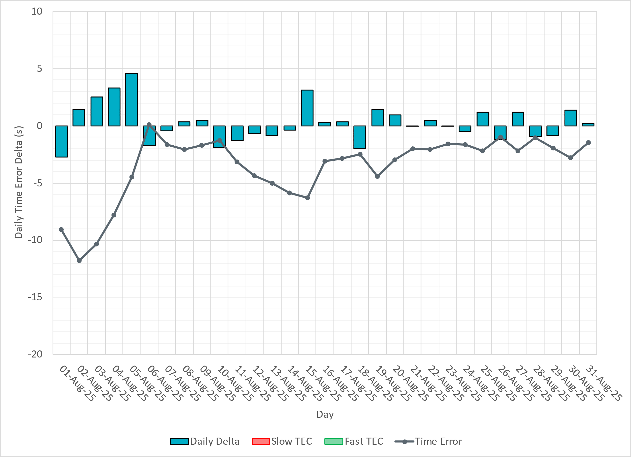
Time Error Corrections

Slide 11
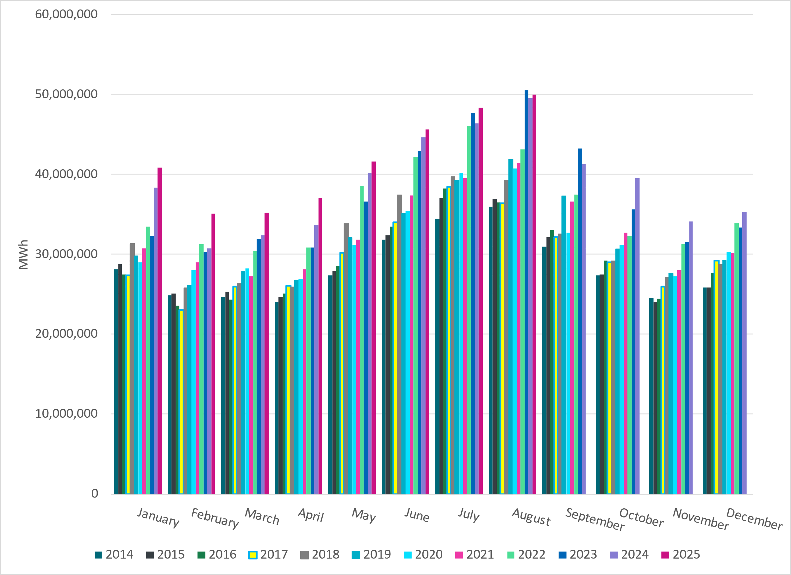
ERCOT Total Energy
Notes:
49,983,164 MWh – Increase in total energy compared to last month

Slide 12
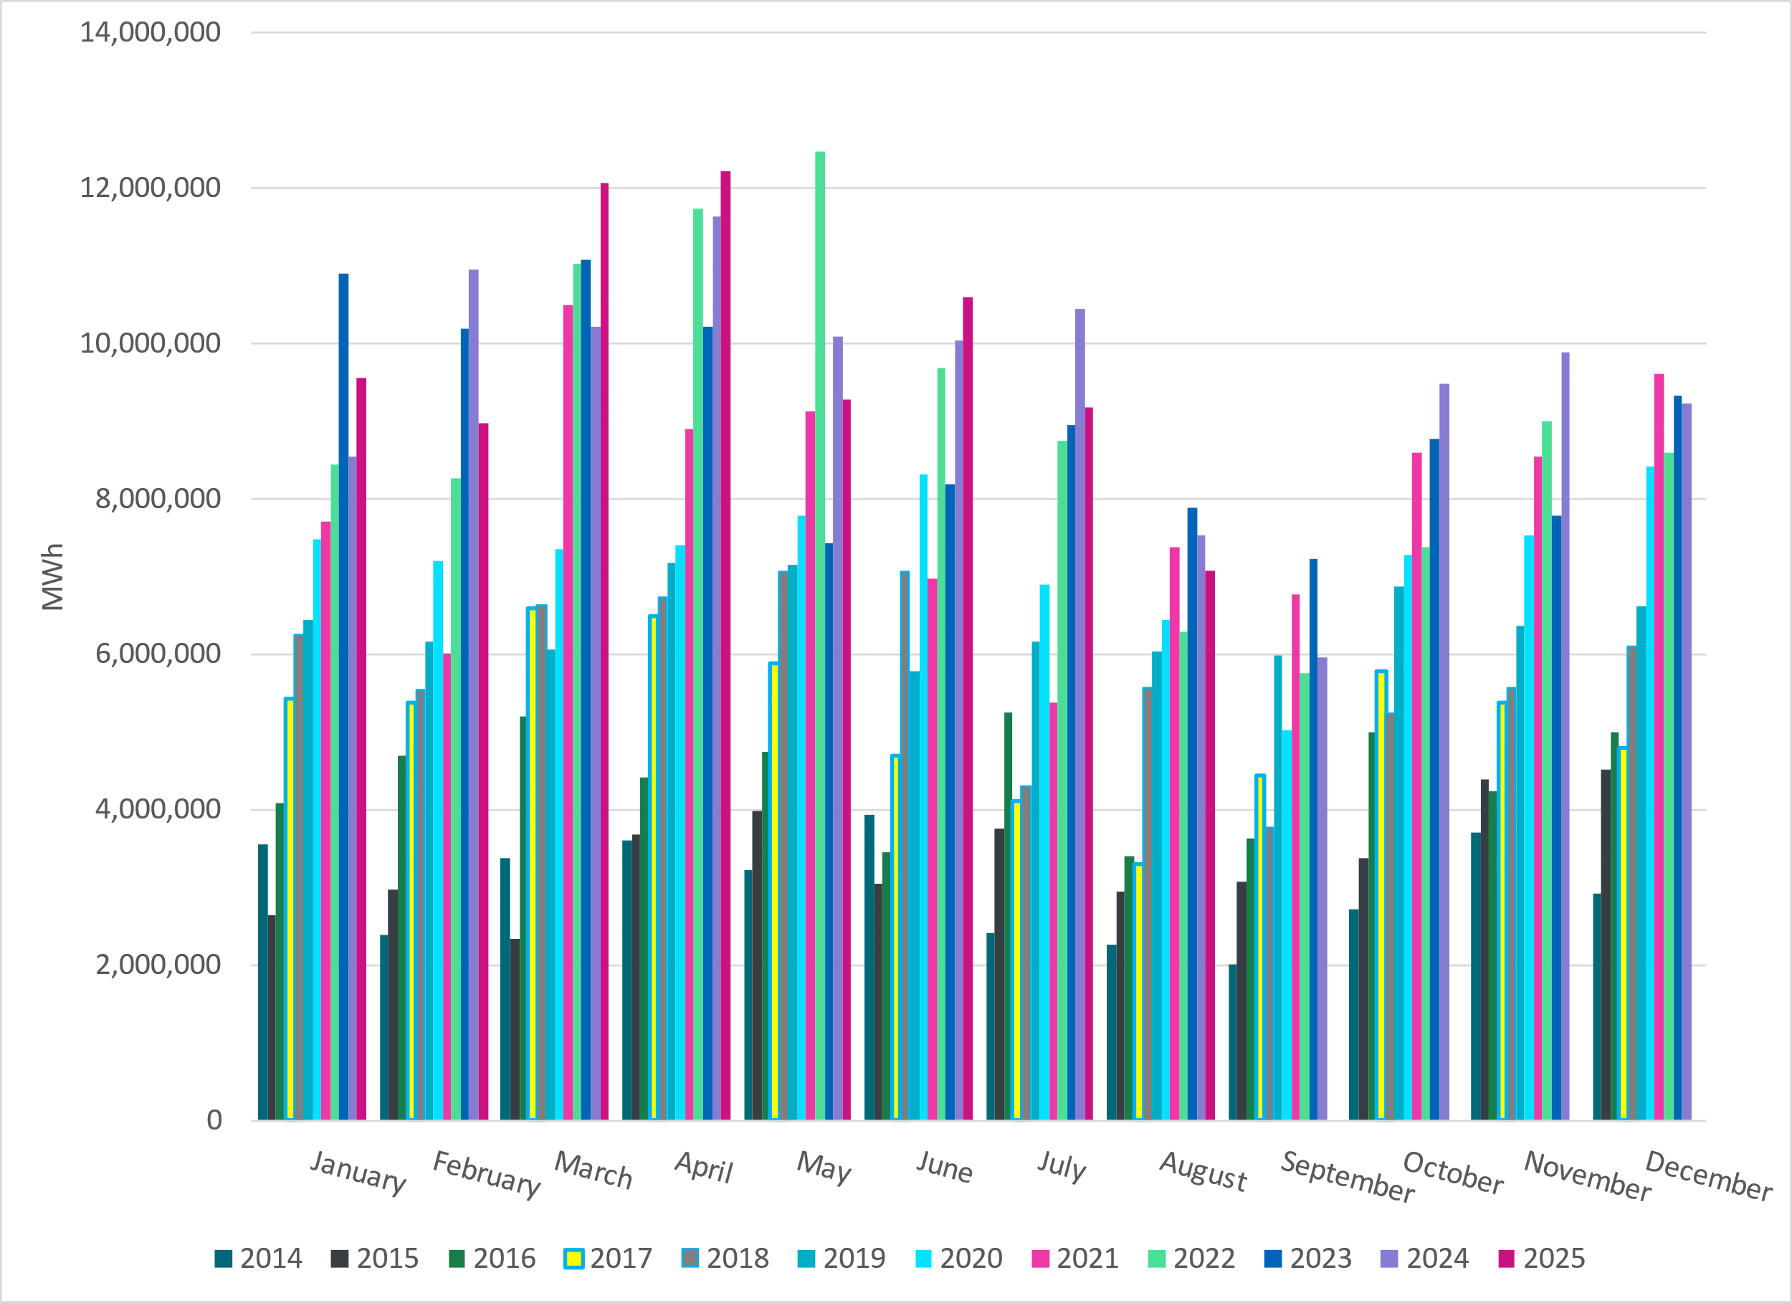
ERCOT Total Energy from Wind Generation
Notes:
7,070,271 MWH – Decrease in total energy from wind compared to last month

Slide 13
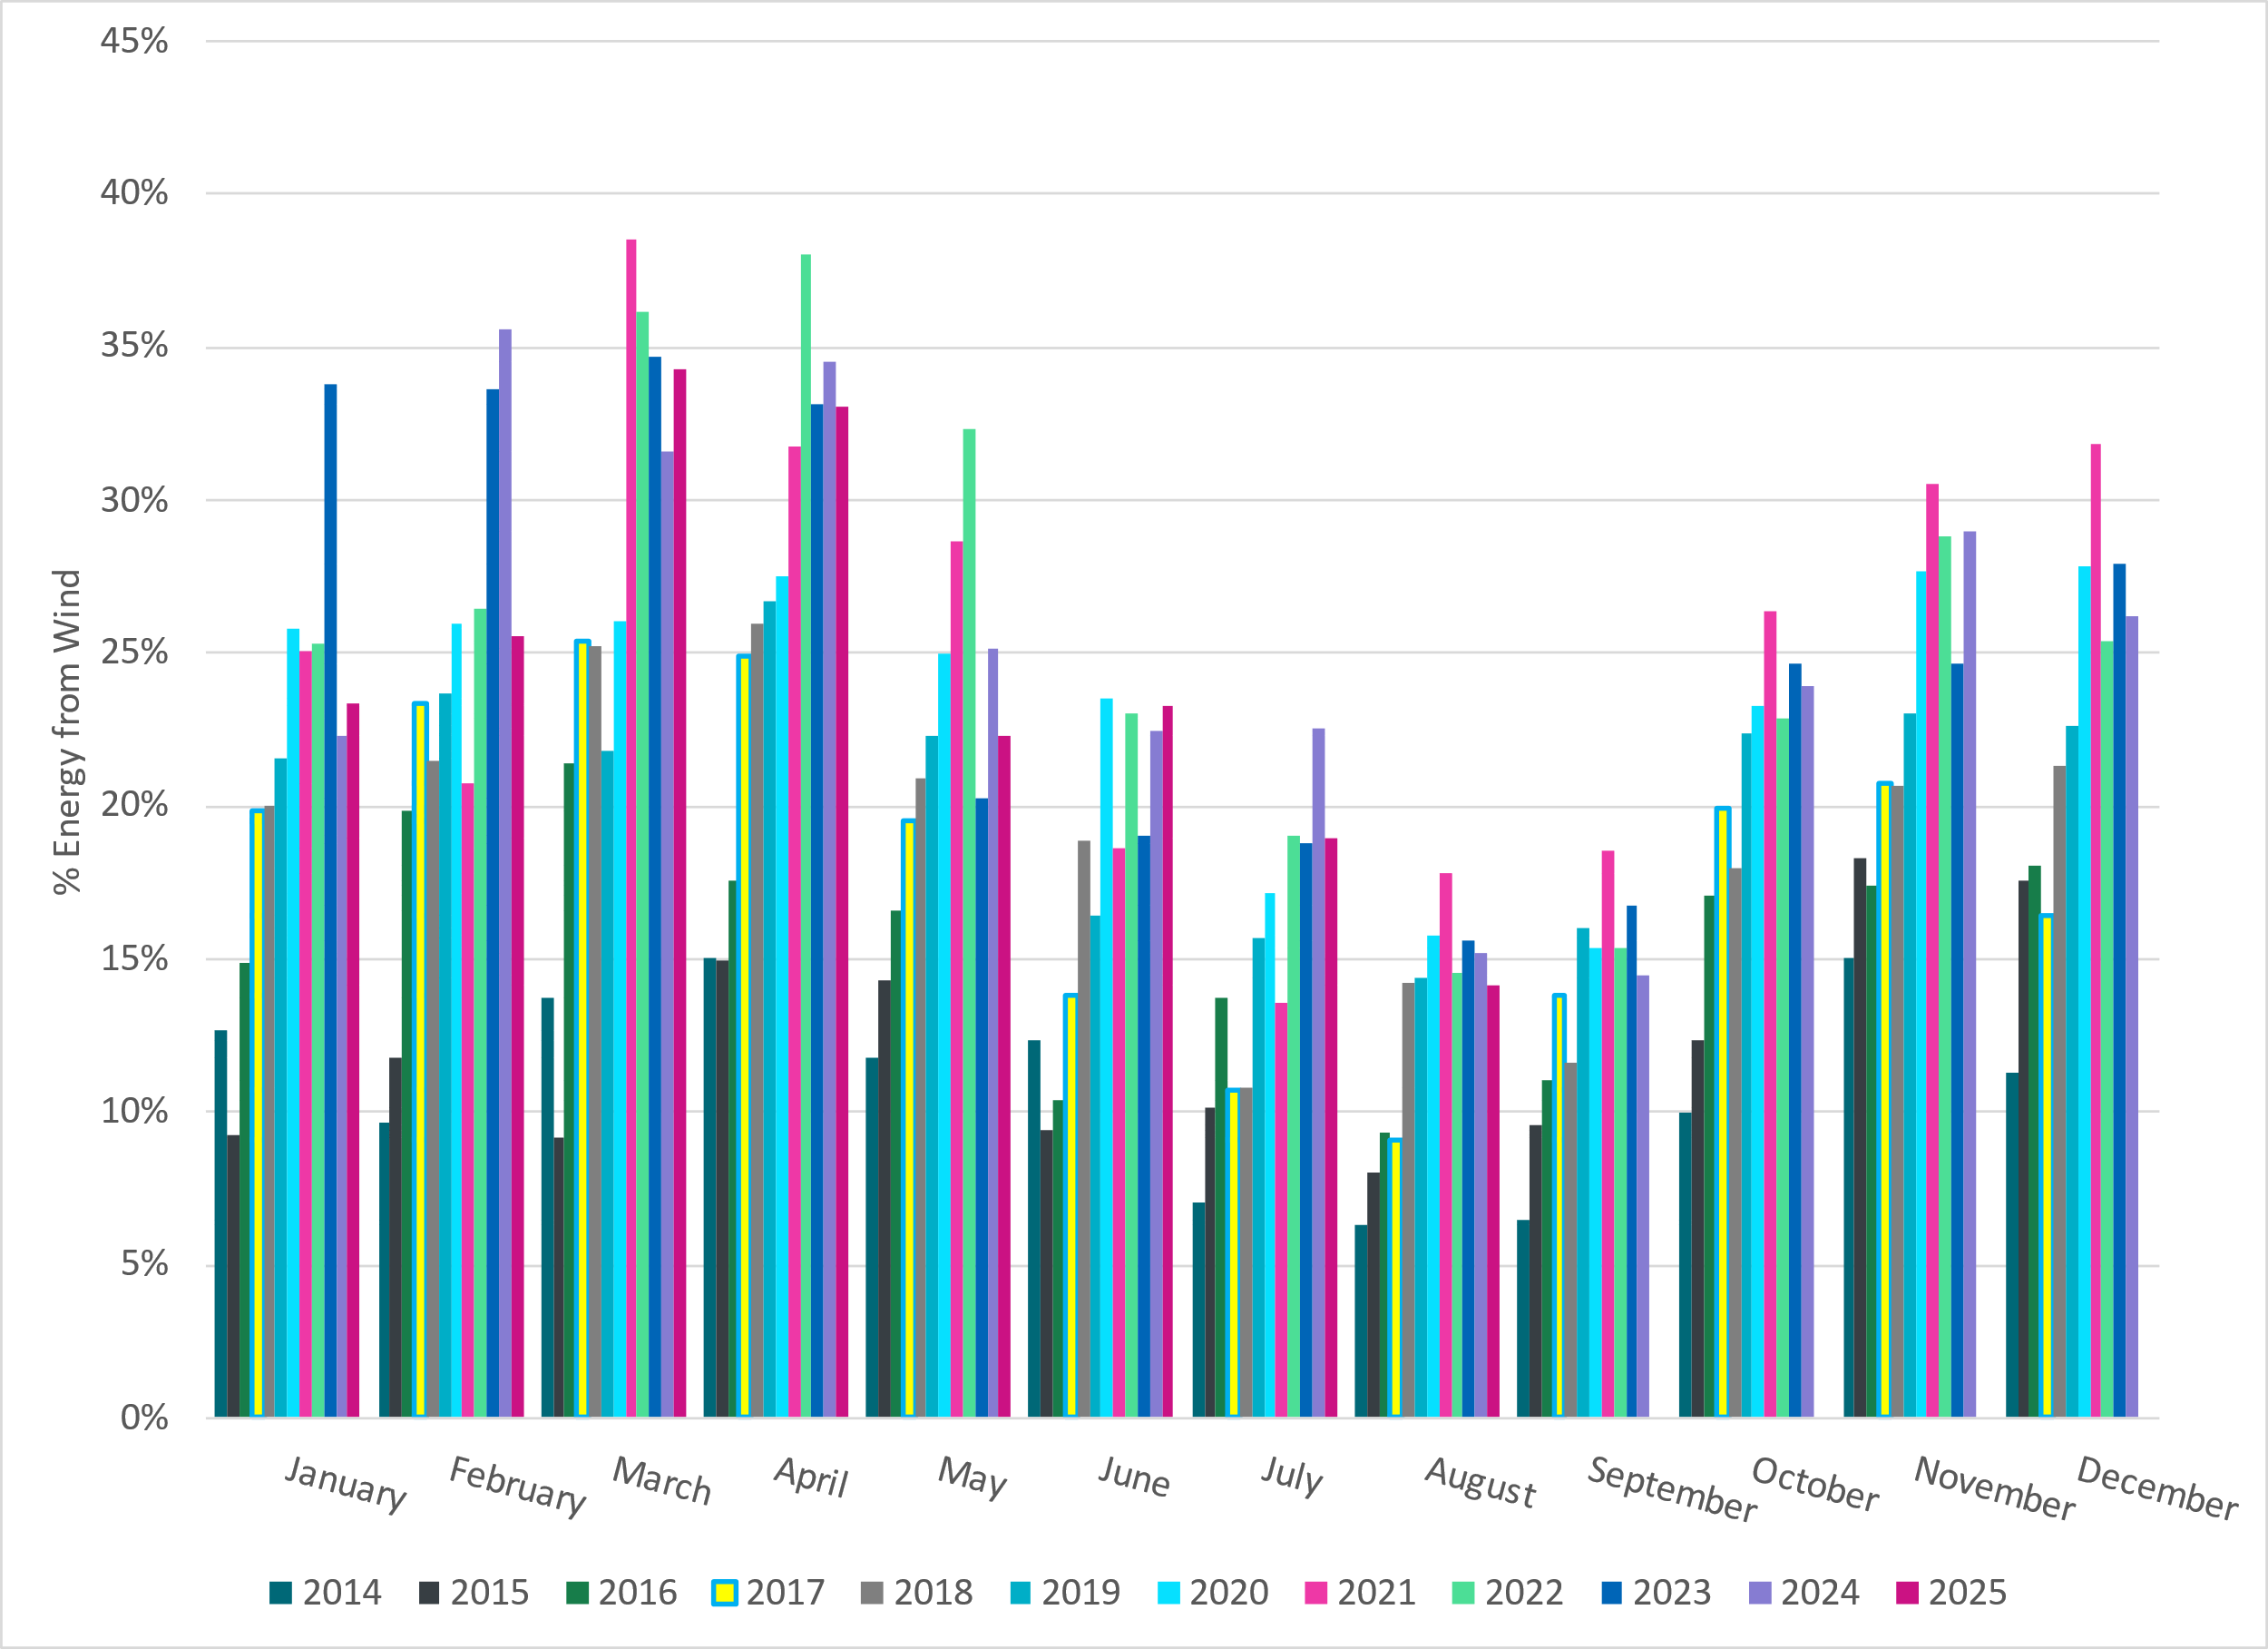
ERCOT % Energy from Wind Generation
Notes:
14.15% of total energy was provided by wind generation

Slide 14
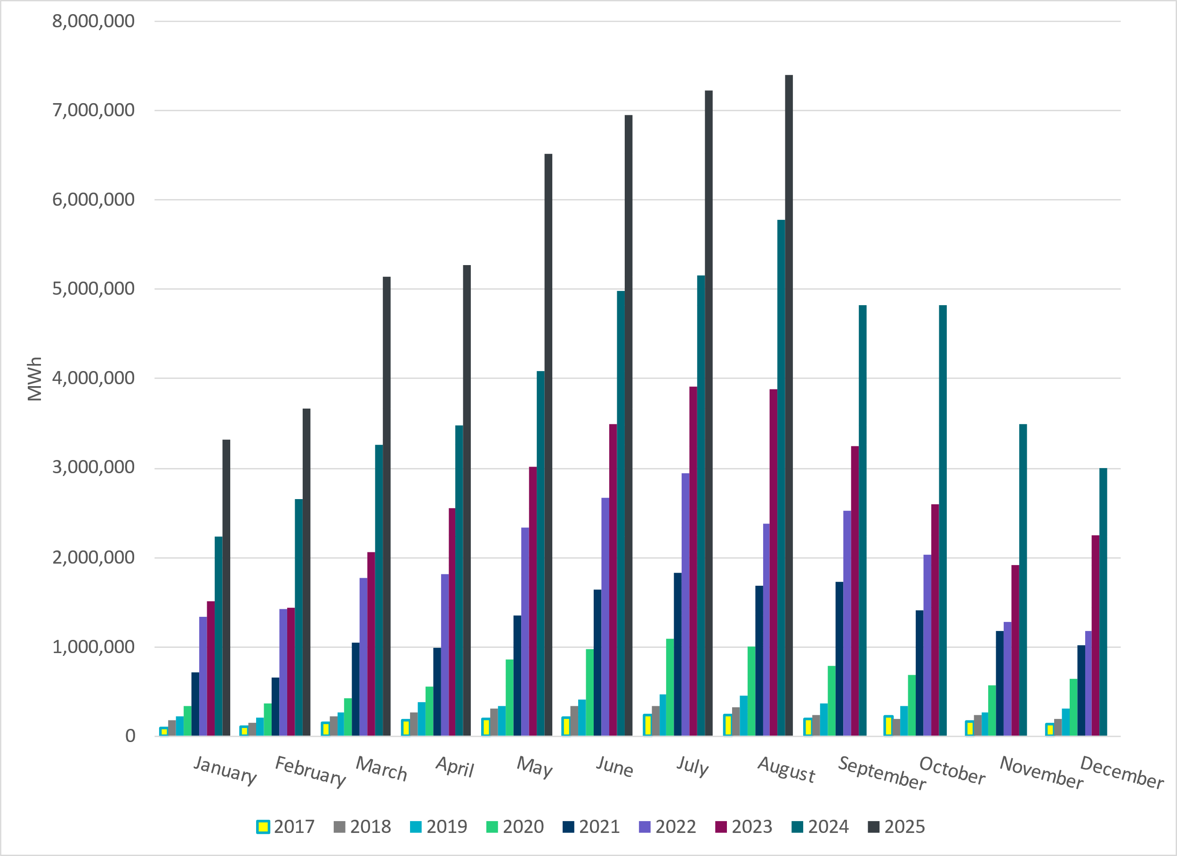
ERCOT Total Energy from Solar Generation
Notes:
7,405,190 MWh – Increase in total energy from Solar

Slide 15
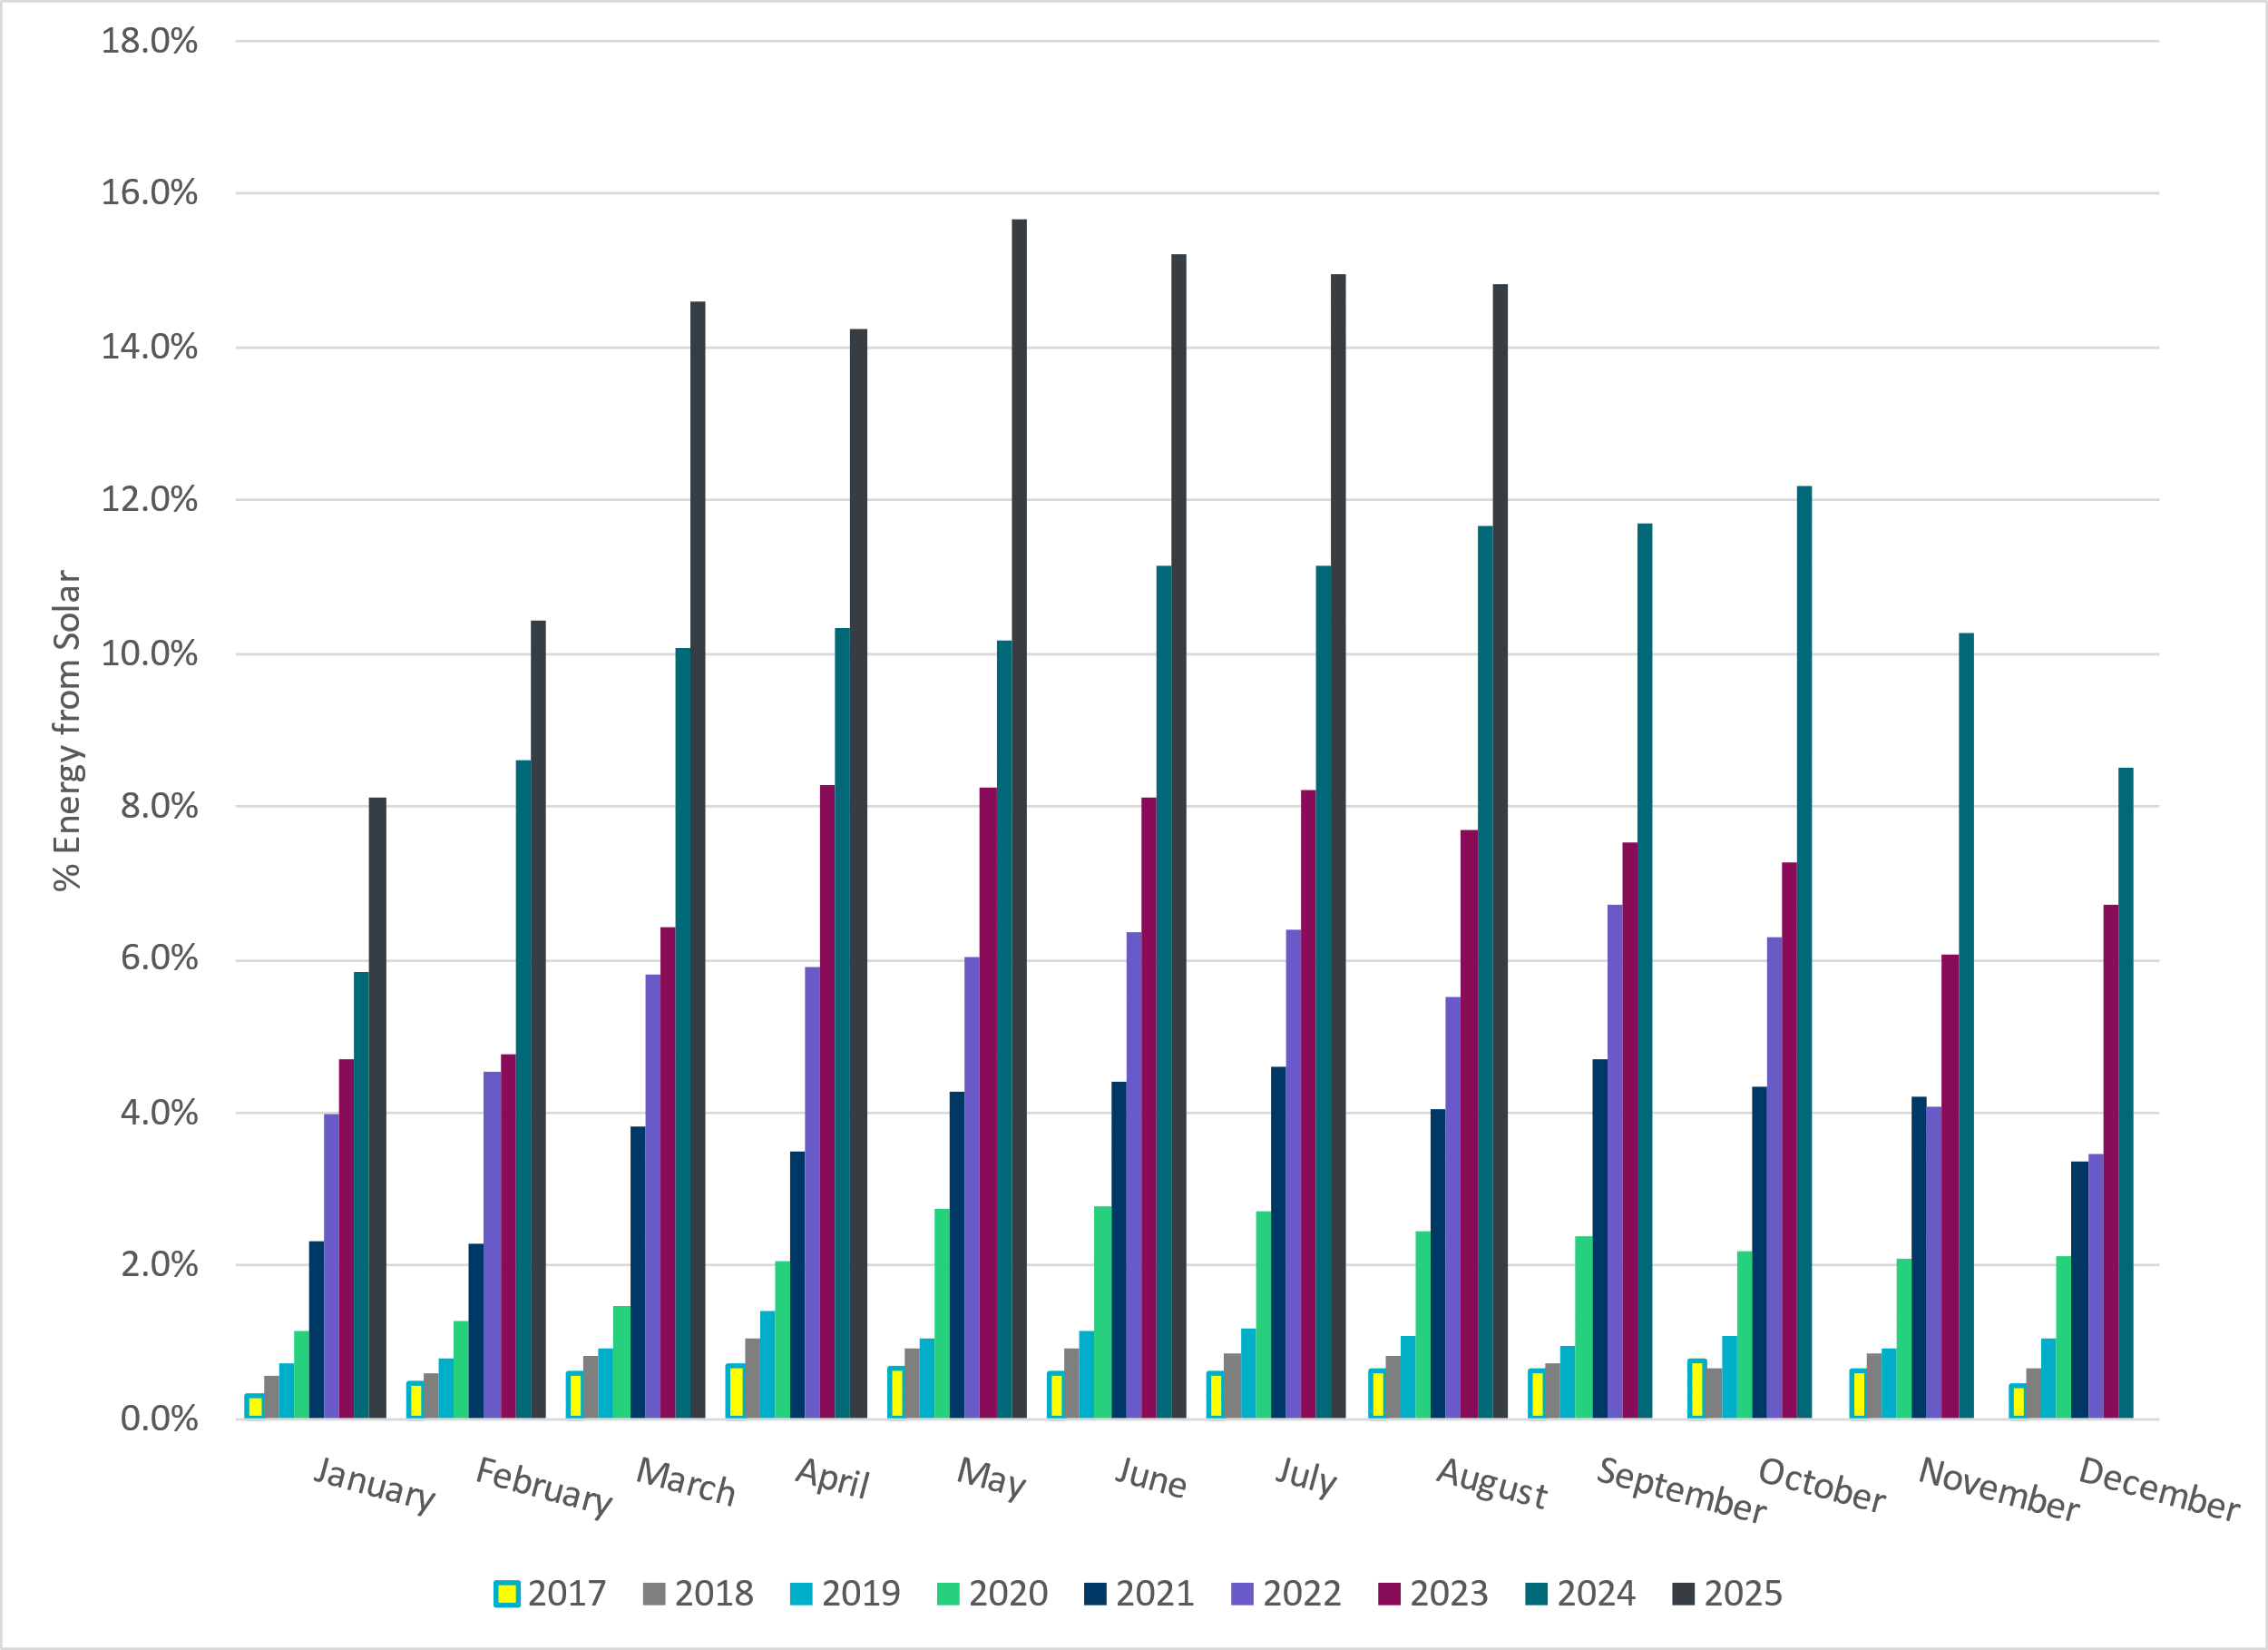
ERCOT % Energy from Solar Generation
Notes:
14.82% of total energy was provided by solar generation

Slide 16
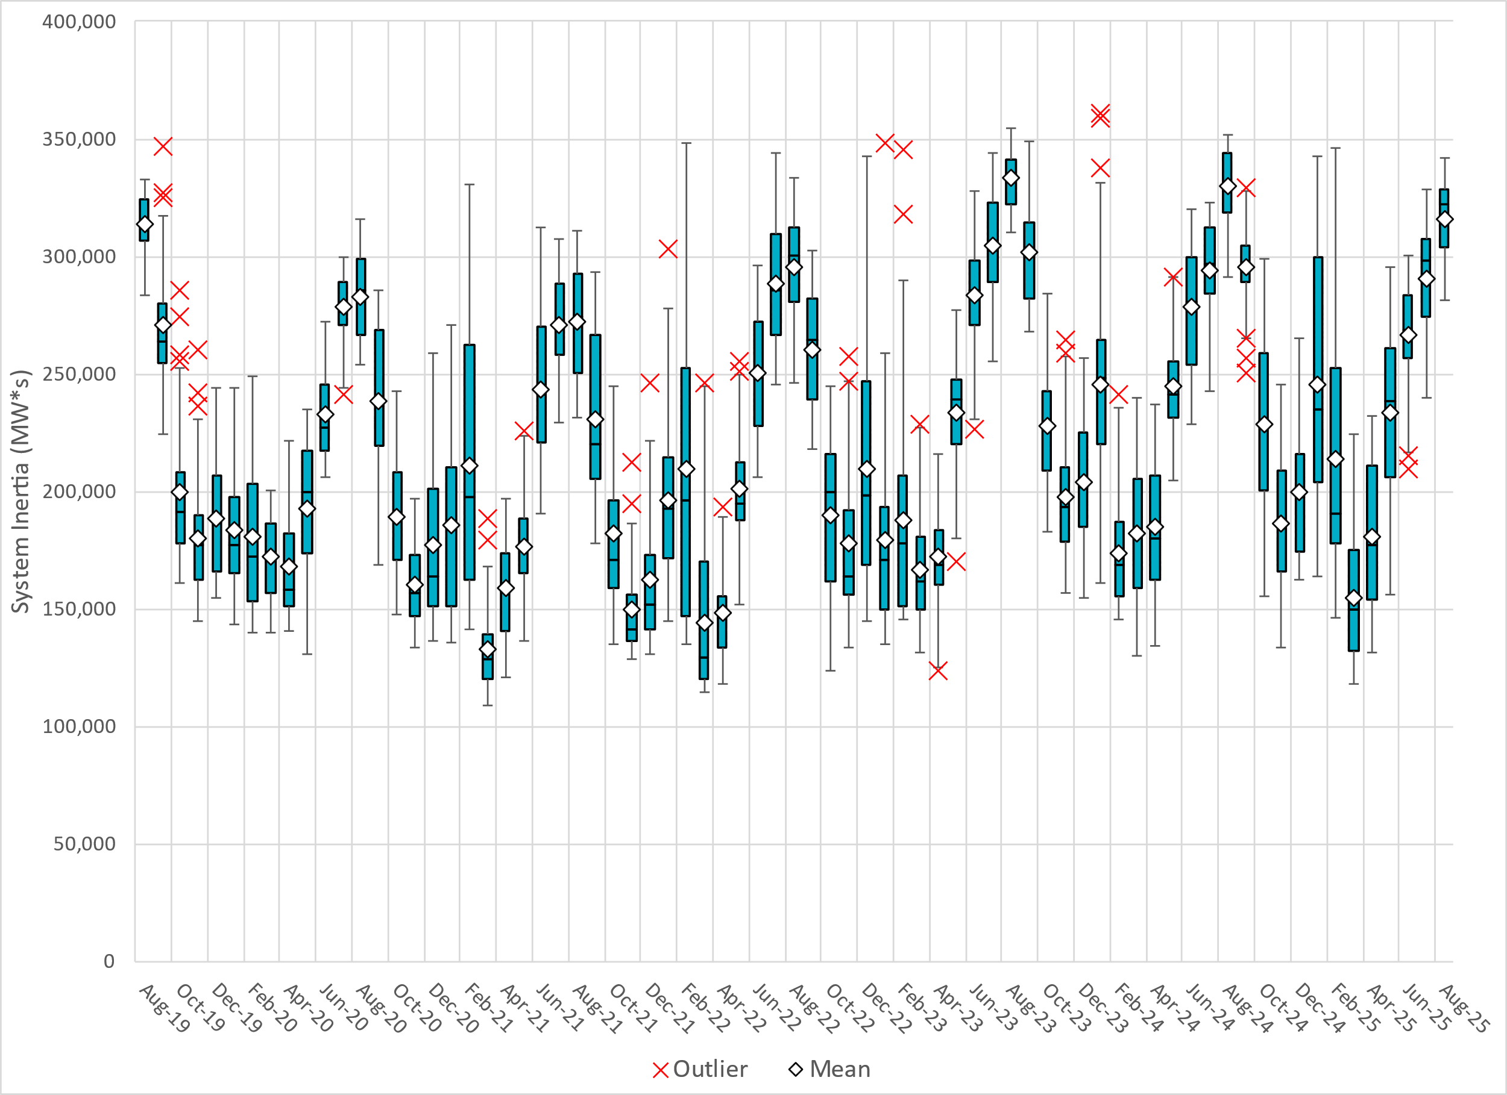
ERCOT Daily Minimum System Inertia
Notes:
Minimum Inertia in August 2025 = 281,291 MW*s on August 10th
Historical Overall Minimum was 109,029 MW*s on 3/22/2021
August Data:
Mean: 316,171 MW*s
Max: 341,787 MW*s on August 20th
Min: 281,291 MW*s on August 10th

Slide 17
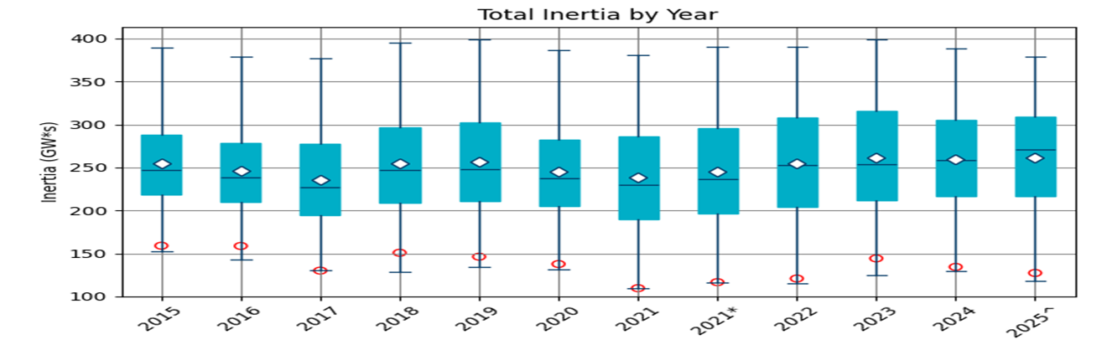
ERCOT Inertia Trend
Date and Time | 2015 11/25 2:00 AM | 2016 4/10 2:00 AM | 2017 10/27 4:00 AM | 2018 11/03 3:30 AM | 2019 3/27 1:00 AM | 2020 05/01 2:00 AM | 2021 03/22 00:00 AM | 2022 03/21 01:00 AM | 2023 04/18 02:00 AM | 2024 03/29 03:00 AM | 2024 03/29 03:00 AM | 2025 03/18 12:00 AM
Min synch. Inertia (GW*s) | 152 | 143 | 130 | 128.8 | 134.5 | 131.1 | 109 | 115 | 124 | 130 | 130 | 118.3
System load at minimum synch. Inertia (MW) | 27,190 | 27,831 | 28,425 | 28,397 | 29,883 | 30,679 | 32,599 | 33,365 | 35,799 | 37,297 | 37,297 | 48,973
Non-synch. Gen. in % of System Load | 42 | 47 | 54 | 53 | 50 | 57 | 65 | 66 | 61 | 68 | 68 | 74
Notes:
Summary of ERCOT inertia for the previous 10 years. Lowest inertia this year was on March 18th.
For each box, the central mark (red line) is the median, the edges of the box (in blue) are the 25th and 75th percentiles, the whiskers correspond to +/- 2.7 sigma (i.e., represent 99.3% coverage, assuming the data are normally distributed. The corresponding lowest inertia in each year is given in the table.
The circle on each boxplot is showing inertia during time when highest portion of load was served by wind/solar generation in that year.

