Slide 1
OTWG Updates
Training and Task Force Updates
Facilitator: Manuel Sanchez (Oncor)

Slide 2
ERCOT Operator Certification Task Force
Chair: Steve Rainwater from ERCOT
ERCOT continues performing testing onsite. Use the link below for more details:
https://web.cvent.com/event/1b1ffc4d-f78a-4e4b-b36b-2894e2835863/summary
ERCOT will have open, two more dates in December 2025 and potentially extending the on-site testing for six months in 2026 until a vendor is selected.

Slide 3
ERCOT Black Start Restoration Training Task Force
Chair: Mark Spinner from ERCOT
Vice-Chair: Nate Perio
The Computer Based Training will need to be completed before 12/31/2025 to receive CE hours.
In-person training during weeks of October 7th (Tu. 0.5 day, Wed. full day, Thu. full day) - November 11th 2025.
For the CBT portion, attendees must provide the same ERCOT LMS username listed in the registration in order to receive the CBT and CEHs.
ERCOT Market notification was sent 8/21/25 (M-A082125-01 2025).

Slide 4
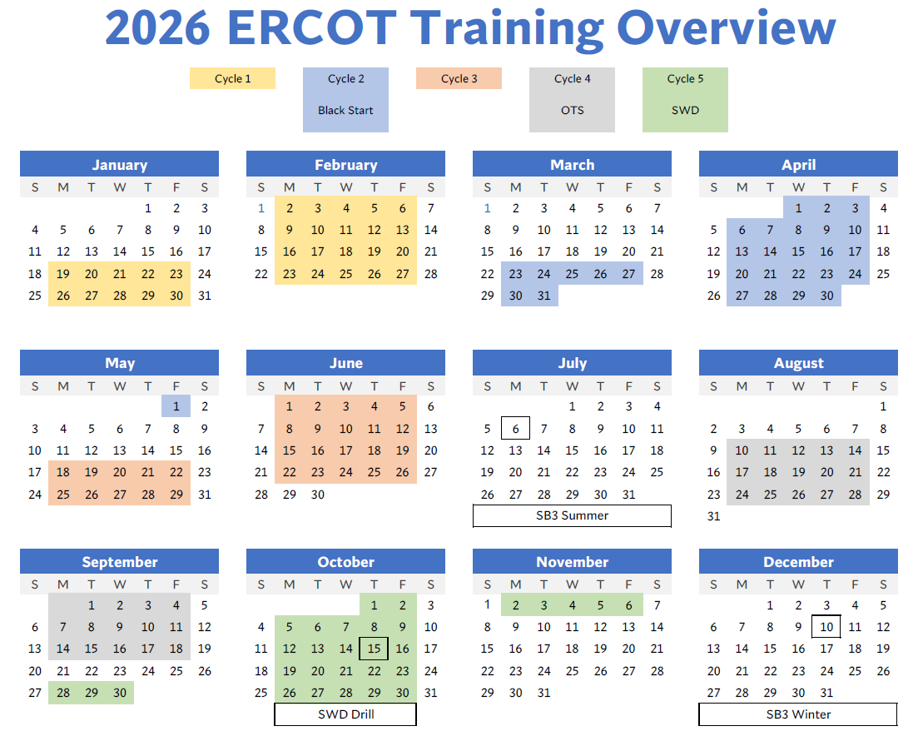
2026 ERCOT Training Overview
Black Start Seminar will be in March-April 2026
Operator Training Seminar will be in October-November 2026
Plans for annual Drills in 2026:
  Load Shed drill (Summer) on 7/6/26
  Severe Weather Drill on 10/15/26
  Load Shed drill (Winter) on 12/10/26
Black Start Seminar
Operations Training Seminar

Slide 5

Questions

