Slide 1
Weekly
RTC+B Market Trials Update
ERCOT Staff
September 29, 2025

Slide 2
Outline
Antitrust Admonition
Expectations of QSEs for the Week
  DAM, Adjustment Period, and SCED
  Next Steps for LFC Testing
    Oct 16 simulation/open loop, Oct 30 closed loop
Issues
Scorecards
DAM and Self-Provision Summary
Reminder of upcoming Schedule
Q&A
Appendix- Supporting Materials:
  Summary of SCED Functionality
  SCED Analysis/Results for prior week
  DAM and AS Self-Provision Education
  Telemetry Screening
  New RTC Pricing Reports location
  NPRR1290 Validation Changes
  Links to Handbooks
  FAQ Updated
  Connectivity and Configuration (digital certs)

Slide 3

WebEx Meeting reminders (same as other ERCOT forums):
Please keep line muted
If you have a question, please use the chat feature to either:
  Type in your question, or
  Type in “Question” and wait to be recognized to state question

Slide 4
Sequence and Dates for Market Trials to Go-Live
Market trials are a progression of activities to mitigate the risk for Go-Live on new systems and processes for both the Market Participants & ERCOT.
30-day Market Notice
11/5/25
March/April
2025
Start
5/5/25
Start
7/7/25
Start
9/2/25
Go-Live
12/5/25*
May 2025
June 2025
July 2025
Aug 2025
Sep 2025
Oct 2025
Nov 2025
Dec 2025
QSE Scorecards & Exit Criteria for each Trial Phase
#1 RTC QSE Submission Testing
(Submit COP, RT AS Offers,
DAM Virtual AS, Outages for ESRs)
#3 Open-loop RTC SCED
(QSE offers, SCED non-binding award/dispatch)
#5 Ongoing Open-Loop
& Periodic Closed-loop SCED/LFC
(QSE RTC offers and telemetry to support closed-loop frequency control test 2-3 tests of 2-4 hour durations)
Transition to Go-Live
Upon completion of testing, confirmation of ERCOT and market readiness for Go-Live.
QSE/Vendor Submission Sandbox and Telemetry Points added Prod EMS model.
#2 RTC QSE Telemetry Checkout (QSEs add/verify new telemetry points for UDSP, New ramp rates, ESR telemetry)
#4 QSE Telemetry Tests
(Individual QSE to follow UDSP and support new ramp rate and ESR telemetry)
#6 Day-Ahead Market
(Non-binding DAM using QSE offers for at least 2 tests)
* Go-Live date reflects 12/5/2025 as first Operating Day
where 12/4/2025 is planned software migration.

Slide 5
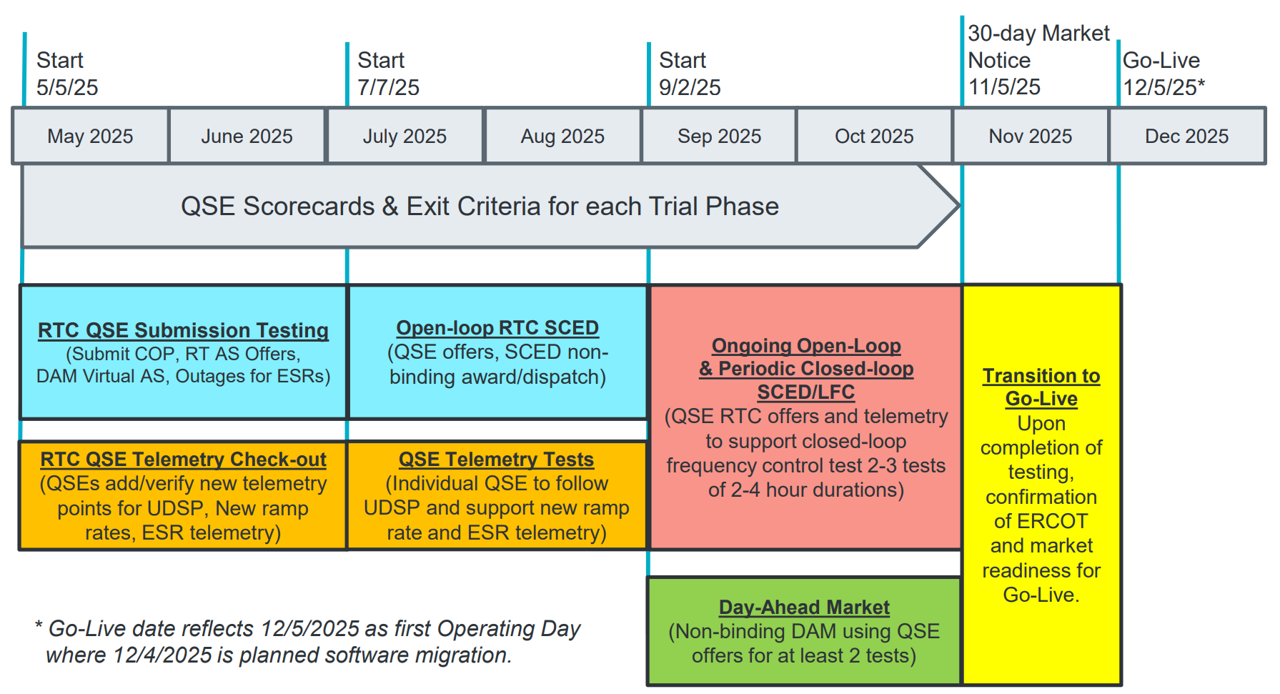
Sep & Oct:
Required live-production test to ensure effective frequency dispatch and control.
Sep & Oct:
Optional Day-Ahead Market
Voluntary Day-Ahead Market for all QSEs will be conducted at least 2 times.
QSE can test their market submissions for Day-Ahead AS Self-Arrangement, AS Only Offers, Trades and normal submissions.
DAM participation is strongly encouraged but not required in Readiness metrics since RTC procures AS in Real-Time.
Participation includes much broader QSE population (marketers and load-only QSEs).
ERCOT and QSEs will conduct live-production tests of RTC-SCED and Load Frequency Control (LFC) prior to go-live.
RTC-SCED and frequency control dispatch during the tests will be binding to manage the reliable operations of the grid for2-4 hours.
ERCOT will coordinate with QSEs on how to submit RTC offers and telemetry for Energy and AS for the two systems (current and RTC system).
ERCOT will provide a summary of the test and use analysis and engineering judgement to assess if the test was successful in controlling frequency.
Market Notice sent regarding DAM for all QSEs

Slide 6
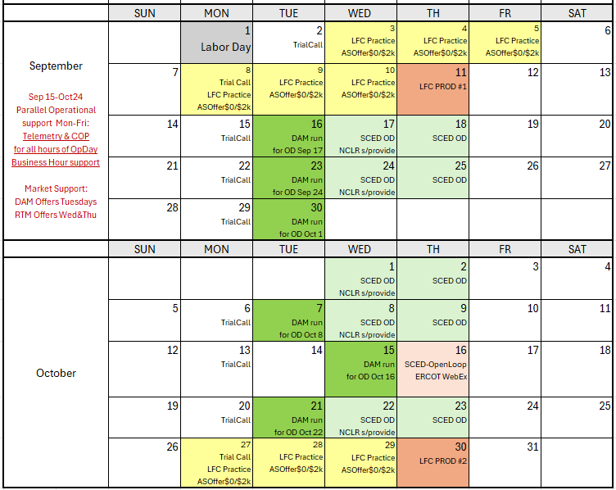
Market Trials Calendar for September/October
We are here….
NCLR s/provide = NCLR can use self-provision in SCED

Slide 7
Market Trials known issues/updates
Current issues/updates:
  Issues:
    Resolved: Self-Provision- For OD Sep 17 ERCOT needed to run (not publish HRUC) for snapshot of Self-Provision to work properly (done in later hours and going forward)
    ERCOT still working to minimize Phase 2 validation impacts
    SCED LFC issues being worked
  Update:
    DAM submissions timeline will be extended to noon for each RTC DAM OD
    Prevent confusion with production
      Give more time after Prod DAM to populate RTC DAM

Slide 8
Scorecards
Expectations similar to August “Monitored Operating Days”
See next 2 slides for prior week performance

Slide 9
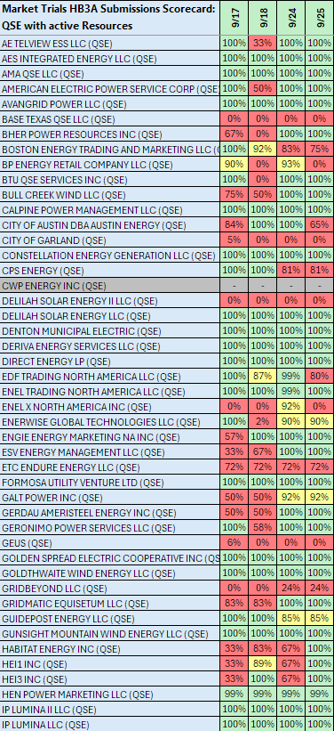
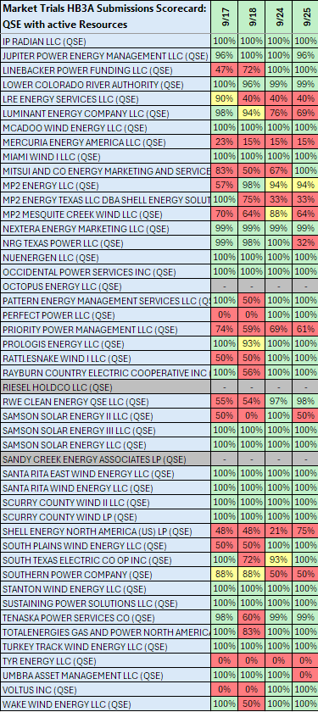
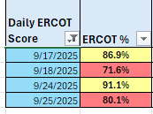
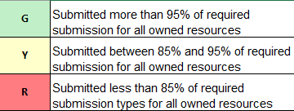
Scorecard 3A for
Handbook 3-
Market submission:
Scores for QSEs with Resources – Appropriate submissions made for each owned resources.
COP – ALL
TPO – Gen, ESR, CLR
ASO – AS Qualified Resources
System Wide Score last week:
Scoring:

Slide 10
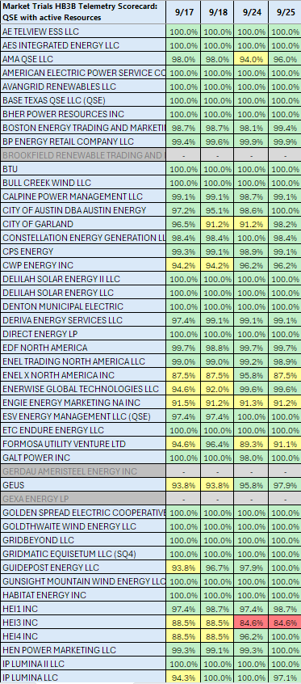
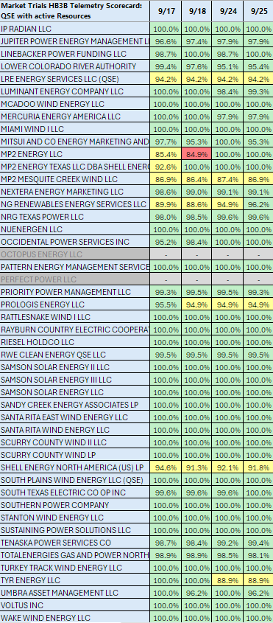
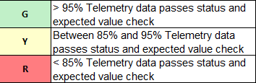
Scorecard 3B for
Handbook 3-
Acceptable Telemetry point values received by
ERCOT for active resources
9/29 Scores for QSE with Resources – Accurate telemetry data sent to ERCOT
Scoring:

Slide 11
Day-Ahead Market Results
Next 4 slides for DAM from prior week
Reminder Appendix has more details of Day-Ahead Market

Slide 12
Current vs RTC DAM Participation – OD 9/24/25
Item | RTC DAM | Current DAM
# Total Unique QSEs | 152 | 466
Min | Max HUB LMP ($/MWh) | 1.50 | 15.03 | 1.97 | 60.50
Min | Max LZ LMP ($/MWh) | 1.50 | 15.03 | 22.61 | 81.05
Objective Function ($M) | ~358 | ~728
PTP INT Count | 7015 | 231,016
PTP MW Qty Cleared (Max Hour) | 21,129 | 107,123
Execution Time (Minutes) | 16 | 91
AS Type | Max RTC Procured MWs | Max Current Procured MWs | RTC Min | Max MCPC ($/MWh) | Current Min | Max MCPC ($/MWh)
ECRS | 2160 | 2877 | 0.10 | 49.50 | 0.05 | 5.00
RRS | 2463 | 2440 | 3.15 | 49.50 | 0.30 | 5.14
NSPIN | 3796 | 2655 | 2.00 | 19.50 | 0.06 | 5.00
RegUp | 694 | 694 | 3.25 | 46.53 | 0.69 | 7.46
RegDn | 564 | 564 | 0.40 | 125.00 | 0.33 | 6.48

Slide 13
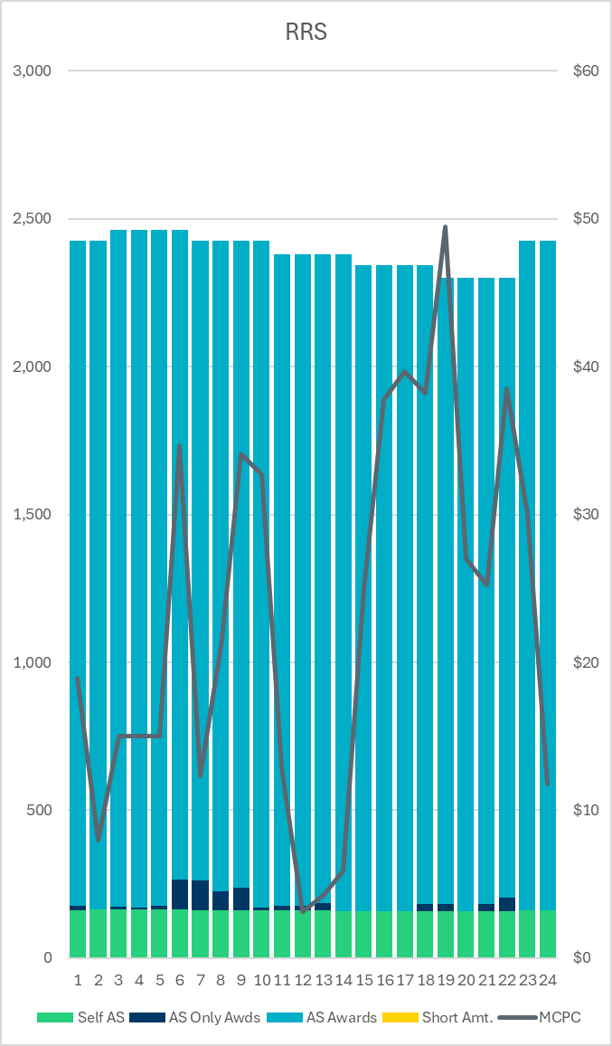
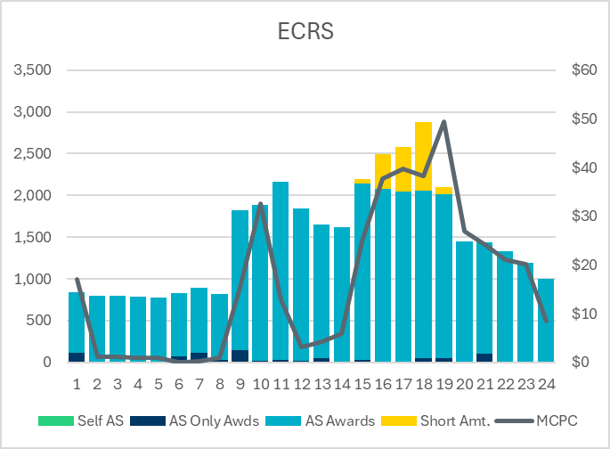
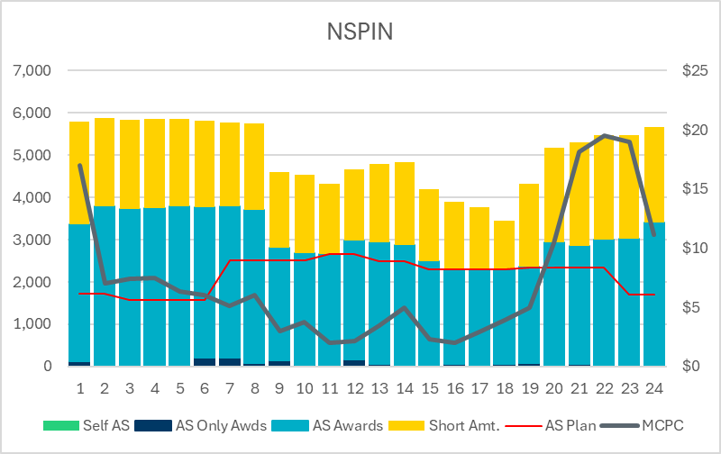
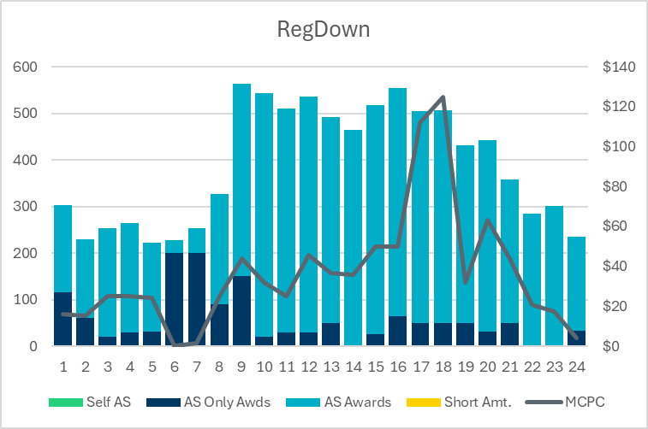
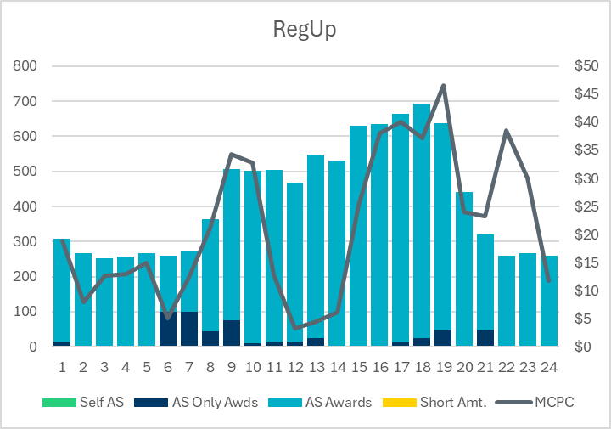
AS Quantities and Prices - DAM RTC OD 9/24/25

Slide 14
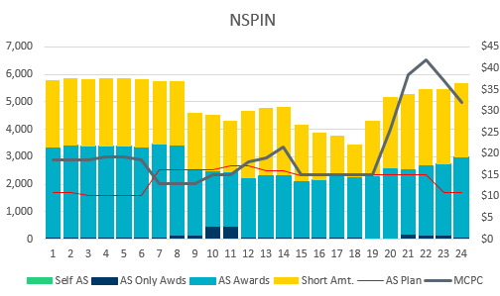
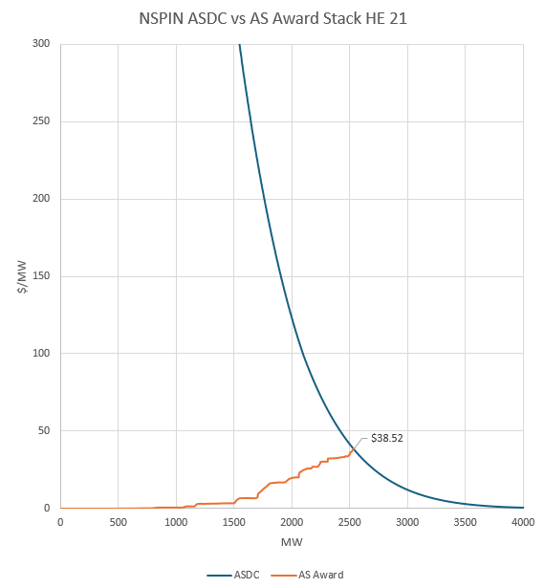
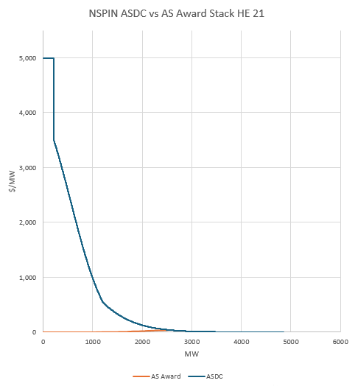
ASDC Price Setting Example
OD 9/17/2025 HE 21
NSPIN MCPC : $38.52
  AS Award stack intersected the ASDC @ 2536.6 MW
  NSPIN AS Plan @ HE 21 : 2339 MW

Slide 15
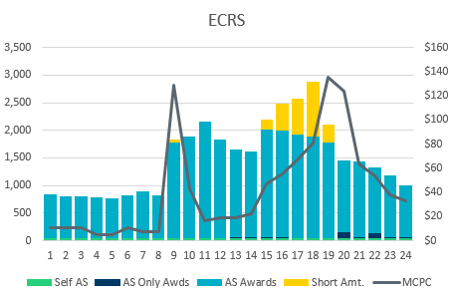
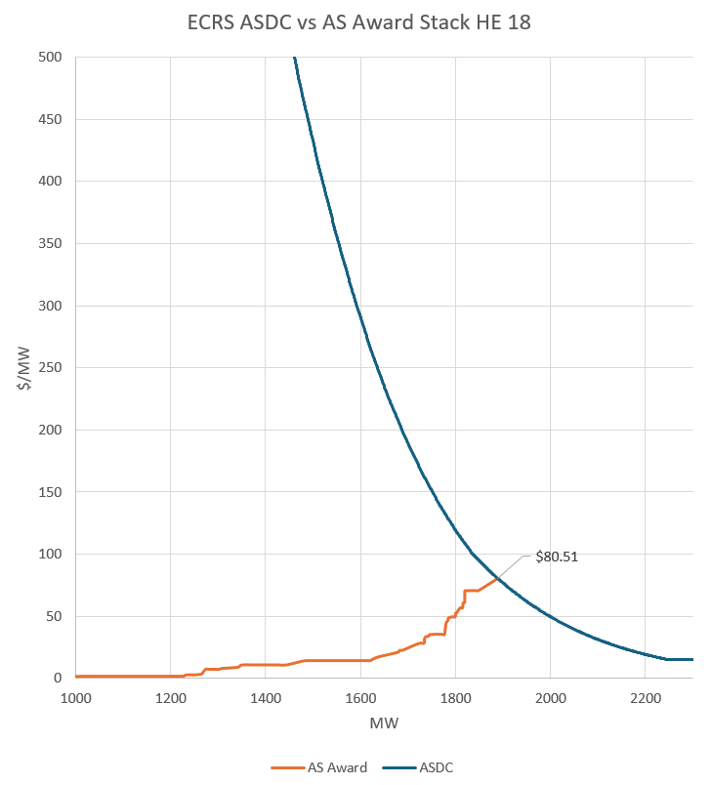
ASDC Price Setting Example
OD 9/17/2025 HE 18
ECRS MCPC : $80.51
  AS Award stack intersected the ASDC @ 1888.6 MW
  ECRS AS Plan @ HE 18 : 2877 MW

Slide 16
AS Self-Provision Observations for OD 9/24
Reminder Appendix has more details of Self-Provision machanics
Delivery Hour 17 (9/24/25):
  1011 MW of RRS awarded to NCLRs in the Day-Ahead Market
  During the hour, NCLRs telemetered ~970 MW of RRS capability
Actual RRS Awards Breakdown:
  ~182 MW of RRS awarded to NCLRs
  ~330 MW were telemetered via self-provision
  ~152 MW of self-provision were awarded
Validation Issues:
  The primary validation issue causing the 180 MW disparity between self-provided amount and self-provision awards was insufficient capacity.
  This serves as a strong indicator that the validation rules are functioning as intended.

Slide 17
SCED Analysis/Observations in Appendix
See Appendix for Prior Week SCED Results

Slide 18
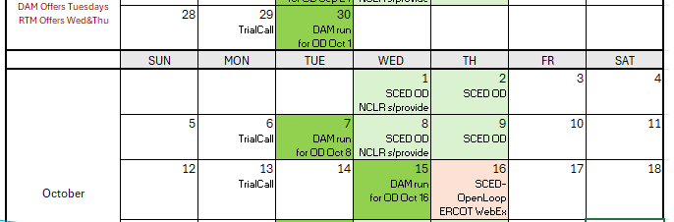
Next 2 weeks:
Same pattern as prior 2 weeks:
Continue to maintain Operational alignment of Telemetry and COP in RTC trials systems
Market sequences:
  TUE: DAM clearing (focus on next day SCED offers and NCLR self-provision)
  WED&THU: SCED offers for all 24 hours of OD
Offers not scripted:
  QSE allowed/encouraged to make economic offers (non-scripted, but reasonable)
  Energy and AS Offers should cover full capability (ie, goal to minimize proxies from ERCOT)

Slide 19
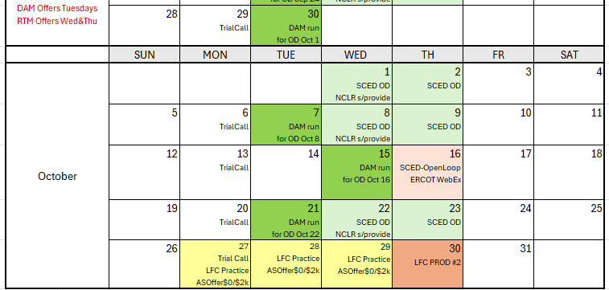
Rest of Sep/Oct Trials
Run DAM/SCED on regular cadence, except for:
LFC Practice/Simulation- Oct 16
Last Planned LFC Test- Oct 30

Slide 20
Upcoming Testing
New activity on October 16 as SCED Open Loop ERCOT WebEx*
  Program considered value of Closed-Loop LFC Test, especially in identifying defects
  On Oct 16, ERCOT will have WebEx call open for real-time questions as QSEs observe both SCED awards and UDSP telemetry
  ERCOT encourages full participation with accurate telemetry and “unscripted market submissions” to help test and shake-out any additional issues
  Focused/support window for Market & ERCOT can provide another round of scrutiny of systems and market outcomes to minimize risk to go-live.
  * Previously referred to on Monday call as LFC Simulation Open Loop Only- replaced with this concept
Confirmed October 30 as second and last planned Closed-Loop LFC Test
  Will essentially be a repeat of September 11 test (similar structure and expectations)
  May be longer (but not to exceed 4 hours) to gain frequency tuning data
  ERCOT will observe Frequency tuning changes in production
  Both ERCOT and QSE opportunity to test any fixes
  Repeat the critical cutover process that will be used 35 days later for go-live
Lack of engagement from other QSEs in DAM
  Considering Market Notice requiring “QSE Acknowledgement of DAM changes and Cutover activities that are forthcoming” to capture QSEs without Resources in engagement.

Slide 21
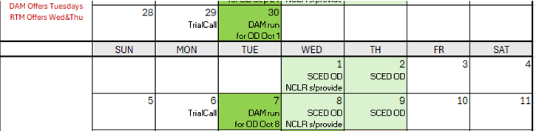
Wrap-Up and Questions
Reminder of this week’s sequence:
  Similar to Monitored OD process in August, with addition of DAM
  TUE: DAM clearing (focus on next day SCED offers and NCLR self-provision)
  WED/THU: SCED offers for all 24 hours of OD
Reminder of Appendix- SCED analysis, Education, Connectivity
Remainder of meeting for Q&A
Can always email the RTC+B Program mailbox: RTCB@ercot.com

Slide 22
APPENDIX- Supporting Materials
Summary of SCED Functionality
SCED Analysis/Results for prior week
DAM and AS Self-Provision Education
Telemetry Screening
New RTC Pricing Reports location
NPRR1290 Validation Changes
Links to Handbooks
FAQ Updated 8/8/2025
Connectivity and Configuration (digital certs)

Slide 23
Summary of SCED functionality
What is RTC SCED using to solve in trials?
  Production Network model from NMMS
  QSE submitted offers (energy and A/S)
  QSE production telemetry
    ERCOT performs some overrides for stale data from QSE sites- improving each week
  Outages in prod telemetry would be outage in RTC SCED
  July 31 improvements implemented:
    NPRR1268/1269 ASDC and Proxies logic implemented
    AS Plan improved and now same as Prod
  Aug 4 improvements implemented:
    IRR Forecast synchronization has been manual, but now automated
  Aug 18 improvements implemented :
    Active constraints flag being manually copied (automation planned for Aug 18)
    Load Forecasts being fed into RTC, but ERCOT manually aligns which forecast is being used based on operator selection in Prod (automation planned for Aug 18)

Slide 24
RTC+B Market Trials Summary
09-24-2025

Slide 25
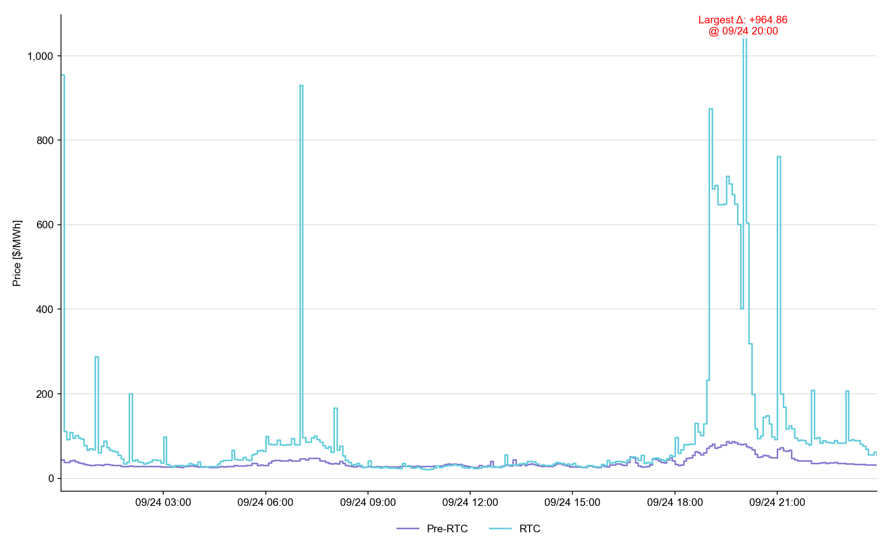
System Lambda (plus Adders)

Slide 26
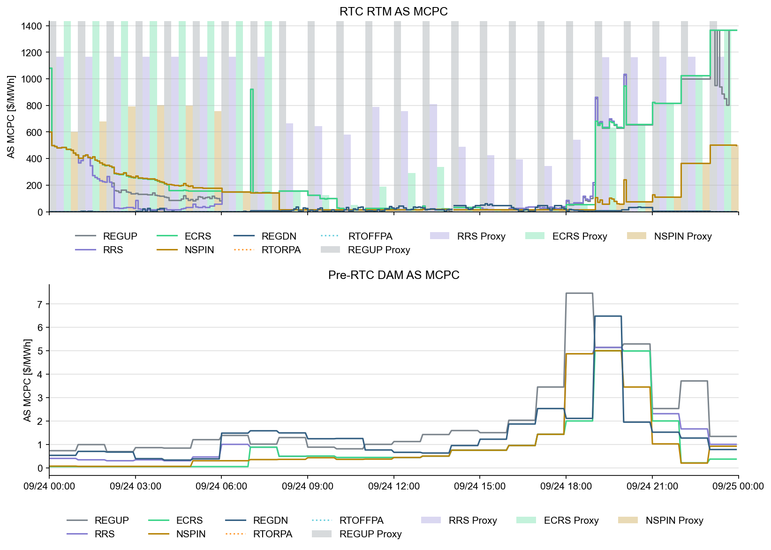
Ancillary Service Prices

Slide 27
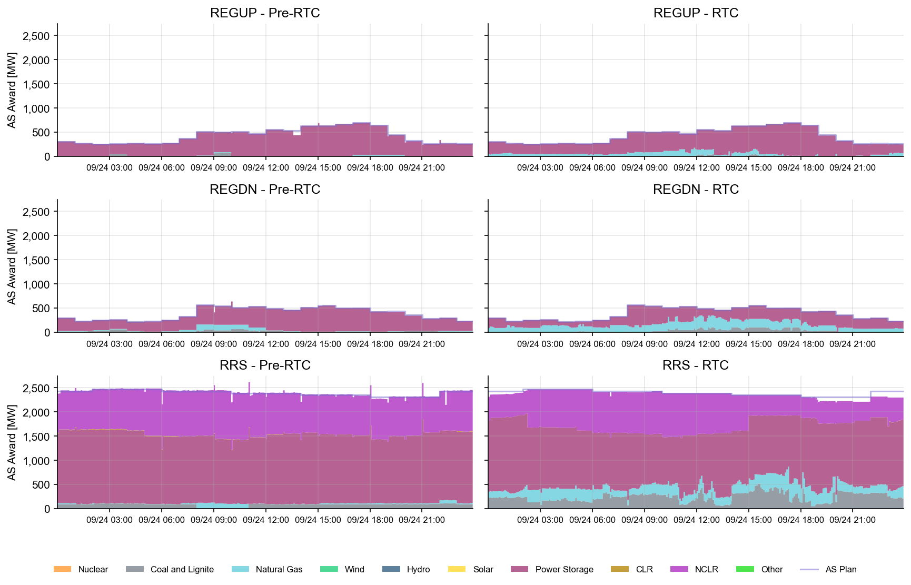
AS Awards* Summary by Resource Type
* Pre-RTC (RTM AS Schedule)
* Pre-RTC (RTM AS Schedule)

Slide 28
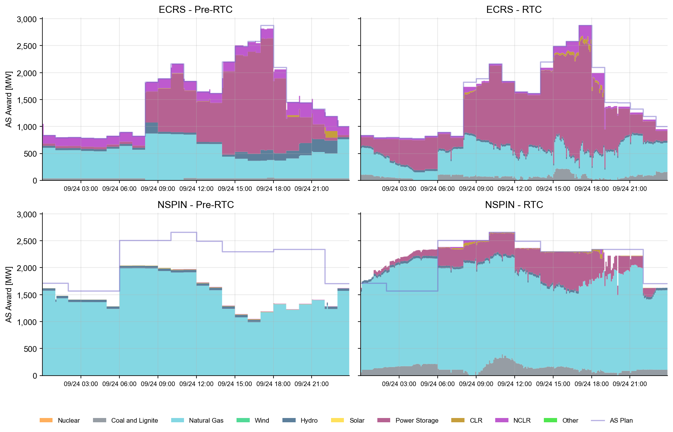
AS Awards* Summary by Resource Type
* Pre-RTC (RTM AS Schedule)

Slide 29
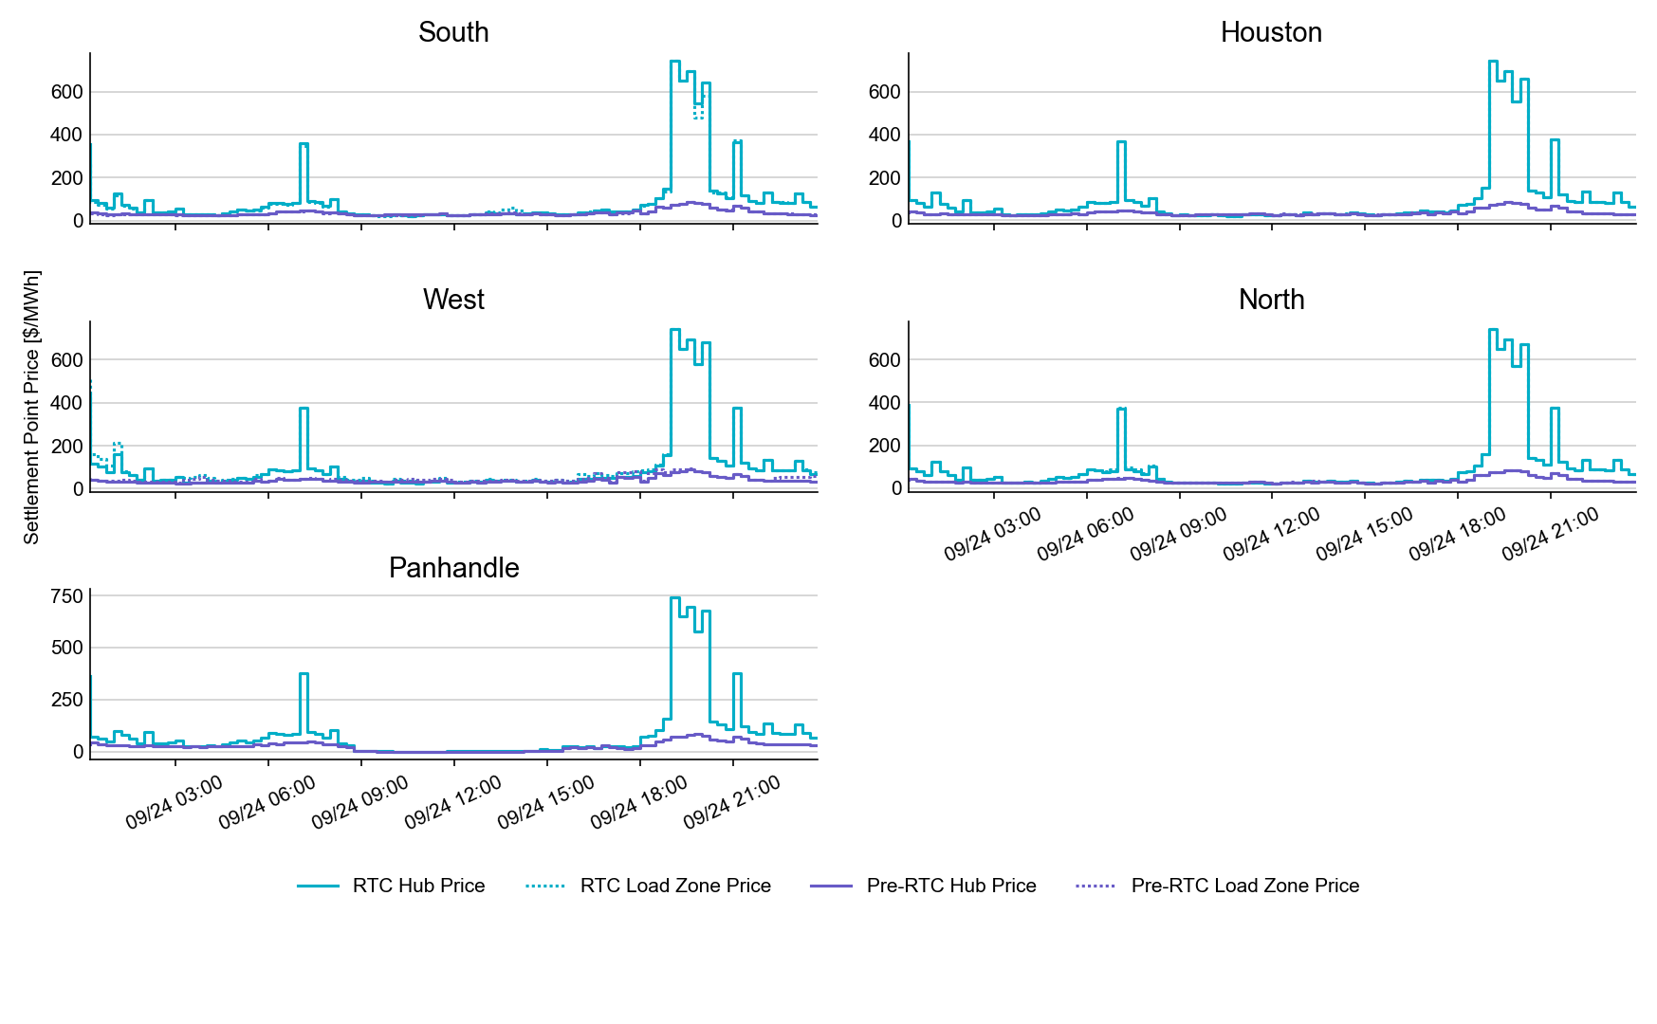
SPP by Hub and Competitive Load Zone

Slide 30
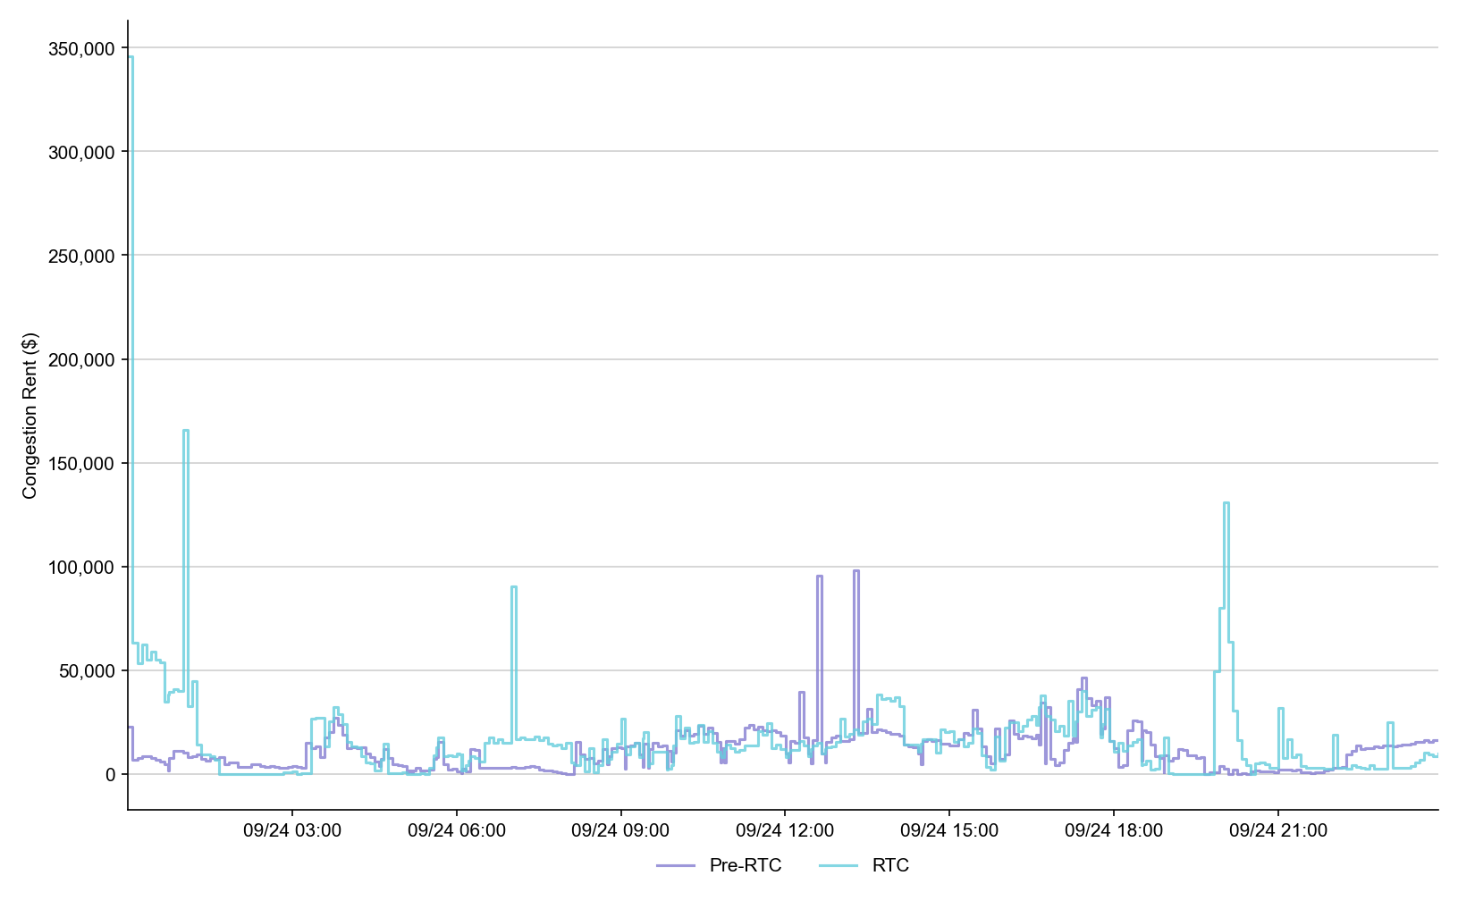
Congestion Rent

Slide 31
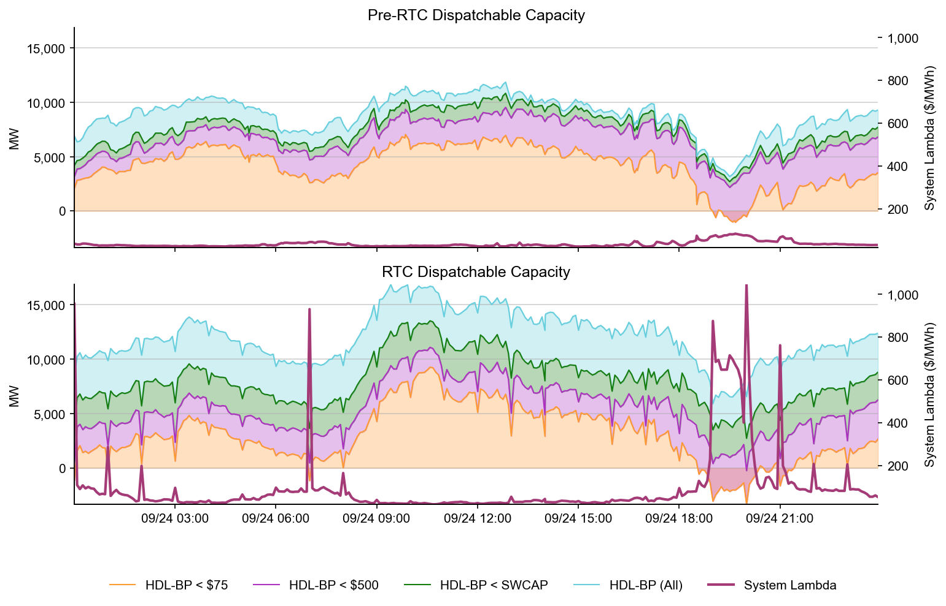
Dispatchable Capacity

Slide 32
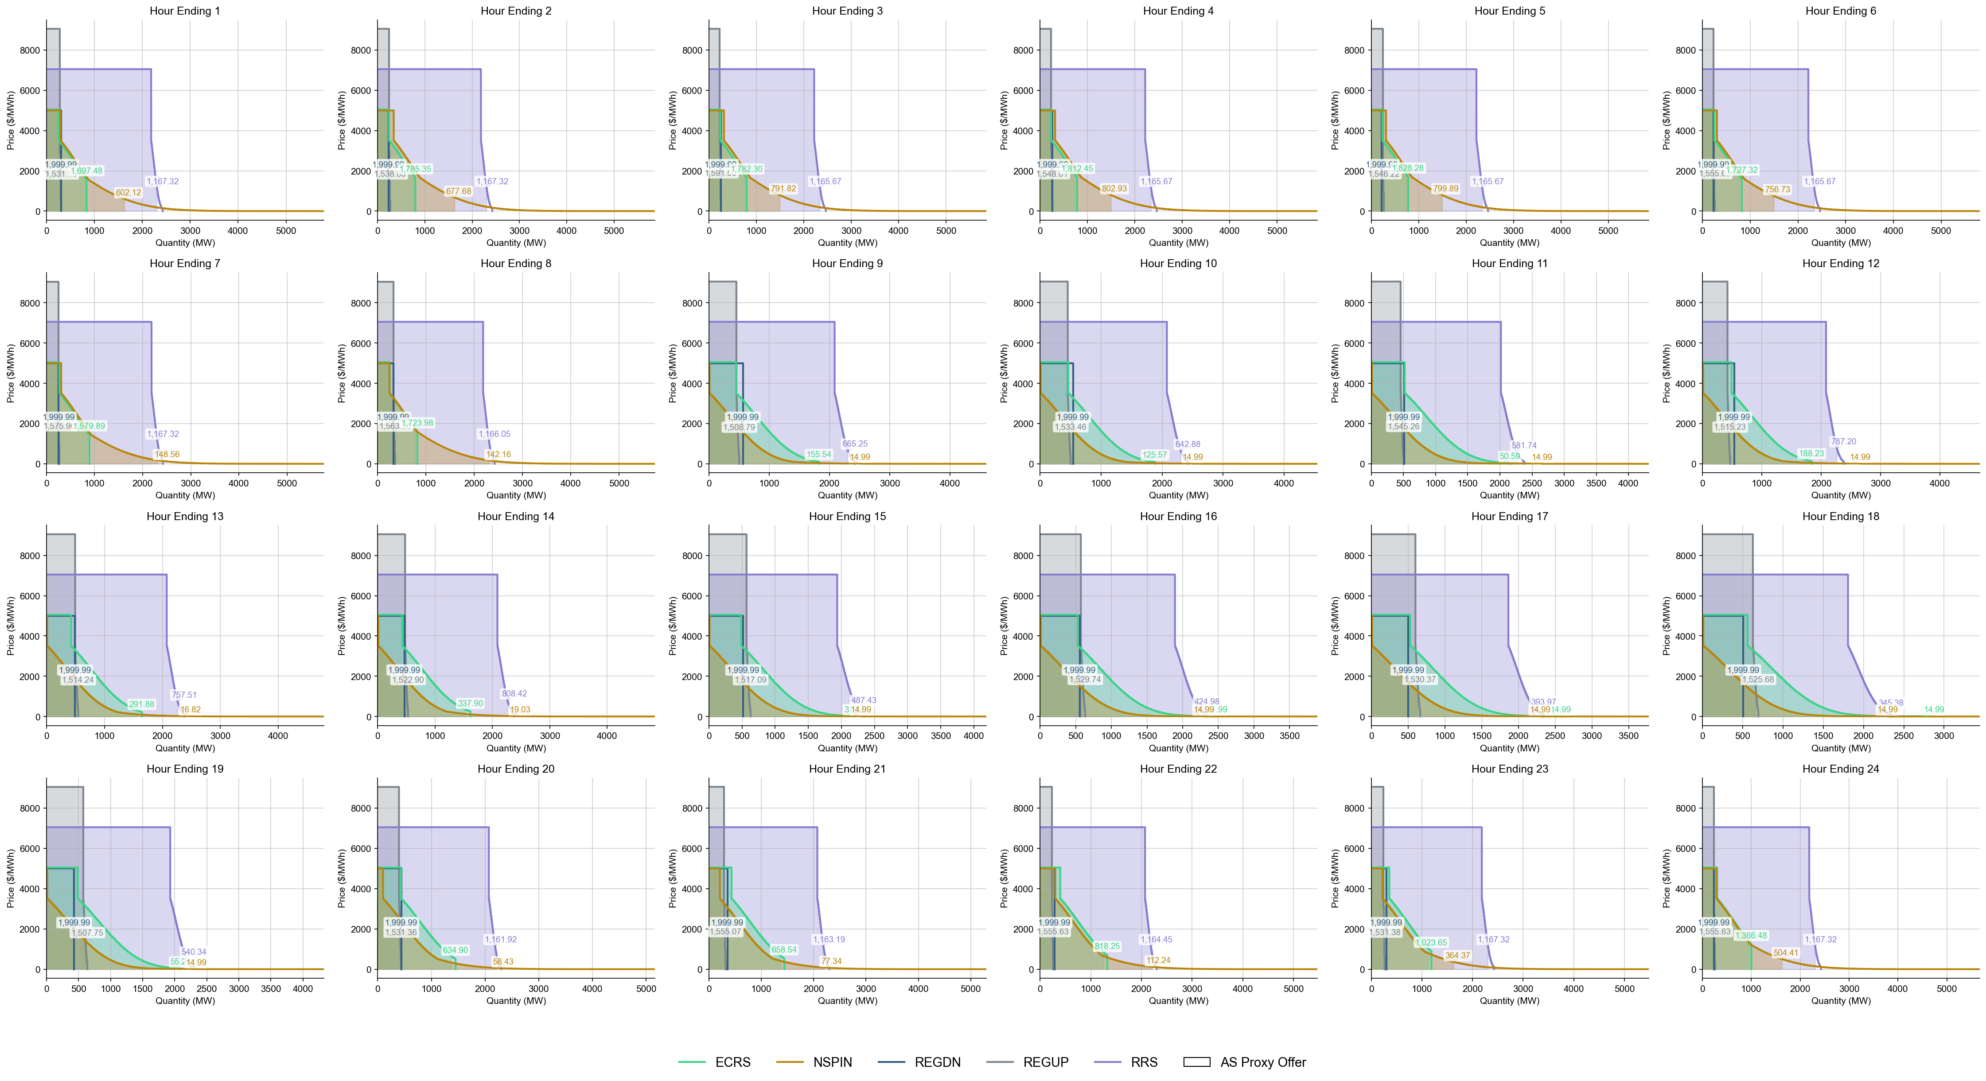
Ancillary Service Demand Curves

Slide 33
RTC+B Market Trials Summary
09-25-2025

Slide 34
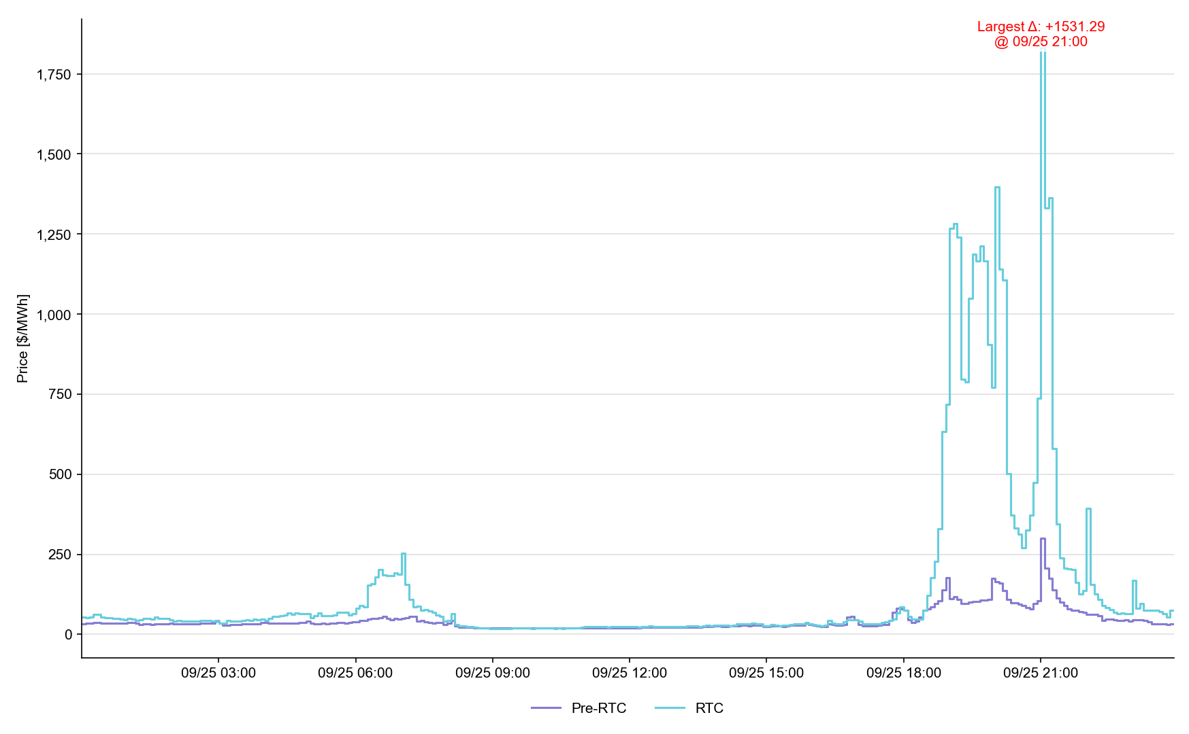
System Lambda (plus Adders)

Slide 35
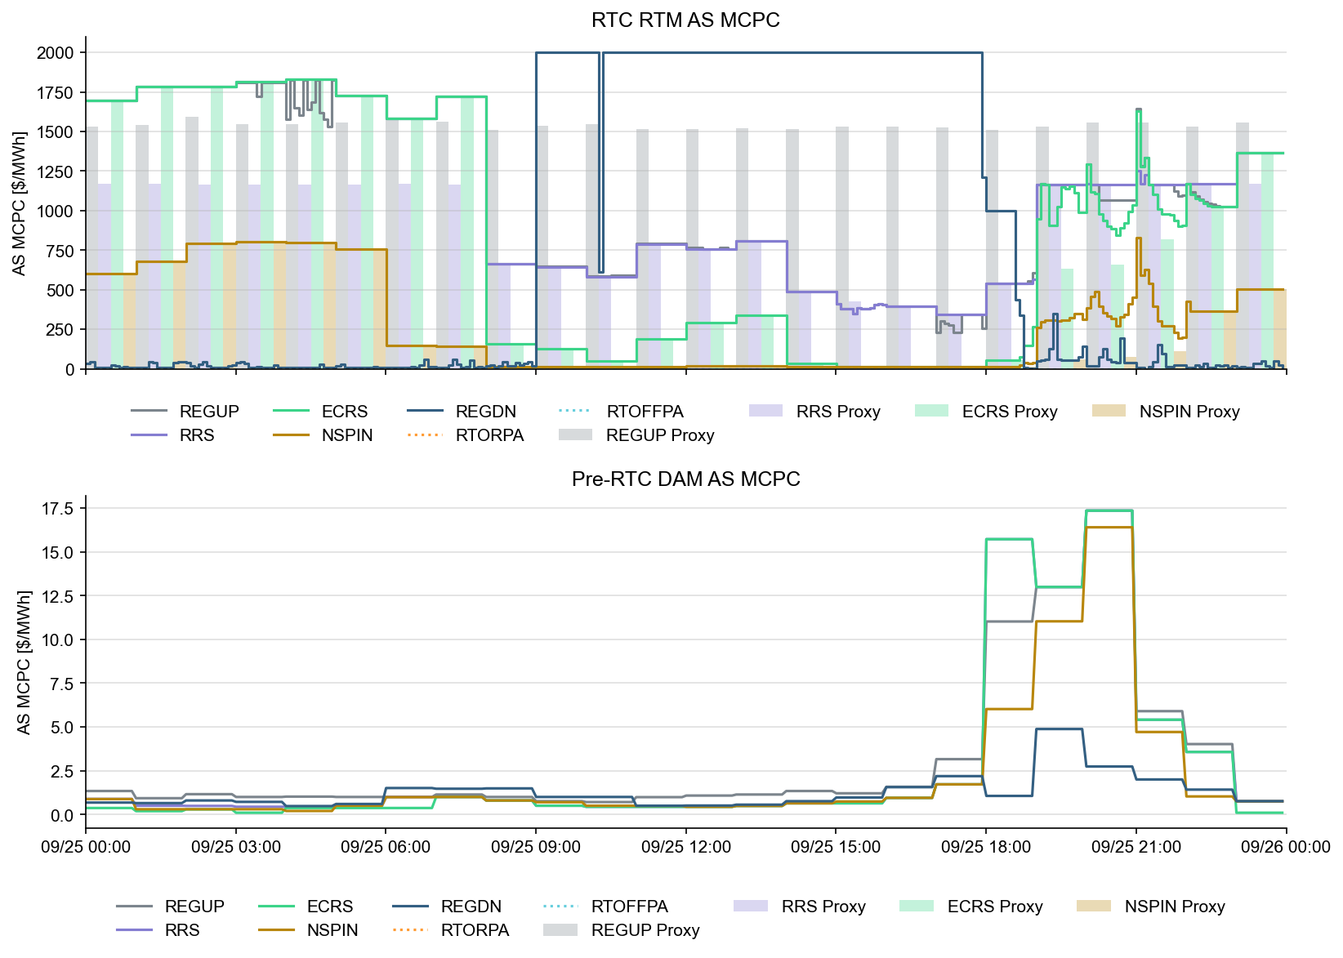
Ancillary Service Prices

Slide 36
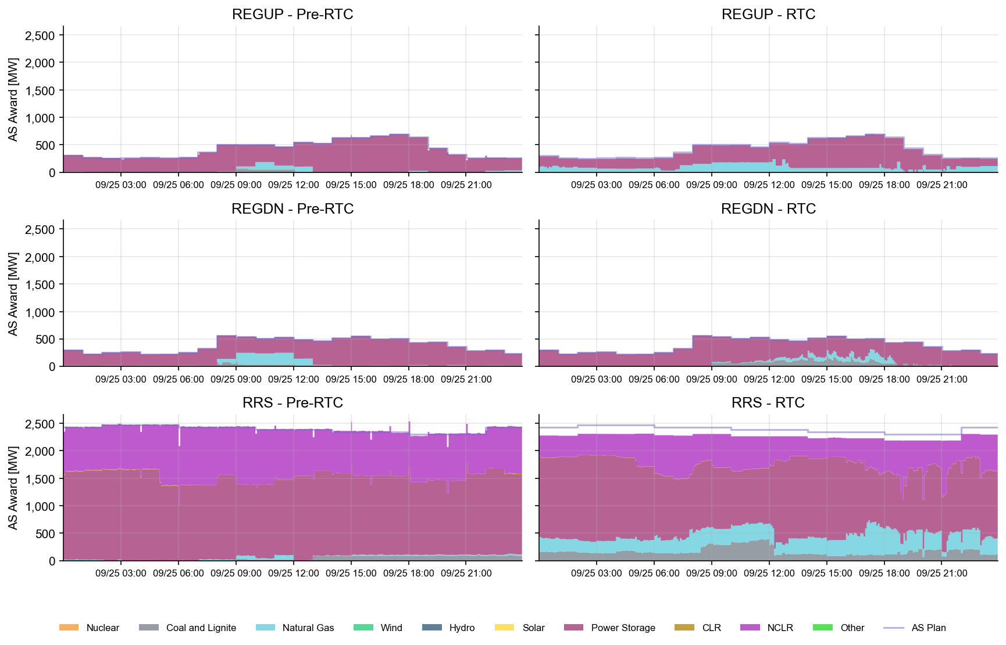
AS Awards* Summary by Resource Type
* Pre-RTC (RTM AS Schedule)
* Pre-RTC (RTM AS Schedule)

Slide 37
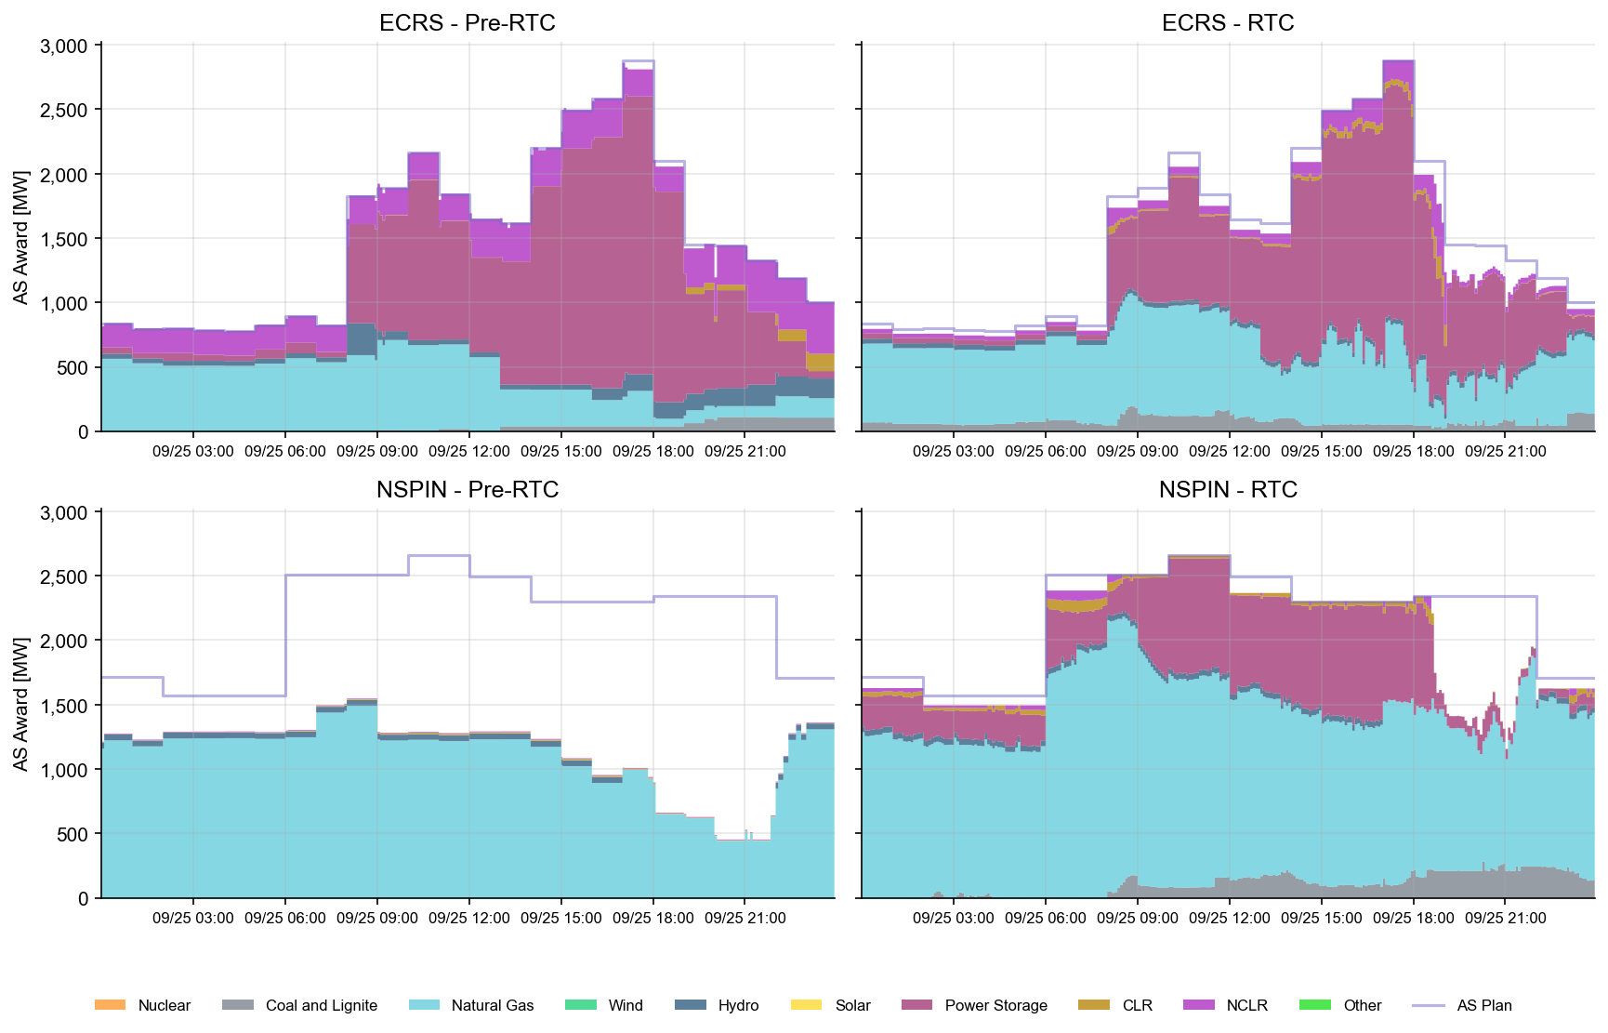
AS Awards* Summary by Resource Type
* Pre-RTC (RTM AS Schedule)

Slide 38
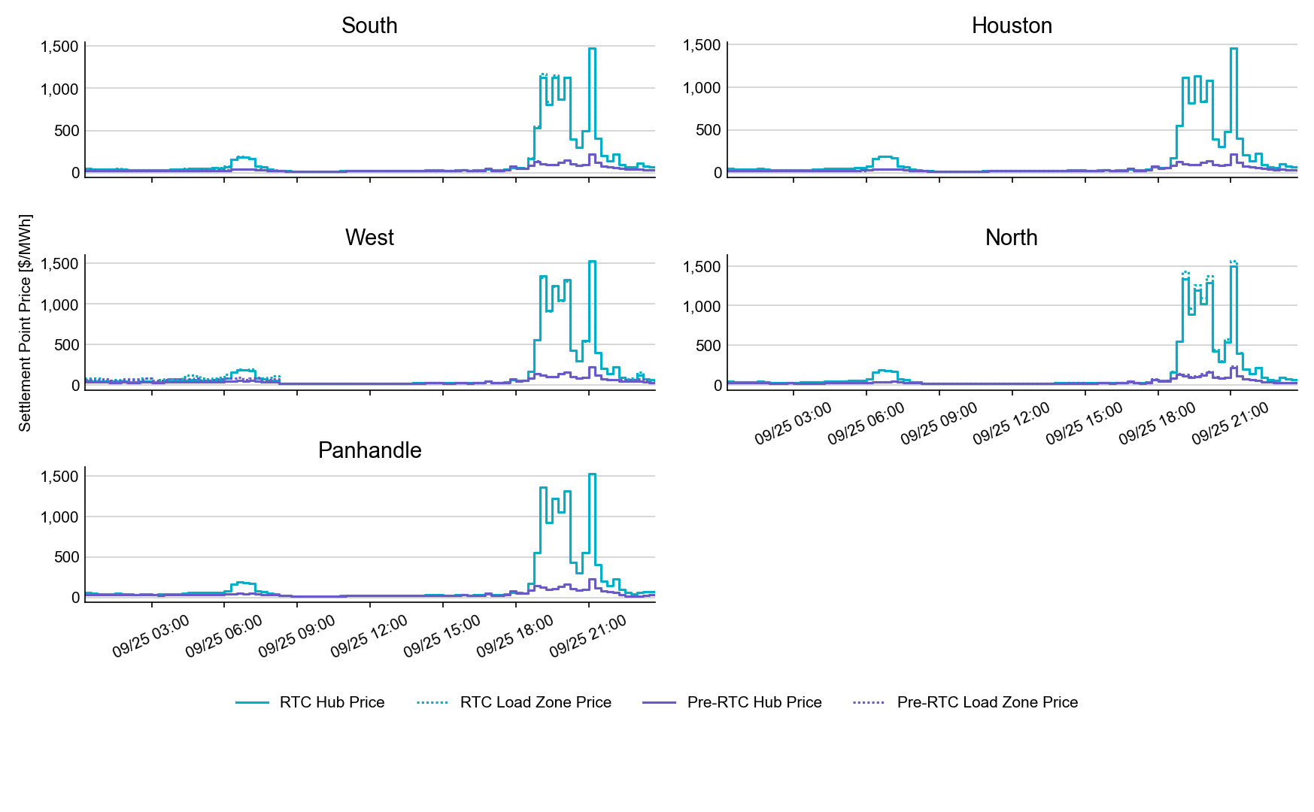
SPP by Hub and Competitive Load Zone

Slide 39
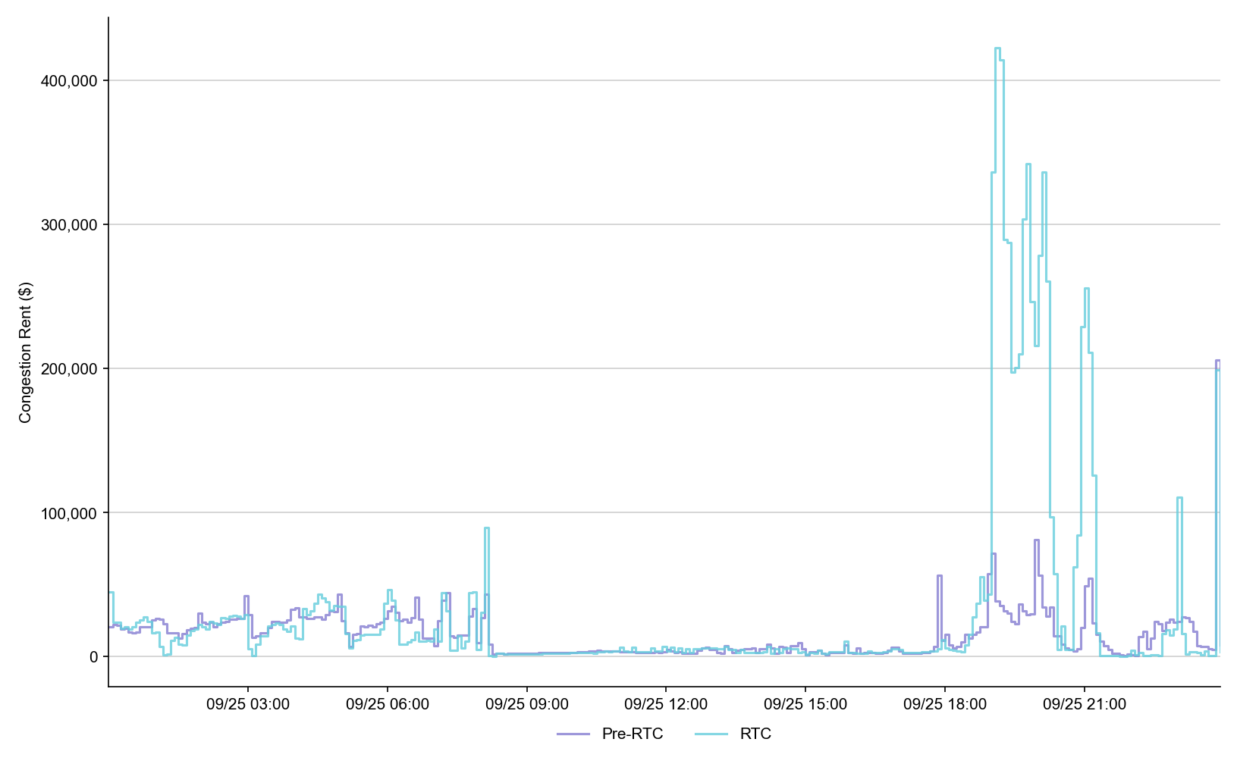
Congestion Rent

Slide 40
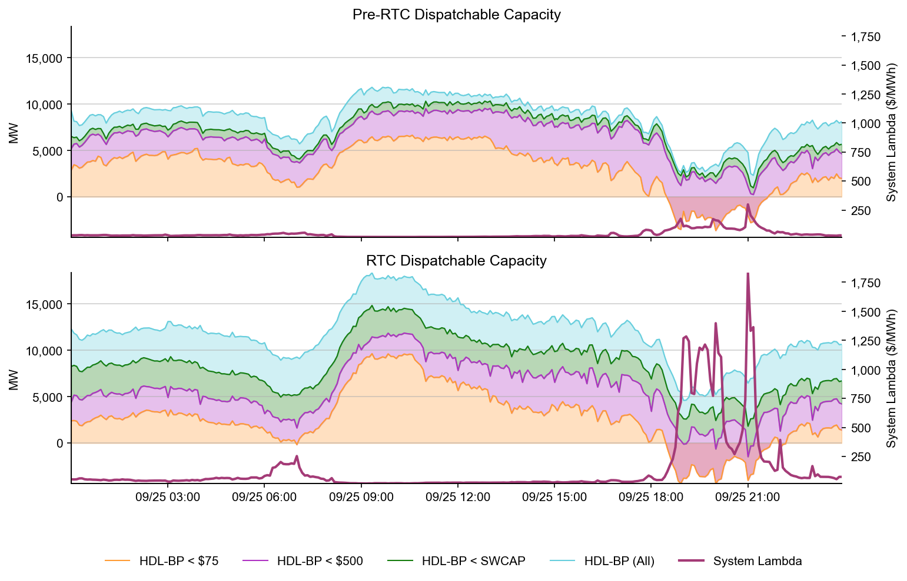
Dispatchable Capacity

Slide 41
Ancillary Service Demand Curves

Slide 42
Day-Ahead Market

Slide 43
DAM Operating Day (OD) Test
Testing strongly encouraged, but not required for all QSEs
  Handbook #6 Day-Ahead Market
  The DAM will run on Tuesdays
  DAM submission window closes at noon.
By 0600 QSEs can validate and confirm report posting:
  Advisory AS Obligation: Available on Market Trials MMSUI (5 significant digits after decimal point)
  ASDCs: Available on Production MIS
  Load Ratio Share and PSS/e files will change with RTC cutover, but will not be visible for OD 9/17
For successful DAM completion, and meaningful results, market participants are strongly encouraged to submit various submission types, and not only submission types listed above (E.g., PTPs, EOOs, EBs, AS Self-Arrangement, non-ESR AS and non-ESR TPO submissions).

Slide 44
DAM Operating Day (OD) Test – Pre DAM
Key DAM Submission Changes
  AS Obligation – no self-arrangement will be allowed over QSE’s Advisory AS Obligation.
    Example: RRS Advisory AS Obligation = 2.18368 -> maximum Self-AS submission = 2.1
  COP – can submit negative LSL/HSL for ESR. Can submit values for AS Capability within the existing AS fields.
  TPO (EB/OC) – negative MW quantity reflects ESR EB/OC. ESR startup and minimum energy costs are not allowed and ESRs are considered self-committed.
  Resource-Specific AS Offers – FRRSUP and FRRSDN offers not allowed. Offers must be between $0 and DAM SWCAP. For ESRs, RRSUFR and ECRSM offers not allowed. All AS offers from ESRs are inclusive of EB/OCs.
  AS Only Offers – Offers must be between $0 and DAM SWCAP. REGUP, REGDN, RRSPFR, Online NSPIN, and Online ECRS are allowed. Other AS types are not allowed. Multi-hour and fixed blocks are not allowed.

Slide 45
DAM Operating Day (OD) Test – Post DAM
Post Publish Report Verification
  AS-Only Awards
  ESR Resource-Specific AS awards
  TPO(EB/OC) awards
  QSEs with Advisory AS Obligations and AS awards can download/review their Final AS Obligations and ensure observe/handle values with up to 5 significant digits after the decimal
  DAM LMPs
  DAM MCPCs
  DAM Constraint Shadow Prices
  Other DAM Awards

Slide 46
NCLR Self-Provision
Reminder:
AS Self-Provision is a special design to allow Non-Controllable Load Resources to self-provide their AS Responsibilities into/through SCED/Real-Time Market

Slide 47
NCLR Resource Status Codes
Pre-RTC
  Resource Status Codes (RST)
  OUTL = 260
  ONRL = 259
  ONECL = 264
RTC+B
  Updated Resource Status Codes (RSTR)
  OUTL = 258
  ONL = 257

Slide 48
Ramp Rates and Capabilities
RTC+B
  Ramp Rates & Awards
  UFRC (UFR Capability)
  UFRA (UFR Award)
  ECRR (ECRS RR Capability *10 Min)
  ECRA (ECRS Award)
  NSRR (NSPIN RR Capability *30 Min)
  NSRA (NSPIN Award)
Pre-RTC
  AS Responsibility and Schedule
  RRRS
  RRSC
  ECRS
  ECSC
  NSRS
  NSSC
QSE to ERCOT Telemetry
ERCOT to QSE ICCP

Slide 49
Self-Provision Achieved via Telemetry Points for NCLRs
LEGEND
QSEs will be able to self-provide in real-time via telemetered ICCP points
ICCP Change Request Example RTC+B V1.4 on RTC ERCOT webpage

Slide 50
The Self-Provision Checklist
Scenario: My Load Resource was awarded 15 MW in the DAM, and I purchased 5 MW via a trade.
My total RRS AS Position is 20 MW.
How to correctly self-provide 20 MW:
    Is my resource qualified?
    Telemetry Points
      RSTR set to ONL (257)
      UFR must be Armed
      Can I cover my obligation?
        Qualified MW Amount ≥ Self-provided amount
        NPF - LPC ≥ Self-provided amount
        Capability to Provide AS ≥ Self-provided amount
      Final Step: Telemeter Self-provision
      “your offers explain your extra”

Slide 51
Scenario 1
NCLR_1 has a 20 MW RRS AS Position, 15 MW from DAM award and 5 MW from RRS Trade
Scenario ** Assume AS qualified for All Headroom (NPF-LPC) | Max Power Cons. | Net Power Flow | Low Power Cons. | Resource Status | Under Freq. Relay | Self-provided RRS UFR (MW) | Self-provided ECRS (MW) | Current Capability to provide UFR (MW) | ECRS (10min) Ramp Rate (MW/min) | RRS UFR AS Award | ECRS AS Award | Notes
 | MPC | NPF | LPC | RSTR | UFR | SPUF | SPEC | UFRC | ECRR | UFRA | ECRA
NCLR_1 is qualified to provide 20 MW. DAM awards NCLR_1 with 15MW RRS. QSE also has additional 5MW RRS Position via RRS Trades. | 20 | 20 | 0 | ONL | Arm | 20 | 0 | 20 | 0 | 20 | 0 | NCLR_1 Telemetry needs to show: Status = ONL, MPC >= NPF >= 20 MW, NPF-LPC >= 20 MW, RRS capability >= 20 MW, RRS self-provided telemetry = 20 MW SCED will respect the 20 MW self-provided RRS and award the resource 20 MW RRS UFR.
QSE to ERCOT Telemetry
ERCOT to QSE ICCP

Slide 52

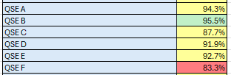
Telemetry Screening for Scorecard 3B for Handbook 3
Acceptable Telemetry Point values received by ERCOT for active resources.
Scoring:
Key points for Telemetry scorecard check
  Device types checked - Units, CLRs, NCLRs, ESRs for each QSE
  RTCB Telemetry status should be “Good” quality
  RTCB Units / CLRs / NCLRs Telemetry values should be within “Expected Range” or an expected value. Details are provided in next few slides.
  Expected values are derived from equivalent analogs in current production, based on defined criteria.
  RTCB ESR telemetry values are checked against corresponding combo model Battery Unit / CLR counterparts in production.

Slide 53
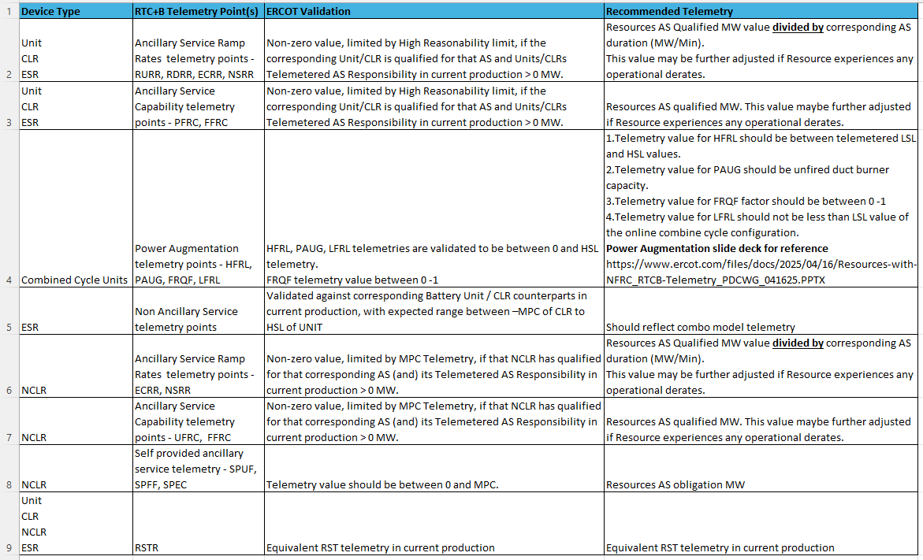
RTC+B Telemetry points screening/validation

Slide 54
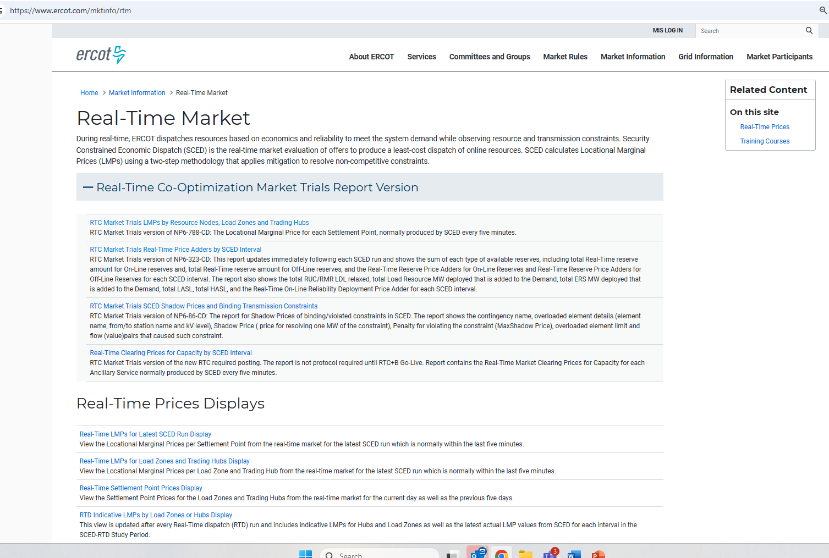
RTC+B New Reports Posted to the ERCOT Website
Links to the available RTC+B versions of Real-Time reports posted on Real-Time Market Information page.

Slide 55
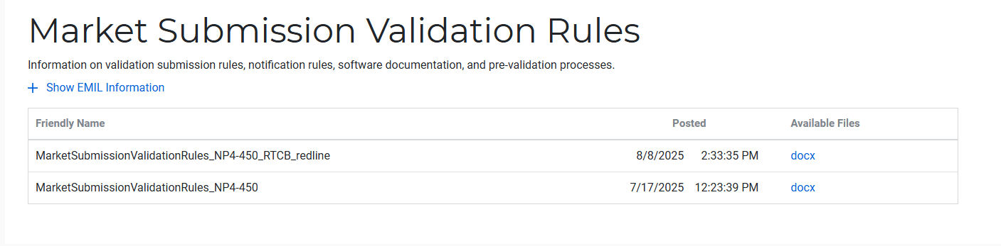
Submission validation update - PROD vs RTC+B
NPRR1290 :
  cleaned up protocol language around submitting offer curves and bid curves
  disallows having more than 2 price/quantity points in a flat/vertical segment of the curve.
Impacts to QSEs during dual-submission – some submissions accepted in Production will be rejected in Market Trials environment:
RTM Energy bids – protocol requiring “increasing quantities” now enforced.
  Reverted this change to validation. Further discussion highlighted protocol should be brought in line to long-standing practice, not validation.
  Example: Bid with Q1=0mw, Q2=10mw, Q3=10mw will be rejected as Q3 does not increase from Q2.
TPO & RTM Bid – more than 2 price/quantity pairs with same price or quantity will be rejected
Market Submission Validation
Rules document updated.

Slide 56
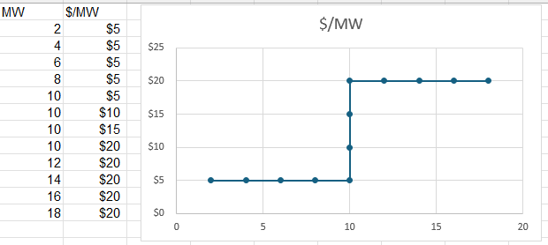
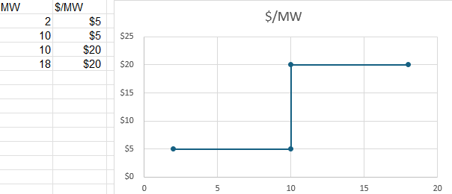
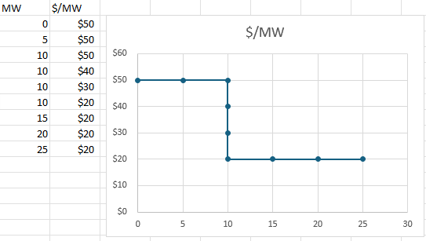
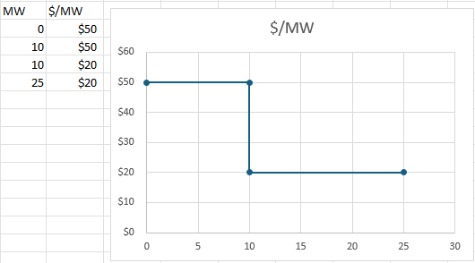
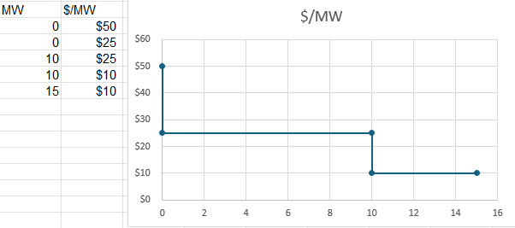
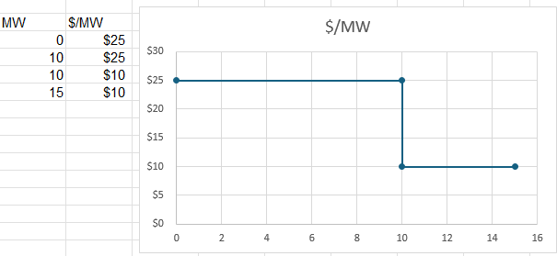
Submission validation update - PROD vs RTC+B
TPO – EB/OC - EOC
RTM EB
RTM EB

Slide 57

Market Trials Framework:
TAC Approved the Market Trials Plan in October 2024
Discussions with RTC+B Task Force have shaped the Handbooks
Handbook #1- QSE Submission Testing
Handbook #2- QSE Telemetry Tests
Handbook #3- Open Loop SCED
Handbook #4- QSE Telemetry Tests
Handbook #5- Close-Loop LFC Tests
Handbook #6- Day-Ahead Market Tests
All are posted on the
RTCBTF Homepage
under Market Trials banner

Slide 58

Market Trials Technical Details
Detailed discussions with TWG have provided technical content details
Digital Certificate details
Connectivity/URL details to User Interfaces and APIs
Reminder of how to submit new ICCP requests
RTC and Production Telemetry connectivity
Network Model Load Schedule
All are posted on the
RTCBTF Homepage
under Technical Details banner

Slide 59

Reminder of RTC+B FAQ
Posted on RTCBTF Home Page under Key Documents
Common questions/responses in Excel Workbook (target weekly updates)
Search workbook for Key Words
Worksheets for categories

Slide 60
RTC+B Market Submissions - Systems configurations
Start
03/2025
Start
05/2025
Start
07/2025
Start
09/2025
Go-Live
12/5/25*
Feb 2025
Mar 2025
Apr 2025
May 2025
June 2025
July 2025
Aug 2025
Sep 2025
Oct 2025
Nov 2025
Dec 2025
Optional: RTC QSE/Vendor Developer
Submission Testing
RTC QSE
Submission Testing
Open-loop
RTC SCED
Ongoing Open-Loop
& Periodic Closed-loop SCED/LFC
Certificate: Current MOTE
Env: ERCOT RTC Market Trial
URL: RTC MIS MOTE URL
Certificate: Current Production
Env: ERCOT RTC Market Trial
URL: RTC MIS Market Trial
Cert: Production
Env: Prod
URL: MIS Prod
QSE/Vendor developer can use MOTE certificates & RTC MIS MOTE API URL to test the submissions until end of submission testing phase (end of June) as needed. At the start of the Open Loop testing, RTC MOTE MIS URLs will be disabled.
URL links: RTC MOTE and Market Trial URL links to be used for MMSUI, OSUI and API submissions. Actual links are provided in next slide.
For notifications/responses to MPs from RTC Market Trials environment, MP will need to provide the listener URL to ERCOT

Slide 61
RTC+B Market Submissions - Systems configurations
(Updated with URLs)
RTC+B Market Trials and Go-live
RTC Phase | Digital Certificate | MMSUI / OSUI URL | API / WAN URL
Vendor/QSE Submissions Testing | Current MOTE | RTC MOTE MIS URLs https://testmarkettrials.ercot.com/mmsui/mmsui/displayTradesLanding.action https://testmarkettrials.ercot.com/osrui/osrui/Summary.action | RTC MOTE API/WAN URL https://testmarkettrialsapi.ercot.com/NodalAPI/EWS/ https://testmarkettrialsapi.wan.ercot.com/NodalAPI/EWS/
Open Loop and Closed Loop Testing | Current Production | RTC Market Trial URL https://markettrials.ercot.com/mmsui/mmsui/displayTradesLanding.action https://markettrials.ercot.com/osrui/osrui/Summary.action | RTC Market Trial API/WAN URL https://markettrialsapi.ercot.com/NodalAPI/EWS/ https://markettrialsapi.wan.ercot.com/NodalAPI/EWS/
From RTC Go-live onwards | Current Production | Current Prod MIS URL mis.ercot.com/mmsui mis.ercot.com/osui | New Production API/WAN URL

Slide 62
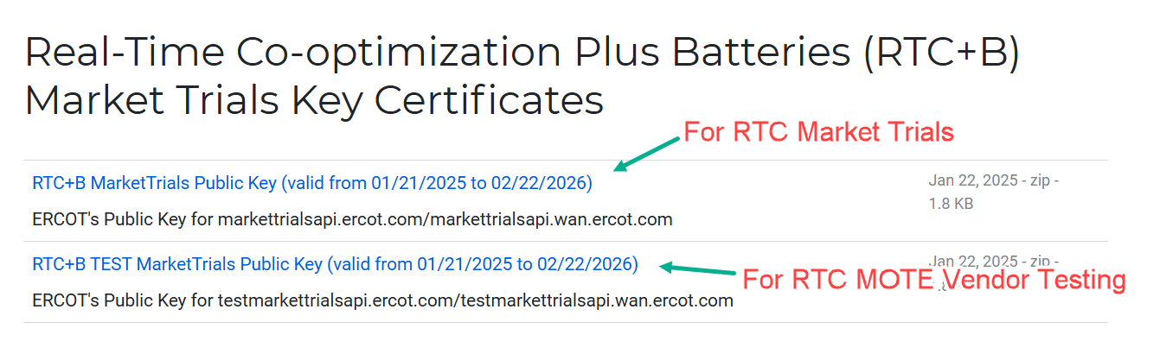
RTC+B Market Submissions - Systems configurations
Public Key Update for WAN/API submissions
For API/WAN submissions into Market Trials environments, need to download public keys and place into the keystore location in system being used for RTC+B submissions.
No change to digital user certificates – continue to use existing MOTE and Production Certificates
Market Trial API Public key location: https://www.ercot.com/services/mdt/webservices

