Slide 1
SSWG Report to ROS
October 2, 2025
Chair: Zach Walker (Zachary.Walker2@oncor.com)
Vice Chair: Chris Ramirez (cramirez@wettllc.com)

Slide 2
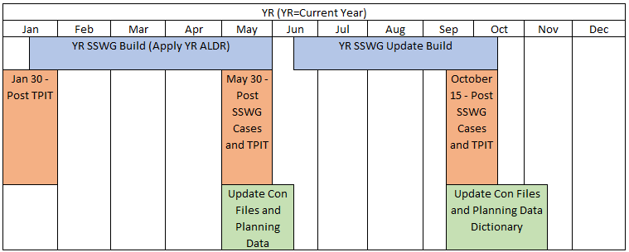
SSWG Report
Key Updates
25SSWG Case Build #2 (update build)
  In Progress: On-Track
  Post-Dispatch Tuning Meetings (9/22 – 9/24)
  Target Posting: October 17th
PGRR127 - Addition of Proposed Generation to the Planning Models
  Continued to be tabled for further discussion
SSWG Report to ROS External

