Slide 1
Project Update
September 17, 2025
Troy Anderson
ERCOT Portfolio Management

Slide 2
Project Update Agenda
  2025 Release Targets
  Priority/Rank Recommendations for Revision Requests with Impacts
    SCR831 – Short Circuit Model Integration
  Technology Working Group (TWG)
    Next meeting is 9/25/2025
  Initiative Ranking Workshop Update
    Draft #1 – Competing Priorities
    Notes and Next Steps
Location of Revision Request Project Information: http://www.ercot.com/services/projects

Slide 3
2025 Release Targets – Approved NPRRs / SCRs / xGRRs
R1
R3
R5
January 1/30 | February 2/27 | March 3/27 | April 4/24 | May 5/29 | June 6/26
NPRR945 NPRR1219 | NPRR1254 RTC+B Market Trials Sandbox Deployed | NPRR1145 | RTC+B Market Trials begin on 5/5/2025 | NPRR1253
R2
R4
R6
ü
ü
ü
RTC QSE Submission Testing
3/1
ü
RTC QSE Telemetry Check-out
1/1
3/7
ü
ü
RTC+B
12/5
July 7/31 | August 8/28 | September 9/25 | October 10/23 |  | December 12/18
NPRR1234(a) |  |  | NOGRR245 |  | PGRR091 SCR828
R7
R8
R9
R10
E
R11
Open-loop RTC SCED
Closed-loop SCED/LFC
NPRR1007-1013
RTC+B Stabilization begins
NPRR963(a)
NPRR965
NPRR1000
NPRR1014
NPRR1029(a)
NPRR1054
NPRR1058
NPRR1172
NPRR1204
NPRR1216
NPRR1236
NPRR1245
NPRR1246
NPRR1268
NPRR1269
NPRR1270
NPRR1282
NOGRR211
NOGRR268
NOGRR277
OBDRR020
OBDRR052
PGRR118
QSE Telemetry Tests
Day-Ahead Market
7/21
E
E
ü
E
Go-live dates can differ from Protocol effective dates – Please refer to market notices for more details
APPENDIX
Red Text: New additions and target release changes
Strike-Through Text: Previous target release
(a), (b), etc.: Multiple phase release
Project Status Codes
NS = Not Started
I = Initiation
P = Planning
E = Execution
H = On Hold
NPRR963(a) – Portion of NPRR
NPRR1029(a) – Market suspension of ESRs portion
NPRR1234(a) – Section 3.10.7.2, paragraphs 14-19
NPRR1253 – ICCP/Public API
RTC+B Market Trials
RTC+B Stabilization
Release targets are subject to change

Slide 4
Priority / Rank Recommendations for Revision Requests with Impacts
Recommendations for…
Revision Request | Description | Priority | Rank | Comments
NPRR1214 | Reliability Deployment Price Adder Fix to Provide Locational Price Signals, Reduce Uplift and Risk | TBD | TBD | $800k-$1.2M, 12-18 months Impacted Systems: MMS, Settlements, Reporting ERCOT requests a continued table at PRS due to RTC+B resource constraints and design concerns
NPRR1285 | Improve Self-Commitment within RUC Opt Out Window | N/A | N/A | <$10k O&M, 1-2 months Impacted Systems: MMS
SCR831 | Short Circuit Model Integration | 2026 | 4810 | $100k-$200k, 7-10 months Impacted Systems: NMMS – combine w/SCR818
PPL Rank Information
Next 2025 Rank in Business Strategy = 4580 Next 2028 Rank in Business Strategy = 5110
Next 2026 Rank in Business Strategy = 4820 Next 2029 Rank in Business Strategy = 5300
Next 2027 Rank in Business Strategy = 4910 Next Rank in Regulatory = 420

Slide 5
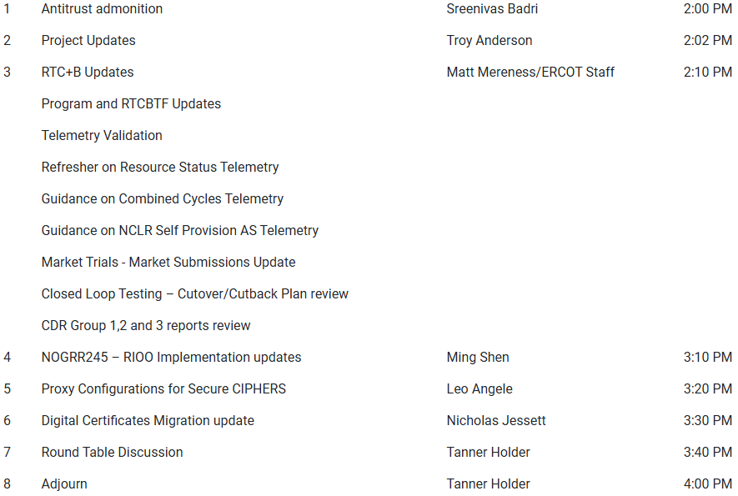
Technology Working Group (TWG)
Agenda for TWG meeting held on 8/28/2025:
Next TWG scheduled for 9/25/2025

Slide 6
Aging Revision Request Project Review Approach
Initiative Prioritization Workshop held on 8/25/2025
Categorize RRs into “Tiers”
  Tier 1 Critical Must-have items (PUCT/Board directives, etc.)
  Tier 2 High Priority Highest priority after Tier 1
  Tier 3 Medium Priority Fit in without impacting Tier 1 and 2 projects
  Tier 4 No Action Not ready for immediate action
  Tier 5 Candidate for Removal May move to another tier after evaluation
Important Point
  Some aging RRs are expected to require language changes to bring them up to current market or system constructs
    Language updates would be made with a new RR
    ERCOT suggests this analysis be limited to aging items that are prioritized high enough to be queued for implementation

Slide 7
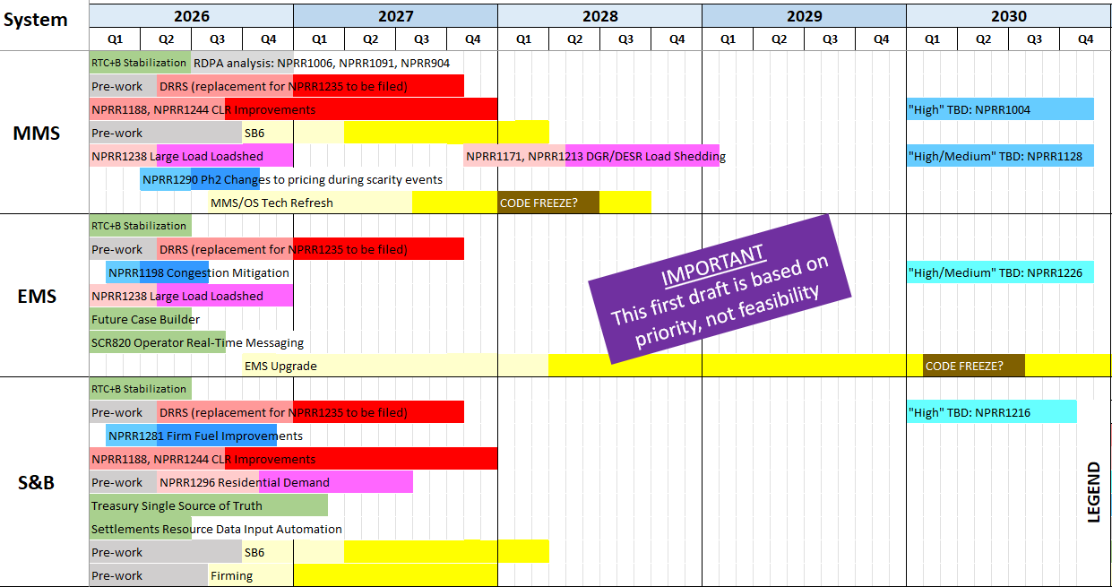
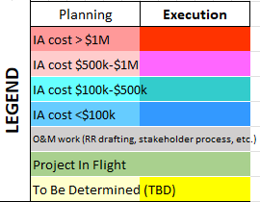
Draft #1 – Competing Priorities
All “High” items considered
Color coding reflects IA project cost estimates
Light and dark shading reflects potential project phase durations
Includes internal ERCOT projects drawing on similar resources
Spreadsheet posted for stakeholder review
Additional Notes:

Slide 8
Aging Revision Request Review at PRS – Status
The active participation and feedback from Market Participants at the 8/25 Prioritization Workshop is greatly appreciated
Draft #1 depicts the competing priorities based on Market Participant feedback and ERCOT management input
ERCOT is actively working the list to determine items that can be delivered in parallel and the sequence of the remaining high priorities
In general, large efforts (red and pink shaded) are slotted first; smaller projects can be worked in around them
Planning and Execution phases are color coded because these portions of major projects can be staggered to maximize throughput
Draft #2 will be brought to the October PRS and is expected to reflect the results of the feasibility analysis currently underway
  Reminder: Some priority items do not have Impact Analyses yet

