Slide 1

NERC EMSWG Update
Wei Qiu, NERC EA
ERCOT TWG Conference Call
September 25, 2025

Slide 2
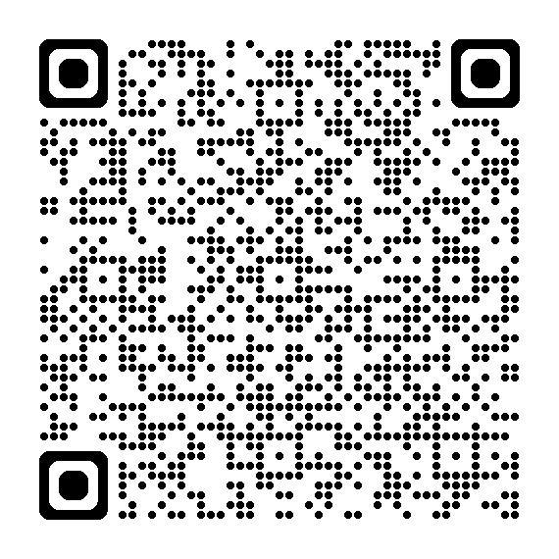
2025 Monitoring and Situational Awareness Technical Conference
Location: SPP in Little Rock, AR
Date and Time:
  Tuesday, October 21, 2025
  Wednesday, October 22, 2025
Theme: Supporting Energy Management and Planning for Our Future
Conference Registration

Slide 3
Presentations
  EMS Events and Situational Awareness Overview – NERC
  Staff Modeling and Approach – SPP and TVA
  Industry
    DLR/AAR – PPL
    EMS upgrade – AEP
    Communications between Control Centers- ERCOT
  Innovations
    AI/ML – PNNL and EPRI
    New SE method – GridScience and Oncor
  Human and AI – Resilient Grid
  Vendor Panel

Slide 4
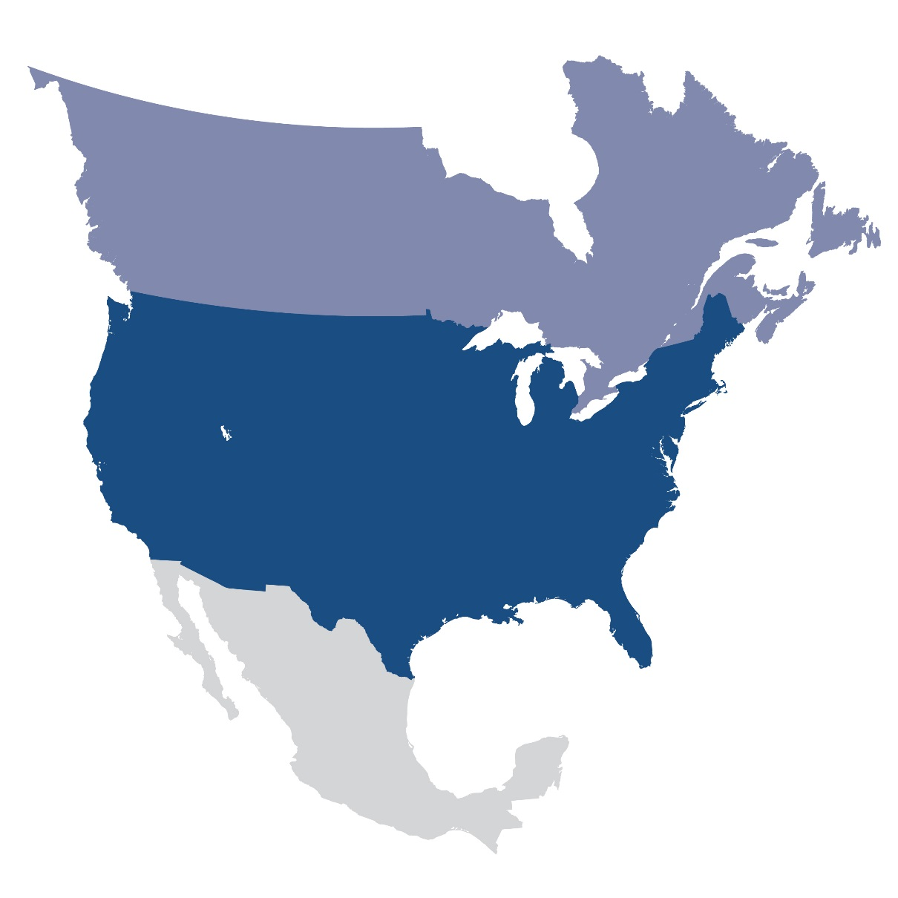
Questions and Answers
Contact Information:
wei.qiu@nerc.net

